Slide 1
Data Handling and Business Intelligence
M5X00842
Introduction
Chris Thomas

Slide 2
Lesson Plan
Module Overview
Assignment Discussion
Tool Installation
What is Data Analysis?
How/Why do we perform it?
What is Business Intelligence?

Slide 3
Module overview
This Module is worth 20 Credits
It is 100% Coursework Assessed
  75% - 3000 Word Data Analysis Report
    Analyse and interpret data from a business
    Present and discuss concepts/theories
  25% - 1,000 Word Review Paper
    Present an overview of a topic in BI
    To be reviewed by lecturer

Slide 4
BIG DATA

Slide 5
homework
You will be advised of what tools to Download and install
  Any issues can be resolved each week
Each week homework to Research
Commit time to the practical's using tools!

Slide 6
What is Data Analysis?
How can we find out if:
  Is Friday 13th unlucky?
  How well are our products selling?
  When is bad weather likely to hit?
  Where are the worst areas for car accidents?
The process of data analysis is to detect patterns within data to discover findings or to test theories
The data may vary, but the process remains the same

Slide 7
TED Talk Data Analysis
https://www.youtube.com/watch?v=8DqQCZMawNg

Slide 8
How do we perform it?
Imagine a scenario where your manager hands you 50GB of data and tells you to improve the business using that data
  What would you do?
Analysing the data right now in it’s current format is likely to be:
  Impractical
  Confusing
  Prone to erroneous findings
So first we need to find out what exactly we need to analyse
  The only way to find out is by taking a look…
  …And through observing the data, we begin to uncover some findings

Slide 9
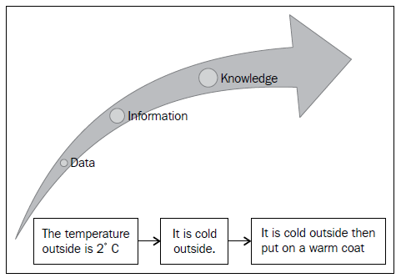
An example

Slide 10
More simple examples
Product Sales
  Porridge sales are higher in winter than other periods
  Stationary sales are higher at the end of school holidays
Opticians
  Majority of customers require a specific type of contact lens
  Glasses frames of a certain style are more popular than others
Education
  Student performance was good with features x and y implemented
  But not so good with feature z implemented

Slide 11
Think of examples where you might use data analysis in business:
  HR
  Marketing
  Finance

Slide 12
So what do we do?
In order to generate accurate data analysis, we need to ensure that data is
  Correct
  Countable
  Standardized
  Non-redundant (in the right place)
This is known as preparing (or pre-processing) the data
Once the data is formatted, we can then process and explore the data
From there, we can generate our predictions/theories
And visualise our results

Slide 13
Why pre-process?
Real Life data can be big, and it can also be messy
Real life data can contain:
  Missing Values
  Different Formats
  Extreme Values
  Redundant Data
Pre-processing will either remove these issues…
…Or take them into consideration during analysis by placing it into a consistent format

Slide 14
How to pre-process?
Two different methods
Manually
  Time-consuming (Especially with large data)
  Prone to introducing additional errors
Automation
  Using a programming language (Python, C/C++, Java etc.) or a tool (OpenRefine) to automate the cleaning
  Requires programming knowledge
  Is faster and more efficient

Slide 15
Data exploration
Once the data is in a complete and consistent format, we can then start the process of exploring the data
There are a number of tools we could use to analyse (or help analyse) the data
Some are open-source and free
Some are commercial but available within the University
Which one we use depends on the data we wish to analyse

Slide 16
List of tools
Statistical Analysis
  R
  Excel
  SciPy
Data Classification/Clustering
  Weka
Topic/Document Modelling
  Mallet
  Wordle
Data Organizers
  Hadoop
  MapReduce
  OpenRefine
This is just a small sample of a larger area. Explore!

Slide 17

Tool description - excel
Excel is a spreadsheet application developed by Microsoft
Pros
  Easy to visualise complex data
  Easy to perform mathematical computations on segments of data
Cons
  Commercial Software
  Performance Impact on large datasets
  Cannot reproduce all types of graphs

Slide 18

Tool Description - Weka
Weka is a collection of machine learning tools that run in Java and developed by the University of Waikato
Pros
  Easy to run classification problems
  Can perform simple visualisations
Cons
  Difficult file format
  Lack of visualisation tools
  Difficult for document classification

Slide 19
visualisation
In order to reveal our findings to a wider audience easily and effectively, we must be able to visualise them
Several of the tools listed previously have the ability to display a multitude of graphs and tables
  WEKA
  Excel
  R

Slide 20
Tool description - wordle
Wordle is a tool used to generate word clouds from segments of text.
Advantages
  Easily visualise frequent word usage in areas of text
  Easy to import
Disadvantages
  Limited usage
  Difficult to visualise numerical word usage

Slide 21
visualisation
In order to reveal our findings to a wider audience easily and effectively, we must be able to visualise them
Several of the tools listed previously have the ability to display a multitude of graphs and tables
  WEKA
  Excel
  R

Slide 22
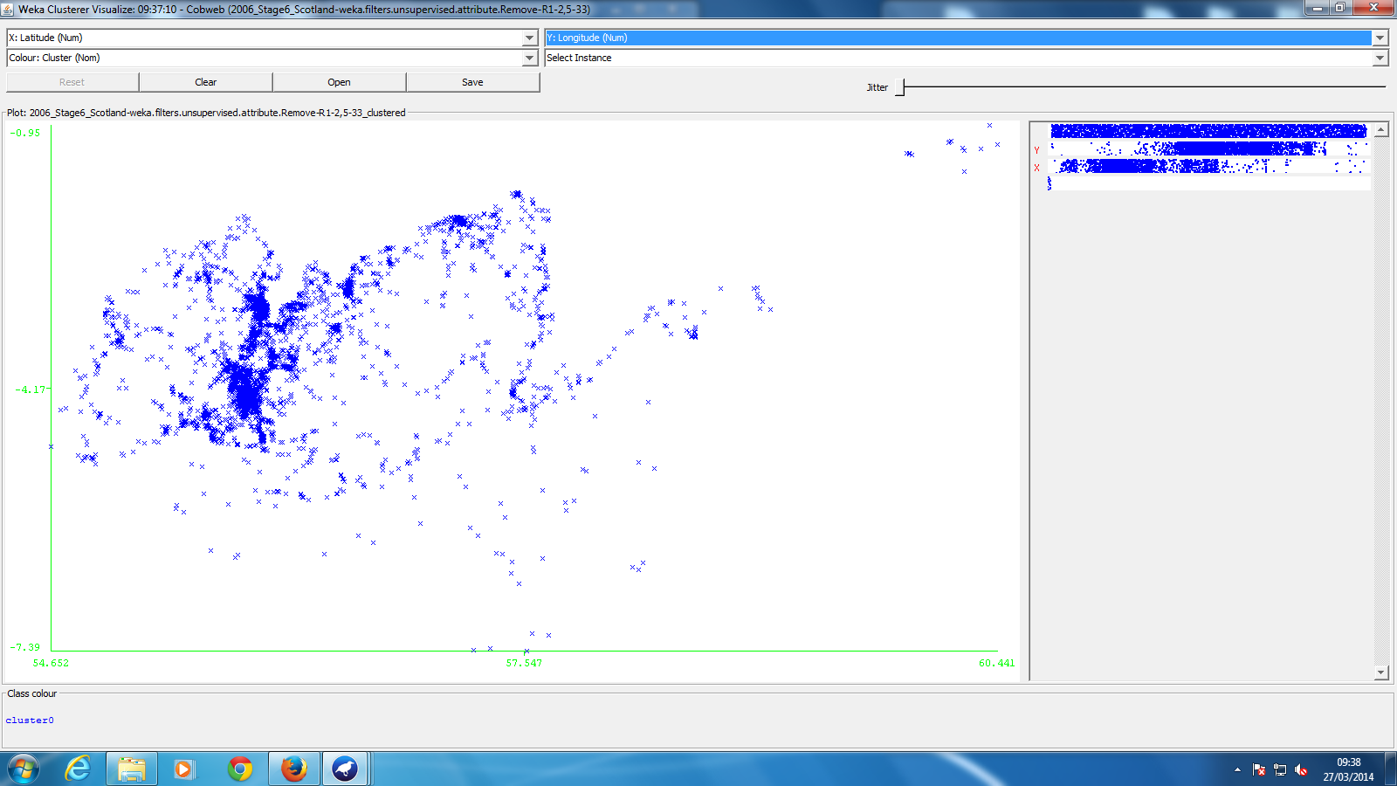
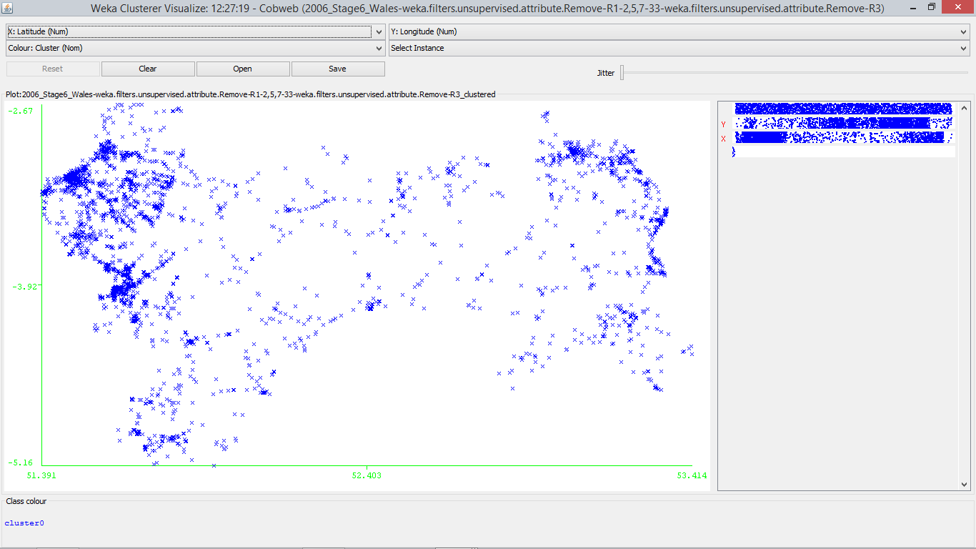
Visualisation Example – Collisions
Notes:
This is a visualisation of locations where car crashes have occurred. Note how the shapes of Scotland (left) and Wales (right) form with
Source: http://data.gov.uk/dataset/road-accidents-safety-data

Slide 23
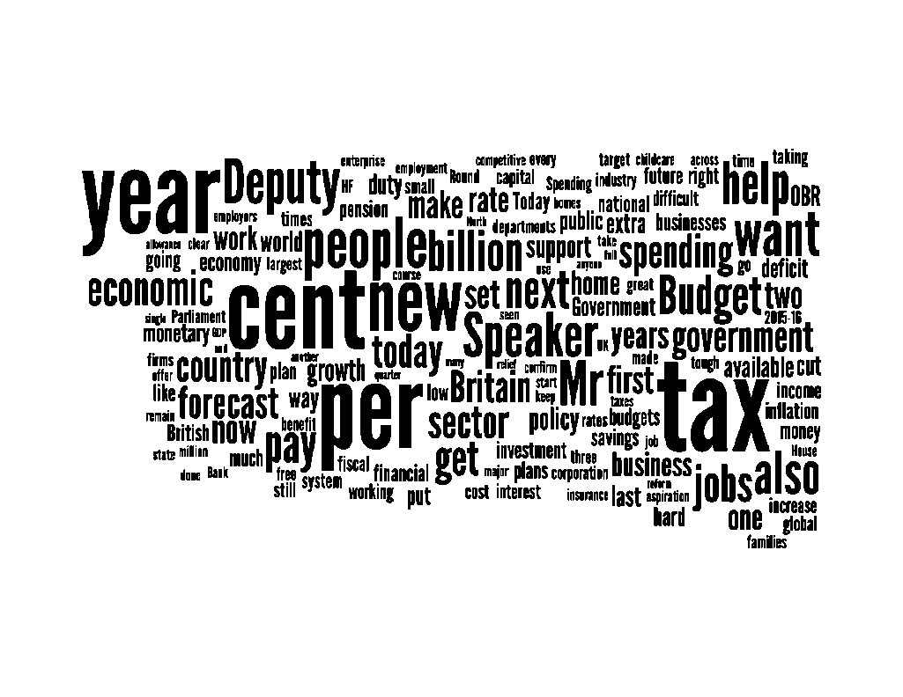
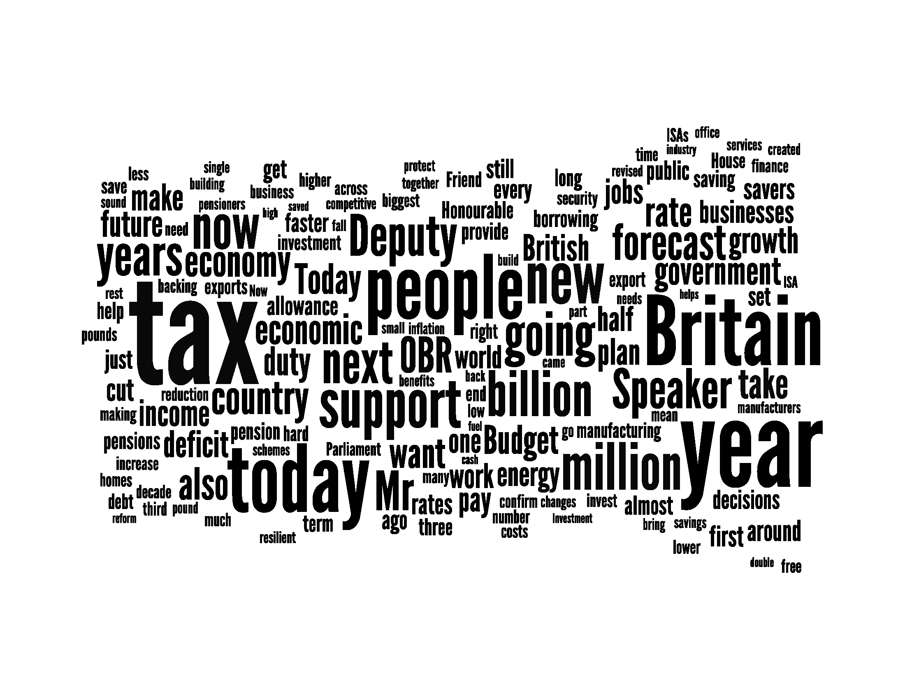
Visualisation Example – uk budget
2013
2014
Notes:
Source: Budget 2013 and 2014 Speeches
https://www.gov.uk/government/speeches/chancellor-george-osbornes-budget-2014-speech
https://www.gov.uk/government/speeches/budget-2013-chancellors-statement
These speeches were processed through Wordle (http://www.wordle.net/) to generate a word cloud of popular words used in the speeches, where larger words indicate higher usage.

Slide 24
Document analysis tools
Numbers are not the only things which can be analysed
Segments of texts hold information which could be valued for knowledge or profit
  Detecting trends on social networking sites (Twitter, Facebook)
  Analysing unknown texts to investigate potential authors/genres

Slide 25
Definition of BUSINESS INTELLIGENCE
BI is an umbrella term that combines architectures, tools, databases, analytical tools, applications, and methodologies
BI's major objective is to enable easy access to data (and models) to provide business managers with the ability to conduct analysis
BI helps transform data, to information (and knowledge), to decisions, and finally to action

Slide 26
Business Intelligence:
  https://www.youtube.com/watch?v=hDJdkcdG1iA

Slide 27
Analytics Overview

Slide 28
Give an example of how data analysis could help:
  HR
  Marketing
  Accounting

Slide 29
Where is the data coming from?
Internal
  Employee data
  Financial data
  Marketing/sales/customer data
External Data
  PESTEL Data
  Market Data
  Competitor data
  Weather…..

Slide 30
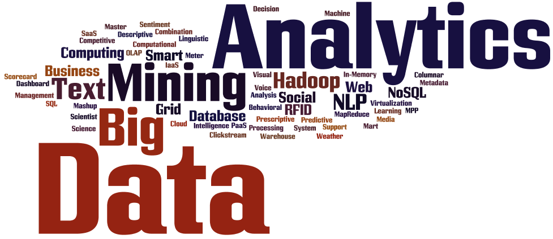
Introduction to Big Data Analytics
Big Data?
  Not just big!
  Volume
  Variety
  Velocity
  http://www.forbes.com/sites/bernardmarr/2016/01/26/how-big-data-and-analytics-changing-hotels-and-the-hospitality-industry/#6b2229644b39

