Slide 1
Barriers and motives for exercise and Physical activity
Week 1 – 2026
Dr Alison connaughton

Slide 2
Learning outcomes:
Identify key barriers to physical activity in different populations
Critically evaluate strategies for overcoming barriers
Discuss implications for intervention in physical activity provision / sport science practice
Resources:
Factors that influence older adults’ participation in physical activity: a systematic review of qualitative studies. https://pmc.ncbi.nlm.nih.gov/articles/PMC10438214/
Self-reported physical activity and sedentary behaviour amongst UK university students: a cross-sectional case study. https://pmc.ncbi.nlm.nih.gov/articles/PMC10438214/

Slide 3
Why Physical Activity Matters
Health, wellbeing, and social benefits
^{List…}

Slide 4
Populations at Risk of a lack of PA / Exercise?
Elderly adults
University students
Other groups?
Resources:
Barriers to and facilitators of physical activity among community-dwelling older adults: a systematic review. https://bmjopen.bmj.com/content/15/8/e095260
Understanding and addressing inequalities in physical activity. https://assets.publishing.service.gov.uk/media/611cd4188fa8f53dcf15655e/PHE_Inequalities_in_physical_activity_August_update_Final.pdf

Slide 5
Overview of Barriers
Intrapersonal (motivation, illness, pain)
Interpersonal (social support, peer influence)
Environmental (access, cost, safety concerns)

Slide 6
Example for a type 2 diabetes population…
Systematic Narrative Review (18 studies from 185)
Intrapersonal: Physical Barrier Category
Pain (general and at specific sites: knees, back, feet)
Fatigue, tiredness, low energy, exhaustion
Being overweight / obese (discomfort in movement, physical limitations)
Poor health or chronic illness
Physical weakness/lethargy
Mobility problems, e.g., joint pain, muscle pain, swelling, imbalance
Hypoglycaemia
Incontinence, diarrhoea
Poor sleep, sleep disturbances reducing capability
Balance issues, fear of falling
Shortness of breath / breathlessness, asthma, breathing difficulties
Sudden decline or loss of ability (due to acute illness, surgery, injury)

Slide 7
Intrapersonal: Psychological Barrier Category
Lack of willpower, motivation, self-discipline, or "laziness"
Low self-efficacy/self-confidence in physical ability
Lack of knowledge / understanding (how, what, how much, or why to exercise)
Negative beliefs / attitudes about exercise
Fear of injury or physical harm from exercise
Embarrassment about participating in activity, especially in public
Frustration, disappointment, stress, or self-stigma relating to exercise
Fatalistic health beliefs (illness as inevitable, outside personal control)
Demotivation after diagnosis or due to seeing limited benefit
Negative perceptions of physical activity
Difficulty remembering or prioritizing to exercise
Unwillingness to exercise or irregular habits / routine
Boredom with activity

Slide 8
Intrapersonal: Social Barrier Category
Competing family/childcare/eldercare obligations
Cultural and gender role expectations
Lack of social support
Opposition or discouragement from significant others, friends, or relatives
Lack of an exercise partner/buddy; feeling socially isolated when exercising alone
Social stigma or self-stigma associated with overweight/diabetes
Fear of judgment, being shamed, or "not fitting in" with others in exercise environments
Social obligations, special occasions, festivals, or rituals interfering with routine
Overprotectiveness by family members or community members discouraging independent physical activity
Unfamiliarity with environment

Slide 9
Environmental: Barrier Category (12)
Lack of time due to work, school, or household responsibilities
Lack of accessible/existing facilities or venues
Expense/costs of facilities, equipment, transport, or programs
Poor or unsafe infrastructure
Weather conditions
Safety concerns
Lack of privacy or hygiene in public facilities
Lack of transportation or difficult logistics
Work schedule inflexibility, overtime, transitions in life stage
Culturally insensitive or inappropriate facilities
Lack of professional guidance
Interruptions in routine

Slide 10
Barriers for Elderly Adults
Common barriers: pain and discomfort, fear of falls, health concerns
Socio-cultural ageing stereotypes, access difficulties
Resources:
Barriers to and facilitators of physical activity among community-dwelling older adults: a systematic review. https://bmjopen.bmj.com/content/15/8/e095260
Factors that influence older adults’ participation in physical activity: a systematic review of qualitative studies. https://pmc.ncbi.nlm.nih.gov/articles/PMC10438214/

Slide 11
Suggest some strategies for overcoming barriers for elderly people…

Slide 12
Strategies for Overcoming Barriers for older adults
Professional support, tailored environments, reducing fear of falls
Family and peer support, community programming
Resources:
Enablers and barriers to older people’s participation in strength and balance activities: A review of reviews. https://pmc.ncbi.nlm.nih.gov/articles/PMC7155318/
P.19/20 - Understanding and addressing inequalities in physical activity https://assets.publishing.service.gov.uk/media/611cd4188fa8f53dcf15655e/PHE_Inequalities_in_physical_activity_August_update_Final.pdf

Slide 13
Barriers for University Students
Time pressures, academic workload
Financial constraints, social priorities, environment
Resources:
Self-reported physical activity and sedentary behaviour amongst UK university students: a cross-sectional case study – Roberts et al. (2024) https://www.tandfonline.com/doi/full/10.1080/09581596.2024.2338182
Barriers and determinants of physical activity among UK university students – Aceijas et al. (2016) https://academic.oup.com/eurpub/article/26/suppl_1/ckw174.255/2449430

Slide 14
Suggest some strategies for overcoming barriers for University Students…

Slide 15
Strategies for University Students
Campus initiatives, affordable sport options
Peer support, academic scheduling solutions
Resources:
Physical activity interventions to improve mental health and wellbeing in university students in the UK: A service mapping study. https://www.sciencedirect.com/science/article/pii/S1755296623000613
Barriers and facilitators to engaging in a university-based exercise programme delivered to students experiencing mental health difficulties: A pilot study. https://www.tandfonline.com/doi/full/10.1080/28324765.2024.2380500

Slide 16
Comparative Barriers
Population | Key Barriers | Example Study
Elderly | Pain, fear of falls | Meredith et al. 2023 https://pmc.ncbi.nlm.nih.gov/articles/PMC10438214/
Students | Time, money, stress | Roberts et al. 2024 https://www.tandfonline.com/doi/full/10.1080/09581596.2024.2338182

Slide 17
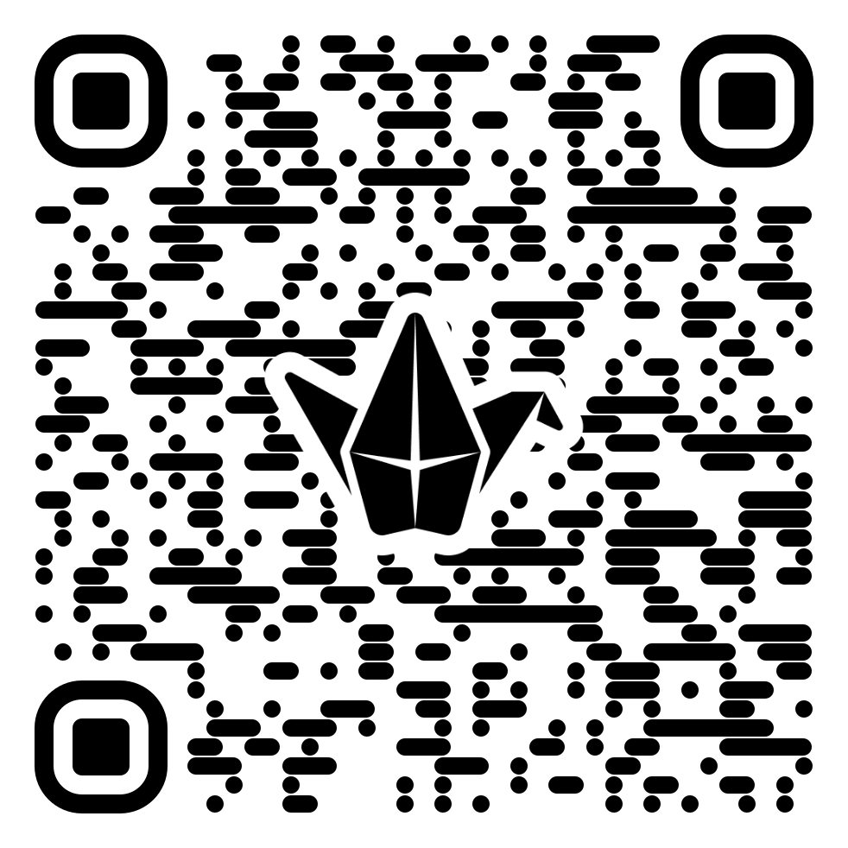
Barriers to exercise and physical activity
Link to Padlet
https://padlet.com/aconnaughton/bmsh5002-26-27-barriers-to-exercise-and-physical-activity-dwh815obqzqa6era

Slide 18
The impact of Covid-19
Recent evidence (Ammar et al., 2020) suggests that physical activity levels have decreased by ~30% and sitting time has increased by ~30%.
This is a major concern as physical inactivity and sedentary behaviour are risk factors for cardiovascular disease, obesity, cancer, diabetes, hypertension, bone and joint disease, depression and premature death (Warburton & Bredin, 2017)

Slide 19
Lockdown
During the initial phase of the COVID-19 pandemic, governing bodies worldwide took decisive action to protect their citizens against the novel coronavirus by enforcing public lockdown and closing all non-essential services.
Although such measures helped to “flatten the curve” and minimize infection rates, the restrictions also had significant consequences on citizens’ health and well-being in that pandemic-related concerns amplified mental distress of citizens worldwide.
Casagrande et al. (2020)
Huang & Zhao (2020)
Jungmann & Witthoft (2020)
Luo et al. (2020)
Mazza et al. (2020)

Slide 20
Exercise behaviour during Covid-19
Did your exercise behaviour change at all during (and now ‘post’) the Covid-19 pandemic?
Consider the following times:
Lockdown (first and second major ones)
Firebreak Wales (two weeks)
Now…Back to normal?

Slide 21
Challenges faced by different countries…
UNICEF young reporters share more about the ways they found to be able to exercise and hang out with friends during the COVID-19 pandemic
https://www.unicef.org/northmacedonia/stories/how-are-young-people-exercising-during-covid-19-pandemic
Different approaches to managing the pandemic / lockdowns.
Task: Choose a country to examine in relation to lockdown and exercise restrictions.
Ireland / New Zealand / Australia / America / France / UK / Spain / China…
or others!

Slide 22
The issue of physical inactivity…
To date, more than 130 authors from across the world have provided COVID- 19-related commentary on these concerns.
Many experts (Arena & Lavie, 2020) have emphasised the importance of increasing healthy living behaviours and others (Hall et al., 2020) have indicated that we are now simultaneously fighting not one but two pandemics (ie, COVID-19, physical inactivity).
Physical inactivity alone results in over 3 million deaths per year (Hall et al., 2020) and a global burden of US$50 billion (Lim et al., 2012)
Immediate action is required to facilitate physical activity during the COVID-19 pandemic because it is an effective form of medicine (Warburton & Bredin, 2017) to promote good health, prevent disease and bolster immune function.
Accordingly, widespread messaging to keep adults physically active is of paramount importance.

Slide 23
Globally, about 1 in 4 people were not meeting these guidelines prior to the pandemic (WHO, 2020) with these numbers differing by age (Statistics Canada, 2020) and income (Spinney et al., 2010) such that younger adults are more likely to meet guidelines than older adults and higher income predicts better adherence to the guidelines than lower income.
An online survey administered during the initial stage of the COVID-19 pandemic found that respondents who were less physically active had worse mental health (Lesser & Nienhuis, 2020).
Another survey conducted at the same time found that more screen time (a common sedentary behaviour) was associated with worse mental health in all respondents except for those who were physically active (Colley et al., 2020).
Physical activity may protect against the expected mental health decline caused by the sedentary lifestyle of enforced lockdown.

Slide 24
Encouraging engagement…
Several organisations including the WHO, American Heart Association and American College of Sports Medicine have offered initial suggestions and resources for engaging in physical activity during the COVID-19 pandemic.
Expanding on these resources, Wedig et al. (2021) provided an infographic which aims to present a comprehensive illustration for promoting daily physical activity to the lay audience during the COVID-19 pandemic
As illustrated, adults are spending more time at home, moving less and sitting more. Physical activity provides numerous health benefits, some of which may even help directly combat the effects of COVID-19.

Slide 25
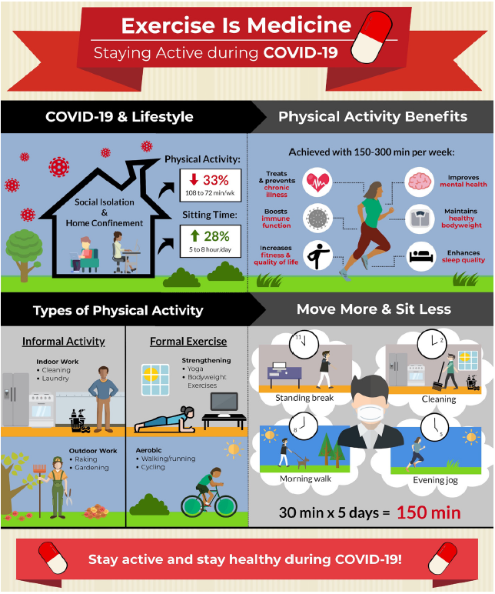
Wedig et al. (2021)

Slide 26
Therefore…
For substantial health benefits, adults should engage in 150–300 min of moderate-to-vigorous intensity physical activity each week and limit the time spent sitting.
The recommended levels of physical activity are safely attainable even at home.
Using a combination of both formal and informal activities, 150 min can be reached during the week with frequent sessions of physical activity spread throughout the day.
Sedentary behaviour can be further reduced by breaking up prolonged sitting with short active breaks.
Infographic offers as an evidence-based tool for public health officials, clinicians, educators and policymakers to communicate the importance of engaging in physical activity during the COVID-19 pandemic.

Slide 27
A mental health paradox: Mental health was both a motivator and barrier to physical activity during the COVID-19 pandemic
One of the most effective interventions to prevent stress-induced mental illness is physical activity (Bull et al., 2020).
People who are more active also tend to be less anxious and depressed (Stubbs et al., 2017), and sedentary people who engage in a new exercise program experience relief from their depressive symptoms (Kvam et al., 2016).
Compared to antidepressant medication, thirty minutes of moderate-intensity aerobic exercise three times weekly may be equally effective at reducing psychological distress and decreasing symptoms of depression and anxiety without any of the drug-related side effects such as nausea, fatigue, or loss of appetite (Kvam et al., 2016; Netz, 2017).

Slide 28
Why has the COVID-19 pandemic exaggerated physical inactivity and sedentary behaviour?
According to the Health Belief Model health-related behavior, and specifically PA, is related to perceived barriers and motivators (Rosenstock, 1974).
Typically, the most common perceived barrier to being physically active is lack of time (Justine, 2013).
Lack of motivation is another commonly cited barrier.
However, given the unprecedented circumstances surrounding the COVID-19 pandemic, people may now be facing unique barriers and motivators to engaging in physical activity.

Slide 29
Having an ‘exercise at home plan’ is All well and good…However…
Covid-19 specific barriers to exercise
Have a look at your previously constructed barriers list on padlet.
  Are any of these still relevant to Covid-19?
What additional barriers to exercise and PA may Covid-19 have specifically caused?
  Children
  Teenagers
  Older adults
  Clinically vulnerable

Slide 30
Reading: Mental Health was both a motivator and barrier to PA during the Covid-19 pandemic

Slide 31
Questions to answer in small groups / pairs
What happened to stress levels during the pandemic?
What happened to MVPA and Strength Training during the pandemic?
Did sedentary activity increase or decrease during the pandemic?
How / did motives change during the pandemic?
How / did barriers to being active change during the pandemic?

Slide 32
Barriers and Motives for Exercise / Physical activity

Slide 33
Marashi et al. (2021)
Aimed to determine what it is about the pandemic that is making people less active. What were the most pertinent motivators reported by those continuing to meet daily PA targets?
They examined shifts in people’s perceived barriers and motivators to being physically active during the pandemic.
Using an online survey, the present study gathered information from 1669 respondents pertaining to their physical activity, sedentary behaviour and mental health before and during the initial lockdown of COVID-19.
Results from this survey not only describe changes in barriers and motivators to PA, but provide concrete factors practitioners can explore with clients in an effort to promote PA behaviour during a global pandemic.

Slide 34
Results:

Slide 35
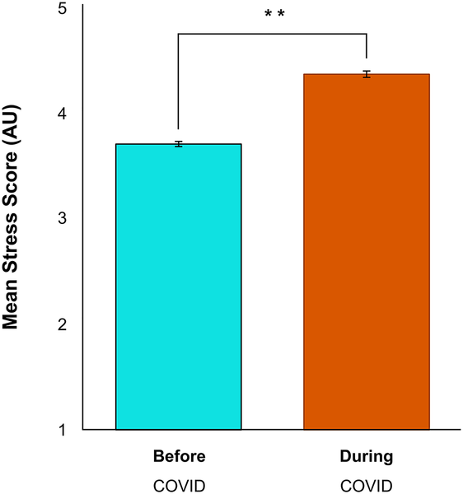
Fig 1. Psychological stress increased significantly during the COVID-19 pandemic (**p &lt; 0.01).
Marashi MY, Nicholson E, Ogrodnik M, Fenesi B, Heisz JJ (2021) A mental health paradox: Mental health was both a motivator and barrier to physical activity during the COVID-19 pandemic. PLOS ONE 16(4): e0239244. https://doi.org/10.1371/journal.pone.0239244

Slide 36
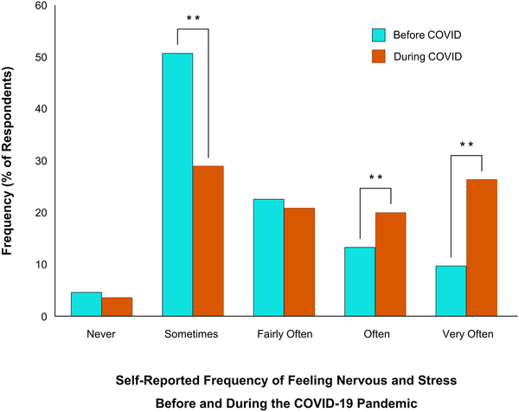
Fig 2. Changes in self-report psychological stress before and during the COVID-19 pandemic.
Marashi MY, Nicholson E, Ogrodnik M, Fenesi B, Heisz JJ (2021) A mental health paradox: Mental health was both a motivator and barrier to physical activity during the COVID-19 pandemic. PLOS ONE 16(4): e0239244. https://doi.org/10.1371/journal.pone.0239244

Slide 37
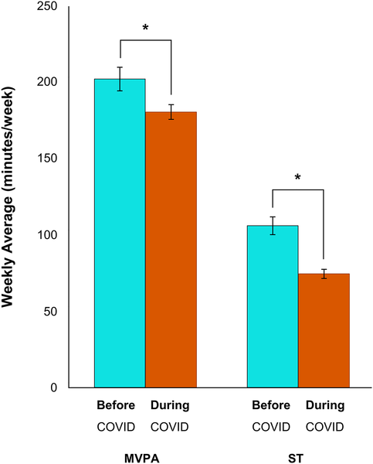
Fig 3. Changes in physical activity levels before and during the COVID-19 pandemic.
Physical activity
Since the onset of COVID-19, respondents’ aerobic activity decreased by 22 minutes (p < 0.05), their strength-based activity decreased by 32 minutes (p < 0.01), and their sedentary times increased by 33 minutes (p < 0.01).
Marashi MY, Nicholson E, Ogrodnik M, Fenesi B, Heisz JJ (2021) A mental health paradox: Mental health was both a motivator and barrier to physical activity during the COVID-19 pandemic. PLOS ONE 16(4): e0239244. https://doi.org/10.1371/journal.pone.0239244

Slide 38
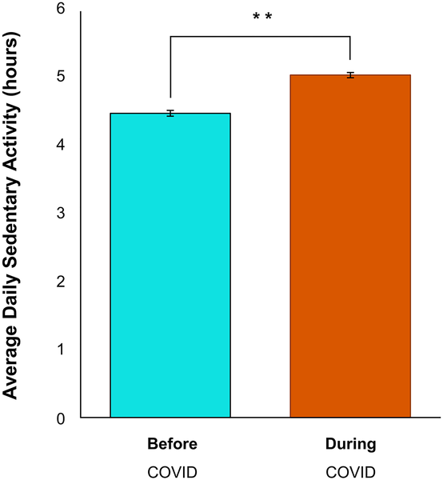
Fig 4. Average sedentary activity before and during the COVID-19 pandemic.
Marashi MY, Nicholson E, Ogrodnik M, Fenesi B, Heisz JJ (2021) A mental health paradox: Mental health was both a motivator and barrier to physical activity during the COVID-19 pandemic. PLOS ONE 16(4): e0239244. https://doi.org/10.1371/journal.pone.0239244

Slide 39
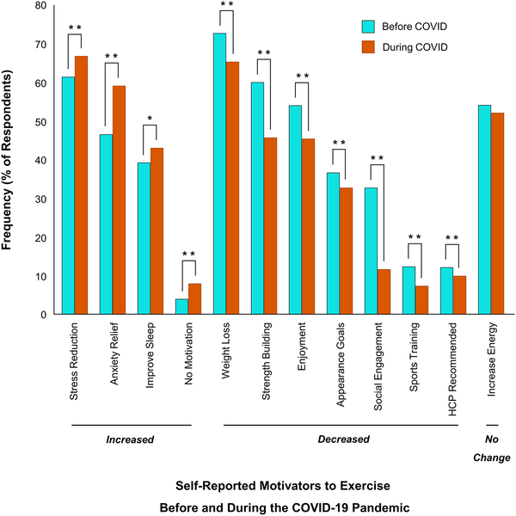
Fig 7. Changes in motivators to exercise before and during COVID-19.
Motivation to Exercise
All motivators shown indicate a significant change (*p < 0.05, **p < 0.01).
Motivators that increased significantly include ‘stress reduction’, ‘anxiety relief’, ‘improve sleep’ and ‘no motivators’.
Motivators that decreased significantly include ‘weight loss’, ‘strength building’, ‘enjoyment’, ‘appearance goals’, ‘social engagement’, ‘sports training’ and ‘healthcare provider (HCP) recommended’.
There was no change in how ‘increase energy’ was viewed as a motivator to exercise during the pandemic (p > 0.05).
Marashi MY, Nicholson E, Ogrodnik M, Fenesi B, Heisz JJ (2021) A mental health paradox: Mental health was both a motivator and barrier to physical activity during the COVID-19 pandemic. PLOS ONE 16(4): e0239244. https://doi.org/10.1371/journal.pone.0239244

Slide 40
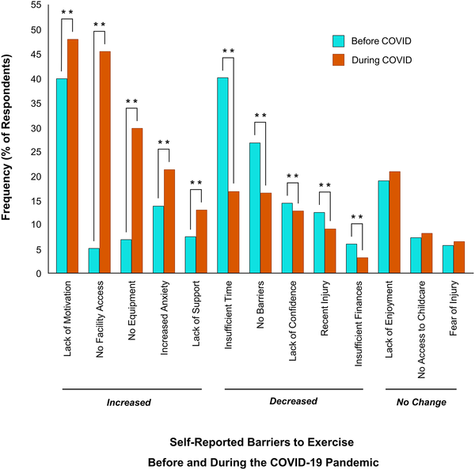
Fig 8. Changes in barriers to exercise before and during COVID-19.
Barriers To exercise
All barriers listed showed a significant change (**p < 0.01).
Barriers which increased significantly since COVID-19 include ‘lack of motivation’, ‘no facility access’, ‘no equipment’, ‘increased anxiety’ and ‘lack of support’.
Barriers which decreased significantly during COVID-19 include ‘insufficient time’, ‘no barriers’, ‘lack of confidence’, ‘recent injury’ and ‘insufficient finances’.
No change in barriers related to ‘lack of enjoyment’, ‘no access to childcare’ and ‘fear of injury’ (p > 0.05).
Marashi MY, Nicholson E, Ogrodnik M, Fenesi B, Heisz JJ (2021) A mental health paradox: Mental health was both a motivator and barrier to physical activity during the COVID-19 pandemic. PLOS ONE 16(4): e0239244. https://doi.org/10.1371/journal.pone.0239244

Slide 41
Mental health as a motivator and barrier to exercise
Results highlighted a paradox with mental health being both a motivator and barrier to physical activity.
People wanted to be active to improve their mental health but found it difficult to be active due to their poor mental health.
Likewise, respondents who were more depressed were also less motivated to engage in physical activity, and amotivation is a symptom of depression itself.
The stressfulness of the pandemic has made this a global issue that now must be considered when devising physical activity programs to support the mental wellbeing of citizens.
The benefits of a two-pronged approach in promoting physical activity during stressful times includes:
  1) adopting a mode of physical activity that supports mental health, and
  2) providing support to help minimize perceived psychological barriers to exercise (Marcus and Forsyth, 2009).
  For example, symptoms of anxiety may increase with high-intensity exercise and therefore moderate-intensity exercise might be preferable (Pauolucci et al., 2018).
At the same time, to help overcome “feeling too anxious to exercise”, people should be encouraged to schedule their physical activity ahead of time in a calendar (Arbour and Ginis, 2007) to reduce feelings of uncertainty and decision fatigue that can aggravate their anxiety symptoms (Azjen, 1991).

Slide 42
Barriers explained…
Not surprisingly, government-mandated closure to gyms and other recreational training facilities made it more difficult for people to be physically active.
The pandemic forced a shift in doing everything at home but not everyone’s home is large enough or well-equipped to support their physical activity needs.
Income level was predictive of activity level during the pandemic.
People who reported “just enough” or “less than enough” income experienced greater decreases in physical activity and worsening mental health, especially younger adults aged 18 to 29 years old.

Slide 43
Limitations of the research and practical implications…
The sample consisted mainly of young (18–29), highly educated (Bachelor’s degree or higher), female-identifying Canadian inhabitants which may limit the generalisation of the results.
On average, respondents were meeting the physical activity recommendations, which is not representative of the population at large.
During stressful times, like the COVID-19 pandemic, people are especially motivated to be physically active for their mental health but may be too anxious or depressed to partake.
The results point to the need for additional psychological support to help people maintain their physical activity levels during stressful times.

Slide 44
Key articles:
Meredith et al. (2023): Factors that influence older adults’ participation in physical activity: a systematic review of qualitative studies. https://pmc.ncbi.nlm.nih.gov/articles/PMC10438214/
Kilgour et al. (2024): Barriers and motivators to undertaking physical activity in adults over 70—a systematic review of the quantitative literature. https://academic.oup.com/ageing/article/53/4/afae080/7655770
Roberts et al. (2024): Self-reported physical activity and sedentary behaviour amongst UK university students: a cross-sectional case study https://www.tandfonline.com/doi/full/10.1080/09581596.2024.2338182
Cavill et al. (2018): Enablers and barriers to older people’s participation in strength and balance activities: A review of reviews. https://pmc.ncbi.nlm.nih.gov/articles/PMC7155318/
Aceijas et al. (2016): Barriers and determinants of physical activity among UK university students. https://academic.oup.com/eurpub/article/26/suppl_1/ckw174.255/2449430

Slide 45
Coursework…

Slide 46
Developing an interview guide: CW 2
Task:
For the remainder of this session, I would like you to put together a draft list of questions that would potentially answer the coursework task.
Motives and barriers to exercise / PA
Type these up into a word document for sharing (one person from the group).
I will collate the draft questions for editing.

