Slide 1
Name : Anam Rabbani
Student ID : 2425710
Module Title : Digital Skills
Lecturer: Muhammad Cassamo
Task 4 - Presentation

Slide 2

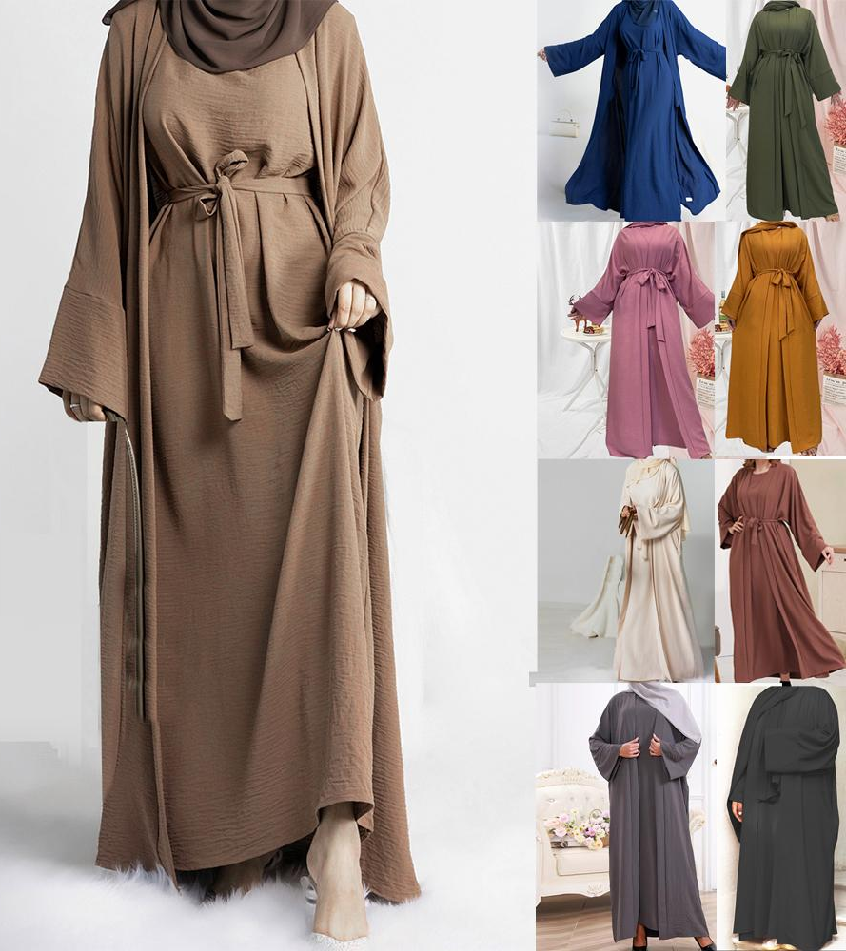
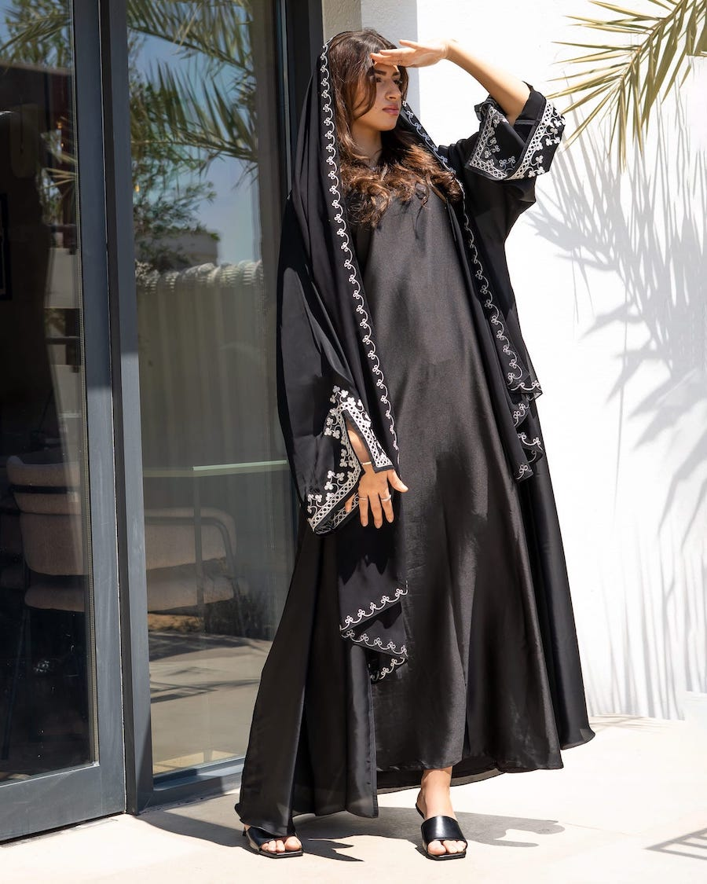

Slide 3
Contents
How I designed My Questionnaire
Collective Data from Questionnaire
Reflection
Marketing and Advert
Any Questions
References

Slide 4
My business - Amal A Collection
I have created a Business Plan called Amal A collection in this module offering Abayas ,modest wear and scarfs women car wear at any time at a amazing price where everyone can afford and is welcome at any point.
It was a very creative module and taught me the skills and tools required to establish a business and how to create a plan.
The video AD gives insights about the background of the business and ensures all the essential information Is provided and showcasing the products and what is on available .

Slide 5
How I designed My Questionnaire?
I used Microsoft Form to create a Questionnaire for my Business.
It's free and easy and can be shared via links too
It was a 10 question survey
The purpose of this questionnaire was so I can get feedback on what customers expectations are and what they expect from my business and to identify what price range customers are after too.
The questionnaire helped me analyse the feedback I received and based on the collected data business will be created .

Slide 6

Collective Data from my research
My research from my questionnaire showed me what material of fabric customers are looking for and found customers shopping habits so if they prefer online shopping or in store
I have created a website and business cards made it easier for customers to shop online leave with a great experience and cards to give for to give info about how to find us online and contact details.
The video AD shows a little insights of the business and the what it will be showcasing after feedback received and put into real life to attract.

Slide 7
Reflection ?
I have learnt that how Important it is to understand your audience before starting your own business and by creating the questionnaire which I never created in the past. It has taught me how to create a questionnaire for future and how I can then collect that data and use it in my business and also create graphs and spreadsheet on excel and store data to reflect on and analyse when needed
new skills I learnt are
creating a website using webaddor
create an advert using TIK TOK
These skills will benefit me in the future when I'm starting my own business, and It can be applied anywhere any fields of work arrangements.
It was indeed a highly creative module I found the tasks difficult at beginning and struggled however I am now confident using the skills I learnt and can apply them when needed without the support of anyone and using my own initiatives as well as It has made me confident to speak about it and show off my skills to other people.
I do believe that I do need to improve some of the skills going forward which are financial strategies and how to create budgeting which is an important and essential skill to have when I have my own business. I will be learning more about excel programme and using correct formulas.

Slide 8
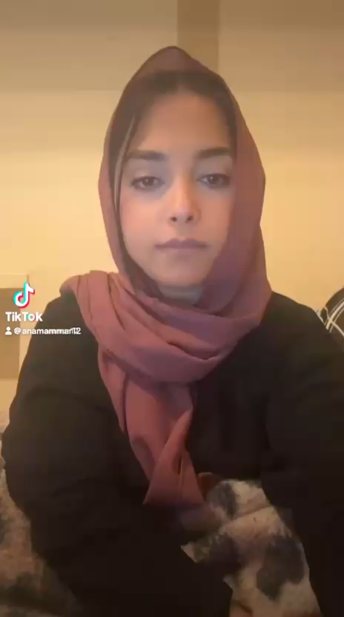

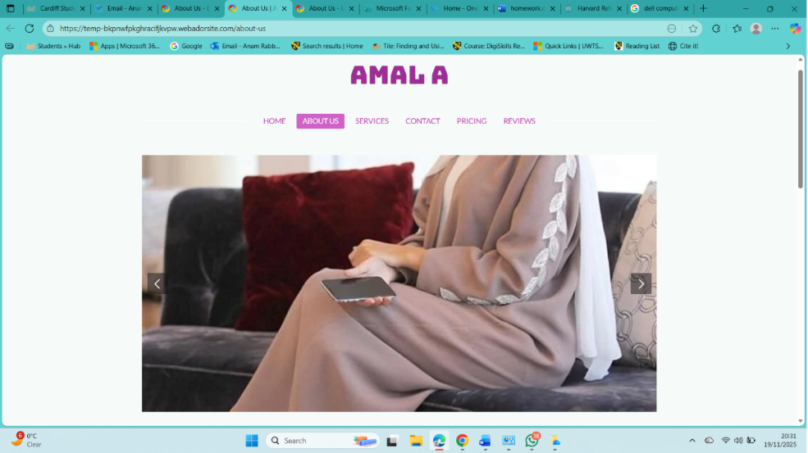
Marketing and Advert

Slide 9

The End
Any Questions
I confirm that I have not used or presented AI generated text and this is my own work created by me and my own research .

