Slide 1

Assignment cover sheet
Student name: | Chan Pui Luen | Student number: | 1715381
Programme: | DBA
Module: | Approaches to Research and Academic Communication | Module Level: | 7
Module code: | SBPD700l | Contribution to Overall Module Assessment (%): | 20% (Oral Presentation)
Lecturer: | Dr Millissa Cheung | Internal Verifier:
Assignment Title: | Oral Presentation | Assignment No : | 2
Hand Out Date: | 26 Aug 2018 | Submission deadline: | 26 Aug 2018

Slide 2
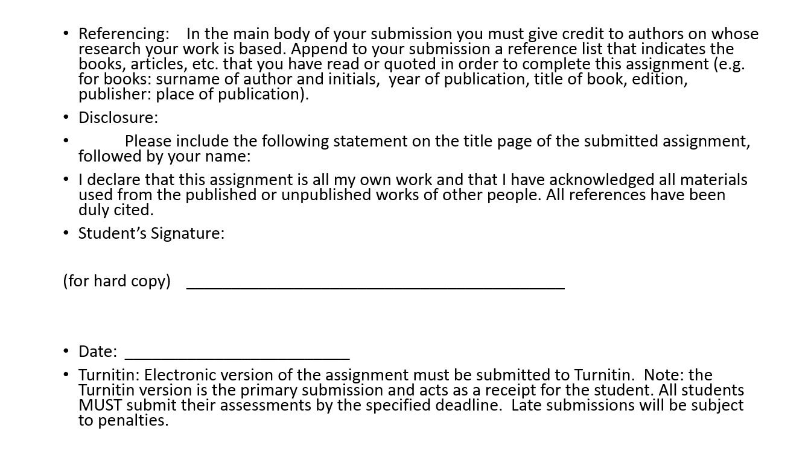

Slide 3
Approaches to Research and Academic Communication
SBPD7001
Student Name: Chan Pui Luen, Paul
Student Number: 1715381

Slide 4
Content
Research Paper Review
“Employees’ Performance in Islamic Banking” by Bambang Bernanthos
Introduction
Theory and Framework
Methodology
Result
Research Gaps
Ethical issues and others
New Research Framework
Conclusions
References

Slide 5
Introduction
Research Paper Review
“Employees’ Performance in Islamic Banking” by Bambang Bernanthos
Bernanthos, B. 2018,’Employees’ Performance in Islamic Banking’, European Research Studies, vol. 21, no. 1, pp 1-42.

Slide 6
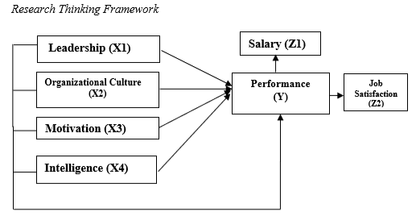
Theory and Framework
The framework of the research study as below shown called Research Thinking Framework. The Research Thinking Framework is including the independent variables is the factors (X): leadership, organizational culture, motivation and intelligence and the dependent variable is the performance (Y). The performance result on the salary (Z1) and job satisfaction (Z2).

Slide 7

Theory and Framework
Leadership – it can drive to achieve in the implementation of tasks effectively in an organization. The good leadership can implement the work in pleasant conditions for the employees to produce good performance.

Slide 8

Theory and Framework
Organizational Culture – it grows and develops by being formed through the process of learning and experience. Through the organizational culture, it can establish the synergic cooperation among the existing employees. The successful of the organization achieve its goals is determined by the employees’ performance.
The organizational culture is not as only the organizational identity and it also can improve performance and development of the organization.

Slide 9
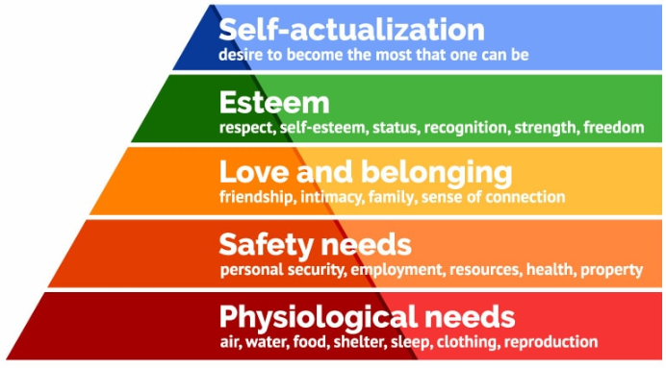
Theory and Framework
Source https://www.simplypsychology.org/maslow.html
Motivation – it related to the level of effort made by someone to pursue a goal, the employee motivation is closely related to job satisfaction and employee’s performance. The research paper has applied the Maslow’s hierarchy of needs theory. The Maslow’s theory introduced five different levels of human needs: Physiological needs, Safety needs, Love and Belonging, Esteem, Self-actualization. Maslow also quoted those needs can apply to everyone and structured according to the hierarchy of needs. (Maslow 1943)

Slide 10

Theory and Framework
Intelligence – is the development of the advanced technology, information developments, the availability of capital and the adequacy materials in the organization. The organization will be hard to achieve its goals, if there have no information technology resources development.

Slide 11

Theory and Framework
The banking industry is the very competitive industry and the industry is facing many challenges on today and the future. Therefore, the banks demand to develop their employees carrying out the good performance to achieve the organization’s goals. The progress of bank can go on by the sustainable employee development progress.
The research studies have found the employee motivation has a positive impact on employee performance. And it related to the employee job satisfaction are including the salary and staff retention. The important of the organization strategy management to cover the factors of employee motivation. The theory and framework from the research papers are provide the positive relationship between the employee motivation and the employee performance with the employee job satisfaction in salary and staff retention.

Slide 12
Methodology
This research study is using the quantitative research from the research data analysis and measurement. The quantitative research analysed by statistical techniques from the research data are provided in number. This research carries out to understand and explain the impact on the independent variable factors which are leadership (X1), organizational culture (X2), motivation (X3) and intelligence (X4) to dependent variable which is performance (Y).
The research hypothesis accuracy testing, the data quality using in the test affect the relationship of research variables in the data analysis. The test uses the research data is reliable and accurately describe the concept measured then the research hypothesis testing will hit the target. Therefore, the validity test is tested and the reliability test on the instrument is also tested.

Slide 13
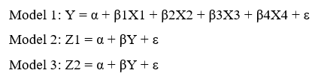
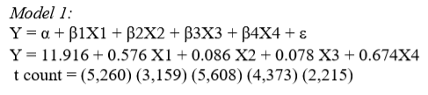


Methodology
The result of the calculation is using SPSS Version 22, the value of multiple linear regression equation between the independent variables X, which are leadership (X1), organizational culture (X2), motivation (X3), intelligence (X4) and dependent variable is performance (Y). The variable Z, which are the salary (Z1) and the job satisfaction (Z2).

Slide 14
Methodology
For leadership (X1): 0.576 means that if leadership variables increase 1 unit then it will improve the performance of 0.576 units.
For organizational culture (X2): 0.086 means that if organizational culture variable increases 1 unit then will improve the performance (Y) of 0.086 units.
For motivation (X3): 0.078 means that if motivation variable increases 1 unit then will increase the performance (Y) of 0.078 units.
For intelligence (X4): 0.674 means that if intelligence variable increases 1 unit it will increase the performance (Y) of 0.674 units.
For variable salary (Z1): 0.674 means if the salary variable increase 1 unit hence will increase performance equal to 0.674 unit.
For the satisfaction variable (Z2): 0.479 means that if the performance variable increases 1 unit then it will increase the satisfaction of 0.479 units.

Slide 15
Result
The following five points are the conclusions of the research:
The research results have found the parameters of the organization are leadership, organizational culture, motivation and intelligence and there have a significant effect on employee’s performance in the National banking in Indonesia. The leadership, organizational culture, motivation and intelligence have a positive impact on employee’s performance.
According to the factors of leadership, organizational culture, motivation and intelligence have a great effect on employee’s performance. Therefore, it recommend the National banking in Indonesia address this issue seriously.
The management is required to implement the leadership and organizational culture in National banking in Indonesia. It can result to increase the innovation and aggressiveness of employees, so that there will have a positive impact on the occurrence of active increase in the working environment. The leadership and organizational culture can certainly affect the employee’s performance.
The leadership can able to motivate subordinates and can establish positive work and become a role model for employees. The leadership can be able to drive the employees to improve their performance.
The employee motivation became a driven for employees to carry out their duties and responsibilities, therefore the salary and job satisfaction increase. The higher employee motivation will able to improve the employee’s performance achievement for the national banks in Indonesia.

Slide 16
Research Gaps
Refer to Research Thinking Framework of the research framework, the author of this research has justified the research gap that the factors are clear located in the research paper. In the framework, the factors leadership, organizational culture, motivation and intelligence impact on employee’s performance and the influence on the salary and job satisfaction.
The research questions has logically derived from the research gap. The topic of the paper “Employee’s Performance in Islamic Banking” which is the research ideas to study the influence factors impact on the employee’s performance in specific industry in banking. The research has provided a spectrum on perspective of look at the studied issue.

Slide 17
Ethical issues and others
The research design is rigorous; however, there have no research questionnaire details quoted in the research paper or in appendix. Therefore, we do not know the samples have a good representative or not. We cannot treat the researcher has mentioned on promoting and respecting for research ethics and we cannot see the research paper has mentioned any consent letters have been sent out and mentioned how to protect the confidentiality of responses.
The employee motivation, employee’s performance and job satisfaction are related to the organization’s performance and the organization’s strategy management in visions, strategies and objectives. The employee gender, age and the working departments (the frontline employees and the back-office employees). Those are the factors should be considered in the questionnaire.
A good working conditions and a good working environment is very important. The working environment is one of the motivation factors can enhance the employees’ productivity and increase their performance in Syndicate Bank in India. (Johri and Vashistha 2015) However, the working environment factor may not apply to well-developed cities like Frankfurt, Hong Kong, London, New York and Tokyo…etc. or the countries since the basic requirement of the working environment has been fulfilled.

Slide 18
Ethical issues and others
There have no research questionnaire details in the paper, that suggest mentioning the research questionnaire details in the paper or in appendix. On the other hand, suggest the Alpha Cronbach values that the reliable alpha count is greater than or equal to 0.70 instead of 0.60. The good standard of instrument could have a higher degree of reliability in higher Alpha Cronbach values.
The research paper has a clarity of structure and coherence. The framework of the research is clearly quoted, and the methodology of the research is also explained clearly. There have a consistency of within text and references section.
However, there will have some improvement areas, the red highlight boxes are the careless mistakes found in the research paper.

Slide 19
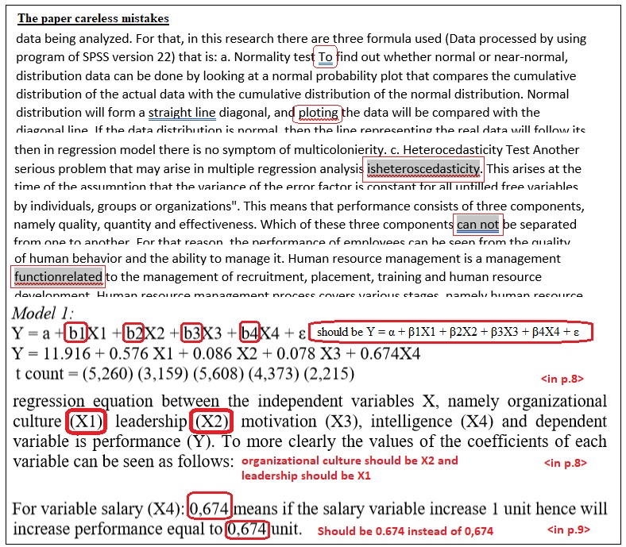

Slide 20
New Research Framework
After the literature review on the topic of ‘Employee Motivation and Employee’s Performance in Banking Industry’ over the last ten years and the journal paper review on “Employees’ Performance in Islamic Banking”. (Bernanthos 2018)
The relationship between employee motivation and employee’s performance that the employee motivation has a positive impact on the employee’s performance as well as organization’s performance. The increase of the employee motivation drive to increases the employee productivity as well as job satisfaction on staff retention for the organization. (Alnasrallah 2016, Bernanthos 2018, Dartey-Baah 2010, Springer 2011) The employee motivation, employee’s performance and employee job satisfaction are related to the organization’s performance and the organization’s strategy management in visions, strategies and objectives.

Slide 21
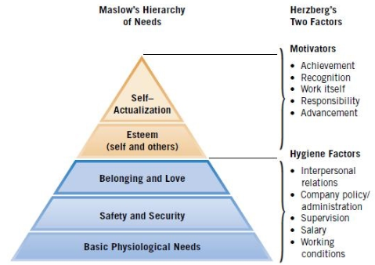
Research Review
The last ten years research studies have found the common factors of the motivation. The social support, employee training and development are the human resource factors benefit on employee job satisfaction and staff retention. The communication, empowerment, leadership influence, salary and incentives are the strategy management factors on employee performance and benefit to the organization’s performance
Motivators
  Vision and Goal
  Communications & Information sharing
  Team work & Social network
Hygiene Factors
  Salary and incentive
  Number of days of annual leave
  Work-life balance
Source
https://www.slideshare.net/doranegoda/frederick-herzbergs-two-factor-theory-of-motivation

Slide 22
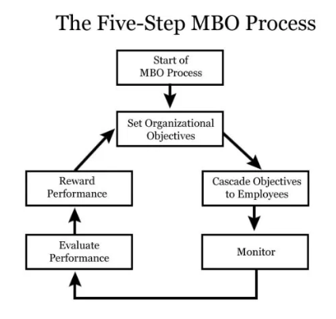
Research Review
Management by Objectives (MBO) (Drucker 1954)
Apply to the New Research Framework
Source
https://www.communicationtheory.org/management-by-objectives-drucker/

Slide 23
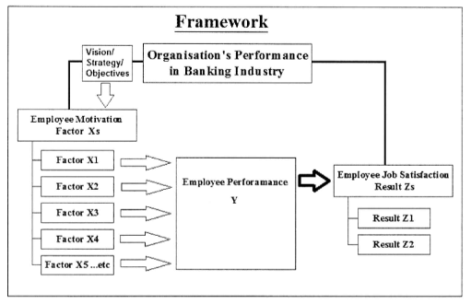
New Research Framework

Slide 24

Conclusions
The relationship between employee motivation and employee’s performance that the employee motivation has a positive impact on the employee’s performance as well as organization’s performance.
The new research framework idea is from Research Thinking Framework in Employees’ Performance in Islamic Banking by Bernanthos. In the framework, all factors are become motivation factors impact on employee’s performance under the organization’s strategy and objective.
The suggest research topic would be “The employee motivation and employee’s performance with job satisfaction in banking industry”.

Slide 25
References
Adyasha, R. 2013,’A Motivated Employee: A Qualitative Study on Various Motivational Practices used in Organizations’, Aweshkar Research Journal, 15, 1, pp. 98-103, Business Source Complete, EBSCOhost, viewed 15 July 2018.
Alnasrallah, Y. 2016,’Employee Motivation and Performance’, International Journal of Scientific & Engineering Research, 7(1).
Bernanthos, B. 2018,’Employees’ Performance in Islamic Banking’, European Research Studies, vol. 21, no. 1, pp 1-42.
Dartey-Baah, K. 2010,’Job Satisfaction and Motivation: Understanding its impact on employee commitment and organizational performance’, Academic Leadership (15337812), 8, 4, Education Source, EBSCOhost, viewed 15 July 2018.
Drucker, P. 1954,’Management by objectives and self-control’, Practice of Management.
Gebczynska, A. 2016,’Strategy implementation efficiency on the process level’, Business Process Management Journal, vol. 22, no. 6, pp. 1079-1098.
Johri, R, & Vashistha, N. 2015,’IMPACT OF WORKING ENVIRONMENT AS A MOTIVATINAL FACTOR FOR EMPLOYEES & ITS EFFECT ON THRIE PERFORMANCE: CASE STUDY OF SYDICATE BANK OF INDIA’, CLEAR International Journal Of Research In Commerce & Management, 6, 3, pp. 40-44, Business Source Complete, EBSCOhost, viewed 15 July 2018.
Kaplan, Robert, S, & Norton D P. 1992,’The Balanced Scorecard – Measures That Drive Performance’, Harvard Business Review, January-February, pp. 71-79.
Kopia, J., Kompalla, A., Buchuller, M & Heinemann, B. 2017,’PERFORMANCE MEASUREMENT OF MANAGEMENT SYSTEM STANDARDS USING THE BALANCED SCORECARD’, Amfiteatru Economic, vol. 19, no.11, pp. 981-1002.

Slide 26
References
Lazaroiu, G. 2015, ‘EMPLOYEE MOTIVATION AND JOB PERFORMANCE’, Linguistic and Philosophical Investigations, vol. 14, pp. 97-102.
Law, M Y., & Gunasekaran, A. 2009,’Dynamic organizational learning: A conceptual framework’, Industrial and Commercial Training, 41(6), 314-320.
Maslow, A H. 1943,’A theory of human motivation’, Psychological review, 50(4), pp. 370.
McGregor, D. 1960,’Theory X and theory Y’, Organization theory, 358374.
McGregor, D. 1967,’The Professional Manager’, New York, NY: McGraw-Hill.
Springer, G J. 2011,’A Study of Job Motivation, Satisfaction, and Performance among Bank Employees’, Journal Of Global Business Issues, 5,1, pp. 29-42, Business Source Complete, EBSCOhost, viewed 15 July 2018.
Tran, T. 2008,’A conceptual model of learning culture and innovation schema’, Competitiveness Review: An International Business Journal incorporating Journal of Global Competitiveness, 18(3), 287-299.
Viorel, L, Aurel, M, Virgil, M, & Stefania, P. 2009,’EMPLOYEES MOTIVATION THEORIES DEVELOPED AT AN INTERNATIONAL LEVEL’, Annals Of The University Of Oradea, Economic Science Series, 18, 4, pp. 324-328, Business Source Complete, EBSCOhost, viewed 15 July 2018.
Vroom, V H. (1964), ‘Work and motivation’, NY: John Wiley &sons, 45.

Slide 27
Thank You

