Slide 1

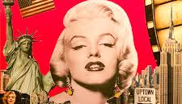
Why Celebrity Endorsement Matters Today
Today's consumers are inundated with advertisements; thus, brands need differentiation. Celebrities already exert considerable influence, and it is generally accepted that people admire their lifestyles, success, and personalities.
Their prominence makes them powerful marketing mediums, which is one reason brands prize them celebrity existence signals notoriety and trustworthiness to consumers.
Studies have found that celebrity endorsements lead to increased awareness and recall of messaging (Wang and Liu, 2023).
Endorsements can also help create positive attitudes and feelings of trust both are critical in a competitive advertising environment (Schimmelpfennig and Hunt, 2020).
Accordingly, brands deploy celebrities to support young consumers' attractive qualities and deep emotional connections (Yue et al., 2023).

Slide 2
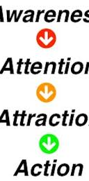
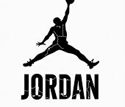
Key Findings & Real-World Example
Evidence is provided for the 4As framework in Celebrity endorsement:
Attention: Celebrities generate immediate visibility in a crowded marketplace (Wang and Liu, 2023).
Attraction: Consumers transfer their positive feelings about the celebrity to the brand (Adam and Hussain, 2017).
Affinity: A consumer's emotional tie or connection to the celebrity builds their trust in the endorsement itself (Osei-Frimpong et al., 2019).
Action: Trust leads to increased purchasing behavior and impulse buying (Yue et al., 2023).
Real World Example - Nike & Michael Jordan
Nike's collaboration with legendary basketball player Michael Jordan is among the most successfully recognised cases of celebrity endorsement (or collaboration) in marketing history. The "Air Jordan" sub brand has become a worldwide success story because consumers looked up to and admired Jordan's talent, legacy, achievements, and cool personality. They had emotionally connected to him which built trust and demand for the shoes. This is a relevant example for this principle in the 4As framework because it provides an example of attraction and affinity collaboratively leading the consumer to the ultimate action of acting on that attraction to purchase Jordan's shoes (more than once).

Slide 3
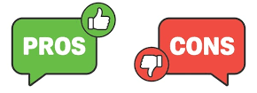

Evaluation & Conclusion
Using celebrities to promote products can be very effective, particularly if there is a good fit between the celebrity and the brand. Research shows that a credible and well-suited celebrity can create purchase intention and brand loyalty (Khan and Khan, 2024). This form of marketing, the endorsement, builds attention, trust and emotional connection and has added value to the marketing mix.
There are, of course, the risks involved. Negative press around a celebrity can also adversely affect the brand, and celebrity endorsement deals can be very costly. However, if companies are careful in selecting celebrities who embody and represent the brand’s values and appeal to the target market, the positives are much greater than the negatives. Overall, celebrity endorsement is still a strong and persuasive marketing tactic that can shape consumer behavior and help brands thrive.

Slide 4
References
Adam, M. and Hussain, N., 2017. Impact of celebrity endorsement on consumers’ buying behaviour. British Journal of Marketing Studies, 5(3), pp.79–121.
Khan, M.M. & Khan, A.M., 2024. The Effect of Celebrity Endorser Selection on Consumer Purchase Intention. The Lahore Journal of Business, 12(1), pp.91–112.
Osei-Frimpong, K., Donkor, G. and Owusu-Frimpong, N., 2019. The impact of celebrity endorsement on consumer purchase intention: An emerging market perspective. Journal of Marketing Theory and Practice, 27(1), pp.103–121.
Schimmelpfennig, C. & Hunt, J.B., 2020. Fifty years of celebrity endorser research: Support for a comprehensive celebrity endorsement strategy framework. Psychology & Marketing, 37(3), pp.488–505.
Wang, S. and Liu, M.T., 2023. Celebrity endorsement in marketing from 1960 to 2021: A bibliometric review and future agenda. Asia Pacific Journal of Marketing and Logistics, 35(4), pp.849–873.
Yue, X., Abdullah, N.H., Ali, M.H. & Yusof, R.N.R., 2023. The impact of celebrity endorsement on followers’ impulse purchasing. Journal of Promotion Management, 29(3), pp.338–358.

