Slide 1
Rich Internet Application Development
Navigation

Slide 2
Navigation a traditional approach
HTML based navigation involves a refresh of the entire browser window
AJAX allows for specific part of a page to be refreshed
Silverlight prior to version 3 provided no built in method of navigation

Slide 3
Navigation in Silverlight
There are three common approaches to implement navigation within a Silverlight site
Code it yourself – the only method available in Silverlight version 1
The TabControl was introduced in Silverlight 2, but has limited visual appeal
The Navigation framework (new to Silverlight 3) provides a navigation environment that links into the browser

Slide 4
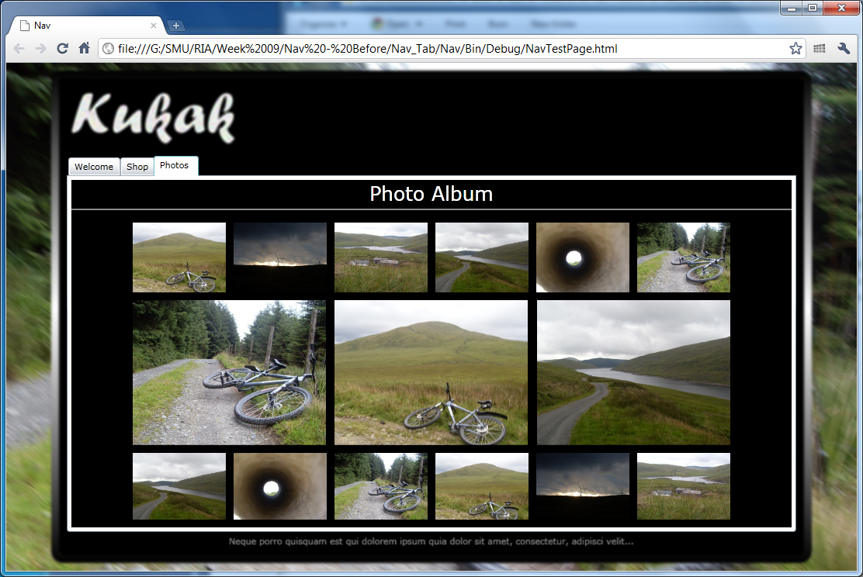
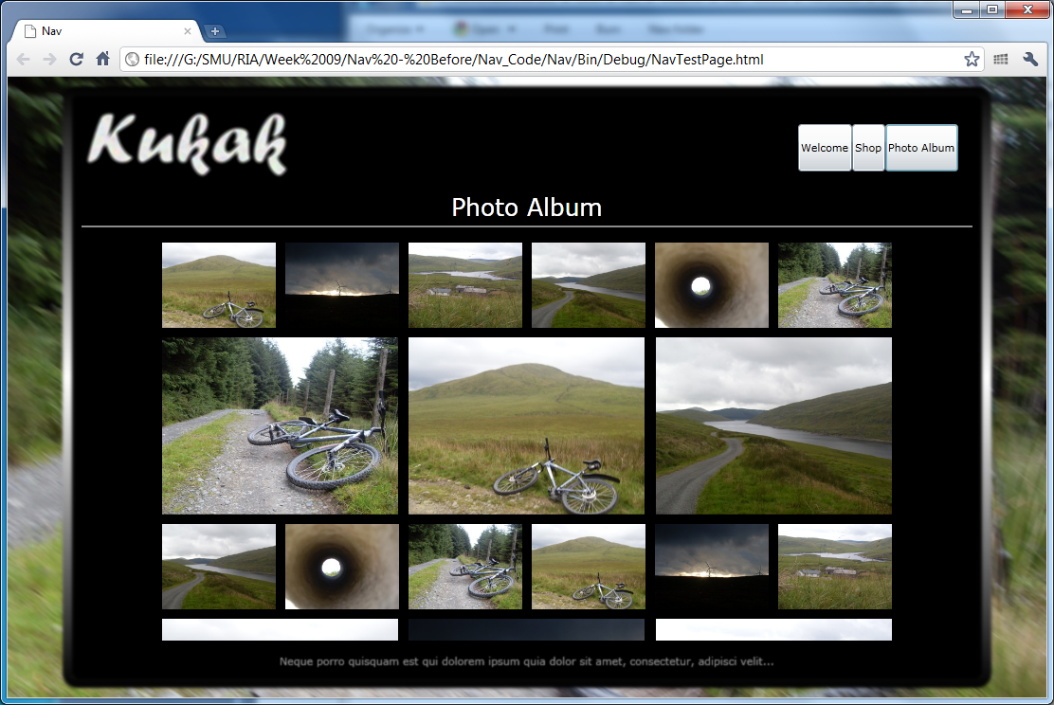
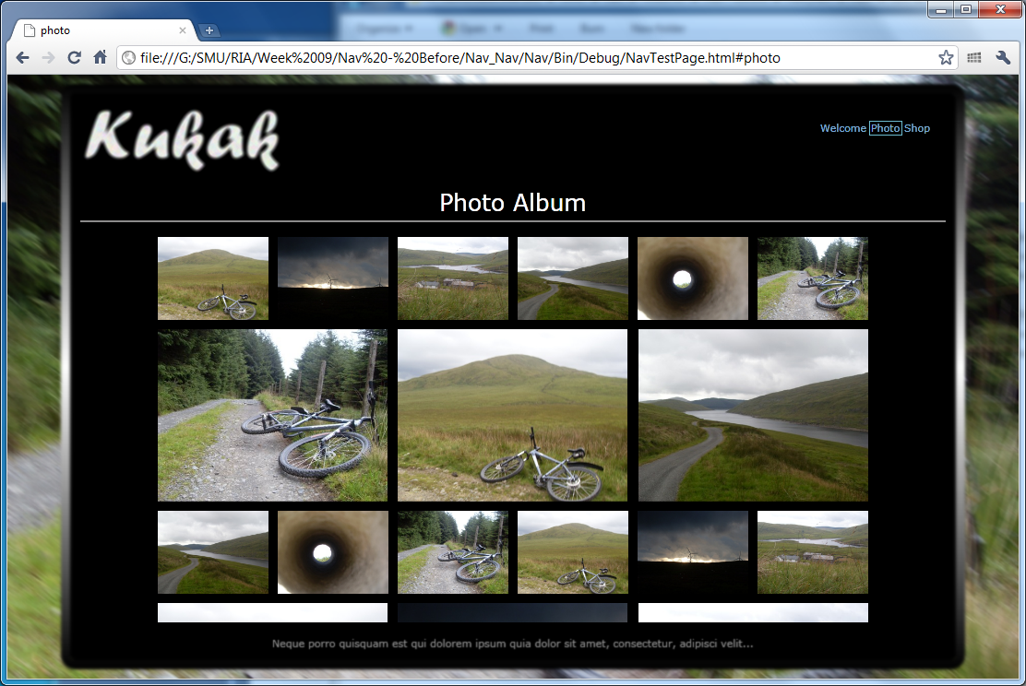
Navigation

