Slide 1
Impact of digital technology at Amazon
Digital skill and Research method
Name:
ID:
Research Topic:
Paulina Dandasova
Roman Ziga
Tomas Adam
Dominik Benak
Name of lecture:
Koushik Modak
1915710
1913284
1917610
1915705
Insights to the modern technology
Background, impact of the technology introduced
Introduction, The challenges, Conclusion
Lessons that can be draw from the case study

Slide 2

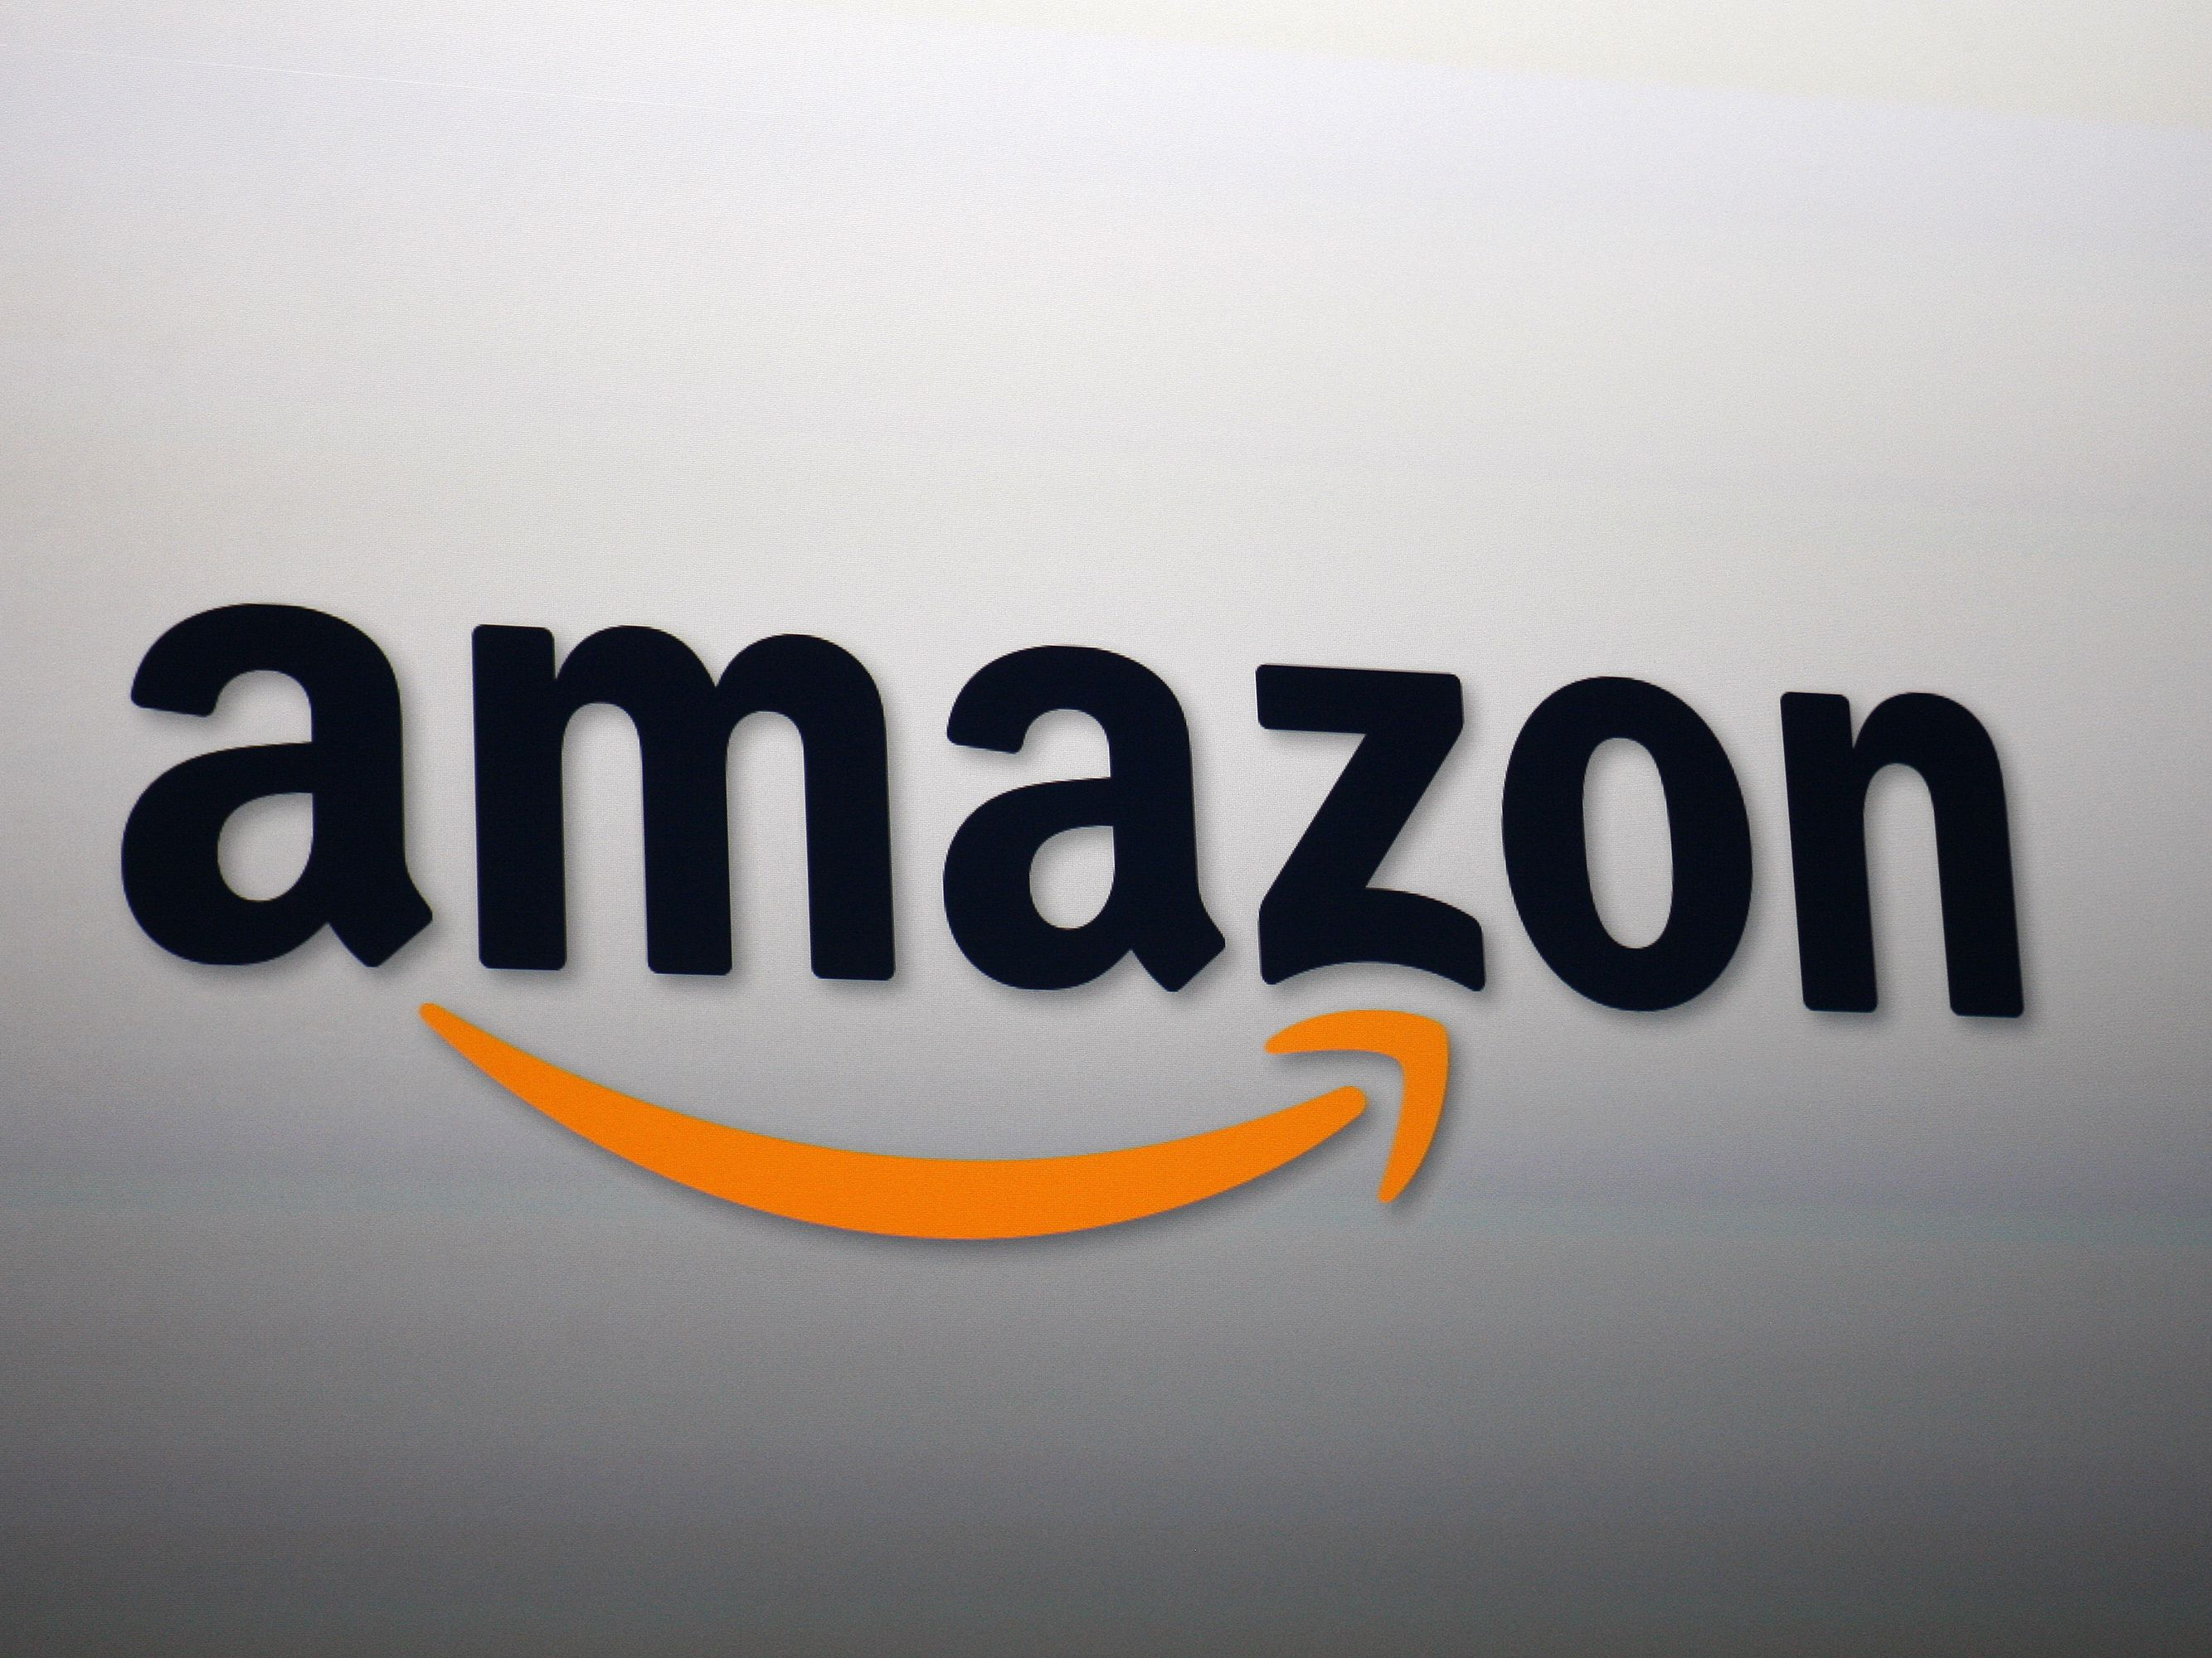
Introduction
In group, we have formed this presentation to show the impact of modern technology on amazon and how it emerged the business that it is today.
(Amazon.com, 2020)
Notes:
Amazon warehouses and the way they work, have gone through rapid changes in the past years. In this presentation, we will present one of the most important changes and how has the modern technology impacted amazon.

Slide 3
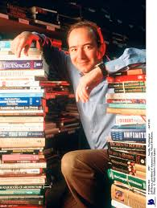
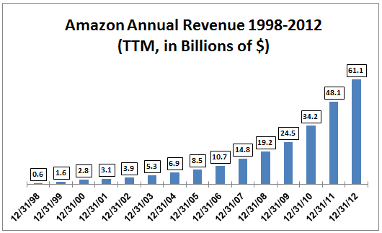
Background of Amazon
Brief history of the organization
(CNBC.com,2020)
Seekingalpha .com,(2020)
Notes:
Amazon was first established in 1994 by Jeff Bezos. The first idea of the company was to sell books online. However 5 years after amazon was founded it became one of the most popular online business selling videogames, toys and games, home-improvement items, electronics and much more. Amazon.com started to grow up fast having 180 000 customers in December 1996 with $15.7 million earnings to $610 million in 1998. In the picture we can see a growing chart of the company since 1998-2012.

Slide 4



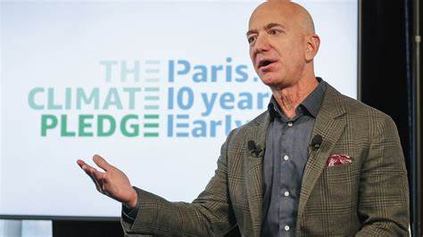

Aims and objectives
Amazon go
Amazon 4-star and pop-up stores
Promoting products on Alexa
Amazon-branded bank accounts
Amazon prime
(amazon.com, 2020)
Gudat S. (2019) Amazon business strategy
Notes:
Amazon Go it’s the first store that sells grocery and prepared food without cashiers or check out lines. Using modern technology, items are scanned, and customers are charged from their account on the way out with their items.
Amazon 4-star and pop-up stores is based on customer. The store is selling items that have 4 stars and above rating, and also selling brand new products which are online on amazon.com.
Promoting products on Alexa is device that allows people to buy their shopping by voice.
Amazon-branded bank accounts is the idea of a product for younger people and it would allow them to shop without bank accounts.
Amazon prime offer services that members can enjoy free e-books, photo storage, ad-free music, discounts at whole foods, and amazon key, a service which enables delivery inside your home.

Slide 5
Mission and vision
Amazon mission statement is;
“We strive to offer our customers the lowest possible prices, the best available selection, and the utmost convenience.”
Amazon vision statement is;
“To be Earth’s most customer-centric company, where customers can find and discover anything they might want to buy online.”
(mission-statement.com/amazon2019)
Notes:
The reason why Amazon had very positive impact on their customers around the world since 1994 is because of its mission and vision statements.
Amazon mission statement describes what customers should expect from the company such as low pricing, variety and personal satisfaction.
Amazon vision statement tells that the company wants to be the destination where all customers feel satisfied in all ways.

Slide 6
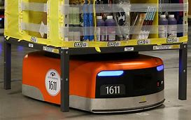
Current status and services of the organisation
Amazon robotics (formerly Kiva Systems) - all about robotics
(Mohan, 2018, amazon products and services)
(CNBCFM.com, 2020)
Notes:
Amazon is currently the largest online retailer offering over 71 products and services. Formerly Kiva is the name of one of the amazon robotics.

Slide 7
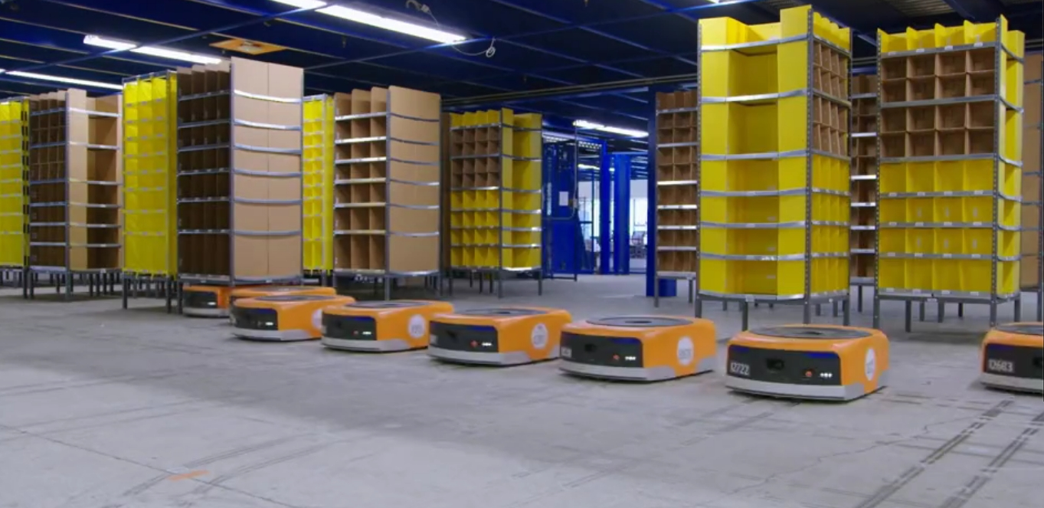
Challenges before modern technology robotics
(Aboutamazon.com, 2020)
Fast delivery service
Job done within 2 hour
LESS PEOPLE WORK
Work hard
Lost package
These challenges will be shown in the next few slides

Slide 8
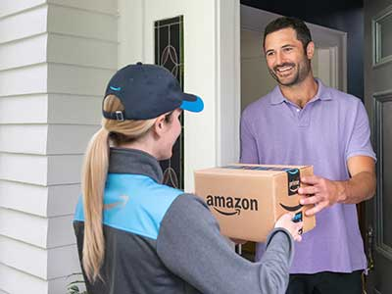
Fast delivery service
Robotics impact on the delivery service
(Amazondeliver.job , 2020)
Notes:
Amazon robotics has had a huge impact on the delivery service. Prior to amazon having robotics in the warehouse, the job was only done by humans. The process of getting and sending a package would have been couple of days. However, now that there are robotics in the warehouse, people can order a package and it will be delivered in the same day.

Slide 9
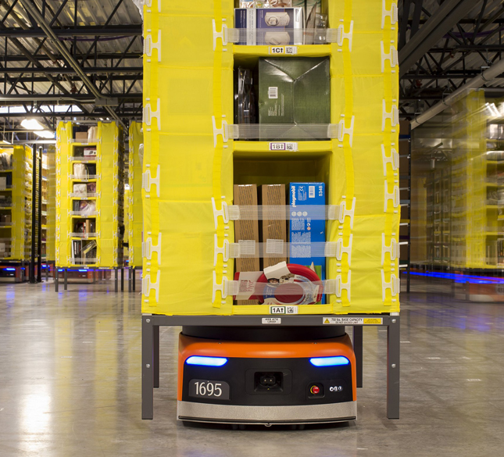
Job of sorting packages
Sorting packages is no longer days long activity.
(machinedesign.com, 2020)
Notes:
Sorting packages is easier and faster than ever. Before the introduction of robotics, sorting packages in the warehouse could take the warehouse operatives days to complete. This is no longer the issue. Robotics now complete this job in 2 hours.

Slide 10
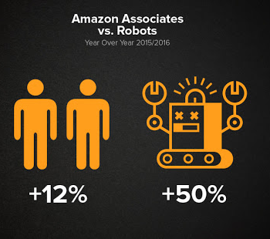
Warehouse operatives
Robotics have an impact on the amount of people working.
(wdwayfind.com, 2020)
Notes:
Amazon robotics have started to replace humans. Much of the work in amazon warehouse is now done by the robotics, this has had an impact on the amount of employees needed in the warehouse. Although, the modern technology of robotics is there to make the warehouse operatives jobs easier and the delivery of products to its customers faster, there is no longer the need for as much employees to work as there had been prior to robotics.

Slide 11
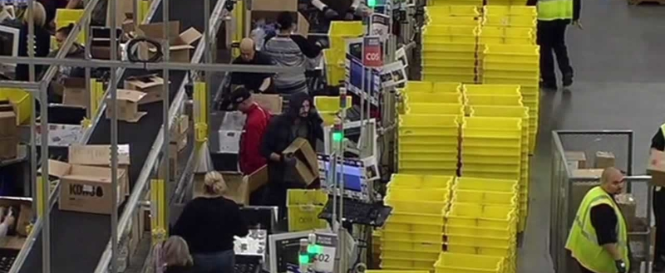
(Amazon.com, 2020)
How hard is it to work at amazon warehouse?
Is amazon warehouse the same as any other warehouse?
Notes:
Amazon warehouse job can now be described as ‘easy’ This is because the robotics now do the hard job. Robotics have not only had an impact on the delivery service and sorting packages but it has also had an impact on the way the employees work. Warehouse operative now no longer need to lift the heavy packages. This is not the only plus for the employees. Robotics in the warehouse bring the package to the worker. Therefore, all that has to be done by the worker is to pack the package. This has had an huge impact on how employees work in the warehouse.

Slide 12
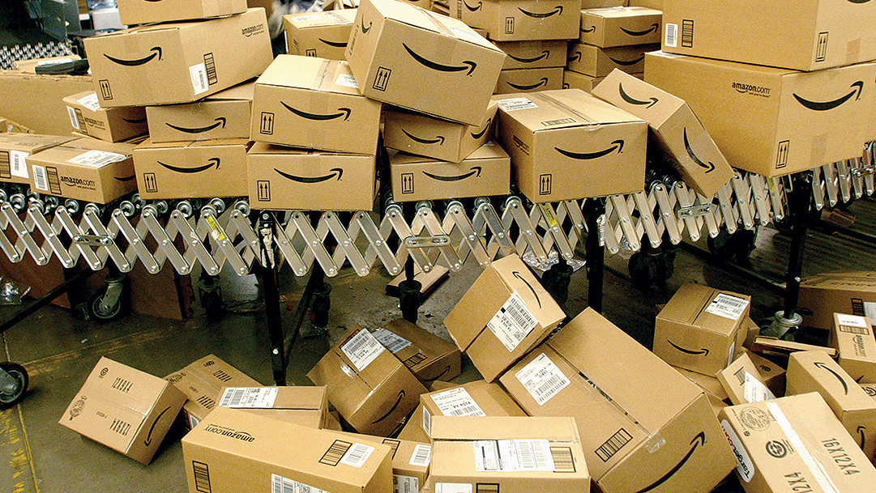
Lost packages
Is it hard to find a lost package at amazon warehouse?
(ttnews.com, 2020)
Notes:
Prior to robotics, losing a package in the warehouse was a big thing. Because amazon warehouses are not small buildings, it was very hard to find a lost package. However, this issue has now been resolved by the robotics. Now, if a package is lost the robotics can easily find the package. This is because the robotics can now identify where in the warehouse exactly the package is. This will allow the worker to find the package easily through a navigation system. The robotics are moving all over the warehouse, in order for the employee to move safely around the warehouse to find the package, their navigation device have sensors which tells the robots that they need to stop as someone is passing by.

Slide 13
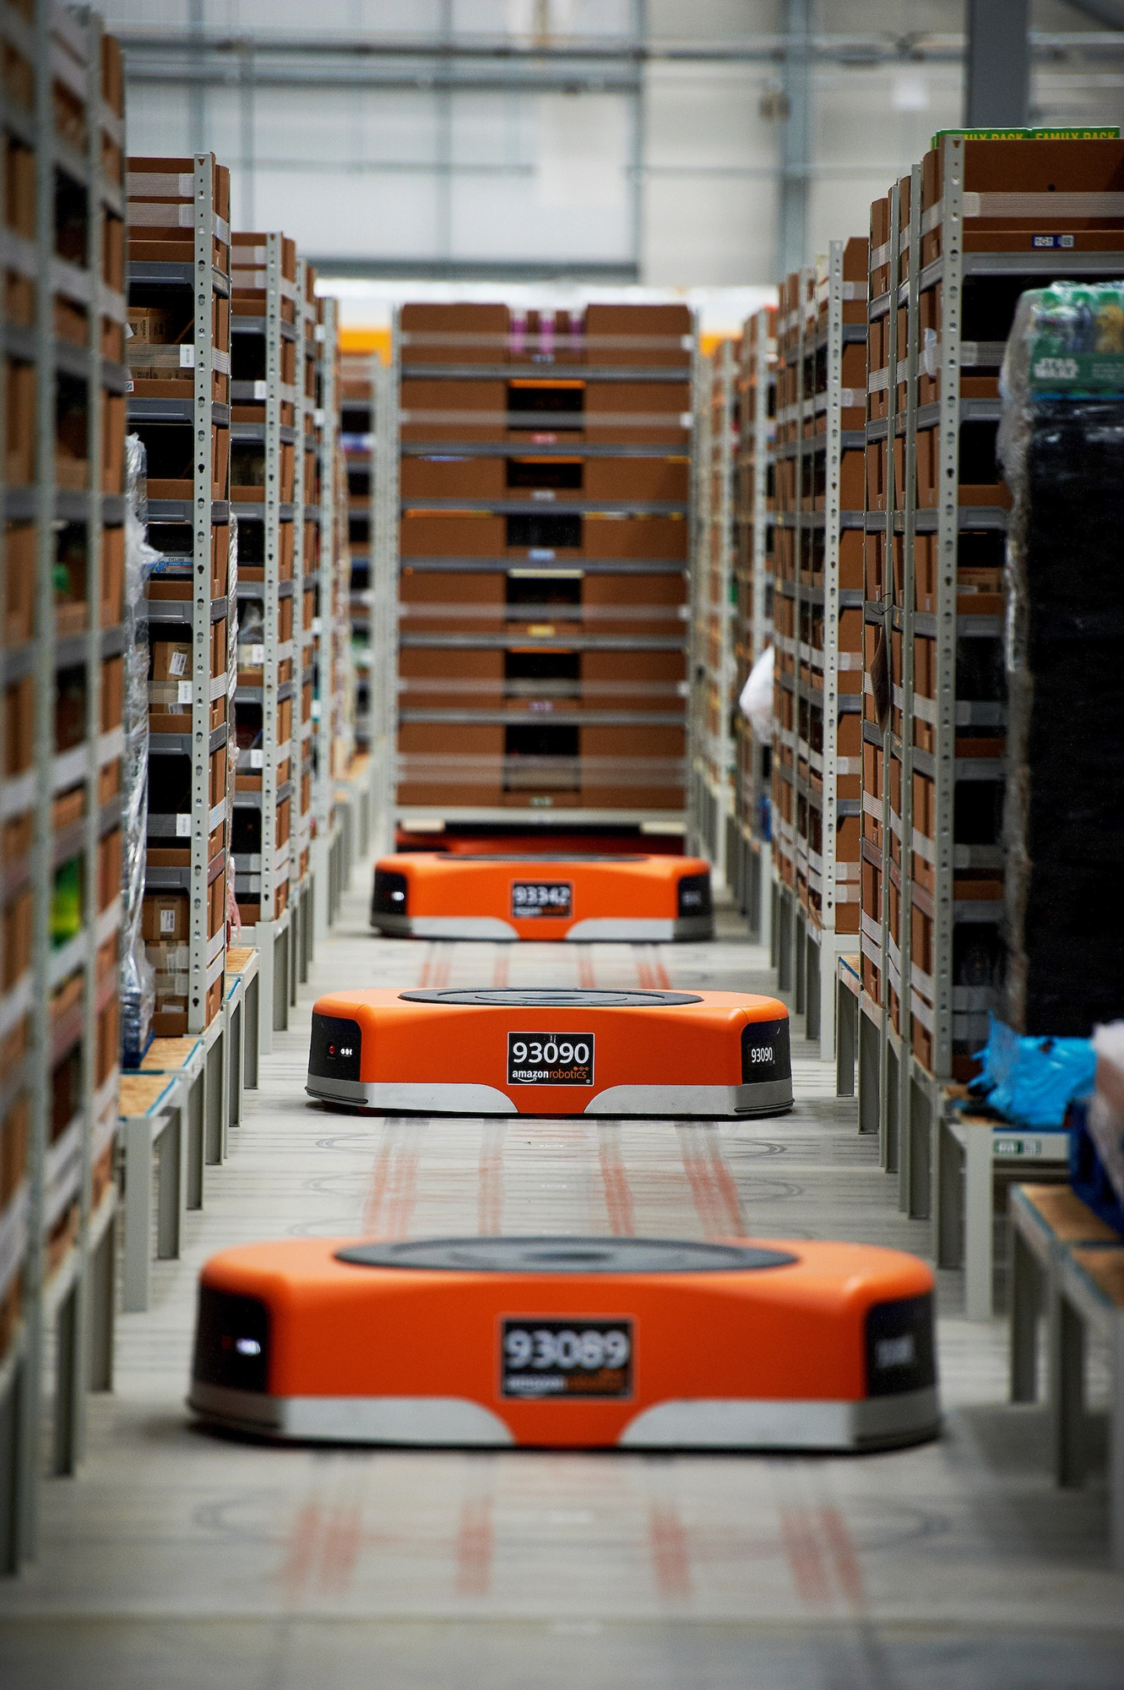
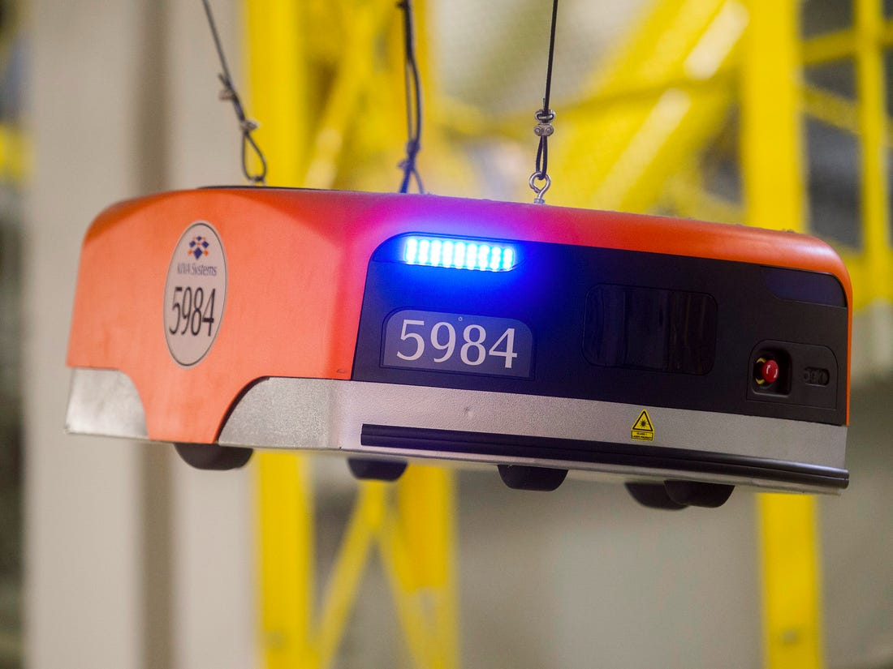
Insights Of Modern Technology
Of Amazon Robotics
Kiva Amazon Robotics
Aws Robomaker
Characteristics
Advantages
Eugene Kim
Jun 15, 2016, 9:02 PM
Notes:
Hello there my name is Paulina Dandasova and i will be speaking to you about insights of amazon modern technology when 2012 Amazon brought robots by Kiva for $775 million and this is the successed throughout the years.

Slide 14
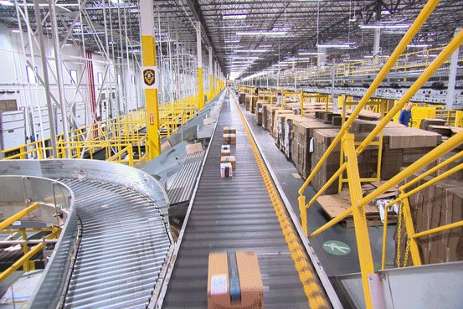
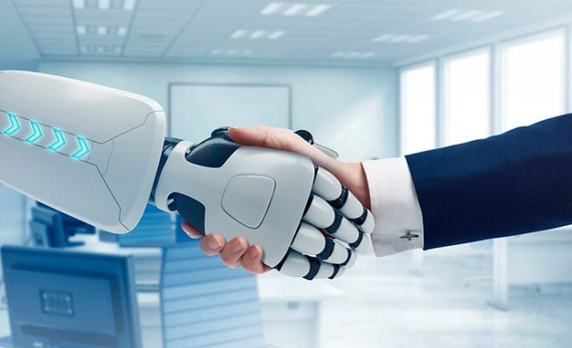
Kiva – Amazon Drive Unit Robot
It’s not Humas vs. Robots., It’s Humas + Robots
Notes:
Significantly Amazons packing and shipping improved and the wider use of robots at the fulfillment centres had a direct impact on its productivity. These robots increase efficiency and safety a fulfillment centers, they make it possibke to store 40 percent more inventory, which in makers it easier to fulfill Amazon Prime and other orders on time since it’s less likely an item will run out. As such, robotics make a significant contribution in Amazon’s drive to deliver a smarter, faster, more consistent customer experience.

Slide 15
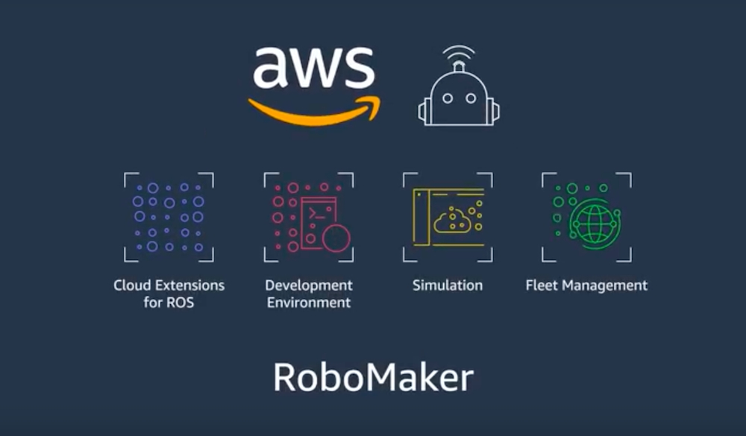
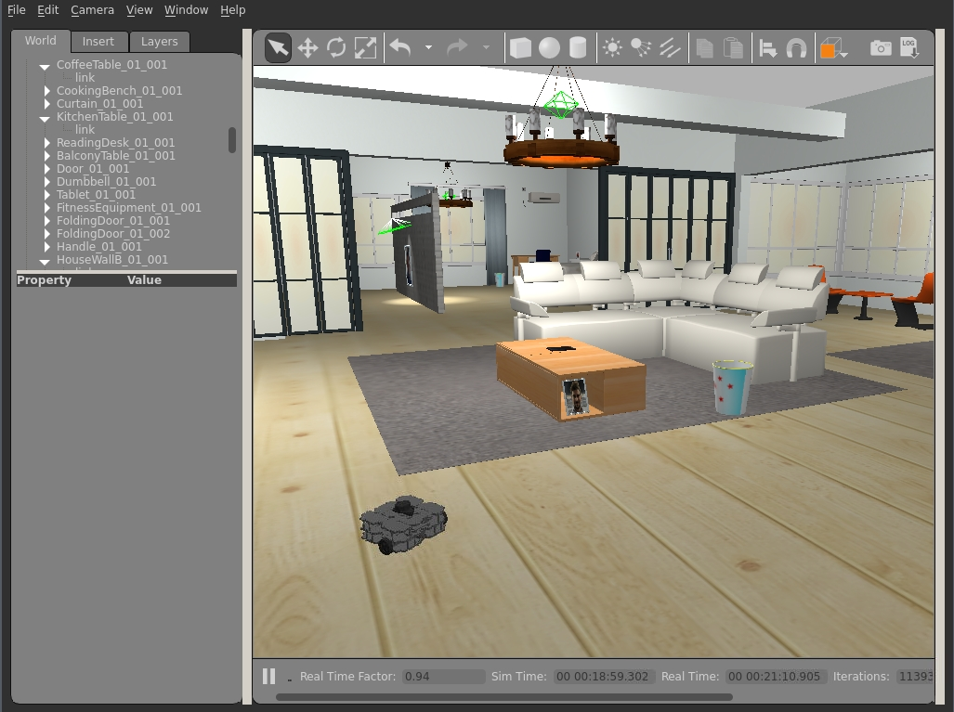
AWS Robomaker
A Clouds Robotics Service
Notes:
AWS RoboMaker is a service that makes it easy to develop, simulate, and deploy intelligent robotics applications at scale. It removes the heavy lifting from each step of robotics development so you can focus on creating innovative robotics application.
How do you use AWS robomaker?
Build a robot application – Build an X86_64 architecture version of the robot application
Build a simulation application - Include a 3D artificial world and Gazebo
Launch a AWS Robomaker simulation- train machine learning models
Deploy a robot application
Access logging and monitoring features

Slide 16
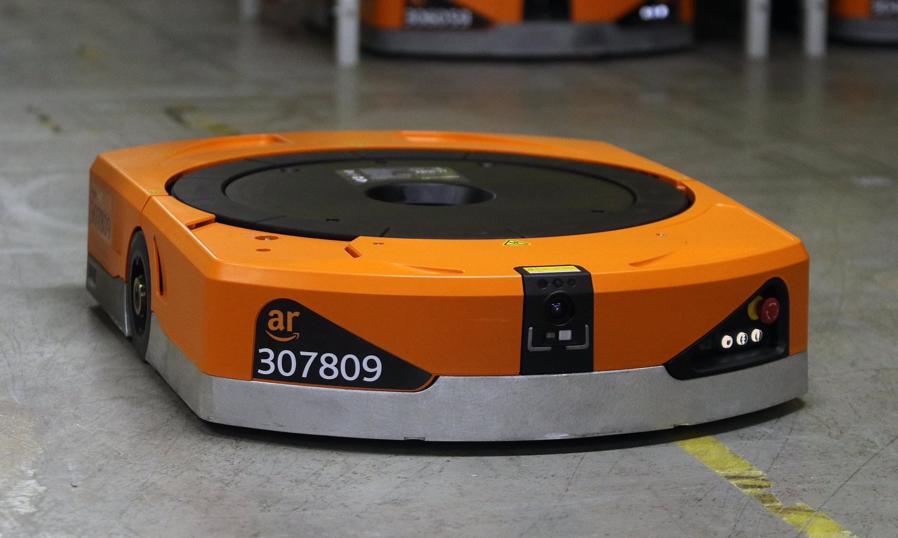
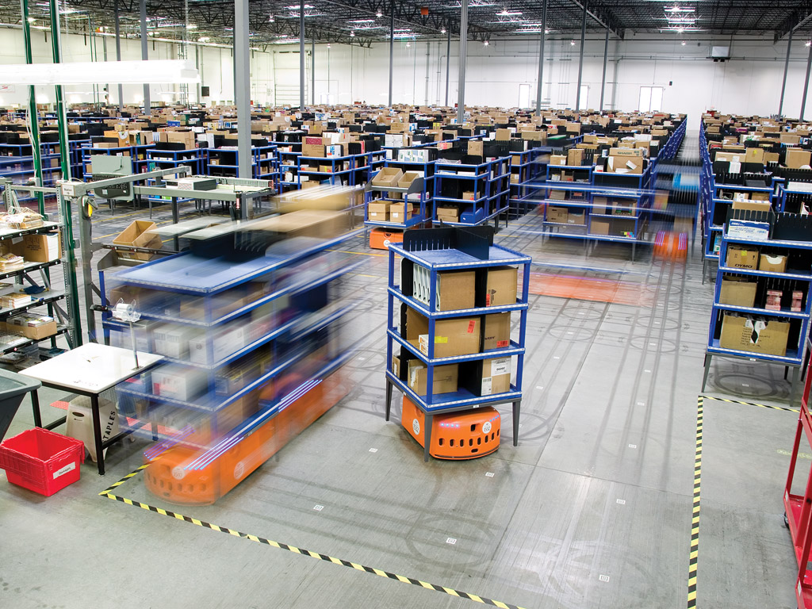
Characteristics Of Amazon Robots
Notes:
These robots, the smaller model are approximately 2 feet by 2.5 feet, 18 inches high and capable of lifting 1,000 pounds. The larger model are capable of carrying pallets with loads as heavy as 3,000 pounds. Both are a distinctive orange colour. The maximum velocity of the robots was 1.3 meters per second.

Slide 17
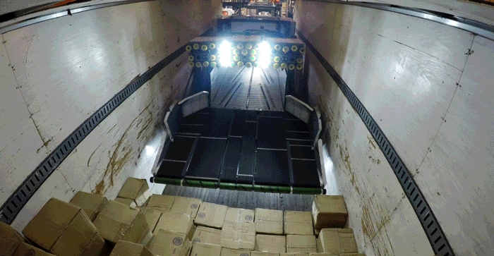
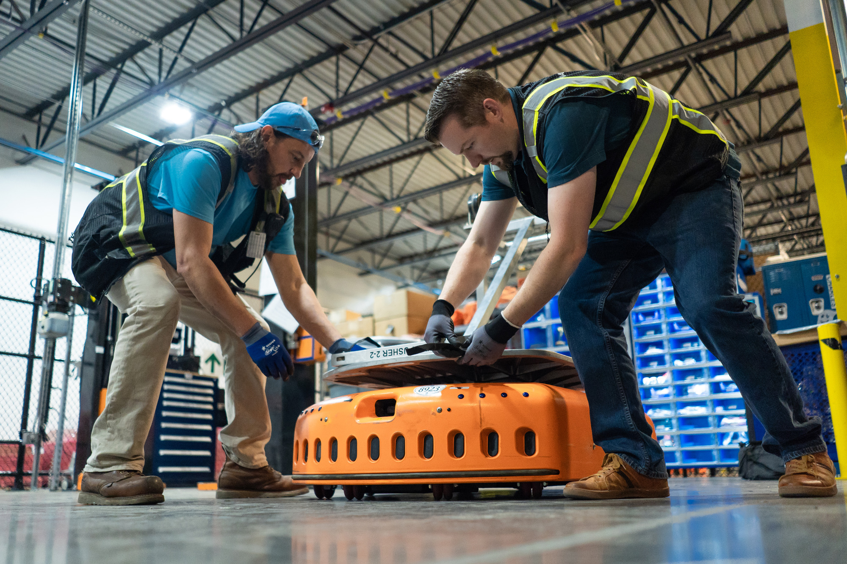
Advantage
Notes:
The “click to ship” time at Amazon has decreased from 60-70 minutes with human opIerators to 15 minutes using Kiva robots. These robots are not only more efficient but also take up less space than their human counterparts.
Another good thing is, unlike a human workforce, robots and machines don’t feel the need to take holidays, sick days or even a lunch break, they dont require a health insurance or a monthly wage.

Slide 18
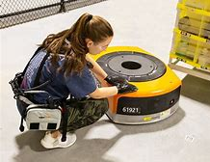
Impact of the technology
Robotics at workplace
Positive impacts
Negative impacts
(Amazon.com, 2020)
Notes:
Amazon was the first online company that invested in robots, to help people working in warehouses with task such as; ability to pick up orders and deposit them in packing stations. In next slideds im going to talk about positive and negative impact of robots in warehouse.

Slide 19
Positive impact of robotics
Doing repetitve tasks
No breaks neccesary
Fewer injuries at work
Notes:
Robots have lots if positive impacts in warehouses. Im going to talk about three main advantages of using modern technology.
Robots are designed to manage routine task with acuracy for a long period of time. Which means that the warehouse can increase the productivity, and also employees can work on different projects.
Most employees needs a break whenever it’s just a tea break or a lunch break to rest. Robots that we are talking about can work long shifts without taking any brake.
Robots are programmed with sensors, they can perform their work while avoiding other robots and objects. This benefit lowers the chances of serious accidents that could impact a human worker’s health and safety.

Slide 20
Negativ impact of modern technology
Job elimination for workers
No adaptability or ingenuity
Substantial monetary investment
Mangumat R. (2017) https://www.flockfreight.com/2017/11/15/pros-cons-of-robots-in-the-warehouse/
Notes:
As technology improves and robots become more intelligent and can do more task, it will be less jobs for people.
The other advantage of robots working in warehouses is that they can only follow the program that its been hard-coded into system. If anything goes wrong in the warehouse, they cant find any solution to solve the problem.
Companies with robotics such is amazon, can save money by paying wages to employee but they have to pay for maintance and programing of technology. As there are only few companies that are using skilled robotics, to maintain and to program them can cost huge ammount of money.

Slide 21

Lesson drawn form the case study
Difference between traditional and modern technology
Why there are important
Consequences of not using it
Notes:
Traditional technology has proven to be very useful in the recent years. Today, technology is very important because it is used for almost everything.
This applies to amazon too, amazon has been using traditional technology such as mobile phones in various ways to for the use of their business. For example, creating an amazon app on the phone, to allow the customers easier access to their products but also to come along with the trends. On the other hand, modern technology such as robotics, is another level of technology. This is the innovation of technology. Robotics are there to replace humans. Robotics has proven to be successful at completing human job, completing the human job even better than humans themselves.
This is very important because robotics get the job done much quicker than humans, which allows quicker services to customers.
Stopping the use of robotics would mean a step back for amazon, this is because the job would not be done as fast as it is now. Therefore, their profit would not be as good as it is now.

Slide 22

Conclusion
(Ethos3.com, 2020)
Notes:
To conclude, Amzon.com has gone through rapid changes and developments through the years. From selling e-books to having robotics working in their warehouse. These changes have gained amazon a better name, more customers and better income. This is a clear positive impact of the modern technology on Amazon.com. Amazon robotics have not only allowed amazon.com to improve its services but also to ease the work of their employees in the warehouse. On the other hand, modern technology and the use of robotics in warehouses has changed the amount of employees needed in the warehouse. Therefore, amazon warehouses now no longer need the amount of employees like they did prior to robotics. Thus, modern technology has impacted amazon.com both in a positive but also in a negative way.

Slide 23
References
CNBC, (2019) Delivery in one day, (online) available at: https://www.youtube.com/watch?v=Yiafb0-gqF4 , (accessed 5 April 2020)
Channel 4, (2019) Amazon warehouse runs by robots, (online) available at: https://www.youtube.com/watch?v=TUx-ljgB-5Q, (accessed 5 April 2020)
DelRey, J. (2019) How robots impact Amazon warehouse, (online) available at: https://www.vox.com/recode/2019/12/11/20982652/robots-amazon-warehouse-jobs-automation, (accessed 5 April 2020)
Simon, M. (2019)Inside the Amazon Warehouse, available at: https://www.wired.com/story/amazon-warehouse-robots/, (accessed 28 April 2020)
Ismail, N. (2017) Modern technology, (online) available at https://www.information-age.com/modern-technology-advantages-disadvantages-123465637/, (accessed 5 April 2020)
Chaffey, D. (2020) home page, (online) https://www.flockfreight.com/2017/11/15/pros-cons-of-robots-in-the-warehouse/, (accessed 5 April 2020)
Mohan, (2018), amazon products and services, (online) available at: https://services.amazon.co.uk/services/sell-online/features-and-benefits.html?ld=SEUKSOAAdGog_2023263780_75431178841_kwd-302400466533_b_372735923213_c_asret_&ld&id=go_cmp-2023263780_adg-75431178841_ad-372735923213_kwd-302400466533_devc_ext-_prd-, (accessed 5 April 2020)

