Slide 1
Contemporary Mental Health ECHC5001
Module Leader: Andrea Williams

Slide 2
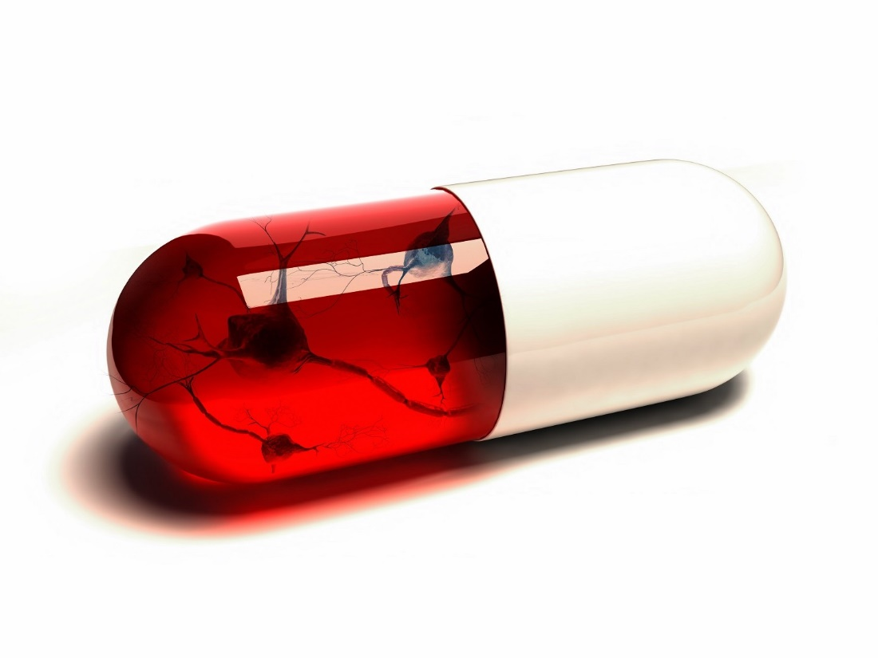
Biological Interventions for Mental Health Problems
Medication
Electroconvulsive Therapy (ECT)
Psychosurgery

Slide 3
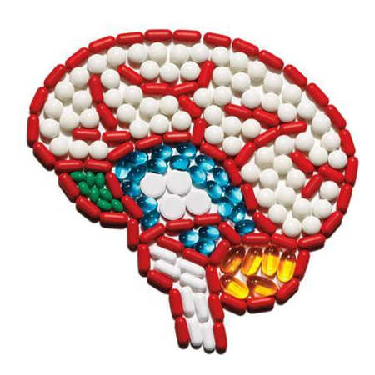
Psychopharmacology
Psyche - Mind
Pharmaka – Drugs/ Medicine
Logos - Study

Slide 4
Psychopharmacology
The generic term for the study and use of psychoactive drugs to alter functioning of brain and nervous system.
Any substance that alter the mind and affect the mood are ‘Psychotropic’ (mind-altering)
Psychopharmacology is the study of the ways in which psychotropic and psychoactive substances affect the mind, behaviour, emotions and consciousness in various ways

Slide 5
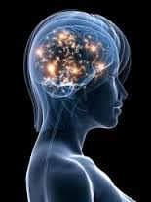
Psychopharmacology
Antidepressants
Anxiolytics
Antipsychotics
Mood Stabilisers
Sedative Hypnotics
Medication used for Parkinsons, ADHD and Sleep Disorders

Slide 6
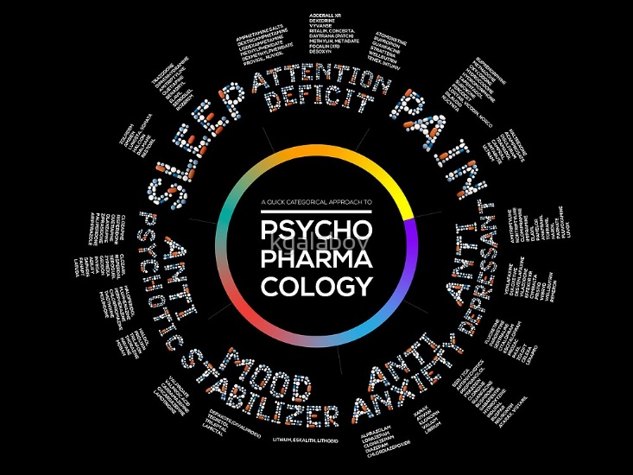

Slide 7
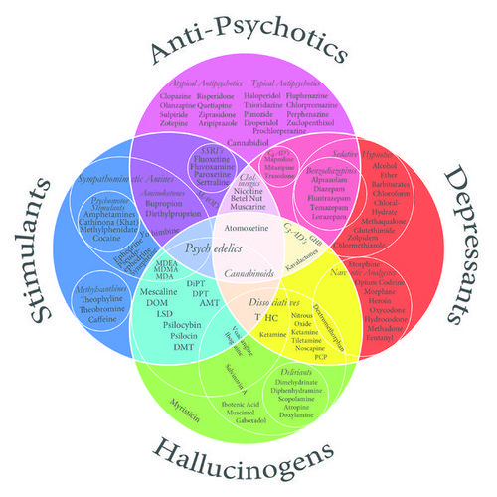

Slide 8
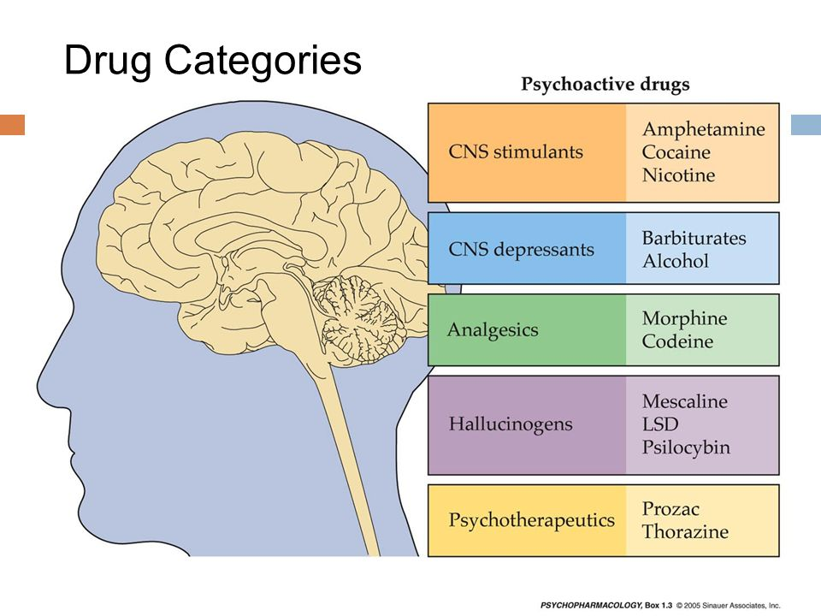

Slide 9

Psychoactive drugs have been used throughout the ages (Siegal, 2005)
Drugs have come into use as a natural by-product of farming
Opium
Cannabis
Alcohol
Hunter-Gather and Tribal Cultures attach spiritual significance to such drug use

Slide 10
What factors need to be considered before prescribing medication?

Slide 11
Psychiatry
Psychotropic drugs are used in the treatment of all forms of mental disorder (Baldessarini, 1999)
Prior to WW2, drugs were used to suppress or manage symptoms i.e. ‘sedatives’ ‘tranquilisers’
1950’s – ‘Pharmacological Revolution’
Psychotropic drugs have powerful effects on central nervous system
Side-effects can be life-diminishing and life-threatening (Kellam, 1987; Waddington et al, 1998)
Benzodiazepines and Neuroleptics(Fisher & Greenberg, 1997; Segal et al, 1992)

Slide 12
Psychopharmacology
All drugs can be toxic and have side-effects.
Alcohol and nicotine cause the most harm (Nutt, King & Phillips,2010)
We have to weigh the toxic effects of drugs against beneficial benefits.
Drugs do not work in the same way for all people, some have reverse effects.
Trial and error - researchers are still trying to find out exactly how some drugs work (Cottingham, 2009)
Psychoactive drugs are thought to affect the brain’s chemical pathways and neurotransmission.

Slide 13
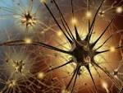
Neurotransmitters
Cells in the nervous system are called neurons
Neurotransmitters are chemicals that allow neurons to send signals across the synapse to other neurons

Slide 14

Several neurotransmitters are important in psychopathology
Serotonin
Dopamine
Norepinephrine
Gamma-aminobutyric acid (GABA)

Slide 15
The Neurotransmitter Hypothesis of Psychopharmacology
Most of the drugs currently used in psychiatry are presumed to act by either increasing or competing with naturally occurring chemicals – neurotransmitters mediate electrical transmission in the brain, spinal cord and muscles
Most psychoactive drugs work by influencing chemical transmission in the synapse, they may mimic the transmitter.
Homeostasis – When psychoactive drugs are suddenly stopped, they may leave the transmission in a worse state than before the drug was started (Rebound effect) More drugs may be needed to produce the same effect, leading to dependency

Slide 16
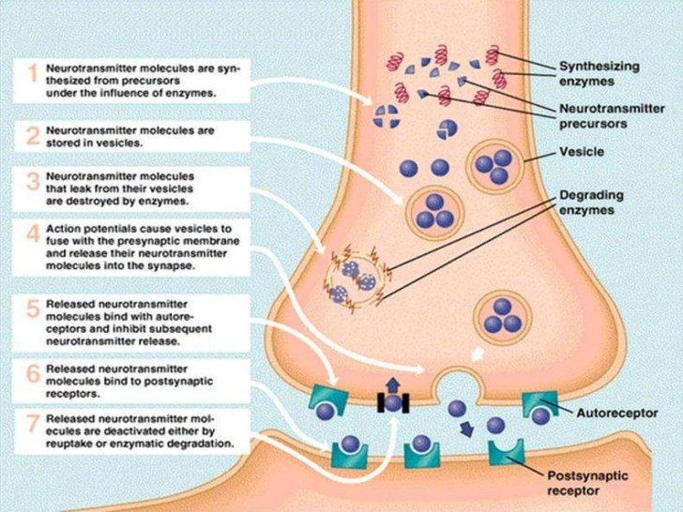

Slide 17
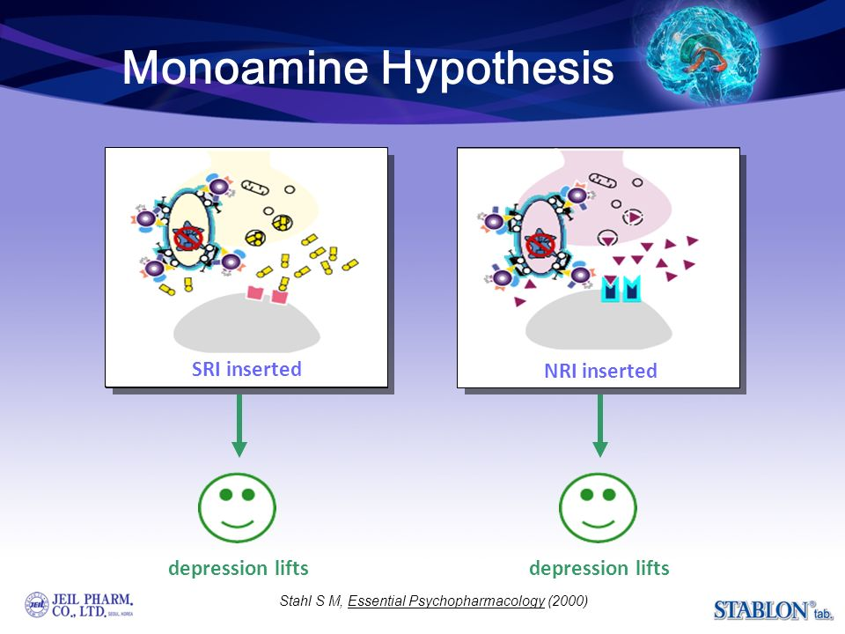

Slide 18
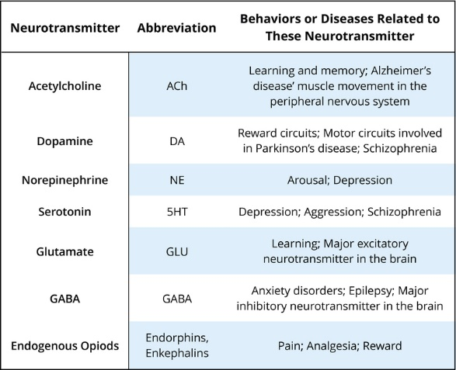

Slide 19
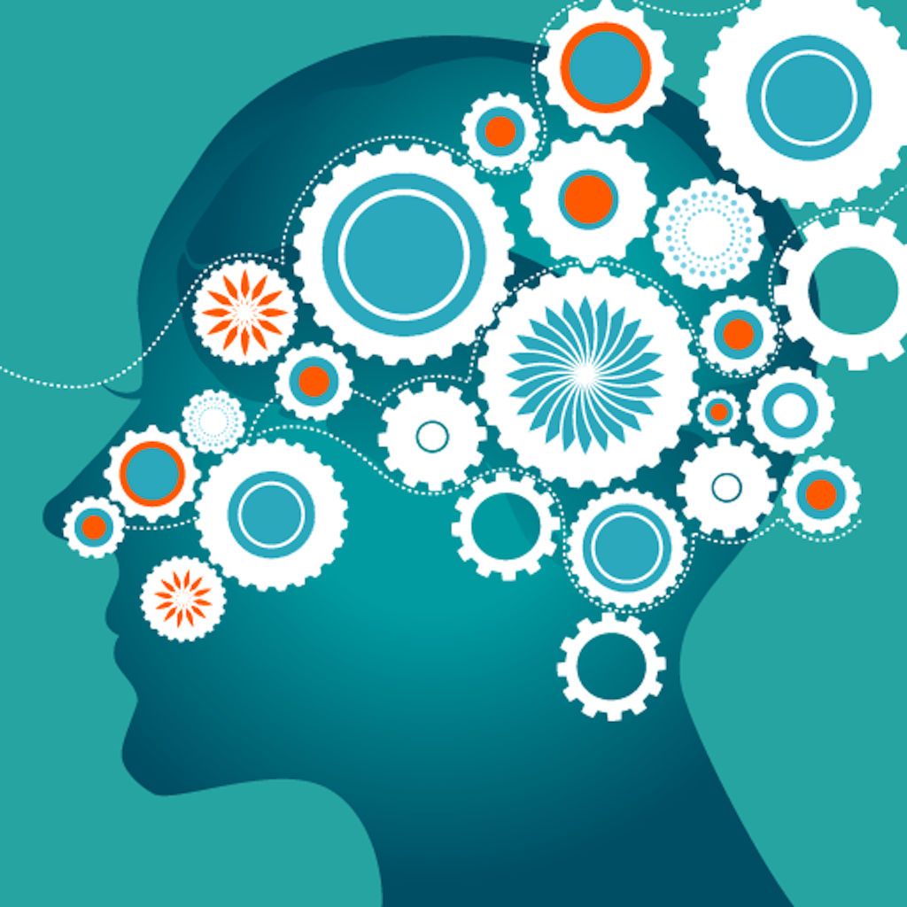
Neurotransmitters and
Serotonin and dopamine associated with depression, mania and schizophrenia
Norepinephrine communicates with the sympathetic nervous system, thus producing states of high arousal and may be associated with anxiety disorders and stress-related conditions
GABA inhibits nerve impulses throughout the brain and is associated with anxiety disorders.

Slide 20
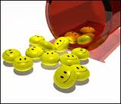
Antidepressants
Monoamine Oxidase Inhibitors (MAOIs)
Tricyclic antidepressants
Selective Serotonin Reuptake Inhibitors (SSRIs)
Serotonin – Noradrenalin Reuptake Inhibitors (SNRIs)
(Healy, 2009)

Slide 21
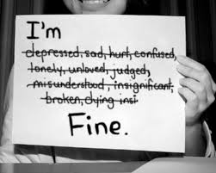
Anti-depressants
A major study in 1965 demonstrated that tricyclic's were more effective than MAOIs, closer investigation suggested that ECT was probably the most effective treatment for depression (Healy 2009)
Tricyclic's act mainly on the serotonin system.
SSRIs, (Prozac) were allegedly non-addictive and supposedly had fewer side effects and easier to administer than tricyclic's and MAOIs.

Slide 22
Do Modern Antidepressants Work?
Up until 2003, the answer to this question was a resounding yes, published studies showed a 95% recovery rate ( Meyers, 2000; Turner et al, 2008)
In 2004 a meta-study by Moncrieff, Wessley and Hardy, 2004 called this research into serious doubt, exposing unpublished data. The true success rate was more like 50%.
This was confirmed in later studies by Pigott et al in 2010.
50% of depressed patients taking placebos also improved
Different antidepressants might work differently for different people - Are all studies really comparing like for like?

Slide 23
Do Antidepressants work?
Many random control studies do have a positive effect, Royal College of Psychiatrists (RCPsych, 2010) claim that antidepressants appear to be twice as effective as placebos.
Modern therapeutic practice combine medication with psychotherapy.
In some cases, whereby patients have severe treatment resistant depression, the only effective treatment is Electro-convulsive therapy (ECT)

Slide 24
Anxiolics (Anti-Anxiety Drugs)
Used in the treatment of anxiety disorders
The first anti-anxiety medication – Barbiturates were highly addictive and dangerous sedatives.
Replaced with Benzodiazepines (Diazepam, Lorazepam) tranquilisers.
Other drugs that might be used are some of the Antipsychotics, SSRIs, Beta-blockers and psycho-stimulants (Dexedrine, Ritalin etc)
Healy, 2009

Slide 25
Anxiolytics
It is believed that Benzodiazepines act on the neurotransmitter gamma-aminobutyric acid (GABA)
Their effect is neither to block nor enhance the functioning of this chemical messenger, but rather to minimise its effect (Tozer and Rowland, 2006)
Anti-anxiety drugs have other important medical uses, i.e. diazepam can be used as a pre-surgery muscle relaxant, beta-blockers are used to regulate cardiac rhythms

Slide 26
Antipsychotics
Used mainly in the treatment of schizophrenia
Typical antipsychotic medication work on so-called typical symptoms of psychosis (delusions, speech abnormalities etc) (Neuroleptics). This drug is believed to work across entire mental illness spectrum, considered to have a wide ranging action.
Atypical antipsychotic medication work on the atypical symptoms (Flattened mood, loss of motivation)
Chlorpromazine discovered by Henri Laborit in 1952, discovered by accident and has a wide ranging action working with other general medical conditions.
Antipsychotics mainly work on the dopamine system (Torrey, 2006)

Slide 27
Mood Stabilisers
A number of drugs are used in the treatment of bipolar disorder
These include lithium components, some antipsychotics and certain benzodiazepines, sometimes a number of approaches are needed in the treatment of bipolar.
Major or minor tranquillisers might be used if manic episodes are sufficiently disruptive.
Drugs that also have prophylactic (preventative) effects (mood stabilisers) may also be used.

Slide 28
Mood Stabilisers
Carbamazepine
Lithium
Valproate
Lamotrigine
Gabapentin

Slide 29
Pharmacological Treatment V Psychotherapeutic Treatment
The mind-body dilemma underpins much of the debate over the psychological explanations of the mental disorders.
Are these disorders caused by psychological dysfunctions in the psyche (mind) or by physical dysfunctions in the body or brain?
Biomedical Model
Bio-psychosocial model
Modern research is narrowing the gap between cognition patterns and neurological and physiological functions.

Slide 30
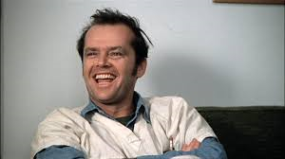
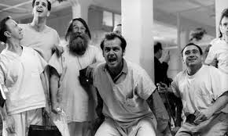
Is psychopharmacology ever justified?
Advances in medical science have been useful in terms of helping us to understand the aetiology and cause of many infectious diseases such as Coronary Heart Disease (CHD) and Aids
Socrates(469-399BC) viewed psychological distress as a blessing and an opportunity to change and take control of one’s life experience.
Feminists argue that women depressed as a result of their home or relationship situation may be sedated by medication and surrender the power to rectify their situation.
Medication might suppress the negative emotions that might power change and escape from the work of self reflection

Slide 31
Placebo Effect
The placebo effect remains an important hidden element in psychiatry
A recent reanalysis of the effects of antidepressants that included unpublished studies demonstrate that the outcome of placebo was no different in people with mild to moderate depression, even though the published studies suggest otherwise (Kirsch, 2008).
We have to consider other factors such as the time people might have been waiting for treatment for example
Jerome Frank (1961) argued the placebo effect of psychotherapy, suggesting that it depends on what patients believe or have most faith in (Chilvers, 2001 argues against this)
There is strong evidence that severe depression, mania, psychosis and ADHD improve with drug intervention

Slide 32

‘THE UNEXAMINED LIFE IS NOT WORTH LIVING’ ‘We may not find what we seek, but the life we live will be one that strengthens our inner selves’ Socrates (469-399BC)
Dysphoria is a natural part of being human and persists even when artificially numbed.
Therefore, dysphoria has an important function that is necessary for survival

Slide 33
Do drugs prevent people from overcoming their own problems?

Slide 34
Are we becoming ‘Cosmetic Psychiatrists’?
Is this ‘Social Engineering’?

Slide 35
Suppose we could add a drug to the public water supply that wiped out fascist or discriminatory thinking?
What about ‘controlling the birth rate’ – what would the arguments be of this sort of chemical ‘social engineering’?

Slide 36
Can counselling take place when the client is very much under the influence of a mood-affecting substance or intoxicated?
Consider the ethical implications of the therapist taking a mood-affecting drug?

Slide 37
Resources
Psychopharmacology
Claringbull, N. (2011) Mental Health in Counselling and Psychotherapy. Learning Matters. Chapter 8.
Feltham, C. and Horton, I. (2012) The Sage Handbook of Counselling and Psychotherapy. London: Sage. P408-415
Pilgrim, D (2017) Key Concepts in Mental Health 4thedn. London: Sage
Woolfe, R., Strawbridge, S., Douglas, B. and Dryden, W., (2010) Handbook of Counselling Psychology 3rd ed. London: Sage. Chapter 32

Slide 38
Resources
Type drug’s name into Google, or type in medicines for… or drugs used in….
Monthly Index of Medical Supplies (MIMMS) www.mims.co.uk
British National Formulary (BNF) http://bnf.org
(Drugs have different generic and trade names)
Royal College of psychiatrists –www.rcpsych.ac.uk – click on ;Mental Health Info.
http://www.bap.org.uk/
http://www.sciencedaily.com/articles/p/psychopharmacology.htm

