Slide 1

Community Care and Management of Longer-term Condition: Arthritis for primary care nurses, general practitioners and physiotherapists
Name: MD.SAKYF JAWAD
ID: 2435265
Lecturer: Mohammed khan
Module code -LCHS7003
Module name - Community Care and Management of Longer-term Conditions

Slide 2
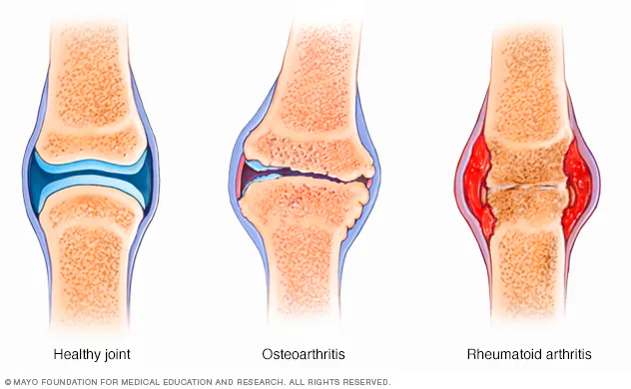
Overview of Arthritis: Definition, Symptoms and Aetiology
Definition:
Arthritis is a broad term describing inflammation and damage within one or more joints (Nichols, 2017).
Arthritis is denoting a condition characterised by the degradation of the smooth cartilaginous layer that coats a joint, leading to osseous friction during joint movement (Allameen et al., 2024).
Symptoms: The most common symptoms are joint pain and stiffness, but reduced mobility is also frequent (NHS inform, 2024).
(Source: (Cleveland Clinic, 2023)

Slide 3
Overview of Arthritis: Definition, Symptoms and Aetiology
Aetiology: The causes of arthritis differ depending on the specific type.
Osteoarthritis typically develops naturally with age, as years of joint use gradually wear down the protective cartilage (Chauhan, Jandu and Al-Dhahir, 2023).
In some cases, the immune system is responsible, as seen in rheumatoid arthritis, where the body mistakenly attacks its own joint tissues (Cleveland Clinic, 2023).
Certain viral infections, including COVID-19, can also trigger forms of viral arthritis.

Slide 4
Prevalence of Arthritis in the UK and Worldwide
Arthritis affects approximately 10 million people in the UK, representing roughly one in six of the population (Senthelal and Thomas, 2023).
Osteoarthritis is the most prevalent form, affecting nearly 9 million people, particularly those aged 45 and over (Wood et al., 2023).
Globally, around 595 million people had osteoarthritis in 2020, which is 7.6% of the world's population (Gilchrist-Park, Kholvadia and Burdick, 2025).
Rheumatoid arthritis affects approximately 1% of the worldwide population (Britto et al., 2025).

Slide 5
Economic and Social Burden of Arthritis
Economic:
The total annual NHS spend related to arthritis and musculoskeletal conditions in England is approximately £5 billion (Coates et al., 2023).
Direct healthcare costs for individuals with moderate-to-severe osteoarthritis pain are five times higher than matched controls without arthritis (Cooper, 2024).
Social:
Approximately 64% report poor sleep quality, affecting health and wellbeing (Giollo et al., 2025).
61% of working arthritis patients think they may need to retire early, and 17% have already done so (Cooper, 2024).

Slide 6
Diagnosis and Initial Assessment of Arthritis
Medical professionals examine joints for swelling, tenderness, warmth, deformity, and functional limitations (Allen, Carville and McKenna, 2018).
To identify functional asymmetry, clinicians compare range of motion of the affected joint to the contralateral side or other comparable joints (Britto, Alavala and Brijesh, 2025).
Common modalities consist of:
  X-ray to assess joint space narrowing, osteophytes, or erosions.
  Ultrasound to detect synovitis, effusion, and soft-tissue involvement.
  MRI for detailed evaluation of cartilage, bone marrow, and inflammatory changes (NHS inform, 2024).

Slide 7
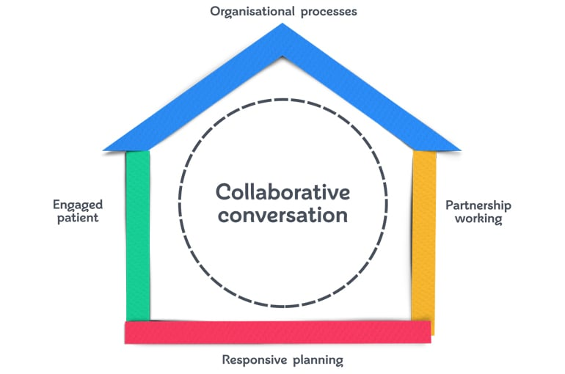
Management of Arthritis Following UK Guidance
Implementation of House of Care Model:
  Right-hand wall – Healthcare Professionals: Clinicians support true shared decision-making by asking “What matters to you?” to understand patient priorities and life circumstances beyond clinical measures .
  Left-hand wall – Engaged Individuals and Carers: Patients and carers are informed and confident, actively contributing to decisions, goal setting, and self-management (Ly et al., 2019).
  Roof – Organisational Processes: Organisations provide the policies, systems, and training needed to deliver consistent personalised care planning (Coulter et al., 2016).
  Central Care Planning Conversation: A focused, person-centred discussion enables individuals to identify needs, preferences, and goals and co-create a meaningful management plan (Health and Social Care Alliance Scotland, 2018).
(Source: (NHS inform, 2024)

Slide 8
Management of Arthritis Following UK Guidance
Exercise and Physical Activity: Core management should emphasize regular exercise as a fundamental intervention (Kerschbaumer et al., 2024).
Weight Management: Achieving and maintaining healthy weight is critical, particularly for weight-bearing joints.
Paracetamol: First-line analgesic, with regular dosing recommended for sustained pain control (NHS inform, 2024).
Conventional DMARDs: Methotrexate is typically first-line therapy, often combined with additional DMARDs (leflunomide, hydroxychloroquine, sulfasalazine) (National Collaborating Centre for Chronic Conditions (UK), 2009).

Slide 9
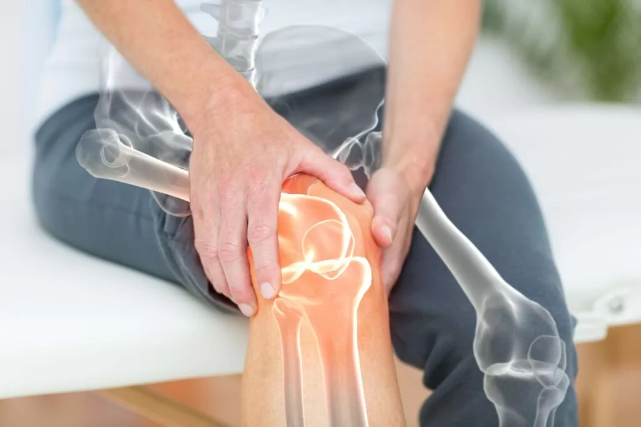
Treatment Options Available in the United Kingdom
For osteoarthritis, Weight reduction, activity pacing, strengthening exercises, and joint protection strategies form the foundation of non-pharmacological care (NHS, 2022).
For rheumatoid arthritis, treatment focuses on slowing disease activity and reducing inflammation to prevent long-term joint damage (NICE, 2020).
Patients with arthritis may be able to access certain community or therapy services directly without first consulting a GP (NICE, 2022).
  GP surgery reception or administrative staff,
  the GP practice website,
  the local Integrated Care Board (ICB)
(Source: (Cooper, 2024)

Slide 10
Comorbidities Accompanying Arthritis
Heart Disease: Individuals with inflammatory arthritis are up to twice as likely to develop cardiovascular disease compared to those without inflammatory arthritis (Kłodziński and Wisłowska, 2018).
Diabetic Neuropathy: Individuals with inflammatory arthritis are about 1.5 times more predisposed to diabetes compared to those without arthritis (Krijbolder et al., 2022).
Osteoporosis: In this disease, the resorption of existing bone occurs at a rate surpassing the formation of new bone (Nichols, 2017).

Slide 11
Prevention of Arthritis
Lifestyle Modification: Healthy weight through diet and exercise is the best primary prevention strategy (Radu and Bungau, 2021).
Physical Activity: Regular exercise, including aerobic activity, strength training, and flexibility work.
Smoking Cessation: Smoking represents the strongest modifiable environmental risk factor for RA (Romão and Fonseca, 2021).
Early Recognition and Diagnosis: Rapid identification and diagnosis of inflammatory arthritis enables early DMARD (Taylor et al., 2021).

Slide 12
Co-productive Care: Skills, Values and Behaviours
Essential Skills:
Effective Communication: Healthcare professionals must use active listening to understand not only clinical symptoms but also patients’ concerns (Voshaar et al., 2015).
Facilitating Shared Decisions Professionals must be able to explain the benefits, risks, and expected outcomes of evidence-based treatments (wales.nhs.uk, 2018).
Essential Values:
Respect and Dignity: Co-productive care is based on respecting people as whole people, not diseases.
Partnership and Collaboration: True partnership recognises that effective health improvement requires both professional and patient effort (Watson, 2013).

Slide 13
Co-productive Care: Skills, Values and Behaviours
Empathetic Engagement: Professionals show genuine care by responding empathetically to patients’ distress and demonstrating commitment to supporting them throughout their condition (Wood et al., 2023).
Team Problem- Solving: Clinicians help patients identify barriers and create realistic solutions that fit their needs.
Consistent Support and Follow-up: Regular review and monitoring, with willingness to modify approaches when outcomes are inadequate (Coates et al., 2023).

Slide 14
Comprehensive Personalised Care Model and Self-Management Support:
  Shared Decisions: After discussing options, benefits, and risks, clinicians and patients choose arthritis treatments like medication, physiotherapy, or lifestyle changes (Dey et al., 2024).
  Personalised care and support planning: A personalised arthritis care plan outlines clinical needs, patient goals, agreed actions, and management barriers.
  Enabling Choice: To meet health literacy needs, arthritis patients are given clear, accessible treatment, provider, and referral options (Fairley et al., 2021).

Slide 15
Comprehensive Personalised Care Model and Self-Management Support:
  Social Prescribing and Community Support: Healthcare professionals refer arthritis patients to exercise groups, peer support, voluntary services, and practical or work assistance (Fairley et al., 2021).
  Self-Management Support: Supported self-management teaches arthritis pain management, pacing, problem-solving, and digital tool use.
  Personal Health Budgets: Physiotherapy, assistive devices, psychological care, and community activities are available to arthritis patients with personal health budgets (Kerschbaumer et al., 2024).

Slide 16
References
Allameen, N.A., Lai, Y.W., Lian, G., Lee, T.Z.-Y., Selvakumaran, S., Tan, R.Y.T. and Xu, C. (2024). Physiotherapy and Occupational Therapy in Rheumatoid arthritis: Bridging Functional and Comorbidity Gaps. Best Practice & Research Clinical Rheumatology, [online] 39(1), p.102032. doi:https://doi.org/10.1016/j.berh.2024.102032.
Allen, A., Carville, S. and McKenna, F. (2018). Diagnosis and management of rheumatoid arthritis in adults: summary of updated NICE guidance. BMJ, p.k3015. doi:https://doi.org/10.1136/bmj.k3015.
Britto, N., Alavala, R.R. and Brijesh, S. (2025). Rethinking arthritis: exploring its types and emerging management strategies. Inflammopharmacology. doi:https://doi.org/10.1007/s10787-025-01833-8.
Chauhan, K., Jandu, J. and Al-Dhahir, M. (2023). Rheumatoid Arthritis. [online] PubMed. Available at: https://www.ncbi.nlm.nih.gov/books/NBK441999/.
Cleveland Clinic (2023). Arthritis. [online] Cleveland Clinic. Available at: https://my.clevelandclinic.org/health/diseases/12061-arthritis.
Coates, G., Clewes, P., Lohan, C., Stevenson, H., Wood, R., Tritton, T., Knaggs, R., Dickson, A.J. and Walsh, D. (2023). Health economic impact of moderate-to-severe chronic pain associated with osteoarthritis in England: a retrospective analysis of linked primary and secondary care data. BMJ Open, [online] 13(7), p.e067545. doi:https://doi.org/10.1136/bmjopen-2022-067545.
Cooper, N.J. (2024). Economic burden of rheumatoid arthritis: a systematic review. Rheumatology, 39(1), pp.28–33. doi:https://doi.org/10.1093/rheumatology/39.1.28.
Coulter, A., Kramer, G., Warren, T. and Salisbury, C. (2016). Building the House of Care for People with long-term conditions: the Foundation of the House of Care Framework. British Journal of General Practice, [online] 66(645), pp.288–290. doi:https://doi.org/10.3399/bjgp16x684745.
Dey, M., Busby, A., Isaac, J., Pratt, A., Mwidimi Ndosi, Young, A., Lempp, H. and Nikiphorou, E. (2024). Personalised care packages for people with rheumatoid arthritis: a mixed-methods study. RMD open, 10(1), pp.e003483–e003483. doi:https://doi.org/10.1136/rmdopen-2023-003483.
Fairley, J.L., Seneviwickrama, M., Yeh, S., Anthony, S., Chou, L., Cicuttini, F.M., Sullivan, K., Briggs, A.M. and Wluka, A.E. (2021). Person-centred care in osteoarthritis and inflammatory arthritis: a scoping review of people’s needs outside of healthcare. BMC Musculoskeletal Disorders, 22(1). doi:https://doi.org/10.1186/s12891-021-04190-z.
Giollo, A., Salvato, M., Frizzera, F., Khalid, K., Botsios, C., Zen, M., Ramonda, R. and Doria, A. (2025). Long-term Outcomes Based on the Sex of the Rheumatologist in a Prospective Cohort of Rheumatoid Arthritis Patients. Mayo Clinic Proceedings, [online] 100(10), pp.1706–1718. doi:https://doi.org/10.1016/j.mayocp.2025.06.017.
Health and Social Care Alliance Scotland (2018). The House of Care Model. [online] Health and Social Care Alliance Scotland. Available at: https://www.alliance-scotland.org.uk/past-work-and-projects/scotlands-house-of-care/the-house-of-care-model/.
Kerschbaumer, A., Smolen, J.S., Ferreira, R.J.O., Bertheussen, H., Xenofon Baraliakos, Aletaha, D., McGonagle, D.G., van, McInnes, I.B., Bente Appel Esbensen, Winthrop, K.L., Wolf-Henning Boehncke, Schoones, J.W. and Gossec, L. (2024). Efficacy and safety of pharmacological treatment of psoriatic arthritis: a systematic literature research informing the 2023 update of the EULAR recommendations for the management of psoriatic arthritis. Annals of the rheumatic diseases, p.ard-225534. doi:https://doi.org/10.1136/ard-2024-225534.
Kłodziński, Ł. and Wisłowska, M. (2018). Comorbidities in rheumatic arthritis. Reumatologia/Rheumatology, 56(4), pp.228–233. doi:https://doi.org/10.5114/reum.2018.77974.
Krijbolder, D.I., Verstappen, M., van Dijk, B.T., Dakkak, Y.J., Burgers, L.E., Boer, A.C., Park, Y.J., de Witt-Luth, M.E., Visser, K., Kok, M.R., Molenaar, E.T.H., de Jong, P.H.P., Böhringer, S., Huizinga, T.W.J., Allaart, C.F., Niemantsverdriet, E. and van der Helm-van Mil, A.H.M. (2022). Intervention with methotrexate in patients with arthralgia at risk of rheumatoid arthritis to reduce the development of persistent arthritis and its disease burden (TREAT EARLIER): a randomised, double-blind, placebo-controlled, proof-of-concept trial. The Lancet, 400(10348), pp.283–294. doi:https://doi.org/10.1016/s0140-6736(22)01193-x.

Slide 17
References
Ly, M., Fitzpatrick, J., Ellis, B. and Loftis, T. (2019). Why are musculoskeletal conditions the biggest contributor to morbidity? - UK Health Security Agency. [online] ukhsa.blog.gov.uk. Available at: https://ukhsa.blog.gov.uk/2019/03/11/why-are-musculoskeletal-conditions-the-biggest-contributor-to-morbidity/.
National Collaborating Centre for Chronic Conditions (UK) (2009). Rheumatoid Arthritis: National Clinical Guideline for Management and Treatment in Adults. [online] PubMed. London: Royal College of Physicians (UK). Available at: https://pubmed.ncbi.nlm.nih.gov/21413195/.
NHS (2022). Overview - Arthritis. [online] NHS. Available at: https://www.nhs.uk/conditions/arthritis/.
NHS inform. (2024). Arthritis. [online] Available at: https://www.nhsinform.scot/illnesses-and-conditions/muscle-bone-and-joints/conditions-that-can-affect-multiple-parts-of-the-body/arthritis.
NICE (2020). Overview | Rheumatoid arthritis in adults: management | Guidance | NICE. [online] Nice.org.uk. Available at: https://www.nice.org.uk/guidance/ng100.
NICE (2022). Quality statement 1: Diagnosis | Osteoarthritis | Quality standards | NICE. [online] www.nice.org.uk. Available at: https://www.nice.org.uk/guidance/qs87/chapter/Quality-statement-1-Diagnosis.
Nichols, H. (2017). Arthritis: Causes, types, and treatments. [online] www.medicalnewstoday.com. Available at: https://www.medicalnewstoday.com/articles/7621.
R Gilchrist-Park, A Kholvadia and Burdick, W. (2025). A person-centered approach to collaboration for osteoarthritis management: a qualitative exploration of patients’ perspectives. Journal of Interprofessional Care, pp.1–9. doi:https://doi.org/10.1080/13561820.2025.2520536.
Radu, A.F. and Bungau, S.G. (2021). Management of Rheumatoid Arthritis: an Overview. Cells, [online] 10(11), p.2857. doi:https://doi.org/10.3390/cells10112857.
Romão, V.C. and Fonseca, J.E. (2021). Etiology and risk factors for rheumatoid arthritis: a state-of-the-art review. Frontiers in Medicine, [online] 8(689698). doi:https://doi.org/10.3389/fmed.2021.689698.
Senthelal, S. and Thomas, M.A. (2023). Arthritis. [online] Nih.gov. Available at: https://www.ncbi.nlm.nih.gov/books/NBK518992/.
Taylor, P.C., Atzeni, F., Balsa, A., Gossec, L., Müller-Ladner, U. and Pope, J. (2021). The Key Comorbidities in Patients with Rheumatoid Arthritis: A Narrative Review. Journal of Clinical Medicine, [online] 10(3). doi:https://doi.org/10.3390/jcm10030509.
Voshaar, M.J.H., Nota, I., van de Laar, M.A.F.J. and van den Bemt, B.J.F. (2015). Patient-centred care in established rheumatoid arthritis. Best Practice & Research Clinical Rheumatology, 29(4-5), pp.643–663. doi:https://doi.org/10.1016/j.berh.2015.09.007.
wales.nhs.uk (2018). Arthritis. [online] 111.wales.nhs.uk. Available at: https://111.wales.nhs.uk/arthritis/.
Watson, S. (2013). Arthritis Prevention: What Can You Do? [online] Healthline. Available at: https://www.healthline.com/health/arthritis-prevention.
Wood, G., Neilson, J., Cottrell, E. and Hoole, S.P. (2023). Osteoarthritis in people over 16: diagnosis and management—updated summary of NICE guidance. BMJ, 380, p.p24. doi:https://doi.org/10.1136/bmj.p24.

Slide 18


