Slide 1
Mark Huntly
m.huntly@uwtsd.ac.uk
ACCA7027
Cloud Engineering
Introduction to Containers

Slide 2
Overview
Why Containerisation and Containers?
Containers Vs VMs
Docker
  Terminology
  Images
  Containers

Slide 3
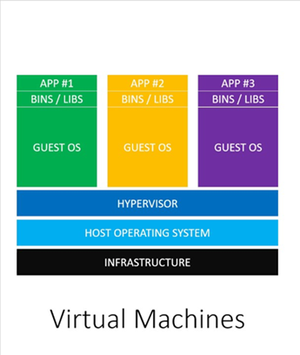
Virtual Machines
Virtual machines make it possible to run multiple applications on the same physical hardware while keeping conflicts among software components and competition for hardware resources to a minimum.
But virtual machines are bulky—typically gigabytes in size. They don’t really solve problems like portability, software updates, or continuous integration and continuous delivery

Slide 4

Why Containers?
Containers make it possible to isolate applications into small, lightweight execution environments that share the operating system kernel.
Typically measured in megabytes, containers use far fewer resources than virtual machines and start up almost immediately.
They can be packed far more densely on the same hardware and spun up and down en masse with far less effort and overhead.

Slide 5
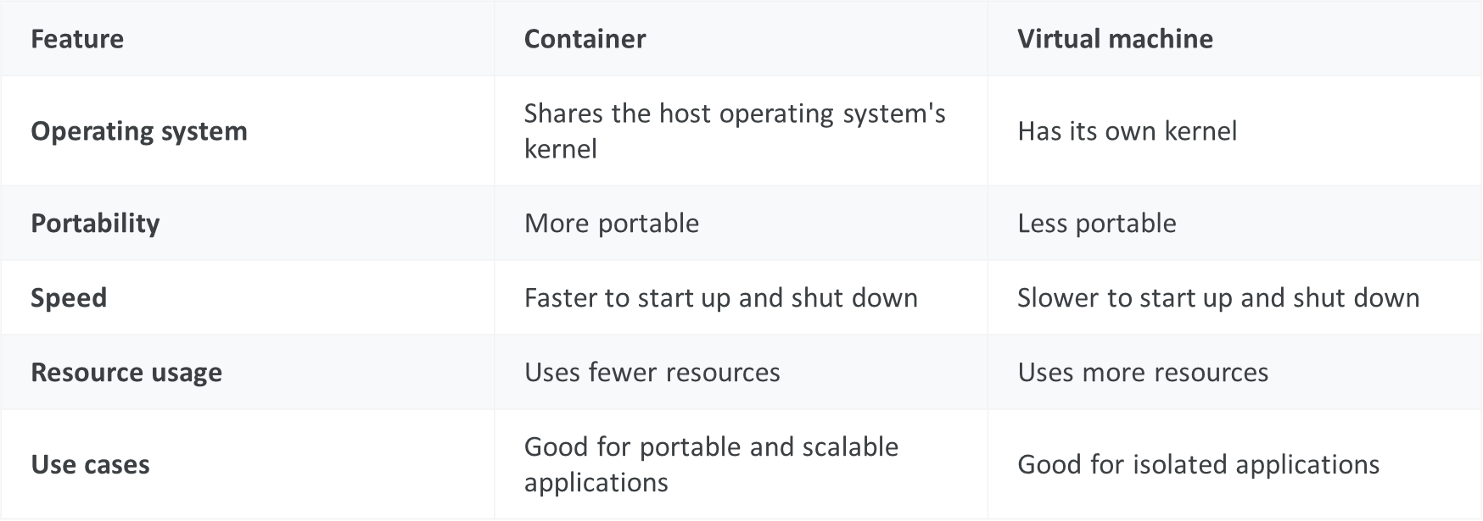
Containers Vs VMs

Slide 6
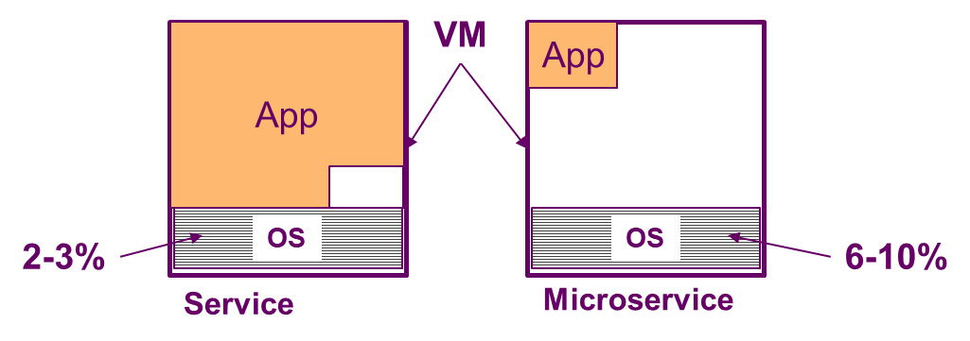
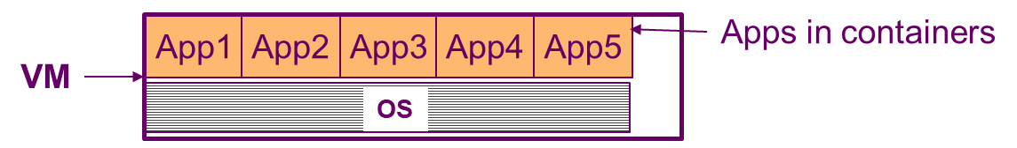
Docker and Microservices
If a VM is running a microservice the overhead of the OS becomes more significant e.g. it can increase from 2-3% of the total CPU load for a full service to 6-10% for a microservice
Using Docker the microservice shares the OS with other microservices with much less overhead and cost
Notes:
The fundamental shift here is moving from hardware-level virtualisation (VMs abstracting physical machines) to OS-level virtualisation (containers abstracting the operating system).
Docker didn't invent containers — Linux namespaces and cgroups had existed for years — but it made them accessible and practical for everyday engineering workflows.
Nearly every modern cloud-native deployment strategy — Kubernetes, serverless runtimes, CI/CD pipelines — builds on this containerisation primitive.

Slide 7
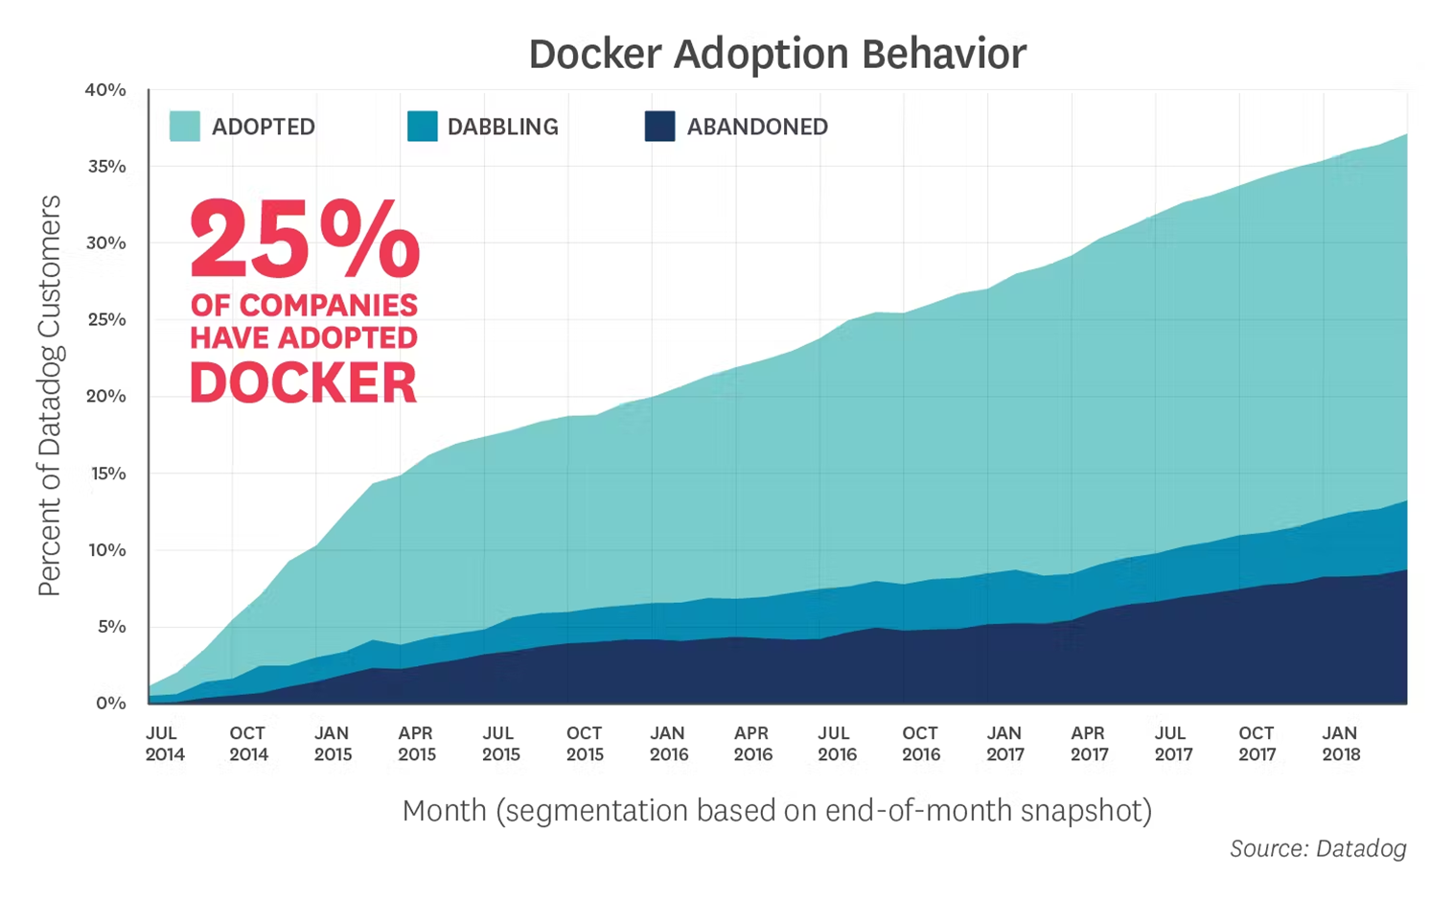

Slide 8
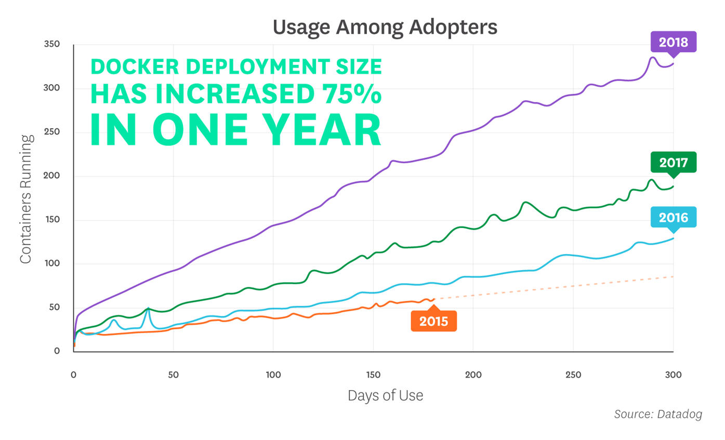

Slide 9
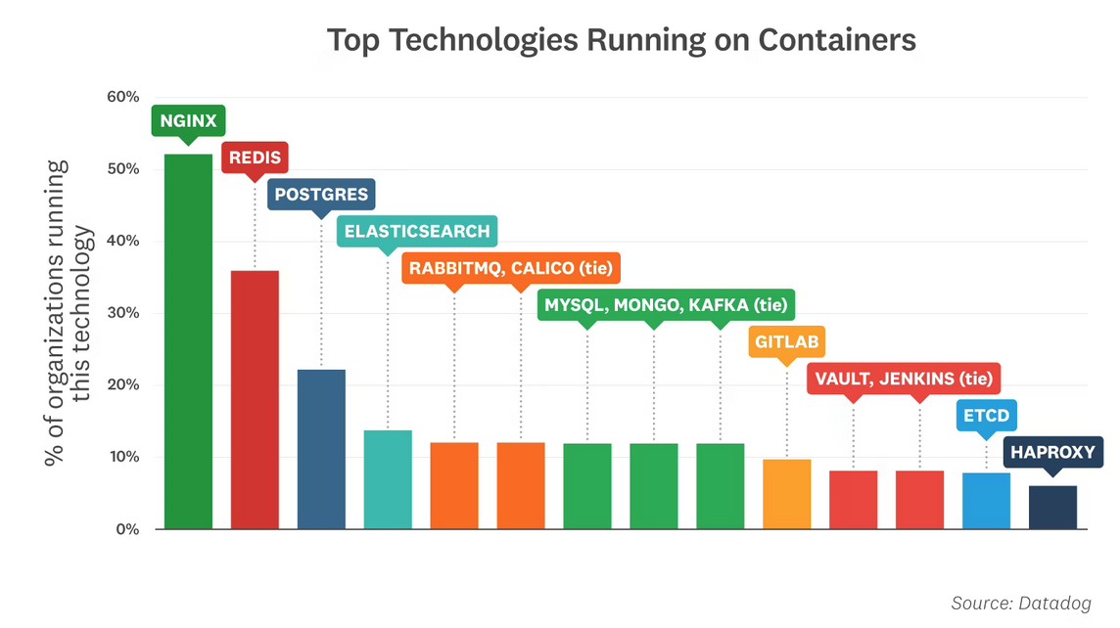

Slide 10

What is a Container?
Actually, a software container (or container for short)
  a container is ” a lightweight, stand-alone, executable package of a piece of software that includes everything needed to run it.”
The key difference is that every container shares the same kernel on the host machine, while each virtual machine has its own kernel.
Basically, a container uses virtualisation techniques at the level of the operating system, not the hypervisor.
Containers use the Open Container Initiative (OCI) format

Slide 11
Definition of a Container
Google:
Containers are lightweight, portable, and self-contained executable images that contain software applications and their dependencies. They are used to deploy and run applications in a consistent way across different environments, such as development, staging, and production.
AWS:
Containers in cloud computing are image files that contain everything needed to run software: code, runtime, libraries, environment variables, and configuration files.
Docker:
A container is a standard unit of software that packages up code and all its dependencies so the application runs quickly and reliably from one computing environment to another.

Slide 12
Containerisation Standard
Containers adhere to the specifications defined by the Open Container Initiative (OCI).
This means that the format of container images are standardised.
It allows consistent running of applications packaged as containers across different computing environments.
Their key charactistics are:
  Portability
  Interoperability
  Scalability

Slide 13
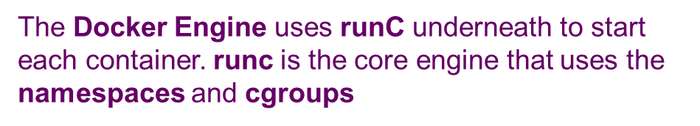
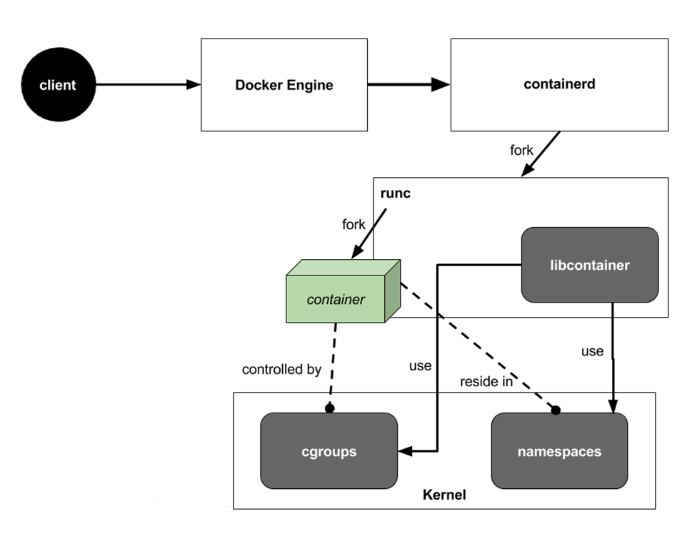

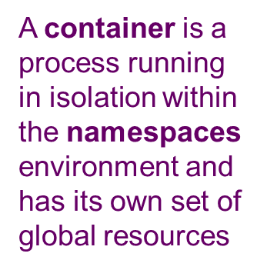
Docker Workings
Linux's container technology is implemented using kernel support for:
Namespaces
Puts a process into isolation so it has its own of set of global resources, such as PIDs and networks.
Cgroups or control groups
A mechanism for metering and limiting resources, such as CPU usage, memory, etc.

Slide 14
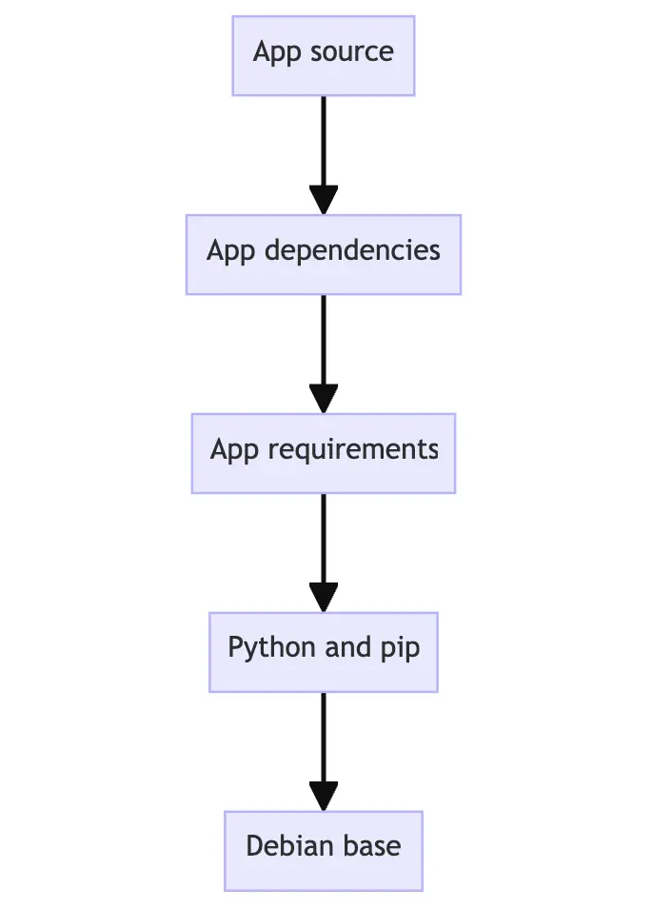
Images and Containers
Container Images are the blueprint used to create a container instance.
Images are generally built in YAML files called the ‘dockerfile’
An image is built in layers which are immutable (once created).
Each layer contains a set of filesystem changes.
https://docs.docker.com/get-started/docker-concepts/building-images/understanding-image-layers/

Slide 15
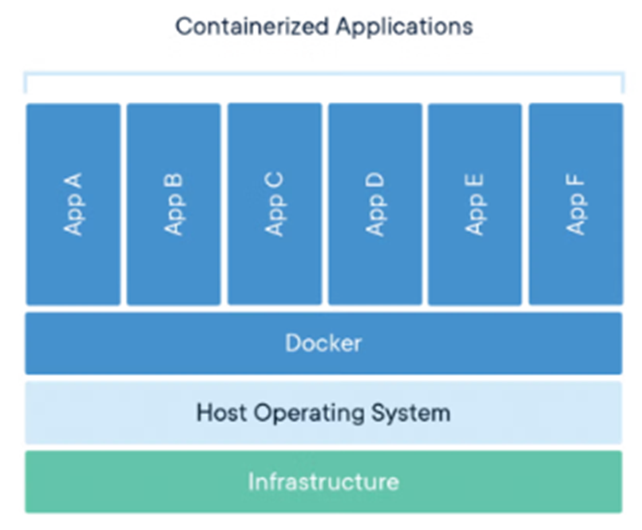
A Docker container image is a lightweight, standalone, executable package of software that includes everything needed to run an application: code, runtime, system tools, system libraries and settings.

Slide 16
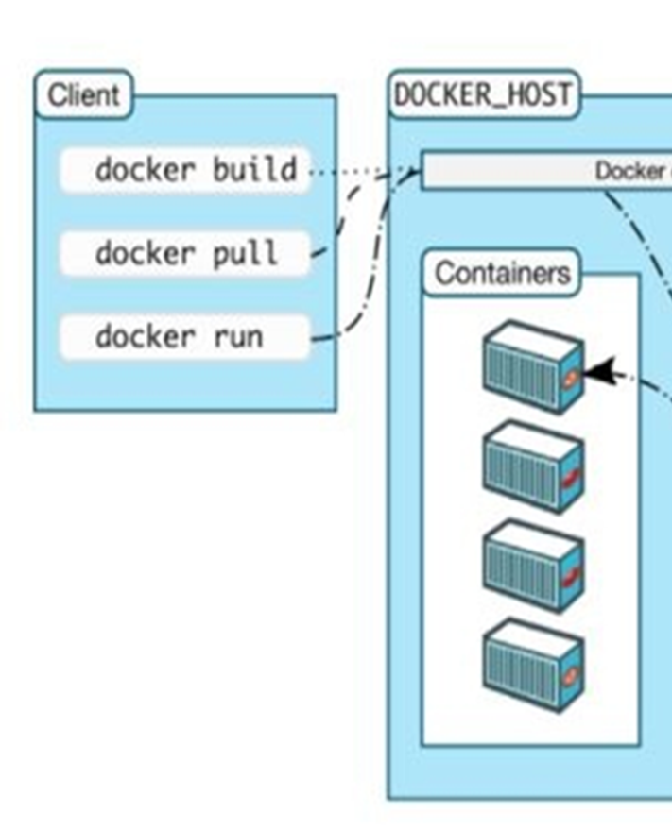
Images and Containers
Containers are running instances of an image.
Containers are their own isolated executable environments.
A container becomes the unit for distributing and testing your application.
https://docs.docker.com/get-started/docker-concepts/building-images/understanding-image-layers/

Slide 17
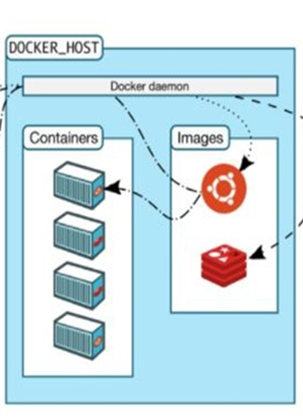
Container Engines
The Container Engine (Docker Machine) creates the containers.
It configures them based on the dockerfile.
There are a number of engines available such as:
  Podman
  Red Hat OpenShift
  Red Hat Cri-o
  LXC
  runC
  Containerd
  Docker

Slide 18

Further Terminology
Docker Client: This is how you interact with your containers. Call it using the user interface for Docker.
Docker Objects: These are your main components of Docker: your containers and images. Container images are read-only, and used to create new containers.
Docker’s architecture is also client-server based

Slide 19
Further Terminology
Daemon: A background process responsible for receiving commands and passing them to the containers via the command line. The daemon manages the lifecycle of the containers.
Docker Registry: These are public or private registries.
The public registry is Docker Hub. These registries are where your container images are stored and retrieved.
Docker’s architecture is also client-server based

Slide 20
Further Terminology
Tag: A label applied to a Docker image to distinguish between images / versions.
Volume: This persists data independent of a container’s lifecycle.
  A named volume maps to a host’s disk.
  Anonymous volumes are decided by Docker where the files are stored.
Docker’s architecture is also client-server based

Slide 21
Overview of the CLI Docker Client
We will use the API based Docker Client through the CLI.
Manage Docker images using “docker image” commands
  docker image COMMAND ← specify “image”
EXAMPLE: List all running images
  docker image ls ← append “--all” to see all the images
Manage Docker containers …. running instances of images
using “docker container” commands
  docker container COMMAND ← specify “container”

Slide 22
Overview of the CLI Docker Client
EXAMPLE: List all containers
  docker container ls –all
EXAMPLE: Start a running container with container ID of 3844477884
  docker container start 3844477884
EXAMPLE: Stop a running container with container ID of 3844477884
  docker container stop 3844477884
EXAMPLE Read the log of a container with container ID of 3844477884
  docker container logs 3844477884

Slide 23
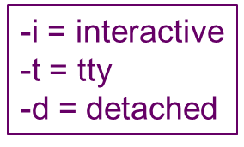
Docker CLI Shortcuts
You can also combine options e.g.
  docker container run -i -t -d debian /bin/bash
can be written in a number of combinations
  docker container run -it -d debian /bin/bash
  docker container run -itd debian /bin/bash
  docker container run -tid debian /bin/bash
  docker container run -dit debian /bin/bash
etc.

Slide 24
Docker CLI Shortcuts
Many commands can be shortened (for backward compatibility reasons i.e. the older form of the commands were shorter)
For example, the following are equivalent
  docker image build -t MY_IMAGE_NAME
  docker build –t MY_IMAGE_NAME ← “image” is implicit
  docker container stop CONTAINER_ID
  docker stop CONTAINER_ID ← “container” is implicit
  docker container ps -a
  docker ps -a ← “container” is implicit

Slide 25
Linux and LXC
LXC (Linux Containers) is an open-source, OS-level virtualization method for running multiple, isolated Linux systems (containers) on a single control host.
When running the commands in these slides it is best to use a BASH (Linux) CLI
In Linux you may need to run them in supervisor mode
Therefore, put “sudo” in front of each command e.g.
  sudo docker image build –t MY_IMAGE_NAME

Slide 26
Exercise – Docker Help and Version
Open command window
  Type in the Docker commands
To see all available commands
  docker --help
  OR JUST
  docker
What version of Docker are we running?
  docker --version

Slide 27
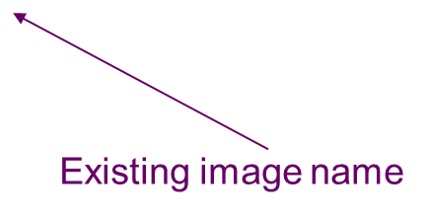
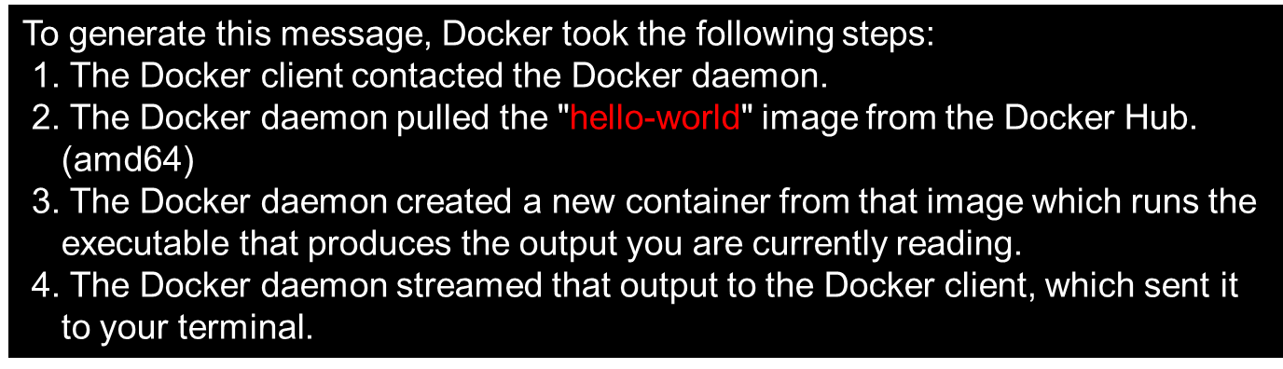
Exercise – ‘Hello World’ Container
Run your first container:
docker container run hello-world
OR in old command format, just
  docker run hello-world

Slide 28
Exercise – ‘Hello World’ Container
You can “pull” an image before running it
docker image pull hello-world
docker container run hello-world
However, docker run will pull the image for us automatically
As could be seen when we run the “hello-world” image

Slide 29
Exercise – Linux OS in a Container
Run Linux in a container
sudo docker container run -it debian /bin/bash
Notice the # prompt, this is the OS running in the container
  Try some Linux commands
  exit to escape

Slide 30

Exercise – Listing Images
To list (ls) the Docker images you have created
  docker image ← List all images
  docker image ls ← List all running images
  docker image ls hello* ← Just list images starting in “hello”

Slide 31
Exercise – Listing Containers
Show all running containers
docker container ls ← old style approach is docker ps
Show all containers (inc. those not running)
docker container ls -a OR docker container ls --all
Show containers matching the given name, id, image, etc.
docker container ls --filter name = container-name
docker container ls -f id = container-id
docker container ls -f ancestor = image-name

Slide 32
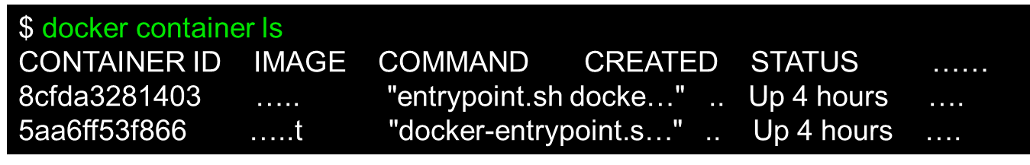
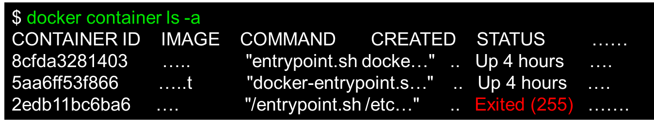
Listing Containers
By default when you list the containers, you only see the running containers
You can list all the containers including stopped containers by appending the --all flag (-a)

Slide 33
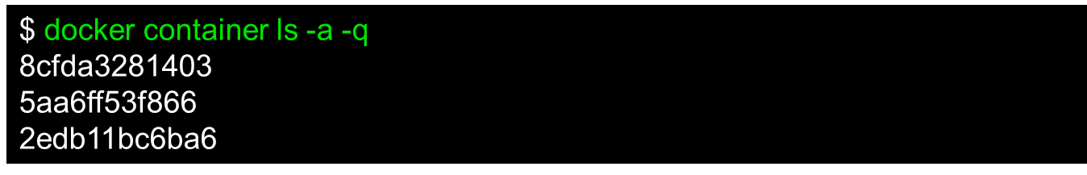
Listing Containers
There are a number of other flags, but one more which is useful is --quiet (-q) which just lists the container IDs

Slide 34
Information - Logs
Show logs before relative time
--until
Examples
--until 42m
--until 3s
Show logs since relative time
--since
Example
-- since 42m
Text information output by the container
(only works if app is generating log info)
  Useful for debugging
  Useful for maintenance
Dump the log to the display:
docker container logs CONTAINER_ID
Dump the log to the display but continue to streaming new output. Ctrl+C to escape
docker container logs CONTAINER_ID -follow
OR SHORTHAND
docker container logs CONTAINER_ID -f

Slide 35
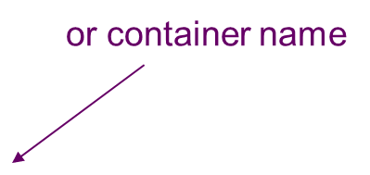
Inspecting Containers and Images
Inspect containers and images
docker container inspect CONTAINER_ID
docker image inspect IMAGE_NAME
  Remember “container” and “image” are implicit if you use the old command form e.g.
  docker inspect IMAGE_NAME

Slide 36
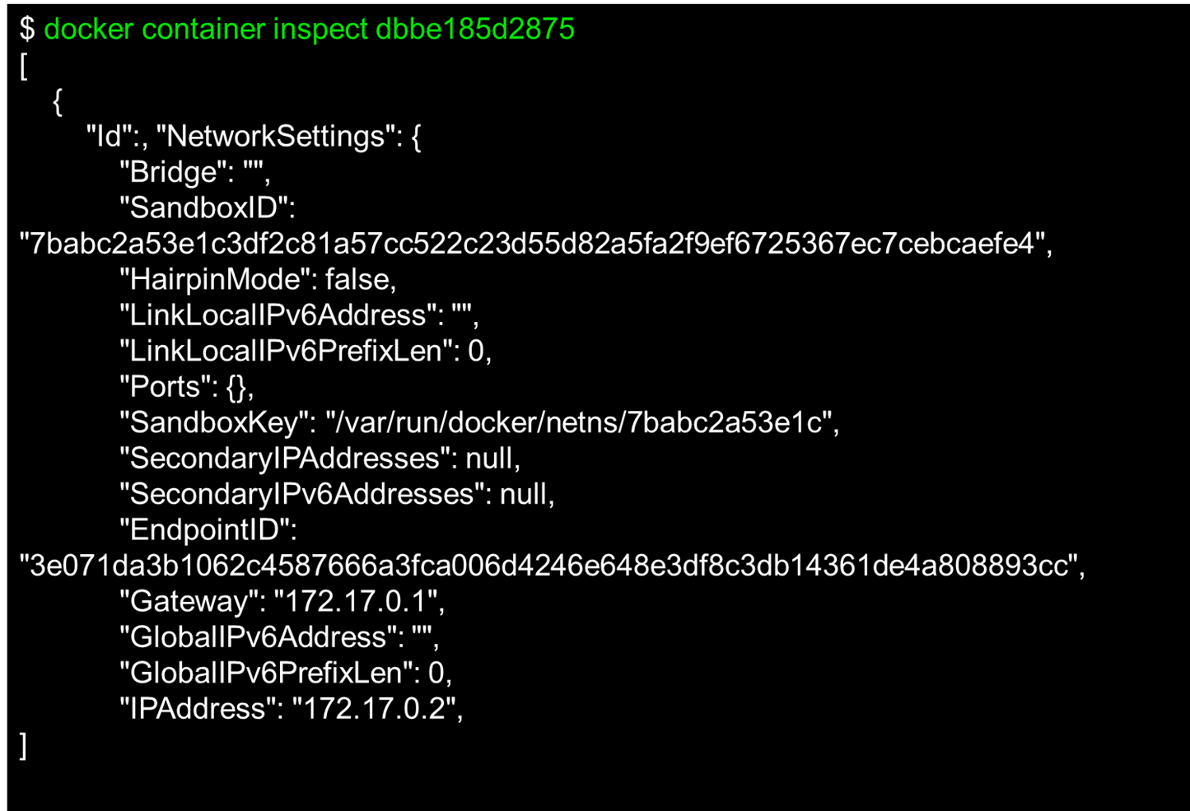
Inspecting Containers and Images

Slide 37
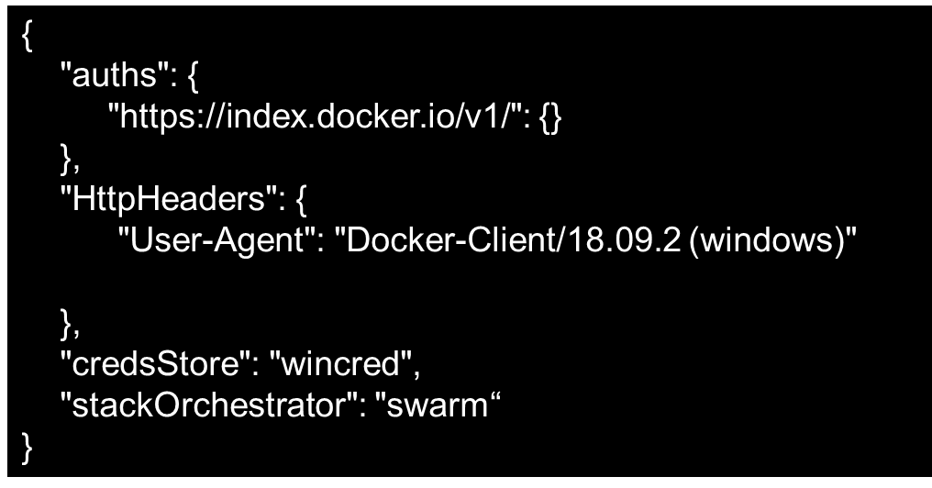
Inspecting Containers and Images
Docker configuration is stored in Docker folder in .docker in your home directory
  C:\Users\your-username\.docker
Don’t change these files except you may wish to edit config.json to configure the output of certain commands.
Note the dot

Slide 38
Summary
Containerisation is a form of virtualisation at the OS level
LXC or Linux Containers are isolated executable environments
Images are the basis for running Containers
The Docker Engine is the most popular way to create and run containers.

