Slide 1

Understanding COPD: Respiratory System Function and Patient-Centered Care Plan
Chronic Respiratory Disease Care Plan
Fictional Patient: James Smith
By Nyall Berry
Student ID: 2329185
Gillian weaver
Introduction to physiology BMHP5023_BIRM

Slide 2
Overview of Chronic Respiratory Diseases
Chronic respiratory diseases are long-term conditions that affects the lungs and airways, making breathing difficult and reducing the body's ability to exchange oxygen and carbon dioxide effectively. This is due to the lungs becoming inflamed, damaged, and narrowed, one main cause is due to smoking but can also affect people who have never smoked.
Common examples include
Asthma
Pulmonary fibrosis
chronic obstructive pulmonary disease
COPD
Systems used to stabilize COPD
Inhalers ​
Spacers ​
Nebulizers ​
Oral therapy
These conditions can often develop gradually and may worsened over time. Individuals with chronic respiratory disease often experience breathlessness, persistent cough, and increased mucus production. These symptoms can impact individual's daily activities and quality of life. This presentation will focus specifically on COPD and how the respiratory normally functions, how COPD affects the system, and how evidence-based care plan can support a patient living with this condition. Guidelines for managing COPD are provided by the National Institute for Health and Care Excellence, which recommends evidence-based treatments and care planning. "One of the primary symptoms of COPD is breathlessness. The Medical Research Council dyspnea scale should be used to grade the breathlessness according to the level of exertion required to elicit it."
(NICE, 5 December 2018)

Slide 3
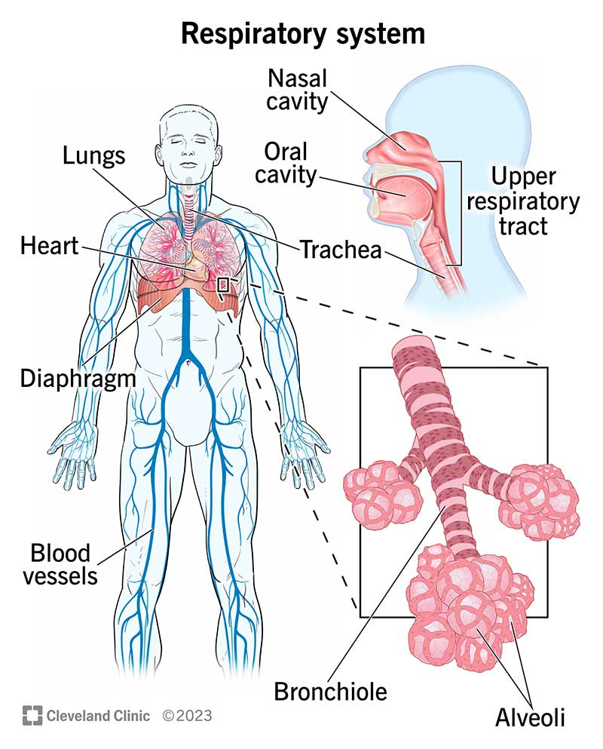
Anatomy of the Respiratory System
The Respiratory system is responsible for breathing and supplying oxygen to the body while removing carbon dioxide.
Main structures include
Nasal cavity - filters, warms and moistens inhaled air
Trachea - carries air to and from the lungs
Bronchi - main airways that branch into each lung
Alveoli - tiny air sacs where oxygen and carbon dioxide are exchanged
Diaphragm - muscle that controls breathing by expanding and contracting the lung
(Cleveland Clinic, 4 September 2024)
Air enters through the nasal cavity, and travels down to the trachea, which carries air towards the lungs. The trachea divides into two bronchi. Inside the lungs, the bronchi divide further into smaller tubes. These small airways lead to tiny air sacs known as alveoli. Oxygen passes from the air in the alveoli into the bloodstream, while carbon dioxide move from the blood into the lungs to be exhaled. Breathing is controlled by the diaphragm, a large muscle located below the lungs.
"The main job of your respiratory system is to bring oxygen into your lungs and move carbon dioxide out of them (gas exchange)." (Cleveland Clinic, 4 September 2024)

Slide 4
Patient Profile
Name: James Smith
Age: 65
Gender: Male
Medical history:
diagnosed with Chronic Obstructive Pulmonary Disease
Hypertension
Frequent chest infections
Chronic cough
James Smith is a 65- year- old retired construction workers who lives with his wife. He was diagnosed with chronic obstructive pulmonary disease 5 years ago also has a history of hypertension, chronic cough, and frequent chest infections.
Jame's lifestyle has a significant smoking history, having smoked around 15 cigarettes a day for 40 years. He also has low levels of physical activity and has previously been exposed to dust through his work in construction, which is a known risk factor to respiratory disease.
These demographic and lifestyle factors place him at higher risk of COPD progression and complications, and they will be important to consider when developing and appropriate care plan.

Slide 5
Risk factors of COPD
The most significant risk factor is smoking, which is responsible for the majority of COPD cases. Long term exposure to harmful particles, such as air pollution or occupational dust and chemicals, also contribute to the development of the disease.
Other factors can include age and history of respiratory infections, which can weaken lung function over time.
In James Smiths case, several of these risk factors are present. He has a long history of smoking, which is the primary cause of his condition. His previous work in construction has exposed him to dust and harmful particles, further damaging his lungs.
Additionally, his age, and low levels of physicals activity may contribute to worsening symptoms and reduced lung capacity. His history of chest infections and increase the risk of exacerbations.
These factors must be considered when developing a personalized and effective care plan.
"The harmful chemicals in smoke can damage the lining of the lungs and airways. Stopping smoking can help prevent COPD from getting worse" (NHS, 11 April 2023)

Slide 6
Communication and Ethical Considerations in COPD care
Communication-
Effective communication is essential in managing chronic conditions such as COPD. Healthcare professionals must ensure that patients clearly understand their diagnosis, treatment options, and how to manage their condition at home. Using simple accessible language helps patients feel more confident in managing their health. Patients should also be encouraged to make their own decisions about their care. This supports patients centered care and helps improve treatment plans.
Ethical-
Ethical considerations are also important for healthcare practice. Professionals must respect patients' autonomy, meaning their right to make decisions about their own treatment. Confidentiality must be maintained at all times to protect the patients personal and medical information. Informed consent is also essential before starting treatments, ensuring patients understand the benefits and potential risks.

Slide 7
Care Plan Interventions for COPD
The care plan for COPD can be created on evidence-based guidelines provided by NICE and the NHS, which aims to reduce symptoms, prevent exacerbations, and improve quality of life. Pharmacological treatment - helps to open ip the airways and improve airflow, which reduce inflammation in the lungs.
Self-management plan - A self-management plan helps with COPD to manage and understand their condition. This includes techniques and positions to help manage breathlessness.
Living with COPD - The NHS offers guidance on living with COPD, which includes taking prescribed medications, stopping smoking, exercising, maintaining a healthy weight, and staying up to date with vaccinations.
COPD care and treatment flowchart - This provides a visual guide to the care and treatment process for COPD, steps to take if a flare-up occurs. It emphasizes the importance of taking prescribed medications and seeking medical advice if symptoms worsen.
These encourage patients to have an advance decision regarding treatment and sharing the plan with healthcare providers and discuss with family and friends to enhance support. This follows the Mental Capacity Act where individuals can make their own choices regarding health. "It is essential for health and social care workers to understand and apply the MCA to ensure that individuals with capacity are supported to make their own decisions." (GOV.UK, 23 June 2025)

Slide 8
Conclusion
To conclude, chronic obstructive pulmonary disease is a long-term respiratory condition that affects lung function and patients' quality of life The respiratory system normally allows oxygen to enter the bloodstream and carbon dioxide to be removed. However, in COPD the airways become inflamed and the alveoli are damaged, which reduces the efficiency of gas exchange. Managing COPD requires a comprehensive care plan that includes regular monitoring, medication, lifestyle changes, and patient education. By following evidence-based guidance from organizations such as the NHS and NICE, healthcare professionals can support patients in managing their condition and improving their overall wellbeing.

Slide 9
Reference Page
"One of the primary symptoms of COPD is breathlessness. The Medical Research Council dyspnea scale should be used to grade the breathlessness according to the level of exertion required to elicit it."​
(NICE, 5 December 2018) https://www.nice.org.uk/guidance/NG115
"The main job of your respiratory system is to bring oxygen into your lungs and move carbon dioxide out of them (gas exchange)." (Cleveland Clinic, 4 September 2024) https://my.clevelandclinic.org/health/body/21205-repiratory-system
Image 1 - (Cleveland Clinic, 4 September 2024) https://my.clevelandclinic.org/health/body/21205-repiratory-system
"The harmful chemicals in smoke can damage the lining of the lungs and airways. Stopping smoking can help prevent COPD from getting worse" (NHS, 11 April 2023) https://www.nhs.uk/conditions/chronic-obstructive-pulmonary-disease-copd/causes/
"It is essential for health and social care workers to understand and apply the MCA to ensure that individuals with capacity are supported to make their own decisions." (GOV.UK, 23 June 2025) https://www.gov.uk/government/publications/health-and-social-care-workers-mental-capacity-act-decisions/making-decisions-about-your-health-welfare-or-finances

