Slide 1
DS3 MODULE
Digital Portfolio
Reflecting on My Digital Skills Journey
Name: Tosin Oluyemi | Course: Digital Skills 3
Week 10 Submission
Notes:
Introduction: Welcome the listener, say your name, course, and what this portfolio is about. (~30 seconds)

Slide 2
Portfolio Overview
This portfolio contains 4 pieces of work from this module, showing a range of digital skills.
01
Budget Spreadsheet
02
Formatted Report
Microsoft Excel
Microsoft Word
Example I found difficult
Example I improved over time
03
Class Presentation
Microsoft PowerPoint
Example I can do confidently
Notes:
Overview: Briefly say what 4 pieces you chose and why you chose a range. (~30 seconds)

Slide 3
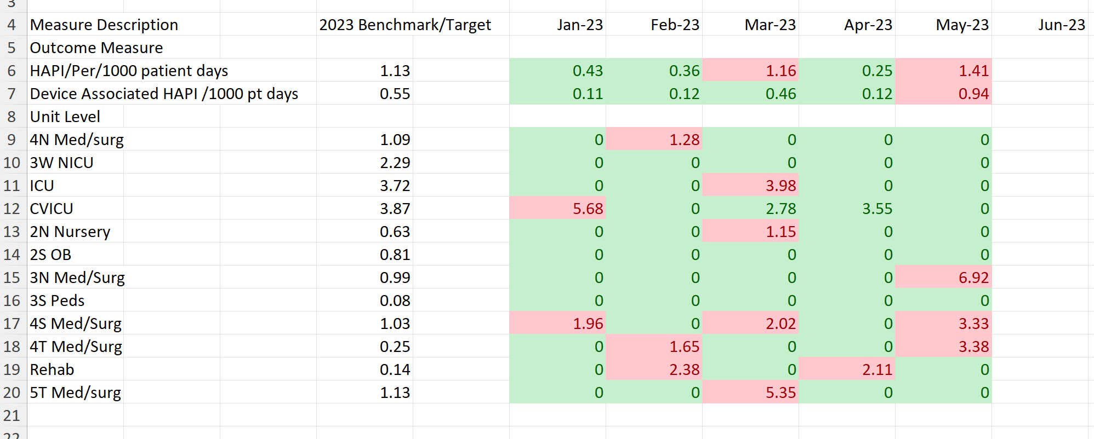
01
Budget
Spreadsheet
Tool: Microsoft Excel
Difficulty level:
★★★★☆ Hard at first
What I did:
Created a healthcare evaluation spreadsheet using rows, columns and formulas.
Skills shown:
Cell formatting, using rows and columns correctly.
What was hard:
The texts keep going outside the cell when filling it up
What I learned:
Absolute vs relative references, and how to use AutoFill to save time.
Notes:
Spreadsheet: Explain what the task was, what formulas you used, why it was hard at first, and what finally helped it click. (~60 seconds)

Slide 4
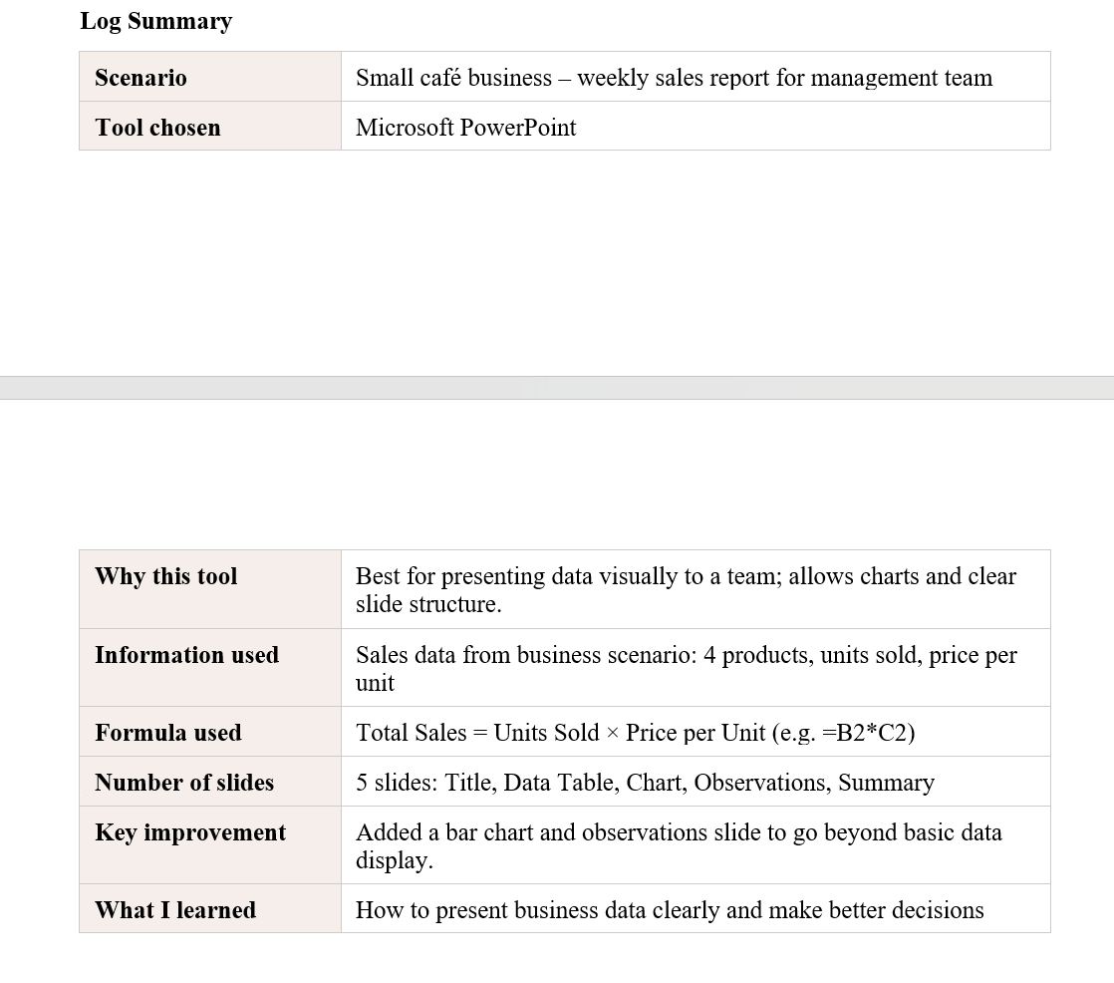
02
[Screenshot of your Word document goes here]
Formatted
Report
Tool: Microsoft Word
Progress:
⬆ Improved over time
What I did:
Wrote a formatted report with headings, bullet points, and page numbers.
Skills shown:
Using Styles for headings, inserting page numbers, adjusting margins and spacing.
What improved:
Early drafts had no consistent formatting. I learned to use Heading 1/2 styles properly.
What I learned:
Professional layout makes documents easier to read and more credible.
Notes:
Word Document: Talk about how your formatting improved — compare early work to later work. (~45 seconds)

Slide 5
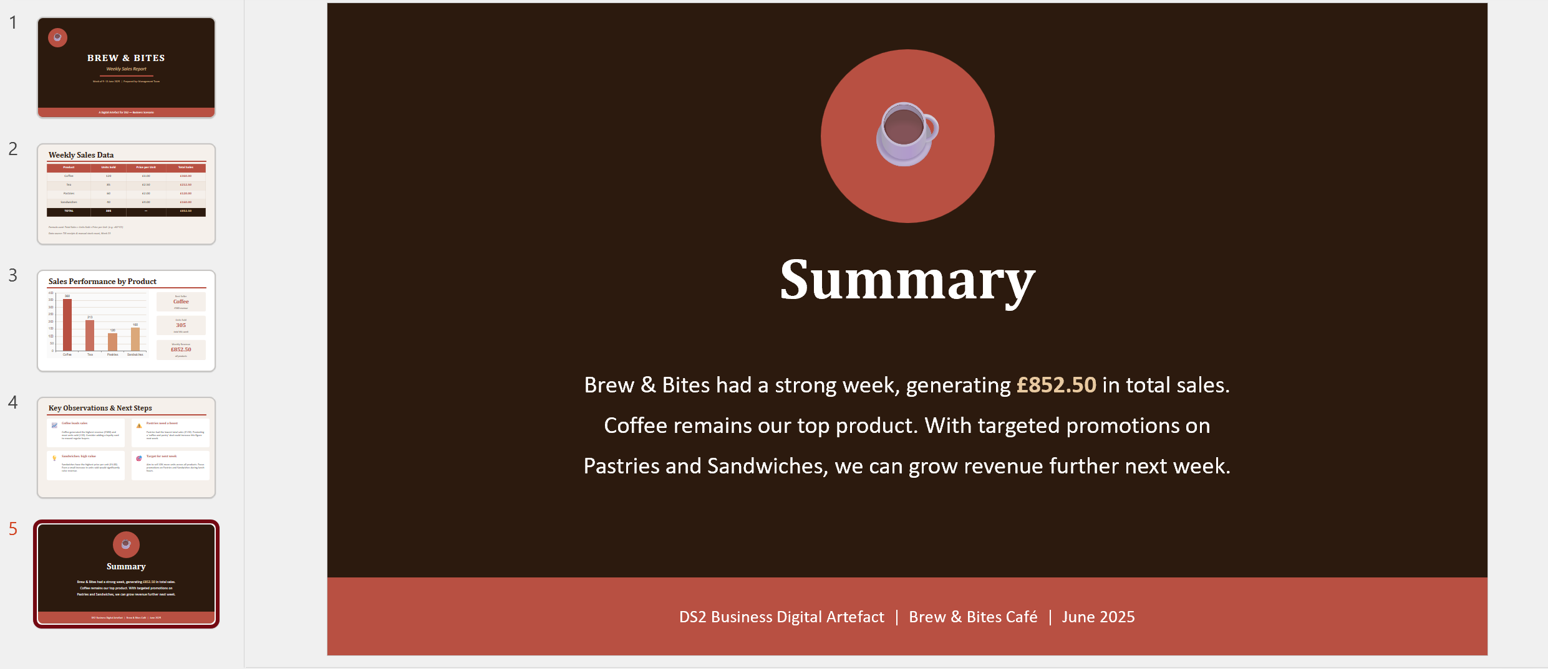
03
[Screenshot of your PowerPoint slides goes here]
Class
Presentation
Tool: Microsoft PowerPoint
Confidence:
✔ Can do confidently now
What I did:
Built a multi-slide class presentation with images, layouts, and transitions.
Skills shown:
Slide design, inserting images, using themes, adding transitions and animations.
Confidence now:
I can build a clean, professional slide deck from scratch without help.
What I learned:
Visual consistency across slides makes presentations look much more professional.
Notes:
PowerPoint: Say what you can do confidently now. Mention specific features you use. (~45 seconds)

Slide 6
My Development
At the Start
During the Module
Now I Can
→ Unsure how to use formulas in Excel
→ Practised formulas with real examples
→ Build a complete budget spreadsheet
→ Documents had inconsistent formatting
→ Learned heading styles in Word
→ Format a professional document
→ Did not know how to use design tools
→ Explored Adobe Express step-by-step
→ Design a clean one-page layout
→ Opening a presentation felt stressful
→ Made slides for a class task
→ Create a polished presentation alone
Notes:
Development: Contrast what you were like at the start vs now. Be honest — struggle is normal! (~30 seconds)

Slide 7
Reflection & Conclusion
What I Learned
How This Helps Me
✔ Digital tools are easier than they look once you practise.
→ I can now format and submit professional assignments.
✔ Making mistakes is part of learning — errors taught me the most.
→ Spreadsheets help me track budgets and organise information.
✔ Formatting and design matter for how work is received.
→ Presentation skills will help me in job interviews and work.
✔ Each tool has a purpose — the right tool makes work faster.
→ I feel more confident using computers in everyday tasks.
Thank you for viewing my portfolio.
Notes:
Conclusion: Reflect on what you learned and how these skills will help in study, work, or daily life. End with a confident closing statement. (~30 seconds)

