Slide 1
Youth Subcultures
By
Jolyon Denton Williams

Slide 2
The Swinging Sixties & The Summer of Love (1965-1967)
The ‘Swinging Sixties’ introduced us to British bands, new art and fashion.
The mod subculture (1963-1967)
Venues: Carnaby Street, Kings Road and Kensington (Fashion) Flamingo club and the Marquee (music)
Drug of choice: Amphetamines (purple hearts)
The ‘Summer of Love’ refers to the hippy counter culture of 1967
Venue: San Francisco (Haight-Ashbury district) & Monterey Pop Festival
Drug of choice: Cannabis and LSD
Notes:
Mary Quant's miniskirt; popular fashion models such as Twiggy and Jean Shrimpton; the political activism of the anti-nuclear movement; and sexual liberation; pirate radio stations like Radio Caroline.

Slide 3
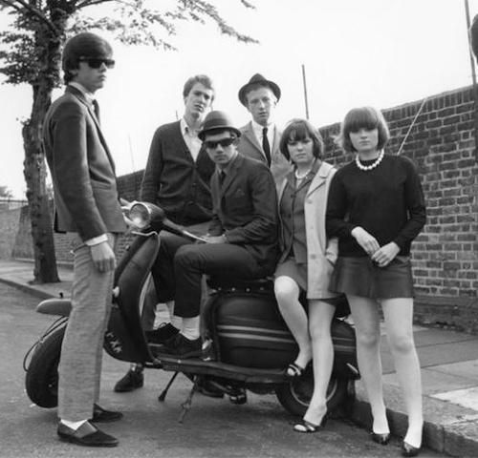
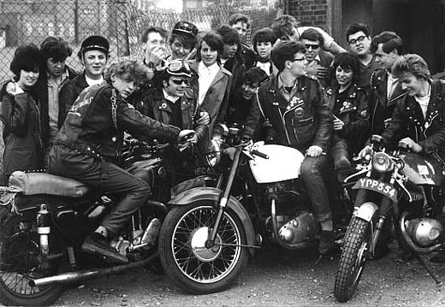
Mods & Rockers
Notes:
Turned-up Levis, Fred Perry T-shirts, Harrington jackets, loafer and Royal shoes, and Sta-prest trousers.

Slide 4
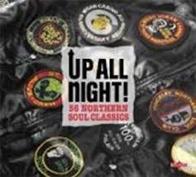
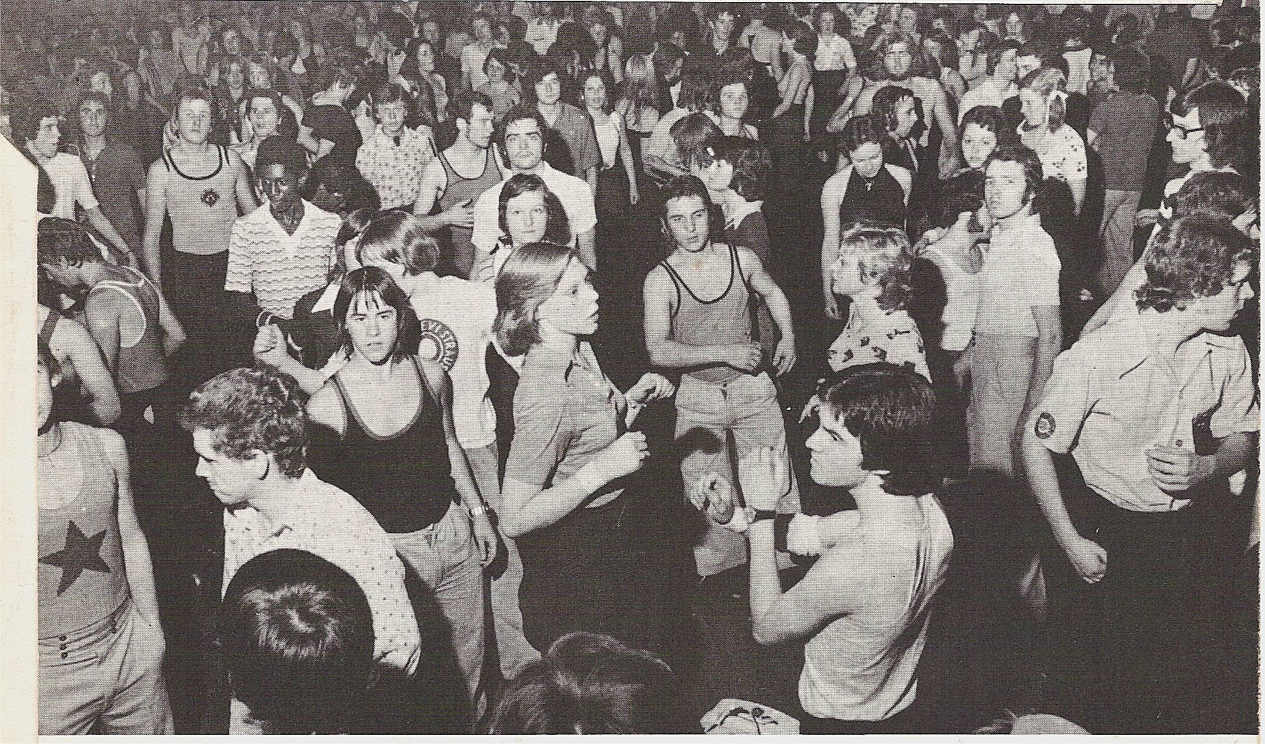
Northern Soul
Northern soul is a music and dance movement that emerged in Northern England in the late 1960s out of the British mod scene.
Based on a particular style of black American soul music, especially in the mid-1960s, with a heavy beat and fast tempo.
“The underground status of the Scene, the centrality of rare records and the inter-generational participation helped to create a set of rules, expectations and statuses that were maintained through an awareness of the history of the Scene often recounted through folklore tales about the people, the places and the music.” Dr Andrew Wilson (2007)

Slide 5
The Second Summer of Love (1987-1989)
The Acid House scene (later known as Rave Culture)
Balearic music imported from Ibiza and New Beat from Belgian
Acid house music from Detroit and Chicago
Venues: Disused warehouses, Shoom, Mud club, Hacienda
Fashion: Dungarees, converse, baggy clothing, bandanas
Art: Psychedelic and smiley faces
Drug of choice: Ecstasy and LSD
Notes:
DJ Alfredo blending records in the ‘balearic’ style, which fused together funk, soul, dance and a few Chicago acid tracks.

Slide 6
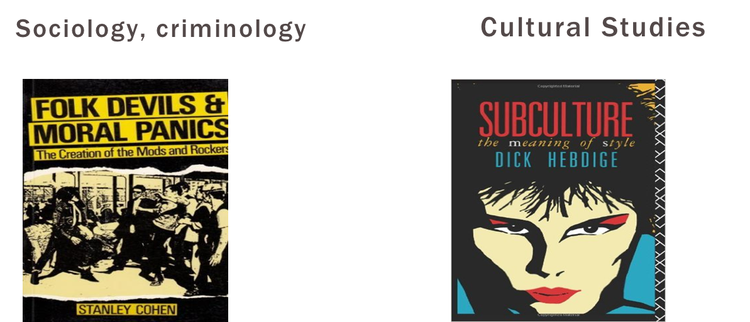
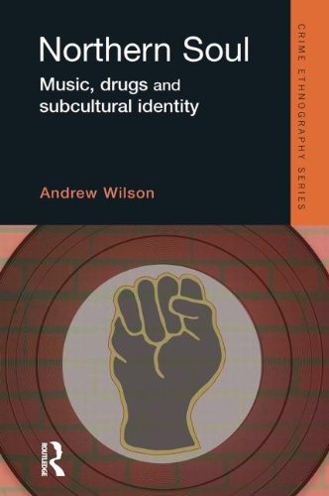
Theoretical sources
Crime ethnography
Notes:
I will be referring to Stanley Cohen, whose theory of ‘moral panics’ offered a means for interpreting the political backlash against mods and rockers in1960s Britain to argue that a similar ‘panic’ emerged as a result of the Acid house phenomenon. Andrew Wilson’s ethnography of northern soul holds some similarity to early acid house. I will also refer to the ideas of Dick Hebdige to think about how ‘style’ plays a role in subcultures.

Slide 7
The effects of migration
“The history of post-war British youth culture must be reinterpreted as a succession of differential responses to the black immigrant presence in Britain from the 1950s onward.” (Hedbidge, Subculture, p. 30)
“The mods were the first in a long line of working-class youth cultures which grew up around the West Indians, responded positively to their presence and sought to emulate their style.” (Hedbrige Subculture, pp. 52–53)

Slide 8
Use of illicit drugs
Dr. Andrew Wilson argues that for a significant minority, "amphetamines symbolised the smart, on-the-ball, cool image" and that they sought "stimulation not intoxication ... greater awareness, not escape" and "confidence and articulacy" rather than the "drunken rowdiness of previous generations."
Wilson argues that the significance of amphetamines to the mod culture was similar to that of LSD and cannabis within the subsequent hippie counterculture.
Dick Hebdige argues that mods used amphetamines to extend their leisure time into the early hours of the morning and as a way of bridging the gap between their hostile and daunting everyday work lives and the "inner world" of dancing and dressing up in their off-hours.

Slide 9
A Political Movement
‘The sheer extent and intensity of the machinery that was necessary to shut down rave is a testament to this.’ (Haq, 2016: 45)
‘As a movement, it enacted a desire to be autonomous, and possessed many other social facets. They embodied a belief in tolerance, a shared positive mind-set and the living of an experimental life. Though curiously embodying both dystopian and utopian impulses simultaneously, part neo-hippy romanticism, part blithe hedonism, raves possessed some extraordinary qualities, transgressing even notions of race and class in terms of participation.’
Nav Haq (2016: 12)

Slide 10
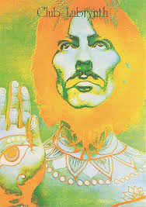
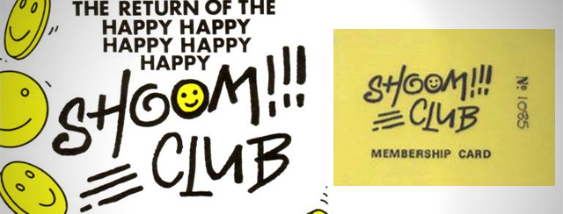
Acciieed: Get right on one matey!
‘It was a brief moment of freedom. Where for the first time a group of people crossed over in their consciousness, a transition point-an Age of Aquarius, whatever you want to call it. Then it all went pear shaped. But for the moment it just worked.’ Lu Vucovic (Promoter of RIP at Clink Street)

Slide 11
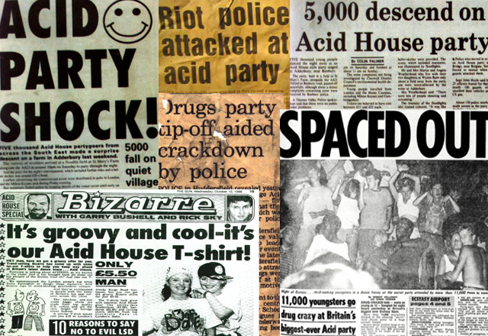
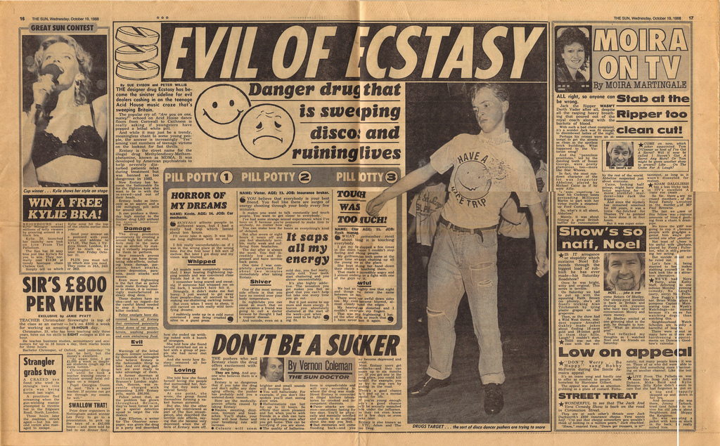
Sensational headlines

Slide 12
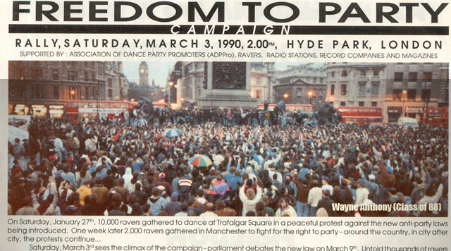
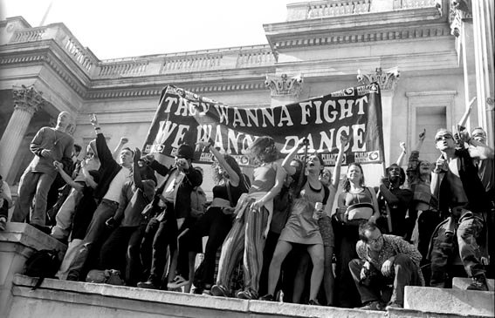

Slide 13
Summary
The Acid House Scene and Rave culture is influenced by previous subcultures
It became a political movement and was worldwide
It was a spiritual revolution and bought people together
It helped break down traditional boundaries and challenge conservative values
It was non-violent and peaceful
It challenged sexism, racism and homophobia

Slide 14
Acid house (1987-1989)
Brothers, sisters…one day we will be free…from fighting, violence…people crying in the street. When the angels from above, fall down and spread their wings like doves. As we walk hand in hand sisters, brothers, we’ll make it to the promised land.
                The Promised Land by Joe Smooth (1988)

Slide 15
References
Berlin, Chelsea Louise Rave Art (London: Carlton books 2014).
Bussman, Jane Once in a lifetime (London: Virgin books 1998).
Cohen, Stanley Folk Devils and Moral Panics: The Creation of the Mods and Rockers (Abingdon: Routledge, 2002 ed. [1972]).
Cohen, Stanley and Jock Young. TheManufacture of News: Social Problems, Deviance and the Mass Media (London: Constable, 1981).
Csordas, T Body, Meaning, Healing (Basingstoke: Palgrave Macmillan 2002).
Hall, Stuart Hall and Tony Jefferson. Resistance Through Rituals Youth Subcultures in Post-War Britain (Hoboken: Taylor and Francis, 2012 [1976]).
Haq, Nav (ed) Rave: Rave and its influence on Art and Culture (London: Black Dog Publishing 2016).
Harvey, Graham Listening People Speaking Earth: Contemporary Paganism (London: C Hurst & Co Ltd 1997).
Hebdige. Dick. Cut ‘n’ Mix: Culture, Identity and Caribbean Music (London: Routledge, 1990).
–. Subculture: The Meaning of Style (London: Routledge, 1995 [1979]).
Turner, Alwyn W. Glam Rock: Dandies in the Underworld (London: V&A Publishing, 2013).
Wilson, A Northern Soul: music, drugs and subcultural identity (Willan publishing 2007).
Williams, Jolyon D In what ways are bodies political? (2nd year Anthropology Essay 3/4/17).
http://www.academia.edu/7515713/Northern_Soul_music_drugs_and_subcultural_identity_introduction_and_Chapter_1_
https://www.theguardian.com/travel/2007/may/27/escape
https://i.pinimg.com/originals/69/e8/c5/69e8c57eaf0f6c6398701192da7bf7bd.jpg
http://www.technostation.tv/90s-rave-culture/
https://www.google.co.uk/search?q=northern+soul+fashion

