Slide 1
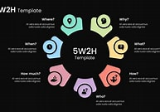
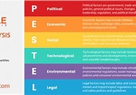
Student name: Diomi kivuvu
Student number:2528622
Module code:lclm4004
Module name: problem solving and decision making
Lecturer name :Said Usman
I have been asked as a business consultant to undertake research to understand and explain the issues that are impacting BASIL BAKERY as it is increasingly concerned that the prospects for continuing his business in its present format is not longer viable.
BASIL bakery opens his door in 2015 with annual figure increasing year after year until 2020 then comes the covid 2019 lockdown the sees his activities decreasing due to multiple factors impacting The Bakery stagnation of sales.
Firstly, I will try to create and apply 5W2H model on the bakery issues, 5W2H is
Where the problem was observed, why did it happen before, what are the symptoms of the problem, how serious the problem is , when the problem occurred, what might have happened but did not happen and how big is the problem and if the cause of the problem known. So problem was observed in a Shopping Retail Park in Conventry, UK. Then defining the symptoms of the problem which is the Bakery activities being decreased since the lockdown in year 2020 and to see how big is the problem: the problem is very serious as the Bakery management is now thinking about stopping the business which is going to have to serious negative impact in the community as they will be loss of job and many families will suffer as a result
PESTEL ANALYSIS:
PESTEL elements can be understood from a LONG perspectives:
LO-local-micro
N-national-micro
G-Global-macro
PESTEL is a framework that helps us understanding actual or potential problem that occur outside business, the framework is useful for identifying elements that affect an organisation from the outside.it does have some variation PEST, PESTLIED, STEEPLE. Pestle analysis is used alongside with SWOT analysis

Slide 2
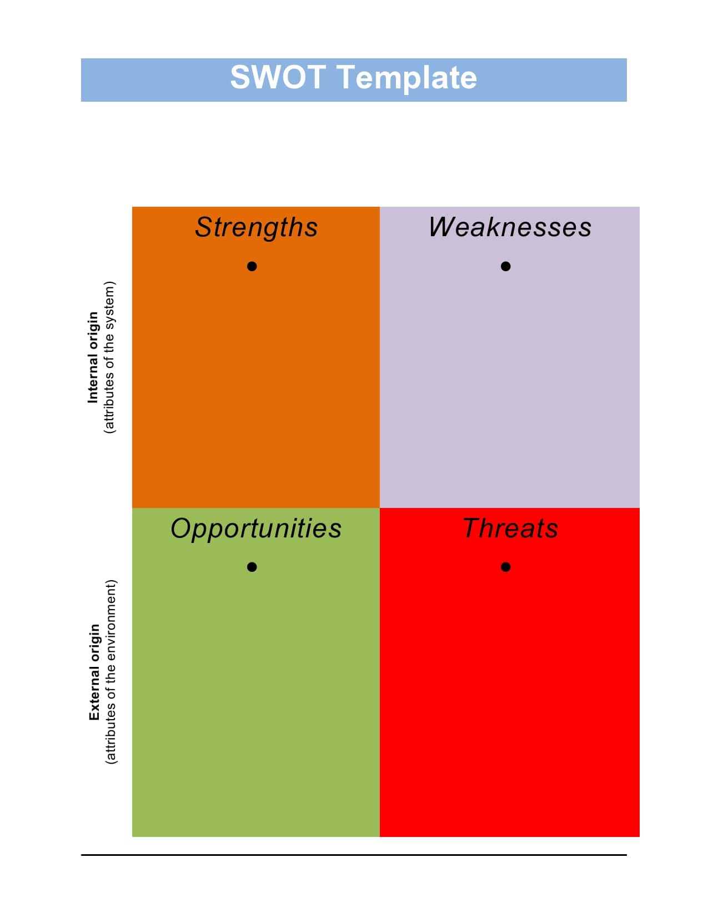
The pollical aspect that hit The BASIL Bakery is the government policy that takes the decision to shut down all activities and put the country to a lockdown that has preventing physical and usual customers to pop inside the bakery.
The economical aspect is disposable income is not as it use to be as people are not coming as it supposed to be so after paying tax the bakery does not have enough left to invest and meeting the employers wages.
The socio cultural aspect is according to me less important but I would say as people not coming inside the retail shop this is still affecting the Bakery in socio cultural aspect
Technological , would the Bakery updating his services by introducing online services or call service where customers were able to make orders online or by phone that could have boosted the amount of orders and obviously the business as well.
Environmental aspect, the Bakery is located inside the business retail park that does not helping either.
Legal aspect, the Bakery has been hit by the Health and Safety aspect as during lockdown people were prevented to be close each other to remain indoors so once again there will be a lack of costumers and decrease of orders
SWOT analysis the swot analysis is a framework for identifying and analyzing the internal and external factors that can have impact on the viability of an organisation. does have four essentials elements
1.strenghths those are the attributes of the organisation that are helpful to achieve the objectives
2.weakness attributes of the organisation that harmful to achieve { example ,lack of needed resources}
3.opportunities those are external conditions that are helpful to achieve the objectives threat: external conditions that are harmful to achieve to achieve the objectives in this case covid 19 was the threat. swot advantage :to understand the business to address the weakness to capitalise opportunities to develop business goals and strategies for achieving them . swot disadvantage :it takes time to do it well does not include all relevant factors for all for elements

Slide 3
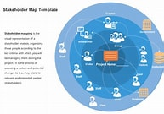
,
We should know that swot when identifying or analysing the problem can be powerful support for decision making because it enables to uncover opportunities for success or to highlight threats before it is too late.
An industry
An industry is a group that related and based on their primary business activities, it is divided in 3 category:
1.Retail: example like supermarket, convenient stores, department stores
2.fashion;like textile design and production, fashion retailing, fashion shows
Food: food processing, dairy product, sea food, beverages
Market
It is a platform where economic actors meet and make key decision for the society. We have got different types of market which are business to business B2B, business to consumer B2C, business to government B2G, consumer to consumer C2C and different type of good , Durable, perishable and electrical
Stakeholder
Is a party that has an interest in a company and can either affect or be affected by the business. The primary stake holders in a corporation are its investor , employee, customer and supplier. Stakeholder can be internal or external to the organisation. In case of Basil Bakery internal stakeholders are: directors, shareholders , management, employee,trustees and volunteers and the external stakeholders are:customers, suppliers, distributors ,competitors ,general public, the government, banks, union.

Slide 4
Fish bone diagram:
Is also called cause and effect analysis , it is analysing the problem. A problem is a gap between how the things are now and how we would like the things to be.
A fishbone diagram, also called an Ishikawa diagram or cause-and-effect diagram, is widely used in quality management and Lean Six Sigma to explore all possible fact contributing to a problem rather than focusing on symptoms.
Product quality
High pricing cost
Low sales
Lack of personnel

Slide 5
After reviewing the situation regarding the Basil Bakery , as a business consultant, I just come up with 3 types of decisions:
A routine decision: The Bakery needs to order more staff in order to allow other people to pick up calls and deal with orders made by customers over the phone
Adaptive decision: those are updating or adjusting decision, The Basil Bakery need to adapt his business according to the current lockdown situation as more people are working remotely so the bakery needs to set up an online service or order by phone service.
innovative decision: The Bakery have to take some modernising decisions by introducing a viable online services.

Slide 6
References:
Akhilendra Singh (2024),The business analysis doctor in 2024 available a t: https:// lucid .com accessed at:10 July 2026
Students Moodle www.bing.com

