Slide 1

IULIAN COZEA

Slide 2
Introduction
This presentation is a report of our visit to Marriott Arden Hotel, Birmingham. Operations within the Marriott hotel such Golf, Bars, Restaurants, kitchen, health and safety and Food & Beverages marketing strategies in the Hotel are included in this presentation.

Slide 3
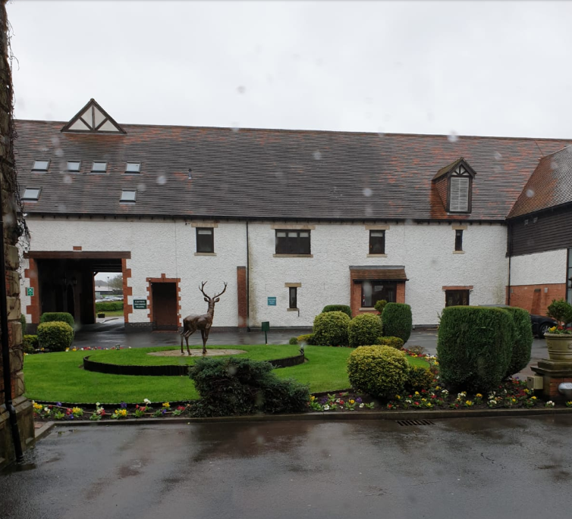
Marriot History
Marriott was founded by John Willard Marriott in 1927 when he and his wife, Alice Sheets Marriott, opened a root beer stand in Washington, D.C. As a Latter-day Saint missionary in the humid summers in Washington, D.C., Marriott was convinced that what residents of the city needed was a place to get a cool drink.

Slide 4
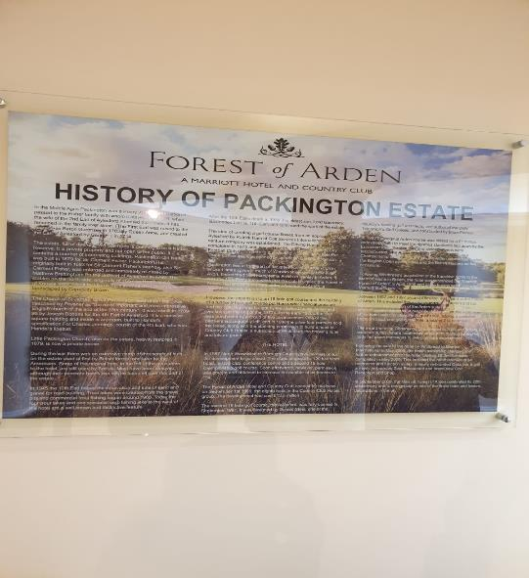
Forest Arden Marriot History
Located in the ancient woodland, Forest of Arden Marriott Hotel & Country Club offers an unforgettable experience. With an excellent location in the West Midlands, nestled between Birmingham and Coventry, the hotel is accessible by train, plane or car.

Slide 5
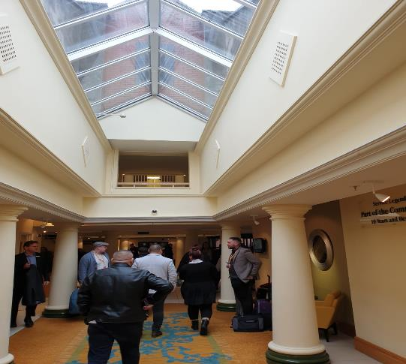
Operation of Marriott
Operations in Marriott Arden include Restaurant, Bars, human resources, housekeeping, security, public relations, food service, sales and finances. Gym and fitness.

Slide 6
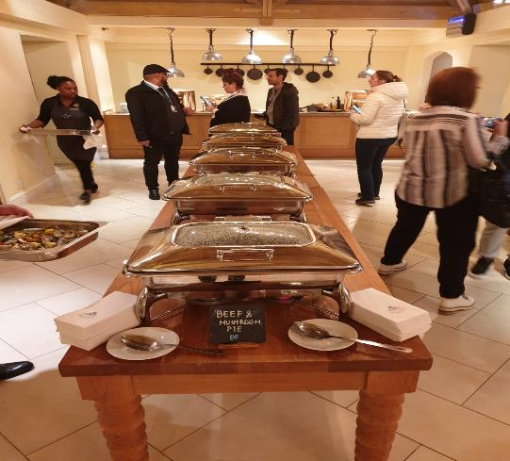
Food & Beverage Detail
The Cast Iron Bar & Grill and the Zest Restaurant helps the Forest of Arden to focus on culinary excellence with restaurant services
The food and beverages services in the Forest of Arden Hotel include: The family style services, international dishes and local dishes,European food.
Sunday lunch and on the afternoon tea.

Slide 7
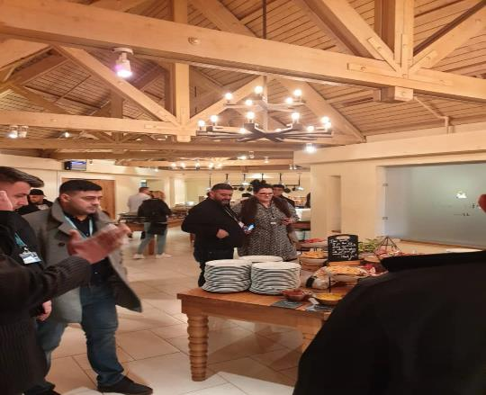
Restaurants of Marriott
Offers both local and international dishes.
Cast IronBar& Grill.
Food are server hot whit 24h delivery.
Good coffee,with professional coffee machenes.

Slide 8
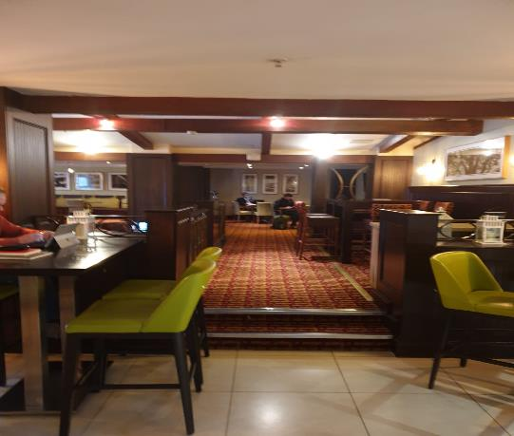
BARS of Marriotts
The menu features a selection of light bites and hearty modern classics as well as an assortment of craft beers, ciders, Champagne, and cocktails.

Slide 9
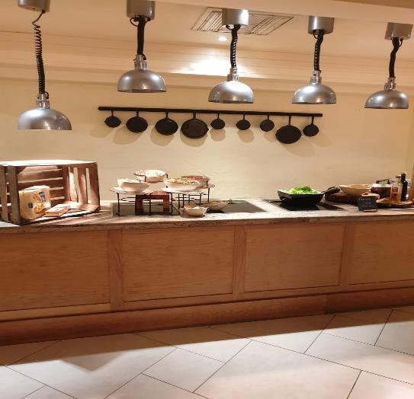
Health, Safety and Kitchen operations in Marriott Arden
The sanitation manager with its team are saddled with overseeing the conditions in the kitchen and the daily sanitation of the environment.
Good Manufacturing Practices (GMPs) are emphasized heavily and encompass very high standards of uniform compliance.

Slide 10
CONCLUSION
Marriott Arden hotel is all about the customer experience; by making the guests feel at home and it resulted in a huge international name in the lodging business over the years.

Slide 11
References
Melia, D.: Trends in the Food and Beverage Sector of the Hospitality Industry. EuroCHRIE Conference, Dubrovnik, Croatia, October 2011.
https://careers.marriott.com/career-paths/food-and-beverage/
https://www.marriott.com/hotels/hotel-information/restaurant/bhxbh-birmingham-marriott-hotel/
https://myassignmenthelp.com/free-samples/marketing-strategy-of-marriott-hotels
https://www.foodsafetymagazine.com/magazine-archive1/augustseptember-2001/marriott-internationale28099s-world-class-recipe-for-safe-great-foods/
http://summercoursegroupsix.blogspot.com/2008/08/conclusion.html

