Slide 1
Database Concepts
Normalisation
B Holland

Slide 2
What is it?
Normalisation is a database design technique, which begins to examine the relationships (called functional dependencies) between attributes)
Normalisation is a formal process based on mathematics which defines a set of rules for creating structures that are arranged in the best way to enable the storage and retrieval of data.
The normal forms are based on the requirement to model data in two dimensional structures consisting of a variable number of rows and a variable number of columns
Attributes describe some aspect of the data or of the relationships between the data that is important to the organisation.
Normalisation uses a series of tests (described as normal forms to help identify a set of suitable relationships that best supports the data requirements of the organisation

Slide 3
The Process and the Purpose of :
To put data into a form that conforms to relational principles. E.g single valued columns each relation representing one entity.
To avoid redundancy by storing each fact within the database only once.
To put data into a form that is more able to accommodate change.
To avoid certain difficulties in updating
To facilitate the enforcement of constrains on the data.

Slide 4
Normalisation and E-R modelling
The two techniques can be used together to produce a more correct model of the data.
You need to have a fairly complete list of all the data items that need to be held in the database before you can begin to normalise.
In a large system this could prove quite complicated and it would be better to organise the data into preliminary groups - i.e. entities.
At the end of normalisation you may need to revise your E-R model to show the normalised entities.

Slide 5
Data redundancy
Transforming data from a problem into relations while ensuring data integrity and eliminating data redundancy.
  Data integrity : consistent and satisfies data constraint rules
  Data redundancy: if data can be found in two places in a single database (direct redundancy) or calculated using data from different parts of the database (indirect redundancy) then redundancy exists.
Normalisation should remove redundancy, but not at the expense of data integrity.

Slide 6
Problems of redundancy
If redundancy exists then this can cause problems during normal database operations:
  When data is inserted the database the data must be duplicated where ever redundant versions of that data exists.
  When data is updated, all redundant data must be simultaneously updated to reflect that change.

Slide 7
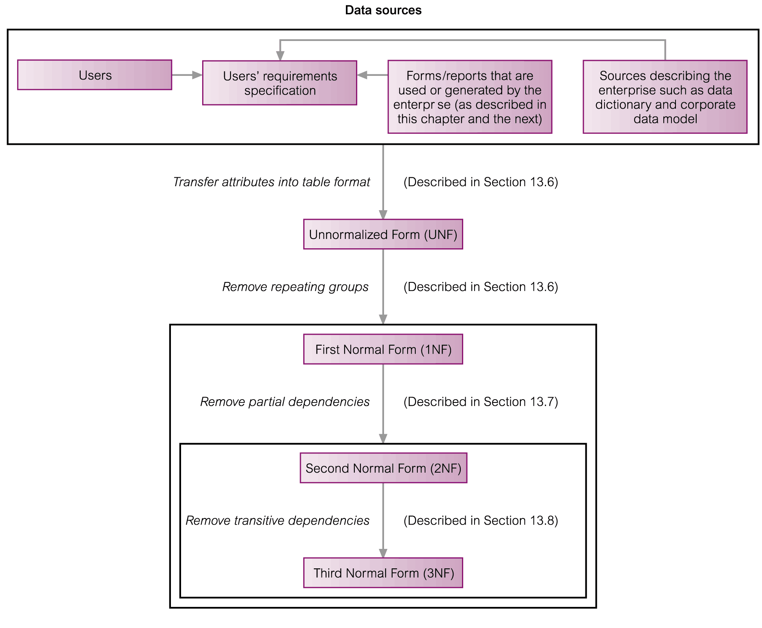
The Process of Normalisation

Slide 8
First Normal Form
Un-normalised form (UNF) describes a table that contains one or more repeating groups.
An entity is said to be in First Normal Form if all the attribute values are atomic. (A relationship in which the intersections of each row and column contains one and only one value)
Each column of the table should contain only one values not multiples as in a list.
1NF – the aim is to remove all of the repeated occurrences of attributes in the logical design, and therefore ensure that the final physical database will be free of redundant data.

Slide 9
UNF to 1NF
Nominate an attribute or group of attributes to act as the key for the un-normalised table.
Identify the repeating group(s) in the un normalised table which repeats for the key attribute(s).

Slide 10
Unnormalised Form (UNF) and First Normal Form (1NF)
Unnormalised Form (UNF)
  A table that contains one or more repeating groups.
  A repeating group is a group of attributes with one or more these attributes containing two or more values for a cell in a table.
First Normal Form (1NF)
  A relation in which the intersection of each row and column contains one and only one value.
  That is, there are no repeating groups.

Slide 11
Sample Data: Student Module Report
studentID | student Name | moduleCode | moduleName | credits | mark1 | mark2 | lecturerID | lecturerName
P100001 | John Kay | M5X0110 | Database Systems | 30 | 75.00 | 65.00 | LO40 | Tina Murphy
 |  | M5X0105 | Web Development | 20 | 79.50 | 69.00 | LO93 | Tony Shaw
P100004 | Aline Stewart | M5X0110 | Database Systems | 30 | 55.00 | 52.00 | LO40 | Tina Murphy
 |  | M5X0105 | Web Development | 20 | 41.00 | 39.00 | LO93 | Tony Shaw
 |  | M5X0104 | Internet Security | 20 | 62.50 | 67.00 | LO93 | Tony Shaw
Assume each module has two assessments and the marks are stored in mark1 and mark2.

Slide 12
UNF to 1NF
Remove the repeating group by
  Entering appropriate data into the empty columns of rows containing the repeating data (‘flattening’ the table).
  Or by
  Placing the repeating data along with a copy of the original key attribute(s) into a separate relation.

Slide 13
UNF to 1NF: Step 2
Method 1: Flatten the table
  Create separate rows for each value in the repeating group of data.
  For the repeating group values (attributes with single values), fill the values down in the new rows created.
Method 2: Splitting the table by placing the repeating data along with the original key attribute(s) into a separate table.
  Note: If there are multiple repeating groups, repeat this process till there are no repeating groups remain.

Slide 14
UNF to 1NF: Step 1
studentID
Identify and Nominate Key:
What are the repeating groups?
studentID | student Name | moduleCode | moduleName | credits | mark1 | mark2 | lecturerID | lecturerName
P100001 | John Kay | M5X0110 | Database Systems | 30 | 75.00 | 65.00 | LO40 | Tina Murphy
 |  | M5X0105 | Web Development | 20 | 79.50 | 69.00 | LO93 | Tony Shaw
P100004 | Aline Stewart | M5X0110 | Database Systems | 30 | 55.00 | 52.00 | LO40 | Tina Murphy
 |  | M5X0105 | Web Development | 20 | 41.00 | 39.00 | LO93 | Tony Shaw
 |  | M5X0104 | Internet Security | 20 | 62.50 | 67.00 | LO93 | Tony Shaw

Slide 15
UNF to 1NF Method 1:
Step 2 - Flattening the Table
Fill the group values down in the empty cells.
studentID | student Name | moduleCode | moduleName | credits | mark1 | mark2 | lecturerID | lecturerName
P100001 | John Kay | M5X0110 | Database Systems | 30 | 75.00 | 65.00 | LO40 | Tina Murphy
P100001 | John Kay | M5X0105 | Web Development | 20 | 79.50 | 69.00 | LO93 | Tony Shaw
P100004 | Aline Stewart | M5X0110 | Database Systems | 30 | 55.00 | 52.00 | LO40 | Tina Murphy
P100004 | Aline Stewart | M5X0105 | Web Development | 20 | 41.00 | 39.00 | LO93 | Tony Shaw
P100004 | Aline Stewart | M5X0104 | Internet Security | 20 | 62.50 | 67.00 | LO93 | Tony Shaw

Slide 16
UNF to 1NF Method1:
Step 2 - Creating Separate Table
Recall that the key field identified was studentID.
Splitting the table by placing the repeating data with this key field (studentID) into a separate table produces the following relations.
Table 1
Table 2 + key field column too, studentID
studentID | student Name | moduleCode | moduleName | credits | mark1 | mark2 | lecturerID | lecturerName
P100001 | John Kay | M5X0110 | Database Systems | 30 | 75.00 | 65.00 | LO40 | Tina Murphy
 |  | M5X0105 | Web Development | 20 | 79.50 | 69.00 | LO93 | Tony Shaw
P100004 | Aline Stewart | M5X0110 | Database Systems | 30 | 55.00 | 52.00 | LO40 | Tina Murphy
 |  | M5X0105 | Web Development | 20 | 41.00 | 39.00 | LO93 | Tony Shaw
 |  | M5X0104 | Internet Security | 20 | 62.50 | 67.00 | LO93 | Tony Shaw
Notes:
StudentID not shown in Table 2 here – see next slide

Slide 17
1NF Tables (from Method 2)
studentID | student Name
P100001 | John Kay
P100004 | Aline Stewart
Student
StudentModule
studentID | moduleCode | moduleName | credits | mark1 | mark2 | lecturerID | lecturerName
P100001 | M5X0110 | Database Systems | 30 | 75.00 | 65.00 | LO40 | Tina Murphy
P100001 | M5X0105 | Web Development | 20 | 79.50 | 69.00 | LO93 | Tony Shaw
P100004 | M5X0110 | Database Systems | 30 | 55.00 | 52.00 | LO40 | Tina Murphy
P100004 | M5X0105 | Web Development | 20 | 41.00 | 39.00 | LO93 | Tony Shaw
P100004 | M5X0104 | Internet Security | 20 | 62.50 | 67.00 | LO93 | Tony Shaw

Slide 18
Second Normal Form (2NF)
A relation that is in 1NF and every non-primary key attribute is fully functionally dependent on the primary key.
This step involves removing partial dependencies.

Slide 19
2NF Steps
Identify the primary key for each 1NF relation.
Identify the functional dependencies in the relation.
Check for partial dependencies
  If partial dependencies exist on the primary key, remove them by placing them in a new relation along with a copy of their determinant (left side).
  And remove the duplicate rows in the new table.

Slide 20
1NF to 2NF: Student Table
What is the primary key? studentID
What are the functional dependencies?
  studentID → studentName
Are there any partial dependencies?
  No, this is a simple functional dependency involving single attributes and it is clear that studentName is fully functionally dependent on studentNo
The Student table can remain as it is.
studentID | student Name
P100001 | John Kay
P100004 | Aline Stewart

Slide 21
1NF to 2NF: StudentModule Table
studentID | moduleCode | moduleName | credits | mark1 | mark2 | lecturerID | lecturerName
P100001 | M5X0110 | Database Systems | 30 | 75.00 | 65.00 | LO40 | Tina Murphy
P100001 | M5X0105 | Web Development | 20 | 79.50 | 69.00 | LO93 | Tony Shaw
P100004 | M5X0110 | Database Systems | 30 | 55.00 | 52.00 | LO40 | Tina Murphy
P100004 | M5X0105 | Web Development | 20 | 41.00 | 39.00 | LO93 | Tony Shaw
P100004 | M5X0104 | Internet Security | 20 | 62.50 | 67.00 | LO93 | Tony Shaw
What is the primary key?
What are the functional dependencies? A few - next slide.

Slide 22
StudentModule Functional Dependencies
Primary key: studentID, moduleCode, so we have:
    studentID, moduleCode → moduleName, credits, mark1, mark2, lecturerID, lecturerName
Recall: partial dependencies involves identifying attributes that are functionally dependent on a subset of the determinant (left-side).
  Nothing is functionally dependent on studentID alone (you need both studentID and moduleCode to determine other values).
  But what about moduleCode?
    moduleCode→ moduleName, credits, lecturerID, lecturerName
  If we extract this dependency from the table, leaving the remaining fields for functional dependency (studentID, moduleCode), we get the two tables on the next slide.
Notes:
Note, there are other functional dependencies in the table, depending on the primary key chosen.

Slide 23
1NF to 2NF: StudentModule Table
ModuleLecturer
StudentModule
moduleCode | moduleName | credits | lecturerID | lecturerName
M5X0110 | Database Systems | 30 | LO40 | Tina Murphy
M5X0105 | Web Development | 20 | LO93 | Tony Shaw
M5X0104 | Internet Security | 20 | LO93 | Tony Shaw
studentID | moduleCode | mark1 | mark2
P100001 | M5X0110 | 75.00 | 65.00
P100001 | M5X0105 | 79.50 | 69.00
P100004 | M5X0110 | 55.00 | 52.00
P100004 | M5X0105 | 41.00 | 39.00
P100004 | M5X0104 | 62.50 | 67.00

Slide 24
2NF Tables
Student
studentID | student Name
P100001 | John Kay
P100004 | Aline Stewart
ModuleLecturer
moduleCode | moduleName | credits | lecturerID | lecturerName
M5X0110 | Database Systems | 30 | LO40 | Tina Murphy
M5X0105 | Web Development | 20 | LO93 | Tony Shaw
M5X0104 | Internet Security | 20 | LO93 | Tony Shaw
StudentModule
studentID | moduleCode | mark1 | mark2
P100001 | M5X0110 | 75.00 | 65.00
P100001 | M5X0105 | 79.50 | 69.00
P100004 | M5X0110 | 55.00 | 52.00
P100004 | M5X0105 | 41.00 | 39.00
P100004 | M5X0104 | 62.50 | 67.00

Slide 25
Third Normal Form (3NF)
A relation that is in both 1NF and 2NF and in which no non-primary key is transitively dependent on the primary key.
Based on the concept of transitive dependency.
Recall that transitive dependency is a condition where:
  A, B and C are attributes of a relation such that if A→ B and B→ C,
  then C is transitively dependent on A through B (provided that A is not functionally dependent on B or C).

Slide 26
2NF to 3NF
Identify the primary key in the 2NF relation
Identify functional dependencies in the relation.
Check if transitive dependencies exist on the primary key and remove them by placing them in a new relation with a copy of their determinant.

Slide 27
2NF to 3NF
Student and StudentModule Tables
All the non-primary keys in the Student and StudentModule tables are functionally dependent on only their primary keys.
They do not have any transitive dependencies.
StudentModule
studentID | moduleCode | mark1 | mark2
P100001 | M5X0110 | 75.00 | 65.00
P100001 | M5X0105 | 79.50 | 69.00
P100004 | M5X0110 | 55.00 | 52.00
P100004 | M5X0105 | 41.00 | 39.00
P100004 | M5X0104 | 62.50 | 67.00
Student
studentID | student Name
P100001 | John Kay
P100004 | Aline Stewart

Slide 28
2NF to 3NF
ModuleLecturer Table
moduleCode | moduleName | credits | lecturerID | lecturerName
M5X0110 | Database Systems | 30 | LO40 | Tina Murphy
M5X0105 | Web Development | 20 | LO93 | Tony Shaw
M5X0104 | Internet Security | 20 | LO93 | Tony Shaw
What is the primary key? moduleCode
What are the functional dependencies?
    moduleCode → moduleName, credits, lecturerID, lecturerName
    lecturerID → lecturerName
Any transitive dependencies?
    Yes: lecturerID → lecturerName
      moduleCode functionally determines lecturerName via the lecturerID.
    Remove this transitive dependency into a separate relation.

Slide 29
2NF to 3NF
ModuleLecturer Table
Create two tables from the ModuleLecturer table
  Lecturer
  Module
lecturerID | lecturerName
LO40 | Tina Murphy
LO93 | Tony Shaw
moduleCode | moduleName | credits | lecturerID
M5X0110 | Database Systems | 30 | LO40
M5X0105 | Web Development | 20 | LO93
M5X0104 | Internet Security | 20 | LO93

Slide 30
The Normalised 3NF Relations
Student
Module
studentID | student Name
P100001 | John Kay
P100004 | Aline Stewart
moduleCode | moduleName | credits | lecturerID
M5X0110 | Database Systems | 30 | LO40
M5X0105 | Web Development | 20 | LO93
M5X0104 | Internet Security | 20 | LO93
Lecturer
StudentModule
lecturerID | lecturerName
LO40 | Tina Murphy
LO93 | Tony Shaw
studentID | moduleCode | mark1 | mark2
P100001 | M5X0110 | 75.00 | 65.00
P100001 | M5X0105 | 79.50 | 69.00
P100004 | M5X0110 | 55.00 | 52.00
P100004 | M5X0105 | 41.00 | 39.00
P100004 | M5X0104 | 62.50 | 67.00

