Slide 1
Working Title:
Escape from reality with me
1500803 – CAMF6001 – assessment one

Slide 2
LOGLINE: A naïve girl and a stressed out boy realise the joy and heartbreak of living life to full when meeting a girl named Leda
SYNOPSIS: Nina is a naive college student who claims to be bored of life, much to the annoyance of her friend Alfie. Nina drowns herself in stories about far away lands whilst Alfie feels constantly pressured to be the best academically from his parents. Both students feel the need to escape their current lives but do not know how to go about it. Enter Leda a girl who moves back to the village and shakes both of their worlds instantly. Nina and Alfie develop crushes on Leda and say this will not affect their friendship when it inevitably does damage it, this creates cracks in the friendships and with that and their taxing home lives this becomes more than any of them can handle alone. Nina gets jealous and begins a fight but realises that her friends need her more than ever. They eventually realise that facing their problems is the only way to solve them and hiding behind masks and books only prolongs the problems.

Slide 3
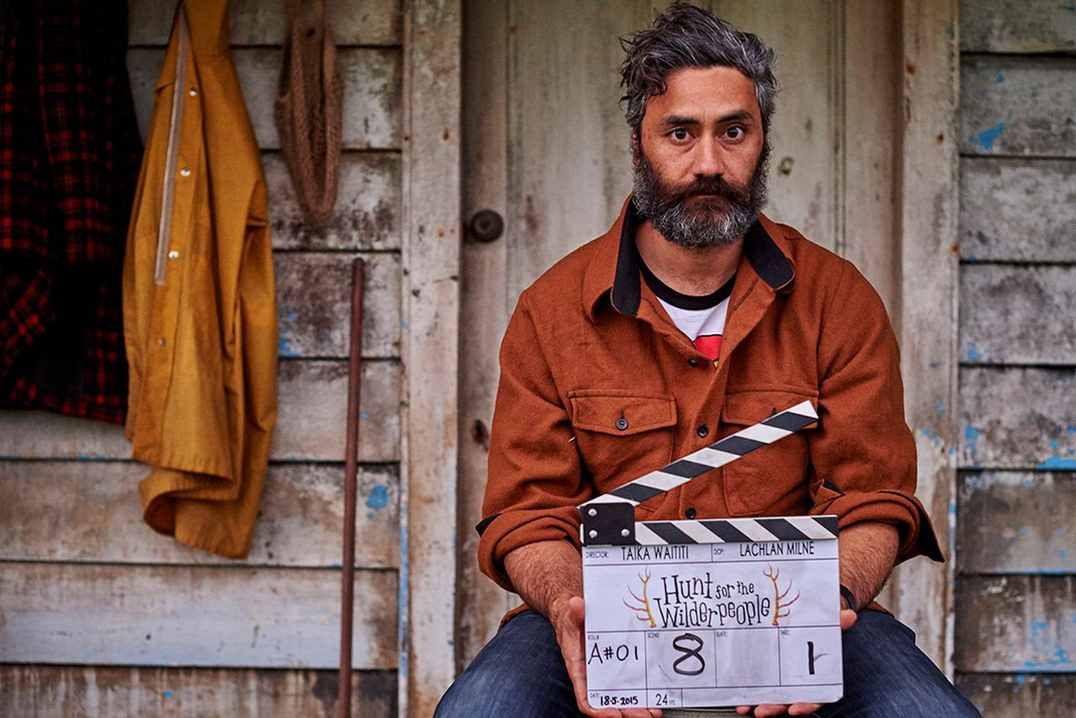





RESEARCH
Looked at a range of coming of age films
Submarine (Ayoade, 2010)
Boy (Waititi, 2010)
Hunt for the wilderpeople (Waititi, 2016)
Perks of being a wallflower (Chbosky, 2012)
Scott Pilgrim vs. the world (Wright, 2010)

Slide 4
SYNOPSIS OF WORK
Genre: coming of age
Location: Swansea
Ages of main cast: 17
Themes: friendship, romance, heartbreak, fear of the future, escapism, alcohol abuse, jealousy
Approx. run time: sixty minutes (60 pages)

Slide 5
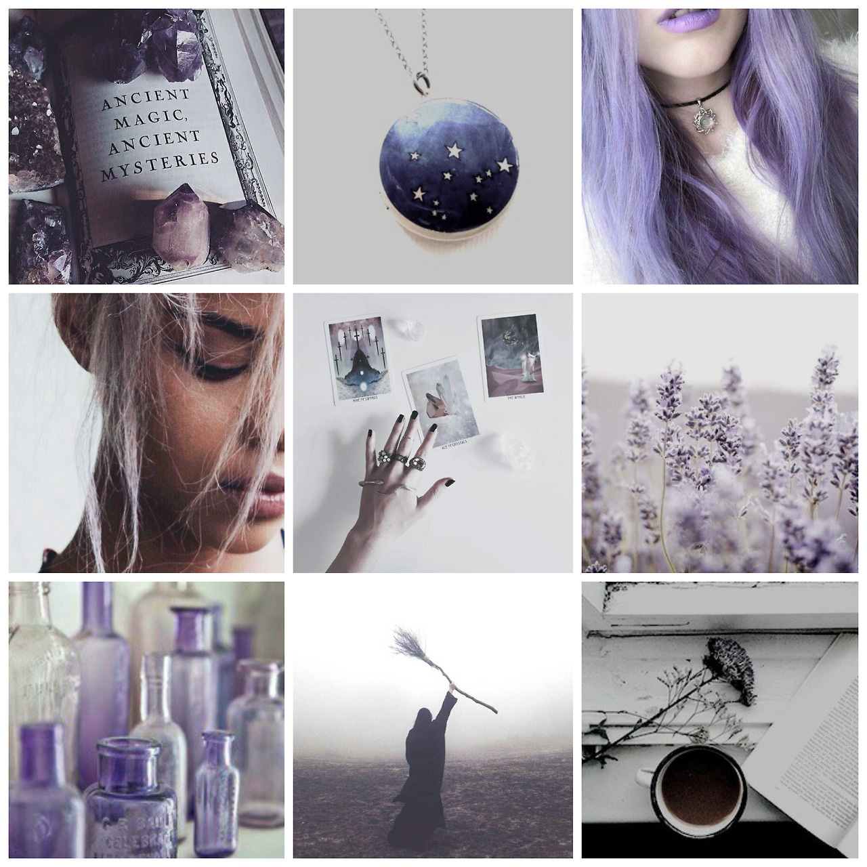
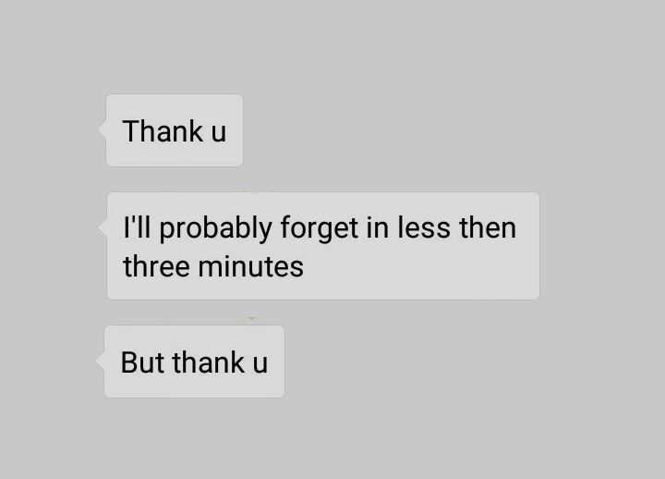
CHARACTER PROFILES - NINA
Physically: dyed hair, expressive dress code
Home life: Alone at home a lot due to parents working
Good qualities: open minded, imaginative, gentle
Bad qualities: Pessimistic, naive, withdrawing, dissatisfied
Fear: The isolation she has created for herself hiding behind fantasy worlds
Inner need: To try and escape the norm
Facts:
College student
Loves fantasy books, TV shows, movies and games
Uses escapism to not deal with life
Believes there is no happy job in life you go to school you work you die
Doesn’t step out of her comfort zone
Her family move around a lot so she stopped bothering trying to fit in or make many relationships
She is in cycle of wanting something more out of life but not doing anything about it
She starts to idolise Leda for having the courage to step out of the norm

Slide 6


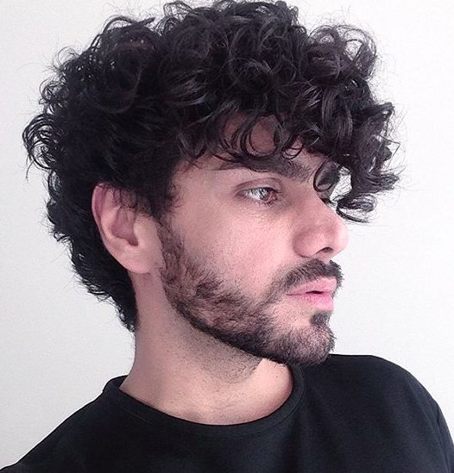

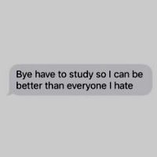
CHARACTER PROFILES - ALFIE
Physically: curly hair, dresses plainly
Home life: Lives with parents and older brother
Good qualities: Hard working, observant, loyal
Bad qualities: drinking, stressed, cynical,
Fear: That he will not live up to his families expectation
Inner need: To live to his family’s expectations but also stand up for himself for the pressure they put on him
Facts:
College student
Knew Leda in primary school
His family pressure him to get to top marks and to make it to top universities
Is turning to darker ways to relieve the pressure
His parents putting their 'encouragement' on him has created sibling rivalry between him and his brother
Went to school with Leda in the past but they were not friends
He wants to break this cycle of pressure but does not know how
He begins to develop a drinking problem

Slide 7
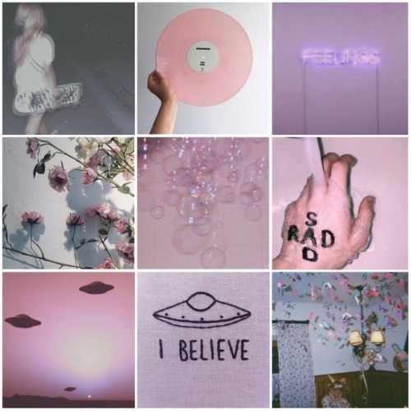
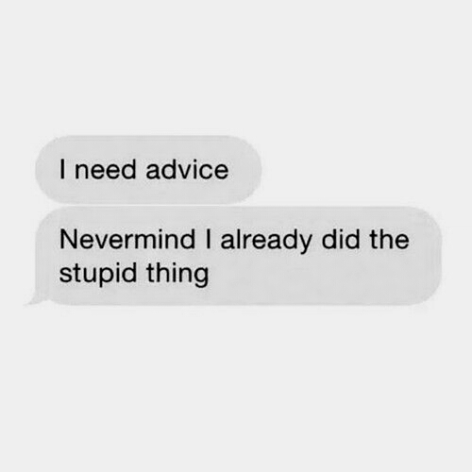
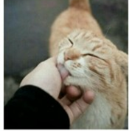
CHARACTER PROFILES - LEDA
Physically: Bright hair, wears bright clothes
Home life: Lives with alcoholic mother
Good qualities: Spontaneous, sympathetic, talkative
Bad qualities: Distrustful, reckless, insecure
Fear: Her mother will get herself hurt badly one day
Inner need: Get her mother to stop this toxic behaviour
Facts :
Lives with her mother but doesn’t get along with her
Loves animals
Is very private about home life
A loud person
Her escapism is life with her friends
Thinks wearing bright clothes makes your day brighter
Used to go to school with Alfie
Had lots of ridiculous rumours surrounding her

Slide 8
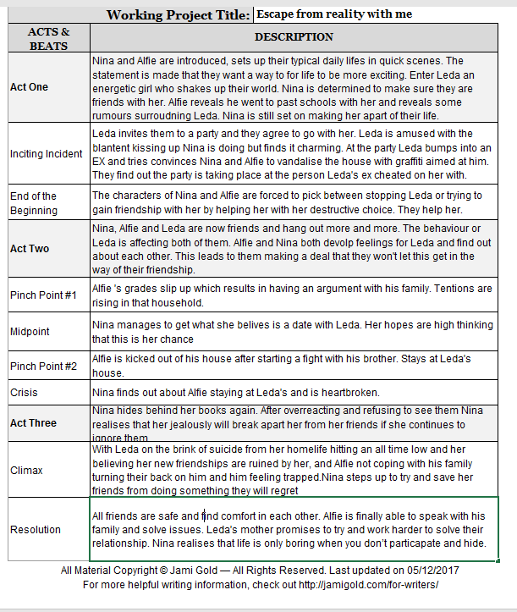
BEAT SHEET

Slide 9
PLOT DIAGRAM
Intervene
Heartbreak
Attraction
Meeting
Leda

Slide 10
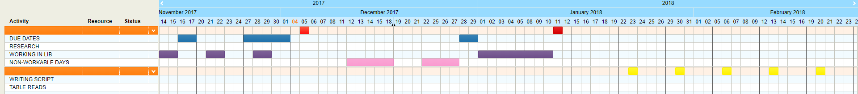
SPECIFIC PLANNING

Slide 11
ISSUES THAT COULD OCCUR
TIME MANAGEMENT
KEEPING TO SCHEDULE
MULTI TASKING COURSEWORK AND PERSONAL LIFE
WRITERS BLOCK

Slide 12
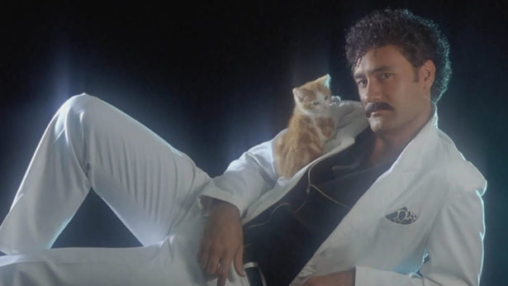
THANK YOU FOR LISTNEING

