Slide 1
International Marketing: Principles and Practices
LCMB 7026
WEEK 7

Slide 2
Week Seven
Managing international distribution and logistics

Slide 3
Last week
We have covered
The most common strategic objectives associated with prices and the methods that may be used to achieve those objectives.
Traditional and culturally based types of advertising appeals that marketing professionals use.

Slide 4
In today’s session….
After reading and studying this session, you will be able to:
  Understand the essential elements of an international marketing channel
  Understand how international marketing channels function through various intermediaries.
  Understand how the marketing team can effectively operate the five tasks associated with the physical distribution of goods.
  Understand what international retailing is
  .

Slide 5

To refresh your memory
What type of appeals are used in this advertising?

Slide 6

To refresh your memory
What type of appeals are used in this advertising?

Slide 7

To refresh your memory
What type of appeals are used in this advertising?

Slide 8
How does today’s session link to your assessment?
Choose one brand from the list below:
• Primark (clothing) - Ireland
• Deliveroo (food delivery) – United Kingdom
• Tata Tiago (car) - India
• Xiaomi (smartphone) – China
• Wizz Air (low-cost airlines) – Hungary
2. Choose two countries as new target markets/ Host countries for your chosen brand
Develop the brand's marketing strategies in those countries. Your analysis should cover the following components:
  Overview of the chosen brand and its operation in the chosen countries.
  Comparison and contrast of:
    Pestle analysis of Country A and Country B
    Cultural and social context of Country A and Country B
    STP strategies in Country A and Country B
    Marketing mix (7Ps) strategies in Country A and Country B
Notes:
The understanding of the international marketing environment could provide context/ overview to your report

Slide 9
Learning objective #1
Understand the essential elements of an international marketing channel

Slide 10
International marketing channels
Marketing channel managements integrates two key areas in marketing strategy: distribution and logistics.
International distribution is the process by which products and services flow between producers, companies that act as intermediaries, and consumers, and includes the transfer of ownership.
International logistics refers to the strategic management of the flow of products and services among marketing channel members, including both upstream and downstream activities.
Upstream activities focus on bringing a product or supplies into a company, while downstream activities concentrate on sending a product or supplies to another channel member for resale.

Slide 11
International marketing channel decisions
Distribution intensity
Selection of distribution channel
Managing distribution channels
Physical distribution

Slide 12
Distribution intensity
The extent to which products are distributed throughout a country and the number of intermediaries utilised to carry a good constitute the product’s distribution intensity.
Strategic decisions regarding the level of distribution intensity are made country-by-country because product demand can vary greatly across countries.
  Marketing infrastructures differ greatly.
  In developing countries, some products can only be made available in limited locations.

Slide 13
International distribution intensity approach
Intensive distribution is an international marketing strategy in which products are distributed through as many wholesalers and retailers as possible in a particular market.
Selective distribution system is a strategy of using only a limited number of channel intermediaries in the international marketing program
Exclusive distribution focuses on offering products through only one wholesaler or retailer in a particular market area.

Slide 14
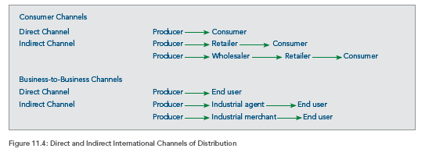
Selection of distribution channels

Slide 15
Channel length
Marketing channel length refers to the number of intermediaries that a product goes through before reaching the consumer.
  In a traditional channel, there are two intermediaries: the wholesaler and the retailer.
  Direct marketing represents the shortest channel length, as the product moves directly from the manufacturer to the retail customer.
Products that are intensively distributed tend to have longer international marketing channels.
Exclusively distributed products often have shorter channels.
International marketing channels differ significantly in both length and complexity.

Slide 16
Managing international distribution channels
Managing the supply channel involves a series of strategic decisions and activities. Each should concentrate on the ultimate goal, which is reaching the target market effectively and efficiently.
The key elements involved are
  establishing international channel strategies,
  selecting intermediary arrangements,
  making channel arrangements and choosing channel partners, and
  managing channel power.

Slide 17
Selecting intermediary arrangements
The second strategic choice is whether to use traditional intermediaries or to create an in-house distribution channel.
Vertical integration means that one member of the market channel merges with or acquires another intermediary.
  Backwards vertical integration occurs when a retail chain develops or acquires its own supplier.
  Forward vertical integration strategies involve manufacturers establishing wholesale distribution systems or company-owned retail outlets.

Slide 18
Selecting intermediary arrangements
Horizontal integration involves acquiring or merging with another company at the same level of the distribution channel
  These efforts include manufacturers joining with other manufacturers, wholesalers acquiring other wholesalers, or retailers merging with or acquiring other retailers.
A gray market is the practice of distributing products through channels that were not authorised by the product's marketer.
  Wholesalers buy a product in one country at a low price and resell it in other markets, or to unauthorised retailers, for profit.

Slide 19
Pair Activity – 30 Minutes
What type of distribution tactic, intensive, selective, or exclusive, do you think should be used for the following products?
Milk in the United Kingdom
Luxury jewellery in France
High-end automobiles in Germany
Cigarettes in Mexico

Slide 20
Learning objective #2
What international marketing channel functions do various intermediaries perform?

Slide 21
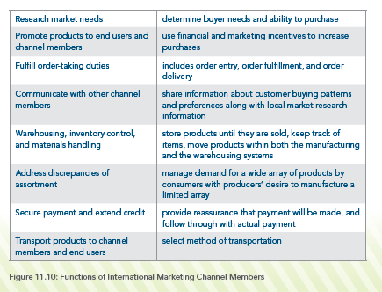
International marketing channel functions

Slide 22
Warehousing, inventory control, and materials handling
Warehousing is the process of storing products until they are sold.
Marketing channel members also focus on inventory control.
  Maintaining an optimal inventory of products that will meet consumer demand without burdening the system with excessive stock constitutes a challenge for logistics managers.
Materials handling includes all activities associated with moving products within the manufacturing and warehousing systems.

Slide 23
Address discrepancies of assortment
One fundamental concern in all domestic and international marketing channels is the discrepancy of assortment problem.
The problem results from the simple idea that producers generally desire to produce a large number of a limited variety of products, while consumers usually desire limited quantities of a wide variety of products.
To remedy this discrepancy, channel members engage in what is known as the sorting function.

Slide 24
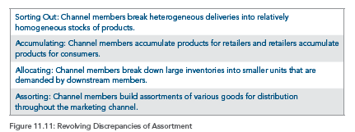
The sorting function

Slide 25
Transportation
The global transportation of products will be an important part of international marketing channels.
Products must be delivered reliably and effectively.
  Deliveries are reliable when they are on time.
  Deliveries are effective when the shipments arrive in good quality, undamaged by the mode of transportation.

Slide 26
Learning objective #3
How can the marketing team effectively operate the five tasks associated with the physical distribution of goods?

Slide 27
Physical distribution
The term logistics refers to all of the activities in the physical movement and storage of goods from the producer to the consumer.
The ultimate objective of a logistics program will be to meet the needs of customers in a convenient and timely fashion at the lowest possible cost.
Five tasks are associated with logistics and the physical distribution of products.

Slide 28
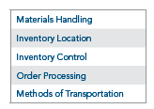
Five tasks of physical distribution

Slide 29
Materials handling
Part of physical distribution involves handling the inflow of raw materials.
  Company leaders balance the costs of holding raw materials against the problems associated with running out.
In global markets, materials handling becomes a major part of the decision to use a mode of entry that involves manufacturing items in different countries, such as franchising, wholly owned subsidiaries, and joint ventures.
  A nation’s infrastructure will be the primary factor in this analysis.

Slide 30
Inventory location
The production team identifies the most efficient and effective methods for storing finished goods before shipping to other businesses and customers.
A warehouse facility stores products before they are placed into the distribution channel.
  Three alternatives are available: a private warehouse, a public warehouse, and a third-party warehouse.

Slide 31
Distribution centers
Distribution centers are not warehouses because they are not designed to store products. Instead, a flow of goods moves through the system.
Distribution centre activities are focused on receiving products, storing them, preparing them for delivery, and shipping.
The physical location of a distribution centre will be important.
  Most are located near major transportation routes, ports, or terminals.

Slide 32
Inventory control
The process of determining the appropriate level of inventory to be manufactured, shipped, and stored at a reasonable cost.
A balance must be achieved between carrying too little inventory, which leads to stock-outs and lost sales, and carrying an excess of inventory.
  Stocks-outs are especially troublesome for international marketers because reorders take additional time for shipment.
  Holding excess inventory increases carrying costs or the monies needed to finance the inventory and warehouse the product.

Slide 33
Order processing
Order processing involves completion of the paperwork associated with shipping orders as well as oversight of the physical movement of the goods.
Bills of lading and other documents should be inspected to make certain an order contains all items.
  Then, payment for the shipment can be authorized by the importing company.

Slide 34
Terrorism and international marketing channels
The increased occurrence of global terrorism has exhibited a significant impact on international distribution activities.
  Due to tighter security restrictions worldwide, delays in product shipments to international destinations have become more common.
In general, terrorism is considered an external risk that directly impacts product flow. It can affect all forms of transportation.
  The increase in piracy, particularly in the Gulf of Aden, the Indian Ocean, and the Arabian Sea near Somalia, has recently been a concern for product transportation.

Slide 35
Learning objective #4
What is international retailing

Slide 36
International retailing
The final destination for many distribution activities will be the retail store or retail outlet.
Retailing activities occur worldwide.
  From the smallest villages to the largest cities, retail commerce plays a significant role in the everyday lives of consumers.
International retailing refers to all of the retail activities that occur across national boundaries.
  The definition focuses specifically on large, international retail firms that conduct operations in more than one country.

Slide 37
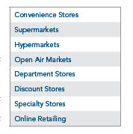
Types of international retail outlets

Slide 38
Group Activity– 30 Minutes
Find a product that is intensively distributed in a country of your choice. Look for this information on the internet. What can you say about its distribution channels in that country?

Slide 39

Any questions?
Next week we will study
Market Entry Methods

Slide 40
References
Baack, D. G. (2018). International marketing., 2nd edition. London: SAGE Publications.
Czinkota, M.R. (2011) International Marketing. Hampsire: Cengage Learning.
De Búrca, S., Fletcher, R. and Brown, L. (2004) International marketing : an SME perspective. 1st ed. Harlow, England: FT Prentice Hall.
Doole, I. and Lowe, R. (2012) International marketing strategy : analysis, development and implementation. Cengage Learning.
Keegan, W.J. and Green, M.C. (2013) Global marketing. 7th ed., global ed. Boston, Mass. ; London: Pearson.
Ko, E., Kim, E., Taylor, C. R., Kim, K. H., & Kang, I. J. (2007). Cross-national market segmentation in the fashion industry: A study of European, Korean, and US consumers. International Marketing Review, 24(5), 629–651.
Mathur, U. C. (2008). International marketing management : text and cases. SAGE.
Wind, Y., & Douglas, S. P. (1972). International market segmentation. European Journal of Marketing, 6(1), 17–25.

