Slide 1

P♥wfectMatch
If it breathes, it breeds

Slide 2
Pawfect Match Software
Our app revolutionizes pet breeding by empowering users to curate their ideal furry companions. Discover and connect with breeders who specialize in creating pets that match your envisioned traits, from appearance to personality. We're dedicated to facilitating the creation of your dream pet, fostering bonds that perfectly align with your desires and preferences.

Slide 3
The Team
Sean Garrington - Business end
Hassan Bahzad - Application design and development
Josh Rigbey - Marketing and Social Media
Harry Elsey - Finances and Accounts

Slide 4
Objectives and Values
Objectives
Responsible breeding
Innovation
Community
Values
Ethical Breeding
Transparency
Compassion
Customer Satisfaction
Education

Slide 5
Code of Conduct
- Compliance
- Behavioural Expectations
- Respect and Inclusion
- Consequences and Reporting

Slide 6
Product Introduction
Hassan Bahzad

Slide 7
Frameworks
I decided to use Bootstrap 5.3’s framework to structure the sites layout as opposed to the alternate frameworks such as MetroUI, Skeleton, or Pure CSS.
This decision was made based on Bootstrap’s popularity, it’s features as well as the fact that I, as the developer, have experience in the Bootstrap framework.

Slide 8
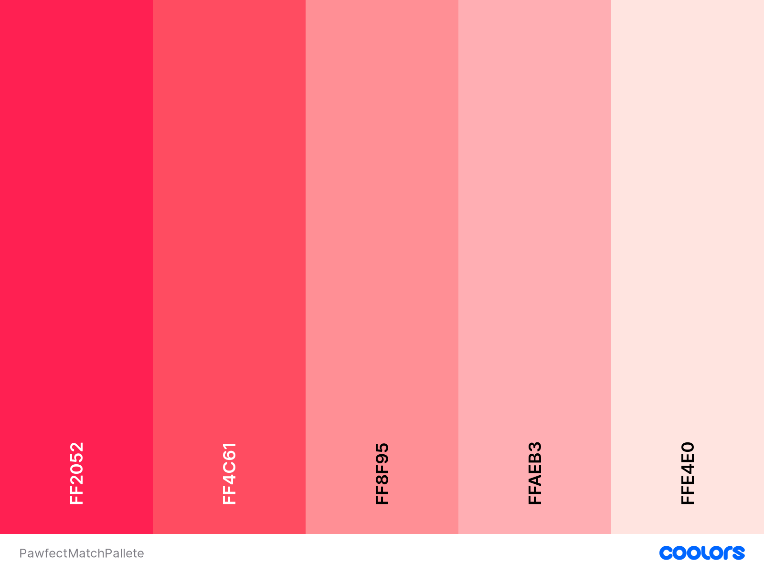
Website Design

Slide 9

Home Page Plan
Product Logo
Login Button
App Title
“PawfectMatch”
Banner w/ Background Image
App Summary
Payment Option Panel
Payment Options
Footer Panel

Slide 10
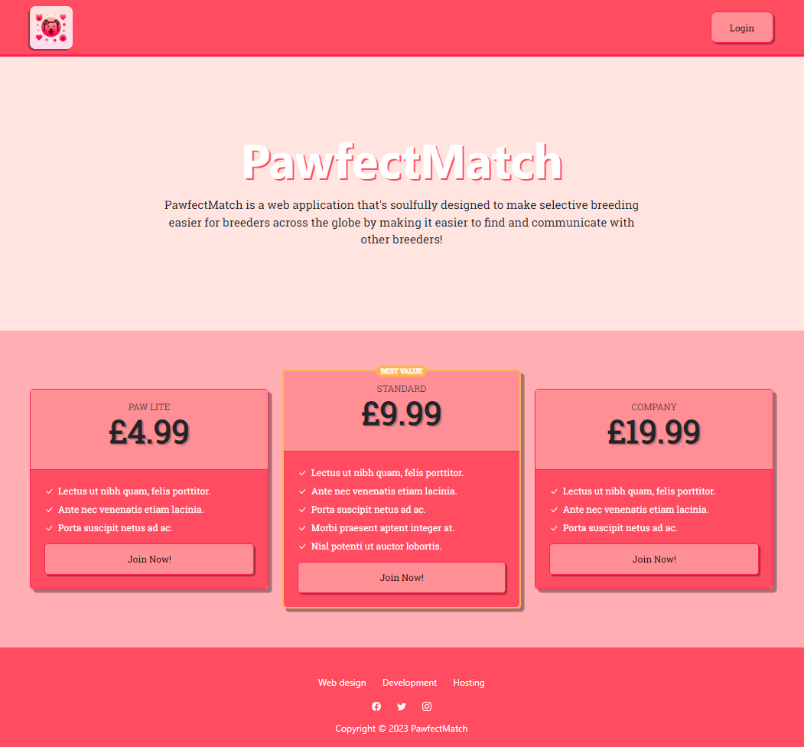
Home Page Skeleton

Slide 11
Planned Features
Account Creation
Animal Posting
User Messaging System
Report Animals/Users
Trust Factor System
Animal Ratings

Slide 12
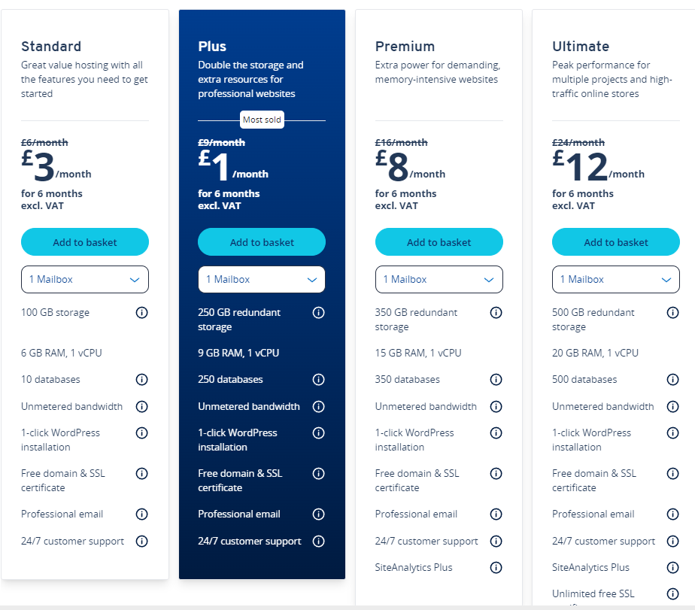
Web Hosting
We will be using IONOS!
Pricing is £12/month.
Suitable for our expected high traffic.
Is among the top 10 hosting services according to Forbes.
[https://www.forbes.com/advisor/business/software/best-web-hosting-services/]

Slide 13
Marketing
Josh’s Slides
- Our competitors
- How we differ from them
- How will we promote our product?

Slide 14

Our Competitors
(Image from https://worldanimalfoundation.org/dogs/cutest-dog-breeds/)
Breeding firms that offer services beyond a stud.
Kennel clubs who do the same but also offer the choice of adoption newborn or rescued animals.
Hobbyist breeders who mainly dabble in domesticated breeding.
Unethical breeders which are not condoned nor affiliated with any official partners and policies related to breeding and welfare of animals

Slide 15
How We Differ
We offer the privacy and independency between our partners through our monthly subscription based fees compared to breeding firms that offer the same service for £300.
Our system allows animals to breed in the domestic environment of their own home reducing the amount of stress, tension and anxiety the animal may feel.

Slide 16

How We Will Be Promoting Our Product
(Image from https://www.ncsc.gov.uk/guidance/social-media-how-to-use-it-safely)
Social media campaigns
Blog posts
Events (both virtual and in person)
Sponsorships

Slide 17

Finances
Harry’s Slides
Relevant financial analysis (e.g. break-even analysis, cost analysis, sales projects, cash-flow forecast)
How much start-up funding will be required? How will it be acquired? (e.g. savings? Grant? Investors?)
How will finances be managed?

Slide 18

Image From: (How to Minimize the Cost of Cash with the Right Retail Cash Management Solution (losspreventionmedia.com)
Labour/Staff
The starting salary for all 4 of us would be the following:
£10 per hour + 1,000 shares P/A + stock options
The shares P/A are the shares within the company and we all will be taking the same amount which will come to 25% shares for each of us.
The stock options will be equal to 3,000 in stock options each every month in which we all agreed on.

Slide 19

Company Cost
Registration of the company is £12
The software licensing we will use will be microsoft 365 business which comes to the prices of £10.30 per month

Slide 20

Equipment cost
The Equipment we will be using will be the following:
Laptops, which one laptop will cost £269 x 4 which in total will come to £1076
Company phone, we will have a company phone between us all which one phone will cost 149 so in total this will come to £596 for all of us to have a company phone

Slide 21
In App Costs
The In app costs will be as following:
App Hostings, will come to around £12 a month equalling to £144 per year
In app Subscriptions we are charging £4.99 a month for all using the app

Slide 22
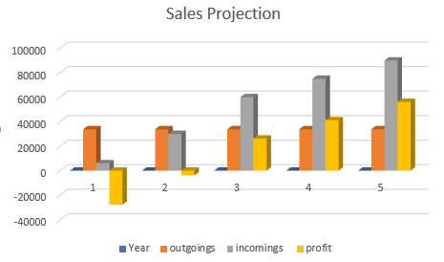
Pie Charts
1st Year

