Slide 1

LCHS4007
Digital Skills & Research Methods
Assessment 1
Lecturer: Anika Tahsin Ahmed
Shackeria Nash Korylco (2509257)
Natasha ferncombe (2512316)
Rajni devi (2508602)

Slide 2
CONTENT PAGE
TITLE PAGE
CONTENT PAGE
INTRODUCATION
WHAT IS EXCEL USED FOR
THE BENEFIT OF EXCEL
WHAT IS TEAMS USE FOR
THE BENEFIT OF TEAMS
THE LIMITATION OF EXCEL
THE LIMITATION OF TEAMS
IMPACT OF LIMITED DIGITAL SKILL USING EXCEL
IMPACT OF LIMITED DIGITAL SKILLS USING EXCEL
DIGITAL SAFETY PRACTICE
REFERENCES

Slide 3
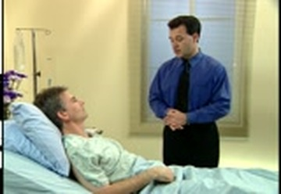
INTRODUCTION
Sunrise residential care(for older and dementia)
We plan to introduce digital tools to improve the quality and efficiency of care
The develop staff confident in using its fall range of application in Microsoft 365
Staff range from a team of nurse ,care worker admin team and visiting health professionals.
Discussing the benefits and limitations of using Microsoft 365
BING (N.D)
.

Slide 4
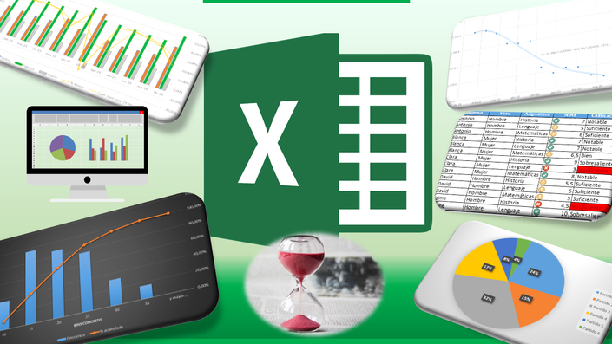
WHAT IS EXCEL?
Excel is a Microsoft feature for use of spread sheets.This allows us to organise calculate and analyze data using tables formats.
Excel is mainly used in businesses and was released in 1985 and was called Microsoft Multiplan. It can be used in all kinds of places from finance departments to health providers and marketing.

Slide 5

WHAT IS TEAMS?
Microsoft Teams is a soft wear for messaging, calling, video meetings and files sharing for businesses of all sizes. Teams has over 32 million users worldwide and over 8 million companies.
Microsoft teams increased dramatically during the Covid 19 outbreak in 2019 when social distensing was put into place, it became a vital tool in maintaining communication.
ThePhoto by PhotoAuthor is licensed under CCYYSA.

Slide 6

THE BENEFITS OF EXCEL!
DATA MANAGEMENT.
This can help with managing and organising patient data, care plans etc.
STAFF ROTAS
So all staff no when they are on shift.
MEDICATION LOGS
Keep track of all medication given times and dates.
INCIDENT REPORTS
Keep track of all incidents and injuries.
BUDGETING
budgets and managing costs.

Slide 7

BENEFITS OF TEAMS!
INSTANT COMMUNICATION.
All staff can communicate with each other.
SECURE MESSAGING.
All messages and patient data are kept safe.
VERTURAL DOCTORS APPOINTMENTS.
So patients that are not mobile can have their appointment.
STAFF MEETINGS.
Staff that are not on shift can still take part in meetings.
Bing (N.D)

Slide 8

EXCEL LIMITATIONS
We know excel provide us with many benefit ,but we should also be aware of its weakness by understanding them ,we can use more factitively in our work.
LIMITED NUMBER ACCURACY
In a care setting ,this could mean that when handling large sets of data ,such as patient Records or medication dosages, any inaccuracies could potentially lead to errors
Rounding errors
This can translate to small discrepancies in dosage calculations or financial records, potentially affecting patients care or budgeting
Not fully secure
In a residential care environment, data security is crucial, so excel 's vulnerability to editing means sensitive patient information could be at risk.
Complexity for new users
Staff who are not familiar with excel might find it inefficient or mistakes in managing care data
Performance issues with large data
When dealing with extensive records, like large number of residents or detailed medical histories ,excel might slow down even crash ,impacting workflow
-

Slide 9
Microsoft Teams limitations
:
Microsoft teams is a useful tool that helps team work together in one place. It is fast simple and keep everything organized. But to get the best results , it is important to know some of its limits and challenges.
Internet connectivity: poor internet can lead to slow loading times dropping calls, and difficulty accessing patient records or communication effectively.
Account limitations: family member or outside consultants using personal accounts cannot join shared channels, which reduces communication and collaboration
Recreating channels causes delays: this means that when shared channel are not copied over automatically, staff will have to set them up again from scratch. This extra effort can slow down workflows and add more work for team.
No email notifications: staff need to regularly check teams to stay update ,which could lead to missed important information if they don't keep an eye on it consistently
Audio and video issues: this can make online meeting ,staff discussions and talking to outside health professionals difficult.

Slide 10

Impact of limited digital skills using Excel
Limited digital skills using Excel can hinder career progression. This could result in errors accruing more frequently.
Lacking in digital skills can limit the care home from moving forward -reason why because technology is on the rise.
Staff may struggle with demands and tasks like data analysis which could lead to slowing down of the care for patients.
Staff may feel reluctant to take on new responsibilities which could lead to stress and lack in confidence.
It would be more likely tasked would be missed and incomplete staff feeling overwhelmed, overlooked and undermined.
Staff may potentially feel excluded and incompetent.

Slide 11

The impact of limited digital skills using Teams can lead to poor coordination could potentially increase the risk to patient.
Critical information may not be stored professionally which could lead to communication gaps and delay in care.
Lack of digital confidence using teams can hinder confidence or competence to carry out effective teamwork
Staff that have limited digital skills can decrease the ability for staff to focus and providing direct care which would be challenging.
They may feel a loss of control over care for the patient because they cannot effectively use digital tools to access information or to communicate their needs.
Staff may feel a sense of isolation, frustration, confusion and exclusion
Limited skills could lead to communication breakdown which can be a potential safety risk due to difficulties in sharing information regarding patient care. Microsoft teams meeting
Impact of limited digital skills using Teams
Better IT (2025) Picture of Teams

Slide 12

Digital safety practice
Practice that Sunrise Residential Care Home could use to create safety practice are;
Gijn (2013) Picture of digital safety
Strengths | Limitations
Creating strong passwords This should include unique passwords using mix up upper case and lower-case letters and also special symbols. Passwords should not be easy to remember and difficult to guess. | Passwords can be shared, guessed, or stolen, which means they aren't secure
Using a password manager Don’t use the same password across different accounts. Store and generate strong passwords. Report incidents | They could lose access to all of their passwords all at once Some password managers do not work correctly on all websites It doesn’t eliminate the need for other cybersecurity measure. Any suspicious emails
Updating software and devices Update software regularly and remove unrecognized IP address Using secure Wi-Fi networks Updating staff regarding new software and give training to staff regularly. Develop new digital safety training across the care home | Outdated software can become a gateway for these malicious actors, leading to data leaks, compromised personal information, and disrupted academic operations. Be aware of using unsecure networks

Slide 13
References.
The health information service
21st March 2022
Using Microsoft in Healthcare - The Health Informatics Service Website
How health professionals can use excel
11 Jan 2025 healthcarecourses.org.uk/articles.aspx?CourseTitle=Developing+Effective+Teamwork+in+Health+and+Social+Care+Settings&id=6779
What is Microsoft teams
Joel Khalili published 5 January 2022
What is Microsoft Teams? How it works, tips and tricks, and more | TechRadar

Slide 14
Reference
Microsoft team.(2025)limits and specification for Microsoft teams.[online]Available at :https//learn.microsoft.com/an-us/Microsoft teams/limits-specification-teams
(accessed:4october2025)
Whiteheart.(2023)data training insights. Institute of analytics- the global body for analytics Available at :http://ioaglobal.org/blog/(accessed:3october2025
Bing(2025).online picture[image].available at:[search on web](accessed:12oct 2025)

Slide 15
References
Aivedo (2023) Picture of elderly in a care home. Availble at https://www.aiveda.co.uk/service/residential-care/ (Accessed 2nd October 2025.)
Better IT (2025) https://better-it.uk/what-is-microsoft-teams/
Confidential information (2024) https://digital.nhs.uk/data-and-information/looking-after-information/data-security-and-information-governance/codes-of-practice-for-handling-information-in-health-and-care/a-guide-to-confidentiality-in-health-and-social-care/a-guide-to-confidentiality/rule-2 (Accessed 2nd October 2025)
Cons of using password manager (2025) https://www.passwordboss.com/pros-and-cons-of-using-a-password-manager/ (Accessed 2nd October 2025)
Digital technology in social care (2025) Avaible at: https://www.skillsforcare.org.uk/Support-for-leaders-and-managers/Managing-a-service/Digital-technology-and-social-care/Digital-technology-in-social-care.aspx (Accessed on 2nd October 2025)
Gijn (2013) Picture of digital safety. Available at https://gijn.org/resource/digital-security/
Information Security Office (2025) https://www.cmu.edu/iso/news/2025/the-dangers-of-not-updating-software.html (Accessed on the 2nd October 2025)
Impact of limited skills (2024). Available at: https://pmc.ncbi.nlm.nih.gov/articles/PMC12058752/ (Accessed on 2nd October (2025)
Limitation of using passwords (2025). Available at https://www.iproov.com/blog/forgotten-passwords-increasing-websites-abandonment-rate (
Accessed 2nd October 2025)
'In the current digital era, healthcare professionals and their leaders are expected to develop proficiency in digital literacy, data management, cybersecurity and ethnical consideration to harness the full potential of digital innovation (Jarva et al.,2023;Kontilla et.,2019)
'Digital skills needs to be situated within a clear pay and progression framework! And are undermined by limited career progression for care workers' As noted by (Ounget Al, 2021)
The concept of digital skills is also argued to be 'fuzzy' as it is used in ways that overlap with related concepts, such as digital competencies, capabilities and literacies'. (Kispeter, E 2018)
'Employers can enable workers to better use their existing skills to improve performance, through creating an environment that provides opportunities to learn and use digital skills and motivates workers (Warhurst and Luchinskaya, 2018)

