Slide 1
Trauma-Informed Approaches:
Historical Context and Modern Application

Slide 2
Contents Page
Development of trauma understanding
The evolution of trauma treatments
Principles of trauma care
Exploration of application of informed trauma approaches

Slide 3
Lesson Objectives
Identify significant events that has contributed towards the development of trauma-informed approaches
1
Explain the principles of trauma-informed care
2
Apply trauma informed principles and methods in practice
3
Compare and contrast methods
4
Evaluate literature on trauma-informed practice
5

Slide 4

Recap from Last Week
Activity: Formative Assessment

Slide 5
Trauma: Reminder
“Trauma refers to single or multiple events that are experienced as harmful or life-threatening and that have lasting impacts on mental, physical, emotional, and/or social well-being well into adulthood” (cited in Wallace, 2020, p.1)

Slide 6
Trauma-informed approach (TIA) and Trauma-informed Care (TIC) are terms used interchangeably.
TIA and TIC do not have a universally accepted definition
“a system development model that is grounded in and directed by a complete understanding of how trauma exposure affects service user’s neurological, biological, psychological and social development” (Paterson, 2014, cited in Wallace, 2020, p.2)
Notes:
Trauma-Informed Approach (TIA) is an approach in health and social care that acknowledges the widespread impact of trauma and understands potential paths for recovery.
The practice focuses on understanding, recognising and responding to the effects of trauma and emphasises creating a safe environment to address but to also avoid re-traumatising individuals.

Slide 7

“Innovation in medicine has often been produced by major crises” (Linden et al, 2013).

Slide 8
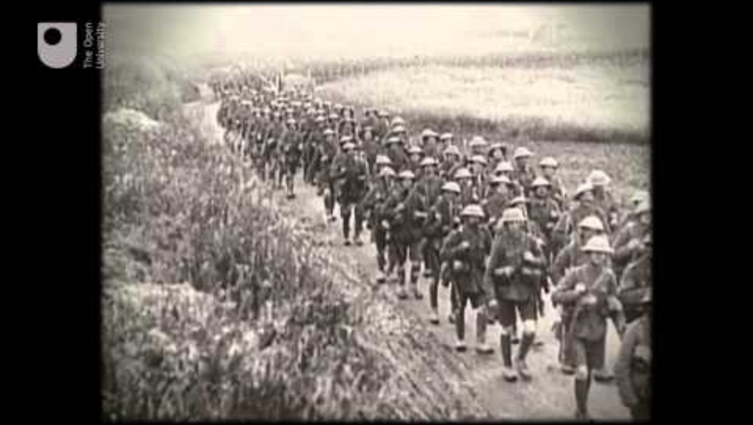
Historical context of trauma-informed approaches: Pre-1980s
There was limited understanding about trauma, its long-term impact, and correlation to mental health.
Early treatments from WWI that address shellshock (Trauma) included:
Electric Shock Therapy
Hypnosis
Task Oriented

Slide 9
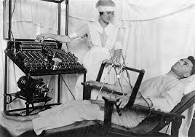
Electrotherapeutic Therapy
Lewis Yealland was a pioneer within the neurological community.
Hysterical disorders of warfare was published in 1918 detailing 44 cases (treated over 196 patients).
Particularly interested in paralysis and loss of speech
Applied weak electrical stimulation directly to the scalp overlying the motor cortex.
Only 7% of treated soldiers returned to active duty

Slide 10

WWII Period
During WWII the term “shellshock” was replaced with “combat or battle exhaustion. ents changed.
Lessons were learned from WWI and treatments were used not in isolation, and Narcotherapy was introduced, which involved:
Using Pentothal ‘truth serum’, soldiers would recount the traumatic experience, and a psychiatrist would use guided questions.

Slide 11

Narcotherapy
Ethically considerations around early treatments remained controversial.
No controlled studies were reported.
It involved the administration of a barbiturate and a stimulant (intravenously).
A state of sedative allowed for soldiers to speak about their experiences

Slide 12
1950-1980’s
The Vietnam War was a controversial war and spanned over decades.
Post- Vietnam, soldiers were not received home with open arms.
Stigma surrounding mental health issues increased: “post-Vietnam syndrome”.
Ill-treated and many benefits were not provided as promised.
Estimated 700,000 Vietnam veterans (25%) required some form of psychological care for the delayed effects of combat exposure (cited in Reisman, 2016) .
Notes:
Stigma around mental health increased due to the lack of credible and accurate information which was difficult to share due to the lack of modern technologies that are applied today to share and inform the public (no email, internet, social media etc.).
Stereotypes were becoming increasingly prevalent (Weak, Permanently debilitated, dangerous, mental health shouldn’t be shared)
People with ill-mental health were often socially isolated.
People who exhibited ill-mental health symptoms were often discriminated against.
People were also institutionalised and often remained in treatment centres for the rest of their lives.
During this period TV shows such as M.A.S.H, which were consider popular, were addressing mental health by providing the general public a first insight of mental health through story telling.

Slide 13
1980-early 2000s
In 1952, the American Psychiatric Association (APA) produced the first Diagnostic and Statistical Manual of Mental Disorders (DSM-I)
Post-Traumatic Stress Disorder (PTSD) replaced all previous terms applied.
PTSD, has traditionally been associated with war and combat
In 1980, PTSD was officially added to the DSMIII

Slide 14
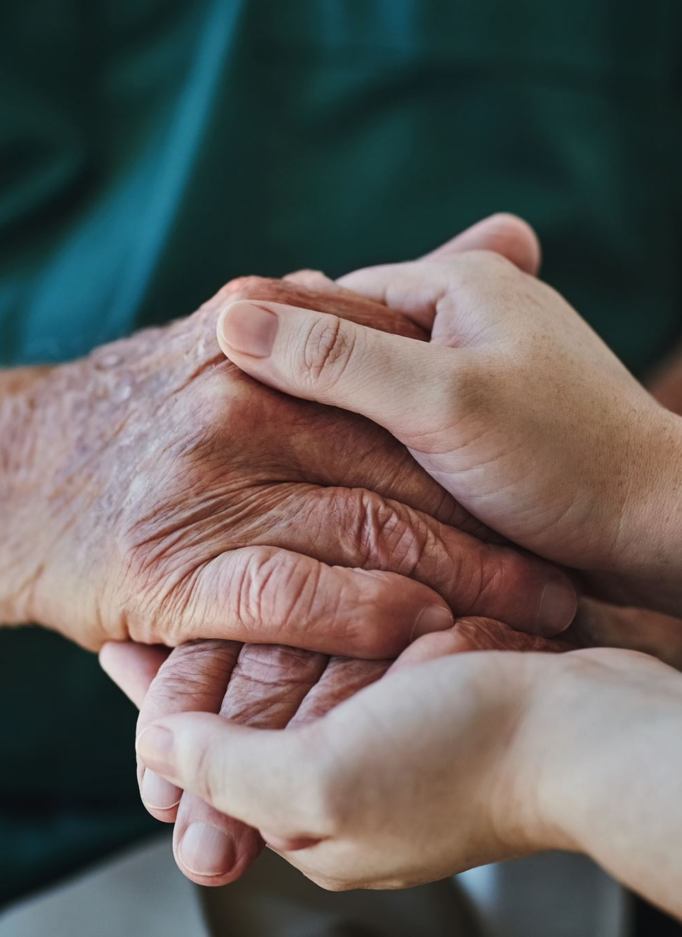
Shift from Traditional Care to Trauma-Informed Care
Traditionally, interventions could be argued as reactive that:
Treats symptoms rather than causes.
May inadvertently re-traumatise individuals by ignoring trauma history.
Informed-Trauma is now considered as proactive:
Aims to understand trauma’s root causes and impacts.
Builds on trust, empathy, and understanding.
Holistic approach to healing and support.

Slide 15
Core Principles of Trauma-Informed Care
Six foundational principles guide trauma-informed practices:
Establishing a safe environment.
Developing trustworthiness and transparency.
Offering systems of peer support.
Promoting collaboration and mutuality between staff and participants.
Supporting the empowerment, voice, and choice of survivors.
Attending to cultural, gender, and historical issues (Wallace, 2020)

Slide 16
Principle 1: Establishing Safe Environment
The physical, psychological and emotional safety of service users and staff is prioritised:
People knowing they are safe or asking what they need to feel safe
Provide reasonable freedom from threat or harm
Attempting to prevent re-traumatisation
Implementing policies, practices and safeguarding arrangements in place
(Office for Health Improvements and Disparities, 2022)

Slide 17

Principle 2: Trustworthiness and Transparency
Reflected in policies with the intention to objectively build trust between staff and service users.
Organisation and staff explain what they are doing and why
Organisation and staff doing what they say they will do
Expectations being made clear and the organisation and staff not overpromising

Slide 18

Principle 3: Choice
“Service users are supported in shared decision-making, choice and goal setting to determine the plan of action they need to heal and move forward”:
Service users and staff have a voice in the decision-making process
Listening to the needs and wishes of service users and staff
Explaining choices clearly and transparently
Acknowledging that people who have experienced or are experiencing trauma may feel a lack of safety or control over the course of their life.

Slide 19

Principle 4: Promoting collaboration
“The value of staff and service user experience is recognised in overcoming challenges and improving the system as a whole”:
Using formal and informal peer support and mutual self-help
Organisation ask service users and staff what they need and collaboratively considering how these needs can be met
Actively involving service users in the delivery of services

Slide 20

Principle 5:Empowerment
Efforts are made to share power and give service users and staff a strong voice in decision-making:
Validate feelings and concerns of staff and service users
Listen to what a person wants and needs
Support people to make decisions and take action
Acknowledge that people who have experienced or are experiencing trauma may feel powerless to control what happens to them,

Slide 21

Principle 6: Cultural Considerations
Move past cultural stereotypes and biases based on (Gender, sexual orientation, age, religion, disability, geography, race or ethnicity:
1
Offer access to gender responsive services
2
Leverage the healing value of traditional cultural connections
3
Incorporate policies, protocols and processes that are responsive to the needs of individuals served
4

Slide 22

Activity
Using the 6 principles, you are going to work in pairs to explore the difficulties and necessities of each principle.
Please see activity document (within week 4 of teaching materials)

Slide 23

PACE
Dr Dan Hughes created PACE as part of attachment-focused family therapy to support adults to build safe, trusting and meaningful relationships with children and young people who have experienced trauma.
P=Playfulness
A=Acceptance
C= Curiosity
E= Empathy
Notes:
The approach focuses on building trusting relationships, emotional connections, containment of emotions and a sense of security

Slide 24
The intentions of PACE
To build trusting relationships, emotional relationships, containment of emotions and security.
It is way of communicating, thinking, feeling and behaviour.
It should not be used as a linear process (step-by-step)

Slide 25
Applying PACE
Using PACE helps adults to:
Slow down reactions
Stay calm
Tune into what the child is experiencing
Understanding a child’s feelings.
Emotionally regulate and guide a child during heightened emotions

Slide 26

Playfulness
Sometimes children give up on the idea of fun/enjoyment and reject affection. Playfulness can:
Allow closeness without being scared
Reassure children their conflict and separation are temporary
Strengthen their relationship and not harm it.

Slide 27
Howe to incorporate playfulness
Use a light tone of voice (story telling)
01
Be conscious of body language (soft facial expressions)
02
Incorporate games and role play to encourage social interactions
03

Slide 28
Acceptance
Acceptance communicates that that the child’s inner life is safe with you.
Demonstrate interest rather not judge or evaluate
A child’s inner life is not right or wrong!
Accepting a child’s intentions does not imply accepting behaviour.

Slide 29
Acceptance
Through acceptance, it is hoped that:
The child becomes aware that the behaviour is criticised and not themselves
Becomes confident and discipline focuses on behaviour
It does not impact the relationship with adults and their self-worth

Slide 30
Applying Acceptance
“I can see how you feel this is unfair. You wanted to play longer”
“You probably think that I don’t care about what you want”
“You were letting me know that you were really scared when you ran
away from me”
“I can hear you saying that you hate me and you’re feeling really cross.
I’ll still be here for you after you calm down”.
“I’m disappointed by what you did, but I know you were really upset. It
doesn’t change how much I care about you”

Slide 31
Curiosity
Children often know the difference between right and wrong and that their behaviour is not appropriate.
Children are more reluctant to explain their actions
Curiosity supports children to reflection and become increasingly aware of their inner self.

Slide 32
Curiosity
Process of discovering meaning behind the behaviour
Adults convey their intentions to simply understand why
Adults' intentions should be to just to understand
It not about lecturing.
Supports the child in understand that their inner life is not bad!
Does doing something bad make them a bad person?

Slide 33
Applying Curiosity
“I’m wondering if you broke the toy because you were feeling angry.”
“I’m thinking you’re a little nervous about going back to school today, and that’s why you don’t want to get ready this morning”.
“I’ve noticed that you’ve been using a really loud voice, and if you’re trying to tell me that you’re angry with me.”
“I’m a little confused. Usually, you love going for a walk, but today you don’t want to go. I’m wondering what’s different about today”.
“When she couldn’t play with you today, I’m wondering if you thought that meant she doesn’t like you.”

Slide 34
Sentence Starters
I wonder if….
Could it be…?
I am trying to imagine….
Can you help me understand…?
Tell me if I’m getting this wrong…
It sounds like you might really be struggling with…
Is there a part of you that…
As you were talking I was starting to think that maybe…
Does this make any sense…?

Slide 35
Empathy
Actively demonstrate that their inner life is important
Adults should demonstrate acknowledgement of how a child is feeling
Supporting a child through their journey
Adults should communicate strength, love and commitment.
Having compassion is paramount.

Slide 36
Applying Empathy
“You are SO upset about this right now. That must be really hard!”
“It hurt so much when she didn’t ask you to play. You were probably
thinking ‘Why did she do that?’ It was a real shock for you.”
“You wanted to have another turn so badly. You were so excited about it
and it’s so unfair that we ran out of time”.
“It seems to you like he hates you. That must be really hard. I know you
like him a lot, so this is pretty confusing”.
“I know it’s hard for you to hear what I’m saying.”
“Me saying ‘No’ has made you angry with me. I get why you don’t want
to talk to me right now”.

Slide 37
Sentence Starters
It sounds like it’s been really tough…
You have had lots of tricky times…
I am so sorry it’s been so hard for you…
I can’t even imagine how that was for you…
I really want to hear how it’s been for you…
That must have been so painful…
I think you are saying….
I think I get it…..
That makes real sense for me…
I think I am starting to understand now…..
I think you might be letting me know that….
If you had words for those feelings, I wonder what they would be….
Let’s make sure I’ve got that right….

Slide 38
PACE Example
Emily asks Mum if she can play on the swings. Mum says she can’t as they need to be home soon. Emily gets very upset and angry and starts yelling “that’s so unfair, I hate you. You’re horrible!!!!”
What is the typical response here?
Notes:
Typical responses include:
Emily, don’t be rude.
Life’s unfair
I am not horrible, and you don’t hate met

Slide 39
PACE Response:
“OH WOW [in an animated voice], you’re feeling REALLY ANGRY [with a concerned expression]....you think I’m being mean by not letting you go on the swings when you really want to go...I’m saying no and you really want to go and that feels rubbish...it’s so frustrating when someone says we can’t do something that we want to do!”

Slide 40
Give it ago
How would you respond to this situation?
Dad picks up Tom from school in the car. When Tom gets in the car, he asks him about his day. Tom has a really angry look on his face, swears at his dad, kicks the back of the seat and says “Shut up!”

Slide 41
CARE Model
Children and Residential Experiences (CARE) concentrates on undertaking a full system approach organizational cultural change for creating trauma in-formed environments.
Six principles:
Developmentally focused
Family involved
Relationship based
Competence centred
Trauma informed
Ecologically orientated

Slide 42
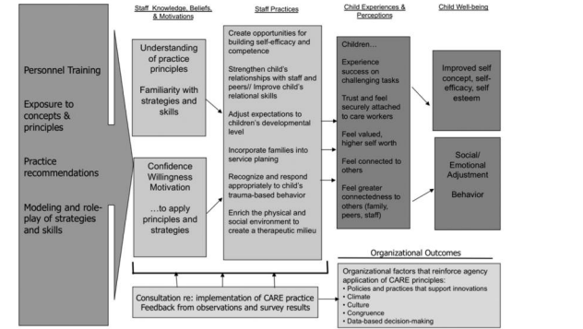

Slide 43
ARC Model
The Attachment, Regulation and Competency (ARC) Model focuses on supporting, children, adolescents and adolescents, and foster caregivers.
Strengthening the caregiving system surrounding children:
Enhancing supports
Skills
Relational resources for adult caregivers.

Slide 44
ARC model Development
Normative childhood development
Traumatic Stress
Attachment
Risk and Resilience

Slide 45
Sanctuary Model
Developed in the 90’s by Sandra Bloom, the sanctuary model concentrates on:
Creating organizations and cultural change for universal and structured training to define problems within trauma
Understand toxic stress
Collaboration
Creating non-violent and therapeutic communities
(Cited in Wallace, 2020)

Slide 46
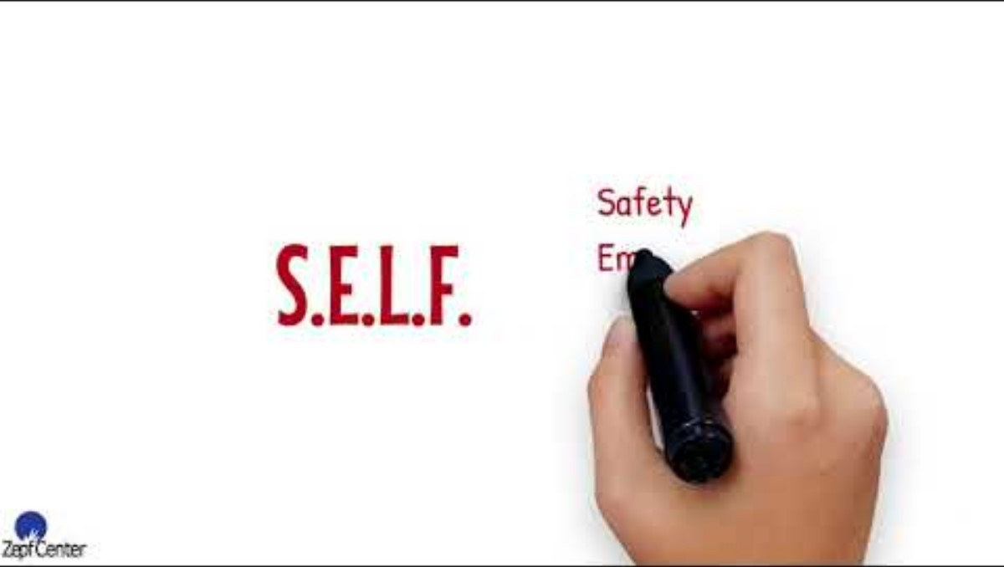
Sanctuary Model

Slide 47
Sanctuary Model: Challenges
Despite being benefits, there are some shortfalls. Firstly, implementation in organizations has been reported. Galvin et al (2021) examined the barriers and organizational implementation of the Sanctuary Model.
Lack of practice-based
Refresher training
insufficient resources
Lack of understanding about the model

Slide 48
Cognitive Behavioural Therapy
CBT Concentrates on the relationship between thoughts, feelings and behaviours.
Typical treatment is delivered over 12-16 sessions
Can be conducted either individually or collectively

Slide 49

How does CBT work?

Slide 50
How does CBT Work
Identifying problems
Understanding thought patterns
Changing behaviour
Structured approach (goal oriented)
Focus on the present
Collaborative effort

Slide 51
CBT and Trauma (PTSD)
Kar (2011) conducted a review that evaluated CBT for those who experience PTSD and paid particular attention to long-term outcomes. The review explored several traumatic experiences:
Terrorism
War
Sexual assault
Road traffic accidents
Refugee status
Disaster workers
Natural disasters
Notes:
Review comprised of 192 articles, of which 31 randomized control trials were reviewed .

Slide 52
Findings
CBT is an effective treatment protocol for those with acute and chronic PTSD.
Evidence of short-term and long-term benefits
CBT recognized as permeative measure
Positive impact on children and young people

Slide 53
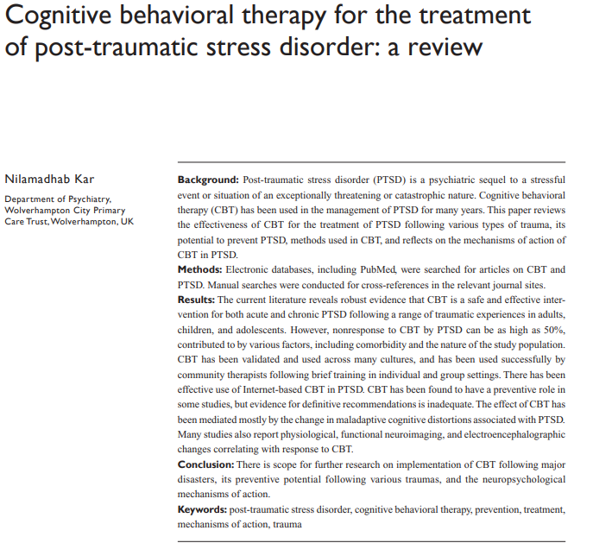
Critique the article

Slide 54
Prolonged Exposure Therapy
An intervention applied within CBT.
Encourages people gradually approach their trauma (memories, feelings and experiences)
Avoidance reinforces fear
Facing their trauma can reduce symptoms of PTSD

Slide 55
Using Prolonged Exposure Therapy
Typically provided over 3 weeks (8-15 sessions)
Sessions conducted over 90 minuets
Understanding is the first stage of treatment
An assessment is conducted
Introduction of techniques introduced

Slide 56
Imaginal Exposure
Describing the event in detail in the present tense
Address the emotions connected
Session recorded so individual and listen back to help to process emotions and practice breathing techniques

Slide 57
In Vivo exposure
Confronting feared stimuli outside of session (“homework”)
Collaborative effort to identify stimuli and situations associated with traumatic fear.
Agreement must be made to avoid distress and harm
Patient encouraged to challenge themselves

Slide 58
Benefits of Trauma-Informed Approaches
Reduced re-traumatization.
Improved client engagement and outcomes.
Greater job satisfaction for service providers.
Strengthened communities and systems of care.

Slide 59
Reference List
Wallace, C. (2020) An overview of Trauma-Informed Approaches (TIA). Cardiff: Cardiff University.
Reisman M. (2016) PTSD Treatment for Veterans: What's Working, What's New, and What's Next. P T. 2016 Oct;41(10):623-634. PMID: 27757001; PMCID: PMC5047000
Linden SC, Jones E, Lees AJ. (2013) Shell shock at Queen Square: Lewis Yealland 100 years on. 136(6):1976-88. doi: 10.1093/brain/aws331.
(Office for Health Improvements and Disparities (2022) Working definition of trauma-informed practice. [Online] Available at: https://www.gov.uk/government/publications/working-definition-of-trauma-informed-practice/working-definition-of-trauma-informed-practice. Accessed 16th September 2024
Kar N. (2011) Cognitive behavioural therapy for the treatment of post-traumatic stress disorder: a review. Neuropsychiatry Disorder Treatment. 2011;7:167-81. doi: 10.2147/NDT.S10389

