Slide 1
Learning &
Collaboration for
Global Citizenship
(BMSP 4003)
Assignment 1 – Contribution to Sustainability
Lauren Emily Price
Student No: 1807244

Slide 2
“Never doubt that a small group of thoughtful committed citizens can change the world; indeed, it’s the only thing that ever has” – Margaret Mead
Notes:
Using the above quote by Margaret Mead as a basis for my research, I will firstly explain what is meant by sustainability and how a particular organisation has changed the world positively to make a more sustainable future.

Slide 3
What Is Sustainability?
“Sustainable development is development that meets the needs of the present without compromising the ability of future generations to meet their own needs" (Brundtland; 1987)
The definition of “sustainability” is the study of how natural systems function, remain diverse and produce everything it needs for the ecology to remain in balance.
It also refers to the need to develop the sustainable models necessary for both the human race and planet Earth to survive.
The World Summit on Social Development in 2005 highlighted three primary areas that contribute to the philosophy and social science of sustainable development.
Notes:
The United Nation’s 1987 Report of the World Commission on Environment and Development: Our Common Future noted that sustainable development meets the needs of the present without compromising the well-being of future generations.

Slide 4

These Three Focus Areas Comprise: -
Economic Development
Social Development
Environmental Protection
Notes:
Economic Development – This refers to how sustainability will affect businesses including jobs and employment. It also highlights the requirement for providing businesses and organisations with incentives in order that they follow guidelines on sustainability which would fall beyond their normal legislative provisos. It is about giving people what they want but without compromising their quality of life.
Social Development – This focuses on the legislation and protection of the health of people from pollution and other harmful activities from businesses and other organisations. There are robust legislations in place in areas of the world such as North America, Europe and the rest of the developed world to ensure that the health and wellness of people is protected. It is about ensuring that access to basic resources is available without compromising quality of life. It is also about education and how important it is to encourage people to get involved environmental sustainability and educating them in this subject.
Environmental Protection – This refers to the future of humanity and the need to protect the environment by means of recycling, reducing power consumption or using alternative methods of transport including bicycles or walking for example. Environmental Protection illustrates the methods of how we should study and protect the planet’s ecosystems, air quality and the integrity and sustainability of resources. It focuses on the factors that that place pressure on the environment. Another aspect covered is how technology will have an impact on creating a greener future, it is recognised that the key to sustainability is the advancement of technology and biotechnology. It is important to protect the future from potential damage that technology advances could cause.

Slide 5
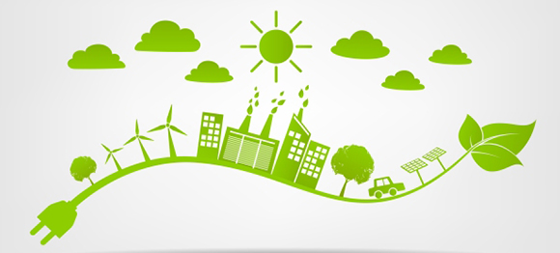
How Do We Create A Sustainable Future?
It is unclear what the future holds in terms of creating a sustainable future but as individuals, we are far more aware of the issues that threaten our health and that of our planet.
Many people are now looking towards a greener future – including businesses.
Not all businesses are willing to change – an organisation that has made headlines by pushing global companies to change their actions is Greenpeace.
Notes:
Businesses are beginning to focus on their Corporate Social Responsibility (CSR) and the way in which they can operate in a more ethical and sustainable way and how they deal with environmental and social impacts.
Greenpeace know that large companies and organisations have the ability and the power to make big changes that can have a positive effect on the future to our planet.

Slide 6
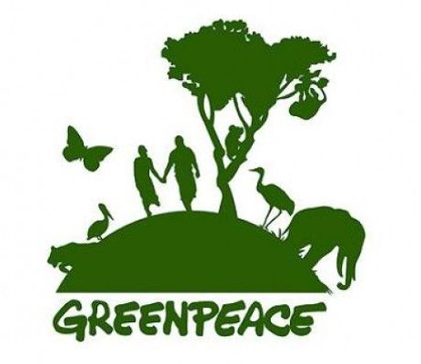
Who is Greenpeace?
'Greenpeace is an independent organisation campaigning to ensure a peaceful and sustainable world for future generations'
(Greenpeace; 2018)

Slide 7
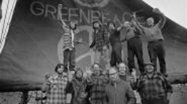
Where It All Began....
Dreaming of a green and peaceful world, a small team of activists set sail on an old fishing boat in 1971. They travelled to Amchitka, a small island off the West Coast of Alaska.
Amchitka was home to a multitude of wildlife, some endangered.
Here, they would 'bare witness' to US Nuclear testing.
Their boat was intercepted before they could reach the island and although the US still detonated the bomb, their mission had sparked a great deal of public interest.
The voice of reason had been heard.
Nuclear testing ended in Amchitka that year and the island was later declared a bird sanctuary.
(Greenpeace; 2018)
Notes:
A small team of activists set sail on an old fishing boat back in 1971 holding on to a belief that even just a few individuals could make a big difference. Spurred on by their vision of a green and peaceful world, they travelled to a small island off the West Coast of Alaska known as Amchitka where at least 3000 endangered sea otters, bald eagles, peregrine falcons and an abundance of other wildlife had taken refuge.
It was also here where they would 'bare witness' to US nuclear testing.
Their boat was intercepted before it could reach Amchitka and although the US still detonated the bomb, the voice of reason had been heard and this sparked a great deal of public interest.
Nuclear testing ended at Amchitka that same year and the island was later declared a bird sanctuary.
It was a victory.
Photo: - Crew of the Phyllis Cormack on the first Greenpeace voyage (Vancouver to Amchitka) in 1971.

Slide 8
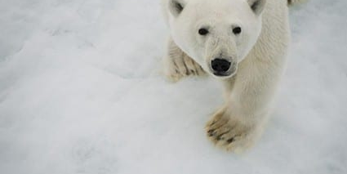
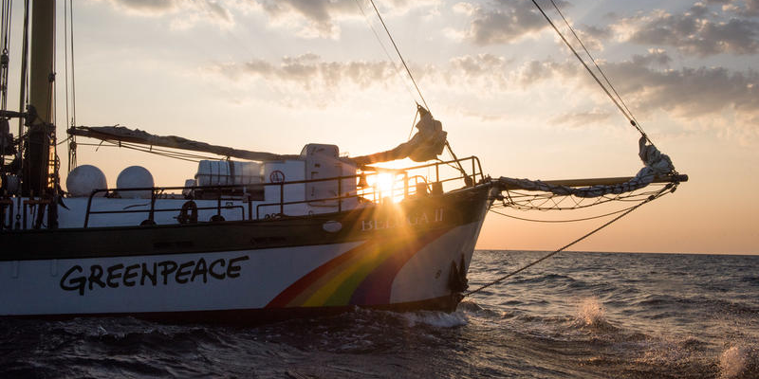
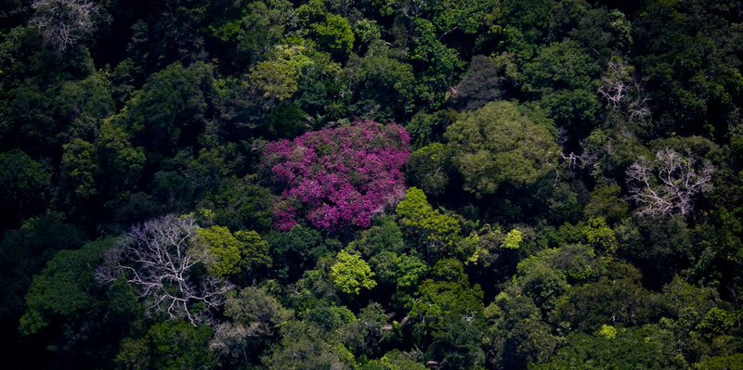

What Do They Do?
Greenpeace defend the natural world and promote peace by investigating, exposing and confronting environmental abuse, and championing responsible solutions for our fragile environment.
THEIR CAMPAIGNS
Fighting Global Warming
Protecting Our Oceans
Protecting Forests
Notes:
Global Warming – People all over the world are finally waking up to this very real threat and are working hard to reduce the use of fossil fuels, stop rainforest destruction and get power from clean energy. They are campaiging for a clean energy future.
Protecting Our Oceans - Our oceans are home to around 80% of life on Earth but they are being destroyed by destructive fishing, pollution and climate change. Greenpeace are campaigning for marine reserves, and for an end to unsustainable fishing. They are also campaigning to end the flow of plastic into our oceans as at present an estimated 12.7 million tonnes of plastic end up in our oceans each year – that's a truck load of rubbish every minute.
Protecting Forests - Greenpeace is working to end deforestation, and to protect the rights of the indigenous peoples and species that depend on them. Their current campaign, which is receiving a lot of media attention, focuses on demanding big companies to get dirty palm oil out of their products. 25 orangutans are lost every day as their forest homes are destroyed to clear the way for palm oil.
Lets take a closer look at one or two of their current campaigns: -

Slide 9
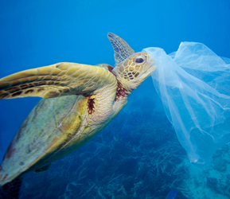
Plastics
Greenpeace is campaigning to end the flow of plastic into our oceans.
An estimated 12.7 million tonnes of plastic end up in our oceans each year
UK supermarkets alone are currently generating 800,000 tonnes of plastic packaging every year.
Greenpeace is calling on big corporations to cut down on plastic, and for governments to take action to tackle the problem.
Notes:
Plastic waste is turning up in every corner of our planet from places such as the Cornwall Coast to uninhabited Islands in the Pacific. It has even been found trapped in ice in the Arctic. The effects that this is having on ocean life is truly devastating. Turtles and seabirds are choking and getting themselves tangled in larger pieces of plastic and smaller pieces of plastic is clogging the stomachs of creatures who mistake it for food. Plastic is entering every level of the ocean food chain and is even ending up in the seafood on our plates.

Slide 10
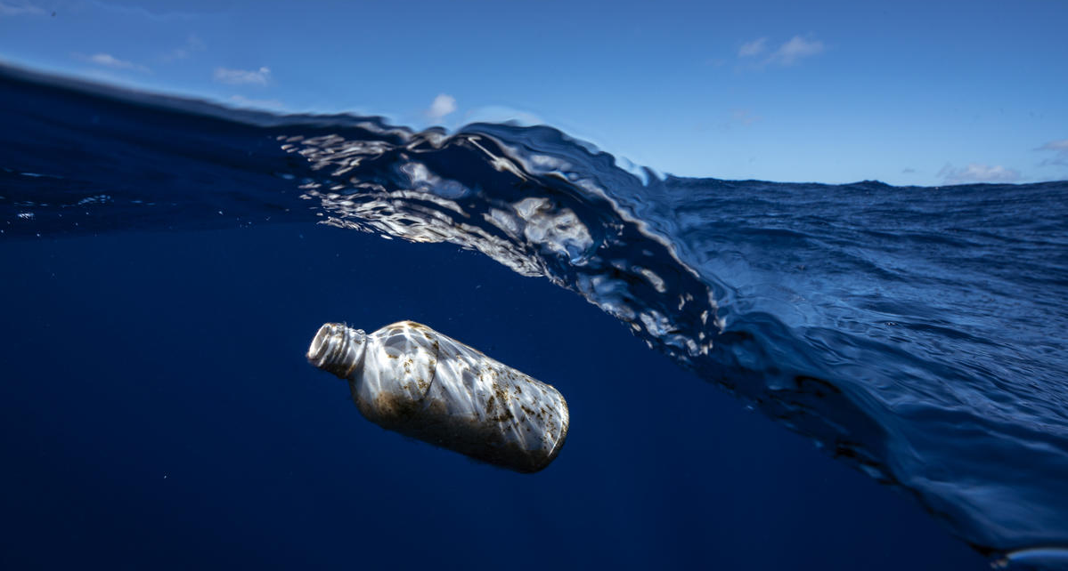
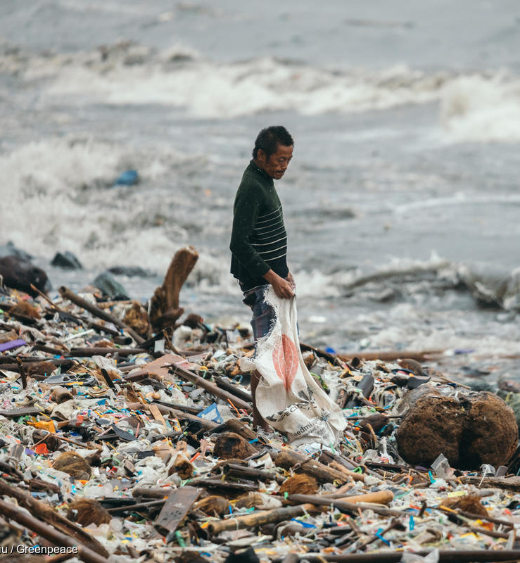
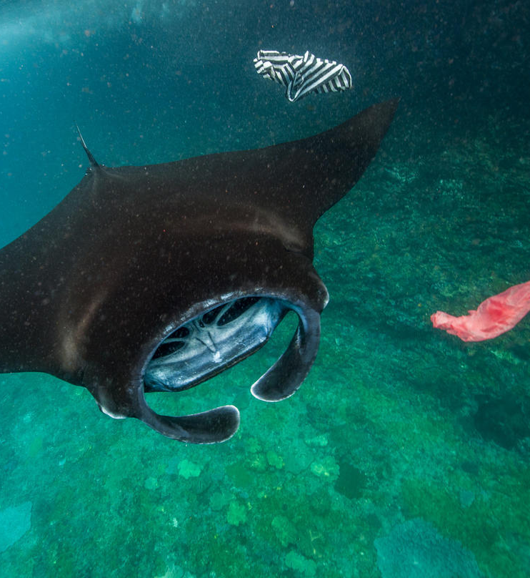
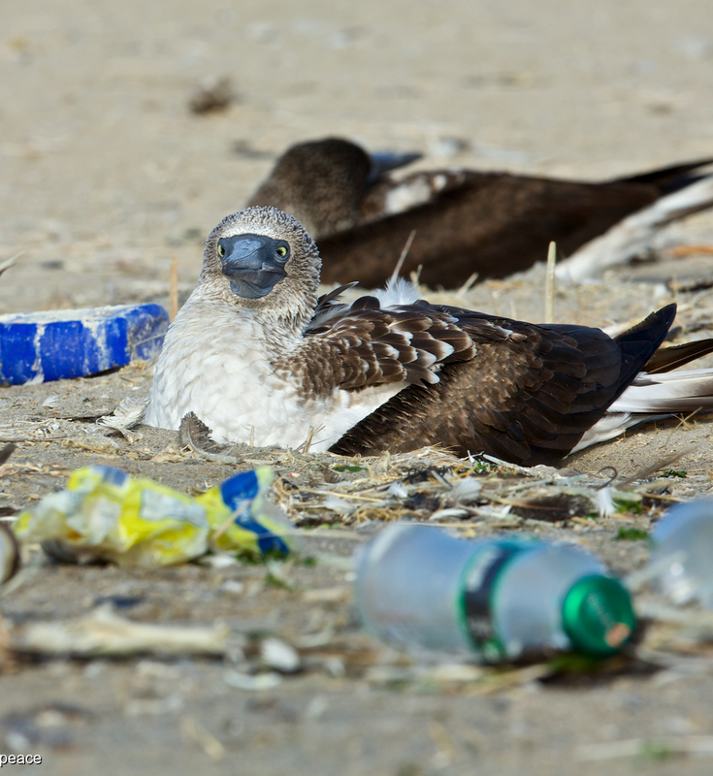
Notes:
Greenpeace are calling on big corporations to reduce their plastic footprint and stop producing excessive plastic packaging that is designed to be used once then thrown away. They are also calling on governments to tackle this problem, by creating closed loop systems that allow us to recover and reuse materials rather than waste them.

Slide 11
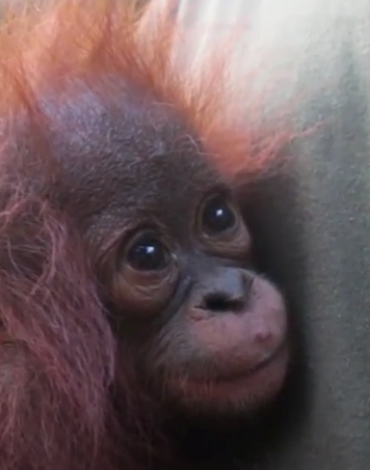
"Theres A Human In My Forest...."
What is Palm Oil?
A type of vegetable oil that comes from Palm Oil Trees, mostly grown on plantations. The oil is found in almost half the products in the UK supermarkets.
What is 'Dirty' Palm Oil?
When huge areas of rainforests are torn down by bulldozers or burned to make way for palm oil plantations.
Notes:
Palm oil is a type of vegetable oil that comes from palm oil trees that are mostly grown on plantations in Indonesia and Malaysia. Their oil is found in almost half the products in UK supermarkets such as chocolate, shampoo, soap, lipstick and margarine.
Dirty Palm Oil is when huge areas of rainforests are torn down by bulldozers or burned to the ground to make way for palm oil plantations. In Indonesia alone, an area the size of a football pitch is lost every 25 seconds. When these forests are destroyed, local people lose their homes and animals such as orangutans are put in danger. In fact, 25 orangutans are lost every day as their forest homes are destroyed to clear the way for palm oil.

Slide 12
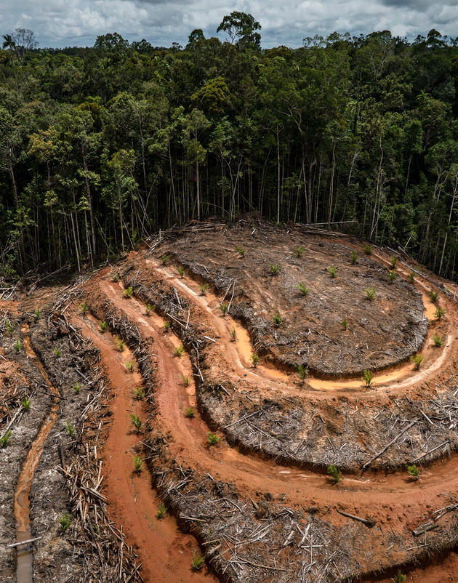
What Is Greenpeace Doing To Stop Dirty Palm Oil?
During the past decade, Greenpeace have persuaded companies including Nestlé, Unilever and Mars to sign global commitments to drop dirty palm oil from their products.
Greenpeace is demanding big companies to keep their promises to get dirty palm oil out of the products we use.
Notes:
In the past decade, Greenpeace have persuaded companies including Nestlé, Unilever and Mars to sign global commitments to drop dirty palm oil in their products.
Greenpeace is demanding big companies keep their promises to get dirty palm oil out of the products you use.
Palm oil is in 50% of supermarket products – such as Kit-Kat, Colgate toothpaste, Johnson’s baby lotion, Dove’s soap, Doritos, Kellogg’s Pop Tarts, Ritz crackers, M&M’s, Head & Shoulders shampoo, and so many others. These companies buy their palm oil from Wilmar – the dirtiest palm oil giant in the world – fuelling destruction, forest fires and human rights abuses across Indonesia.
Palm oil does not have to come from rainforest destruction. Palm oil production is actually really land efficient, however, traders like Wilmar are working with companies destroying new areas of rainforest to grow it.
But Wilmar won’t change until big companies stop buying its dirty palm oil – and that‘s why Greenpeace are calling on these companies to drop Wilmar.

Slide 13
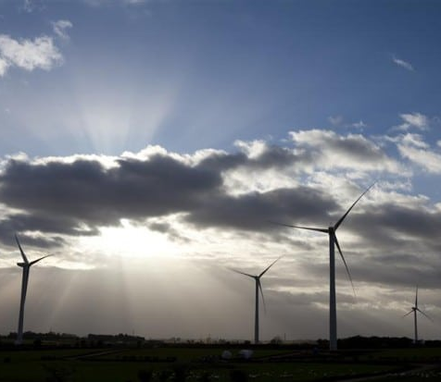
Climate Change
Greenpeace is campaigning for a clean energy future.
Clean Energy includes energy sources that come from the Earth's natural resources – Sunlight, Wind, Waves, Tides and Geothermal Heat.
Two major advantages -
1. It will never run out
2. It does not pollute the planet
Notes:
One of the many ways Greenpeace is fighting climate change is by campaigning for a clean energy future.
Sunlight, wind, waves, tides and geothermal heat are all examples of clean energy that come from the Earth's natural resources.
Clean energy has two great advantages:
1. It will never run out – unlike oil, coal and gas for example.
2. It does not pollute the planet
Clean energy already meets around a quarter of electricity demand in the UK and that figure could rise dramatically which in turn would help cut emissions and create jobs, but only with the right investment could this happen.
Greenpeace campaigning hard to make this happen, and to finally put clean energy where it belongs – at the very heart of our energy system.
(Greenpeace; 2018)

Slide 14
Greenpeace Is Changing The World
“The modern society of consumerism and rampant ‘development’ is destroying our world” (Greentumble; 2016).
Our economic and social system requires that we consume more than we need; we buy more than we want; we dispose of things rather than repair them.
On this ever-changing planet we live on, humans will always want more. Greed is an understandable social inevitability.
We live in a world that continually promotes greed because manufacturers and producers require us to be greedy; so we consume more.
Greenpeace is the definition of sustainability. They are fighting to create a sustainable world for future generations. They promote responsible solutions for our fragile environment.
Because humans by nature, consume and destroy – Greenpeace is always going to be fighting. Every time they look to solve a problem, we will inevitably create a new one.

Slide 15
References
Barre, D. (2014). Greenpeace Shares Strategies to Help Create a Sustainable Future. Available at: https://www.prweek.com/article/1313903/greenpeace-shares-strategies-help-create-sustainable-future
Brand, R. (2012). (Facebook). Available at: https://www.facebook.com/RussellBrand/videos/491637887986280/ (Accessed: 15th November 2018)
Brundtland, G. (1987). Report of the World Commission on Environment and Development; Our Common Future. Available at: http://www..un-documents.net/our-common-future.pdf
Greenpeace. (2018). Clean Energy. Available at: https://www.greenpeace.org.uk/what-we-do/climate/energy/
Greenpeace. (2018). Our History. Available at: https://www.greenpeace.org.uk/about/impact/history/
Greenpeace. (2018). Plastics. Available at: https://www.greenpeace.org.uk/what-we-do/oceans/plastics/
Greenpeace. (2018). What Is Palm Oil? Available at: https://www.greenpeace.org.uk/what-we-do/forests/indonesia/what-is-palm-oil/
Greenpeace. (2018). What Does Greenpeace Do? Available at: https://www.greenpeace.org.uk/about/faq/

Slide 16
References Cont.
Greentumble Editorial Team. (22nd July 2016). The Negative Effects of Consumerism. Available at: https://greentumble.com/the-negative-effects-of-consumerism/
Mason, M. (2018). What is Sustainability and Why is it Important? Available at: https://www.environmentalscience.org/sustainability
Sustainability Degrees (2013-2018). What is Sustainability? Available at: https://www.sustainabilitydegrees.com/what-is-sustainability/

