Slide 1

Organisational Leadership – Theory into Practice
Rachel Smith, MA

Slide 2
Organisational Leadership – Theory into Practice
What do you think this subject is about?
Why is this subject in the 3rd year?
What do you expect to get from it?.

Slide 3
Aims and Learning Outcomes
Analyse
Critically analyse the theories and models of leadership at a strategic level:
Assess
Assess the effectiveness of application
Demonstrate
Demonstrate presentation and team working skills
Reflect on
Reflect on effective leadership decision making and problem solving within a practical environment.

Slide 4
Safe Learning Environment
What does a safe learning environment meant to you?
Why is it important?

Slide 5
Experiential Learning
https://www.youtube.com/watch?v=aF63HHVbpQ8

Slide 6

Individual Learning Styles

Slide 7
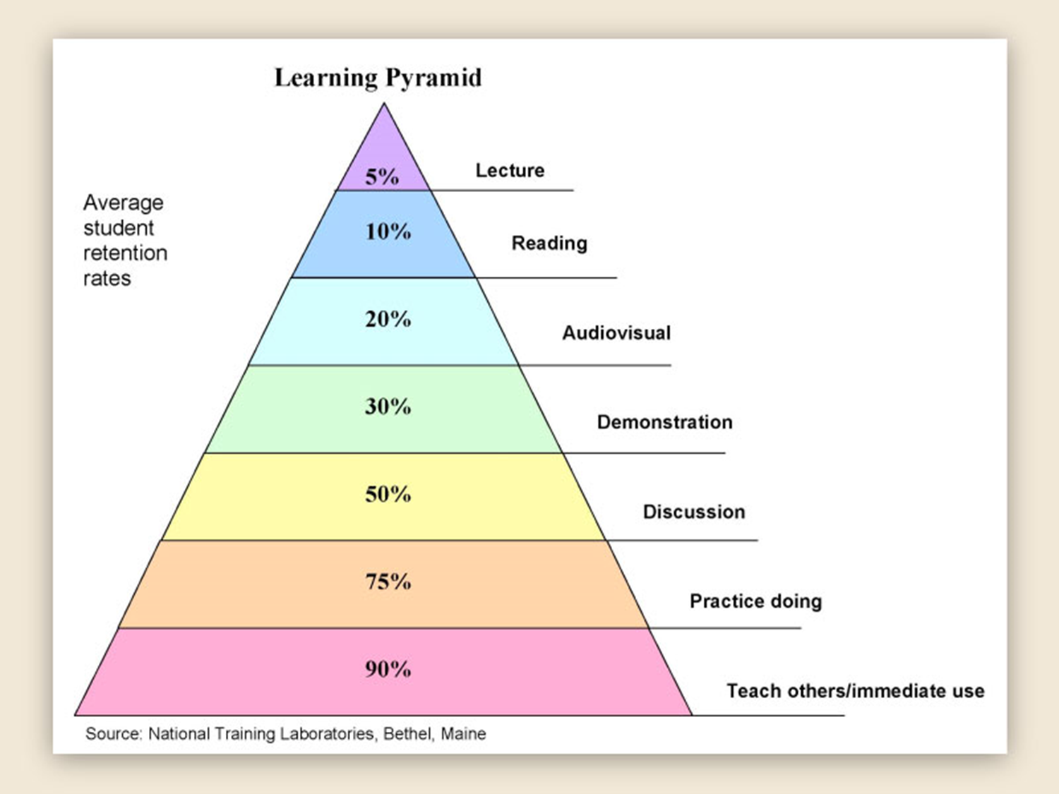
Learning Pyramid
Notes:
Although disputed, the source of the pyramid can be attributed to NTL Institute for Applied Behavioral Science as they explain as follows:
Thanks for your inquiry of NTL Institute. We are happy to respond to your inquiry about The Learning Pyramid. Yes, it was developed and used by NTL Institute at our Bethel, Maine campus in the early sixties when we were still part of the National Education Association's Adult Education Division. Yes, we believe it to be accurate - but no, we no any longer have - nor can we find - the original research that supports the numbers. We get many inquiries every month about this - and many, many people have searched for the original research and have come up empty handed. We know that in 1954 a similar pyramid with slightly different numbers appeared on p. 43 of a book called Audio-Visual Methods in Teaching, published by the Edgar Dale Dryden Press in New York. Yet the Learning Pyramid as such seems to have been modified and always has been attributed to NTL Institute.
To summarize the numbers (which sometimes get cited differently) learners retain approximately:
>>90% of what they learn when they teach someone else/use immediately.
>>75% of what they learn when they practice what they learned.
>>50% of what they learn when engaged in a group discussion.
>>30% of what they learn when they see a demonstration.
>>20% of what they learn from audio-visual.
>>10% of what they learn when they've learned from reading.
>>5% of what they learn when they've learned from lecture.
Feel free to use the Learning Pyramid (below) as you wish without charge - and cite at the bottom - "NTL Institute for Applied Behavioral Science, 300 N. Lee Street, Suite 300, Alexandria, VA 22314. 1-800-777-5227

Slide 8
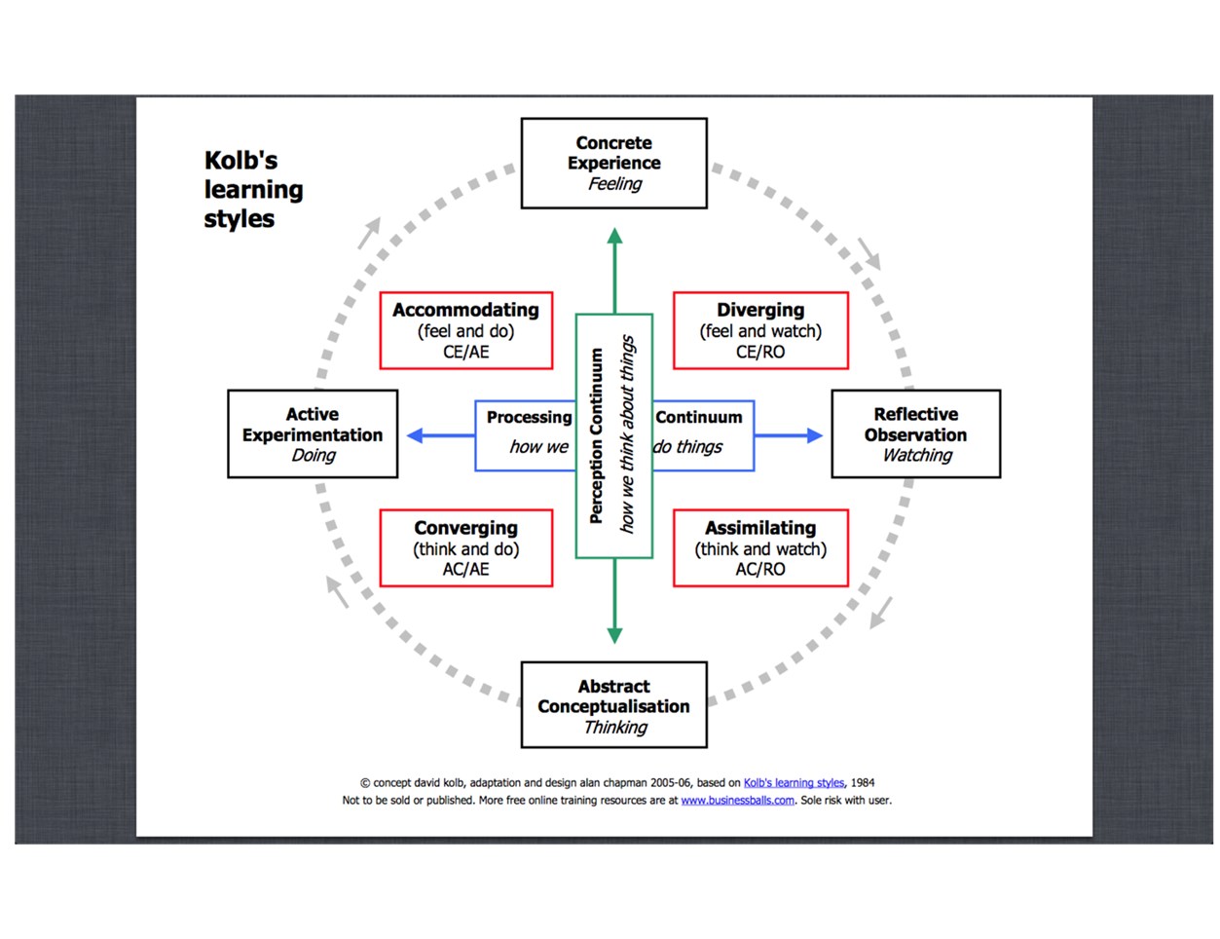
Kolb’s Learning Styles
Notes:
Although disputed, the source of the pyramid can be attributed to NTL Institute for Applied Behavioral Science as they explain as follows:
Thanks for your inquiry of NTL Institute. We are happy to respond to your inquiry about The Learning Pyramid. Yes, it was developed and used by NTL Institute at our Bethel, Maine campus in the early sixties when we were still part of the National Education Association's Adult Education Division. Yes, we believe it to be accurate - but no, we no any longer have - nor can we find - the original research that supports the numbers. We get many inquiries every month about this - and many, many people have searched for the original research and have come up empty handed. We know that in 1954 a similar pyramid with slightly different numbers appeared on p. 43 of a book called Audio-Visual Methods in Teaching, published by the Edgar Dale Dryden Press in New York. Yet the Learning Pyramid as such seems to have been modified and always has been attributed to NTL Institute.
To summarize the numbers (which sometimes get cited differently) learners retain approximately:
>>90% of what they learn when they teach someone else/use immediately.
>>75% of what they learn when they practice what they learned.
>>50% of what they learn when engaged in a group discussion.
>>30% of what they learn when they see a demonstration.
>>20% of what they learn from audio-visual.
>>10% of what they learn when they've learned from reading.
>>5% of what they learn when they've learned from lecture.
Feel free to use the Learning Pyramid (below) as you wish without charge - and cite at the bottom - "NTL Institute for Applied Behavioral Science, 300 N. Lee Street, Suite 300, Alexandria, VA 22314. 1-800-777-5227

Slide 9
Benefits of understanding learning styles
Team selection and demographics
Task allocation and acceptance
Understanding of own and others behaviour
Value strengths – identify areas of development
Tailor delivery/research

Slide 10
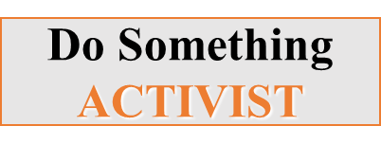
Kolb/Honey & Mumford Models

Slide 11
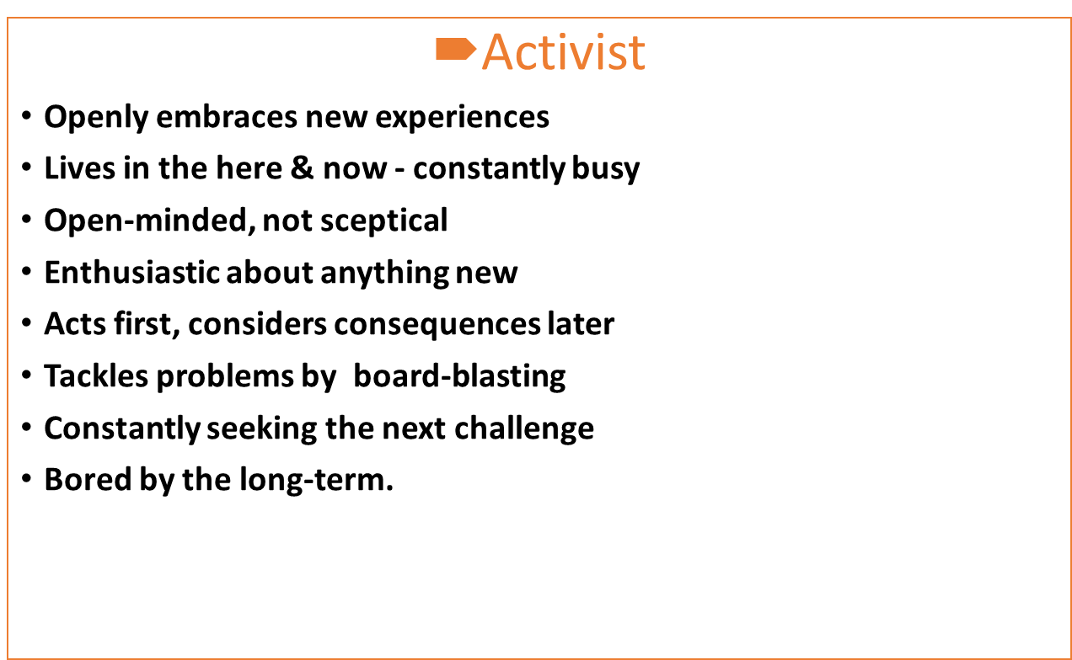
Learning Style Characteristics

Slide 12

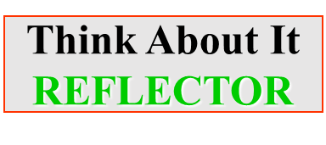
Kolb/Honey & Mumford Models

Slide 13
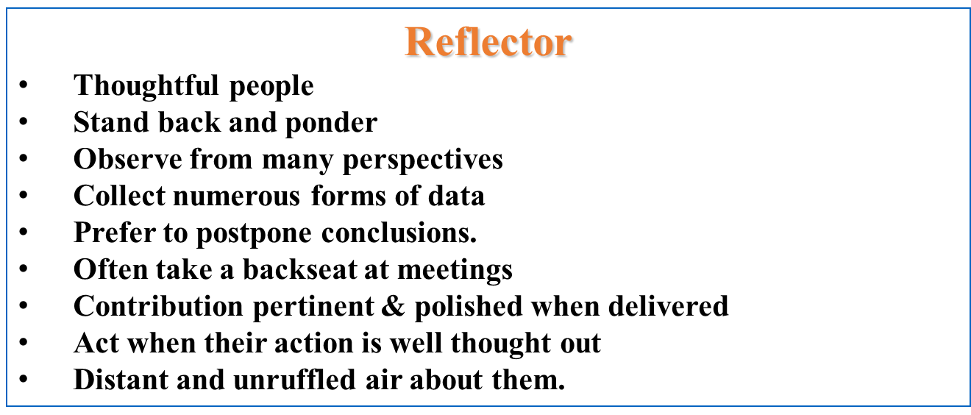
Learning Style Characteristics

Slide 14


Kolb/Honey & Mumford Models

Slide 15
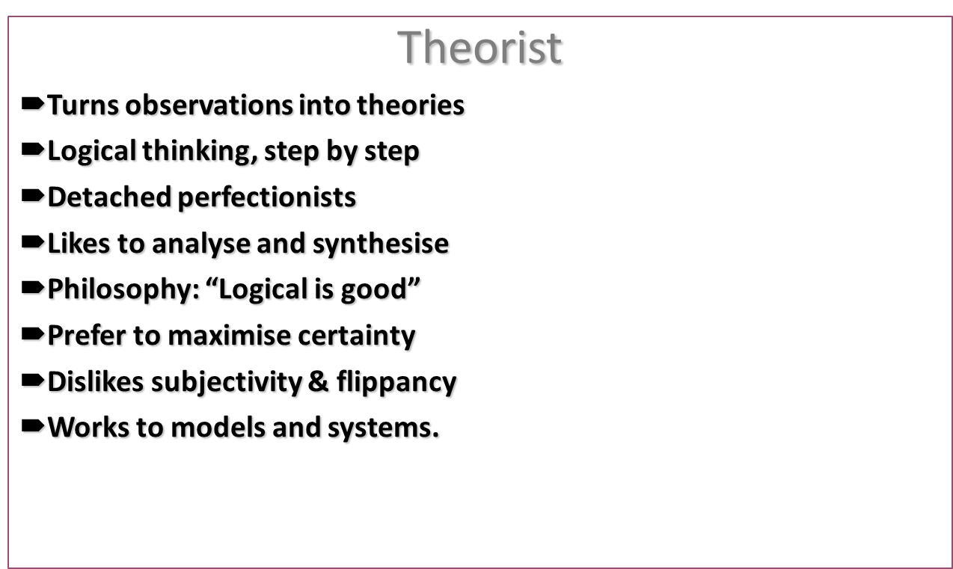
Learning Style Characteristics

Slide 16
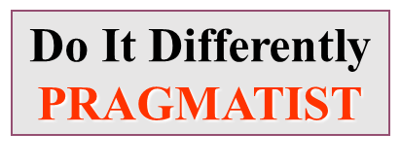

Kolb/Honey & Mumford Models

Slide 17
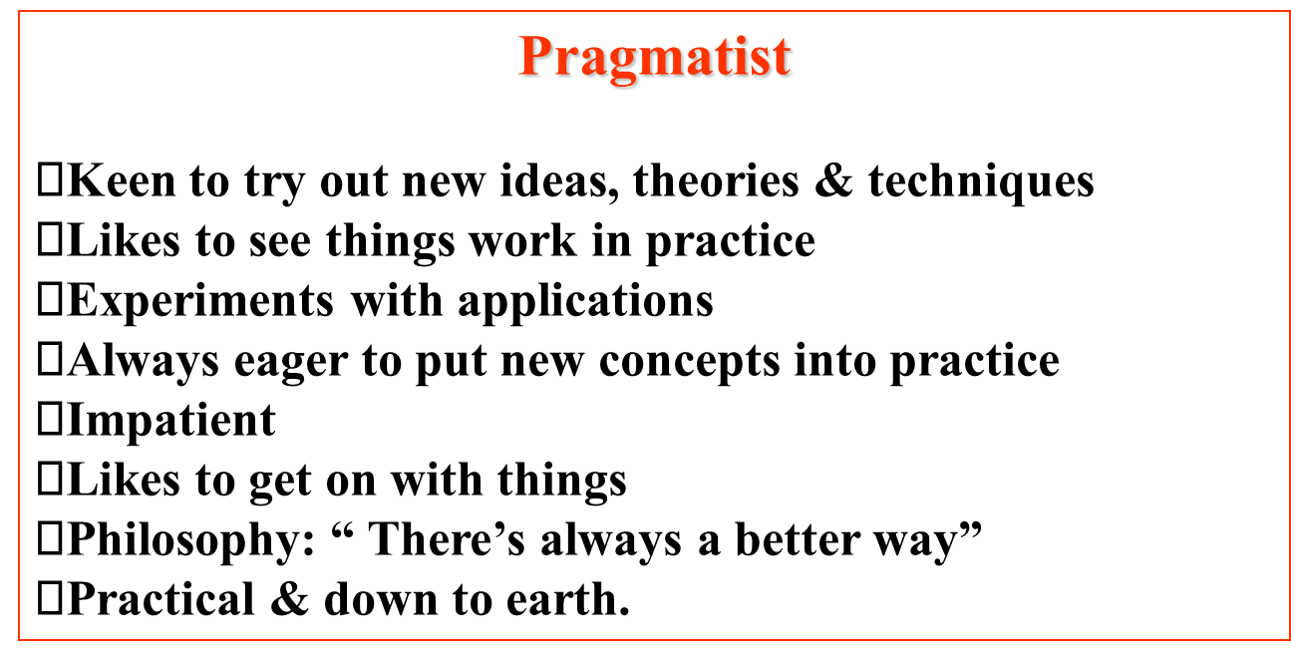
Learning Style Characteristics

Slide 18

Kolb/Honey & Mumford Models

Slide 19
Learning Style Questionnaire
Which learning style do you think most suits your character and personality?
Lets find out!
Complete the following learning style questionnaire:
We will discuss the questionnaire and your findings in the tutorial.

Slide 20

Your findings

Slide 21

Any Questions?

