Slide 1
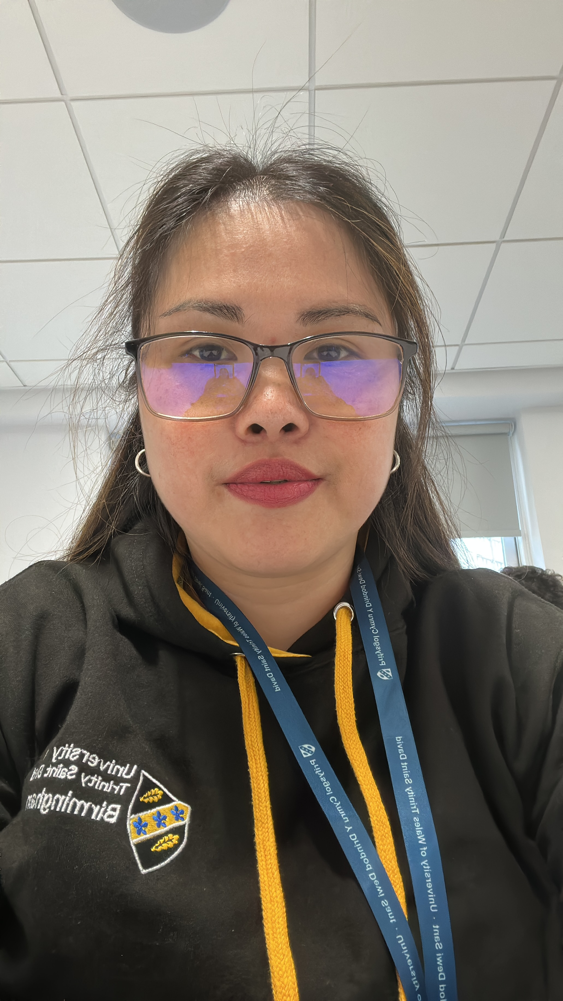
Student Name: REYLANI ACUNA
Student ID: 2536095
Lecturer’s Name: ANNA MARIE DUFFICY
Module Code: LCLM 4004
Module Name: Problem Solving and Decision-Making
Component 1: Basil’s Bakery

Slide 2
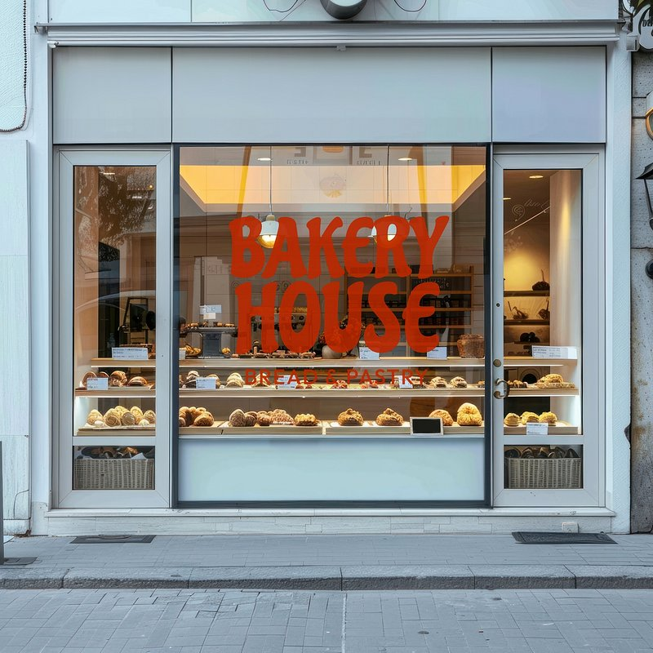
BASIL’S BAKERY
Basil’s bakery, who opened in 2015 and it’s located in a retail park in Coventry, Uk. The bakery is known for his skills, baking cakes, pastries and bread using high-quality organic ingredients. Local shopper and skills worker who’s living and working in the area value the bakery because the food is tasty and the location is convenient.
To analyse the problem that Basil’ business have, I will use PESTEL framework and apply the Cause-and –Effect model. In the end, I summarize all the key finding of the problems.

Slide 3
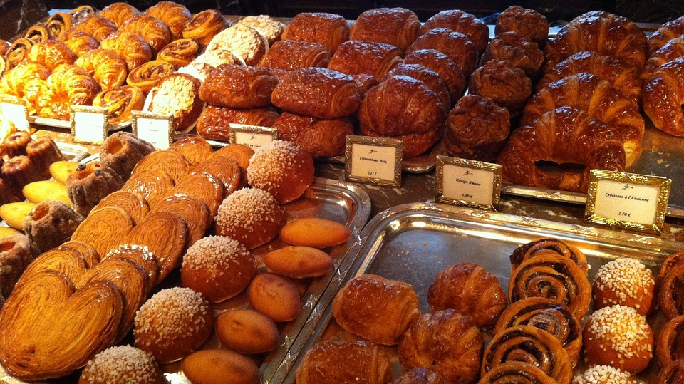
BASIL’S BAKERY
Basil’s bakery, who opened in 2015 and it’s located in a retail park in Coventry, Uk. The bakery is known for his skills, baking cakes, pastries and bread using high-quality organic ingredients. Local shopper and skills worker who’s living and working in the area value the bakery because the food is tasty and the location is convenient.
The sales of the bakery increased year on year, however in 2020, when Covid lockdown restriction hits, the sales decreased and until now, the sales been stagnated.

Slide 4
PROBLEMS
EXTERNAL FACTORS
Closure of some shops and changing patterns of nearby office workers.
Lost of loyal costumer , who lost their job or working from home.
Delivery order and pre-order which Basil cannot provide.
Increasing overhead costs, such as utility bills, rent business rates and insurance.
INTERNAL FACTORS
Inability to adapt changing customer preference and demands for delivery services and pre-orders.
Inability to efficiently manage busy periods and long waiting times.
Reliance on organic produce, which can be costly and unpredictable in terms of availability and pricing

Slide 5

A cause-and-effect diagram (also called a fishbone diagram or Ishikawa diagram) is a tool used to organise and analyse the possible reasons why a particular problem happens.
• The effect/problem is written at the right-hand side (the “head” of the fish).• The possible causes are grouped into main categories that branch off from it (the “bones” of the fish), such as:
- People
- Process
- Equipment
- Materials
- Environment
- Management / Policy
It helps you:
1. Break down a complex issue into manageable parts
2. Identify likely causes to investigate
3. See relationships between different factors
In Basil’s Bakery, for example, sales falling would be the effect on one side, with branches for causes like reduced footfall, job losses/hybrid working, service limitations (no delivery/pre-orders), higher overheads, and volatile organic ingredient costs.
  Sproull, R. (2018). The problem-solving, problem-prevention, and decision-making guide : organized and systematic roadmaps for managers (p. 1 online resource). Taylor & Francis. Page 33-34

Slide 6
PESTEL FRAME
POLITICAL | ECONOMIC | SOCIAL | TECHNOGICAL | ENVIROMENTAL | LEGAL
Government regulation for small business | Economic Inflations | Closure of neighbours shops | Delivery options | Unpredictable and cost source of organic products | Food safety regulations
Climate changes for the organic produce | Increase of rent and utility bills | Working from home | Online ordering system | Climate changing | Labor laws
Adapted from: CIPD PESTEL TEMPLATE Reference 8351 (Issued: March 2023)

Slide 7
FISHBONE DIAGRAM
Methods
Machines
People
FOOTFALL
Delivery Transportation
Costumers
Shop closure
Delivery platform
Staff
Root Problem: STAGNATED
Organic Ingredients
Grown Produce
Weather
Distance
Utility Bills
Covid
Materials
Measurement
Environment
THE PROBLEM SOLVING: PAGE 33-34

Slide 8

Provide a summary of your Key Findings
1.THE BUSINESS SALES STAGNATED AFTER PANDEMIC.
2. REDUCED FOOTFALL AND SHOP CLOSURE.
3. CHANGES IN WORK PATTERNS AND COSTUMERS LOSING JOBS.
4. LACK OF STAFF TO PROVIDE PRE-ORDERS AND DELIVERY SERVICE
5. UTILITY BILLS INCREASING AND INGREDIENTS COST ARE UNPREDICTABLE.

Slide 9
Reference List:
UNIVERSITY ON -LINE BOOK:
Proctor, T. (2019) Creative problem solving for managers : developing skills for decision making and innovation . Fifth edition. Edited by Tony Proctor author. New York : Routledge, p. 1 online resource.
Brooks, I. (2011) The international business environment : challenges and changes . 2nd ed. Edited by J. Weatherston and G. Wilkinson. Harlow, England ;; New York : Financial Times/Prentice Hall, pp. xxv, 347 p. :

Slide 10

Thank you for listening

Slide 11


