Slide 1
Planning and analysing community sport development
By Jordan Protheroe

Slide 2
Activity session
The activity I have chosen would be a tournament of a five a side football match with participants being between the ages of 7-11 tears old. The reason why I have chosen to do a football tournament is because of the physical demands and team work it requires to make a winning tea.

Slide 3
Partners/funding for the session
The way we will come to get the funding for this day out would be by having a sponsored walk which then the money will be generated into help organize the event. Also we will be having raffles throughout the day with prizes for both the children and the adults so that there's some fun in there for them too.
The partners I would be choosing for this session would be members of the local public (volunteers) along with some friends to make this all a success. With myself and other people once being a child ourselves we understand what will attract and stand out to this certain age group and that would be rewards and also free food to help make the day successful.

Slide 4
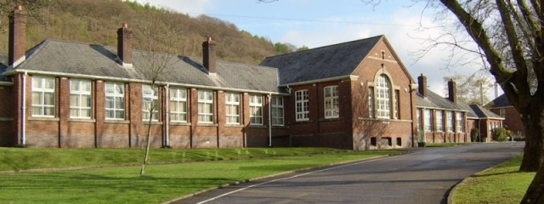
Llangatwg Community School
Llangatwg community school has lots of open area for this day do be a success. With this open area we could have multiple games going on with food and drinks being provided within a different area while at the same time there's enough room for everyone to walk and view what's going on throughout the day and to also socialize.

Slide 5
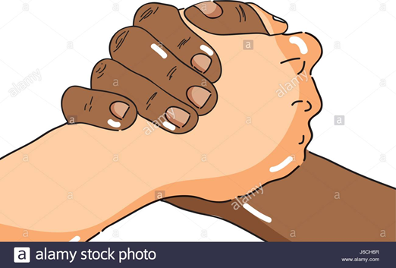
How I will develop the session
With this session I have a very good idea on how to develop the session. After the first set of teams gets through to the next round, whenever a team scores a goal, 1 person from the other team must sit out of the game for 45 seconds increasing the pressure and also throwing in more use of teamwork within the game. Having this applied to every team going on throughout the day will help teams to learn their mistakes and to communicate more with each other

