Slide 1
Stakeholder Analysis & CSR (Corporate Sustainable Responsibility)
Learning Objectives
Purpose
Values
Stakeholders
Introduce Stakeholder Analysis:
Mendelow’s (1981) Power/Interest Matrix
Introduce how to conduct a Stakeholder Analysis
CSR theories

Slide 2
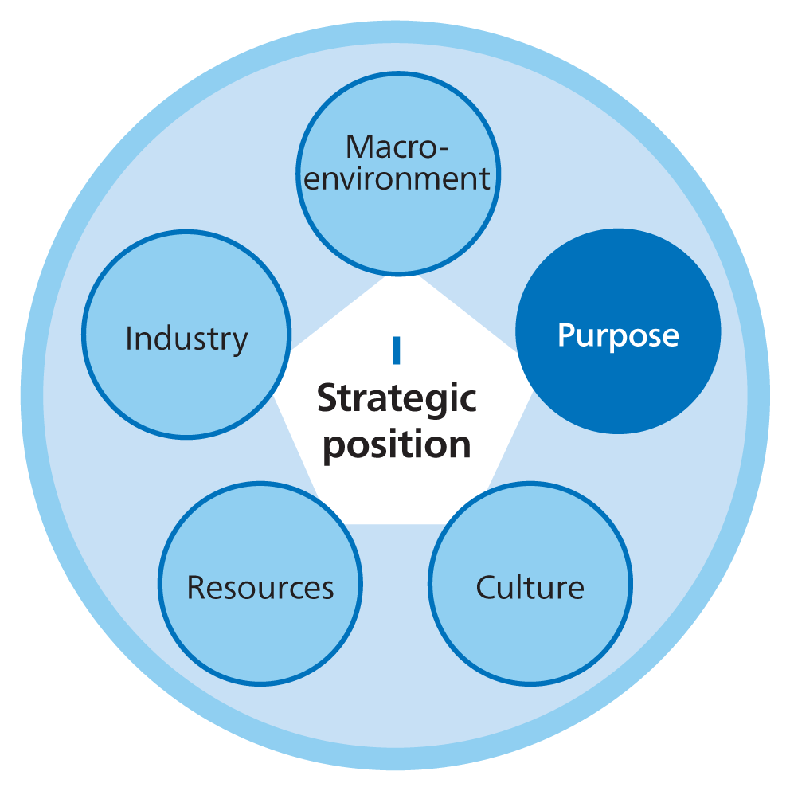
Notes:
BlackRock is the world’s largest asset management company, responsible for investments from pension funds, insurance companies, individuals, charities and universities totalling $9 trillion. In the Spring of 2021, Larry Fink, BlackRock Founder and Chief Executive, issued the latest of his annual ‘letters to CEOs’, the leaders of the companies he invests in. Reviewing lessons from the COVID crisis, he noted how ‘purposeful companies’ – committed to environmental, social and governance (ESG) objectives – had outperformed others. Larry Fink concluded: ‘It is clear that being connected to stakeholders – establishing trust with them and acting with purpose – enables a company to understand and respond to the changes happening in the world. . . . The more your company can show its purpose in delivering value to its customers, its employees, and its communities, the better able you will be to compete and deliver long-term, durable profits for shareholders.’1
For Larry Fink, the most powerful investor in the world, it is clear that organisational purpose matters. Purpose is concerned with the value an organisation seeks to create for its stakeholders, potentially including both financial and non-financial forms of value. Purpose defines what a strategy is for: in other words, what the organisation is trying to achieve with its strategy. For a for-profit business, purpose might include not only making profits but creating value by providing products or services that enhance people’s lives in various ways. As in Figure 1.4 in Chapter 1, purpose can provide a broad and inspiring frame within which strategic vision, mission and objectives can be defined. Vision, mission and objectives should flow logically from purpose. Strategy is purposeful when purpose coherently informs the key strategic decisions of an organisation.
However, coherence around purpose is hard to achieve, with the potential for conflict, particularly between financial and non-financial forms of value. The chapter therefore addresses the relationship between purpose and the goals of various stakeholder groups. Stakeholders are those individuals or groups that depend on an organisation to fulfil their own goals and on whom, in turn, the organisation depends. It is the goals of stakeholders – including investors, customers, employees and communities – that typically inform organisational purpose. However, stakeholders vary in what they seek. Tying stakeholder goals together into a coherent organisational purpose is the role of organisational governance, the structures and systems by which organisations are held accountable for their actions. Effective governance is essential to keeping purpose and strategy aligned with the goals of the stakeholders upon which the organisation depends.
The three rings in Figure 6.1 encapsulate the relationships involved in purposeful strategy. At the core are the values (or ideals) that underpin stakeholder goals. These values are building blocks for the organisational purpose that forms the second ring. It is the outer ring of governance that should hold these elements together, ensuring that decision makers are accountable for consistency between the values, purpose and actual strategy. If this third ring of governance fails, then coherence between values, purpose and strategy is liable to collapse. Incoherence means confused employees internally and frustrated stakeholders externally.
This chapter addresses organisational purpose as follows:
●Section 6.2 starts with the values of organisational stakeholders, from which organisational purpose is formed.
●Section 6.2 continues with stakeholder mapping, analysing which stakeholders are most powerful and most attentive to strategic issues and then focusing on owners, typically a particularly powerful group of stakeholders.
●Section 6.3 then turns to organisational purpose itself, with its incorporation of both narrow economic goals and higher goals, such as environmental sustainability and societal welfare.
●Section 6.3 also considers corporate social responsibility and the management of hybrid organisations that combine widely different values in their strategies.
●Finally, Section 6.5 considers issues of governance, the systems that hold organisations accountable for the delivery of their organisational purpose.

Slide 3
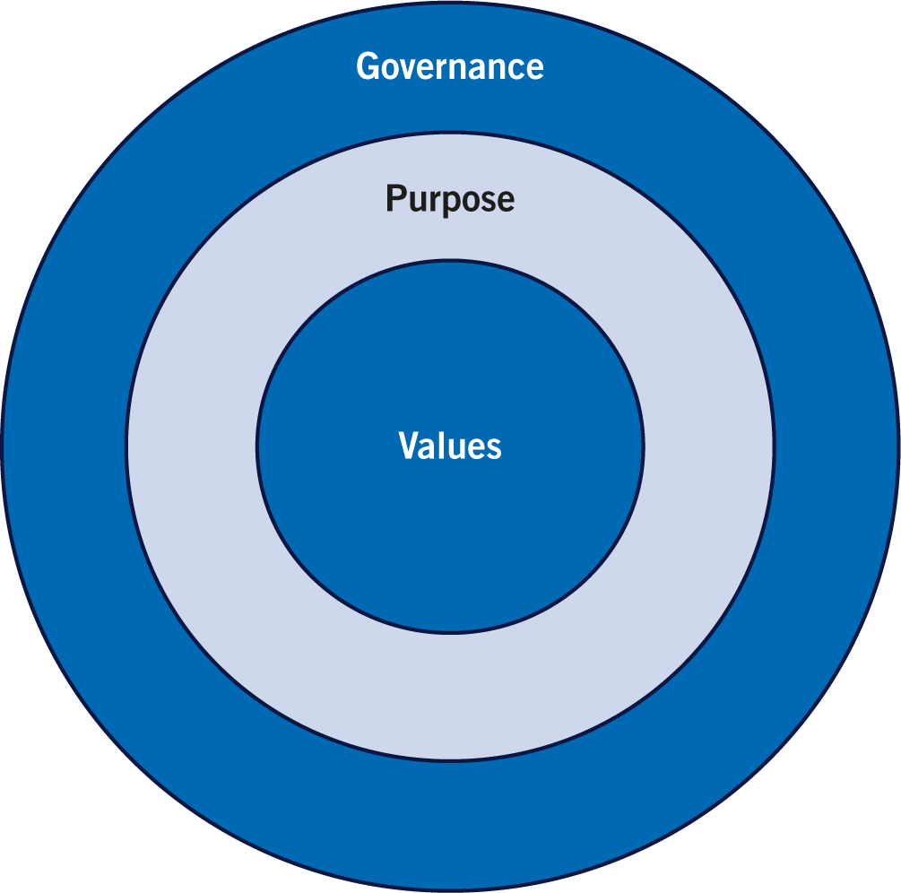
Figure 6.1
Values, purpose and governance

Slide 4
The organisation’s stakeholders
The organisation must define and express their purpose to stakeholders.
Who do you think are the stakeholder of an organisation?
Stakeholders are those individuals or groups that depend on an organisation to fulfil their own goals and on whom, in turn, the organisation depends.
Four key elements to define an organisation’s purpose:
  Mission Statement – purpose/differentiation
  Vision Statement – future achievement
  Statement of Corporate Values – guiding core principles
  Statement of Objectives – specific outcomes to achieve
Notes:
An organization's purpose must be clearly communicated to all individuals and groups that have an interest in or are affected by the organization's activities (stakeholders), such as customers, employees, investors, and the community. This is done through a mission statement, vision statement, corporate values, and objectives, ensuring alignment between the organization's goals and stakeholder interests.
What is a stakeholder?
A stakeholder is any person, group, or organization that has an interest in the activities of a business or organization and can affect or be affected by its operations.
Who are the stakeholders?
Stakeholders of an organization can include:
Internal Stakeholders:
Employees: People who work for the organization and help to achieve its goals.
Owners and Shareholders: Individuals or groups who have invested in the company and have a financial stake in its success.
External Stakeholders:
Customers: People who purchase the organization's products or services.
Suppliers: Businesses or individuals who provide resources or materials to the organization.
Investors and Creditors: Individuals or institutions that provide funding or loans to the organization.
Communities: The local areas where the organization operates and which are affected by its activities.
Government and Policy Makers: Bodies that set regulations and policies that impact the organization.
Four key elements for defining an organization's purpose:
Mission Statement:
Explains the organization's fundamental purpose and what makes it different from others.
Vision Statement:
Describes the desired future achievement or state the organization aims to reach.
Statement of Corporate Values:
Outlines the guiding principles and core beliefs that influence the organization's decisions and behavior.
Statement of Objectives:
Specifies the concrete, measurable outcomes the organization intends to achieve.

Slide 5
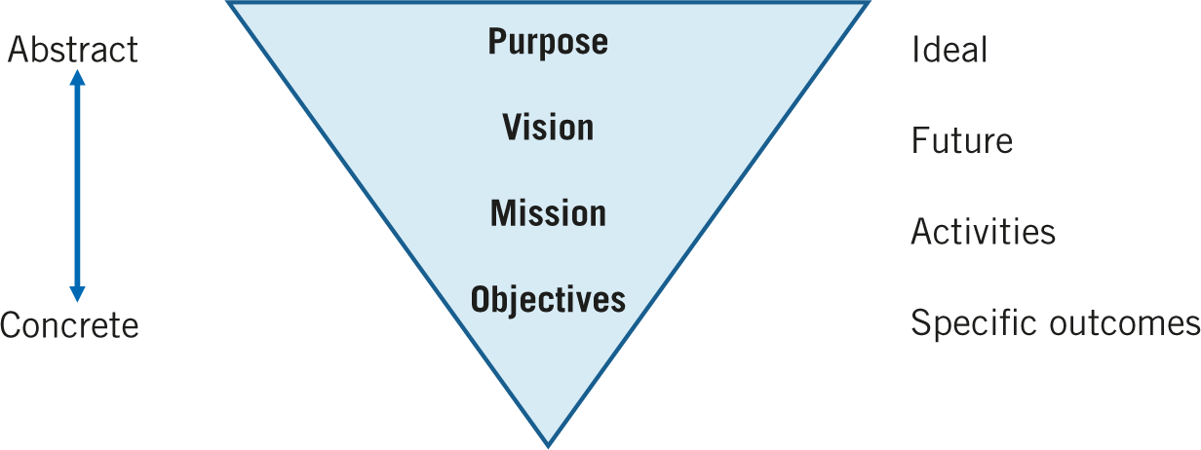
Figure 1.4
Strategic hierarchy
Notes:
1.2.2 Purpose, vision, mission, objectives
What is a strategy for? Harvard University’s Cynthia Montgomery5 answers by arguing that the core of strategy is defining and expressing a clear and motivating purpose for the organisation. Whether in the private or public sector, this purpose is generally loftier than just maximising profits: it could be to improve the environment or help the wider community for instance. Such a broader view of purpose is more likely to motivate employees and stakeholders than profits alone. Indeed, focusing exclusively on short-term profits can be detrimental to longer-term value creation.
●Organisational Purpose is the reason why a company exists. It stems from internal drivers, such as the founders’ and subsequent organisational leaders’ beliefs and commitments, and external drivers including stakeholder influences (see Chapter 6 for further elaboration). Purpose is also influenced by broader contextual pressures, such as environmental shocks from a pandemic or climate change, that may cause firms to revisit and adjust their purpose. If the stakeholders of an organisation can relate to such a purpose it can be highly motivating.6 According to Montgomery, the stated purpose of the organisation should address two related questions: how does the organisation make a difference; and for whom does the organisation make that difference? These questions challenge strategists to move from the abstract concept of purpose towards concrete action. Chapter 6 examines purpose in more depth.
●A vision statement is concerned with the future the organisation seeks to create. The vision typically expresses an aspiration that will enthuse, gain commitment and stretch performance. So, here the question is: ‘What do we want to achieve?’ Porras and Collins suggest managers can identify this by asking: ‘If we were sitting here in twenty years what do we want to have created or achieved?’ They cite the example of Henry Ford’s original vision in the very early days of automobile production that the ownership of a car should be within the reach of everyone. For the Swedish music site Spotify, the vision is to become ‘the Operating System of music’, a universal platform for listening just as Microsoft is for office software.
●A mission statement aims to provide clarity about what the organisation is fundamentally there to do on a daily basis, for employees and stakeholders. It can be thought of as a way of moving forwards towards the vision. This is often expressed in the apparently simple but challenging question: ‘What business are we in?’ Two linked questions that can clarify an organisation’s ‘business’ are: ‘What would be lost if the organisation did not exist?’; and ‘How do we make a difference?’ Though they do not use the exact term ‘mission statement’, Collins and Porras7 suggest that understanding the fundamental mission can be done by starting with a descriptive statement of what the organisation actually does, then repeatedly delving deeper into the organisation’s mission by asking ‘Why do we do this?’ They use the example of managers in a gravel and asphalt company arriving at the conclusion that its mission is to make people’s lives better by improving the quality of built structures. At the University of Utrecht in the Netherlands, the mission includes educating students, training the next generation of researchers and addressing social issues.
●Objectives are statements of specific outcomes that are to be achieved. In the for-profit sector, these are often expressed in precise financial terms, for instance, the level of sales, profits or share valuation in one, two or three years’ time.8 In non-profit organisations, objectives will focus on providing services to target groups rather than financial objectives, although the organisation will need to generate sufficient income to cover their costs. Increasingly, organisations are also setting objectives referred to as ‘the triple bottom line’, by which is meant not only economic objectives such as those above, but also environmental and social objectives to do with their corporate responsibility to wider society (see Section 6.3).
Figure 1.4 shows a four-step hierarchy that connects the broad, abstract concept of purpose to narrower, concrete objectives by way of the organisation’s vision and mission.
Purpose, vision and mission statements can offer more enduring sources of direction and motivation than dry financial objectives. However, these statements should be authentic and meaningful. Purpose, vision and mission statements are sometimes ineffective because they are too bland and too wide-ranging,
1.2.3 Strategy statements
David Collis and Michael Rukstad10 at the Harvard Business School argue that all entrepreneurs and managers should be able to summarise their organisation’s strategy with a ‘strategy statement’. Strategy statements should have three main themes: the fundamental goals (purpose, vision, mission or objectives) that the organisation seeks; the scope or domain of the organisation’s activities; and the particular advantages or capabilities it has to deliver all of these.

Slide 6
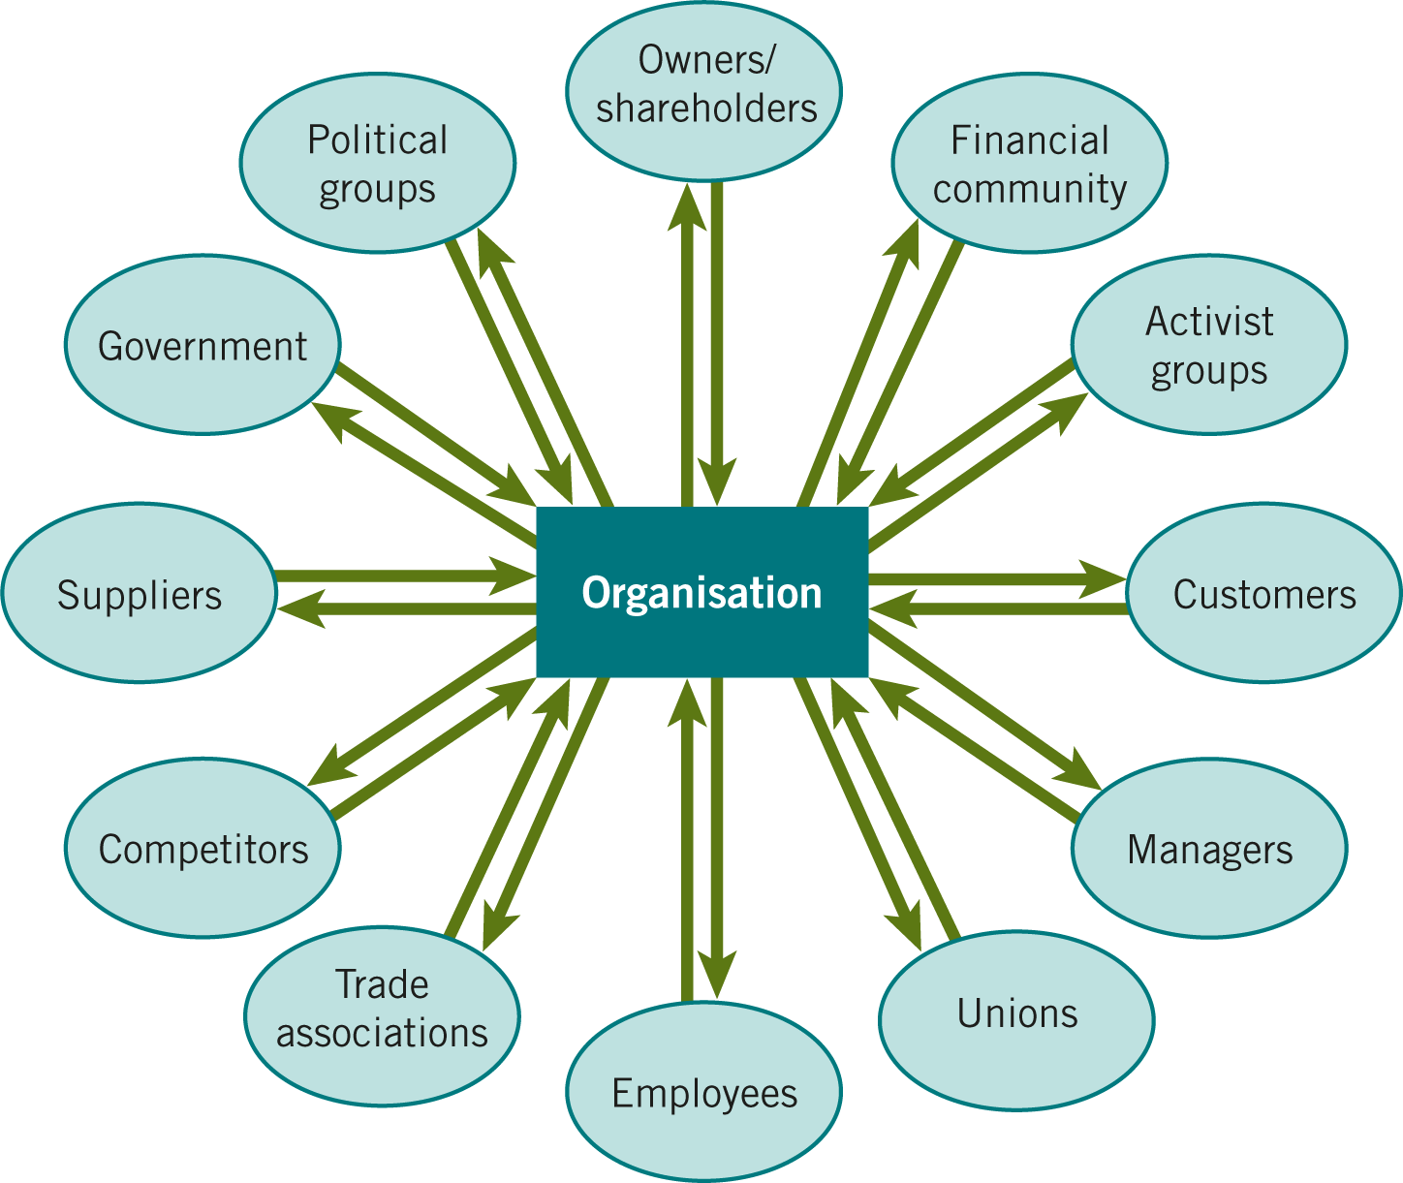
Figure 6.2
Stakeholders of a large organisation
Source: Adapted from R.E. Freeman (1984) Strategic Management: A Stakeholder Approach, Pitman. Copyright 1984 by R. Edward Freeman.
Notes:
6.2 Organisational and stakeholder values
Organisations often talk of ‘creating value’. For many organisations, this just means creating financial value in terms of profits. However, organisations can create value in other senses, for example, helping disadvantaged communities or introducing life-enhancing innovations. This section is concerned with the full range of values (or ideals) that can both inspire strategy and guide behaviours as it is implemented. As in Figure 6.1, these values are at the heart of strategy. Ultimately, organisational values derive from the values held by the organisation’s various stakeholders. Consistency with the values of important stakeholders (whether investors, employees or customers) is essential for organisations in order to maintain the support that allows continued operations. Ignoring the values of any one of these stakeholders can be fatal to the organisation. Investors can sell out, employees lose motivation and customers turn away in disgust.
6.2.1 Organisational values
Many organisations have explicit statements of their guiding values. These organisational values are the underlying and enduring ideals, beliefs and principles that guide an organisation’s strategy and define the way that the organisation should operate.2 Values are, quite literally, what organisations value. For example, the Charityworks organisation, devoted to recruiting and developing young talent in the United Kingdom non-profit sector, declares its values to include innovation, creativity, commitment and fun.3 The leading strategy consulting firm McKinsey & Co. describes itself as a ‘values-driven organisation’, whose core values include putting the client’s interests ahead of the firm’s, maintaining an independent perspective and preserving client confidentiality. For McKinsey, these values ‘inform both our long-term strategy as a firm and the way we serve our clients on a daily basis’. Recognising the challenges of staying true to its values, the firm reserves one day a year to reflect as a group on the meaning of its values for its work and the lives of its employees.4
These values define an organisation’s operating principles, for example, fun at Charityworks or putting clients first at McKinsey. They set guidelines on what can and cannot be done. Adopted strategies should not violate these values. Values can also set the goals of strategy, crucial to issues of strategy evaluation, discussed in Chapter 13. By setting strategic goals, values shape what an organisation creates for its stakeholders as part of its purpose. For Charityworks above, the value of innovation would define a goal of creating new services, with success based, for example, on the number of young charity workers trained and employed. Values inform goals and then goals determine what is actually achieved. Thus, values shape the fundamental direction of strategy, providing the guiding light for what is appropriate for the organisation as a whole. Values are key drivers for strategy.
Values can be identified from the formal values statements many organisations publish, though these espoused values may differ from values operating in practice. It is important to check formal value statements with what organisations actually do. Nonetheless, even operating values cannot diverge too far from the broader ideals from within the surrounding society: these are the norms of the institutional environment in Chapter 3. Even if they are operating within the letter of the law, organisations that flagrantly breach societal values will lose customers, alienate employees and embarrass investors (see Illustration 6.3 on Rio Tinto). Two sets of institutional norms are particularly influential on the values of contemporary organizations:
●the United Nations’ 17 Sustainable Development Goals (SDGs) are a particularly influential source of values, with aspirations ranging from the elimination of poverty, through gender equality to climate protection (see also Chapter 3). In 2019, 17 leading corporations declared their support for the SDGs, declaring themselves ‘Business Avengers’. These companies included Coca-Cola, Mars, Microsoft, Nike and Unilever. Recognising the 2030 deadline for delivering the SDGs, the 17 companies described the 2020s as the ‘Decade of Delivery’, promising to incorporate the United Nations’ goals into their individual strategies. Thus, the consumer products company Unilever has a ‘Compass Strategy’ with specific targets such as 25 per cent recycled plastic usage by 2025 and zero emissions by 2030 (see Illustration 6.1 on Unilever).
●Another contemporary norm influential on values is equality, diversity and inclusion (EDI). Diversity refers to the range of people employed within an organisation: such diversity might include gender, ethnicity, age, physical abilities, sexuality, cognitive style, religion, education or class. Inclusion refers to whether this range of people feel that they belong and are truly heard, with representation at the top levels of the organisation. Equality refers to the policies that support diversity and inclusion in the organisation, ensuring that everybody has fair opportunities: this might include policies on gender or specific ethnic groups, for example. Strategies drawing on the values of equality, diversity and inclusion can make good business sense. The French energy management company Schneider Electric follows an EDI strategy for at least three reasons: it helps motivate employees; it reflects the diversity of its markets around the world; and it gives top management the breadth of perspectives it needs for strategic decision making in a complex business environment.5
Although many large companies do commit to widely shared values in society, they can experience conflict between the concerns of different stakeholders. The creation of ‘shareholder value’ in the form of financial profit for owners may contradict the broader social values of an organisation’s other stakeholders.6 See Illustration 6.1 on Unilever, for example. It is important, therefore, to understand the variety of stakeholders impacting on strategy and to grasp which stakeholders are most influential.
6.2.2 Stakeholder groups7
Organisational values are derived from the organisation’s stakeholders. Their values shape both strategic decisions and the effectiveness of strategy implementation. Stakeholders are those who have some kind of stake in the future of the organisation. These stakeholders depend on the organisation and, reciprocally, the organisation typically depends on them. Charities and non-profit organisations clearly have a range of stakeholders including both the groups they serve and those who fund them. However, profit-driven companies too can be very diverse in their stakeholders. In the Petrobras case at the end of this chapter, the Brazilian oil company identifies no fewer than 13 groups of stakeholders, including investors, customers, suppliers, the workforce, public authorities, scientists and local communities.
To the extent their organisations depend on them, managers must take all stakeholders into account. However, stakeholder demands can diverge widely: for instance, in many companies, profit maximisation on the part of investors may come at the expense of customers who want quality products, employees who want good jobs and groups in the wider society who want a clean environment. Each of these stakeholders has different degrees of power. It is important, therefore, that managers understand who their stakeholders are, what they value and which have most influence upon the organisation. Accordingly, stakeholders can be usefully divided into five (potentially overlapping) types, categorised according to the nature of their relationship with the organisation and how their values might influence strategic direction (see Figure 6.2):
●Economic stakeholders, including suppliers, customers, distributors, banks and owners (shareholders). The values of these stakeholders are typically economically orientated, concerned for profits, prices or similar. However, economic stakeholders may also adopt more social values, for instance the sustainability of their supply chain. In 2022, 70 per cent of shareholders in Costco, the huge US warehouse chain, defied advice from the company’s directors and voted for net-zero greenhouse gas emissions by 2050.
●Social/political stakeholders, such as policy-makers, local councils, regulators and government agencies that may influence the strategy directly or via the context in which strategy is developed. The values of these stakeholders are typically complex and diverse: they might try to combine social values with other benefits such as economic growth in their locality.
●Technological stakeholders, such as key adopters, standards agencies and ecosystem members supplying complementary products or services (e.g., apps for particular mobile phones). For these stakeholders, values such as innovation and information-sharing are typically important.
●

Slide 7
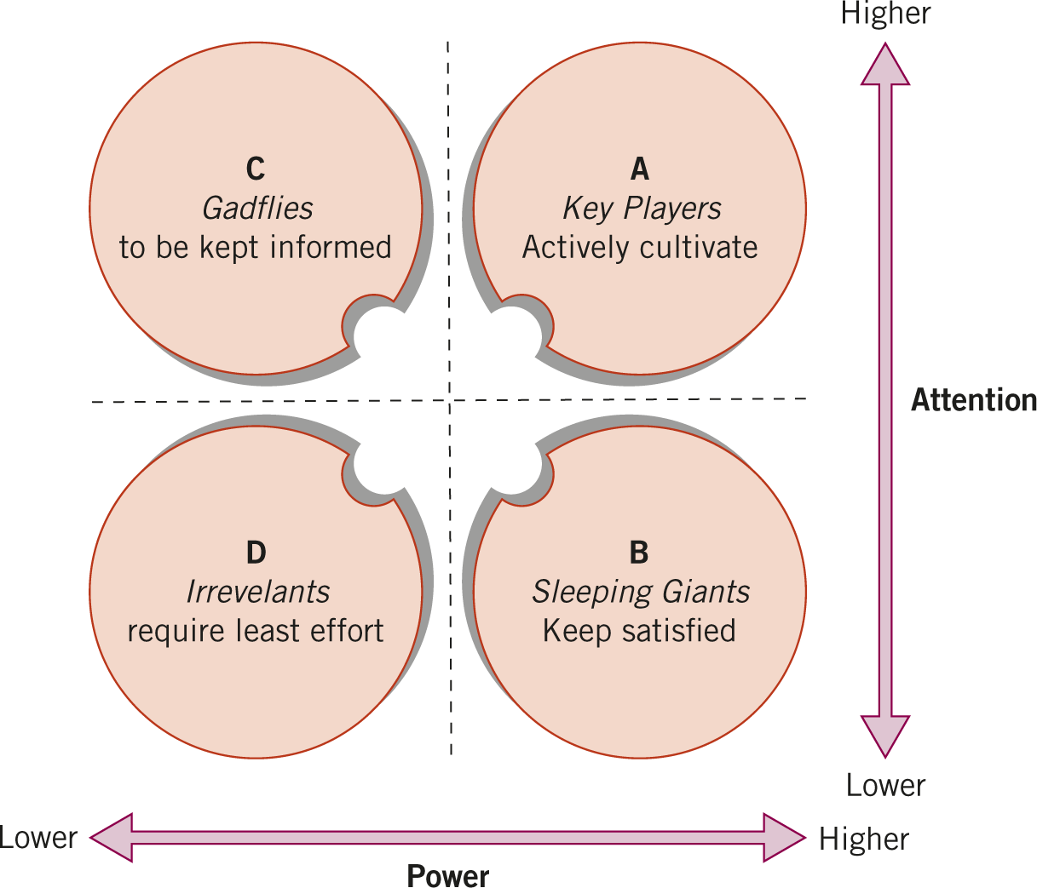
Figure 6.3
Stakeholder mapping: the power/ attention matrix
Adapted from R. Newcombe (2003) ‘From client to project stakeholders: a stakeholder mapping approach’, Construction Management and Economics,
vol. 21, no. 8, pp. 841–8.
Notes:
6.2.3 Stakeholder mapping8
Given that there are often so many stakeholders, it is useful to categorise them according to their likely influence on strategic decisions. In weighing up strategies, not all values are equal. Organisations are coalitions of stakeholders, each of which has different levels of power and each of which gives different amounts of attention to strategic issues.9 Stakeholder mapping identifies stakeholder power and attention in order to understand strategic priorities. Strategic priorities normally have to be consistent with the values of the most powerful and attentive stakeholders.
The power/attention matrix shown in Figure 6.3 classifies stakeholders in relation to the power they hold and their attention to particular strategic issues. The matrix allows different stakeholders to be plotted according to relative positions along continuous axes running from low to high. Stakeholders can be plotted on the matrix either according to the overall power and attention they exert on the organisation’s strategy in general or according to the power and attention they exert on particular issues. While plotting stakeholders according to overall power and attention is a useful summarising device, it is important to understand that, in practice, stakeholder positions are likely to vary according to each issue: stakeholders may have more power in some domains than others and will care more about some issues than others. For example, shareholders may pay more attention to profits than to inclusion and diversity issues, while employees might take the opposite view. Power and attention can be assessed as follows.
Figure 6.3 Stakeholder mapping: the power/attention matrix
Adapted from R. Newcombe (2003) ‘From client to project stakeholders: a stakeholder mapping approach’, Construction Management and Economics, vol. 21, no. 8, pp. 841–8.
Figure 6.3: Long Description
Power10
In designing strategy, it is important to understand which stakeholders are most powerful. Power is the ability of individuals or groups to persuade, induce or coerce others into following particular strategies. Power not only derives from people’s hierarchical position within an organisation or from formal corporate governance arrangements. Power can also be a function of the resources or know-how they control or the networks they have built up. For example, the walk-outs by Google engineers during 2018 were effective in changing the company’s approach to sexual harassment because the company depended so much on the engineers’ expertise and support.11
The wide range of power sources underlines the importance of recognising different indicators of power. The powerful are not just those sitting at the top of the formal hierarchy. Some people may be influential because of their informal status within the organisation, for instance, as significant innovators in the past or as trusted advisers to top management.12 Alternatively, they may be powerful because they provide a crucial resource and are collectively well-organised, as in the case of the Google engineers.
Attention
Attention matters as well as power.13 Attention refers to how closely stakeholders monitor the activities of an organisation. Stakeholders vary in the attention they pay and which issues they care about. Even powerful stakeholders may not attend closely to everything. For example, many companies have institutional shareholders (e.g., pension funds) as major shareholders, but because these shareholders hold shares in many different companies, they may not care greatly about the detailed strategy of any single company.
In assessing the attention that stakeholders are likely to pay, three factors are particularly important:
●Criticality: stakeholders will pay more attention to issues that are critical for them. For example, shareholders might not see health and safety at work as critical, but employees very likely will.
●Channels: stakeholders will pay more attention where there are good channels of information and communication. For example, it is increasingly common nowadays for chief executives to invite their shareholders to ‘strategy days’ or ‘strategy reviews’, providing opportunities for detailed discussions of strategy that might otherwise not be possible.14 Where channels are poor, stakeholders may be unable to pay sufficient attention even to issues they regard as critical: for example, many ethical investors (such as religious and political groups) care passionately about employment conditions for overseas workers, but lack the information channels to find out about them.
●Cognitive capacity: sometimes, stakeholders simply do not have the cognitive capacity to process all the information they have. Thus, institutional investors may have access to a host of information about the strategies of all the various companies they invest in, but reduce complexity by focusing on simple measures such as forecast financial earnings, rather than the details of company strategy.
The power/attention matrix of Figure 6.3 indicates the type of relationship that managers might typically establish with stakeholders in the different quadrants. Generally, relationships are more intense as they progress from quadrant D up to quadrant A. Thus, cultivating the support of key players (quadrant A) is of greatest importance: these might be major investors, for example. However, it is also important to satisfy the sleeping giants in quadrant B: these might be government regulators. Although sleeping giants might generally be relatively passive, difficulties can arise when dissatisfaction awakens their attention and they reposition to segment A: here they may challenge the strategy. The gadflies in quadrant C, for example, community campaign groups, can usually be managed largely by information provision. Although not powerful themselves, it is important not to alienate such stakeholders because they can influence more powerful stakeholders: for example, community campaigners might awaken the giants in quadrant B.
The power/attention matrix is a useful tool for analysing potential coalitions of stakeholders for or against particular decisions. Aligning potential supporters for strategic initiatives is often crucial in the process of strategic change (see Chapter 16). Building supportive stakeholder coalitions is at the core of strategy, therefore.

Slide 8
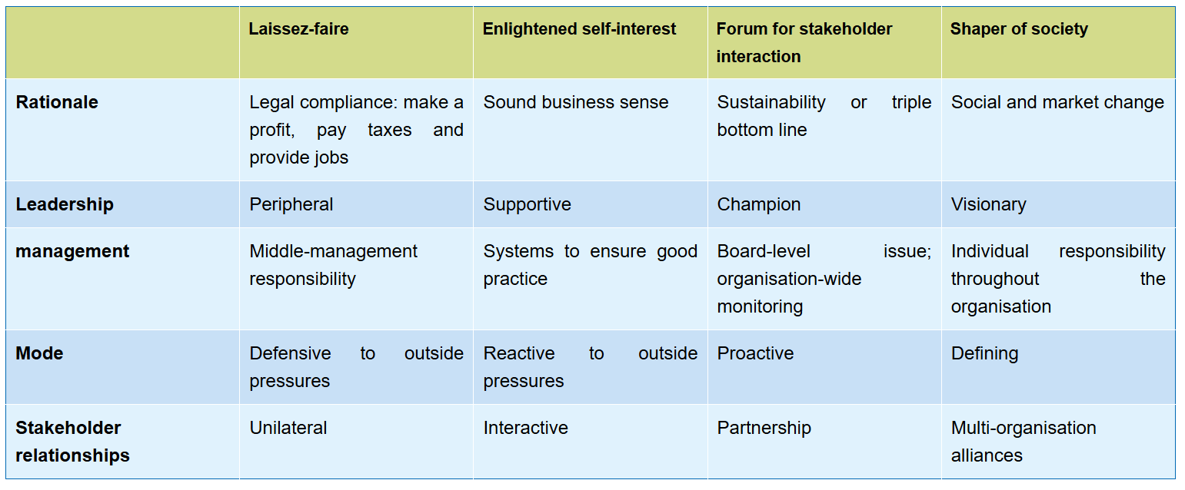
Organisational purpose
Social responsibility
Notes:
The notion of organisational purpose acknowledges that organisations may be driven by non-economic values. While many organisations are exclusively focused on profit, and some employees motivated primarily by the financial rewards, purpose increasingly draws on the social values of key stakeholders. Purpose becomes strategic when it is incorporated into the mission, vision and objectives of the organisation (see Chapter 1). Mission, vision, objectives and purpose should all be aligned. Organisations frequently publish their mission, vision and purpose on their websites, though (as with values) these official declarations should be read critically.
However, while purpose does acknowledge obligations to society at large, commitments to social responsibility can vary from the minimal to the transformational. Purpose can also introduce tensions between financial and social interests: organisations become ‘hybrids’, combining different principles for action. This section explores different levels of commitment to corporate social responsibility and ways of managing organisational hybridity.
Social Responsibility
An underlying theme in this chapter is the question of whether organisations are just for the benefit of a primary stakeholder, such as the shareholders of a company, or whether they have a responsibility to a wider group of stakeholders. This section considers different approaches to corporate social responsibility in strategy.
The regulatory environment may determine an organisation’s minimum obligations towards its stakeholders. However, stakeholders typically expect greater responsibility on the part of organisations, and managers’ own personal ethics are likely to set higher standards too. Corporate social responsibility (CSR) is the commitment by organisations to behave ethically and contribute to economic development while improving the quality of life of the workforce and their families as well as the local community and society at large.23 CSR is, therefore, concerned with the ways in which an organisation exceeds its minimum legal obligations. Social responsibility feeds into organisational purpose.
Different organisations take different approaches to CSR. Table 6.1 outlines four basic types to illustrate these differences. They represent progressively greater commitments to the higher goals of organisational purpose and a greater breadth of criteria against which strategies will be judged. The discussion that follows also explains what such approaches typically involve in terms of the ways companies act.24 Illustration 6.3 discusses the approach of leading mining company Rio Tinto, plunged into crisis in 2020.
The laissez-faire view (literally ‘let do’ in French) represents an extreme stance. In this view, organisations should be let alone to get on with things on their own account. Proponents argue that the only responsibility of business is to make a profit and provide for the interests of shareholders.25 There is no direct responsibility to any other stakeholders beyond what is prescribed by law. It is the government’s job to protect society through legislation and regulation. Expecting companies to exercise social duties beyond this only confuses decision making, introduces additional costs and undermines the accountability of managers to their shareholders. In this view, society benefits anyway from the profits: after all, these can either be used for further investment in the business or be paid out to shareholders, who may be pensioners relying on the income or similar. This laissez-faire stance may be taken by executives who are persuaded of it ideologically or by smaller businesses that do not have the resources to do other than minimally comply with regulations. There is no organisational purpose in the sense of commitment to higher goals than financial performance.
Enlightened self-interest is guided by recognition of the potential long-term financial benefit to the shareholder of well-managed relationships with other stakeholders. Here, the justification for social responsibility is that it makes good business sense. For example, an inspiring organisational purpose will generate employee energy and improve internal collaboration.26 Building supportive coalitions with a range of stakeholders, even critical ones, can increase organisational resilience in times of crisis.27 It is this sense of enlightened self-interest that BlackRock chief Larry Fink was appealing to in his letter to CEOs at the beginning of this chapter. Indeed, there is mounting evidence that responsible strategies can also reward shareholders.28 Thus, like any other form of investment or promotion expenditure, corporate philanthropy or welfare provision might be regarded as sensible expenditures. These enlightened self-interest organisations often publish Environmental-Social-Governance (ESG) or Integrated reports, providing public indicators of their performance across a range of measures relating to the environment, human capital and governance arrangements, for example.29 Enlightened self-interest does allow for organisational purpose, with higher goals than just profit, but it does not expect these higher goals to entail any long-term sacrifice.

Slide 9
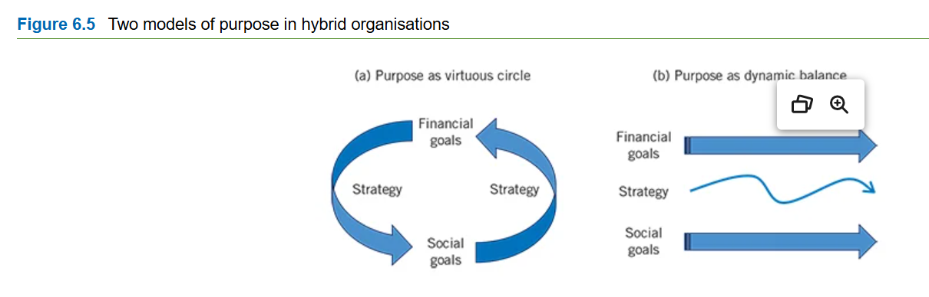
Organisational purpose
Social responsibility
A forum for stakeholder interaction
Managing hybrid organisations
Notes:
A forum for stakeholder interaction30 explicitly incorporates multiple stakeholder interests and expectations rather than just shareholders as influences on organisational purposes and strategies. Here, the argument is that the performance of an organisation should be measured in a more pluralistic way than just through the financial bottom line. Such organisations typically adopt the principle of sustainability in strategy, offering a better quality of life by attending to all three dimensions of environmental protection, social responsibility and economic welfare. Performance here is often measured and rewarded in terms of the triple bottom line – social and environmental benefits as well as profits (see Section 13.2.1). Companies in this category might retain uneconomic units to preserve jobs, avoid selling ‘anti-social’ products and be prepared to bear reductions in profitability for the social good. This approach does accept some possible sacrifice in pursuit of the higher goals of organisational purpose.
Shapers of society regard financial considerations as of secondary importance or a constraint. These are visionary organisations seeking to transform society and social norms. Public-sector organisations, social movement organisations and charities are often committed to this kind of stance. There are also social entrepreneurs who found new organisations that earn revenues but pursue a specific social purpose (see Chapter 11). For example, Traidcraft UK is a public limited company with a chain of retail shops that fights world poverty by promoting ‘fair trade’. For shapers of society, the social role is the raison d’être of the business, not profits. Financial viability is important only as providing the means for continuing the social mission. These organisations adopt the strongest form of organisational purpose.
Managing hybrid organisations
For many organisations, the different stakeholder values that inform organisational purpose effectively makes them organisational hybrids. Hybrid organisations combine values and structures that would not normally go together.31 Many public-sector organisations have to combine potentially conflicting values: for example, Amsterdam’s city authority trades off some economic growth against achieving social goals (see Illustration 6.4 on Amsterdam’s doughnut economic model). Similarly, social enterprises combine what would otherwise be charity or public-sector objectives with private-sector business models: for example, as a B corporation (see Section 6.2.3), coffee-company Cafédirect sells coffee commercially but donates half its profits to its coffee growers. However, organisational purpose means that even purely private sector organisations can take on hybrid characteristics: businesses strive to reconcile economic motives with social and environmental commitments (see again Illustration 6.1 on Unilever).
One way in which hybrid organisations manage these combinations of values and structure is the virtuous circle model (see Figure 6.5a). Here, strategy is set to serve both social objectives and financial objectives at the same time. The social and the financial feed into each other in a self-reinforcing circle. The pursuit of social goals provides some economic benefit (for example, more committed employees or more attractive products), thereby generating more profits which, in turn, can be invested into advancing social goals still further. This is the enlightened self-interest model of Section 6.3.1. Managing virtuous circle organisations involves making sure that financial objectives continue to serve social objectives. For example, the more profits Cafédirect makes, the more it can give to its coffee growers, and (hopefully) the higher quality of its coffee beans.
This virtuous circle model of mutually reinforcing social and financial objectives is exemplified by the shared value approach of Harvard Business School’s Professor Michael Porter.32 The principle of shared value involves creating economic value by addressing social needs and challenges. Social demands are not a constraint but a source of economic opportunity. There are three key opportunities for creating shared value:
●By reconceiving products and markets: for example, food companies might redefine their product as about health rather than taste.
●By redefining productivity in the value chain: for example, reducing both cost and carbon emissions by sourcing locally rather than from far away.
●By building local communities (‘clusters’): for example, improving workforce skills by investing in local education facilities.
A second way of managing the challenges of hybridity is the dynamic balance model. This fits situations where social and financial objectives conflict with each other. In these situations, there are real trade-offs between different objectives: one stakeholder group is liable to benefit at the expense of others, at least in the short term. Here, strategy must navigate between opposing values, with the balance between them adjusting to circumstances over time (Figure 6.5b). This is closer to the stakeholder interaction model of Section 6.3.1 and is the situation that faces many organisations, especially in highly competitive markets.
The dynamic balance model offers three ways of managing the tensions between social and financial objectives:33
●Establishing organisational guardrails: top managers can install structures or systems that safeguard the social aspects of purpose. For example, in 2019, Facebook (now Meta) responded to criticisms of its social media by setting up an independent Oversight Board, including 20 societal leaders and industry experts from outside the company. This Oversight Board helps keep Facebook’s strategy within certain limits, for example, on privacy and hate-speech. In Figure 6.5b, the guardrails might be seen as the two horizontal arrows that set boundaries for organisational conduct: although strategy might go closer to either financial or social goals at various points in time, it never goes over either boundary.
●Dynamic decision-making: here, decision makers recognise the importance of responding flexibly to changing circumstances, altering the balance between financial and social goals over time. In Figure 6.5b, this flexibility is represented by the curving strategy line between the two horizontal guardrails. Thus, the yoga-apparel company Lululemon Athletica oscillates between an employee-centric culture and a more hard-hitting managerial style. The company avoids settling on one extreme or another and, instead, repeatedly readjusts as circumstances require. In favourable economic times, it might be possible to do more for social goals; in tougher times, it might be better to focus temporarily on financial goals.
●Both/and leadership: leaders need to be committed to both social and financial aspects of organisational purpose, not see themselves as the guardians of just one or the other. For example, the chief finance officer (CFO) should regard themself as the guardian of both financial and social assets. The CFO is not just worried about money. Conversely, the Chief Purpose Officer (CPO) – a senior management role at companies ranging from accountants Deloitte to healthcare company Roche – should champion both financial performance and social purpose. The CPO is not just a champion of purpose. The principle of both/and supersedes either/or.

Slide 10
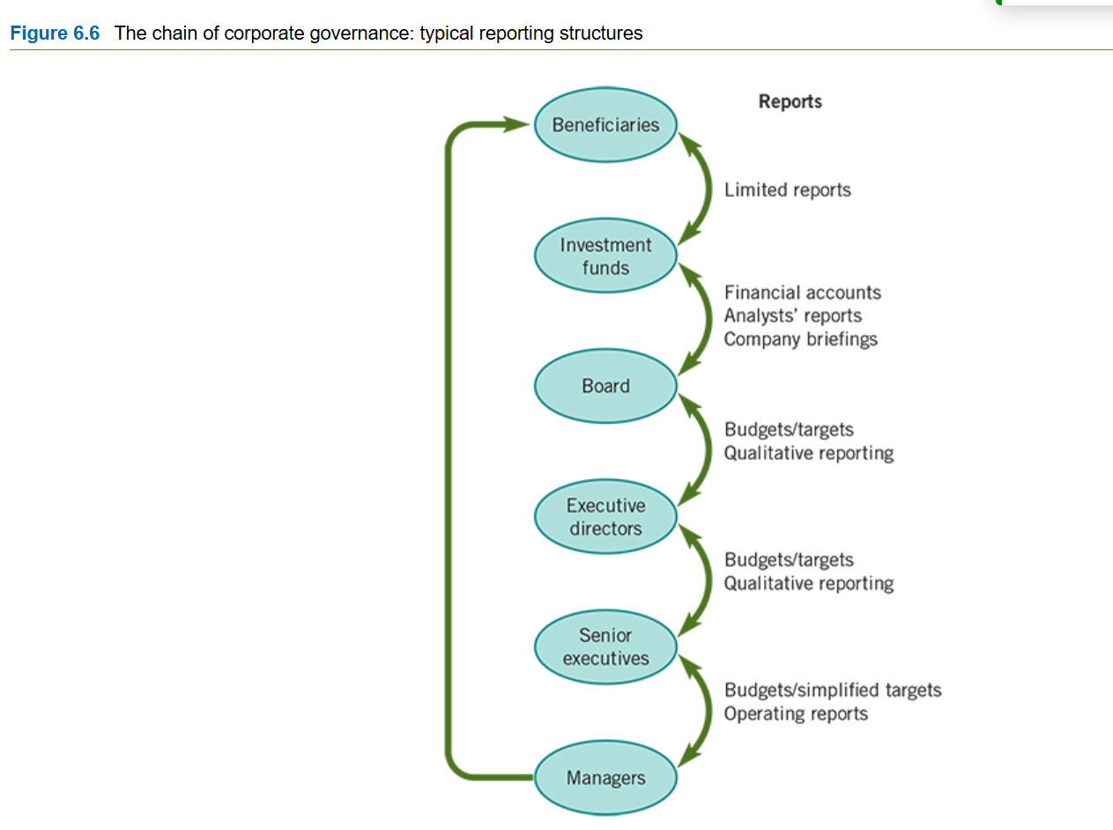
Organisational Governance
Notes:
rganisations are held accountable for their purpose by systems of corporate governance. Governance is concerned with the structures and systems of control by which managers are held accountable to those who have a legitimate stake in an organisation.34 Key stakeholders in governance are typically the owners, but may include other groups such as employee representatives. Connecting stakeholder values with management action is a vital part of strategy. Failures in governance have contributed to calamitous strategic choices in many leading companies, even resulting in their complete destruction. In 2020, the CEO of Wirecard, the German fintech company, was arrested on suspicion of falsifying financial accounts and the company went bankrupt with debts of €3.5bn and a further €1.9bn unaccounted for. The non-executive directors of the company, its auditors and the German financial regulator had all failed to ensure proper control over the company. With the survival of whole organisations at stake, governance is increasingly recognised as a key strategic issue.
Managers and stakeholders are linked together via the governance chain. The governance chain shows the roles and relationships of different groups involved in the governance of an organisation. In a small family business, the governance chain is simple: there are family shareholders, a board with some family members and there are managers, some of whom may be family too. Here there are just three layers in the chain. However, large publicly quoted corporations have more extended governance chains, potentially diluting accountability for strategy. Figure 6.6 shows a governance chain for a typical large, publicly quoted corporation. Here, the size of the organisation means there are extra layers of management internally, while being publicly quoted introduces more investor layers too. Thus, individual investors (the ultimate beneficiaries) often invest in public corporations through investment funds such as unit trusts or pension funds. Investment funds then invest in a range of companies on behalf of beneficiaries, providing them with limited reports on portfolio performance. In turn, the investment funds receive reports from the companies they invest in, in the form of briefings and annual accounts, the responsibility of company boards of directors. Boards are themselves at the top of an internal chain, in which each layer reports on performance against budgets and target, both quantitatively and qualitatively (i.e., verbal reports). In sum, the managers at the bottom are accountable to the ultimate beneficiaries at the top, but only through many layers of reporting. Beneficiaries may not even know in which companies they have a financial stake and have little power to influence companies’ strategies directly.
Economists analyse the relationships in such governance chains in terms of the principal–agent model.35 Here, ‘principals’ employ ‘agents’ to act on their behalf, just as homeowners pay estate agents to sell their homes. Classically, the principal is simply the owner and the agent is the manager. However, the reality for large publicly quoted corporations is usually more complex, with principals and agents at every level. In Figure 6.6, the beneficiaries are the ultimate principals and fund trustees and investment managers are their immediate agents in terms of achieving good returns on their investments. Further down the chain, company boards can be considered as principals too, with senior executives their agents in managing the company. Thus, there are many layers of agents between ultimate principals and the managers at the bottom, with the reporting mechanisms between each layer liable to be imperfect.
The governance issues in principal–agent theory arise from three problems:
●Knowledge imbalances. Agents typically know more than principals about what can and should be done. After all, it is they who are actually doing the job and they have presumably been hired for their expertise.
●Monitoring limits. It is very difficult for principals to monitor closely the performance of their agents. This limit is made worse because principals usually have many investments, so their attention is likely to be split several ways.
●Misaligned incentives. Unless their incentives are closely aligned to principals’ interests, agents are liable to pursue other objectives that reward them better. Principals might introduce bonus schemes in order to incentivise desired performance, but then agents may game the system: for example, they might use their superior knowledge to negotiate bonus targets that are, in reality, easy to meet.
Principal–agent theory, therefore, stresses the importance of knowledgeable principals, effective monitoring systems and well-designed incentives in order to make sure that large organisations actually pursue the purposes that their owners set for them. Illustration 6.3 on Zee Entertainments reveals some of the problems of shifting ownership and the mixing of principal and agent roles.

Slide 11
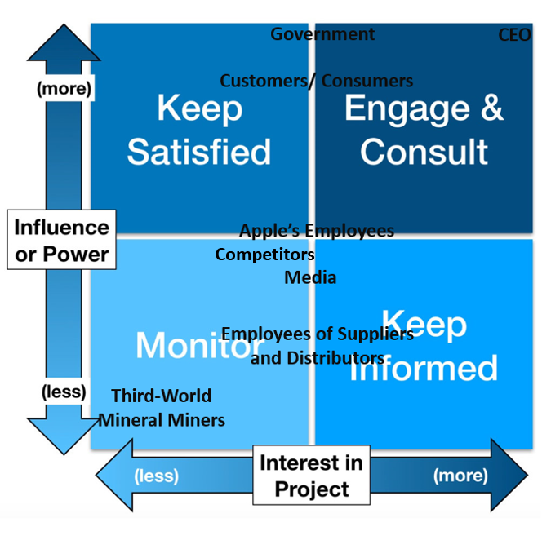
Stakeholder Analysis:
Mendelow’s (1981) Power/Interest Matrix
This allows businesses to identify
Stakeholder’s interests and influences towards a project
Which method and level of communication that is needed
How to increase stakeholder interests
However
It is a subjective viewpoint
Doesn’t identify whether interests are positive or negative

Slide 12
How to conduct a Stakeholder Analysis
1. Identify Stakeholders
Brainstorm broadly
to identify all individuals, groups, and entities, both internal (employees, leadership) and external (customers, suppliers, regulators), who are invested in your project or strategy.
Ask key questions
to ensure comprehensive identification: Who cares about this project? Who will be impacted? Who can influence it? Who must approve it?
Notes:
To conduct a stakeholder analysis for business strategy, identify all stakeholders who can affect or be affected by your strategy, then prioritize them using a power-interest grid to assess their influence and interest levels. Next, understand each group's needs, expectations, and motivations to anticipate their reactions. Finally, develop tailored communication and engagement strategies for different stakeholder groups and monitor and adjust these plans as the strategy evolves.

Slide 13
How to conduct a Stakeholder Analysis
2. Prioritize Stakeholders
Create a Power-Interest Grid: (also known as a power/interest matrix) to categorize stakeholders.
  High Power, High Interest: "Manage Closely" – Engage these key players actively.
  High Power, Low Interest: "Keep Satisfied" – Keep them informed and address concerns to prevent issues, but don't over-engage them.
  Low Power, High Interest: "Keep Informed" – Provide regular updates and information.
  Low Power, Low Interest: "Monitor" – Keep a watchful eye on changes but require minimal communication.

Slide 14

How to conduct a Stakeholder Analysis
Notes:
This video explains the different levels of engagement for each category in a stakeholder matrix: https://www.youtube.com/watch?v=PXCo92Iag3g&t=93s

Slide 15
How to conduct a Stakeholder Analysis
3. Understand Stakeholder Needs & Interests
Dig deeper: to uncover their specific needs, concerns, motivations, and expectations.
Assess alignment: with your business strategy's priorities and identify any potential conflicts.
Consider potential reactions: to the strategy, including positive and negative views, and brainstorm ways to address resistance or build support.

Slide 16
How to conduct a Stakeholder Analysis
4. Develop Engagement Strategies
Tailor your approach: for each stakeholder group based on their position in the power-interest grid.
Create a communication plan: that defines the best methods and frequency for engaging with each group.
Incorporate stakeholder feedback: into the strategy and project planning to improve outcomes and secure buy-in.

Slide 17
How to conduct a Stakeholder Analysis
5. Monitor & Adjust
Regularly review and update: your stakeholder analysis.
Monitor for shifts: in stakeholders' needs, priorities, and levels of influence as the project or strategy progresses.
Be prepared to adjust: your strategies and communication plans to maintain alignment and manage emerging challenges.

Slide 18
Stakeholder Analysis
Summary
Purpose
Values
Stakeholders
Introduced Stakeholder Analysis:
Mendelow’s (1981) Power/Interest Matrix
Introduced how to conduct a Stakeholder Analysis

Slide 19
CSR
Caroll’s CSR Pyramid (Carroll, 1991)
Economic
Legal
Ethical
Philanthropic
Notes:
1. Carroll’s CSR Pyramid
Carroll’s CSR Pyramid suggests that businesses have four types of responsibility: economic, legal, ethical and philanthropic. The economic responsibility is to remain profitable and financially viable. Businesses must also obey the law, behave ethically even where the law does not require it, and contribute voluntarily to society through activities such as charitable giving or community initiatives. The model can be used to examine whether an organisation's CSR activities represent a genuine commitment to wider responsibilities or are primarily focused on reputation and profitability.
How students could use it: Students could apply the pyramid to a company such as Tesco or Unilever and examine how its CSR activities address the four responsibilities. They could then critically consider whether the different responsibilities can conflict with each other and whether CSR can realistically be separated from the need to make a profit.

Slide 20
CSR
Stakeholder theory – Freeman (Freeman, 1984)
Employees
Customers
Suppliers
Local communities
Governments
Investors
Environmental groups
Notes:
2. Stakeholder Theory – Freeman
Stakeholder Theory argues that organisations should consider the interests of all stakeholders, rather than focusing exclusively on shareholders. Stakeholders can include employees, customers, suppliers, local communities, governments, investors and environmental groups. The theory suggests that organisations can achieve longer-term success by developing relationships with these different groups and recognising their interests when making strategic decisions.
How students could use it: Students could examine a company's CSR activity and identify which stakeholders benefit from it. They could then consider whether the organisation is genuinely responding to stakeholder needs or simply using CSR to improve its reputation. Students could also explore situations where stakeholder interests conflict—for example, when improving employee conditions increases costs for shareholders—and evaluate how the organisation should respond.

Slide 21
CSR
The Triple Bottom Line (Elkington, 1997)
People
Planet
Profit
Notes:
The Triple Bottom Line (TBL) suggests that organisational performance should not be judged solely by financial profit. Instead, organisations should consider three dimensions: People, Planet and Profit. The approach encourages businesses to consider their social and environmental impacts alongside their economic performance. It therefore provides a useful framework for thinking about sustainability as part of business strategy rather than as a separate CSR activity.
How students could use it: Students could select a company's CSR or sustainability initiative and assess its impact across the three dimensions. For example, they might consider whether a move towards sustainable packaging benefits the Planet, improves outcomes for People, and remains financially viable through Profit. They can then critically evaluate whether the organisation has genuinely achieved a balance between the three or whether one dimension has been prioritised over the others.

Slide 22
CSR
Creating Shared Value – Porter Kramer (Porter & Kramer, 2011)
Argues that businesses can create economic value by addressing social problems.
Notes:
Creating Shared Value – Porter & Kramer
Creating Shared Value (CSV) argues that businesses can create economic value by addressing social problems. Rather than seeing CSR as something separate from the core business, Porter and Kramer suggest that social and environmental issues can sometimes provide opportunities for innovation, competitive advantage and business growth. For example, developing more sustainable products may benefit society while also creating new markets or reducing business costs.
How students could use it: Students could examine whether a company's CSR activity creates value for both the organisation and society. They might consider whether the activity creates new customers, reduces costs, improves efficiency, strengthens competitive advantage or opens new markets. They should also question whether the claimed social benefits are genuine and whether CSV risks presenting social responsibility primarily as a means of making profit. This allows students to critically assess whether CSR can become an integral part of competitive strategy.

Slide 23
References
Carroll, A. B. (1991). The pyramid of corporate social responsibility: Toward the moral management of organizational stakeholders. Business Horizons, 34(4), 39–48. https://doi.org/10.1016/0007-6813(91)90005-G
Elkington, J. (1997). Cannibals with forks: The triple bottom line of 21st century business. Capstone.
Freeman, R. E. (1984). Strategic management: A stakeholder approach. Pitman.
Mendelow, A. (1981). Stakeholder analysis for strategic planning. Long Range Planning, 14(5), 12-21.
Porter, M. E., & Kramer, M. R. (2011). Creating shared value. Harvard Business Review, 89(1–2), 62–77.

