Slide 1
LCHS4006 Psychology in Health and Social Care
Individual Presentation – Working with children in a social care setting age group: 7-11 years
Student Name: SAsha ahmed
Student ID: 2123641
LEcture name: emmanuel asante

Slide 2
Introduction
This presentation will focus on the developing two creche activities of refugee children aged from 7 to 11 years.
As a lead volunteer of the centre I am going to explain two progressive activities for these children, while their mothers will attend a weekly one-hour support session.
Moreover, a psychological theory will be discussed for a better understanding of these activities.

Slide 3
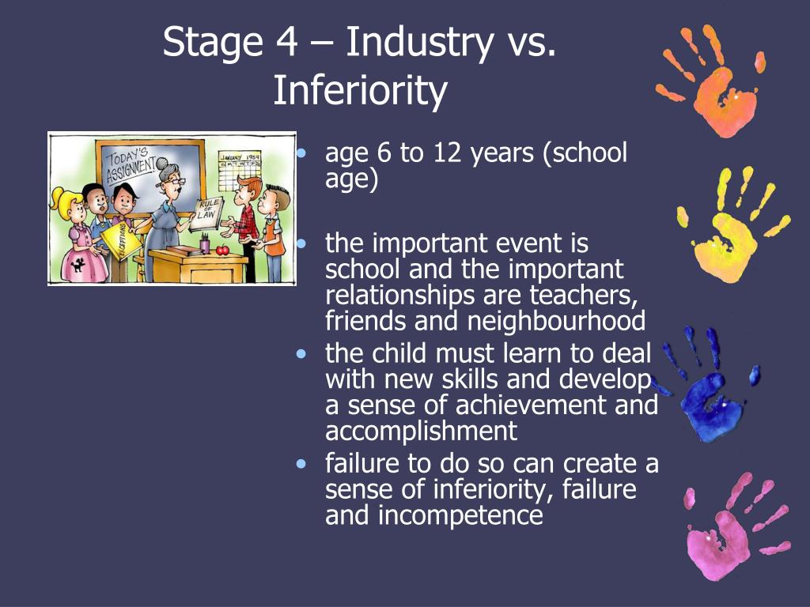
Psychological Theory
Psychologist Erik Erikson suggested the psychosocial theory of development in 1950.
▪︎In this theory Erikson classified the human life span into eight stages, the fourth stage is about elementary (7-10 years) children who either end up in the industry group or the inferiority group (Maree, 2022).
▪︎If a child of this age is nurtured well, he can gain skills and new knowledge which will make him industrious. On the other hand, they might go through an inferiority complex if they are not given proper guidance and security.
▪︎The children of a refuge centre are already deprived of many primary rights, that’s why these elementary children need to learn important social factors to understand self-worth (Pobjoy, 2017).

Slide 4

Activity 1
One mandatory activity should be reading comic books that mention social issues (Khofifah and Ramadan,2021). The animation of these books attracts the children, so they can enjoy their leisure time and gain knowledge at the same time. Further, these comics will create communicational awareness among the kids which supports Erikson’s theory. Though these comic books might look thinner to older people still it is long stories for children, which is why they shouldn’t read more than two books a week since it will put pressure on them (Scheck, 2014). Their mothers can read with them to help them in understanding the themes.

Slide 5
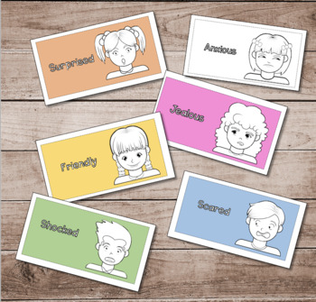
Activity 2
Another beneficial activity for these children would be playing emotion charades.
▪︎ In this game various emotions are written on paper chits then they are dropped in a hat from which each child picks out a chit. The mentioned emotion is acted by that child.
▪︎Refugee children can play this with their friends, and their mothers can also participate to monitor their growth.
▪︎This activity will enable the kids to recognize emotions and behaviours in different circumstances. Their adaptation to environmental and social structure becomes easier, it motivates them to develop adequate communicational skills (Rauvola and Rudolph,2022).
▪︎This activity further aligns with Erikson’s theory according to which understanding social concepts can prevent inferiority in children (Daniels and Rabar, 2019).

Slide 6
Conclusion
Children in refuge centres need extra care and attention than children growing up in a healthy domestic environment, the responsibility for the volunteers is much more when the shelter is women based. Due to the hardships of single parenting volunteers need to plan activities that will help in the children’s mental and social development. This essay discussed two such activities which will assist elementary kids in acquiring social skills. To understand the significance of these activities, a correlation between them and Erikson’s psychosocial theory has been analysed too.

Slide 7
References
Daniels, N. and Rabar, S. (2019). Social skills activities for kids : 50 fun activities for making friends, talking and listening, and understanding social rules. Emeryville, California: Rockridge Press.
Khofifah, S. and Ramadan, Z.H. (2021). Literacy conditions of reading, writing and calculating for elementary school students. Journal of Education Research and Evaluation, 5(3), pp.342-349.
Maree, J.G. (2022). The psychosocial development theory of Erik Erikson: critical overview. The Influence of Theorists and Pioneers on Early Childhood Education, pp.119-133.
Pobjoy, J.M. (2017). The Child in International Refugee Law. Cambridge University Press.
Rauvola, R.S. and Rudolph, C.W. (2022). Integrating lifespan development theories: Implications for the study of age (ing) and work. In Age and Work. Taylor & Francis.
Scheck, S. (2014). The Stages of Psychosocial Development According to Erik H. Erikson. München: GRIN Verlag GmbH.

