Slide 1
How did Hitler remove boundaries to consolidate his power as a dictator?

Slide 2
Introduction
In this PowerPoint I will be talking about the boundaries that Adolf Hitler had to overcome to consolidate his power as a dictator from January 30th 1933 to August 2nd 1934. At this time Hitler is Chancellor and Paul Von Hindenburg is President of Germany.

Slide 3
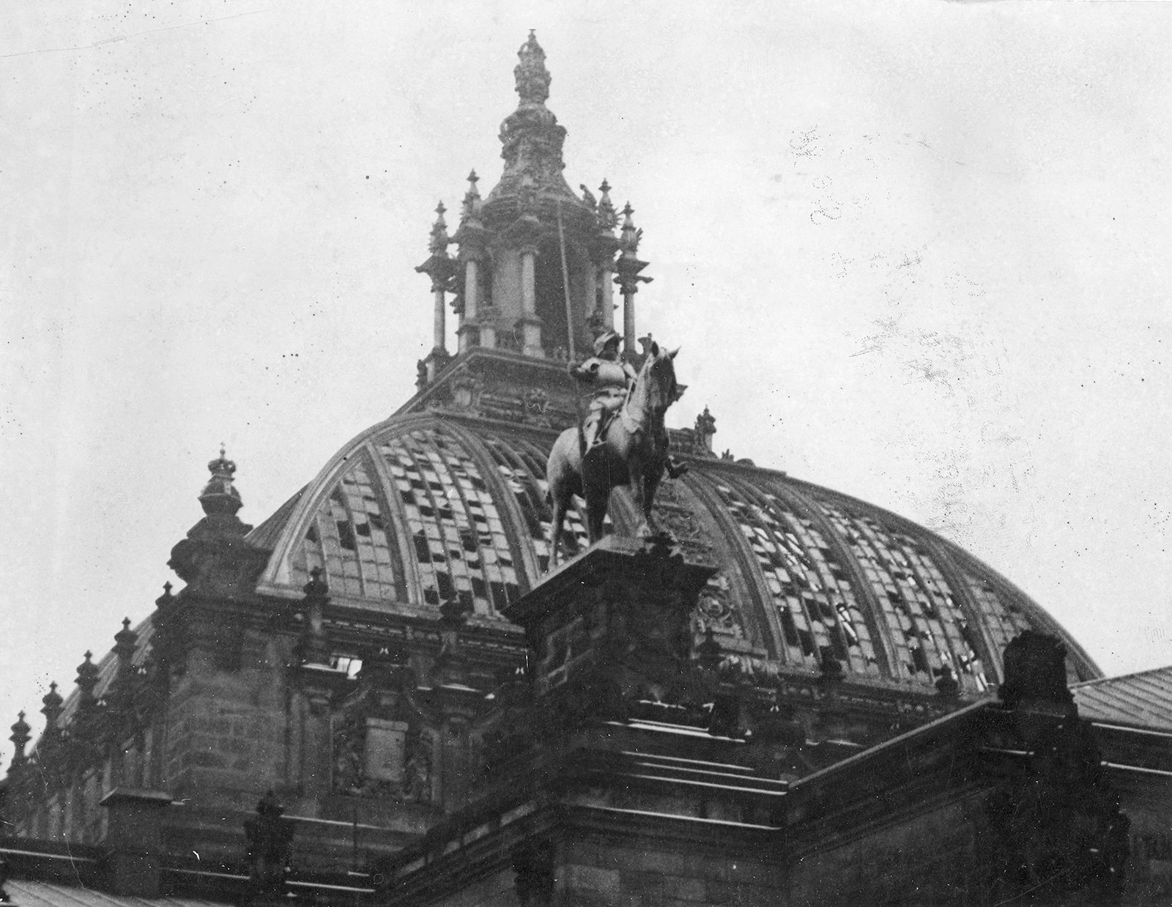
Enabling Act
Legislation that allowed Hitler to create and pass legislation without the use of the democratic system1.
A temporary enabling act was passed due to a fire in the Reichstag2.
To pass the enabling act Hitler needed two thirds of the vote3.
The bill passed 444 to 944.
This allowed Hitler to consolidate his power further and create a one party state.
5

Slide 4
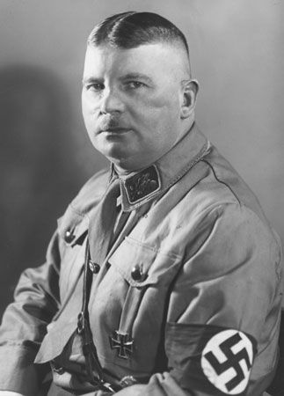
Night of the Long Knives
This was an event that happened on June 30th 1934 to eliminate opposition in Hitlers own party1.
Hitler feared that the SA had become too powerful and were a threat to his position as a dictator2.
On the night of June 30th Hitler ordered the murder of Ernst Rohm and other leaders of the SA. Along with the leaders of the SA Hitler ordered the elimination of others such as Gustav von Kahr, Edgar Jung and Erich Klausener3.
4

Slide 5
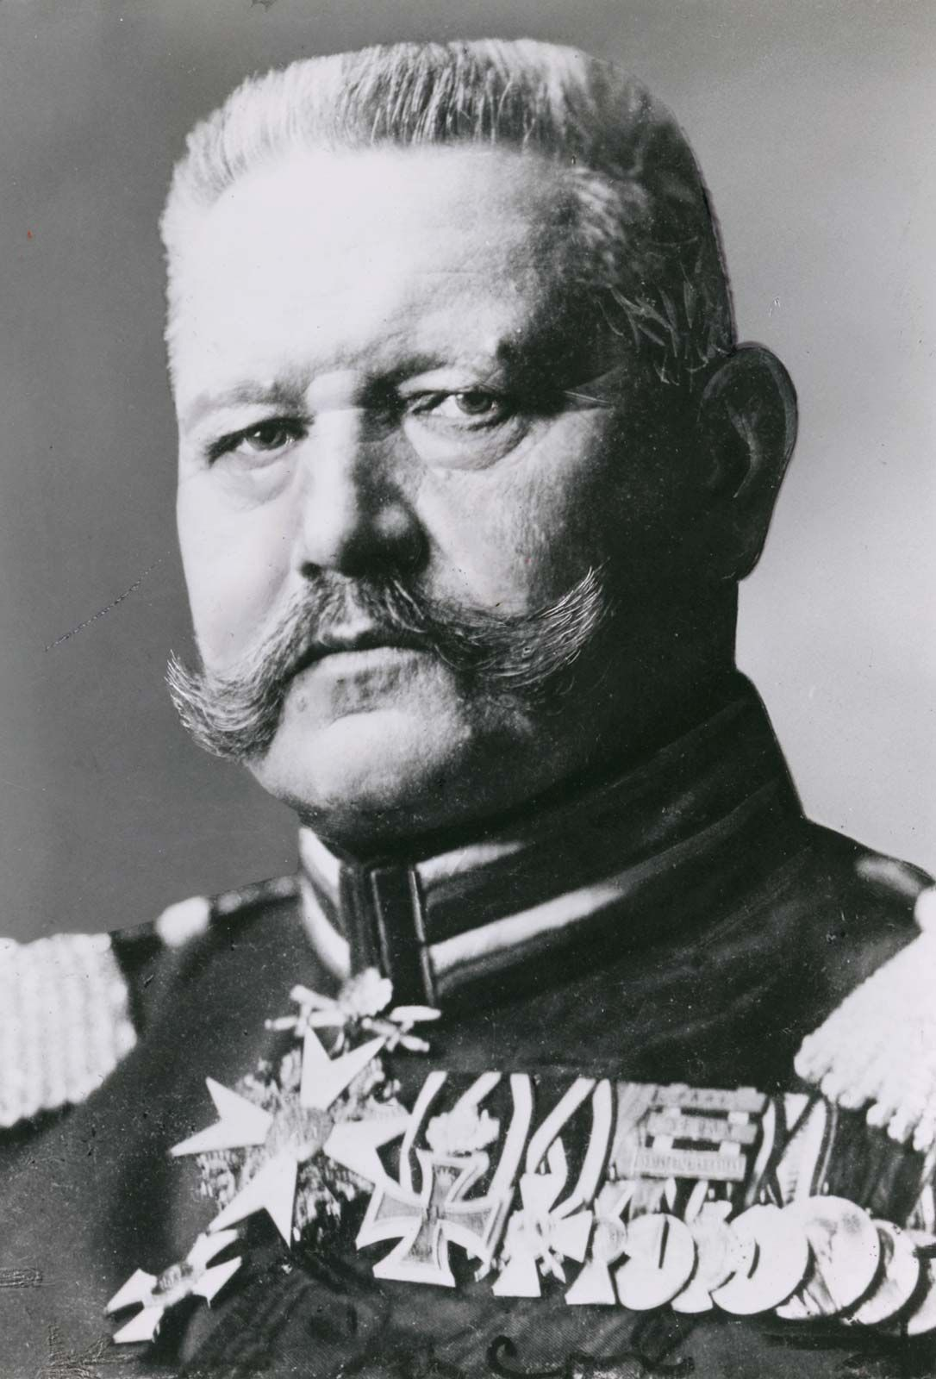
Paul Von Hindenburg
- Can be considered to be both a boundary and an enabling factor.
By July 1933 Germany already a one party state, however Hitler cannot completely consolidate power as Hindenburg is still president of Germany and can take Hitler out of power1.
Hindenburg does not intervene with the Night of the Long Knives or the passing of the Enabling Act.
- Hindenburg Dies August 2nd 1934, within 24 hours of his death Hitler proclaims himself as the new leader of Germany, thus consolidating his power as a dictator2.
3

Slide 6
Conclusion
In Summary Hitler mainly overcame the boundaries to consolidate his power democratically. However, there were boundaries that Hitler couldn’t overcome such as Hindenburg.

Slide 7
Bibliography
Britannica, The Editors of Encyclopaedia. "Enabling Act". Encyclopedia Britannica, 26 April 2024, Available at:https://www.britannica.com/topic/Enabling-Act . Accessed 3rd November 2024.
2. The Holocaust Explained. “How did the Nazi Gain Power”, No Date, Available at: https://www.theholocaustexplained.org/the-nazi-rise-to-power/how-did-the-nazi-gain-power/. Accessed 3rd November 2024.
3. Britannica, The Editors of Encyclopaedia. “Reichstag Fire”. Encyclopedia Britannica, No Date, Available at: https://www.britannica.com/event/Reichstag-fire#/media/1/496432/252914. Accessed 3rd November 2024.
4. Britannica, The Editors of Encyclopaedia. "Night of the Long Knives". Encyclopedia Britannica, 25 October 2024, Available at:https://www.britannica.com/event/Night-of-the-Long-Knives. Accessed 3rd November 2024.
5. Britannica, The Editors of Encylopaedia. “Night of the Long Knives. Encyclopedia Britannica, Available at: https://www.britannica.com/event/Night-of-the-Long-Knives#/media/1/414975/31010. Accessed 3rd November 2024.
6. Britannica, The Editors of Encyclopaedia. “Paul Von Hindenburg”. Encyclopedia Britannica, No Date, Available at: https://www.britannica.com/biography/Paul-von-Hindenburg#/media/1/266224/101290. Accessed 3rd November 2024.

