Slide 1
Professional Promotion
By Nicole Wallace

Slide 2

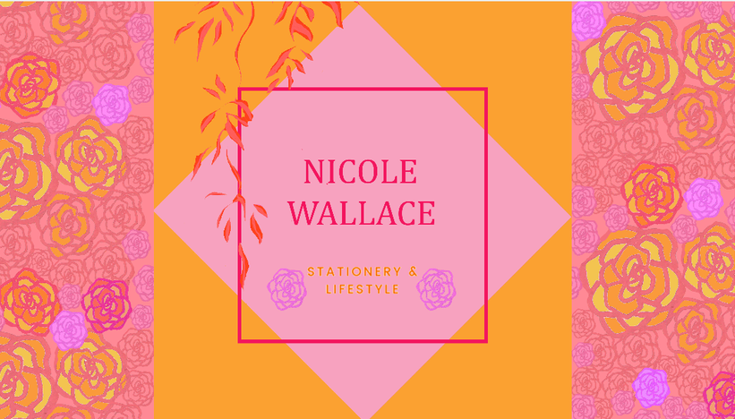
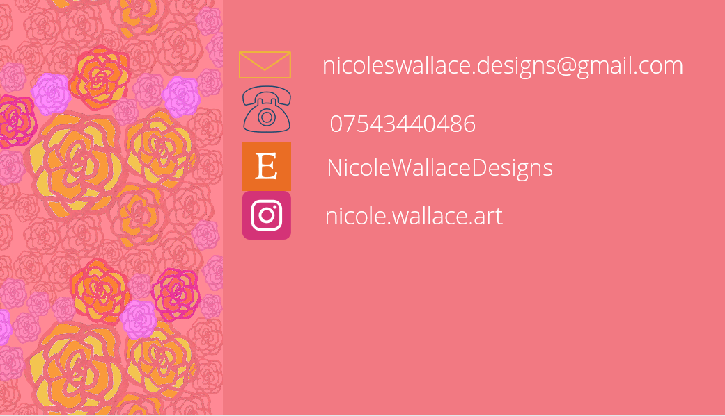
My Final Logo and Business Card Designs

Slide 3
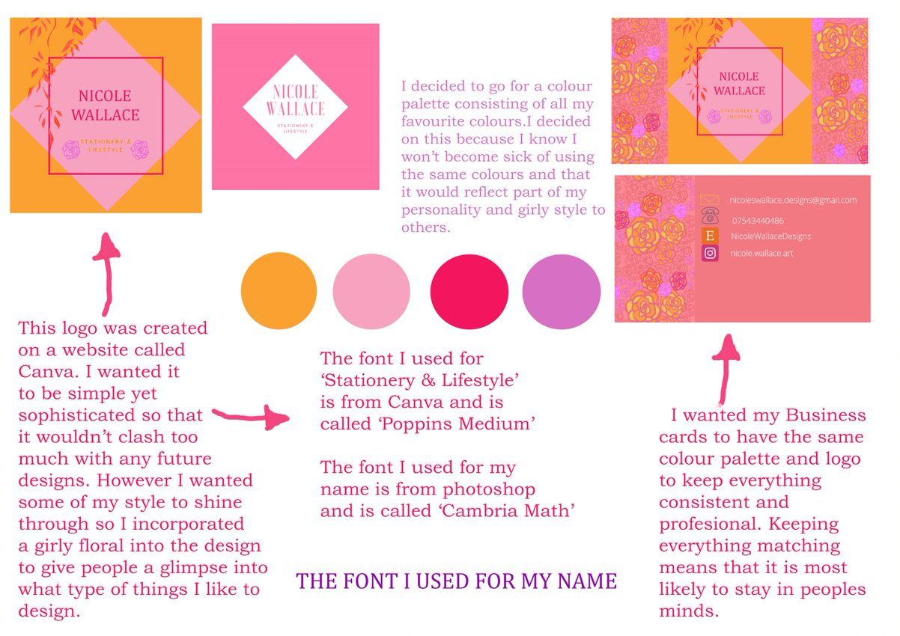

Slide 4
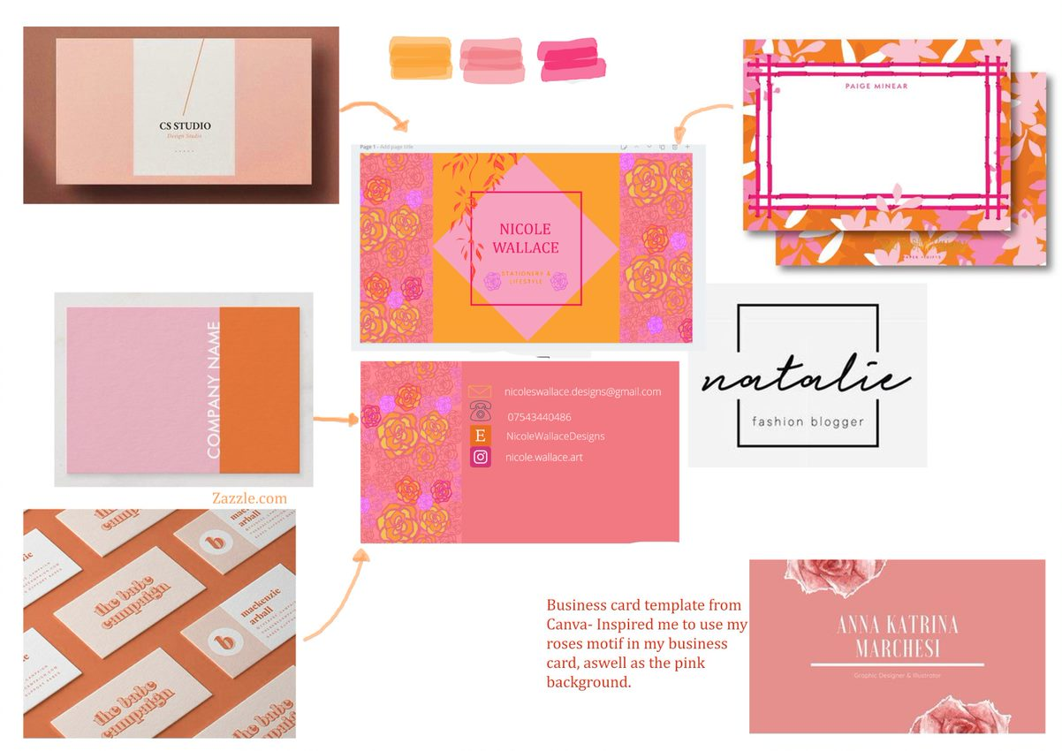

Slide 5
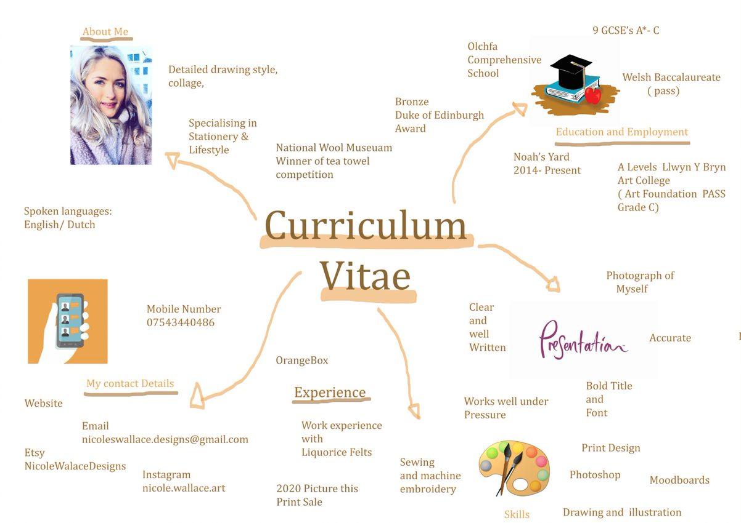

Slide 6
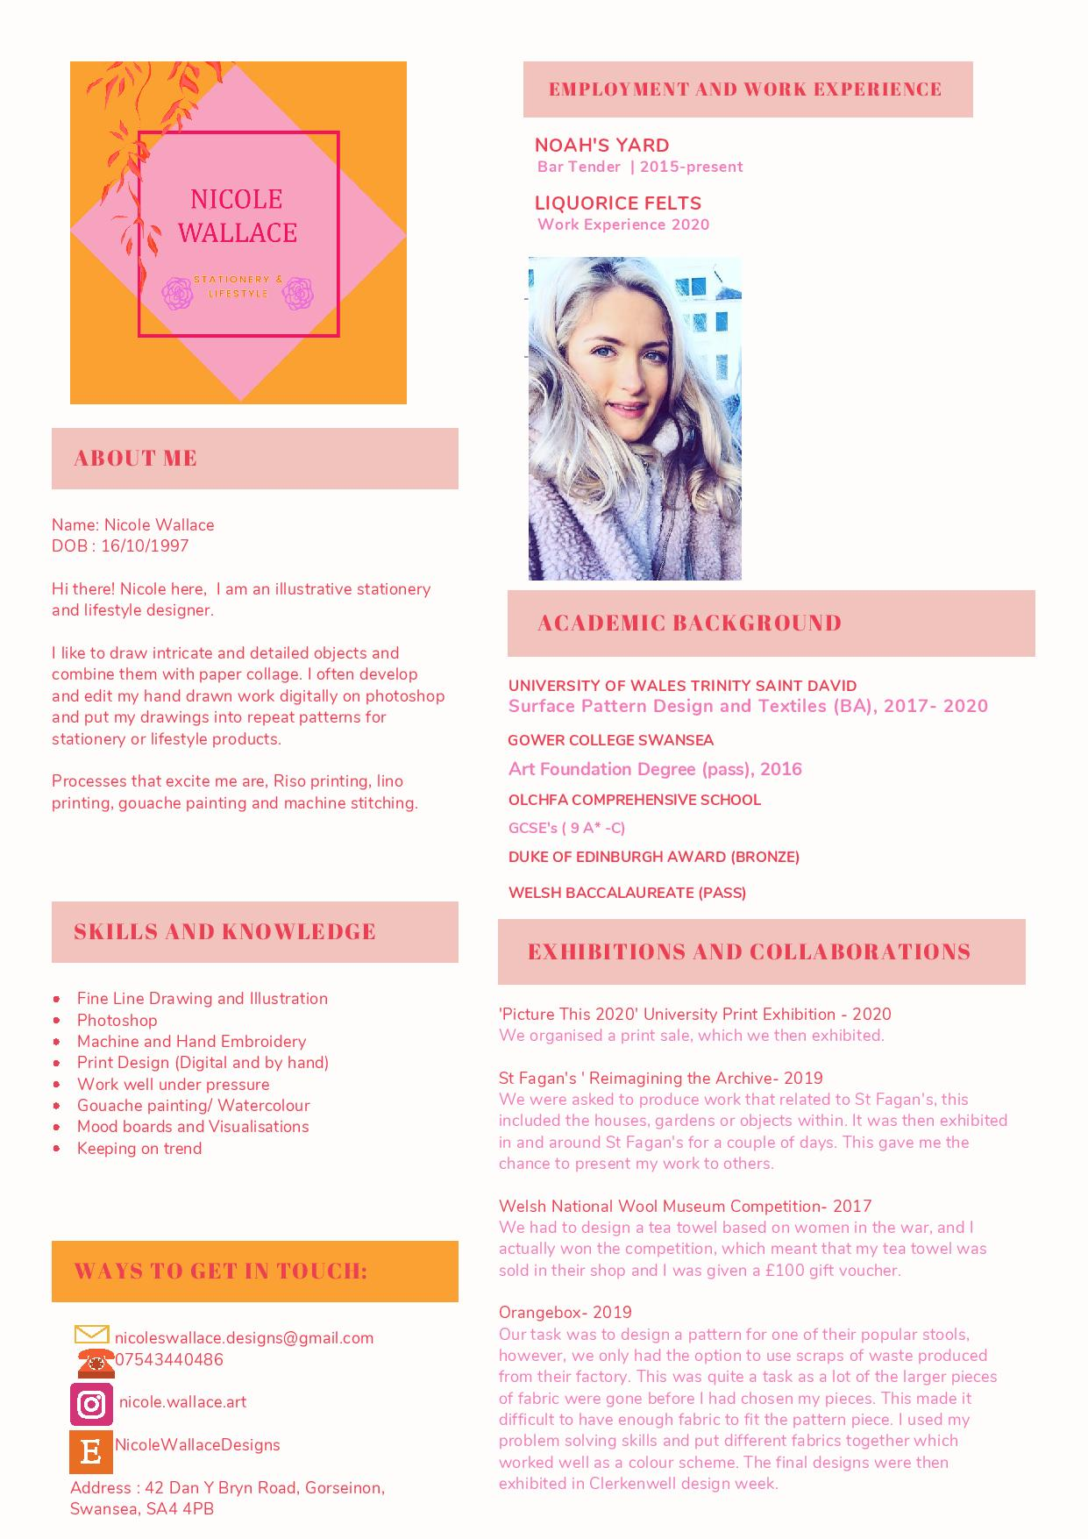

Slide 7
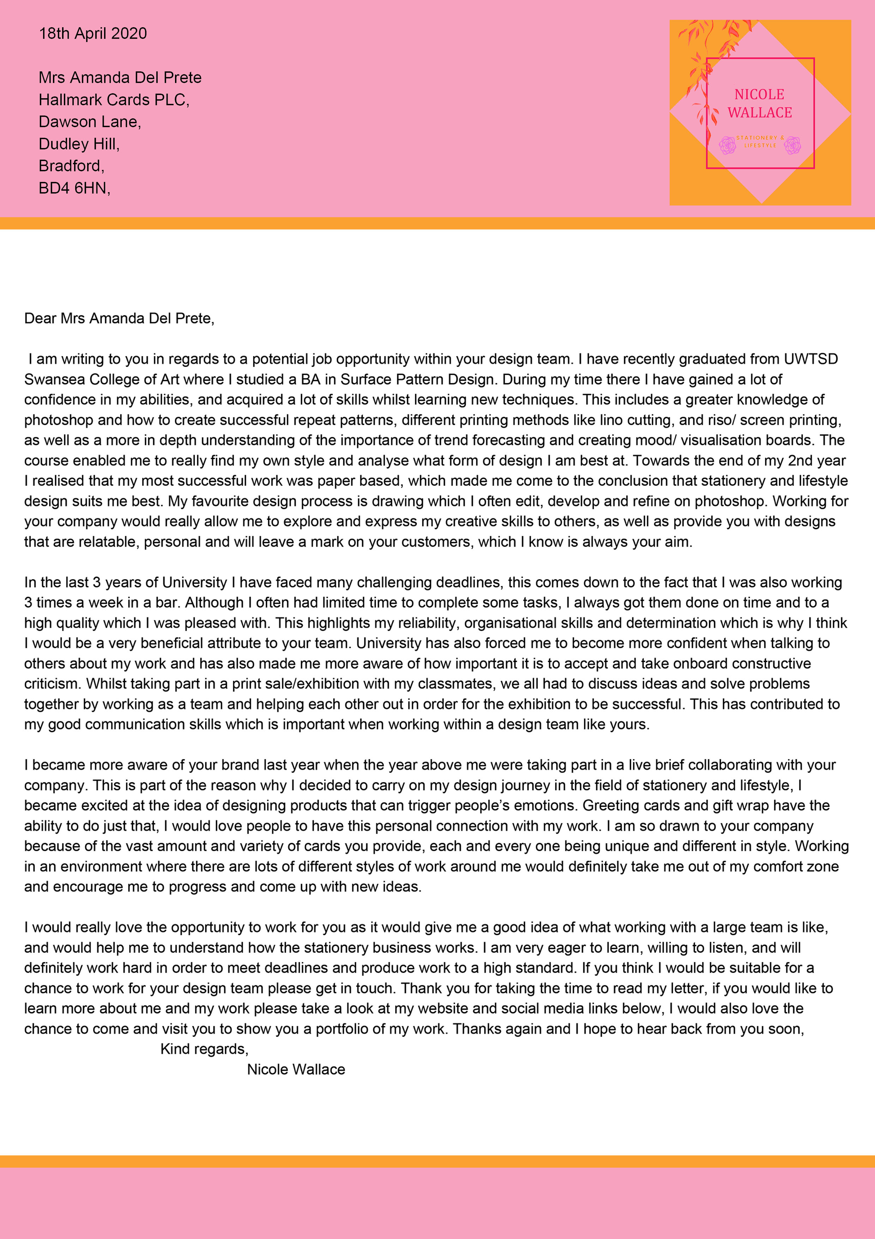
Letter to a
Potential employer

Slide 8
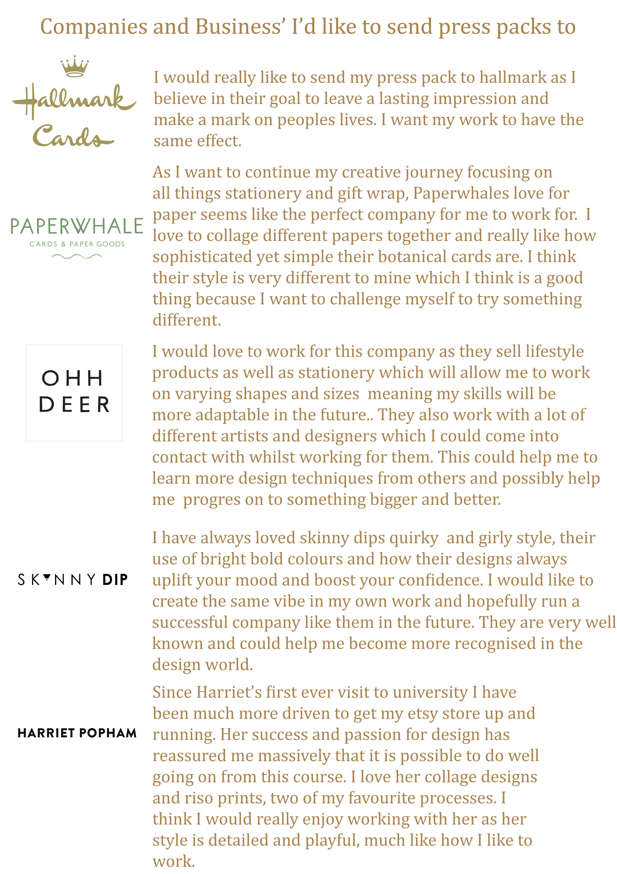
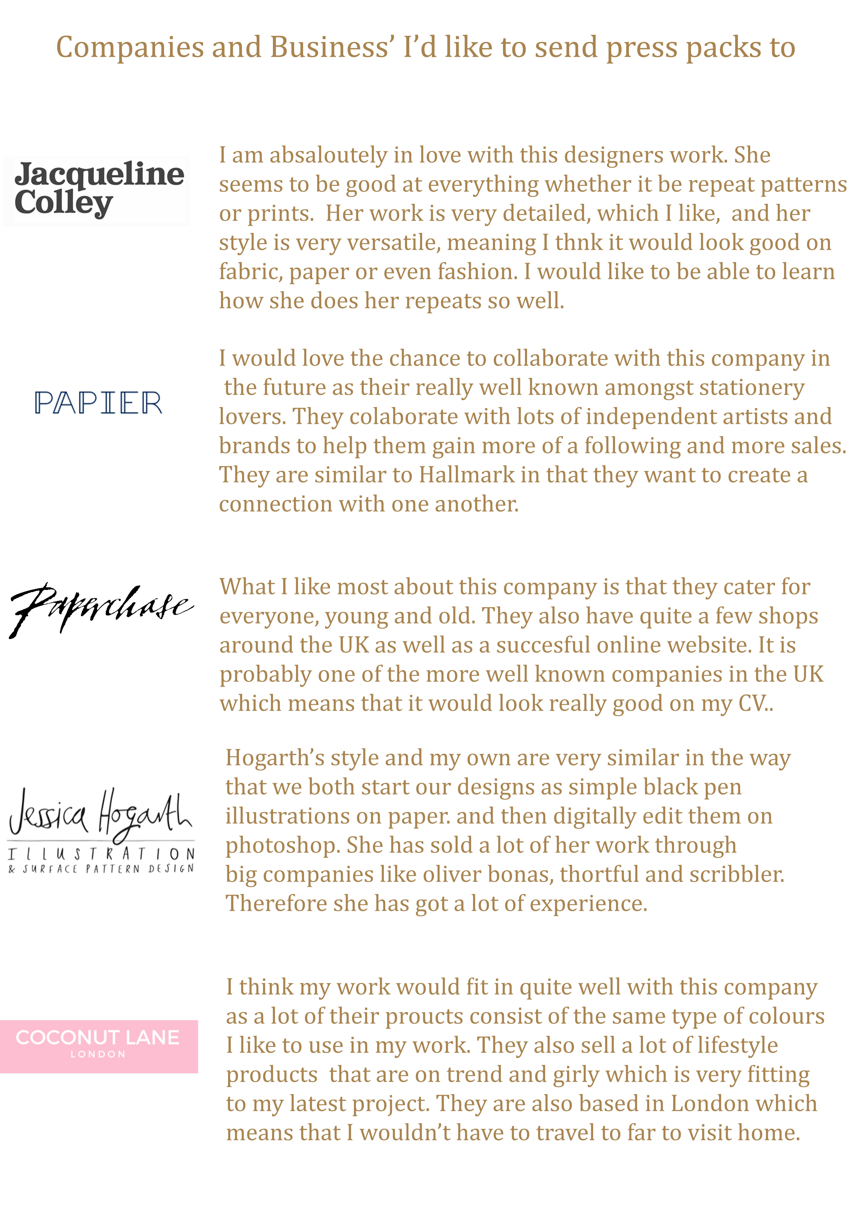

Slide 9
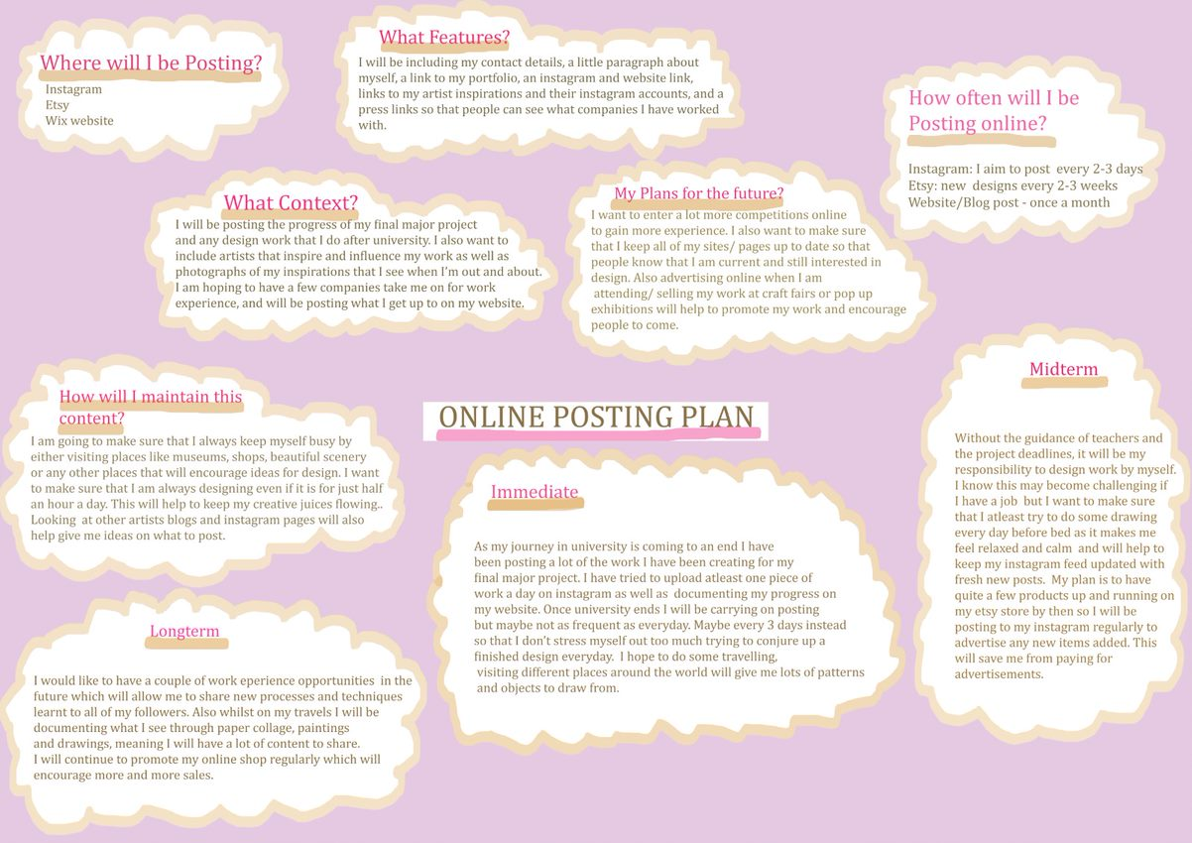

Slide 10
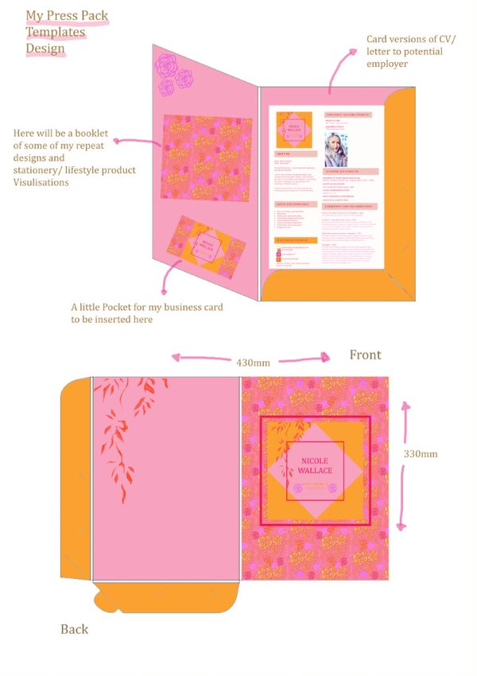

Slide 11
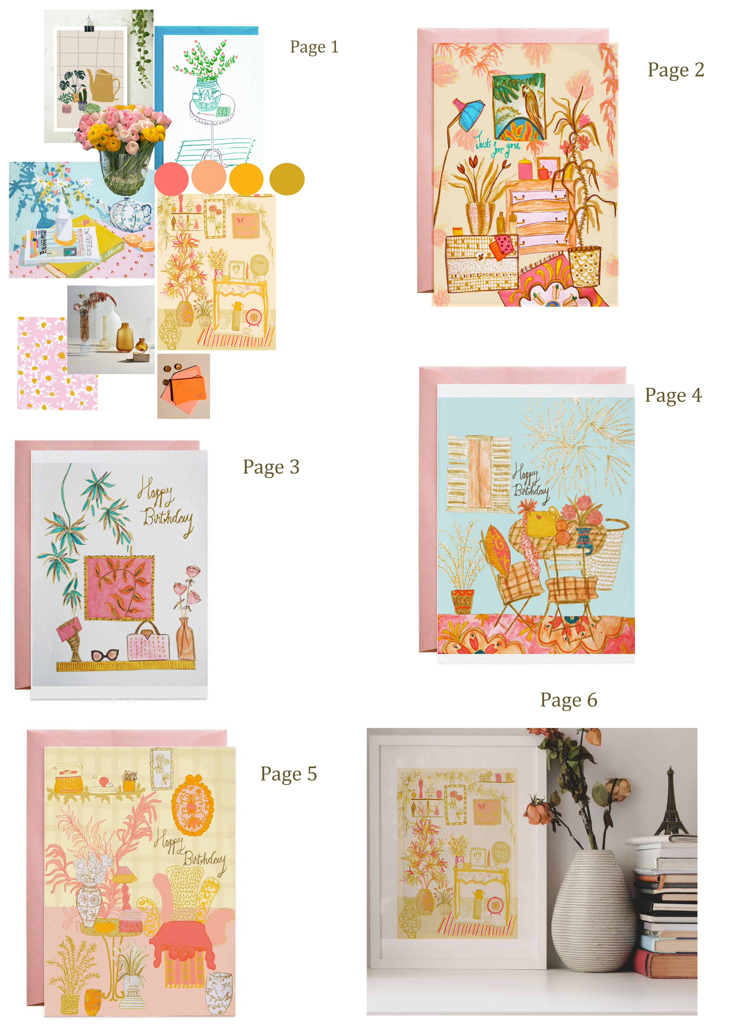
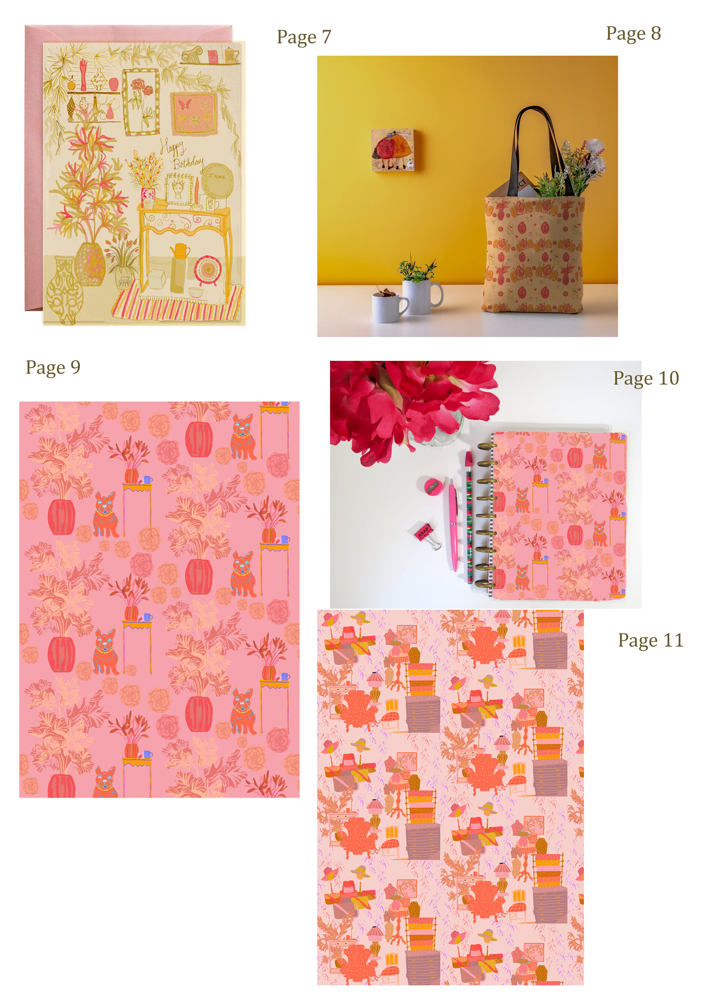
Here are the pages
That I will include in
The booklet of my
Work in my press
Pack!

Slide 12
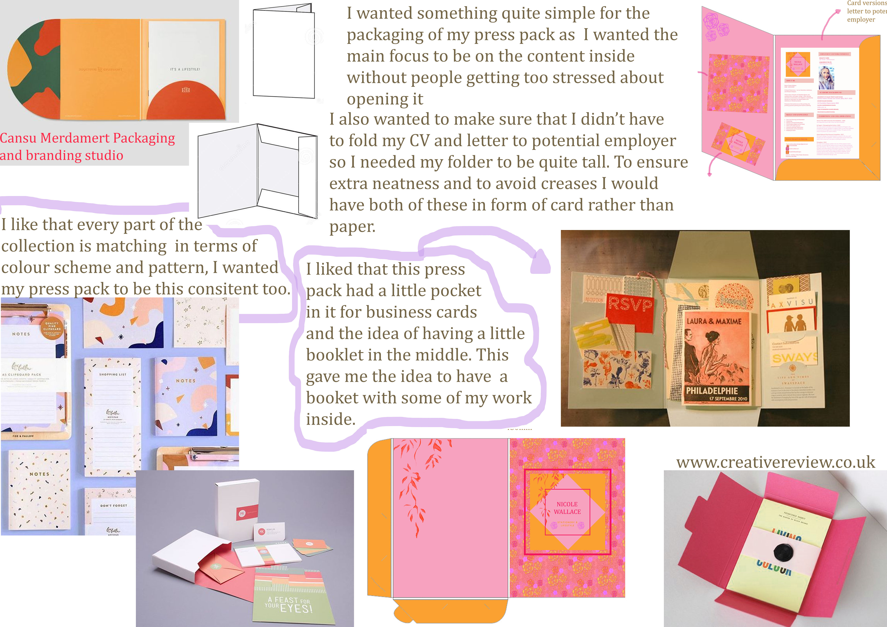

Slide 13
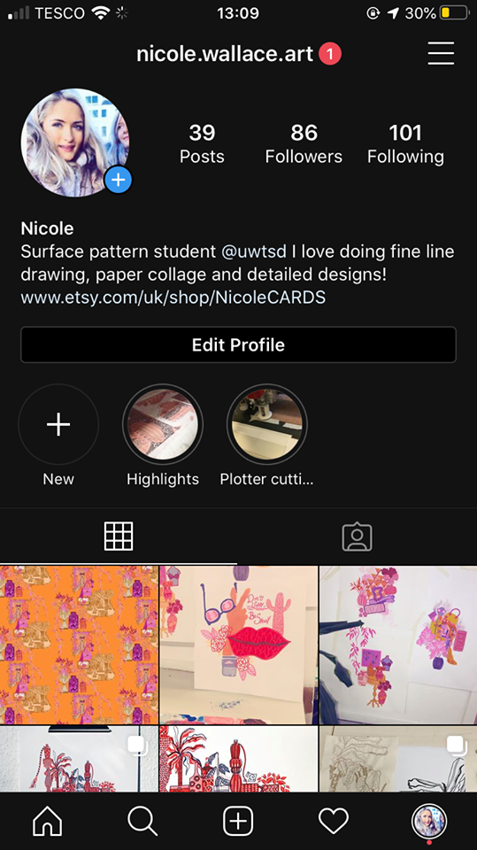
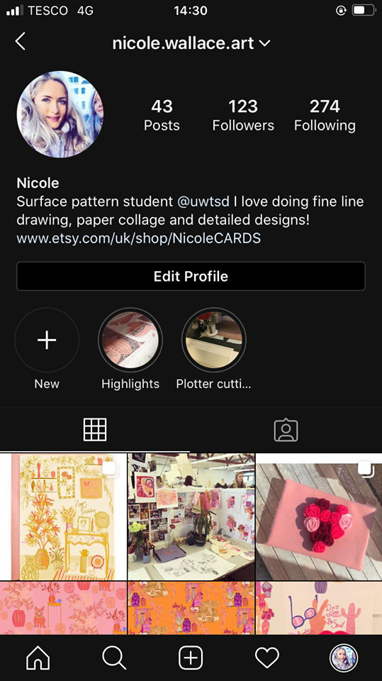
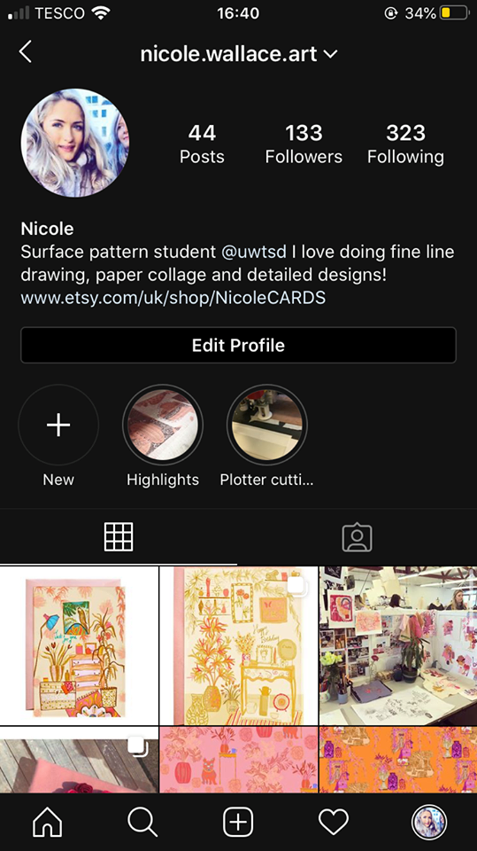
Following more people on instagram, posting more things and liking other artists' posts have helped me gain more of a following on social
Media
My Online Presence
Instagram: nicole.wallace.art
https://nicolesanne28.wixsite.com/website-1 - My website link
Etsy- NicoleWallaceDesigns

Slide 14
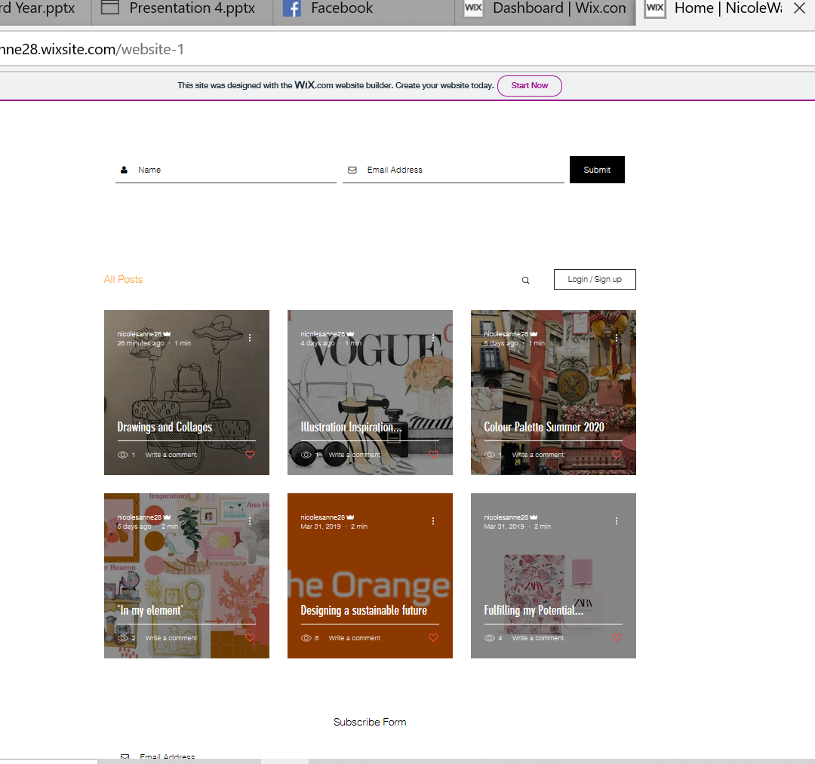
I have also been adding
Blogposts to my website
Regularly to keep it up to date

Slide 15


