Slide 1
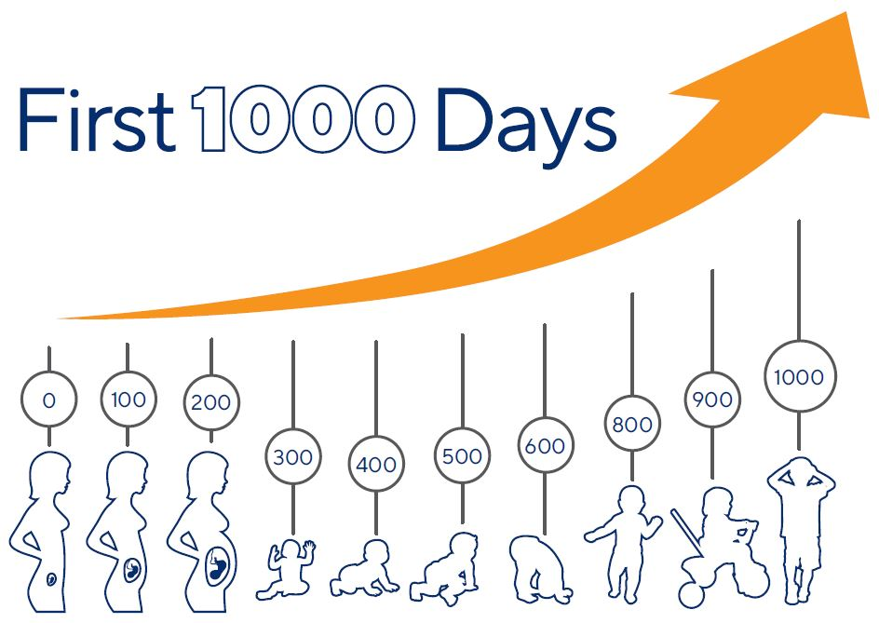
The first 1000 days
2405002
ECEY4005/C
(Ausnutria Nutrition Institute, n.d.)

Slide 2

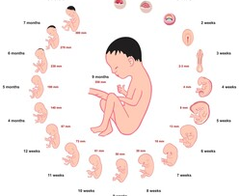
What is the first 1000 days?
The first 1000 days is a child’s life from conception to the age of 24 months. Within the first 1000 days a child’s brain, body and immune system grow and develop the most (Australia, 2021).
Nutrition within the first 1000 days has an impact on a child’s growing brain. A mother’s nutrition has an impact on the child during pregnancy. It is important that women have good nutrition within their pregnancy to benefit the development of the baby. If a child has poor nutrition, it can have a major impact on the child’s brain and affect how well they do in school within the future and later in life when they become adults and begin working (Thousand Days, 2018).
(Adobe Stock, n.d.)

Slide 3
What is the first 1000 days?
Pregnancy
Within pregnancy the baby will develop the most. During the first 12 weeks of pregnancy a baby will have formed all their organs, limbs, bones and muscles. The heart and digestive system have also been developed, and the baby will have a strong heartbeat. By 20 weeks the mother will begin to feel the baby move within the stomach. By 32 weeks a baby’s organs have fully developed, and their lungs are strong enough to breath air. The baby’s brain is rapidly developing, and they can hear and see. By 40 weeks the baby’s brain has developed and is able to control their temperature when they leave the womb (Health direct Australia, 2024).
Infancy
By the age of 2 months an infant will be able to lift and turn their head when they are laying on their back. By the age of 6 months an infant will be able to sit up alone without any support. They are also able to grasp blocks using the ulnar palmar grasp. They will also be able to babble and laugh by the age of 6 months. By 12 months an infant will be able to balance while standing alone and will begin to take some steps. An infant will also be able to imitate sounds and say “mama” and “dada” (MedlinePlus, 2023).
Toddler
By the time a toddler is 2 years old they will most likely be able to say a range of sentences up to 2-4 words. They will have developed the ability to identify items when the names are said. They will begin to copy the carers/practitioners around them. They will show more independence as they develop further. (YOUR BABY AT 2 YEARS, n.d.)

Slide 4
Why is the first 1000 days important?
The first 100 days is important as this period has a life-long effect on a child’s health and wellbeing. It is important that children have a loving and secure relationship with their carer as this is the key aspect of how a baby will learn to think, communicated and show their emotions. Interacting with a baby/child is important as they begin to imitate what they see and hear. While the baby is in the womb the food the mother intakes is what the baby intakes therefore it is important that women eat a healthy diet during pregnancy as this can have an impact on a baby within the future (Australia, 2021b). Breastfeeding is encouraged during the first 6 months as it meets the needs of the baby’s nutrition, and it can protect a baby from infections and diseases (NHS, 2023).

Slide 5
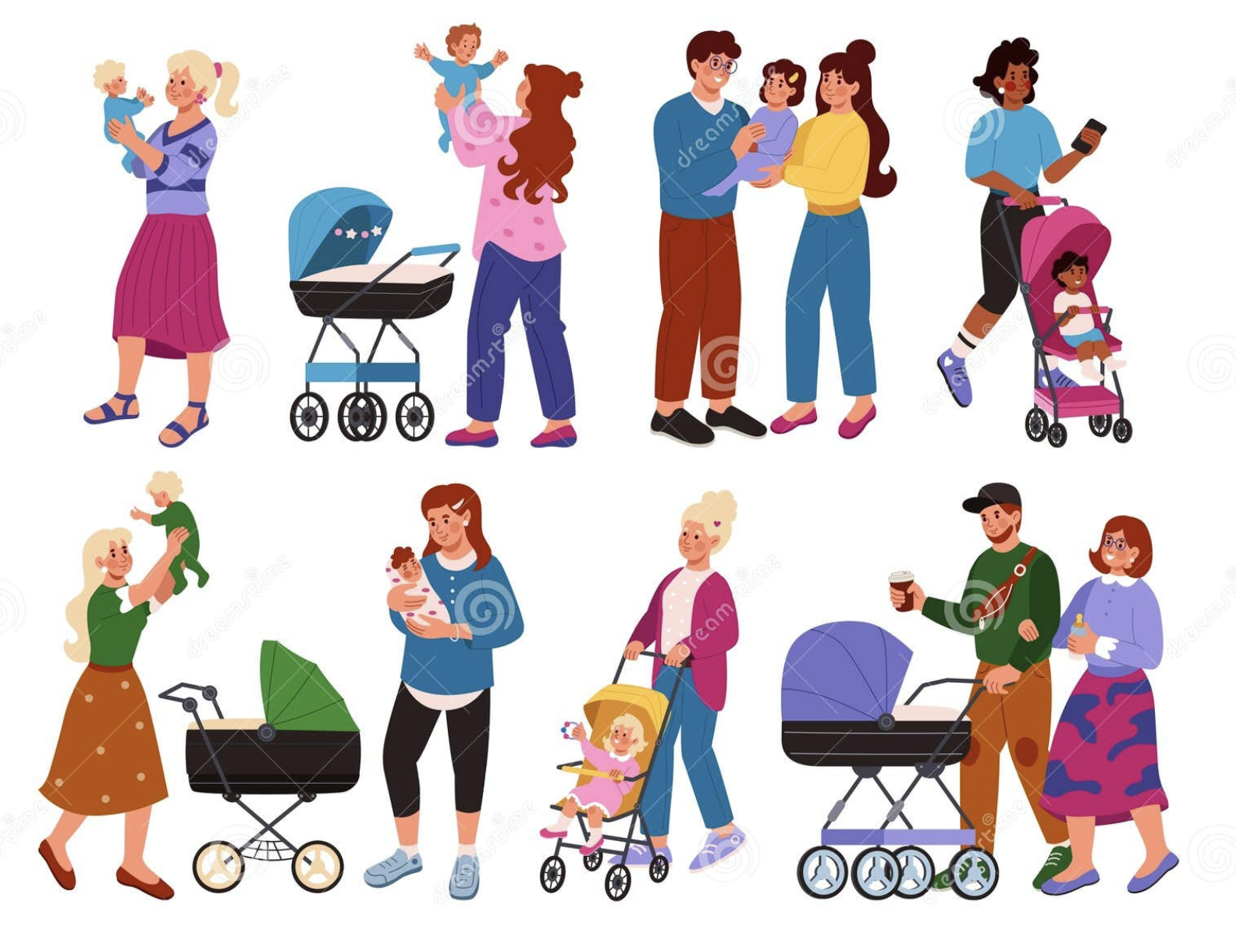
Exceptional caregiving
(Наталья Мишинцева, 2024)

Slide 6
What is exceptional care?
Safety and security
When considering exceptional care it is important that parents create a secure attachment with their baby as they are the most important person to their baby within the first 1000 days. The relationship that is created will have a positive impact on the way that the infant/toddler develops. If a baby has a loving and safe relationship with their caregiver the baby will experience important brain activity. If a baby has a positive relationship with their caregiver, they are more likely to be able to create further relationships with others. When a caregiver has a positive relationship with their baby, they can identify their baby’s language for example from their cues, movements, behaviour and their words (Herr, 2015). Bowlby suggests that infants are born with the need to create attachments with their caregivers (Cherry, 2023).
Opportunities for learning.
An infant/ toddler will learn best by having an enabling environment. An enabling environment will give infant/toddlers safe and varied space to learn, grow and develop. It is important to have a range of opportunities for infants/toddlers to be able to extend their learning and discover new things themselves. Promoting independence allows infants/toddlers to think for themselves and discover what to do in different situations. The indoor environment should feel homely for the children as they spend roughly the same time within a setting as what they would at home. This will allow children to feel more comfortable within the area. Outdoor play allows children to explore the area without limitations like the indoor area. Within the outdoor they can explore and use their senses. It is important to provide a range of different resources for example, bikes, tyres, logs, branches. These items will allow children to use their imagination. (Learning Journals, 2022)

Slide 7
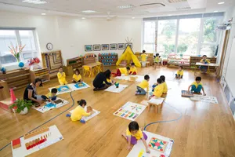
What is exceptional care?
(Christle, 2024)
Environment
Montessori believed that children benefitted from a prepared environment. This allows children to explore things on their own while practitioners sit back and interact when the child needed support. Within this method the environment is set out to cater the children’s needs and interests. Within this method of learning Montessori believed that children develop their independence, confidence and their learning (Montessori Academy, 2023). This is important to consider in order to meet exceptional care within the setting.

Slide 8
Why is exceptional care important?
Safety and security
It is important for a bay to have a healthy attachment with their caregiver as it is a vital aspect to early brain development that will have an impact on the baby’s development. By having secure relationship caregivers can identify their babies’ needs for example sleep, milk/food (Herr, 2015).
Opportunities for learning
Within an enabling environment it is important that is gives a home-to-home atmosphere for the children. If a child feels relaxed and comfortable within the setting, they are more likely to go off and play within the environment. Within an enabling environment it encourages a child’s development further as it gives children a better understanding of different needs, textures. (Learning Journals, 2022)

Slide 9
Professional Partnerships

Slide 10
What is the role of an early year’s practitioner in supporting children and families in the first 1000 days?
A practitioner can support children and families when a child begins in a setting. Each child will be given a key person when they begin, and this individual is able to support the child and family during the settling in process. It is important that a key person works with the parents to ensure they understand the child’s daily routine and they can ensure that the routine is followed as best as possible within the setting. A key person is there to create a bond with the child while they are away from their main carer therefore their role is important to ensure a child’s development. When a bond is created the child will feel safe and secure within the setting (www.annafreud.org, n.d.).
When children have a bond with their key worker, they are more confident in learning new things and exploring different activities within the setting. Children will also feel more confident in making friends with other children in the setting. If a child has a bond with their key person, they are more likely to thrive (Story, 2021).
It is important that practitioners create enabling environments for children within the setting to ensure it meets learning experiences and encourages further development. Children enjoy being able to make choices of their own and show independence within their learning (Eaton, 2023).
It is important practitioners observe children during play to identify areas they are thriving to give the child extra challenge to enhance their development within the setting. Observing children will allow practitioners to understand the child better and allows them to see how they interact with other children during play and how they play together (Spreeuwenberg, 2022).

Slide 11
The importance of effective partnership working
Communication between parents and practitioners is important to ensure the child’s growth and developmental needs are met. Parents can share a child’s interests, strengths and challenges with the practitioner in order the practitioner to understand the child. This also allows practitioners to plan activities around the likes of the child and creating activities that will encourage children to work on the things that they struggle doing (eyworks Limited, 2023).
Using an online app is a good form of communication between parents and practitioners. This allows parents to see what their child has eaten/slept and more while they are at work. Parents get a notification as soon as the practitioner has updated the child’s account. One example of an online app some settings use is baby days (Babysdays.com, 2021).
When a child begins in a new setting the communication with the parents/carers is important as it allows the practitioner to find out information about the child. This will allow the key worker to support the child and offer comfort while the child is within the setting. If a practitioner is aware of the child’s interests, they can plan activities to ensure that they interested in what is happening throughout the day. This will also help and be a distraction for the child. It is important that a key person gets to know the child and understands their needs, likes and dislikes (Story, 2021).

Slide 12
Consider maternal factors that could impact development and what support could be offered
A maternal factor that could have an impact on a child’[s development within the first 1000 days is a mother’s wellbeing. Around 30-58% of pregnant women suffer from anxiety or depression. It is diagnosed when there are signs of excessive worry, unrealistic view of problems, physical symptoms (headaches, tension). Women’s anxiety worsens within the third trimester due to the worry of childbirth. 51.4% of women suffer from anxiety after childbirth (Araji et al., 2020). A mother’s mental health can have an impact on a child’s development in many ways. According to (Araji et al., 2020) a mother’s mental health can lead to a poor attachment and bond with the infant after birth. It can also lead to the difficulty of being able to breast feed the infant this can lead to poor nutrition to the infant.
There are many options of support available for new mothers who suffer from postnatal anxiety and depression. A mother can speak to her midwife who will support her and refer her to a mental health service. If a mother is suffering before birth, she can go to see her doctor or midwife and they will provide the support before birth and after birth. A mother can try different options herself without the medical support. This includes speaking to friends and family, resting when available and light exercise and doing things that she enjoys (NHS, 2022).

Slide 13
What are the challenges in providing high quality care?
Staffing
Low staffing can have an impact within providing quality care within a setting. This will have an impact in many ways. This could lead to management being within ratio’s therefore when new staff begin within the workplace, they aren’t receiving appropriate induction due to management being in ratio’s and unable to leave the units. Staff shortages can have an impact on individuals’ emotional well-being. This can have an impact on staff as they may need to do extra work within the workplace to make up for the low staffing. For example, they may have a larger load of children files to complete and observations to complete on a regular basis. When new staff begin it is important that they receive the appropriate induction to ensure that the safeguarding policy is followed appropriately. This can lead to staff missing the opportunity to log their concerns appropriately due to being unaware of the safeguarding policy, this could lead to a child not receiving the appropriate care at home and their development being hindered (Owston, Jones and Stanley, 2024).
Staff training
Staff training is an important aspect to providing high quality care. It is important that settings ensure that staff are up to date with their training to be able to provide quality care within the setting. This can be a challenge due to staff training and professional development being the last priority in some childcare settings. Staff training is important for staff to expand on their understanding of children’s development and learning. Staff attending training days can be difficult due to lack of staffing in the setting. If there isn’t enough staff to cover the correct ratio’s they won’t be able to attend the training courses. Some training courses are in the evening this can also be difficult due to staff having home commitments (Anon, 2020). Some settings offer apprenticeships and allow practitioners to train and gain qualifications while getting experience in the workplace. By offering apprenticeships practitioners can learn from other practitioners. This can also put some strain on other staff due to having to show them what to do and how to do things within the workplace. Trained staff have more experience within the workplace and understand the development of children and how children will benefit and learn. (contributors and admin, 2022). Having a apprentice within the setting could have an impact on providing high quality care due to not having training before beginning within the setting.

Slide 14
Activities
What are the benefits: does the activity provide ‘meaningful learning’

Slide 15
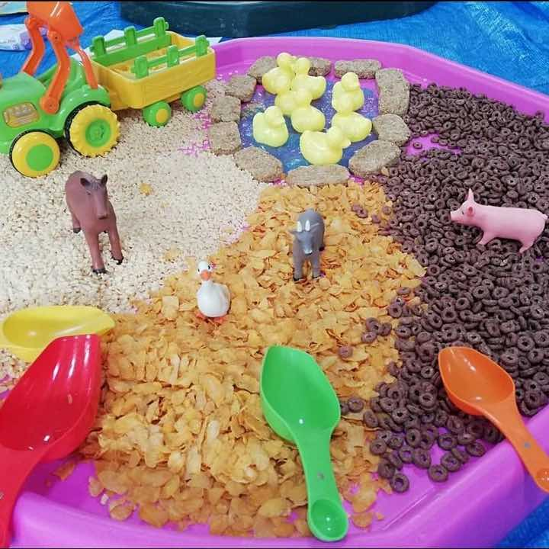
Cereal Messy play
A cereal messy play is a sensory activity for infants. Different cereals will give children different textures to explore. Within the activity there is a farm theme. This allows children to identify the different animals and the different areas they are within the farm from the different cereals in the messy play. By using cereal messy play within the setting children experience different textures and it is also editable. Infants enjoy putting everything in their mouth therefor by creating a cereal messy play it allows children to also explore different tastes by using a range of different cereals.
Messy play will benefit a child’s development in many ways. It allows infants to improve their physical skills as this will encourage them to play with smaller objects. They can feel and hold different textures in their hands. This messy play will have a benefit on a child’s fine motor skills as they will be using their fingers to hold the animals and grab the cereal. Messy play is a good way of introducing group activities to infants. It allows infants to begin to learn and understand sharing the different animals with others and taking turns in having the different animals and being in the different areas of the messy play. Messy play allows children to use their imagination, they can try new things and experiment within a safe environment (Anon, 2019).
(Laura, 2021)

Slide 16
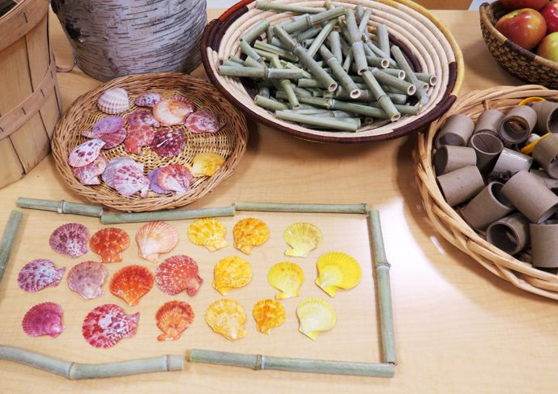
Loose parts
Children enjoy exploring different textures and materials. Loose parts allow infants to investigate open ended nature. It allows infants to learn from physical objects. Loose parts allow children to play with objects in the way that they want and in many ways. Loose parts provide children with a range of different play possibilities. It is important that loose parts objects give infants the opportunity to touch, explore, move and bang.
Loose parts support an infant social and emotional learning and development. It also encourages infant’s social skills and self-esteem. Loos parts support an infant’s language development by using sounds to express the noise that objects make. It also allows infants and children learn new words and it encourages infants/children to gain a wider range of vocabulary. Practitioners can encourage infant’s/children to learn new words by promoting words during play (www.communityplaythings.com, n.d.).
Loose parts encourage infants/children to use what if scenarios. This promotes their problem-solving skills and what they can do. By using their imagination, they can bring excitement into their play (Louv, n.d.).

Slide 17

International approaches
A curriculum for non-maintained nursery settings
Te wh$\acute{a}riki$early childhood curriculum New Zealand
This curriculum recognises that every child within a setting is unique and that their development progresses the most between birth and the age of 5. This curriculum supports holistic development and is the main aspect of the pedagogical practice. It is important that professionals provide engaging experiences for the children within the setting. It is the practitioner’s role to use their observations to plan activities in the interests of the children. There are 5 developmental pathways within the curriculum -
Belonging
Communication
Exploration
Physical development
Wellbeing (Welsh Government, 2022).
These aspects of the curriculum depend on the interactions and learning experiences and environments provided within the setting (Welsh Government, 2022).
Within this curriculum it states that each child has a unique journey, and they come into the world eager to learn. Teachers and educators work together for. Child to reach their maximum ability. This curriculum Is a play-based learning. Children learn through play, and this allows children to explore and develop skills. Within this curriculum it is based on holistic development. It has four principles within the curriculum –
Empowerment – this ensures that children are valued and respected.
Holistic development – this states that a child’s development is considered a whole.
Family and community – Family and community are an important aspect of a child’s learning.
Relationships – this states that children learn through different relationships, places and things (Ministry of Education, 2017).
Both curriculums have their similarities. They both look at a child’s holistic development and support the children’s learning and development. Both curriculum state how play have an importance around a child’s learning and development. Te whariki and the curriculum for non-maintained funded settings promote creativity and imagination.

Slide 18
Reference list
Adobe Stock. (n.d.). Stages Of Pregnancy Development Images – Browse 3,604 Stock Photos, Vectors, and Video. [online] Available at: https://stock.adobe.com/uk/search?k=stages+of+pregnancy+development.
Anon, (2019). Messy Play. [online] Available at: https://www.cambspborochildrenshealth.nhs.uk/child-development-and-growing-up/hand-skills/messy-play/#importance.
Anon, (2020). Why Plan for Staff Training for Your Childcare Centre | VIP Education. [online] Available at: https://vipeducation.co.uk/why-plan-for-staff-training-for-your-childcare-centre/.
Araji, S., Griffin, A., Dixon, L., Spencer, S.-K., Peavie, C. and Wallace, K. (2020). An Overview of Maternal Anxiety During Pregnancy and the Post-Partum Period. Journal of Mental Health & Clinical Psychology, [online] 4(4). Available at: https://www.mentalhealthjournal.org/articles/an-overview-of-maternal-anxiety-during-pregnancy-and-the-post-partum-period.html.
Ausnutria Nutrition Institute. (n.d.). Gentle nutrition for natural growth and development of infants. [online] Available at: https://ausnutria-nutrition-institute.com/knowledge-base/gentle-nutrition/.
Australia, H. (2021a). The first 2 years of a baby’s life can impact their health and wellbeing later on. Here’s what you can do to give your child the best possible start. [online] www.pregnancybirthbaby.org.au. Available at: https://www.pregnancybirthbaby.org.au/the-first-1000-days.
Australia, H. (2021b). The first 2 years of a baby’s life can impact their health and wellbeing later on. Here’s what you can do to give your child the best possible start. [online] www.pregnancybirthbaby.org.au. Available at: https://www.pregnancybirthbaby.org.au/the-first-1000-days.

Slide 19
Babysdays.com. (2021). Baby’s Days Childcare Software for Nurseries, Pre-Schools and Childminders. [online] Available at: https://www.babysdays.com.
Cherry, K. (2023). What Is Attachment Theory? [online] Verywell Mind. Available at: https://www.verywellmind.com/what-is-attachment-theory-2795337.
Christle, C. (2024). Montessori schools | Theory, History, & Facts. [online] Encyclopedia Britannica. Available at: https://www.britannica.com/topic/Montessori-schools.
contributors, M.O., Jacob Thornton, and Bootstrap and admin (2022). Why good quality training in early years matters. [online] Montessori Apprentice Academy. Available at: https://montessoriapprentice.co.uk/why-good-quality-training-in-early-years-matters/.
Eaton, C. (2023). Enabling environments and their impact on children’s learning. [online] Early Education. Available at: https://early-education.org.uk/enabling-environments-and-their-impact-on-childrens-learning/.
eyworks Limited (2023). Parent Communication in Early Years Settings | eyworks. [online] eyworks. Available at: https://www.eyworks.co.uk/blog/parent-communication-in-early-years-settings/.
Healthdirect Australia (2024). Conception and Fetal Development. [online] www.pregnancybirthbaby.org.au. Available at: https://www.pregnancybirthbaby.org.au/conception-and-fetal-development
Herr, A. (2015). Building a Secure Attachment with your Baby | CAPPA. [online] https://cappa.net/. Available at: https://cappa.net/2015/04/18/building-a-secure-attachment-with-baby/.

Slide 20
Laura (2021). 14 Messy Play Activities to Keep Children Busy and Learning all Year - Ready Steady Let’s Get Messy. [online] Ready Steady Let’s Get Messy. Available at: https://www.letsgetmessy.co.uk/2021/01/10/14-messy-play-activities-to-keep-children-busy-and-learning-all-year/ [Accessed 19 Jan. 2025].
Learning Journals (2022). How to Create an Enabling Environment in Your Early Years Setting. [online] Learning Journals. Available at: https://learningjournals.co.uk/create-enabling-environment-early-years-setting/.
Louv, R. (n.d.). Loose Parts Play. [online] Play Scotland. Available at: https://www.playscotland.org/loose-parts-play/.
Medlineplus (2023). Infant - newborn development: MedlinePlus Medical Encyclopedia. [online] Medlineplus.gov. Available at: https://medlineplus.gov/ency/article/002004.htm.
Ministry of Education (2017). Te Whāriki He whāriki mātauranga mō ngā mokopuna o Aotearoa Early childhood curriculum. [online] Available at: https://assets.education.govt.nz/public/Documents/Early-Childhood/ELS-Te-Whariki-Early-Childhood-Curriculum-ENG-Web.pdf.
Montessori Academy (2023). Prepared Environmemt | Montessori Academy Childcare. [online] Montessori Academy. Available at: https://montessoriacademy.com.au/montessori-education/prepared-environment/.
Наталья Мишинцева (2024). Family walk. Mother with baby stroller. Parents of twins. Caregiver buggy. Park stroll. Mom and dad together with. [online] Dreamstime. Available at: https://www.dreamstime.com/family-walk-mother-baby-stroller-parents-twins-caregiver-buggy-park-stroll-mom-dad-together-children-father-happy-image331232352 [Accessed 19 Jan. 2025].

Slide 21
NHS (2022). Postnatal Depression. [online] NHS. Available at: https://www.nhs.uk/mental-health/conditions/post-natal-depression/overview/.
NHS (2023). Benefits of Breastfeeding. [online] nhs.uk. Available at: https://www.nhs.uk/conditions/baby/breastfeeding-and-bottle-feeding/breastfeeding/benefits/.
Owston, L., Jones, A. and Stanley, Y. (2024). Maintaining quality early years provision in the face of workforce challenges – Ofsted: early years. [online] earlyyears.blog.gov.uk. Available at: https://earlyyears.blog.gov.uk/2024/05/13/maintaining-quality-early-years-provision-in-the-face-of-workforce-challenges/.
Spreeuwenberg, R. (2022). The importance of observation in early childhood education (with a free ebook). [online] www.lillio.com. Available at: https://www.lillio.com/blog/assessing-toddler-development-through-observation.
Story, N. (2021). Supporting Children And Parents With Transitions. [online] Nursery Story. Available at: https://nurserystory.co.uk/resource-centre/supporting-children-and-parents-with-transitions/.
Thousand Days (2018). Why 1,000 Days - 1,000 Days. [online] 1,000 Days. Available at: https://thousanddays.org/why-1000-days/.
Welsh Government (2022). A curriculum for funded non-maintained nursery settings. [online] Available at: https://hwb.gov.wales/api/storage/b1801d78-38c3-4320-9818-d9996c21aef8/220914-a-curriculum-for-funded-non-maintained-nursery-settings.pdf.
www.annafreud.org. (n.d.). Relationship with the key person in a childcare setting. [online] Available at: https://www.annafreud.org/resources/under-fives-wellbeing/common-difficulties/relationship-with-the-key-person-in-a-childcare-setting/.
www.communityplaythings.com. (n.d.). Loose Parts play for Infants and Toddlers. [online] Available at: https://www.communityplaythings.com/resources/articles/loose-parts-play-for-infants-and-toddlers.
YOUR BABY AT 2 YEARS. (n.d.). Available at: https://www.michigan.gov/mikidsmatter/-/media/Project/Websites/mikidsmatter/documents/MDE_MilestoneChecklist_2YRS.pdf?rev=3028a55cae88432aa68166a2dcfcfac8.

