Slide 1



CertHE Skills for the Workplace
BMSK4003
Digital Skills and Research Methods
Session 2

Slide 2
Objectives of session:
Use the internet and google for digital research;
Evaluate digital content;
Assess the implications for business ;
Blogs and adding images.

Slide 3

Online Digital Research
The University’s online library should be one the first port-of-call for academic research.
Tertiary sources of information include search engines which lead to secondary sources and facilitate primary sources. (These are sources that index, abstract, organize, compile, or digest other sources)

Slide 4

Research sources
Primary sources are created as close to the original as it is possible to be. (examples : a photograph of an event or Data from an experiment)
Secondary sources are based on or about the primary sources. (example, articles and books in which authors interpret data from another research team's experiment)
Tertiary sources - summarize or synthesize the research in secondary sources. For example, textbooks and reference books are tertiary sources.
different kinds of research call for using primary, secondary, and tertiary sources in different ways. For example, a research Report usually requires a combination of primary and secondary sources.

Slide 5

Primary sources provide first hand evidence gathered by the author(s). They may be created or documented at the time of an event, as in scholarly research articles, diaries, photographs, conference proceedings, and newspaper reports. A primary source may also be documented at a later time, such as autobiographies, memoirs, and oral histories...but these are still first hand accounts.
Secondary sources -describe interpret or analyse information obtained from other sources (often primary sources). Examples of secondary sources include many books, textbooks, and scholarly review articles.
Tertiary sources compile and summarize mostly secondary sources. Examples might include reference publications such as encyclopedias, bibliographies or handbooks.

Slide 6




Search engines
Search engines are special websites that have indexed billions of pages - and make it easy for you to find a website or page in an instant..

Slide 7
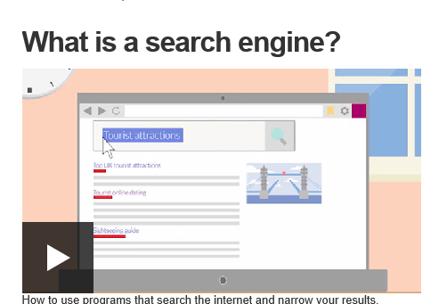
http://www.bbc.co.uk/webwise/0/22562913

Slide 8

Pro’s & Con’s

Slide 9

Google for Digital Research
Google has consistently been amongst the most popular of search engines.
Google Scholar provides a simple way to broadly search for scholarly literature. Search across many disciplines and sources: articles, theses, books, abstracts and court opinions, from academic publishers, professional societies, online repositories, universities and other web sites. Google Scholar helps you find relevant work across the world of scholarly research.

Slide 10
Research Search Engines
iseek
Refseek
Microsoft Academic search
Notes:
http://education.iseek.com/iseek/home.page
iSeek is easily one of the best and widely used search engines for academic research on the internet. It has been especially designed keeping the students, teachers and scholars in mind. This search engine shows only reliable and relevant results that ultimately save your time and enable you to get your work done quickly. You can find safe, authoritative, intelligent and time-saving resources with iSeek.
https://www.refseek.com/
Refseek is an academic search engine which is simpler than Google even in appearance. Refseek does not claim to offer more results than Google. Instead, it removes results that are not related to science, academia and research. The best thing about Refseek is that you can search for information related to your subject without getting distracted by sponsored links.With a database of over one billion documents, web pages, books, journals, newspapers, online encyclopedias and articles, Refseek is your ultimate companion for academic research.
https://scholar.google.co.uk/
As the name suggests, Google Scholar is an academic search engine from the house of Google. Especially designed to search for scholarly literature, it helps you find relevant information from the world of scholarly research. With Google Scholar, you can explore many sources such as books, dissertations, articles and abstracts from various academic publishers, professional societies, universities and other websites. In May 2014, third-party researchers estimated that Google Scholar database contains roughly 160 million documents.
https://academic.microsoft.com/
Microsoft Academic Search is a great search engine from the software giant Microsoft. It gives you the ability to explore more than 38 million publications. One of the best features of this search engine is that it provides trends, graphs and maps for your academic research. It contains more than 40 million publications and 20 million authors

Slide 11

How do SEO works?
https://www.rankwatch.com/learning/content/13-how-do-search-engine-rank-web-pages
Notes:
Spider crawls across the internet to find best information that suits your search words
Follows the links to those websites

Slide 12
Evaluating Digital Content
One of the easiest and most memorable ways to do this is to apply the C.R.A.A.P. Test.
Currency - How up to date is the information? When was it published? Does this matter?
Relevance - Is the information relevant? Is it at the appropriate level? Is it general or specific?
Authority - Who are the authors? What are their 'credentials'? Have you heard of them?
Accuracy - Can you verify the information? Is it biased? Has it been peer reviewed?
Purpose - Is the purpose of the website clear? Is it trying to sell something?
https://www.youtube.com/watch?v=lAWhE0mj69I

Slide 13
Search Engine Optimisation
Search engine optimisation (SEO) changes on a regular basis.
Large organisations often employ people solely to ensure that they remain at the top of Google Search pages (without paying for Ad Words).
Recently Google changed the way sites are ranked so that sites that are 'mobile- friendly' appear higher up the results lists.
A knock-on effect of this is that web developers have been forced to redesign their sites in order to maintain their position.
Does your employer have a website? Have some of these elements been considered in its design?

Slide 14


Slide 15

Blogs
Academic blogging serves the following purposes:
provides regular feedback between you and the instructors to help match your expectations;
serves as a platform for synthesis of new knowledge and ideas;
helps to develop critical thinking;
helps to elicit topics of interest, challenging topics that need improvement etc;
helps to clarify troublesome concepts.

Slide 16

A good post is personal, reflective, and substantive. Additionally, your reader must understand clearly what you have written. If it is provocative or controversial, references should be provided to substantiate your thoughts.
The following factors contribute to a good post:
good “snappy” titles;
good content;
controversial content;
images to illustrate your views and inform your readers;
humour, word play, or even satire to strengthen your post and entertain your readers.

Slide 17

Adding- a photo/ Image
Go to www.pexels.com
Find a picture on any subject you like!

Slide 18
Adding a photo/ Image
Click on the ‘down arrow’ on pop-up window

Slide 19

Adding a photo
Click on the Free Download button on the right hand side:
A pop-up window should appear:
Notes:
This needs to be in Internet Explorer Chrome just saves all downloads into the download folder automatically
Save the photo to where you want to access it from

Slide 20
Adding a photo
Click ‘Save As’
Save this image on your U drive (so you can access it from any computer)
If you want to: create a folder called “My Photos for blogging”

Slide 21
Adding a photo
Create a new blog post
  Give it a title
  Add a few words of description

Slide 22
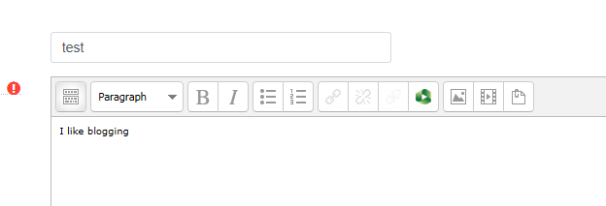
Adding a photo
Click on ‘image button’ on tool bar

Slide 23
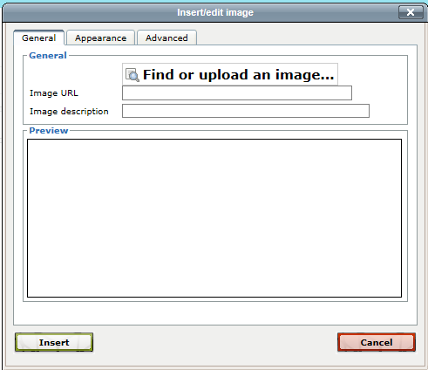
Image box appears
Click here

Slide 24
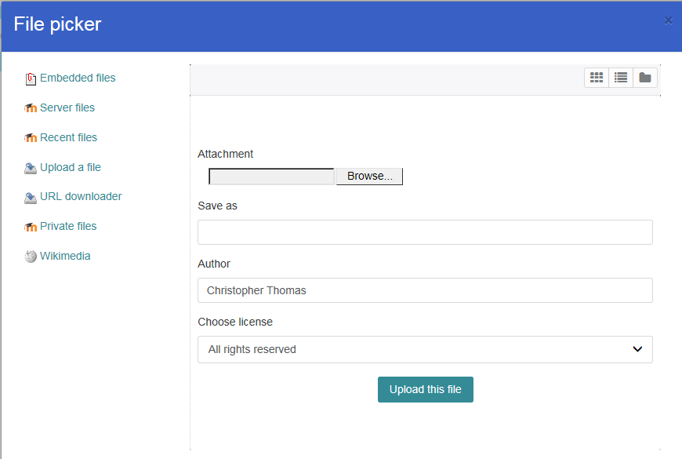
New pop up box
Click here

Slide 25
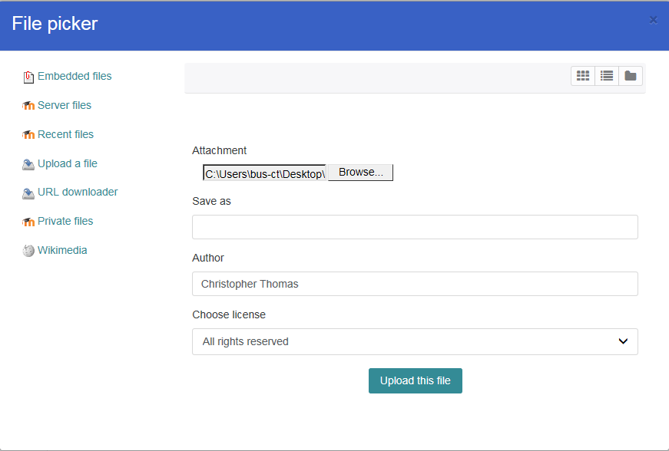
Adding a photo
Find you picture on your U: Drive
Double click on it
Click: Upload this file

Slide 26
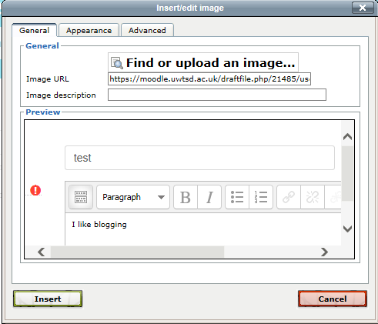
Adding a photo
Click: insert

Slide 27
Today’s Blog
Using SEO i.e. google
That talks about search engine skills
That is authoritative/reliable (CRAAP)
(Make it reflective/ Relevancy to your personal employability skills and how its beneficial in current work place setting - references)

