Slide 1
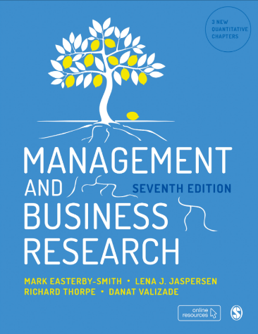
Management and Business Research
Mark Easterby-Smith, Richard Thorpe, Lena J. Jaspersen and Danat Valizade

Slide 2
What is a literature review
MBR 7th ed
Chapter 2
Module Name
Presenter Name
Email

Slide 3
Literature review
A literature review is an analytical summary of an existing body of research in the light of a particular research problem or question
In a literature review, researchers describe, evaluate and clarify what is already known about a subject area.

Slide 4

literature review
Supports researchers to learn from previous research
Identifies flaws in previous research
Outlines gaps in the knowledge about a certain topic
Provides research context
Helps to refine its topic
Indicates what a research project is adding to the understanding of a field
Justifies why the research is being undertaken
Ensures that the research undertaken fits in with the existing wider research within the subject area.

Slide 5
Literature Review Terminology
Process of reviewing the literature
A specific type of text

Slide 6
Literature review in the research process
Literature Review
Research Question
Data Collection
Discussion and Conclusion
Data Analysis

Slide 7
Sources of information
Peer-reviewed journal articles
  UT Dallas List
  ABS List
Academic books and reference works
Working papers and theses
Academic websites, research blogs and podcasts
Grey literature: Publications and websites by governmental and non-governmental bodies, including firms and media outlets

Slide 8
Criteria for evaluating sources of information
Purpose
Authorship
Credibility and accuracy
Timeliness
(based on a similar set of more specific questions developed by Fink, 2005)

Slide 9

Questions?

