Slide 1

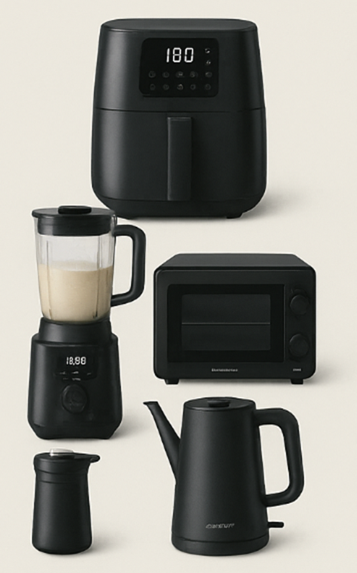




PureKitchen TM
Smart Home Cooking Made Affordable
Cook Smart. Spend Less.
Mission
Empower households to cook smarter — not spend more.
Target Audience
  Cost-conscious young adults and families
  Health-focused home cooks
  Tech-savvy value seekers
Why PUREKITCHEN™?
  Smart connectivity and guided cooking app
  Modern minimalist design
  Energy-efficient performance
  24-month warranty for peace of mind
  Priced 20–40% lower than premium brands
Product Line
  Smart Air Fryer
  Smart Blender
  Smart Mini Oven
  Smart Kettle
Customer Benefits
  Healthier meals • Faster cooking • Save money
Available soon via ALDI Special Buys & Click-and-Collect!
Contact info:
123-4567-890
purekitchen@aldi.com
www.aldi/purekitchen.com

