Slide 1
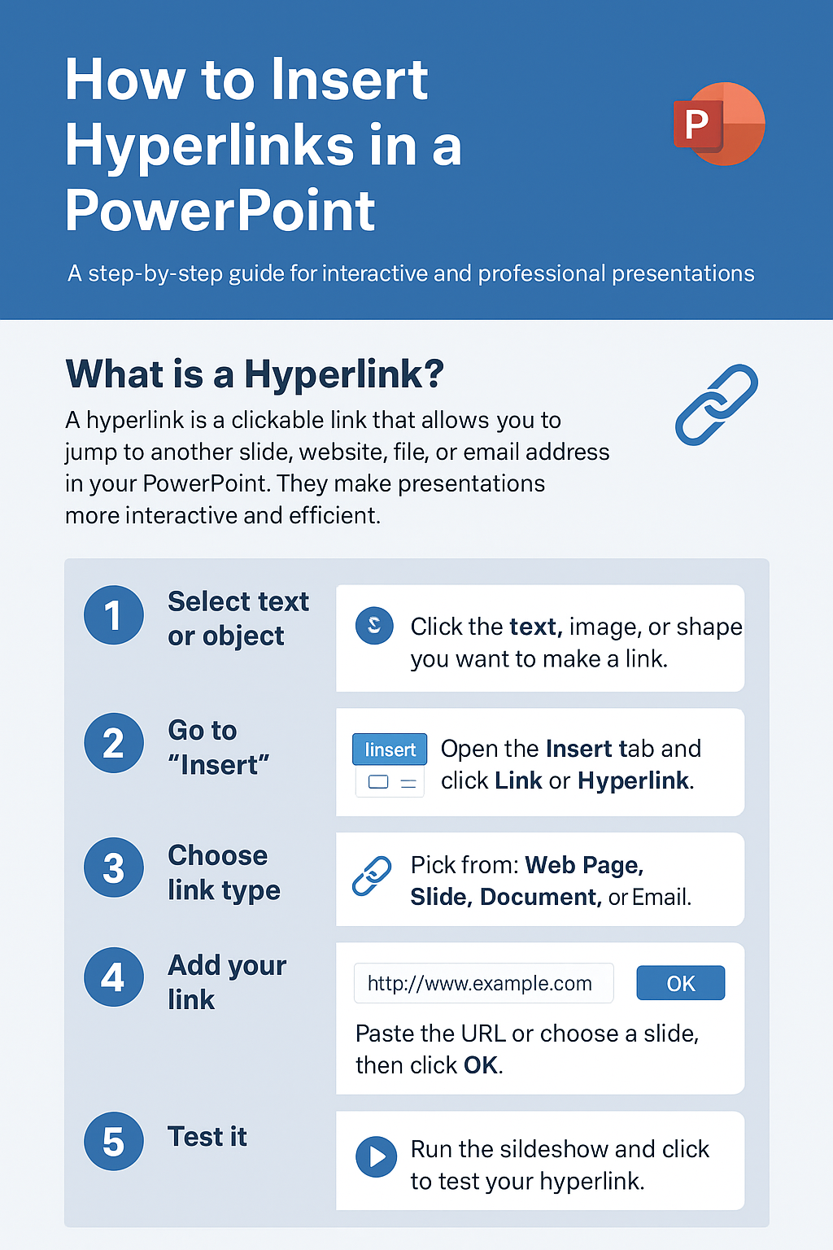
How to insert hyperlinks to PowerPoint
What is a hyperlink?
A hyperlink is a clickable link that allows you to jump to another slide, website, file, or email address directly from your PowerPoint presentation.
Why use them?
To make your slides interactive
To link to external websites or resources
To navigate between slides in large presentations
Step 1: Select the text or object
Click on the text, image, or shape that you want to turn into a link.
Step 2: Open the hyperlink menu
Go to the Insert tab on the top menu.
Click Link or Hyperlink.
Step 3: Choose your link type
In the dialog box, select one of the following:
Existing File or Web Page – link to a webpage or file.
Place in This Document – link to another slide.
Create New Document – link to a new file.
E-mail Address – link to send an email.
Step 4: Insert your link
Type or paste the web address (URL) or choose the slide/file you want.
Click OK.
Step 5: Test the hyperlink
Start the Slide Show and click your link to make sure it works
Tips Section
🧠 Use descriptive link text (e.g., Visit Company Website instead of Click Here).
🎨 Keep consistent link colours for a professional look.
🔍 Always test links before your presentation.

