Slide 1
Criminal Investigations
Week 2
BMPS6018
Initial investigations

Slide 2
Aims for today
Review the initial investigation stages
Material
Locards theory
Forensics
Golden Hour principles

Slide 3
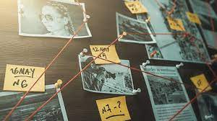
Investigative Strategies
Investigative Strategies
Identifying a line of enquiry to pursue
Determining the objective of pursuing a particular line of enquiry
Identifying the investigative action(s) necessary to efficiently achieve that objective taking into account resources, priorities & proportionality
Conducting the investigative action & gathering the maximum amount of material which may generate further lines of enquiry
We’ll revisit this in a few workshops time...

Slide 4

Initial Investigation

Slide 5
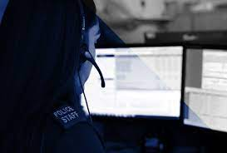
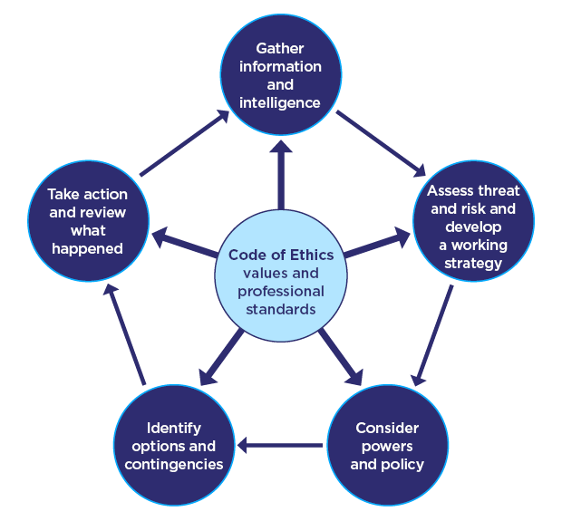
What happens when you dial 999/101?

Slide 6
THRIVE
The National Decision Model is the basis of decision making
THRIVE provides a framework to support our decision making, informing a holistic understanding of the situation.
THRIVE is an integral part of our ethical decision making.
THRIVE will be used to assess situations where decision making, and management of risk has a range of considerations and responses related to the circumstances.
All Police Officers and Staff who deal with calls for service, reports or the management of investigations from the public.
THRIVE is designed to jointly assess risk and decision making in a consistent way using the National Decision Model.
THRIVE aligns to the Code of Ethics and National Decision-Making model and helps police respond at pace. THRIVE has the values at its heart.

Slide 7
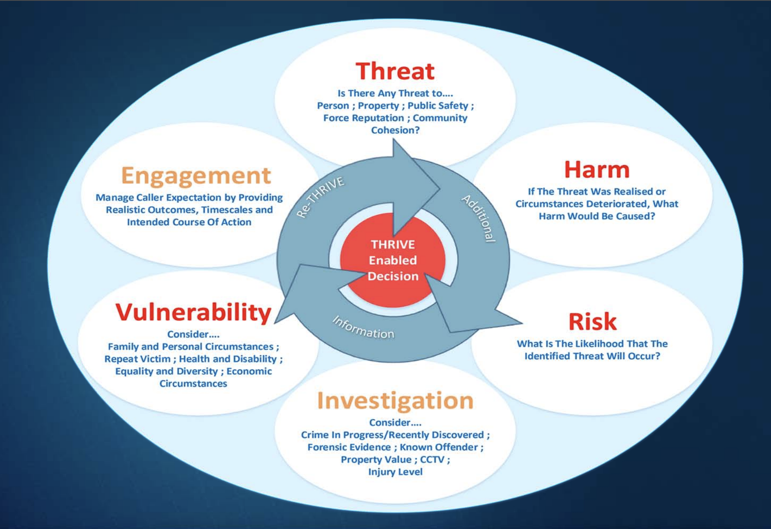

Slide 8
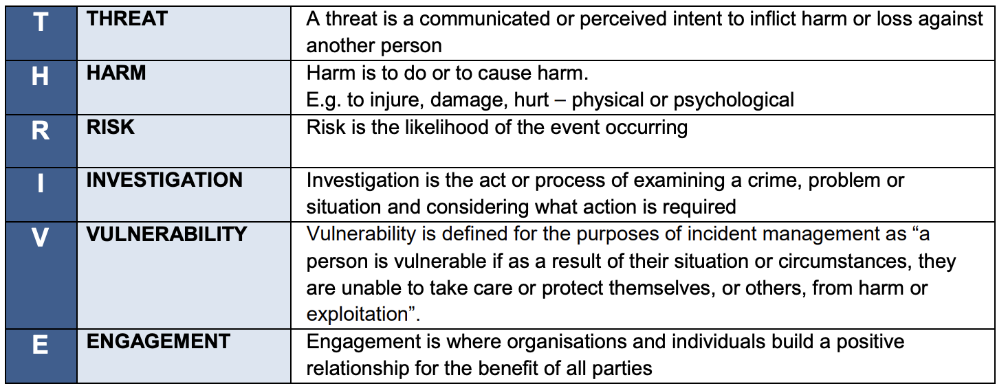

Slide 9
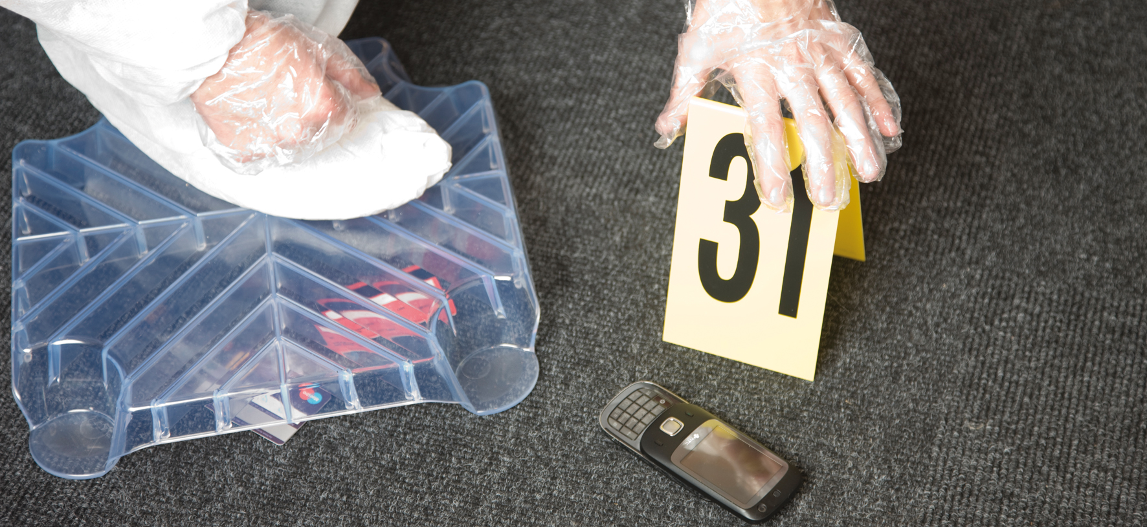
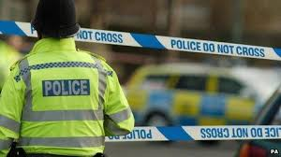
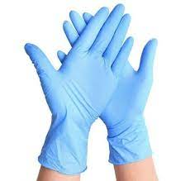
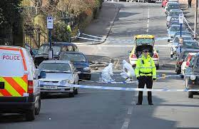

Slide 10

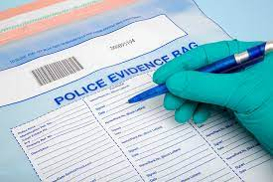
Evidence in Investigations
Physical evidence- documents, objects, etc.
Forensic evidence- fingerprints, DNA, etc.
Digital evidence- computer records, CCTV etc.
Expert witness evidence
Intelligence
…..and many more!
All Material
Notes:
Question- Where will we obtain evidence from?
All provide assistance within an investigation

Slide 11
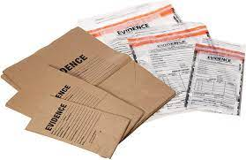
‘Material’
(Criminal Procedure and Investigations Act 1996)
Material is defined as:
‘material of any kind, including information and objects, which is obtained in the course of a criminal investigation, and which may be relevant to the investigation.’
Relevant if:
appears that it has some bearing on any offence under investigation, or
on the surrounding circumstances of the case, unless it is incapable of having any impact on the case.
Notes:
Common formats of material include:
statements
documents
reports
physical exhibits
fingerprints
images
audio or video recordings

Slide 12
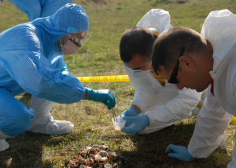
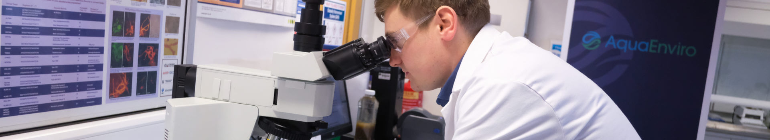
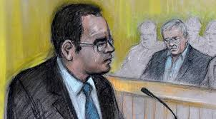
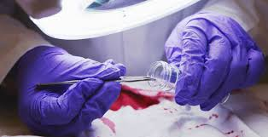
Forensic Science
Plays a crucial role in many criminal prosecutions, every piece of forensic evidence goes through three key stages between its recovery from the crime scene to the presentation of scientific findings at court.
The Recovery and
Continuity of Evidence
The Interpretation and evaluation of scientific evidence and the presentation of scientific results in court.
Analysis of the evidence recovered from crime scenes

Slide 13
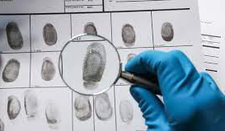
Forensics
Investigating a crime scene and forensic analysis using specialist procedures and techniques can provide evidence to:
Prove that a crime has been committed
Exclude a suspect from a scene
Link a suspect with a scene
Establish the identity of a victim, suspect or witness
Corroborate or disprove witness accounts
Interpret the scene in relation to movements within the scene and sequences of events
Link crime scene to crime scene and provide intelligence on crime patterns
(College of Policing, 2021)

Slide 14
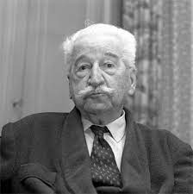
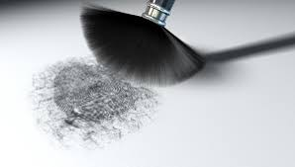
The Principal of Exchange (1920)
Dr Edmond Locard (1877-1966)
“EVERY CONTACT LEAVES A TRACE!”
The theory that anyone who enters a scene both takes something of the scene away with them and leaves something of themselves behind (including police!)
Normally caused by objects / substances coming into contact with one another, leaving a minute sample on contact surfaces.
Examples:
Fingermarks
DNA
Fibres
Footwear marks

Slide 15
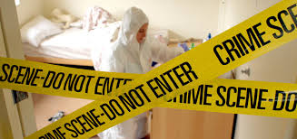
IMPORTANT!
Cross Contamination
The techniques of crime scene management are based on Locard’s Principle of Exchange
If procedures and practices are not adopted to prevent it, cross contamination WILL happen!
1.Think of scenarios where this could happen?
2.What procedures / practices?
(Some are common sense!)

Slide 16
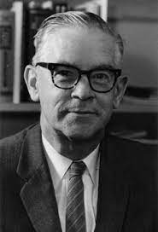
Paul L. Kirk. (1902-1970)
“Wherever he steps, whatever he touches, whatever he leaves, even unconsciously, will serve as a silent witness against him.
Not only his fingerprints or his footprints, but his hair, the fibres from his clothes, the glass he breaks, the tool mark he leaves, the paint he scratches, the blood or semen he deposits or collects.
All of these and more, bear mute witness against him. This is evidence that does not forget. It is not confused by the excitement of the moment. It is not absent because human witnesses are. It is factual evidence. Physical evidence cannot be wrong, it cannot perjure itself, it cannot be wholly absent. Only human failure to find it, study and understand it, can diminish its value.”

Slide 17
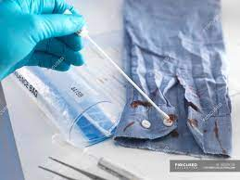
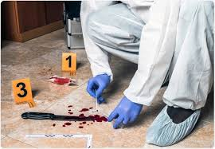
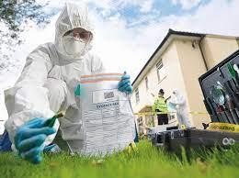
Sources of Forensic Evidence
Evidence can be collected and preserved from the following three sources
People
Item
Location
(College of Policing, 2021)

Slide 18
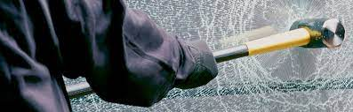
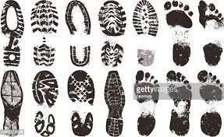
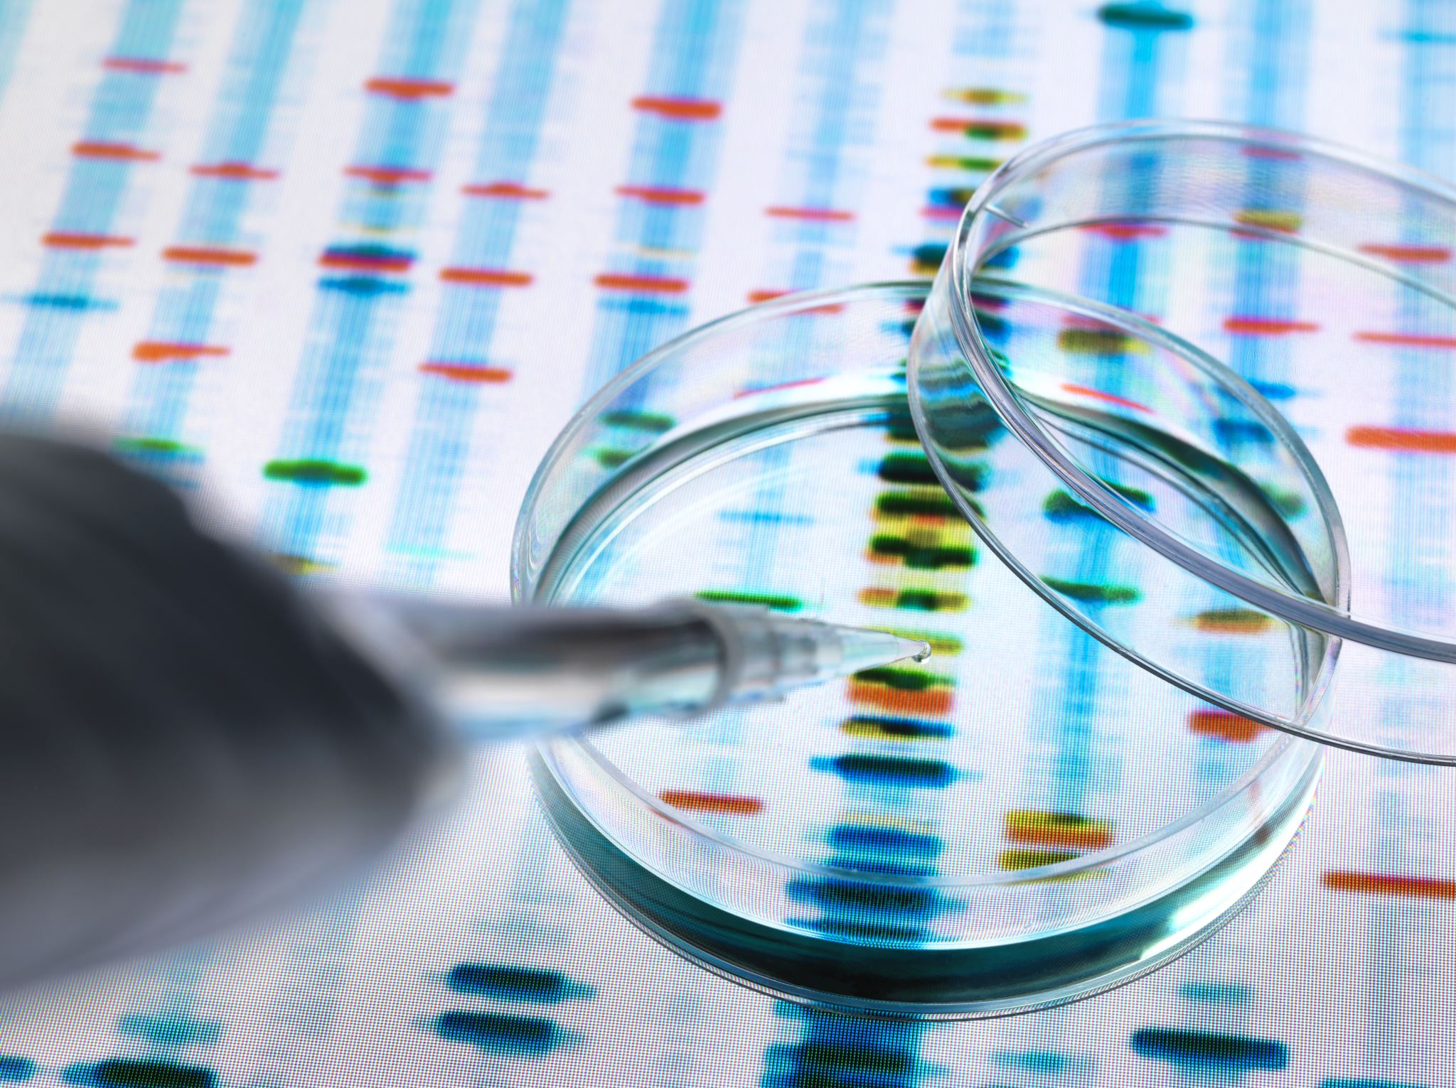
Types of Forensic Evidence
1. Trace evidence
2. Impressions or marks
3. DNA
(College of Policing, 2021)

Slide 19
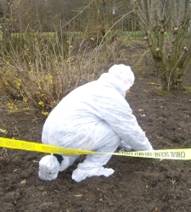
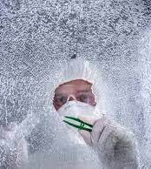
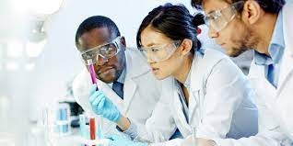
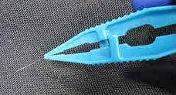
Trace Evidence
Very small quantities of material
Transfer from suspect to crime scene / victim & vice versa
Fibres
Glass fragments
Paint flakes
Pollens
Soils
Insects
(College of Policing, 2021)

Slide 20
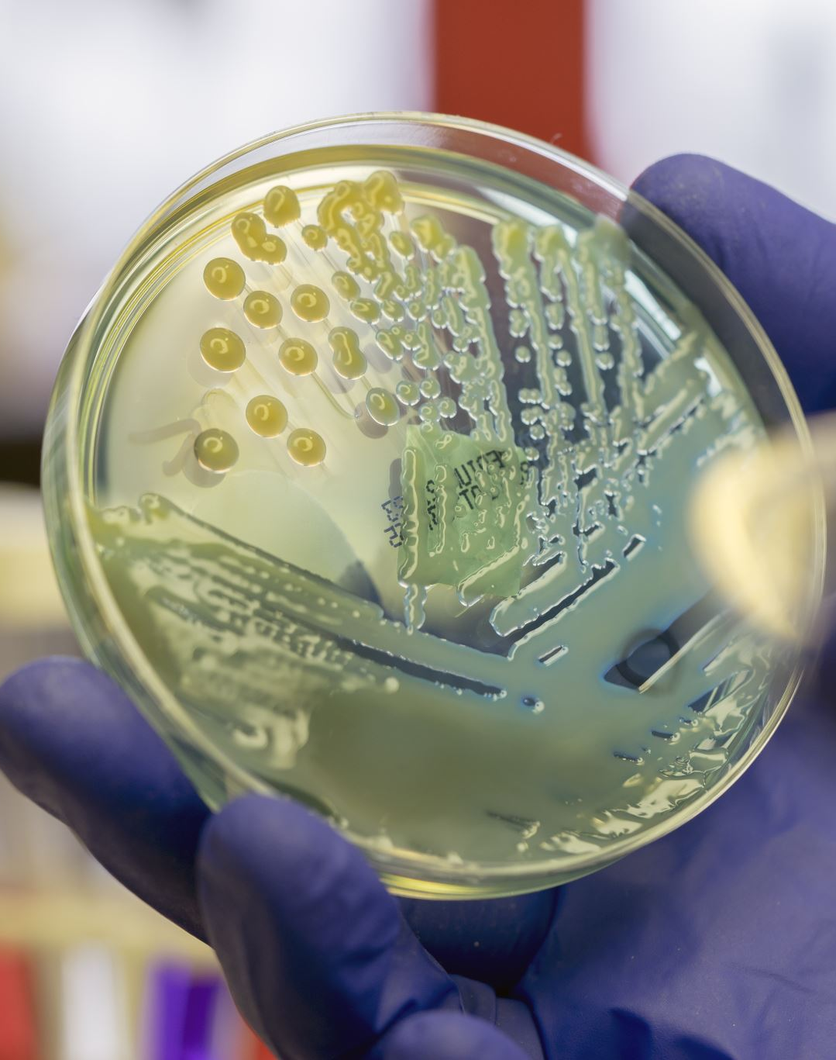
Task
Research into the case of Holly Wells and Jessica Chapman
What evidence was found to convict Ian Huntley?

Slide 21
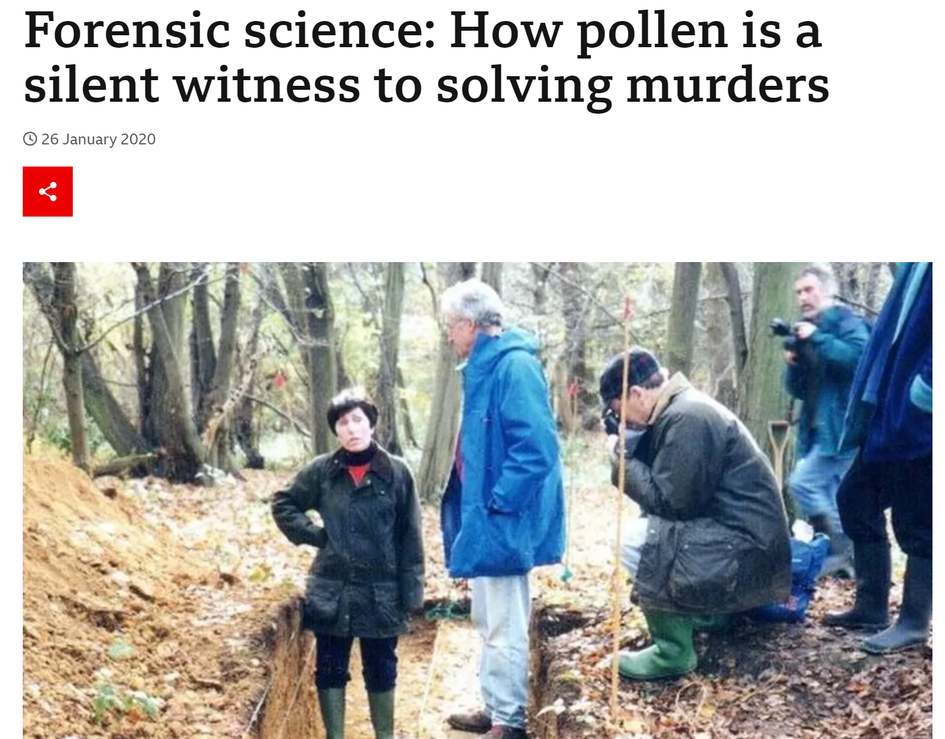

Slide 22
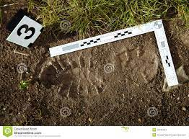
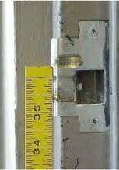
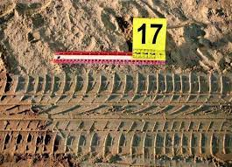
Impressions
Footwear marks
Tyre marks
Other types of marks
(College of Policing, 2021)

Slide 23
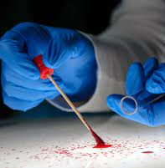
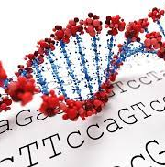
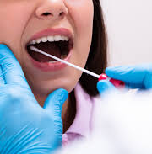
DNA Evidence
Blood
Semen
Saliva
Hair (with roots)
Body tissue
......and more!
(College of Policing, 2021)

Slide 24
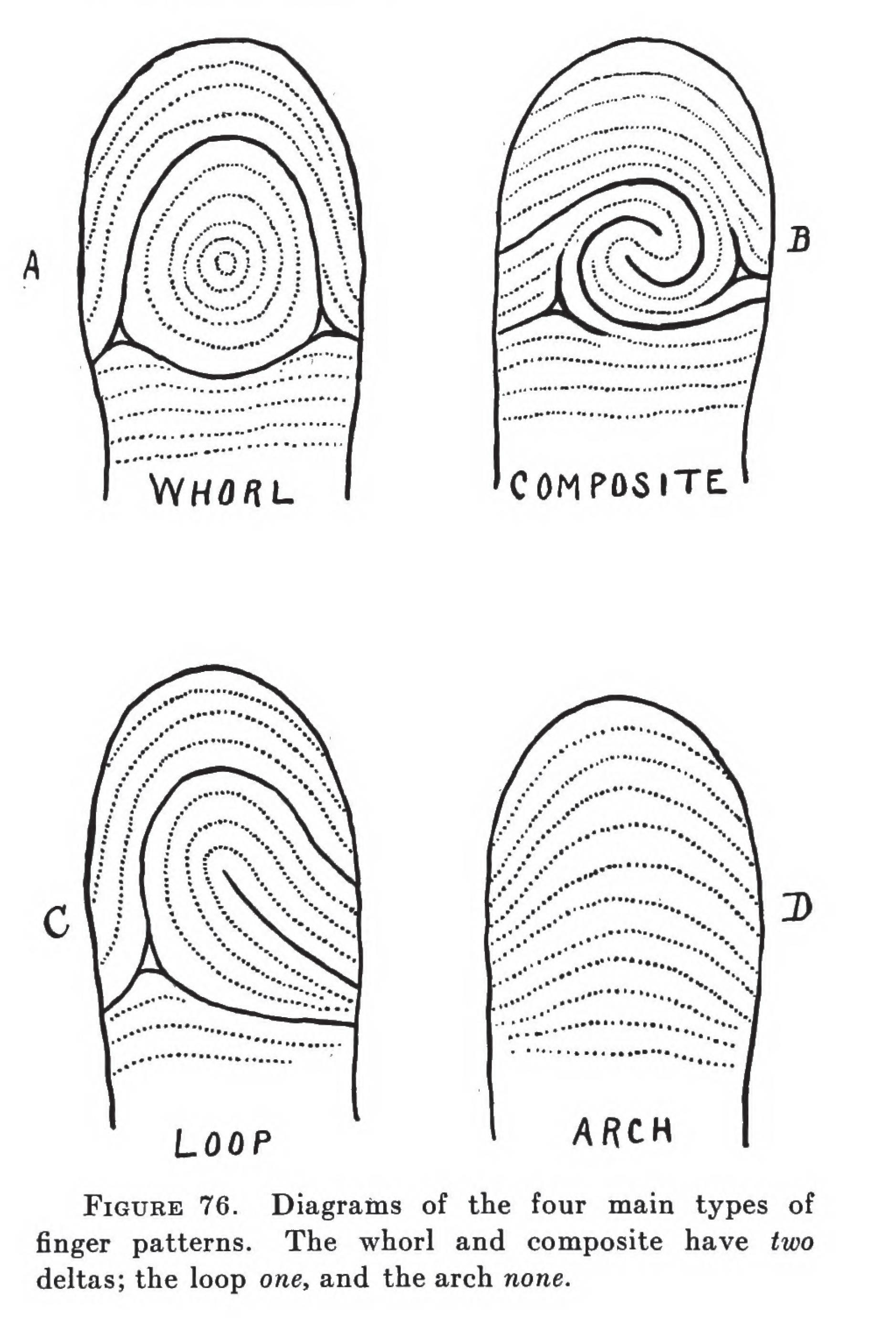
Finger Marks
Ridged skin on our fingers can leave marks on textured surfaces
Imaged, compared and used as forensic evidence
The term ‘fingerprints’ refers to the images made which can be compared to the fingers marks at a crime scene
Not just fingers – palms, toes, sole patterns
CJS – every one is unique (Including identical twins)
(College of Policing, 2021)

Slide 25
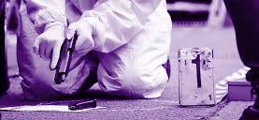
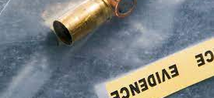
Firearms
Spent (used) bullets or cartridges = rich sources of evidence
The barrel and the firing mechanisms leave marks on the bullets and the cartridge cases when being fired
The National Ballistics Service (NABIS) can examine these and sometimes link the back to a weapon and vice versa.
(College of Policing, 2021)

Slide 26
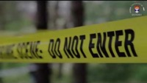
Group Task:
Identify 5 key/interesting points from the video to report back to the whole group.

Slide 27
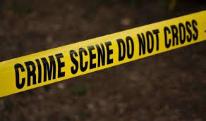
Managing Scenes
Identifying
Identifying scenes
Securing
Securing scenes
Preserving
Preserving scenes
Searching and examining
Searching and examining scenes
Releasing
Releasing scenes

Slide 28
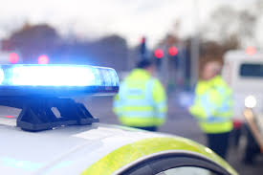
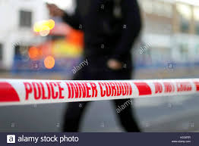
Scene Control
Identify and obtain details of witnesses.
Onlookers can be a help or a hindrance. Use them or get rid of them!
Control peoples movements -Cordons.
Forensically, why are cordons important?

Slide 29
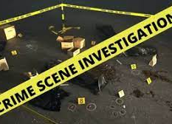
Identifying Scenes…
Examples:
Victims, witnesses & suspects
Routes to and from the scene
Weapons
Suspect’s home address or other premises associated with the suspect or the commission of the offence
Vehicles
Deposition or dump sites

Slide 30
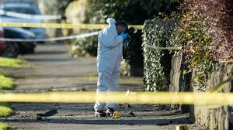
Importance of securing the scene?
Maintain the integrity and provenance of any material which may be recovered from it.
Reduces the opportunities for the material to become contaminated or inadvertently cross-contaminated.
Tape
Scene guard
Vehicles
Road blocks / diversions
Temporary fencing
Suitable PPE
Scene log
The 4 R’s

Slide 31
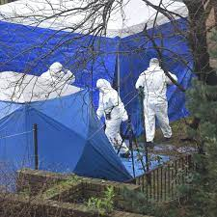
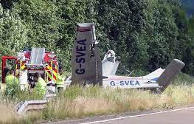
Releasing the scene
Do not release a scene until satisfied all expert advice has been considered (i.e, PolSA)
Once areas which have been covered by crime scene tents and stepping plates have been searched, the scene can be cleaned and released.
Considerations - environmental health department or the local health authority, eg, where chemicals or biological substances may have been found.

Slide 32
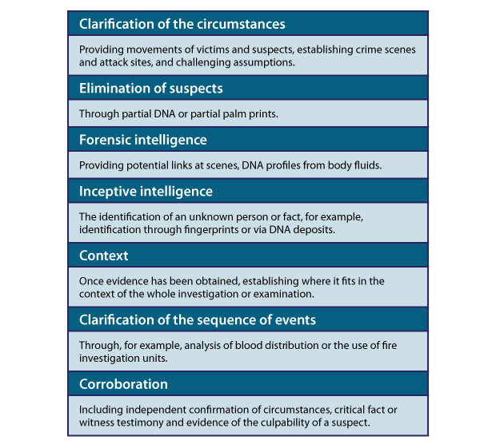


The Forensic Strategy
Enables the potential of material recovered during crime scene examination to be maximised, and can help with:

Slide 33

Specialist Support
Criminal Investigation Department
Financial Crime
Surveillance Unit
Hi-tech Crime
Medical experts
Open-source experts
Collision Investigation Unit

Slide 34


Preserving the scene
Damage being caused by exposure to the elements
Animal disturbance
Disturbance by material being moved from its original position
Microbiological activity causing decay to material
Disturbance by items being taken into it
Disturbance by material being removed from it
Cross-contamination by transference between scenes.
…Try to prevent!!

Slide 35


Areas of discussion…
Sources of forensic evidence
Priorities of scene preservation
The Forensic Evidence Process
Identifying sources of evidence
Generic considerations when collecting and preserving evidence from a source
Collecting and preserving forensic evidence through the use of packaging, people & locations
Preserving forensic evidence at major, critical and major crime incidents

Slide 36



Theories / Principles
Legislation
Police Powers (Search & Seizure)
Policies and Procedures
Case studies
Information & Intelligence
Conducting investigations
Incident Management
Misuse of Drugs Act 1971
Roads Policing
Public Protection
Application of knowledge
Scene Management
Identifying
Securing
Searching and examining
Cross contamination
Releasing

Slide 37

Think: Recovery and Continuity of Evidence
A murder takes place in a house in Swansea.
The body is stored in the garden shed until the hours of darkness when it is transported in a vehicle to a remote spot in the Brecon Beacons where it is buried in a shallow grave. The murderer disposes of the tools used to dig the shallow grave at the council refuse tip and their clothes in a rubbish bin in the park before showering at the local baths. Two days later the body is found by a dog walker.
Where is the scene?

Slide 38
Think: Recovery and Continuity of Evidence
A murder takes place in a house in Swansea.
The body is stored in the garden shed until the hours of darkness when it is transported in a vehicle to a remote spot in the Brecon Beacons where it is buried in a shallow grave. The murderer disposes of the tools used to dig the shallow grave at the council refuse tip and their clothes in a rubbish bin in the park before showering at the local baths. Two days later the body is found by a dog walker.
Where is the scene?

Slide 39

The Role of a Crime Scene Investigation (CSI)
To process crime scenes using specialist, approved techniques to visualise, capture and recover digital and trace evidence, and gather information and intelligence as part of an investigation (COP, 2020)

Slide 40


Remember!
The actions of the
first officer(s) in attendance at a scene can be crucial in maintaining the value of the physical evidence that may be present.

Slide 41

“The Golden Hour”
Term used for the period immediately after an offence has been committed, when material is readily available in high volumes to the police.
Positive action in the period immediately after the report of a crime will:
minimize the amount of material that could be lost to the investigation
maximize the chance of securing the material that will be admissible in court.
Remember CLADD!
Concealed
Lost
Altered
Damaged
Destroyed
(College of Policing, 2020)

Slide 42

Golden Hour Principles
Taken from:
College of Policing (2020)

Slide 43


Slide 44



Slide 45
Forensics- The real CSI
BBC iPlayer - Forensics: The Real CSI - Series 2: 1. An Admission of Murder

Slide 46
To conclude
Review the initial investigation stages
Material
Locards theory
Forensics
Golden Hour principles
Next week- Technology and arrests in investigations

