Slide 1
Learning in the Digital Era
ADPA4001

Slide 2
Coleg Cymraeg Cenedlaethol
Sian Dickie’s presentation is now in Adnoddau Ychwanegol / Additional Resources.
Within the context of DPI (Design and Performing Arts) context, you can email me with any queries: J.Pugh@uwtsd.ac.uk

Slide 3
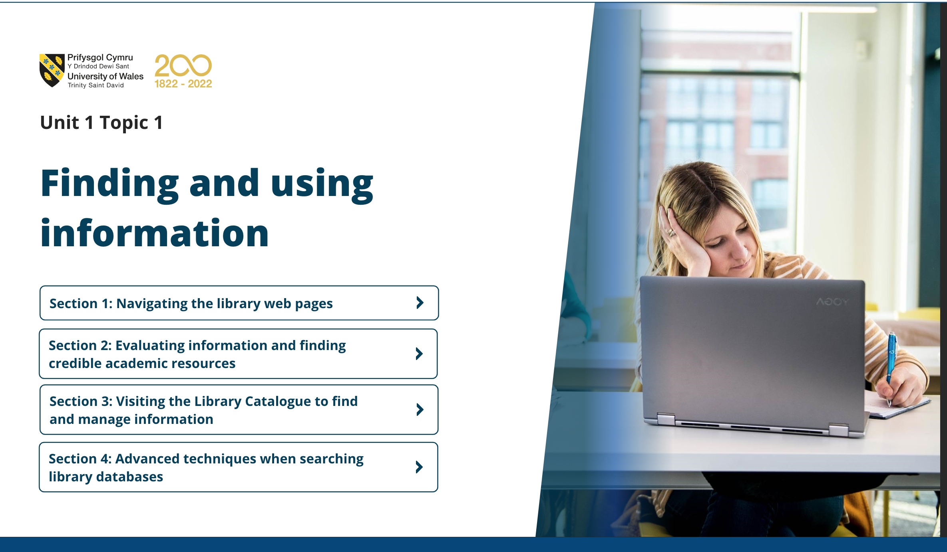
Learning in the Digital Era
Today:
Access to content
Familiarise with Learning Outcomes
Student expectations
Notes:
Moodle
Unit 0
Unit 1

Slide 4
Out of interest….
What’s the best film ever made…?

Slide 5

Learning in the Digital Era
Before starting the journey – my question to you is; what are you first?
How do you define yourself?
How do you define your professional interest?
Is that you?

Slide 6
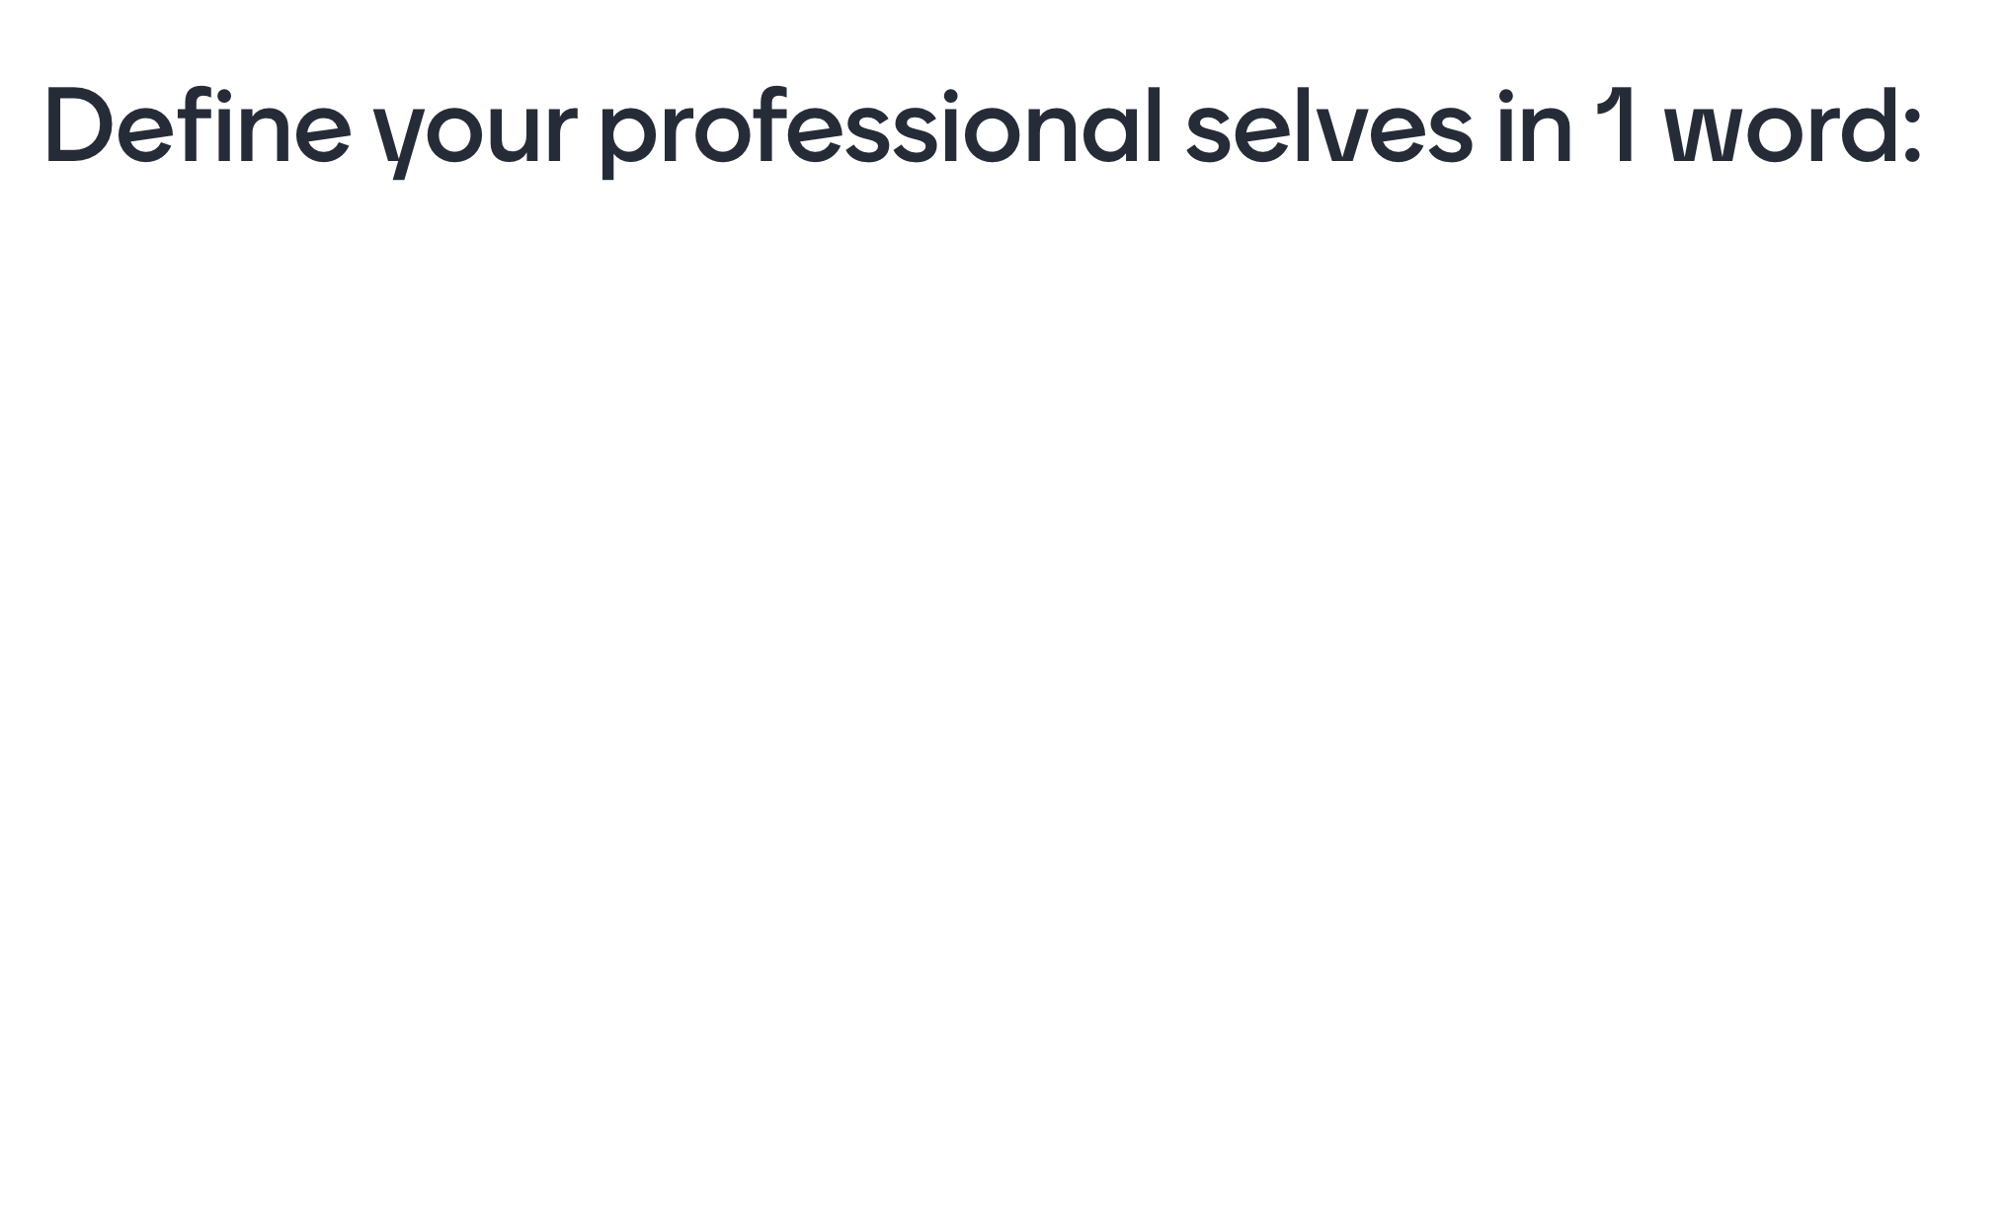
Mentimeter
Got to Mentimeter.com on your phone or laptop and enter the code: 1224 0462

Slide 7
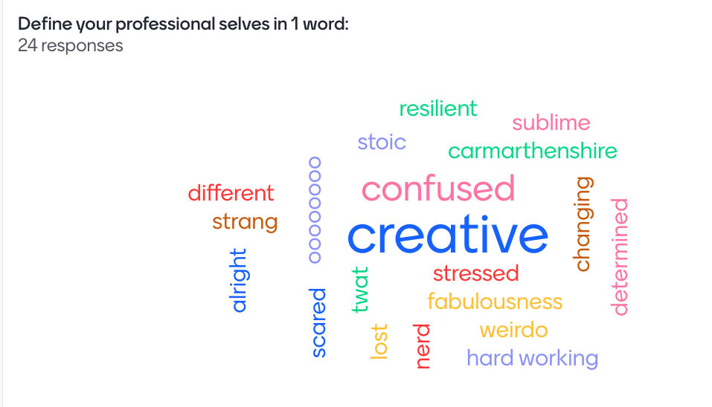
Your Mentimeter results:

Slide 8
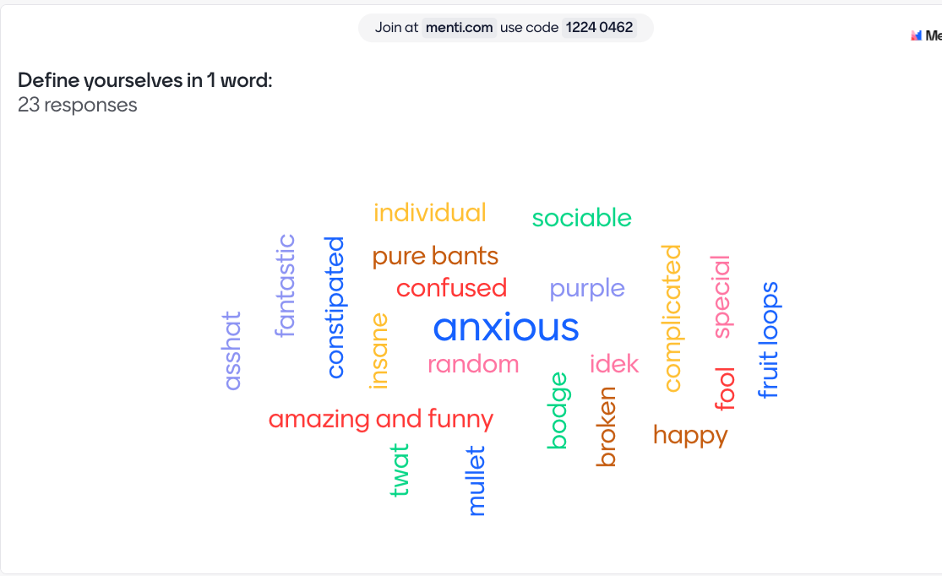
Upon reflection, are your really represented by these words?

Slide 9
Out of interest….
What’s the best song ever made…?

Slide 10
What is a Learning Outcome?
The skills or aptitudes that you need to achieve during your engagement with a module.
You will be assessed upon your ‘demonstration’ of learning outcomes in your assessments
You were introduced to your Programme of Study handbook last week.

Slide 11
Learning in the Digital Era: the business end…
Learning Outcomes:
Demonstrate the foundational skills required to be a resilient and healthy independent learner.
Practise the principles of learning agility.
Use suitable technology to support and enhance their learning experience within the discipline area

Slide 12
Learning in the Digital Era
What do you need to do?
Take it easy and find your own way of learning
Always consider the lectures and online content in relation to your programme of study.

Slide 13
Learning in the Digital Era
What does that mean?
Context
What is a foundational skill for an actor?
What is learner agility for an adventure filmmaker?
What is suitable technology for a set designer?
Notes:
the circumstances that form the setting for an event, statement, or idea, and in terms of which it can be fully understood.

Slide 14
Out of interest….
What’s the best artwork ever made…?

Slide 15
Context
Rhetorically, what is our ‘context’?
Individual
Social
Political
Professional
Personal
…it always can change…
Notes:
the circumstances that form the setting for an event, statement, or idea, and in terms of which it can be fully understood.

Slide 16
Breakout Sessions
Each week we will break from the lecture set up and your will work in groups on a task.
There are 2 extra spaces booked for you – Parry 1 and Parry 2.
Your can work in your discipline groups or in mixed groups.
Notes:
This week – in your discipline groups

Slide 17
Out of interest….
What’s the best stageplay ever made…?

Slide 18
Breakout Task
‘As Einstein famously put it, ‘we cannot solve our problems with the same thinking we used when we created them’ (Graves, 2022:227)
In your groups, discuss:
What ‘problems’ currently face your field of study?
What is the prevalent context of the issues in your opinion and experience? (e.g. tech, politics, customers/consumers, AI, finance?)
How might you approach solving them?
Notes:
Carwyn Graves Welsh Food Stories p227 2022
However, Einstein never said these exact words and certainly wasn’t describing Welsh food when he said ‘The unleashed power of the atom has changed everything save our modes of thinking and we thus drift toward unparalleled catastrophe
A new type of thinking is essential if mankind is to survive and move toward higher levels.’
From "Atomic Education Urged by Einstein", New York Times (25 May 1946),
https://www.quora.com/Did-Albert-Einstein-ever-say-write-that-We-cant-solve-problems-by-using-the-same-kind-of-thinking-we-used-when-we-created-them-If-so-where-and-when-did-he-say-write-so 01/10/22

Slide 19
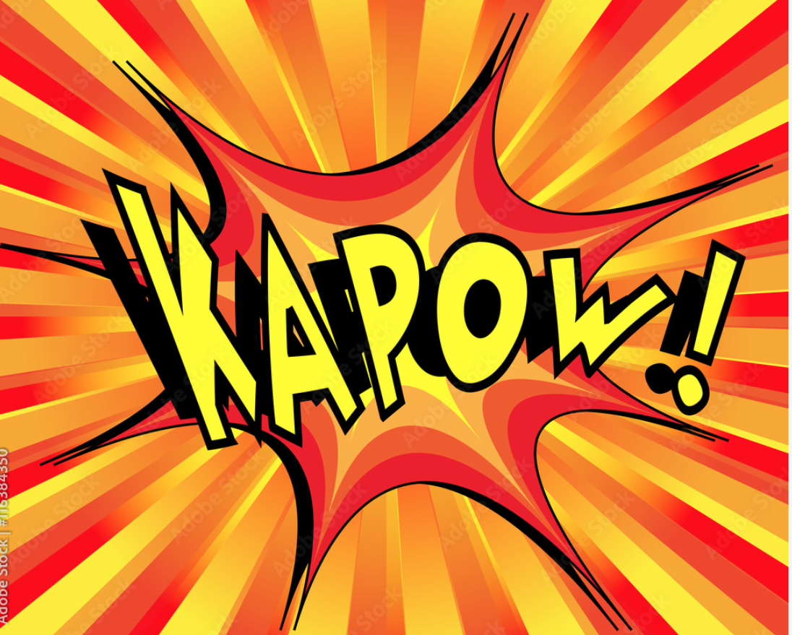

Slide 20
Breakout feedback
What were the main topics of discussion?

Slide 21
Breakout feedback
What were the main topics of discussion?
Are there any common themes between groups?

Slide 22
Learning in the Digital Era
Converting challenging conversations into transformative ones.
Preparing to ‘develop emotional intelligence, enhance self-awareness, build empathy, and hone their ability to influence changes’
Notes:
Inspired by AdvanceHE website – transformative conversations programme detail:
https://www.advance-he.ac.uk/programmes-events/development-programmes/transformative-conversations-programme?_cldee=70aBYXah86nG7WJr0kOdT_R4X1--3ASQAX74gAb8HOJVArKzg3ehq70cnRGpch6B&recipientid=lead-17eba8a42f4eec118f8e000d3a0cec88-7f197e97aae54e6bb3fc57510cb7839d&utm_source=ClickDimensions&utm_medium=email&utm_campaign=Monthly%20Newsletter%20-%20September%202022&esid=d29a16d3-de3f-ed11-bba2-0022481b537c

Slide 23
Assessment
How can we make this about all of you individually?
How can we bridge the gap between head and hands – theory and practice?
What are our aspirations? What do we want to achieve?
‘Student Achievement can be - Socially worthwhile – but not instrumentally useful…’ (McArthur, 2022)
Can we nurture a sense of achievement for social and individual wellbeing through assessment?
Individual – personalised -value
Notes:
What are our aspirations? What do we want to achieve? Inspired by Dr Jan McArthur, AdvanceHE 2022 - Aspiring through assessment: Rethinking the role of assessment in programme design and student achievement

Slide 24
Assessment
How can we make this about all of you individually?
How can we bridge the gap between head and hands – theory and practice?
What are our aspirations? What do we want to achieve?
‘Student Achievement can be - Socially worthwhile – but not instrumentally useful…’ (McArthur, 2022)
Can we nurture a sense of achievement for social and individual wellbeing through assessment?
Can we create individual or ‘personalised’ value through taking part in assessment?
Notes:
What are our aspirations? What do we want to achieve? Inspired by Dr Jan McArthur, AdvanceHE 2022 - Aspiring through assessment: Rethinking the role of assessment in programme design and student achievement

Slide 25
Assessment
Component 1
Evidence of Learning E-Portfolio
Deadlines – task specific:
20th October
10th November
24th November
15th of December
Component 2
Coursework:
Personal Development Plan & video:
12th of January 2024
Notes:
Show doc
9th Feb Feedback

Slide 26
For next week
Do something creative for yourselves.
Notes:
…be something?

Slide 27
For next week
Do something creative for yourselves.
Choose to…
Watch something
Listen to something
Read something
Discuss something
Make something…
Notes:
…be something?

Slide 28
For next week
Do something creative for yourselves.
Appreciate the modules that you’re studying and consider your goals for them.

Slide 29
For next week
Do something creative for yourselves.
Appreciate the modules that you’re studying and consider your goals for them.
Explore Moodle and start working through the online materials.

Slide 30
Our task as a University
“Transforming education, transforming lives” UWTSD ‘motto’.
Help students ‘imagine otherwise’ outside of the world of work.
To stop education having a disconnection from life.
Notes:
McArthur 2022 QAA seminar

Slide 31
Diolch yn fawr am eich cyfraniad.
Thank you for your contribution.

