Slide 1
LCHS4007 Digital Skills & Research Methods Assessment 1
LECTURER: ANIKA TASHIN AHMED
EDWIGE TATY-BITEMO (2511480)
NIKITA NANA ANGELINA WILSON (2506894)

Slide 2
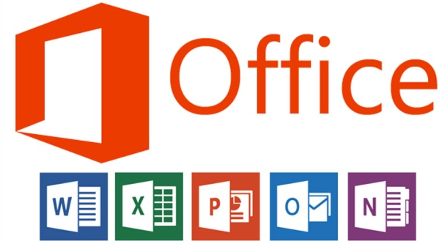
Introduction
The aim of this presentation is to explore the use of Excel in Sunrise Residential Care Home.
It will analyse the MS Team as a collaborative tool for staff and professionals.
The presentation will highlight challenges caused by limited digital literacy.
A digital safety checklist will be presented, followed by the conclusion
ThePhoto by PhotoAuthor is licensed under CCYYSA.

Slide 3

TABLE OF CONTENT
Benefits of MS TEAM
References
Limitations of MS TEAM
References

Slide 4
BENEFITS OF MS TEAM
Centralised Communication: Team communication and collaboration within the healthcare home can be enhanced through secured chat, video calls and voice.
Dedicated Channels: MS Team is beneficial in sharing updates an information. Thereby, fostering improved patient care with virtual appointments(Metha et al.,2023).
Workflow management: MS Team is effective in designing the schedules and conducting the virtual visits. Simplified the workflows for the clinicians and staffs.
Microsoft teams Pros:
Excellent Chat Feature
Collaboration Tools
Robust Security
Sunrise Residential care home can make sure of MS Teams to improve organisational communication and patient care.

Slide 5
REFERENCES:
Gupta,A., Narula,A., Patel,D.,Arifin, M., Wheeldon, H., Ajayi, A., Sachdeva, G., and Aung, N. (2024). A quality improvement project to increase junior doctors' satisfaction with the handover process using Microsoft Teams (MS Teams) as a platform. BJPsych, 11(2), pp.S92-S92. Available at : https://www.cambridge.org?core/journals/bjpsych-open/article/quality-improvement-project-to-increase-junior-doctors-satisfaction-with-handover-process-using-microsoft-teams-ms-teams-as-a-platform-/1D48CE65EC7E9F9D69EF48EBF54CC018
Mehta, J., Yates, T., Smith, P., Henderson, D., Winteringham, G., and Burns, A. (2023). Rapid implementation of Microsoft Teams in response to COVID-19: one acute healthcare organisation's experience> BMJ health & care informatics ,27(3), pp.23-3. Available at: https://pmc.ncbi.nlm.nih.gov/articles/PMC7661347/

Slide 6
LIMITATIONS OF MS TEAMS
Risk of Data Breaches: Inadequate knowledge and improper set-up can increase the risk of sensitive data breaches (Clavelou, 2024).
Lack of dedicated IT support: Specialised IT support and resources at healthcare settings are not available easily.
Complicated Data Governance: The multiple data generated in Teams are stored in different location and thereby increases the challenge to manage and monitor (Azbeg et al., 2022).
Unplanned user training: Lack of proper training can create issues for the health care
Microsoft Teams Cons:
Runs slow at teams
Confusing Interface
Performance Issues
Without proper training, complicated data governance of MS Team, and lack of specialised IT support can hinder the work process
And patient safety outcomes at Sunrise Residential care home care.

Slide 7
REFERENCES:
Azbeg, K., Ouchetto, O. and Jai Andaloussi, S. (2022) ,BlockMedCare: A healthcare system based on iot, blockchain and IPFS for data management security', Egyptian Informatics Journal,23(2). Available at: https://doi.prg/10.1016/j.eij.2022.02.004.
Clavelou, P. (2024). Can we optimize our teams? Multidisciplinary care for multiple sclerosis. Expert Review of Neurotherapeutics, 13(2), pp.39-44. Available at: https://www.tandfonline.com/doi/abs/10.1586/14737175.2013.865873
ThePhoto by PhotoAuthor is licensed under CCYYSA.
ThePhoto by PhotoAuthor is licensed under CCYYSA.

Slide 8
TABLE OF CONTENT
How to use ms Teams in a care home
The impact of Excel and MS Teams
References

Slide 9
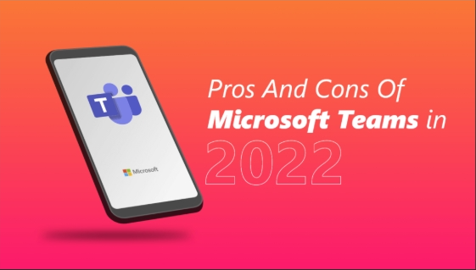
HOW TO USE MS TEAM IN A CARE HOME
Staff us MS Teams to share resident updates, schedule shifts, and hold virtual consultations with doctors and family members (Gao et al., 2023)
Benefits:
Enabling instant communication between carers, nurses, and external professionals, improving response times.
Centralising care records and task lists, reducing manual paperwork and disruption errors (Giri et al., 2024).
(Wan.io)
Limitations:
Network issues can delay urgent messages or disrupt video consultations .
Some senior staff struggle with digital navigation, reducing overall efficiency

Slide 10
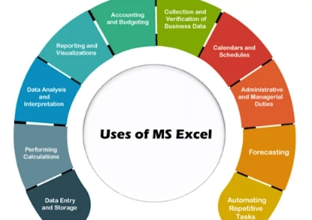
THE IMPACT OF EXCEL AND THE MS TEAM
Wrong records in the Excel cause medication errors or misunderstandings of the schedules of the Wrong records in the Excel cause medication errors or and the routine care is interfered with
Employees who cannot access Teams are not updated on critical shifts and care notes, which delays the necessary information (Barber et al., 2023).
A deficiency in digital confidence laeds to dependency on other people, which slows down the decision making process during emergencies.
Ineffective date management raises the amount of workload on the administration at the expense of the personal care of residents {cornliusson et al. 2022} .
(Vijaycomputeracademy.com)

Slide 11
REFERENCES
Barber, L.K., Kuykendall, L.E. and Santuzzi, A.M. (2023) 'How managers can reduce ''always on'' work stress in teams: An optimal work availability frame wok', Organizational Dynamics, 52(3),p. 100992. Available at: https://doi.org/10.1016/j.orgdyn.2023.100992.
Bhadouria, A.S (2022) 'Study of: Impact of Malicious Attacks and Data Breach on the Growth and Performance of the Company and Few...', ResearchGate ,10(10). Available at: https://doi.org/10.29322/IJSRP.X2022.p091095
Corneliusson, L., Pesonen, T., Salla Lehtoaro, Juhani Sulander, Noro, A. and Timo Sinervo (2022)'Managers' Perspectives of Quality of Care in Service Housing and Home care Services: A Qualitative Study',8,p. 233372142211429-233372142211429. Available at :https://doi.org/10.1177/20552076231151567
Giri.P. Campus, K. and Pokhara{2024} MANAGEMENT INFORMATION SYSTEM REPORT

