Slide 1
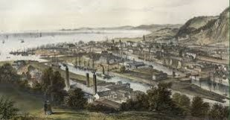
Industrial Revolution
Week one – Anthony Burns

Slide 2
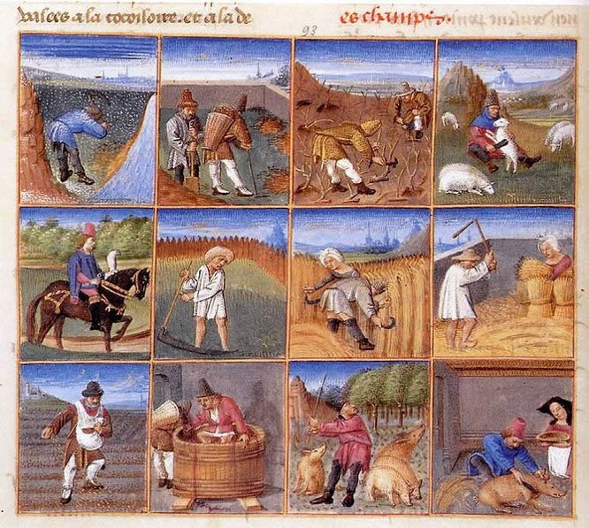
The Agricultural Revolution
The British Agricultural Revolution mid 17th – late 19th century
Seed Planting 1701
– Jethro Tull
Notes:
The British Agricultural Revolution, or Second Agricultural Revolution, was the unprecedented increase in agricultural production in Britain due to increases in labour and land productivity between the mid-17th and late 19th centuries. Agricultural output grew faster than the population over the century to 1770, and thereafter productivity remained among the highest in the world. This increase in the food supply contributed to the rapid growth of population in England and Wales, from 5.5 million in 1700 to over 9 million by 1801, though domestic production gave way increasingly to food imports in the nineteenth century as the population more than tripled to over 35 million.^{[1]} The rise in productivity accelerated the decline of the agricultural share of the labour force, adding to the urban workforce on which industrialization depended: the Agricultural Revolution has therefore been cited as a cause of the Industrial Revolution.
Significance[edit]
The Agricultural Revolution was part of a long process of improvement, but sound advice on farming began to appear in England in the mid-17th century, from writers such as Samuel Hartlib, Walter Blith and others,^{[36]} and the overall agricultural productivity of Britain started to grow significantly only in the period of the Agricultural Revolution. It is estimated that total agricultural output grew 2.7-fold between 1700 and 1870 and output per worker at a similar rate.
However, historians continue to dispute when exactly such a "revolution" took place and of what it consisted. Rather than a single event, G. E. Mingay states that there were a "profusion of agricultural revolutions, one for two centuries before 1750, another emphasising the century after 1650, a third for the period 1750-1880, and a fourth for the middle decades of the nineteenth century".^{[2]} This has led more recent historians to argue that any general statements about "the Agricultural Revolution" are difficult to sustain.^{[3][4]}
One important change in farming methods was the move in crop rotation to turnips and clover in place of fallow. Turnips can be grown in winter and are deep-rooted, allowing them to gather minerals unavailable to shallow-rooted crops. Clover fixes nitrogen from the atmosphere into a form of fertiliser. This permitted the intensive arable cultivation of light soils on enclosed farms and provided fodder to support increased livestock numbers whose manure added further to soil fertility.
Bullet two - Seed planting[edit]
Before the introduction of the seed drill, the common practice was to plant seeds by broadcasting (evenly throwing) them across the ground by hand on the prepared soil and then lightly harrowing the soil to cover the seed. Seeds left on top of the ground were eaten by birds, insects, and mice. There was no control over spacing and seeds were planted too close together and too far apart. Alternately seeds could be laboriously planted one by one using a hoe and/or a shovel. Cutting down on wasted seed was important because the yield of seeds harvested to seeds planted at that time was around four or five.
The seed drill was introduced from China to Italy in the mid-16th century where it was patented by the Venetian Senate.^{[33]} Jethro Tull invented an improved seed drill in 1701. It was a mechanical seeder which distributed seeds evenly across a plot of land and at the correct depth. Tull's seed drill was very expensive and fragile and therefore did not have much of an impact.^{[34]} The technology to manufacture affordable and reliable machinery, including Agricultural machinery, improved dramatically in the last half of the nineteenth century

Slide 3
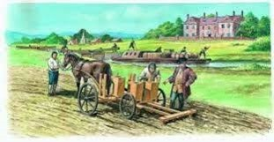
The Agricultural Revolution
Crop Rotation
  Ideally, wheat, barley, turnips and clover would be planted in that order in each field in successive years 1800s
Enclosure culminating in the General Enclosure Act of 1801
Development
of a National Market By the 19th century, marketing was nationwide and the vast majority of agricultural production was for market rather than for the farmer and his family
Selective Breeding livestock In England, Robert Bakewell and Thomas Coke introduced selective breeding as a scientific practice – 18th century
Transport Infrastructure
Notes:
Bullet one
One of the most important innovations of the British Agricultural Revolution was the development of the Norfolk four-course rotation, which greatly increased crop and livestock yields by improving soil fertility and reducing fallow.^{[5]}
Crop rotation is the practice of growing a series of dissimilar types of crops in the same area in sequential seasons to help restore plant nutrients and mitigate the build-up of pathogens and pests that often occurs when one plant species is continuously cropped. Rotation can also improve soil structure and fertility by alternating deep-rooted and shallow-rooted plants. Turnip roots, for example, can recover nutrients from deep under the soil. The Norfolk System, as it is now known, rotates crops so that different crops are planted with the result that different kinds and quantities of nutrients are taken from the soil as the plants grow. An important feature of the Norfolk four-field system was that it used labour at times when demand was not at peak levels.^{[8]}
Planting cover crops such as turnips and clover was not permitted under the common field system because they interfered with access to the fields. Besides, other people's livestock could graze the turnips.^{[9]}
During the Middle Ages, the open field system had initially used a two-field crop rotation system where one field was left fallow or turned into pasture for a time to try to recover some of its plant nutrients. Later they employed a three-year, three field crop rotation routine, with a different crop in each of two fields, e.g. oats, rye, wheat, and barley with the second field growing a legume like peas or beans, and the third field fallow. Normally from 10% to 30% of the arable land in a three crop rotation system is fallow. Each field was rotated into a different crop nearly every year. Over the following two centuries, the regular planting of legumes such as peas and beans in the fields that were previously fallow slowly restored the fertility of some croplands. The planting of legumes helped to increase plant growth in the empty field due to the ability of the bacteria on legume roots to fix nitrogen (N₂) from the air into the soil in a form that plants could use. Other crops that were occasionally grown were flax and members of the mustard family.
Convertible husbandry was the alternation of a field between pasture and grain. Because nitrogen builds up slowly over time in pasture, ploughing up pasture and planting grains resulted in high yields for a few years. A big disadvantage of convertible husbandry was the hard work in breaking up pastures and difficulty in establishing them. The significance of convertible husbandry is that it introduced pasture into the rotation.^{[10]}
The farmers in Flanders (in parts of France and current day Belgium) discovered a still more effective four-field crop rotation system, using turnips and clover (a legume) as forage crops to replace the three-year crop rotation fallow year.
The four-field rotation system allowed farmers to restore soil fertility and restore some of the plant nutrients removed with the crops. Turnips first show up in the probate records in England as early as 1638 but were not widely used till about 1750. Fallow land was about 20% of the arable area in England in 1700 before turnips and clover were extensively grown in the 1830's. Guano and nitrates from South America were introduced in the mid-19th century and fallow steadily declined to reach only about 4% in 1900.^{[11]} Ideally, wheat, barley, turnips and clover would be planted in that order in each field in successive years. The turnips helped keep the weeds down and were an excellent forage crop—ruminant animals could eat their tops and roots through a large part of the summer and winters. There was no need to let the soil lie fallow as clover would re-add nitrates (nitrogen-containing salts) back to the soil. The clover made excellent pasture and hay fields as well as green manure when it was ploughed under after one or two years. The addition of clover and turnips allowed more animals to be kept through the winter, which in turn produced more milk, cheese, meat and manure, which maintained soil fertility. This maintains a good amount of crops produced.
The mix of crops also changed: the area under wheat rose by 1870 to 3.5 million acres (1.4m ha), barley to 2.25m acres (0.9m ha) and oats less dramatically to 2.75m acres (1.1m ha), while rye dwindled to 60,000 acres (25,000 ha), less than a tenth of its late medieval peak. Grain yields benefited from new and better seed alongside improved rotation and fertility: wheat yields increased by a quarter in the 18th century^{[12]} and nearly half in the 19th, averaging 30 bushels per acre (2,080 kg/ha) by the 1890s.
Bullet two – Enclosure
In Europe, agriculture was feudal from the Middle Ages. In the traditional open field system, many subsistence farmers cropped strips of land in large fields held in common and divided the produce. They typically worked under the auspices of the aristocracy or the Catholic Church, who owned much of the land.
As early as the 12th century, some fields in England tilled under the open field system were enclosed into individually owned fields. The Black Death from 1348 onward accelerated the break-up of the feudal system in England.^{[17]} Many farms were bought by yeomen who enclosed their property and improved their use of the land. More secure control of the land allowed the owners to make innovations that improved their yields. Other husbandmen rented property they "share cropped" with the land owners. Many of these enclosures were accomplished by acts of Parliament in the 16th and 17th centuries.
The process of enclosing property accelerated in the 15th and 16th centuries. The more productive enclosed farms meant that fewer farmers were needed to work the same land, leaving many villagers without land and grazing rights. Many of them moved to the cities in search of work in the emerging factories of the Industrial Revolution. Others settled in the English colonies. English Poor Laws were enacted to help these newly poor.
Some practices of enclosure were denounced by the Church, and legislation was drawn up against it; but the large, enclosed fields were needed for the gains in agricultural productivity from the 16th to 18th centuries. This controversy led to a series of government acts, culminating in the General Enclosure Act of 1801 which sanctioned large-scale land reform.
The process of enclosure was largely complete by the end of the 18th century.
Bullet three – National Market
Development of a national market[edit]
Regional markets were widespread by 1500 with about 800 locations in Britain. The most important development between the 16th century and the mid-19th century was the development of private marketing. By the 19th century, marketing was nationwide and the vast majority of agricultural production was for market rather than for the farmer and his family. The 16th-century market radius was about 10 miles, which could support a town of 10,000.^{[18]}
The next stage of development was trading between markets, requiring merchants, credit and forward sales, knowledge of markets and pricing and of supply and demand in different markets. Eventually, the market evolved into a national one driven by London and other growing cities. By 1700, there was a national market for wheat.
Legislation regulating middlemen required registration, addressed weights and measures, fixing of prices and collection of tolls by the government. Market regulations were eased in 1663 when people were allowed some self-regulation to hold inventory, but it was forbidden to withhold commodities from the market in an effort to increase prices. In the late 18th century, the idea of self-regulation was gaining acceptance.^{[19]}
The lack of internal tariffs, customs barriers and feudal tolls made Britain "the largest coherent market in Europe
Bullet four
Selective breeding of livestock[edit]
In England, Robert Bakewell and Thomas Coke introduced selective breeding as a scientific practice, mating together two animals with particularly desirable characteristics, and also using inbreeding or the mating of close relatives, such as father and daughter, or brother and sister, to stabilise certain qualities in order to reduce genetic diversity in desirable animal programmes from the mid-18th century. Arguably, Bakewell's most important breeding programme was with sheep. Using native stock, he was able to quickly select for large, yet fine-boned sheep, with long, lustrous wool. The Lincoln Longwool was improved by Bakewell, and in turn the Lincoln was used to develop the subsequent breed, named the New (or Dishley) Leicester. It was hornless and had a square, meaty body with straight top lines.^{[25]}
Bakewell was also the first to breed cattle to be used primarily for beef. Previously, cattle were first and foremost kept for pulling ploughs as oxen or for dairy uses, with beef from surplus males as an additional bonus, but he crossed long-horned heifers and a Westmoreland bull to eventually create the Dishley Longhorn. As more and more farmers followed his lead, farm animals increased dramatically in size and quality. The average weight of a bull sold for slaughter at Smithfield was reported around 1700 as 370 pounds (170 kg), though this is considered a low estimate: by 1786, weights of 840 pounds (380 kg) were reported,^{[26][27]} though other contemporary indicators suggest an increase of around a quarter over the intervening century.
Bullet five –
Transportation infrastructures[edit]
High wagon transportation costs made it uneconomical to ship commodities very far outside the market radius by road, generally limiting shipment to less than 20 or 30 miles to market or to a navigable waterway. Water transport was, and in some cases still is, much more efficient than land transport. In the early 19th century it cost as much to transport a ton of freight 32 miles by wagon over an unimproved road as it did to ship it 3000 miles across the Atlantic.^{[21]} A horse could pull at most one ton of freight on a Macadam road, which was multi-layer stone covered and crowned, with side drainage. But a single horse could pull a barge weighing over 30 tons.
Commerce was aided by the expansion of roads and inland waterways. Road transport capacity grew from threefold to fourfold from 1500 to 1700.^{[22][23]}
Railroads would eventually reduce the cost of land transport by over 95%; however they did not become important until after 1850.

Slide 4
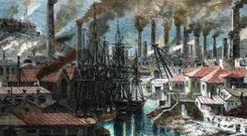
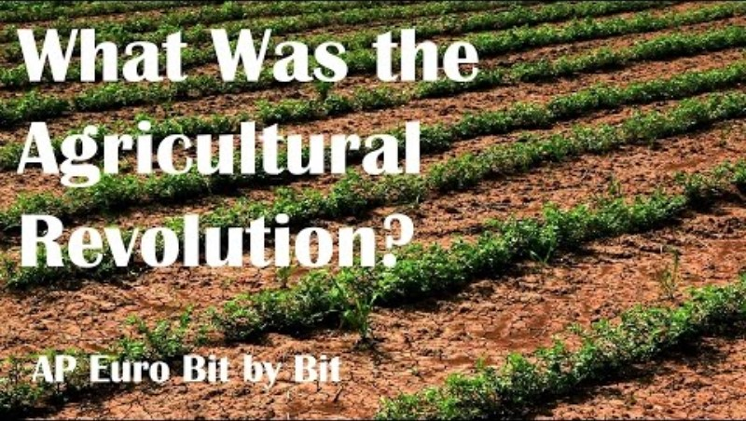
Agricultural Revolution Video
Agricultural Revolution Video Link
Agriculture
Notes:
https://www.youtube.com/watch?v=zGVCYQoaWvs

Slide 5
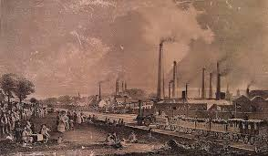
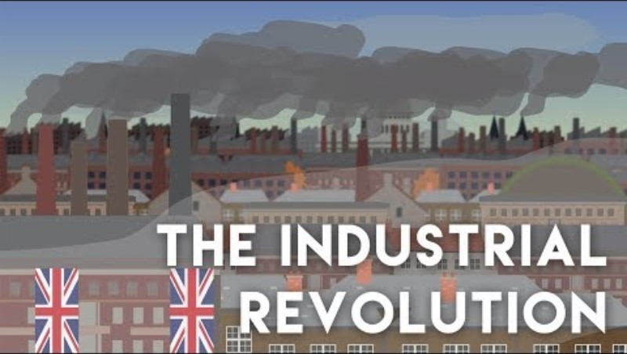
Introduction to the Industrial Revolution
Notes:
https://www.youtube.com/watch?v=xLhNP0qp38Q

Slide 6

Introduction to the Industrial Revolution
Notes:
https://www.youtube.com/watch?v=x9BdVHCuNPs

Slide 7
Industrial Revolution
Started in the latter half of the 18th century
Transformed largely agrarian societies in Great Britain, Europe and USA into Industrialised and urban ones.
Fuelled by the game changing steam power it spread from Great Britain across the world.
Notes:
The Industrial Revolution marked a period of development in the latter half of the 18th century that transformed largely rural, agrarian societies in Europe and America into industrialized, urban ones.
Goods that had once been painstakingly crafted by hand started to be produced in mass quantities by machines in factories, thanks to the introduction of new machines and techniques in textiles, iron making and other industries.
Fueled by the game-changing use of steam power, the Industrial Revolution began in Britain and spread to the rest of the world, including the United States, by the 1830s and ‘40s. Modern historians often refer to this period as the First Industrial Revolution, to set it apart from a second period of industrialization that took place from the late 19th to early 20th centuries and saw rapid advances in the steel, electric and automobile industries.

Slide 8
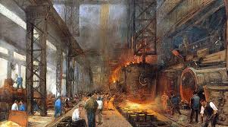
Industrial Revolution
Why did it start in the UK?
Starting in the mid 18th century – innovations like the Spinning Jenny etc.
More efficient mechanized production meant textile factories – British Iron industry
New techniques Iron Smelting with coke – enabling production to expand and rail roads
Notes:
Bullet one - Thanks in part to its damp climate, ideal for raising sheep, Britain had a long history of producing textiles like wool, linen and cotton. But prior to the Industrial Revolution, the British textile business was a true “cottage industry,” with the work performed in small workshops or even homes by individual spinners, weavers and dyers.
Bullet two - Starting in the mid-18th century, innovations like the flying shuttle, the spinning jenny, the water frame and the power loom made weaving cloth and spinning yarn and thread much easier. Producing cloth became faster and required less time and far less human labour.
More efficient, mechanized production meant Britain’s new textile factories could meet the growing demand for cloth both at home and abroad, where the nation’s many overseas colonies provided a captive market for its goods. In addition to textiles, the British iron industry also adopted new innovations.
Chief among the new techniques was the smelting of iron ore with coke (a material made by heating coal) instead of the traditional charcoal. This method was both cheaper and produced higher-quality material, enabling Britain’s iron and steel production to expand in response to demand created by the Napoleonic Wars (1803-15) and the later growth of the railroad industry.

Slide 9
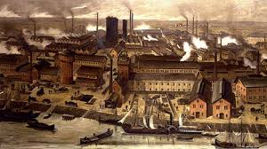
Industrial Revolution
Steam
Early 1700s - Thomas Newcomen designed the prototype for the first modern steam engine
In the 1760s, Scottish engineer James Watt began tinkering with one of Newcomen’s models
Deeper mines, railroads and steamships
Notes:
An icon of the Industrial Revolution broke onto the scene in the early 1700s, when Thomas Newcomen designed the prototype for the first modern steam engine. Called the “atmospheric steam engine,” Newcomen’s invention was originally applied to power the machines used to pump water out of mine shafts.
In the 1760s, Scottish engineer James Watt began tinkering with one of Newcomen’s models, adding a separate water condenser that made it far more efficient. Watt later collaborated with Matthew Boulton to invent a steam engine with a rotary motion, a key innovation that would allow steam power to spread across British industries, including flour, paper, and cotton mills, iron works, distilleries, waterworks and canals.
Just as steam engines needed coal, steam power allowed miners to go deeper and extract more of this relatively cheap energy source. The demand for coal skyrocketed throughout the Industrial Revolution and beyond, as it would be needed to run not only the factories used to produce manufactured goods, but also the railroads and steamships used for transporting them.

Slide 10
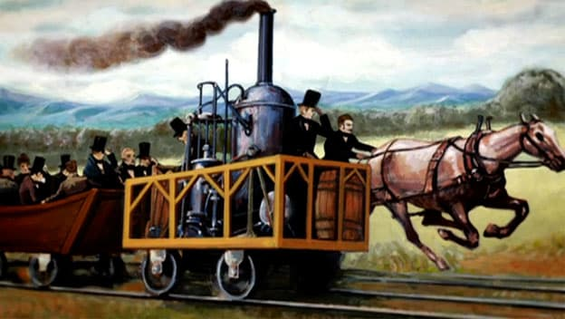
Industrial Revolution
Transportation During the Industrial Revolution
2,000 miles of canals were in use across Britain by 1815
In the early 1800s Richard Trevithick
Notes:
Britain’s road network, which had been relatively primitive prior to industrialization, soon saw substantial improvements, and more than 2,000 miles of canals were in use across Britain by 1815.
In the early 1800s, Richard Trevithick debuted a steam-powered locomotive, and in 1830 similar locomotives started transporting freight (and passengers) between the industrial hubs of Manchester and Liverpool. By that time, steam-powered boats and ships were already in wide use, carrying goods along Britain’s rivers and canals as well as across the Atlantic.

Slide 11
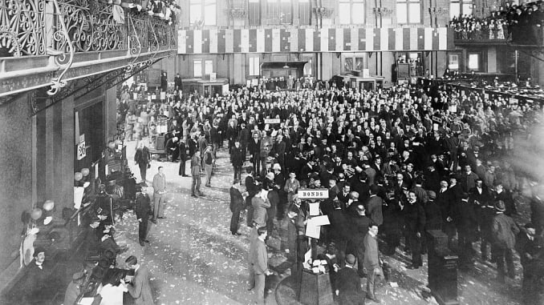
Industrial Revolution
Communication and Banking in the Industrial Revolution
The latter part of the Industrial Revolution also saw key advances in communication methods
A stock exchange was established in London in the 1770s
Adam Smith (1723-1790) Wealth of Nations
Notes:
Bullet one -The latter part of the Industrial Revolution also saw key advances in communication methods, as people increasingly saw the need to communicate efficiently over long distances. In 1837, British inventors William Cooke and Charles Wheatstone patented the first commercial telegraphy system, even as Samuel Morse and other inventors worked on their own versions in the United States. Cooke and Wheatstone’s system would be used for railroad signalling, as the speed of the new trains had created a need for more sophisticated means of communication.
Bullet two - Banks and industrial financiers rose to new prominent during the period, as well as a factory system dependent on owners and managers. A stock exchange was established in London in the 1770s; the New York Stock Exchange was founded in the early 1790s.
Bullet three- In 1776, Scottish social philosopher Adam Smith (1723-1790), who is regarded as the founder of modern economics, published The Wealth of Nations. In it, Smith promoted an economic system based on free enterprise, the private ownership of means of production, and lack of government interference.

Slide 12
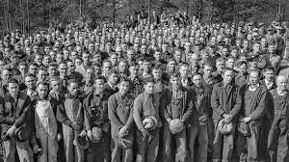
Industrial Revolution
Working Conditions
People moved from rural areas to cities in larger numbers
Middle class upper class standard of living increased, but the working class continued to struggle
Notes:
Bullet one - Though many people in Britain had begun moving to the cities from rural areas before the Industrial Revolution, this process accelerated dramatically with industrialization, as the rise of large factories turned smaller towns into major cities over the span of decades. This rapid urbanization brought significant challenges, as overcrowded cities suffered from pollution, inadequate sanitation and a lack of clean drinking water.
Meanwhile, even as industrialization increased economic output overall and improved the standard of living for the middle and upper classes, poor and working class people continued to struggle. The mechanization of labor created by technological innovation had made working in factories increasingly tedious (and sometimes dangerous), and many workers were forced to work long hours for pitifully low wages. Such dramatic changes fueled opposition to industrialization, including the “Luddites,” known for their violent resistance to changes in Britain’s textile industry.
In the decades to come, outrage over substandard working and living conditions would fuel the formation of labor unions, as well as the passage of new child labor laws and public health regulations in both Britain and the United States, all aimed at improving life for working class and poor citizens who had been negatively impacted by industrialization.

Slide 13
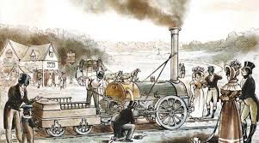
References
Agricultural Revolution
Ncbi.nlm.nih.gov. (2020). [online] Available at: https://www.ncbi.nlm.nih.gov/pmc/articles/PMC2531035/pdf/medhistsuppl00026-0061.pdf [Accessed 21 Jan. 2020].
Bbc.co.uk. (2020). BBC - History - British History in depth: Agricultural Revolution in England 1500 - 1850. [online] Available at: http://www.bbc.co.uk/history/british/empire_seapower/agricultural_revolution_01.shtml [Accessed 21 Jan. 2020].
Victoriacountyhistory.ac.uk. (2020). The Agricultural Revolution | VCH Explore. [online] Available at: https://www.victoriacountyhistory.ac.uk/explore/themes/agriculture/agricultural-revolution [Accessed 21 Jan. 2020].

Slide 14
References
Anon, (2020). [online] Available at: https://webs.bcp.org/sites/vcleary/ModernWorldHistoryTextbook/IndustrialRevolution/IRbegins.html [Accessed 21 Jan. 2020].
Historic UK. (2020). Timeline of the Industrial Revolution - Historic UK. [online] Available at: https://www.historic-uk.com/HistoryUK/HistoryofBritain/Timeline-Industrial-Revolution/ [Accessed 21 Jan. 2020].
History Discussion - Discuss Anything About History. (2020). History of The Industrial Revolution. [online] Available at: http://www.historydiscussion.net/history/industrial-revolution/history-of-the-industrial-revolution/1784 [Accessed 21 Jan. 2020].

