Slide 1

Academic writing
Your “know how guide”.
This Photo by Unknown Author is licensed under CC BY

Slide 2

Previously in…

Slide 3

Passport for Learning
In your Passport for learning, please complete the following:
Reflection activity
Skill Self-Assessment

Slide 4
Lesson Objectives
To explain the structure of an essay and reports
To demonstrate how to structure an essay
To describe the importance of the writing process
To apply the PEEL method to write paragraphs

Slide 5
What is academic writing?
Academic writing is a formal style of writing used in universities and scholarly publications.
Academic writing can be broadly considered as objective

Slide 6
Common concerns
According to Moore (2010, p, 96) there are several concerns that individuals face when they engage in academic writing:
Not feeling as if academic writing can be creative or enjoyable.
Not knowing enough about the ‘rules’
Not feeling confident
Not planning how to write.
Not managing time
Leaving too much to the last minute
Notes:
20

Slide 7
Common feelings
Moore (2010) also asserts that there are several common feelings associated with academic writing:
Frustration
Stress
Anxiety
Irritation
Uncertainty
Fear
Boredom
Motivation
Confidence
Excitement
Notes:
Take a moment to reflect on how you feel about academic writing and try to identity the reasons behind the feeling.

Slide 8
Key pieces of information
Godwin (2019,p9) outlines seven pieces of information that you need prior to beginning your assignment.
Deadline
Word Count
Format/structure
Percentage worth
Learning outcomes
Professional outcomes
Assessment criteria

Slide 9

The writing process
Both Moore (2010) and McMillan (2019) both agree that writing involves more than putting words on paper and that there is a process which students to need to go through to produce a successful assignment.

Slide 10
The writing Process
Gather Information
Process information
Creating text
Edit and review
Final checks
Submit
Notes:
Gathering information:
Reviewing the assignment brief (assessment format, date and word count) and the guidance provided.
It may be also useful to review the module reading list before conducting wider materials.
Process information:
Reading materials
Making notes
Paraphrasing information
Evaluating materials
Identifying arguments
Creating the text:
Using the materials that you have processed, you can now begin putting your ideas onto a page.
Editing and reviewing:
During this stage, it may be useful to present a draft, if a draft week has been provided.
During this stage you will need to proofread your assignment and identify whether anything needs changing.
Final Checks,
It is useful to read your assignment a couple of days before to see whether there any grammar or punctuation errors which may to be changed before submitted.

Slide 11
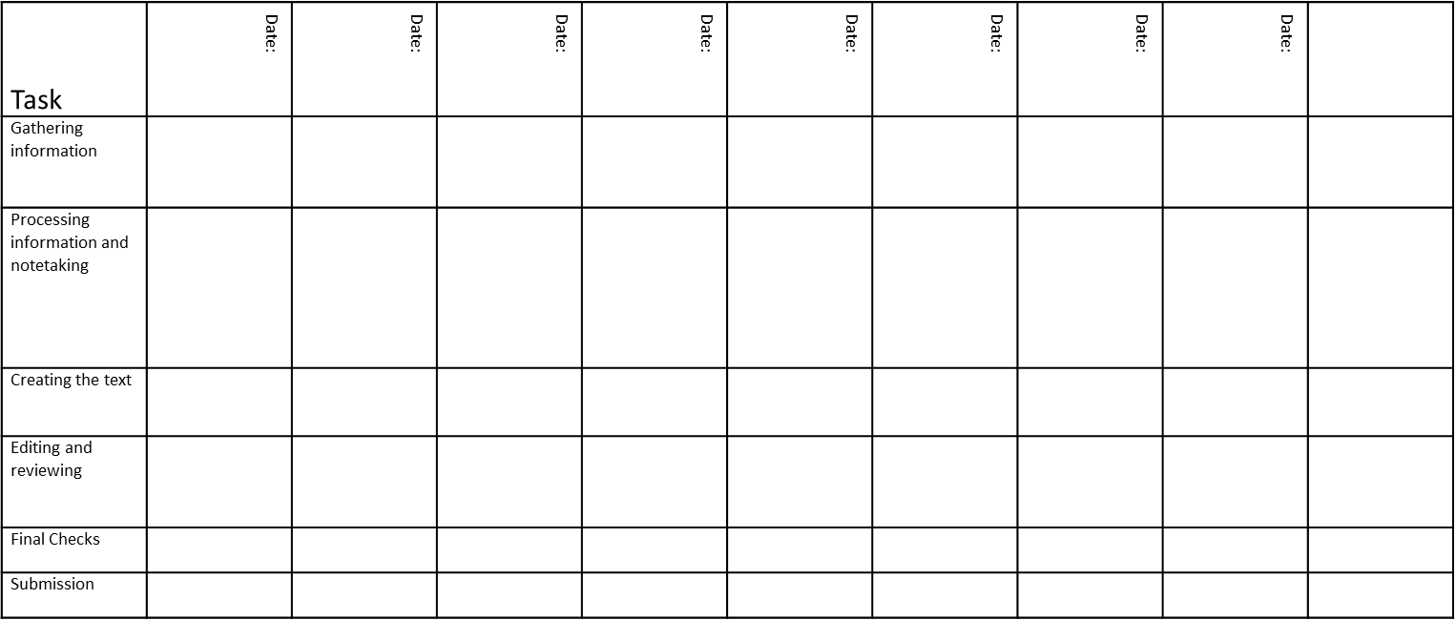
Organising your writing

Slide 12
Reasons for assessment
McMillan (2019) explains that universities employ different assessments the demonstrate the following:
Your knowledge and understanding of a topic
Your ability to conduct research
Your ability to organise and present information

Slide 13
Assessment types
At university you will be presented with assignments that utilise various formats. These include:
Essays
Reports
Portfolios
Presentations
Literature Review

Slide 14
What is an essay
The word essay comes from the Latin word meaning ‘to present a case’.
In an essay you are presenting a case, presenting information to the reader.
This will involve you presenting other people’s arguments.

Slide 15
Why are essays used for assessment?
To give you the opportunity to demonstrate that you know and understand specific information related to your course
To give you the opportunity to show how you handle information – how you organise it, analyse it, evaluate it.

Slide 16
An essay…
Is written in continuous prose –
No subheadings
No bullet points
No pictures, illustrations, charts, or graphs
Has a set length
Usually have +/- 10% flexibility
Has a set form
Beginning, middle and an end

Slide 17
Essay Structure
Title or Question
Introduction (10%)
Main Body (80%)
Conclusion (10%)
Reference List (essential) not included in word count. (Bibliography only if requested by lecturer).

Slide 18
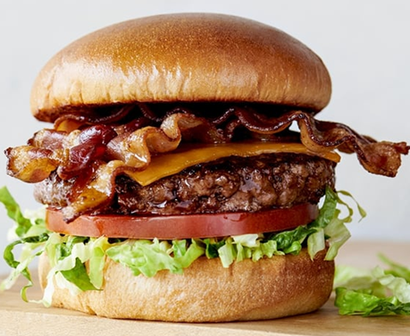
Essays are like burgers
Notes:
Essays can be compared similarly to a structure of a burger. For examples, the top bun can be considered an an introduction to an essay. The burger and filling can be considered as the money body as this is where you will find most of the detail, and the conclusion is the bottom bum, a section of an essay that summaries the entirety of the essay,

Slide 19
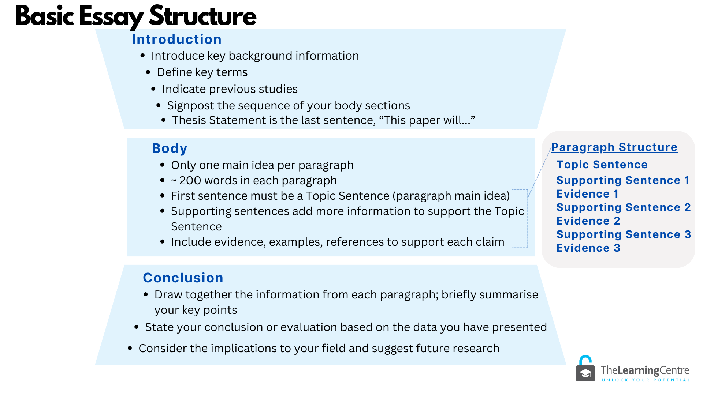

Slide 20
Essays
Introduction – write this last
Usually short and introduces the context and reason for writing the essay.
‘Here’s what this essay is going to show’
Main body
Develops key themes and topics around the writer’s position or argument, which link together to produce a logical and coherent progression of ideas. Each paragraph links to the ‘thesis statement’ or title
Conclusion – write this last
Summarises the content of the essay and presents concluding arguments and implications for the future
‘Here’s what this essay has shown’

Slide 21
Introduction
This is where you tell the reader exactly how you are going to tackle the question or address the task.
This is where you provide an agenda of your essay and signpost what is to come!
Is very important – it establishes the context, topic and focus of your response to the essay question.
A good introduction should present an interesting, succinct and logical reason for writing the essay/assignment that will encourage the reader to continue to read.

Slide 22
Introduction (Beginning)
The introduction is setting the scene, providing some background and context for the assignment topic. For example…
Tells the reader what the topic is about…
Grabs the reader’s attention…
Gives a clear idea of what will be discussed…
(Cottrell, 2019)
Notes:
Examples of other characteristics of an introduction:
An attention-grabbing statement.
For example - identification of a problem, a controversial issue or point of view, or the relevance of the topic today.
Definitions and explanations of key terms
You should have identified what these are from your analysis of the assignment question /task.
This is setting your parameters!
Background and scene setting
Provide an overview and context for the topic.
Maybe briefly describe and summarise the condition that lead to the problem you are discussing.
Identifying the focus
Narrows the context to the focus area, relevant titles and thesis statement by setting parameters.
Maybe include some of the key writers, critics, theorists and experts connected to the research and discussion.

Slide 23
Main body
The main body is where you will do the arguing/informing. This will be split into different paragraphs and should focus on one point at a time. Each paragraph could be structured using the PEEL method:
Point – What is the main idea or argument
Explain – Give more detail about the your point
Evidence – Give an example or proof to support your point
Link – Link it back to the main topic or to the next point
We will take a look shortly.

Slide 24
Conclusion (The End)
The end is where you will draw your assignment to a close by:
Summarising the main points
Show why the topic is important
Not presenting any new information (including references and citations)
(Cottrell, 2019)

Slide 25

Break

Slide 26
Academic Writing: Paragraphs
Paragraphs are distinct units of writing that focus on one main idea or topic, consisting of several sentences that work together to develop and explain that idea. In academic writing, paragraphs serve several key purposes:
Structure and Organization:
Develop Ideas
Coherence

Slide 27
PEEL Method
Point
Evidence
Explain
Link
Notes:
Academic writing is more than just chucking a few paragraphs together; it is an art form and takes considerable amount of time construct.
There are several methods to write, but the PEER Method is one way where you can clearly structure your work .
P= Point, this is known as your topical sentence
Evidence: This is where you incorporate literature to support your topical sentence
Explain: This is where you interpret, analyse and evaluate what the literature is telling you
Repat: This is where you mirror your topical sentence and tie it to your essay question/title, or try and link to the next paragraph.

Slide 28
P – Point
P – Point
Start with a clear topic sentence. This tells the reader the main idea of the paragraph is going to be.
Example:
“One important opportunity I have experienced when using digital tools in my learning is the ability to access information quickly.”
This sentence gives the reader what the main idea is.
(Mortiboys, 2013)

Slide 29
E2 – Evidence
Give an example or proof to support the point you have made. This could be a fact, a story, or something you saw or read.
Example:
“For example, when I was working on an Assignment for Academic Skills, I used the online library to find sources, which helped me understand the topic better. According to Smith (2025), students who use digital resources can improve their research skills and gain deeper insights into their subjects.
(Mortiboys, 2013)

Slide 30
Compare and Contrast
Compare – showing similarities
Thomas (2018) identifies that… Jones (2017) shares a similar view, adding…
Jones (2017) and Thomas (2018) are of the same opinion that….
Contrast – showing differences
Thomas (2018) identifies that…, however Jones (2017) takes an opposing view, adding…
Jones (2017) disagrees, highlighting that…

Slide 31
E1 – Explanation
Give more detail about your point. For example, explain your idea more so the reader understands it better.
Example:
“Digital tools like online search engines and educational websites allow me to find answers and resources fast, which helps me understand topics better.”
This gives more detail about the main idea that was originally made.
(Mortiboys, 2013)

Slide 32
L – in PEEL
Finish the paragraph by linking back to the main question or connecting to the next point.
Example:
“This shows that digital tools can improve how we learn by giving us easy access to useful information.”
This point brings it back to the original topic.
(Mortiboys, 2013)

Slide 33
PEER Example
Point: Digital technology plays a crucial role in enhancing teamwork in health and social care settings.
Evidence: For instance, the use of Electronic Health Records (EHRs) allows team members to share patient information in real time, ensuring that all professionals have access to up-to-date data (Odeh et al., 2020). Additionally, telemedicine platforms facilitate collaboration between healthcare providers across different locations, improving response times and coordination (Dixon et al., 2021).
Explanation: By improving communication and enabling better access to information, digital technology reduces errors, supports decision-making, and streamlines processes. These tools not only allow for efficient communication between team members but also ensure that the patient receives well-coordinated care from a multidisciplinary team.
Relevance: In a healthcare environment that is becoming increasingly complex, these digital tools are vital for promoting effective teamwork, leading to improved patient outcomes and greater efficiency within health and social care services (Topol, 2019).

Slide 34
PEEL Method Activity
You have been presented with a paragraph form an essay, but this paragraphs has been structured incorrectly. You task is to rearrange this paragraph, so it follows the PEEL method of writing.

Slide 35
Essay common mistakes
Lack of a Clear Statement (Not answering the essay question)
Weak introduction
Poor essay structure
Lack of topical sentences
Lack of paraphrasing
No inclusion of citations
Using contractions (Don’t, Won’t, Can’t, Shoudn’t)
Weak conclusion

Slide 36
Report Writing
Report writing is a structured form of writing designed to present information clearly and concisely.
It is commonly used in academic, business, and professional settings to communicate findings, analysis, or recommendations.

Slide 37
Purpose of report writing
Inform: To provide clear and objective information about a specific topic or project.
Analyse: To assess and interpret data or research findings
Recommend: To suggest courses of action based on the information presented.
Evaluate: To critically examine a situation, project, or process.

Slide 38
Report Structure
Title Page
Executive Summary/Abstract
Table of Contents
Introduction
Methodology
Findings/Results
Discussion/Analysis
Conclusion
Recommendations
References
Appendices

Slide 39
Top Report Writing
Tips
Objective and Clear: Reports are typically written in an objective and neutral tone, avoiding personal opinions unless specifically requested.
Concise: Keep sentences clear and to the point, avoiding unnecessary jargon or overly complex language
Structured: Information should be logically organized and easy to navigate, with clear headings and subheadings.

Slide 40
Common report mistakes
Lack of clarity or focus.
Overloading the report with unnecessary details.
Failing to provide evidence for findings or recommendations.
Poor organization or formatting.
Inconsistent referencing or missing sources.

Slide 41
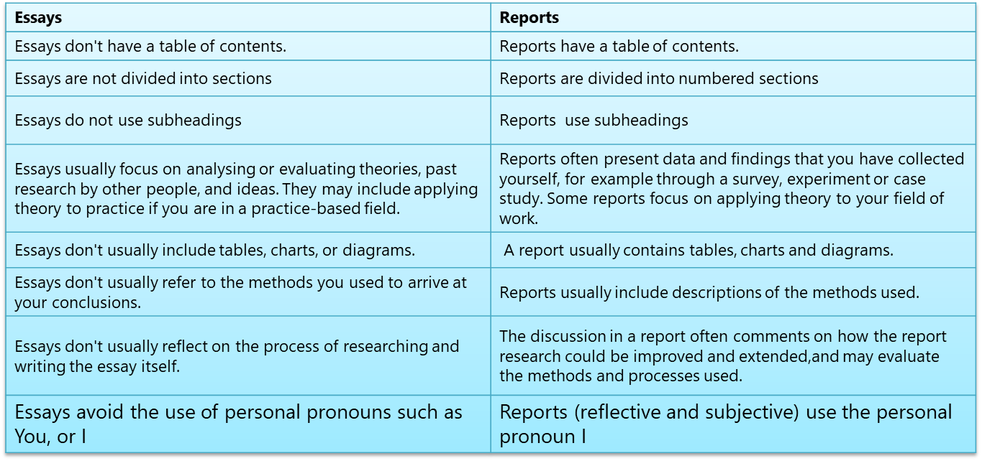
Essay vs Reports

Slide 42
Top tips
Reading improves your writing
Follow the writing process
Organize your time to write
Attend study skills support sessions
Don’t be afraid to ask questions
Present drafts
Ensure to review your assignment brief

