Slide 1
MARKETING ENVIRONMENT AUDIT of b&b marcus
Osarobo Imade - 1815187
Nathalie Quayle -1815194
Merit Okafor - 1815216
Jackie Belford - 1815143
Lecturer Name: JAHANZEEB QURASHI

Slide 2
Business Overview
In the business overview section you actually get down to the nuts and bolts of how the business will operate.
B&B Marcus is located in Lagos, Nigeria very close to the sea side.
The B&B offers 10 different tips of rooms
The B&B are all about service and our desire to deliver beyond expectation. They know no limit and this philosophy keeps us out in front .
Are always working hard to ensure that every one of our serviced is maintained to the highest standards, providing executive luxurious accommodation

Slide 3
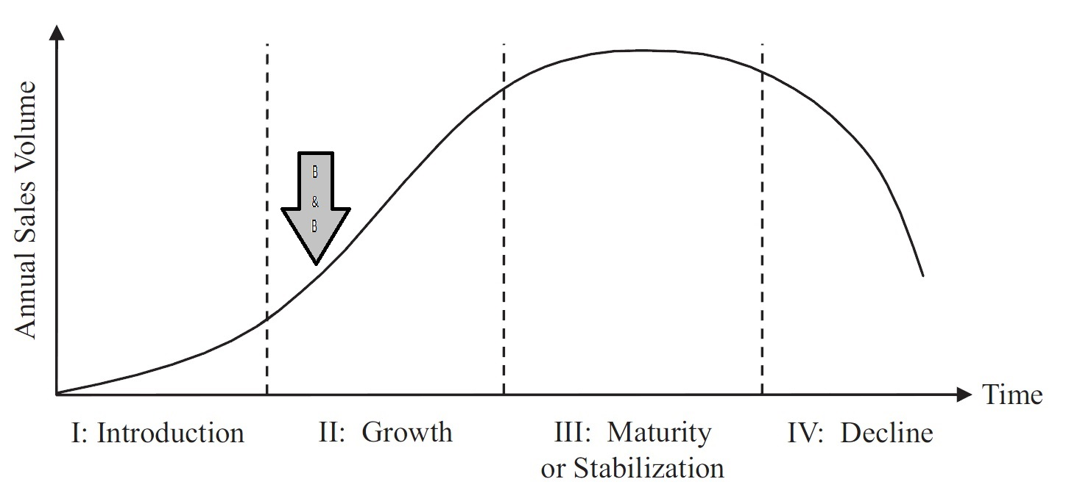
Industry life cycle

Slide 4
CONTENT
Executive summary
Business Overview
Industry life cycle
Products & Services
Target Market
Marketing Segmentation
Marketing Communication mix
Micro Environment
BCG Matrix
SWOT
Marco Environment
PESTEL
Conclusion
References

Slide 5
Products & Services
Services:
24-hour reception service
Foreign Exchange
Information about attractions.
Information about hotel services
Rental of safety deposit box
Restaurant
Leisure areas like swimming pools
24hr Standby Generators
Satellite Channels
Lift to all floors
Daily Housekeeping
Products:
B&B Marcus offers food beverages, room services, news articles, event planning, zoo exhibitions, tips and trends

Slide 6
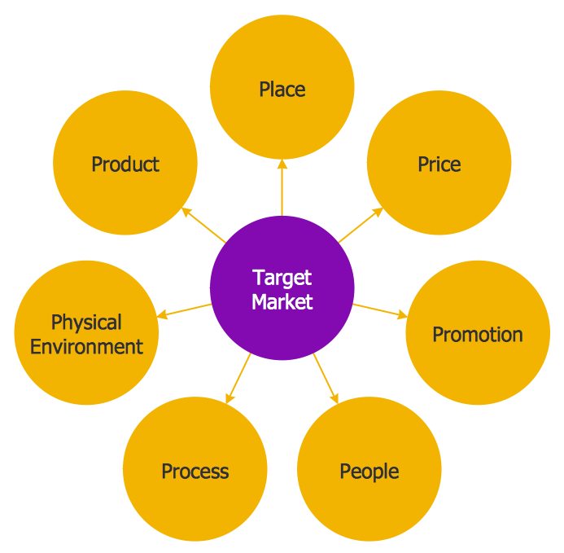
Target Market
The company’s target audience are costumers are low income earning families who are searching for an B&B to pay cheap prices The rooms are really simple but also quite sophisticated and clean, they also tend to be bigger.

Slide 7
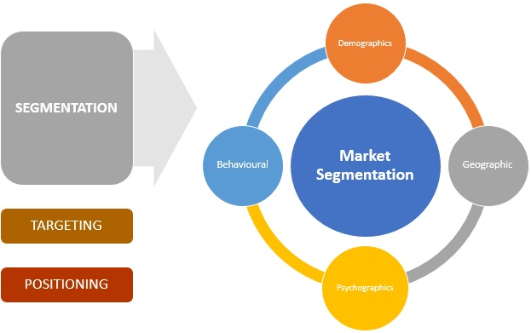
Marketing segmentation
Market segmentation it helps a business in focusing the most revenue-generating segment and fulfil their demands to satisfactory level.
Segmentation is the first step in determining who your marketing should target. Segmentation helps you know which groups exist so you can later identify which groups to target.

Slide 8
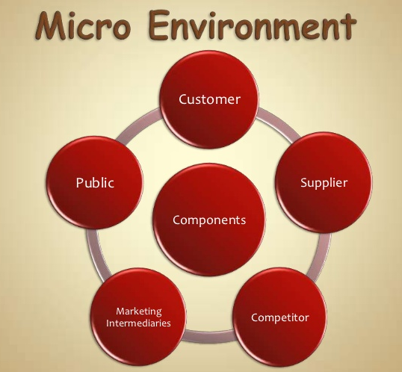
Micro Environments:
Customer: The person who pays .
Suppliers : with their bargaining power
Competitors: entities that complet for resources and markets.
Marketing : price, market maturity, cost structure.
Public are groups that may have a significant impact on marketing activities formulated to contribute to customers' satisfaction with a product and an organization.

Slide 9
EXECUTIVE SUMMARY
Osarobo Imade – C.E.O
Merit Okafor – Manager
Nathalie Quayle – Acquisition Manager
Jackie Belford – Assistant Manager

Slide 10
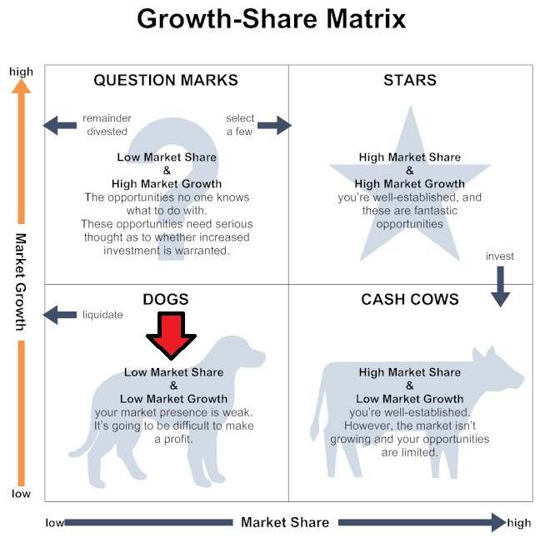
BCG MaTRIX
BCG matrix is a framework created by Boston Consulting Group to evaluate the strategic position of the business brand portfolio and its potential
BCG matrix (or growth-share matrix) is a corporate planning tool, which is used to portray firm’s brand portfolio or SBUs on a quadrant along relative market share axis (horizontal axis) and speed of market growth (vertical axis) axis.
Relative market share.
Market growth rate.
Dogs.
Cash cows.
Stars.
Question marks.

Slide 11
Strengths
• The organisation has a very strict code of conduct that has to be followed by every employee to the finest detail.
• Hotel Palm Beach has a focus on innovation: their operational philosophy is centred on innovation, most of its procedures and systems try to integrate commitment and innovation to ensure total value for money.
•The Hotel is a competitive brands in the business and it tries to continuously reinvent itself to combat competition.
Weaknesses
• Excessive focus on expansion: Hotel Palm Beach is trying to become a huge empire instead of slowing renovating the property currently owned.
SWO T
Opportunities:
• The shift in costumer attitude and retention: people across the world are more willing and open to stay in hotels when they travel even with family.
• Increase in global travel
• Focus on personalisation: costumers want personalised attention and most of the times are also willing to pay for it.
Threats:
Hotel Palm Beach has competition with hotels like Palm Royal and Diamond Hotel etc who are in constant pursuit of becoming market leaders.
Since it is an Hotel, it is extremely vulnerable to terrorist attacks.
Economic recession: The global recession has hit the hospitality business adversely and many properties are out on the market for sale because they are unable to generate revenues.

Slide 12
Macro Environments
Economic:
Factors that affect customers buying package holidays
Social:
Forces that affect social basic values, views, perceptions, preferences and behaviours
Technological:
Using social media to advertise product
Environmental:
Natural resources that affect marketing activities
Political:
Tax policy, Labor law
Environmental law, Trade restrictions, Tariffs, Political instability

Slide 13

Nigeria is one of the leading country in oil and gas(OPEC)
The youth and their political inactivity.
Lack of interaction between the government and society. The human development
Social problems at the individual level include juvenile, drug addiction.
In traditional society like Nigeria, some of the cultural factors that have led to social problems
Technology is derived from the root word ”techne” which means activities by which man seeks to adapt to his environment.
The Nigeria system seems broken, and it is shallow.
Civil rights communities keep talking about these issues.
Environmental issues in Nigeria today it is the air pollution, even simple activities like breathing can become dangerous because of the dirty air.

Slide 14
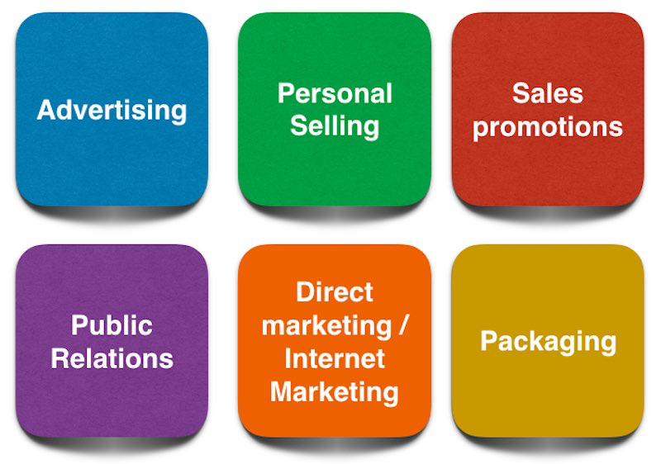



      MARKETING COMMUNICATION MIX
Advertising:
Hotel travel sites I.e. Trivago- television
Social Media:
Facebook, Instagram and YouTube
Costumers Service:
Feedback from customers

Slide 15
Conclusion
Based on this evaluation we suggest the B&B Marcus starts dealing with public relation to hit their target market and make the hotel more popular and well known. Their only form of communication mix is Advertising. We must develop more communication strategies to reach maximum targets of clients which will help us to expand.We are focused on exceeding every guests’ expectation willing to accommodate for every need. Over delivering on even the smallest promises ensuring every guest receives the same quality service.

Slide 16
REFERENCES
https://en.wikipedia.org/wiki/File:Circle-spoke-Diagram-Target-Market.png pic.1
https://en.wikipedia.org/wiki/File:Circle-spoke-Diagram-Target-Market.png
Isioto, Nte. N, Philip-kpae F. O, Dickson Rachael (2017), Roadmap towards Nigeria's Technological and Industrial Independence. International Journal of Engineering and Emerging Scientific Discovery, Vol. 2, N0. 2, June 2017 (Online) available at http://www.casirmediapublishing.com
Costa, C. (2012). Evaluating Product Lines Using the BCG Matrix (VIDEO). Available at: http://www.youtube.com/watch?v=Uuuxs9gO8C0
https://www.slideshare.net/17somya/marketing-micro-environment pic.1

