Slide 1

Psychopathological Classifications and Provisions(BMHP6029LON)
Student name: Daberechi Onyinye Eze
Student ID:2232114
Assignment Title: Neurodevelopmental Disorder
Lecturer:Bianca Sanfilippo

Slide 2
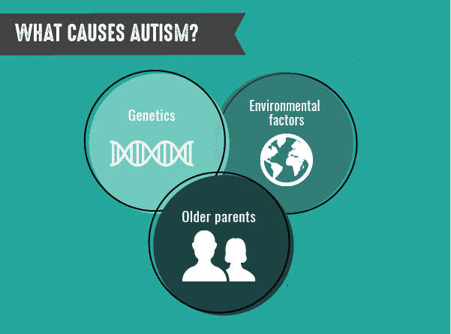
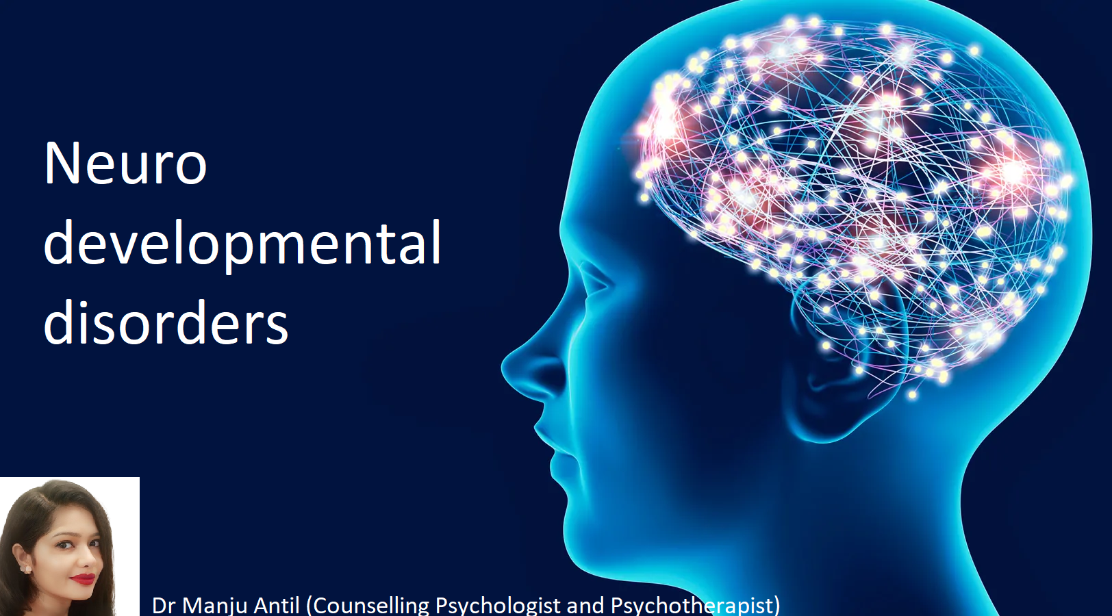

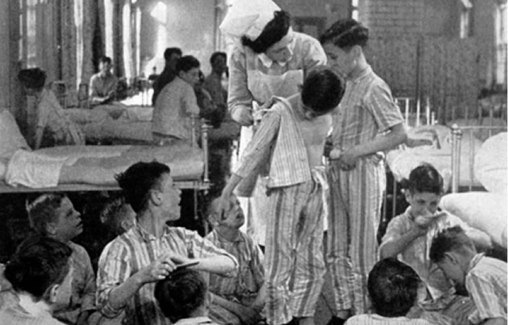
(Ardell and Tager, 1982)
Neurodevelopmental Disorder
Code:6A02-Austism spectrum Disorder(WHO,2019)
Introduction
Autism spectrum disorder (ASD) is a lifelong development condition that reflect how people perceive their environment, world, communicate and interact with other people(Kroncke et al.,2016).
. With developing challenges in social interaction, restricted interest,
and a repetitive behaviour on the part of the autistic, it is a “spectrum” because it presents a wide range of unique strengths and support needs(Ostrowski et al.,2024).
Autistic people often possess unique strengths such as exceptional attention to detail, strong visual learning capabilities, and creative alternative perspectives.
(Suelo et al., 2019).
ss
Causes of Autism
Cause of autism comes in form of prolong labour during childbirth(Iles,2021).
Genetic disorder which is inherited from family.
A combination of genetic and environmental influences, rather than a single cause(Mckenzie et al.,2021).
It can also be a disability caused by differences in the brain.
Historical perspectives and treatments
Autism spectrum disorder (ASD) has developed from being viewed on the pre – NHS period of 1940s as a rare and dangerous emotional disturbance to a diverse, neurodevelopmental condition.
Between 1911 – 1940, Eugen Bleuler named “autism” as emergency services to describe a symptom of schizophrenia.
In 1943, Leo Kanner published a document on “early infantile autism” of which he considers rare.(WHO, 2019).
In 1943, Leo Kanner published a document on “early infantile autism” of which he considers rare.
In 1950, Bruno Bettelheim, a psychiatrist by training popularised the “Refrigerator Mother”. (cold, unloving parenting) caused autism(Heflin, 2017).
(Das et al.,2020)
jjj
Recommendations
Improving autism treatment requires personalised, multidisciplinary approach which focuses on early intervention, enhancement of the quality of life and supporting communication(Wong et al.,2022).
Key recommendation include evidence – based, play – based therapies, implementing occupational and speech therapy, strengthening care givers training, providing tailored and planned mental health support and avoiding harmful and non - evidence based intervention(Ostrowski et al.,2024).
Key recommendations includes early intervention for children aged 12 to 48 months to enhance their social and communication skills(Mckenzie et al 2021).
Providing tailored treatment to a unique standard which takes into consideration the needs, strengths and the preference of the autistic person rather than using a one –size fits – all approach to deal with individual problems((Ostrowski et al.,2024).
(Dr. Manju,2024)
(Ardell and Tager, 1982)
(Cook, 2020)
Conclusions
The disease (ASD) is a lifelong, neuro – developmental condition which has been characterised by challenges in social communication and restricted, repetitive behaviour.(WHO, 2019).
Instead of been classified as a disease that can be cured, it has increasingly been understood through a neurodiversity research as a different way of thinking.(Wong et al.,2022)
While genetic evidence is a very strong factor, the etiology of the disorder is complex and this is why early intervention is important in improving long – term outcomes and quality of life of the autistic.
Key characteristic of ASD is in its unique strengths and challenges in behaviours, interaction and learning(Kroncke et al.,2016).
It is assumed that the cause is unknown, but evidence points to strong genetic neurological and early – life environmental factor

Slide 3
References
Ardell, D.B. and Tager, M. (1982). Planning for Wellness. Kendall/Hunt Publishing Company.
Cueto, M., Brown, T.M. and Fee, E., 2019. The World Health Organization: A History. Cambridge University Press
Cook, K. 2020. Thriving with Autism. Callisto Media, Inc.
Das, U.N., Papaneophytou, N. and El-Kour, T. 2020. Autism 360°. Amsterdam: Academic Press.
Heflin, L.J. 2017 ‘Historical perspectives and etiology of autism spectrum disorders’, in Unknown (ed.) Historical perspectives and etiology of autism spectrum disorders. Available at: https://www.education.uw.edu/tlh/wp-content/uploads/2017/07/Heflin-Ch-2-Historical-Perspectives.pdf (Accessed 18 March 2026).
Iles, A., 2021. Autism spectrum disorders. Primary Care: Clinics in Office Practice, 48(3), pp.461-473.
Kaufman, J.A., Wright, J.M., Rice, G., Connolly, N., Bowers, K. and Anixt, J., 2019. Ambient ozone and fine particulate matter exposures and autism spectrum disorder in metropolitan Cincinnati, Ohio. Environmental research, 171, pp.218-227.
Kroncke, A.P., Willard, M. and Huckabee, H., 2016. What is Autism? History and foundations. In Assessment of Autism Spectrum Disorder: Critical Issues in Clinical, Forensic and School Settings (pp. 3-9). Cham: Springer International Publishing.
McKenzie, C., 2021. The national strategy for autistic children, young people and adults (2021–2026). International Journal of Positive Behavioural Support, 11(2), pp.53-54.
Okoye, C., Obialo-Ibeawuchi, C.M., Obajeun, O.A., Sarwar, S., Tawfik, C., Waleed, M.S., Wasim, A.U., Mohamoud, I., Afolayan, A.Y. and Mbaezue, R.N., 2023. Early diagnosis of autism spectrum disorder: a review and analysis of the risks and benefits. Cureus, 15(8).
Ostrowski, J., Religioni, U., Gellert, B., Sytnik-Czetwertyński, J. and Pinkas, J., 2024. Autism spectrum disorders: etiology, epidemiology, and challenges for public health. Medical science monitor: international medical journal of experimental and clinical research, 30, pp.e944161-1.
Park, S.H., Demetriou, E.A., Pepper, K.L., Song, Y.J.C., Thomas, E.E., Hickie, I.B., Glozier, N. and Guastella, A.J., 2019. Validation of the 36‐item and 12‐item self‐report World Health Organization Disability Assessment Schedule II (WHODAS‐II) in individuals with autism spectrum disorder. Autism Research, 12(7), pp.1101-1111.
Subramanyam, A.A., Mukherjee, A., Dave, M. and Chavda, K., 2019. Clinical practice guidelines for autism spectrum disorders. Indian journal of psychiatry, 61(Suppl 2), pp.254-26.
WHO, C.O., 2020. World health organization. Air Quality Guidelines for Europe, (91).
Wong, P.W.C., Lam, Y.Y., Lau, J.S.P., Fok, H.K. and WHO CST Team Servili Chiara 4 Salomone Erica 5 6 Pacione Laura 4 5 Shire Stephanie 6 Brown Felicity 7 8, 2022. Adapting and pretesting the World Health Organization’s Caregiver Skills Training Program for children with autism and developmental disorders or delays in Hong Kong. Scientific Reports, 12(1), p.16932.

