Slide 1

MARKETING MANAGEMENT
The selected International organization is the SONY PLAYSTATION
Tufil Ahmed Mubinmiya Shaikh
Student no: 2243082

Slide 2
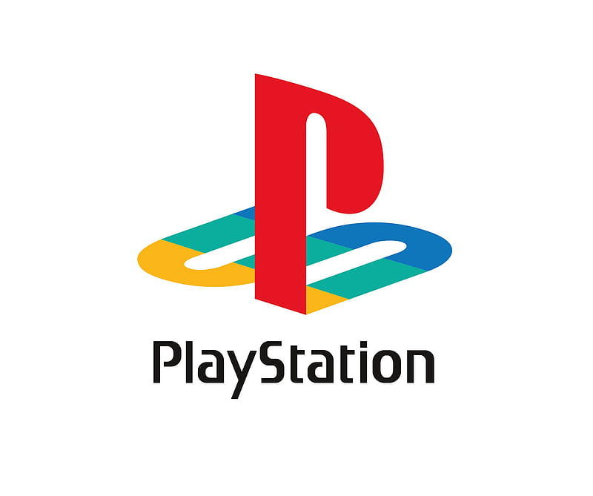
Introduction:
The PlayStation was created by Ken Kutaragi, who was amazed by the 3D computer graphics capabilities of Sony's System G workstation He set out on a secret quest to create a new video game system employing cutting-edge 32-bit technology. The console was code-named "PS-X" and was eventually released in 1994 as the PlayStation.
Over 100 million PlayStation systems have been sold globally, making it a major success. It is credited with making 3D graphics more widely used in video games and opening the door for the industry's future. Gran Turismo, Metal Gear Solid, and Final Fantasy VII are some of the most played PlayStation games.

Slide 3
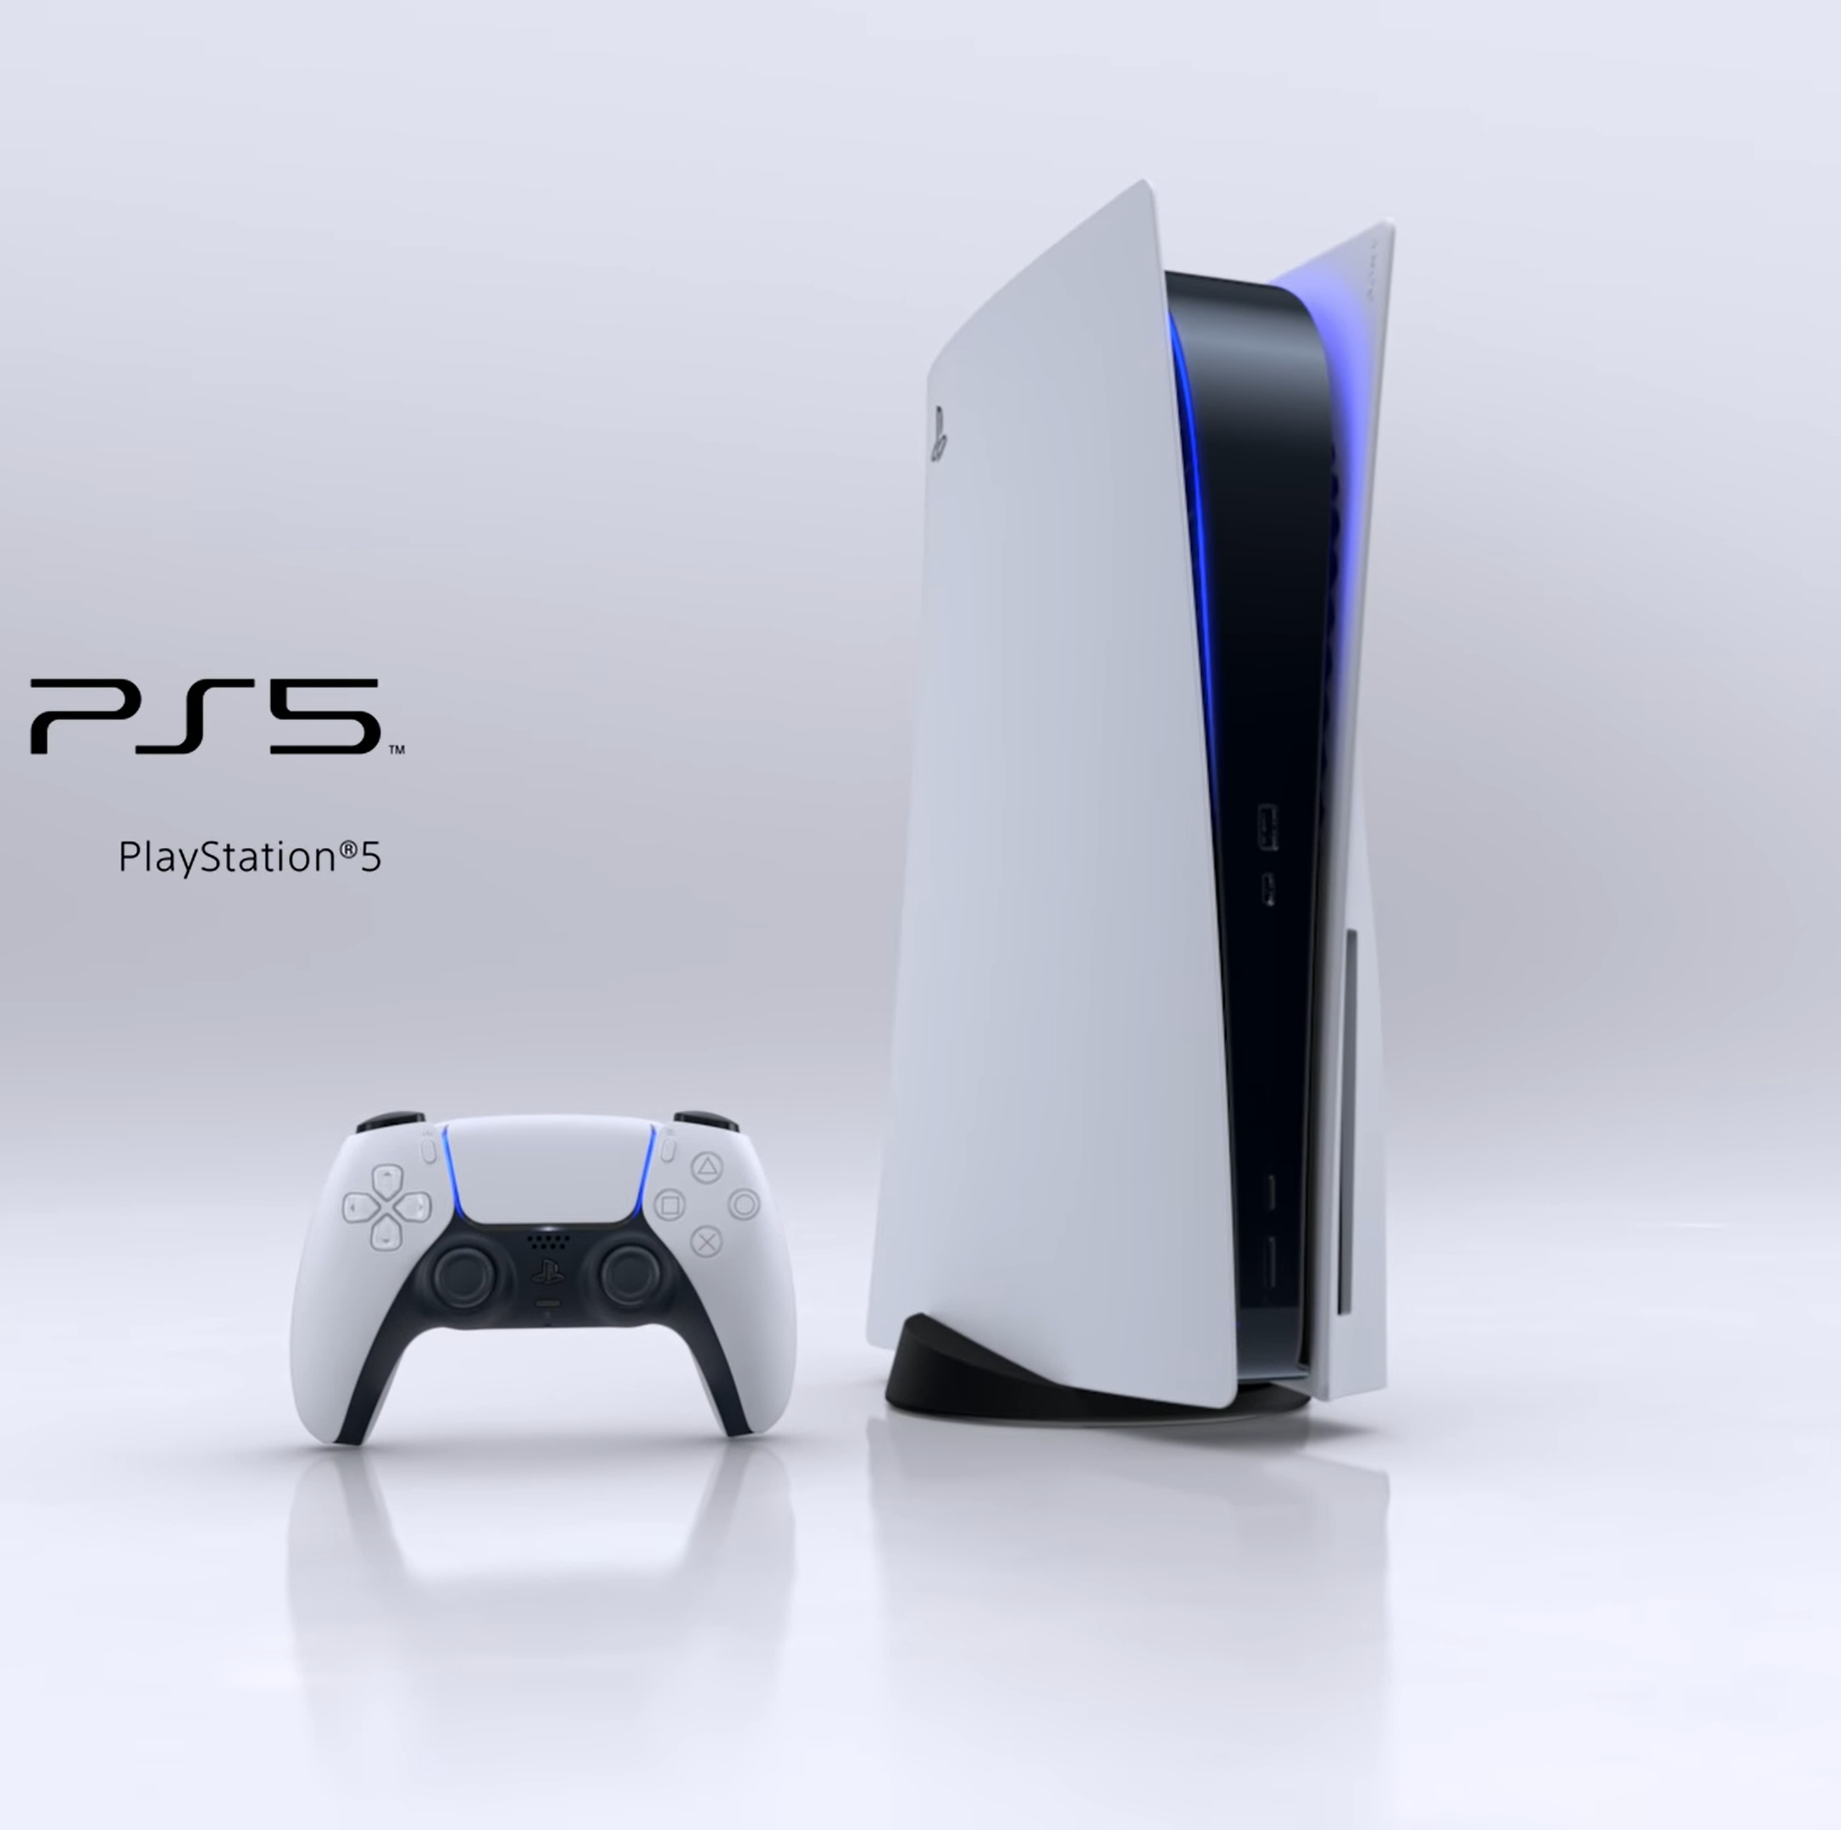
Introduction:
PlayStation is facing a number of challenges in the post-pandemic era. These challenges include increased competition from other gaming consoles and games, supply chain disruptions due to COVID-19, shifting consumer habits as people spend more time online, and new technologies, such as cloud gaming and virtual reality, that could make it easier for people to play games without having to buy a console.
Sony PlayStation uses a strong brand identity, a variety of product marketing strategies, a variety of pricing strategies, and a variety of distribution channels to promote its products and maintain its competitive edge in the video game industry. For example, PlayStation is associated with innovation, quality, and entertainment. They use advertising, public relations, and social media marketing to promote their products. They offer discounts and promotions, as well as releasing new products at different price points. They use retailers, online retailers, and direct-to-consumer channels to get their products into the hands of consumers.

Slide 4

Market Analysis: Internal factors that drive PlayStation's global business environment post-pandemic contribute to PlayStation's market success:
Strong brand recognition: One of the most well-known gaming brands in the world is PlayStation. PlayStation has a considerable competitive advantage over its rivals thanks to this tremendous brand recognition.
Product portfolio: PlayStation has a strong product portfolio that includes a variety of popular consoles, games, and accessories.
Strong financial position - PlayStation is a financially strong company.
Committed workforce - PlayStation has a committed workforce that is passionate about gaming.
Global reach - With operations in over a hundred nations, PlayStation is a truly global company.
Effective marketing and advertising strategies – PlayStation operates in over 100 countries and has a global presence.
Top-notch goods and services - PlayStation goods and services are renowned for their excellence.

Slide 5
Market Analysis : External Factors impacting PlayStation's global business environment post-pandemic & external factors create challenges and opportunities for PlayStation
Industry trends: The video game industry is constantly evolving, and PlayStation needs to keep up with the latest trends in order to stay competitive. Some of the key trends that are shaping the industry include the rise of cloud gaming, the increasing popularity of mobile gaming, and the growing demand for cross-platform gaming.
Technological advancements: Technological advancements are also having a significant impact on the video game industry. For example, the development of new virtual reality (VR) and augmented reality (AR) technologies is opening up new possibilities for gaming. PlayStation needs to be at the forefront of these technological advancements in order to stay ahead of the competition.
Changes in consumer preferences: The preferences of video game consumers are also changing. In the past, gamers were primarily interested in playing single-player games. However, in recent years, there has been a growing demand for multiplayer games. PlayStation needs to adapt to these changes in consumer preferences in order to remain successful.

Slide 6
Resource Allocation:
Investing in new technologies & Strategic decisions.
Investing in new technologies: PlayStation is investing in new technologies like cloud gaming and virtual reality to stay ahead and foster growth. This includes PlayStation Now, a cloud gaming service, and the release of PlayStation VR2, an immersive VR headset. These investments demonstrate their commitment to leveraging technology for competitive advantage.
Developing New Games: PlayStation is dedicated to developing new games that cater to evolving gamer preferences and maintain a robust game portfolio. In 2022, they successfully released acclaimed titles like Horizon Forbidden West, Gran Turismo 7, and God of War Ragnarök, demonstrating their commitment to delivering compelling gaming experiences that resonate with players.
Expanding into new markets: PlayStation is strategically expanding into new markets, starting with the launch of PlayStation Plus in India in 2022. This move marks the first availability of the service in the country, with plans to expand further into other emerging markets in the near future. By entering these markets, PlayStation aims to reach a broader audience of gamers and secure a stronger market position.
Partnering with other companies: PlayStation is partnering with companies, like Epic Games, to tap into new markets and fuel growth. The collaboration brought Fortnite to PlayStation Plus, the first free-to-play game in the service. More partnerships are planned to introduce new games and features, showcasing PlayStation's commitment to innovation and enhancing the gaming experience.

Slide 7

Competitive Strategy for Sustainable Competitive Advantage.
Sony took over several London landmarks, including the Piccadilly Lights, to promote the launch of the PlayStation 5. This was a very effective way to reach a wide audience and to generate excitement for the new console.
Differentiate its products: PlayStation can differentiate itself through innovation, developing new technologies like cloud gaming and virtual reality for a unique gaming experience. Additionally, focusing on quality by creating visually stunning and well-made games adds another differentiating factor. Lastly, offering competitive pricing and value through product bundles or additional services further sets PlayStation apart in the market.
Target specific market segments: To target specific market segments, PlayStation can tailor its approach by focusing on different types of gamers through family-friendly games for casual gamers and competitive multiplayer games for hardcore gamers. Additionally, by strategically targeting geographical regions with high growth potential, such as emerging markets, PlayStation can effectively expand its reach and capitalize on new opportunities.
Leverage emerging technologies: PlayStation leverages emerging technologies like cloud gaming and virtual reality to offer innovative gaming experiences and enhance the user experience. Cloud gaming eliminates the need for game downloads, while leveraging these technologies enhances the overall gaming experience.
Enhance customer engagement: PlayStation enhances customer engagement through diverse features and services, such as subscription-based game libraries and social media platforms for gamer connections. Additionally, by prioritizing excellent customer service, including easy access to support and responsiveness to feedback, PlayStation ensures a positive customer experience.

Slide 8
Green Marketing and CSR Strategies
By continuing to implement these strategies, PlayStation can position itself as a leader in the video game industry in terms of environmental sustainability, ethical practices, and social responsibility.
Green marketing
CSR – Corporate Social Responsibility
Sony could reduce the environmental impact of the PlayStation by using more recycled materials in the manufacturing process. Sony could also make the console more energy efficient.
PlayStation has also made a commitment to using recycled materials in its products. The company's latest console, the PlayStation 5, is made with over 30% recycled materials.
Sony could encourage players to use renewable energy sources.
PlayStation has made a commitment to environmental sustainability. The company has set a goal of reducing its carbon emissions by 20% by 2025.
PlayStation also promotes green marketing through its advertising campaigns. For example, the company's "Play Has No Limits" campaign features images of gamers playing games in environmentally friendly settings.
Environmental sustainability: PlayStation has partnered with the Rainforest Alliance to promote sustainable forestry practices. The company has also pledged to use 100% renewable energy in its operations by 2040.
Social responsibility: PlayStation supports a number of charitable organizations, such as the Red Cross and UNICEF. The company also encourages its employees to volunteer their time to help others.
Sony was blocked from shipping PlayStation game systems to Europe because of cadmium in the cables. The total cost of the environmental problem was over $130 million.
This is a good example of how corporate irresponsibility and oversight of health or environmental demands can cause major financial troubles.
PlayStation is also committed to social responsibility. The company supports a number of charitable organizations, such as the Red Cross and UNICEF.
PlayStation also promotes CSR through its employee volunteer program. The company encourages its employees to volunteer their time to help others.
PlayStation can continue to reduce its carbon emissions and use recycled materials in its products.
PlayStation can also continue to promote green marketing through its advertising campaigns.

Slide 9
Recommendations for Gaining a Competitive Advantage
Let's provide some steps Sony PlayStation can do to improve its position in the market based on our research and discussions.
Continue to invest in exclusive games:
PlayStation has a long history of developing and publishing exclusive games. These games are a major draw for gamers, and they help to differentiate PlayStation from its competitors. PlayStation should continue to invest in exclusive games, and it should also focus on developing high-quality games that are both critically acclaimed and commercially successful.
Market challenges/Focus on innovation:
PlayStation has a reputation for innovation, and it should continue to focus on developing new technologies and features. This could include developing new gaming hardware, such as virtual reality headsets, or developing new gaming software, such as cloud gaming services.
Marketing effectiveness:
To succeed in marketing, PlayStation should create impactful campaigns that effectively reach its target audience through various channels. Monitoring campaign effectiveness and making necessary adjustments ensures wise allocation of marketing resources. Additionally, fostering customer relationships, community building, and delivering excellent customer service are vital for PlayStation's success.
Green marketing initiatives:
To showcase its dedication to environmental sustainability, PlayStation should persist in decreasing carbon emissions and incorporating recycled materials into its products. Employing green marketing by featuring gamers in eco-friendly settings in advertising campaigns can further promote sustainability. Collaborating with organizations focused on environmental causes will raise awareness and contribute positively to the environment.

Slide 10

Conclusion:
PlayStation is a global leader in the video game industry. The company has a strong brand identity, invests heavily in R&D, and has a strong marketing and customer service team. PlayStation is also committed to environmental sustainability, ethical practices, and social responsibility. In the post-pandemic era, PlayStation will need to continue to invest in R&D and marketing to stay ahead of the competition. The company should also focus on developing effective marketing systems and processes to reach its target audience and build relationships with its customers.
Additionally, PlayStation's commitment to sustainability, ethics, and social responsibility will help the company attract and retain customers who are interested in these values.

Slide 11
Reference:
playstationmuseum.com. (n.d.). PlayStation History. [online] Available at: https://playstationmuseum.com/history.html.‌
www.etchuk.com. (n.d.). The State of Games: Spending, the post-pandemic era, and what to do now. [online] Available at: https://www.etchuk.com/play/blog/the-state-of-games-spending-the-post-pandemic-era-and-what-to-do-now [Accessed 13 Jul. 2023].
Meyer, P. (2016). Sony’s Generic Strategy & Intensive Growth Strategies. [online] Panmore Institute. Available at: https://panmore.com/sony-generic-strategy-intensive-growth-strategies.
‌Miljenović, D., Maradin, D. and Prohaska, Z., 2015. Corporate social responsibility and financial sustainability. Economic Policy Today: Political Rhetoric or a True Reform.
Asher, C. (2022). Playing dangerously: The environmental impact of video gaming consoles. [online] Mongabay Environmental News. Available at: https://news.mongabay.com/2022/10/playing-dangerously-the-environmental-impact-of-video-gaming-consoles/.
Gordon, L. (2019). The environmental impact of a PlayStation 4. [online] The Verge. Available at: https://www.theverge.com/2019/12/5/20985330/ps4-sony-playstation-environmental-impact-carbon-footprint-manufacturing-25-anniversary.
www.campaignlive.co.uk. (n.d.). Sony PlayStation 5 takeover of London landmarks culminates with Piccadilly Lights. [online] Available at: https://www.campaignlive.co.uk/article/sony-playstation-5-takeover-london-landmarks-culminates-piccadilly-lights/1700662.
‌Pereira, J.P.L., 2012. Brand reputation and crisis management: Playstation Network case study (Doctoral dissertation).
‌Niu, Y., 2021, August. SWOT Analysis on Sony’s PlayStation Under COVID-19. In 2021 International Conference on Modern Educational Technology and Social Sciences (ICMETSS 2021) (pp. 5-8). Atlantis Press.

