Slide 1

NAME : SHAH NEELKUMAR JIGARKUMAR
STUDENT ID: 2506171
MODULE: ENTERPRISE NETWORK SECURITY

Slide 2
TITLE
Securing Enterprise Network using Check Point GAiA

Slide 3
Objectives and Scope
Enterprise Network Overview: Two sites (SWANSEA and LONDON) connected via firewall
Aims: Install and configure GAiA on A-SMS and A-GW
Implement inbound and outbound firewall rules
Configure additional security features
Perform connectivity testing
Align with assignment criteria (deployment, configuration, troubleshooting, demonstration)

Slide 4
Enterprise Network Architecture
Swansea Site:
  A-SMS (10.1.1.101)
  A-GW (10.1.1.1)
  Internal network: IntCP
London Site:
  London LAN connected via A-GW
Internet access via NAT interface
A-SMS manages A-GW through IntCP network nabling centralized security policy enforcement.

Slide 5
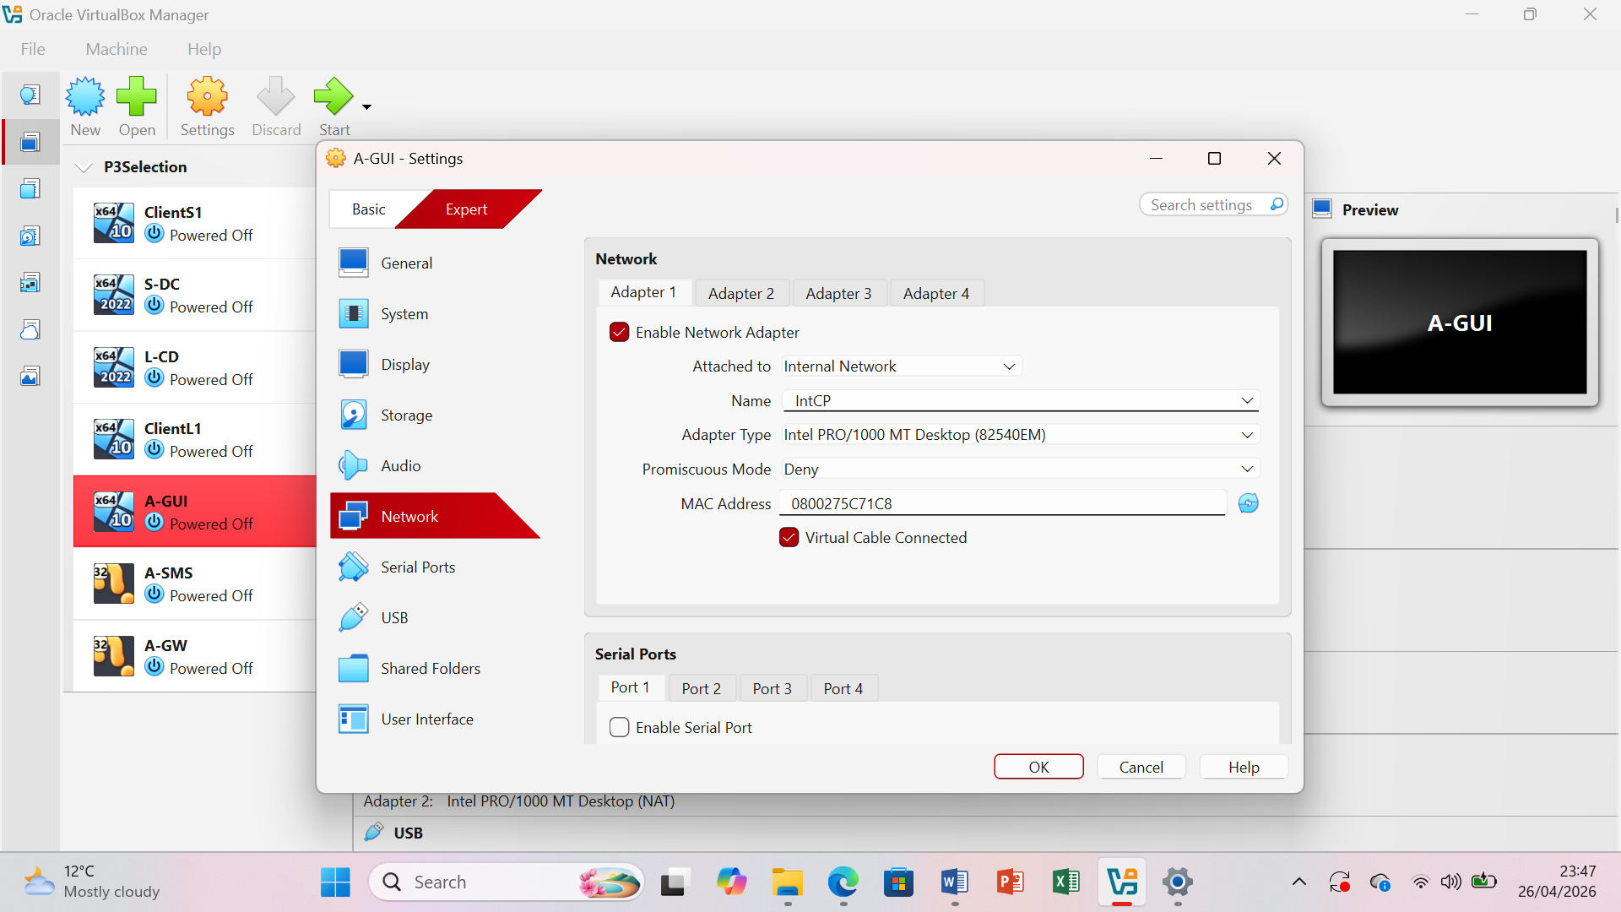
Virtual Machine Network Setup
VMs used: A-SMS, A-GW, A-GUI
Internal Network “IntCP” used for communication
NAT adapter used for internet access
A-GW has multiple adapters:
  IntCP
  IntSwa (internal network)
  ExtLCD (London network)
  NAT
Initial configuration included a mismatch in internal network naming (IntSwa vs IntCP), which caused communication issues.

Slide 6
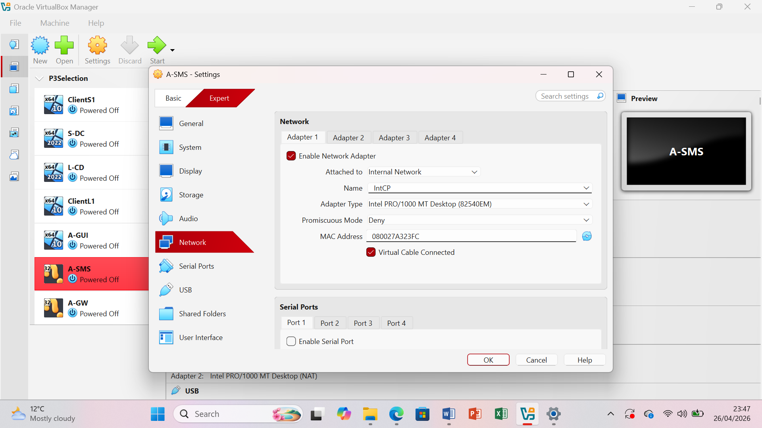
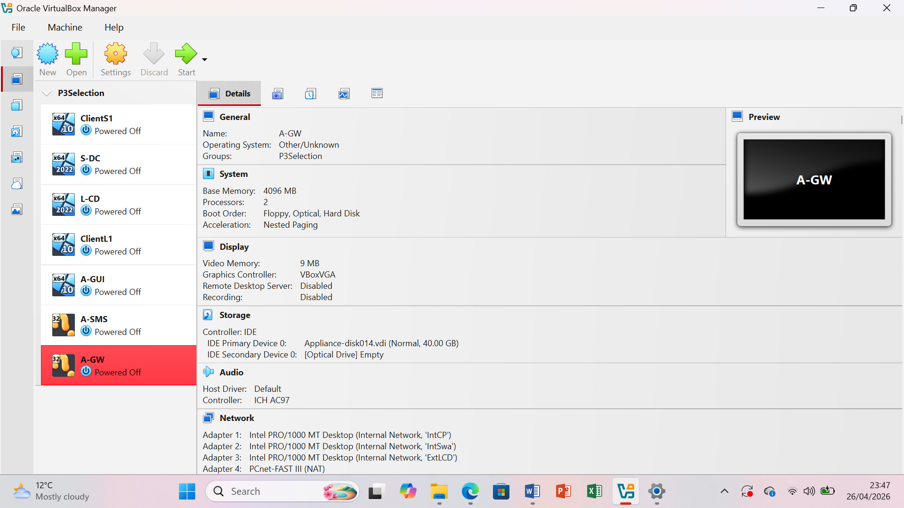

Slide 7
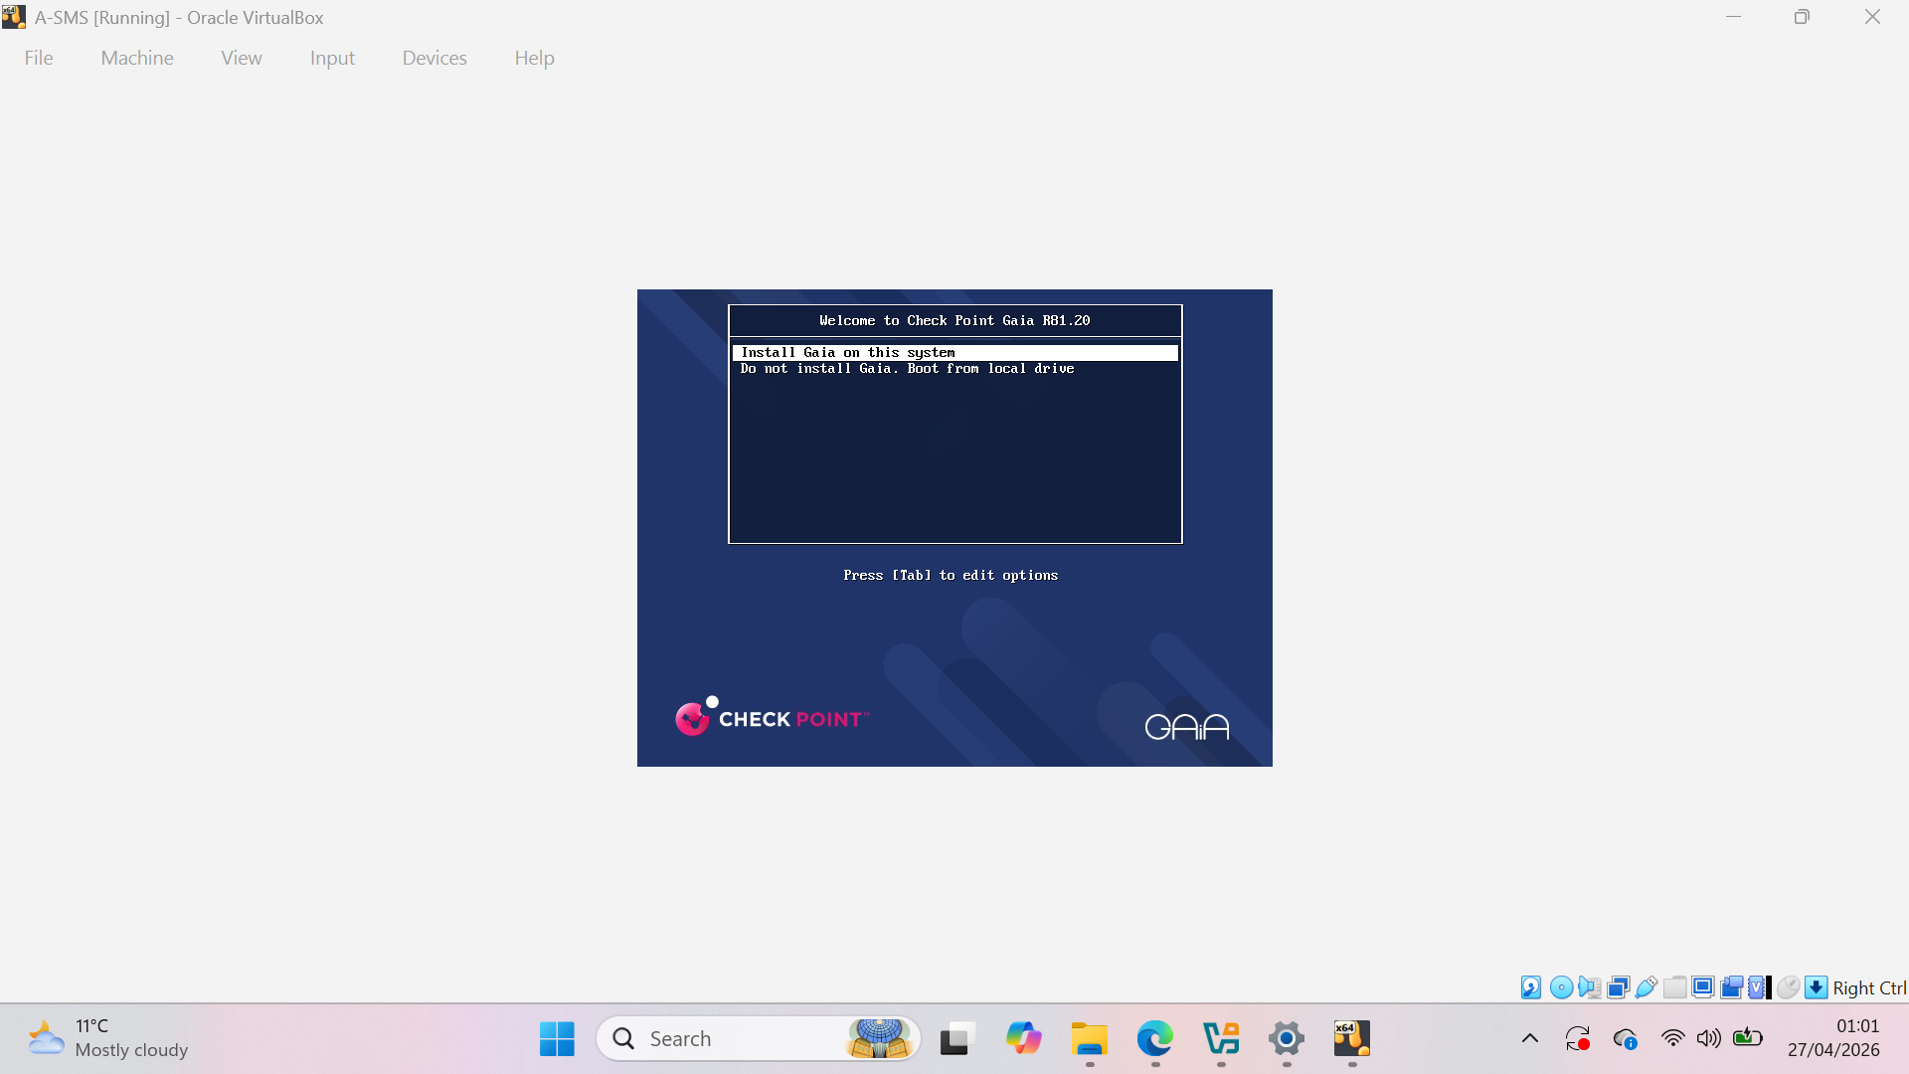
A-SMS Initial Configuration
GAiA First-Time Configuration Wizard executed
Admin user “shahneel” created
Basic system configuration completed
GAiA R81.20 successfully installed
A-SMS ready for management

Slide 8
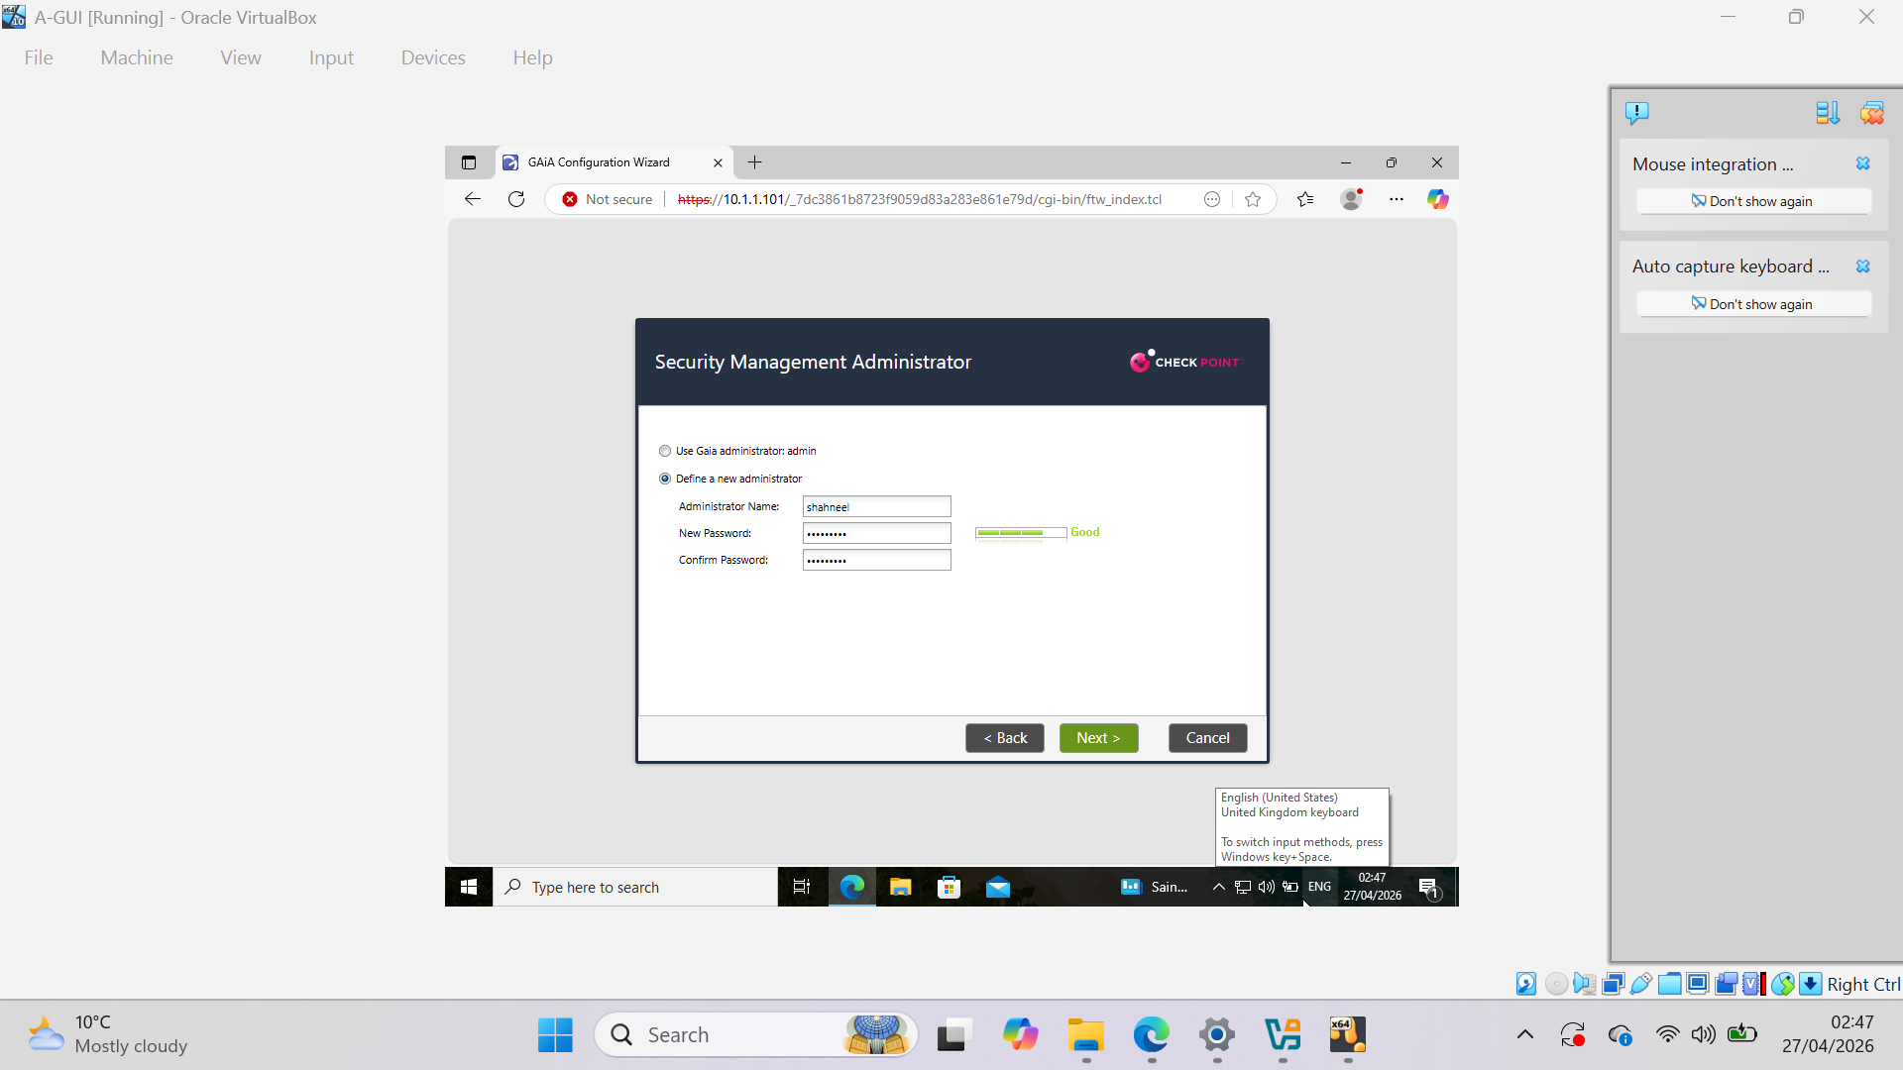
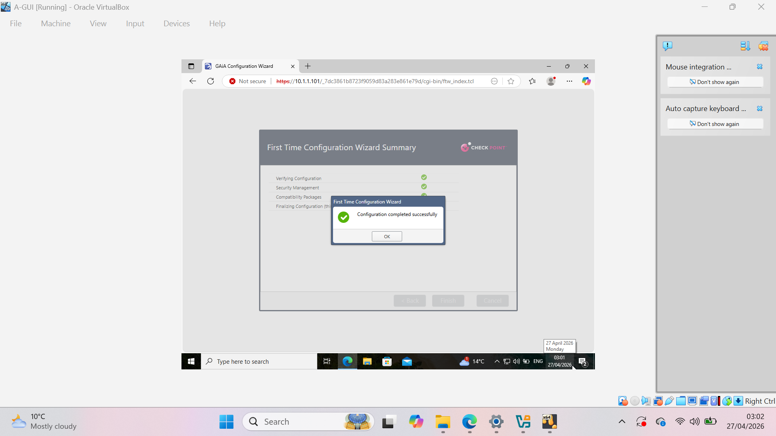

Slide 9
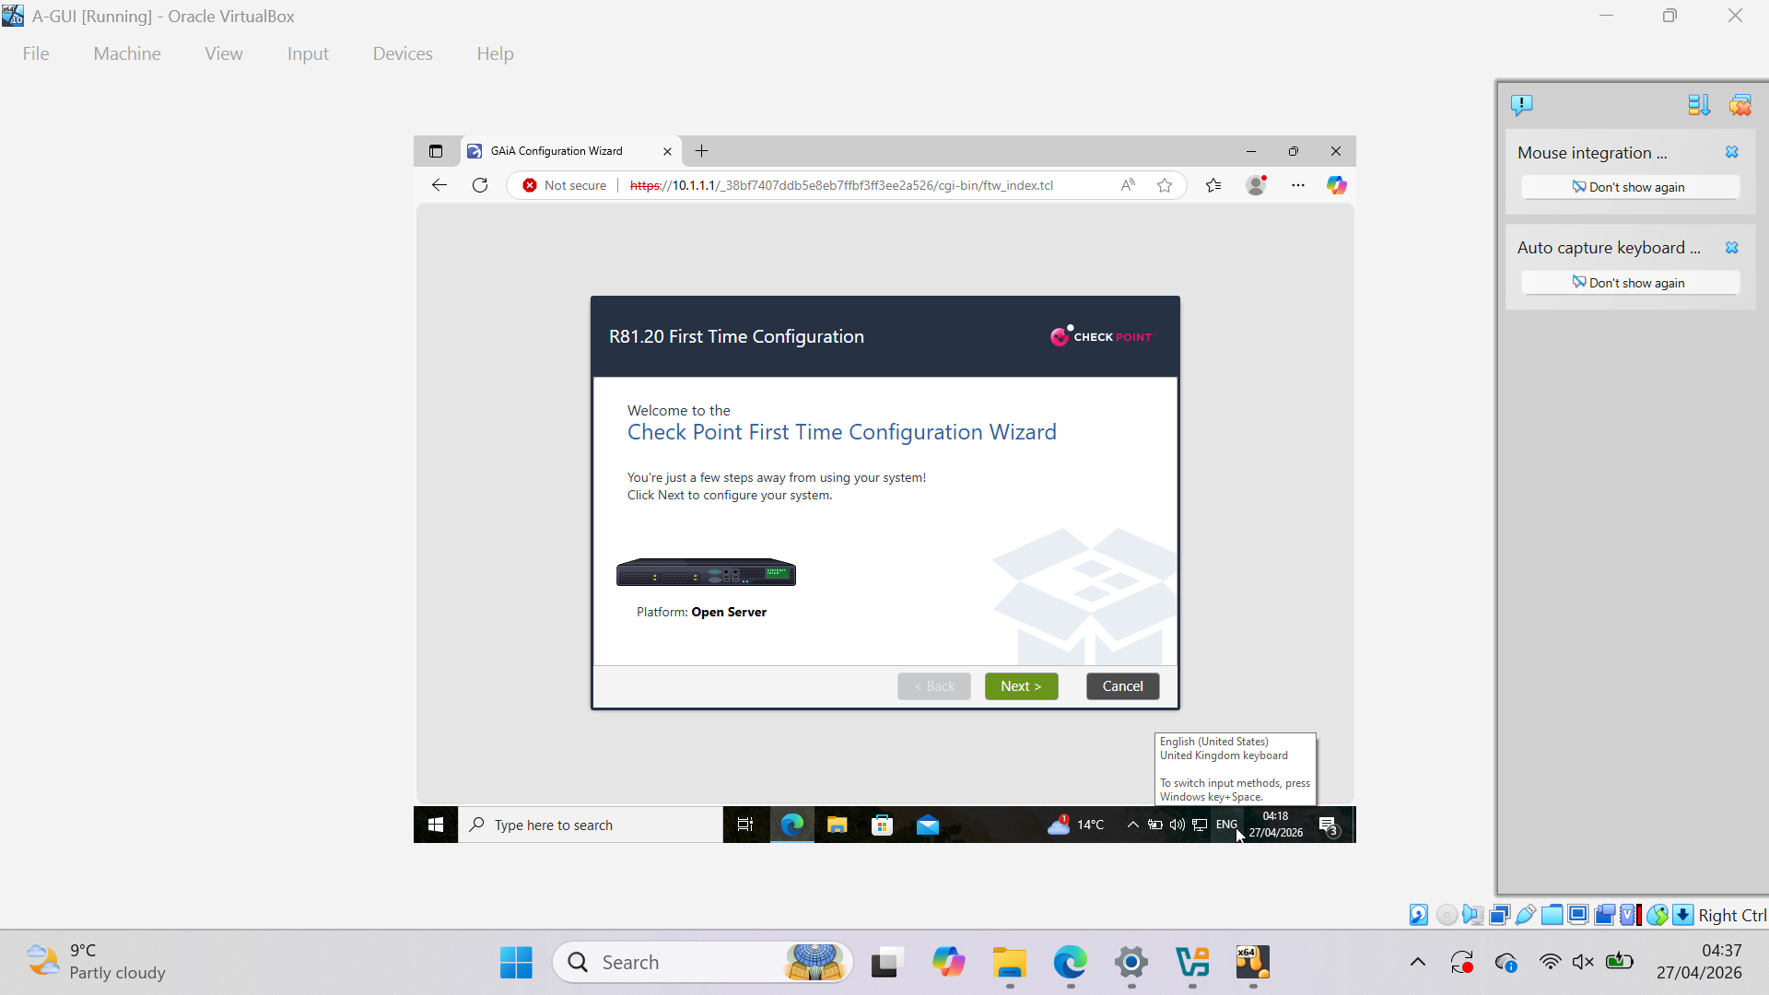
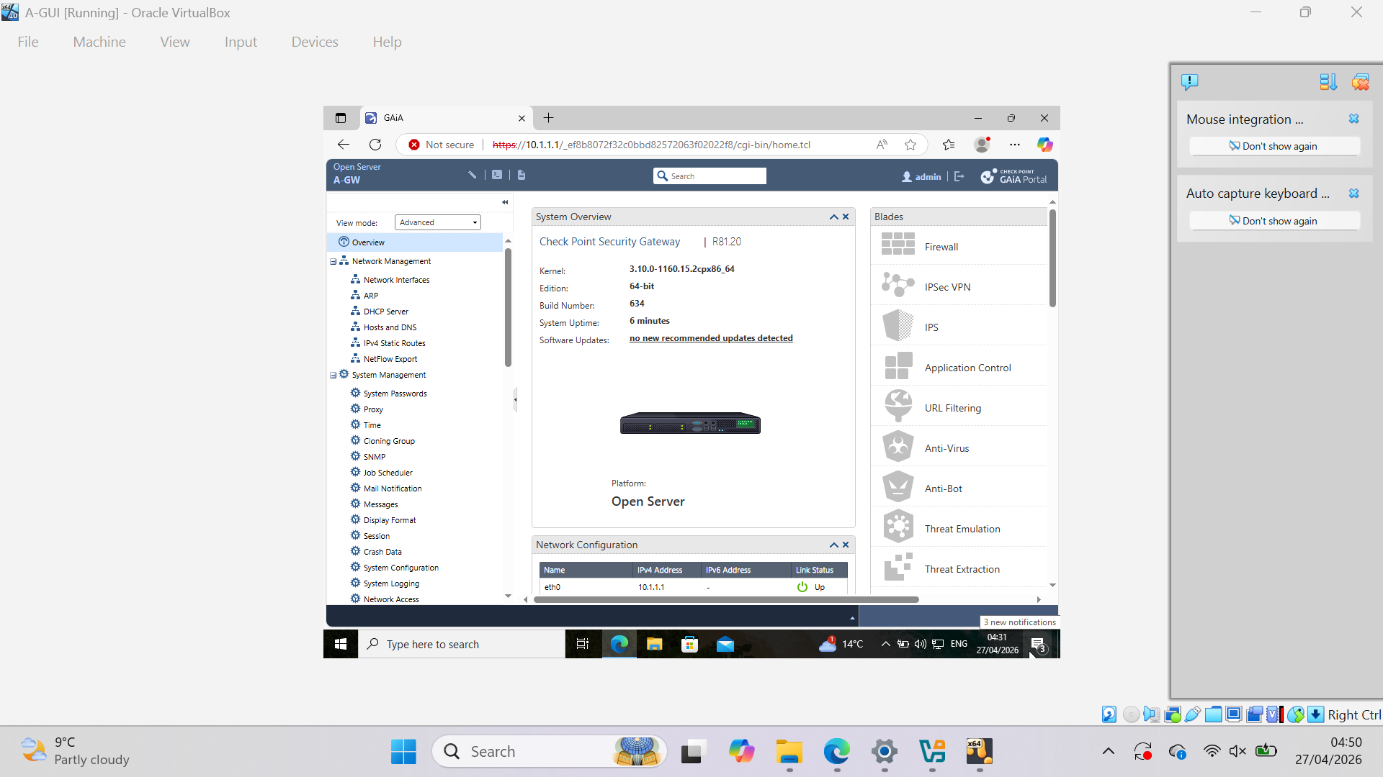
GW Initial Configuration
GAiA wizard executed on A-GW
Hostname configured as A-GW
Activation key entered
Initial trust setup completed
Gateway ready for SmartConsole

Slide 10
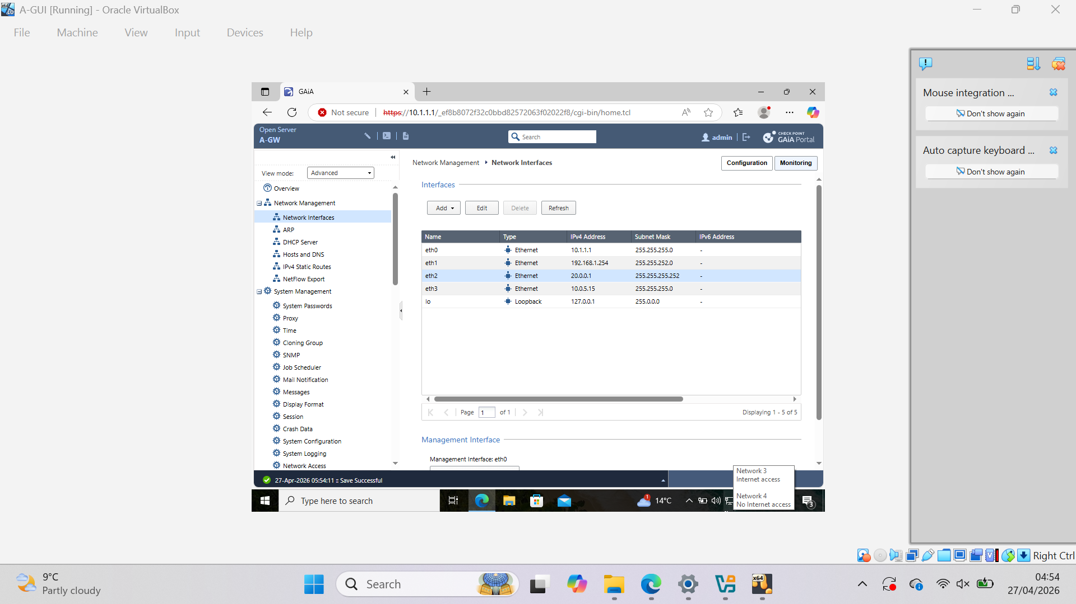
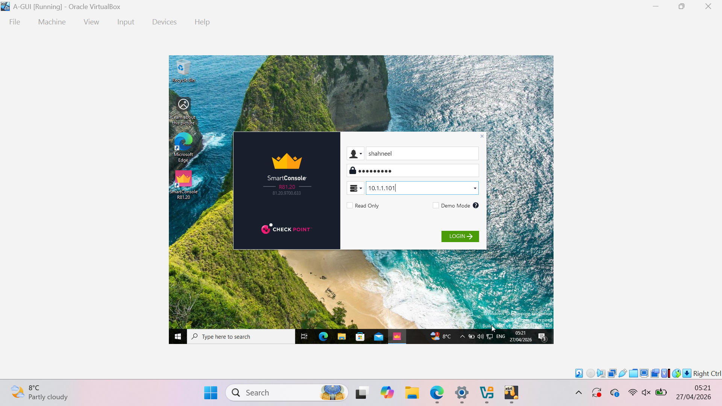

Slide 11
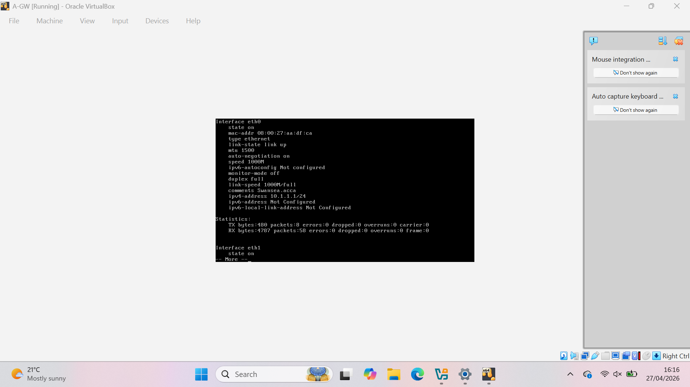
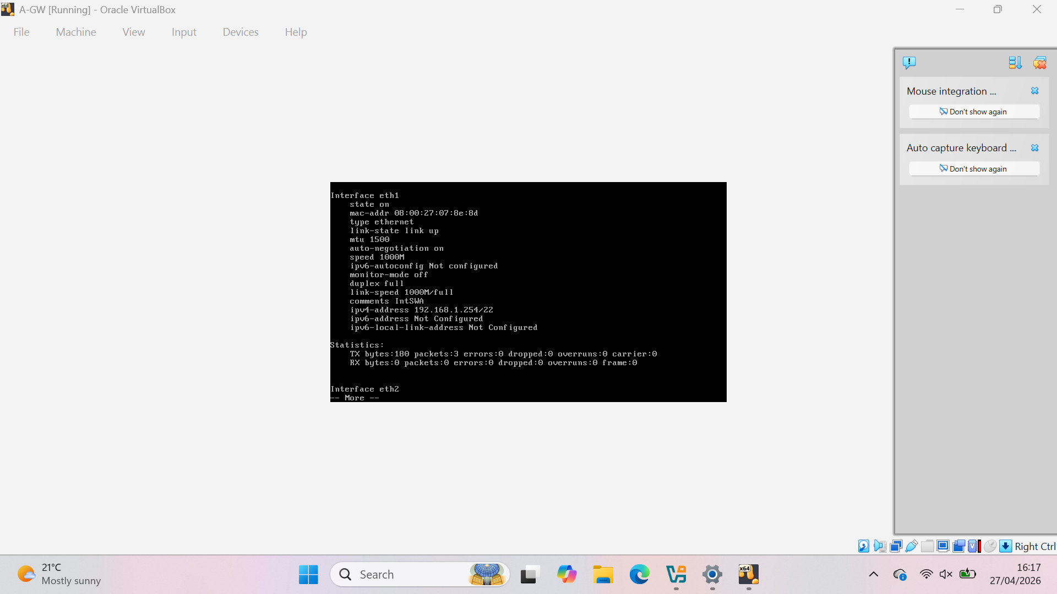
Interface and IP Configuration
A-GW Interfaces:
  eth0: 10.1.1.1/24 (IntCP)
  eth1: 192.168.1.254/22 (misconfigured)
  eth2: 20.0.0.1/30 (London LAN)
  eth3: NAT interface
A-SMS Interface:
  eth0: 10.1.1.101/24
A subnet mismatch was identified between interfaces, which resulted in connectivity issues between A-SMS and A-GW.

Slide 12
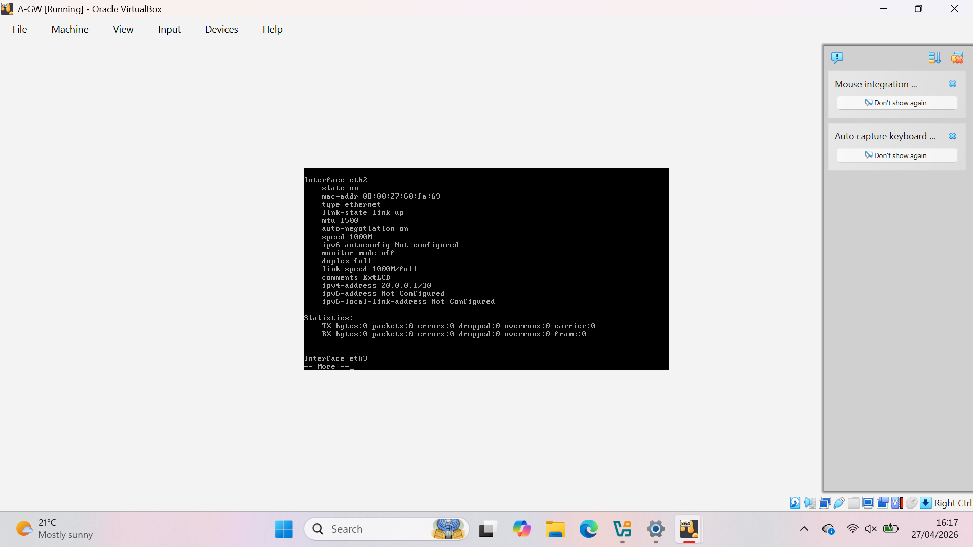

Slide 13
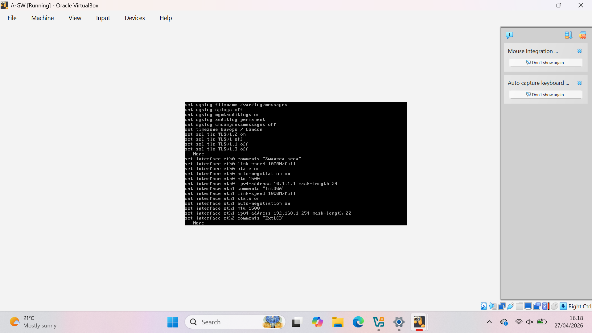
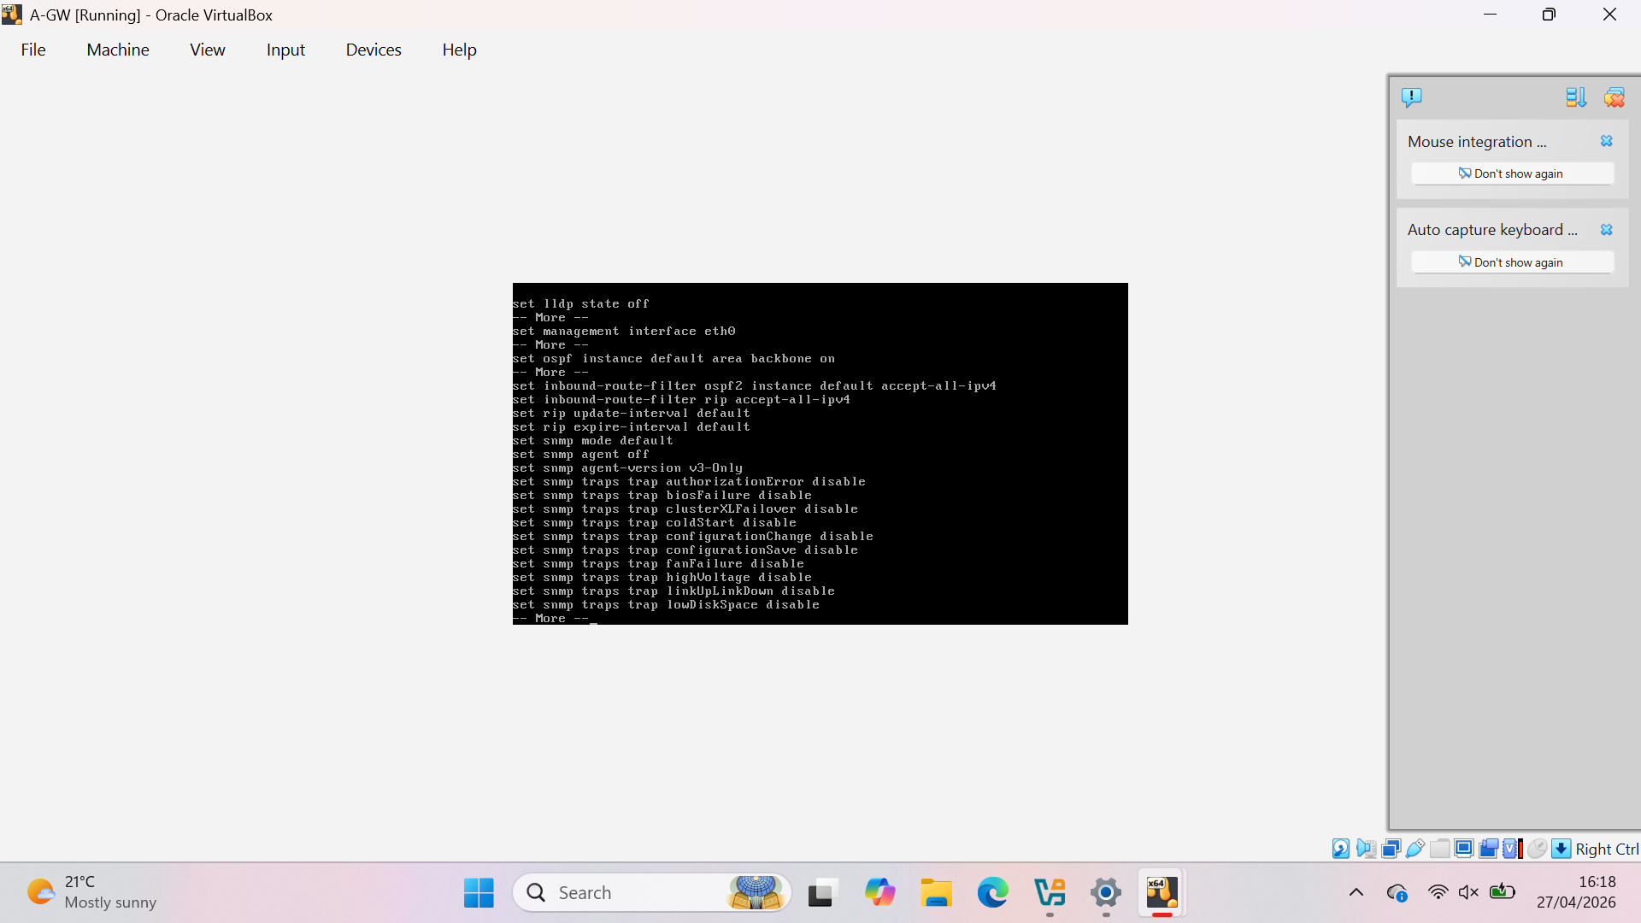
Connectivity Test
Ping test from A-GW to A-SMS
0% packet loss
Initial connectivity was achieved; however, intermittent communication issues were observed due to network configuration mismatches

Slide 14
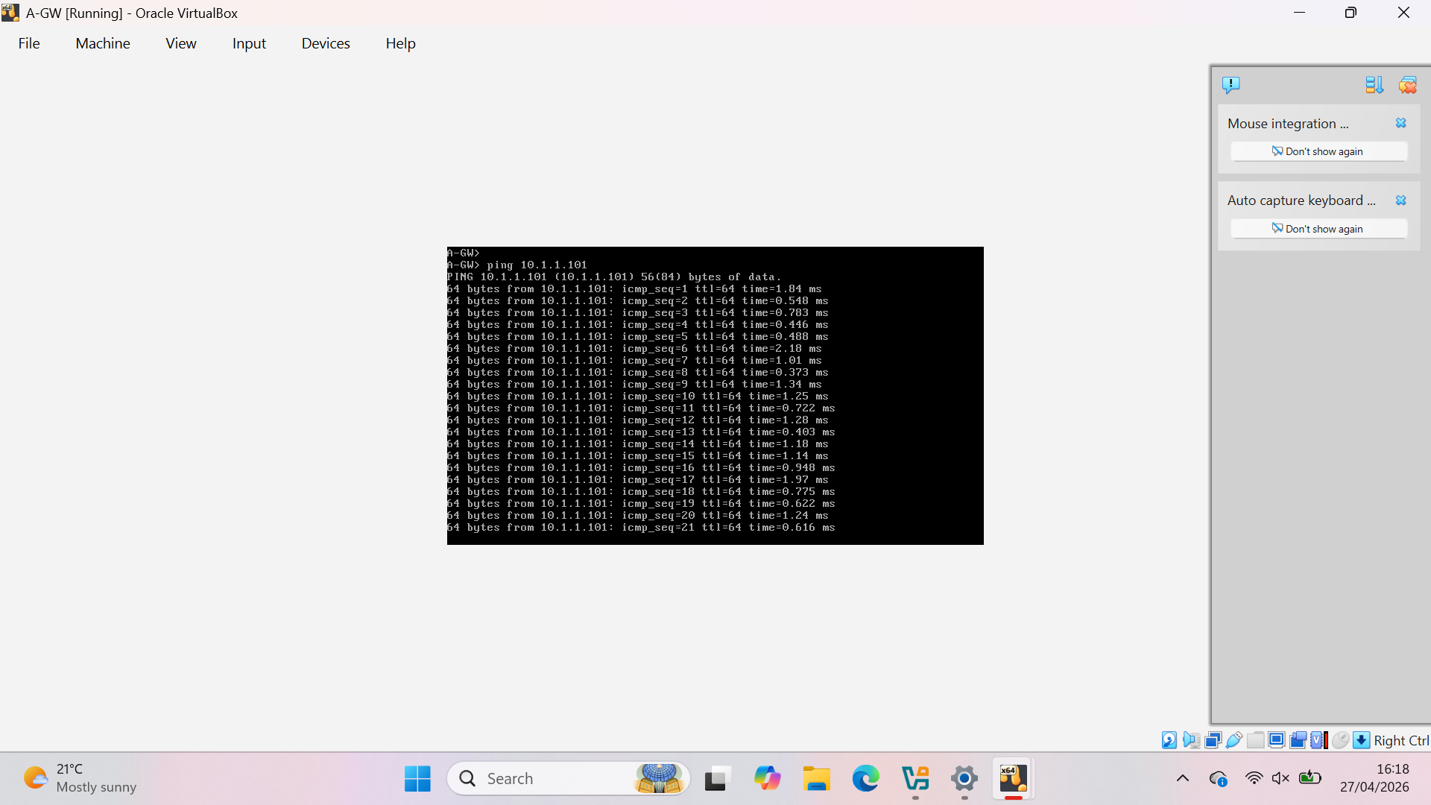
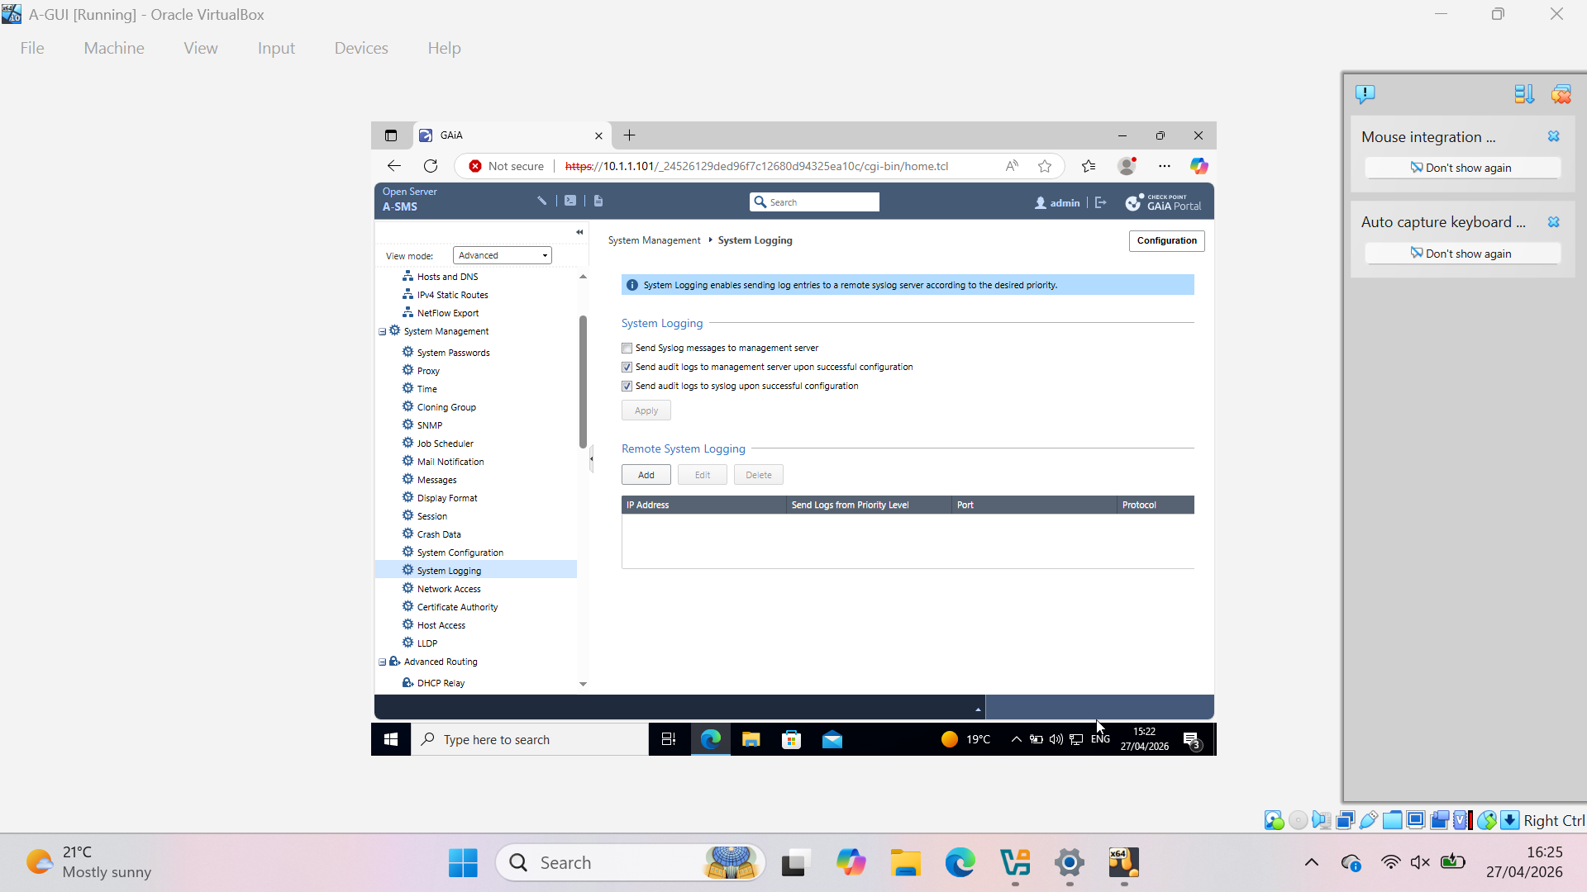
SmartConsole and SIC Initialization
SmartConsole connected to A-SMS
Gateway object detected
A-GW showed “Failed to connect”
SIC initialization attempted but initially failed due to connectivity and service issues

Slide 15
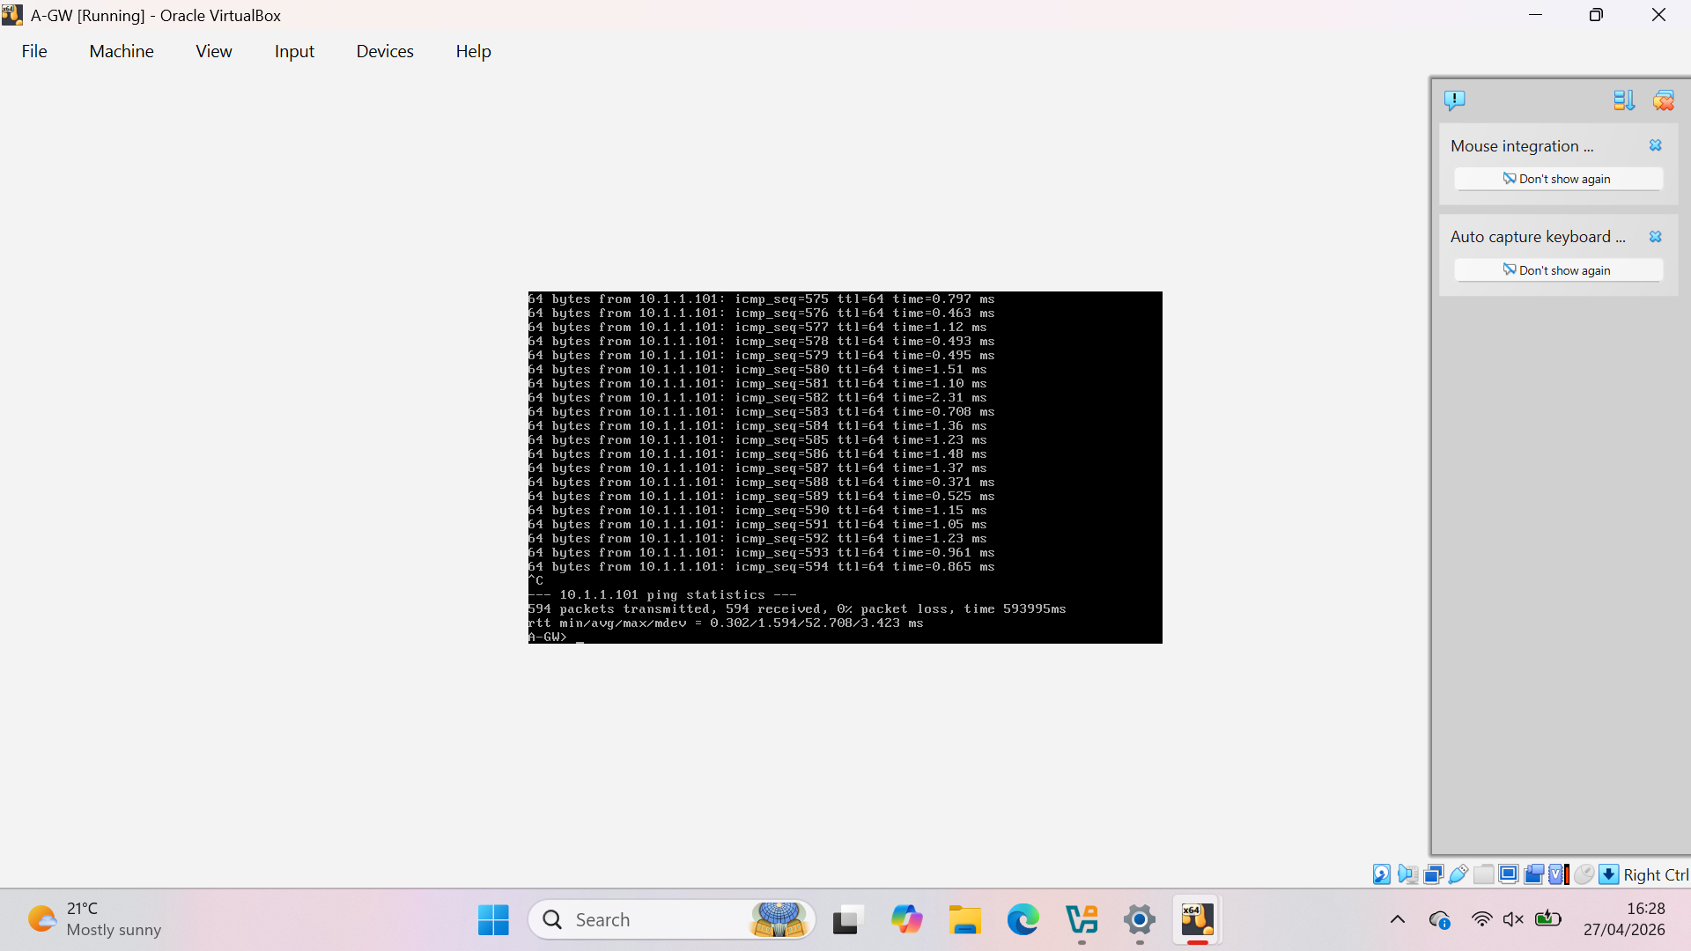
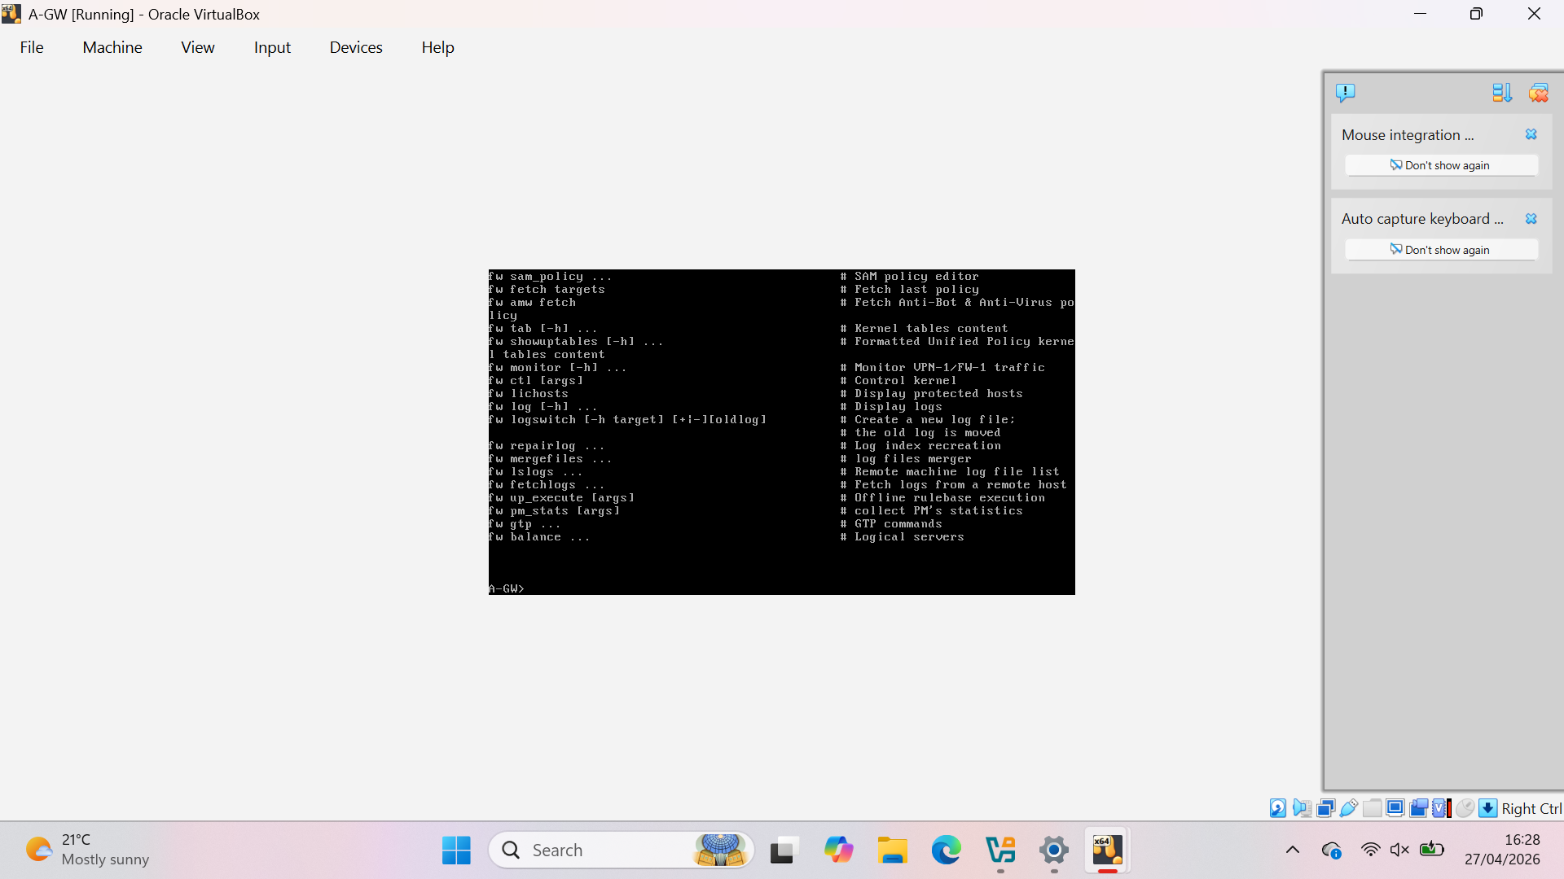

Slide 16
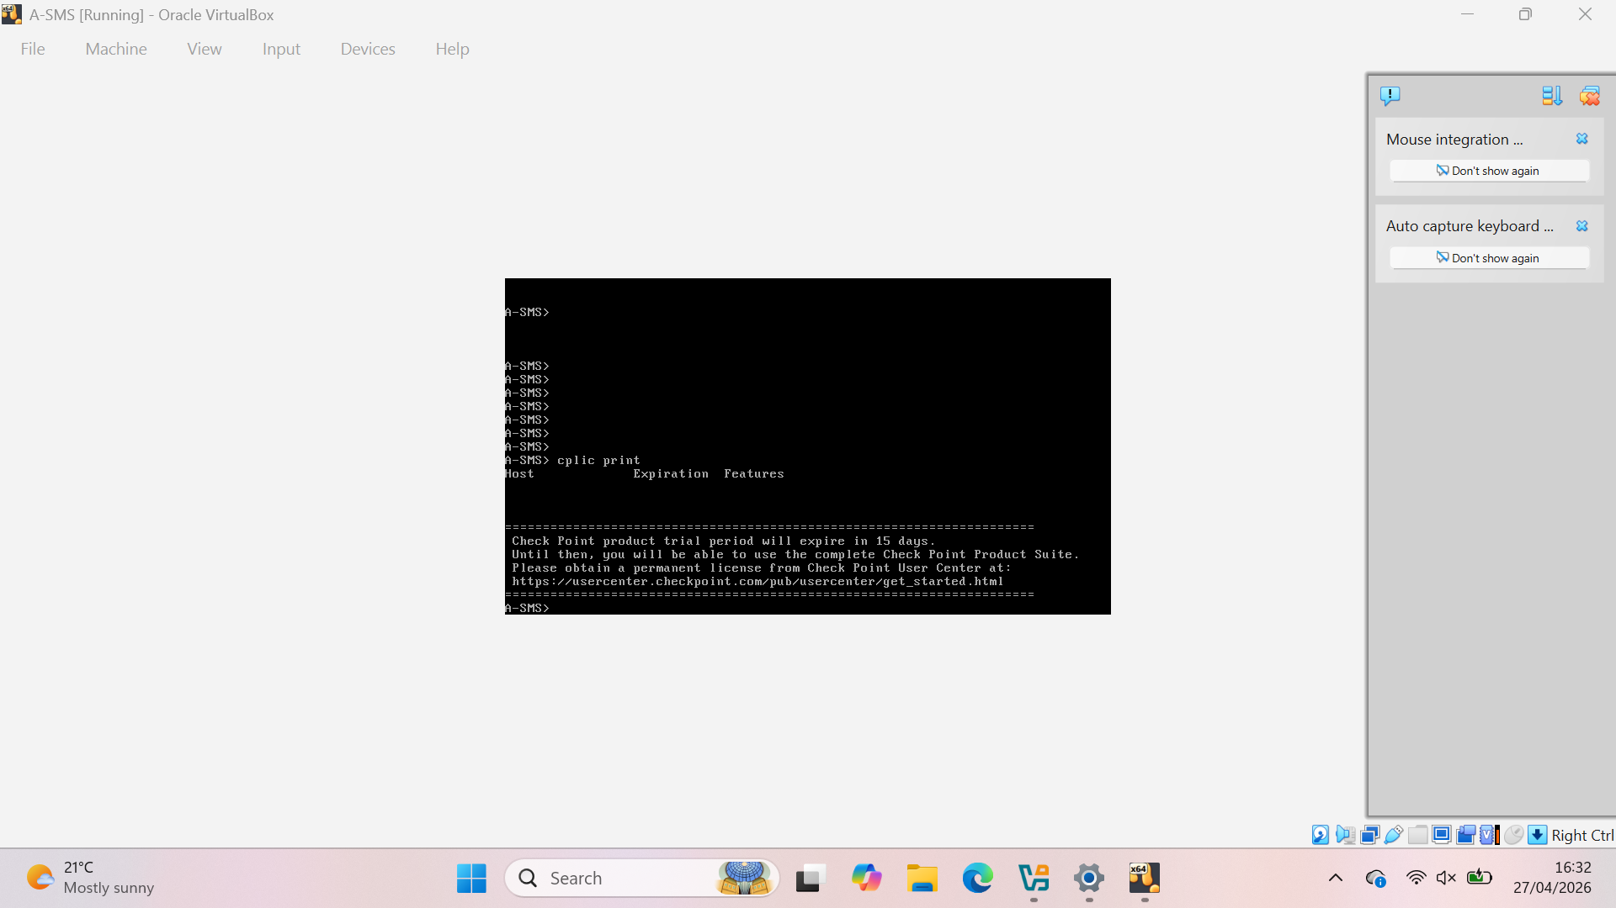
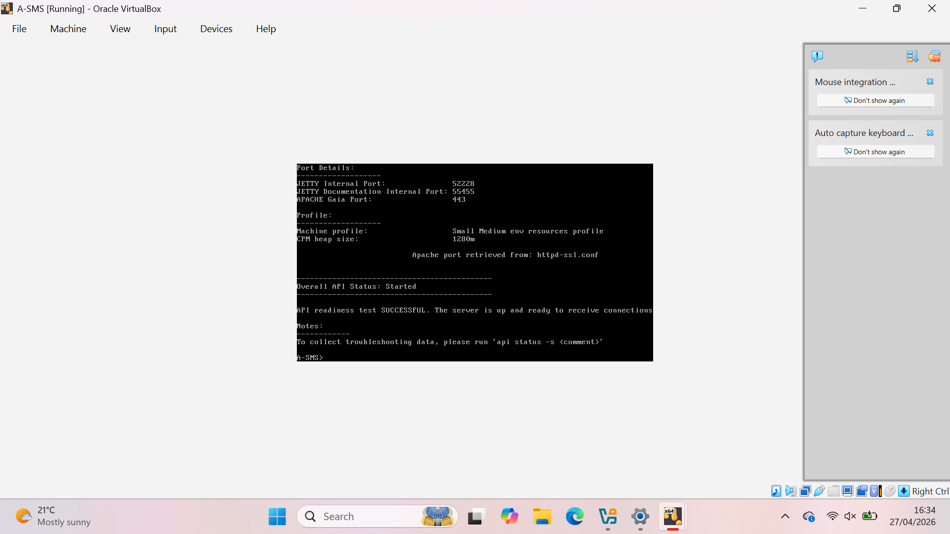
SIC and Licensing Troubleshooting
SIC initialization failed initially
Services restarted using cpstart
SIC reset and re-initialized
SIC was re-initialized after troubleshooting, resulting in partial establishment of trust between A-SMS and A-GW.
15-day trial license activated

Slide 17
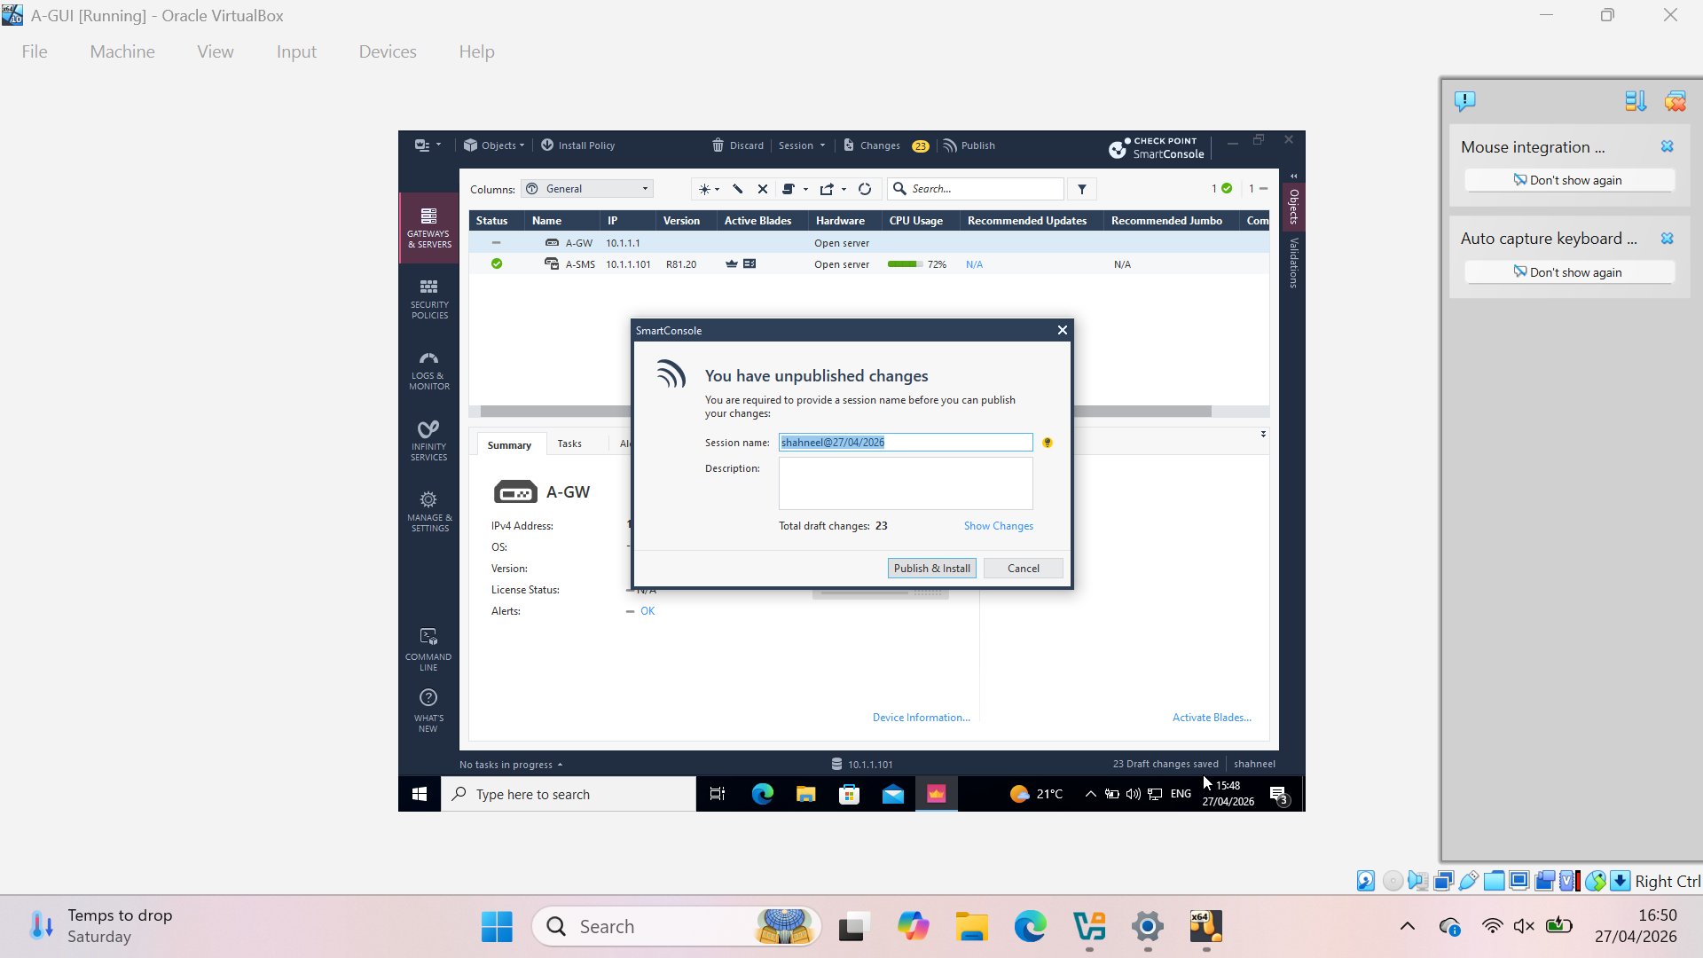
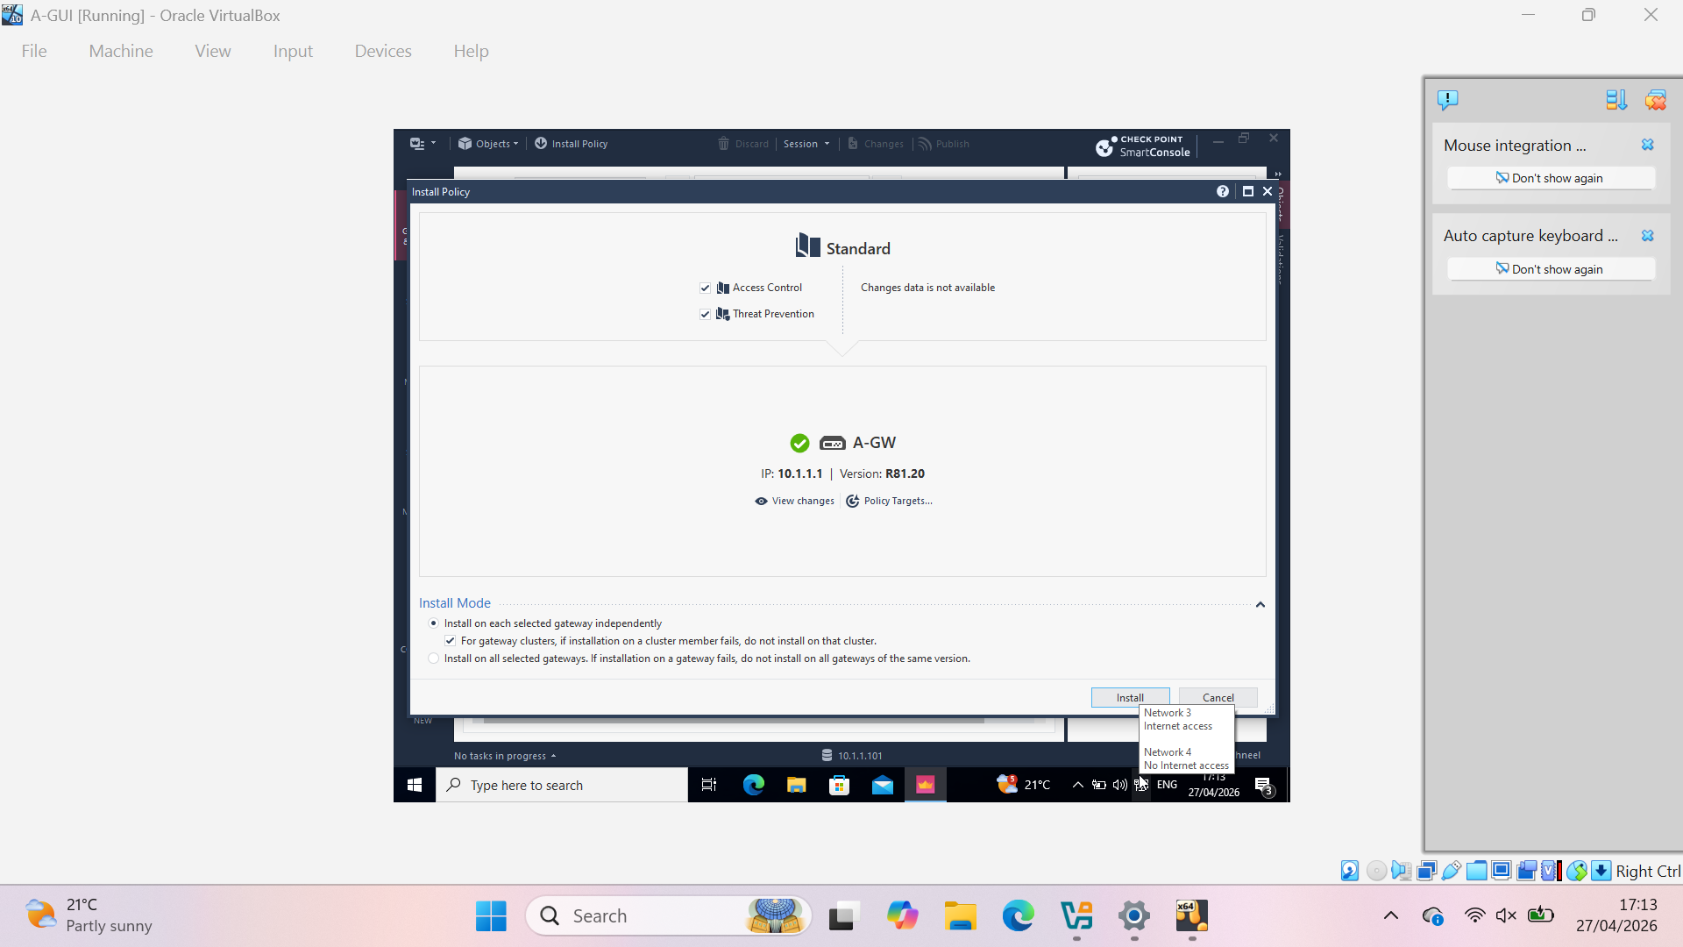
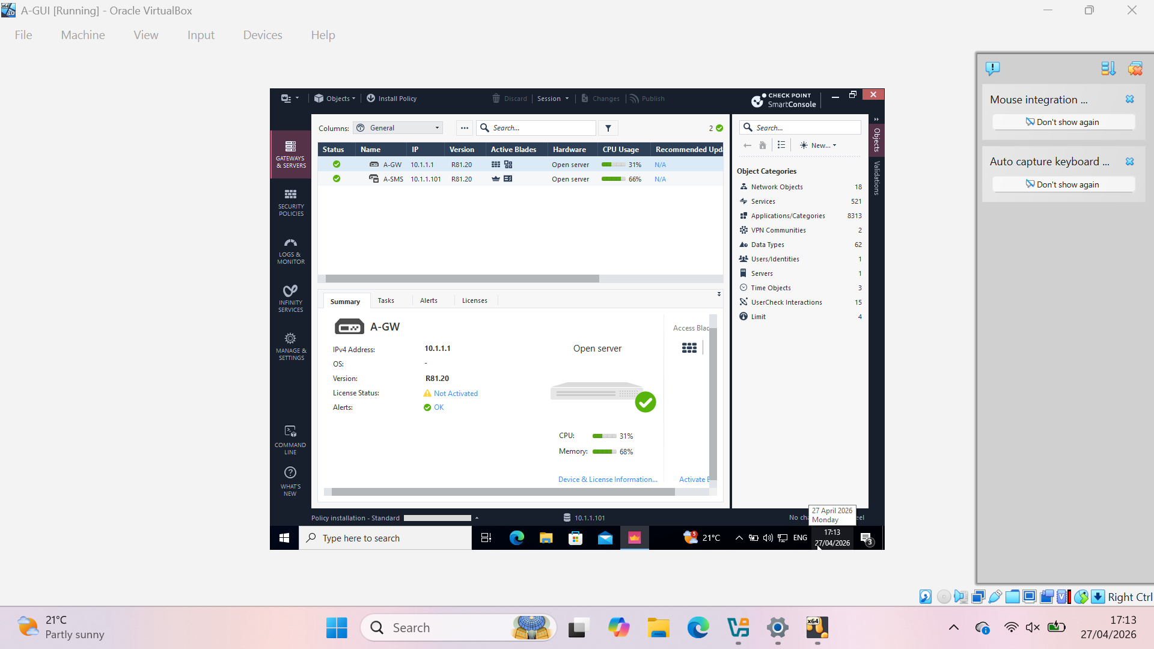
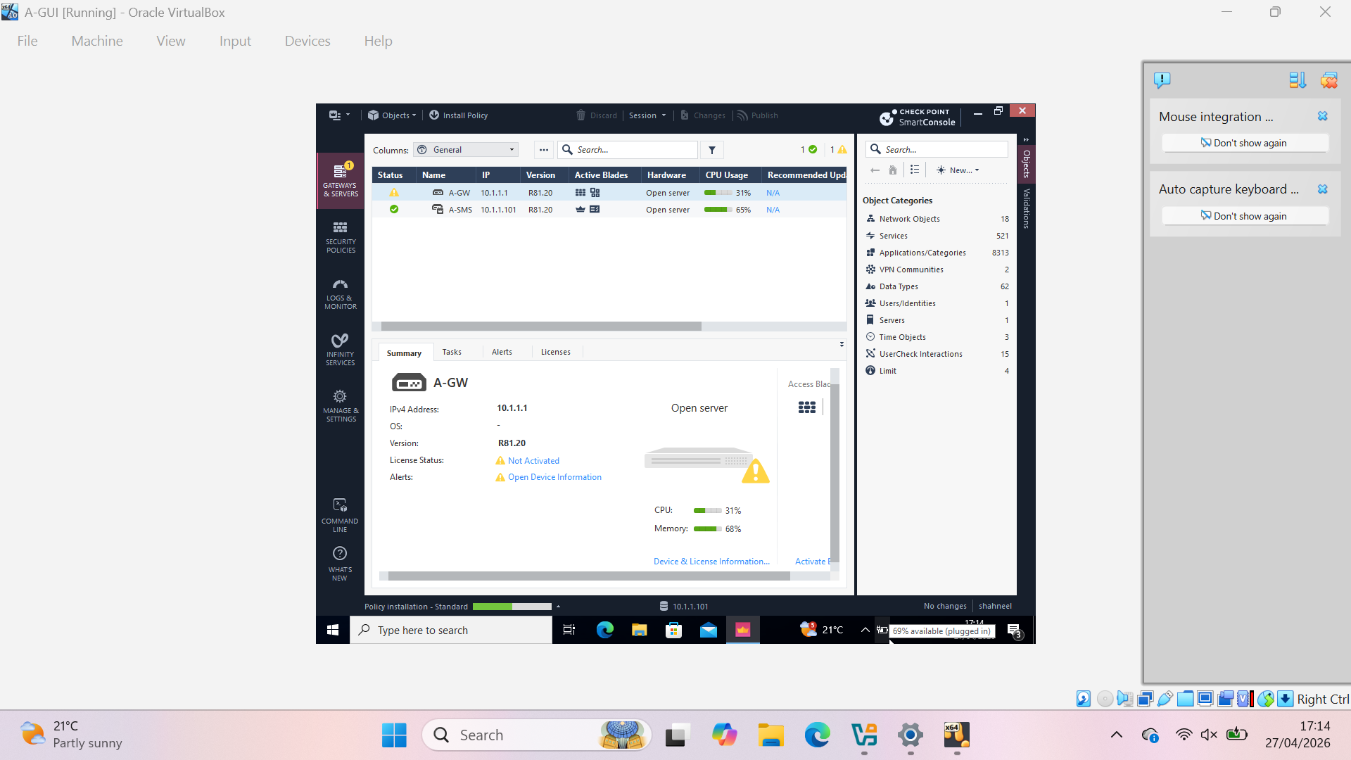

Slide 18
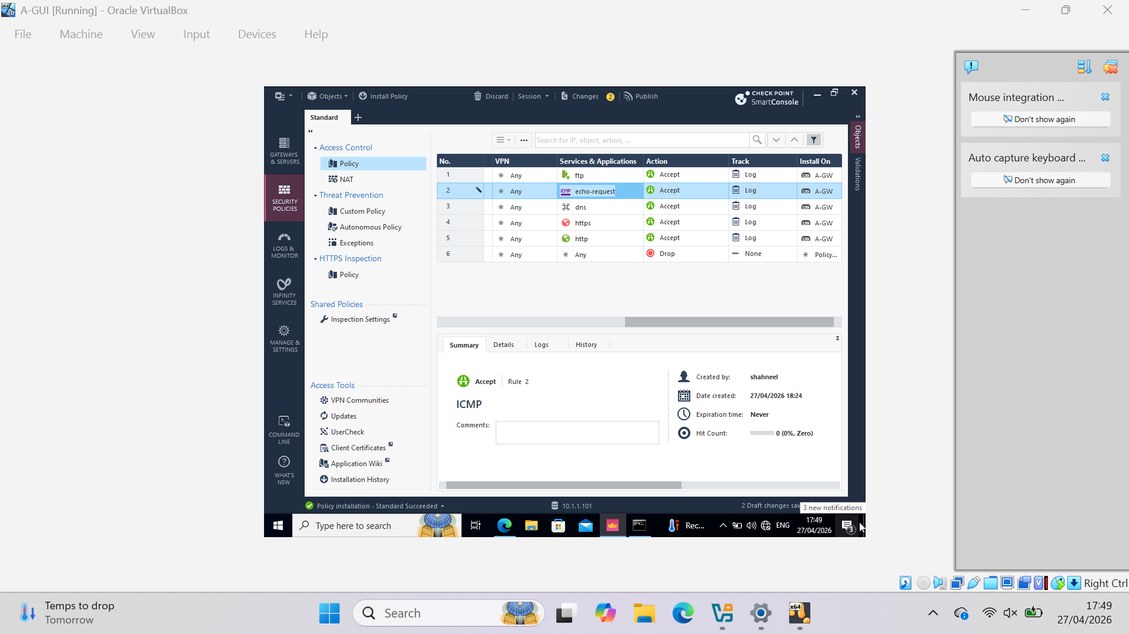
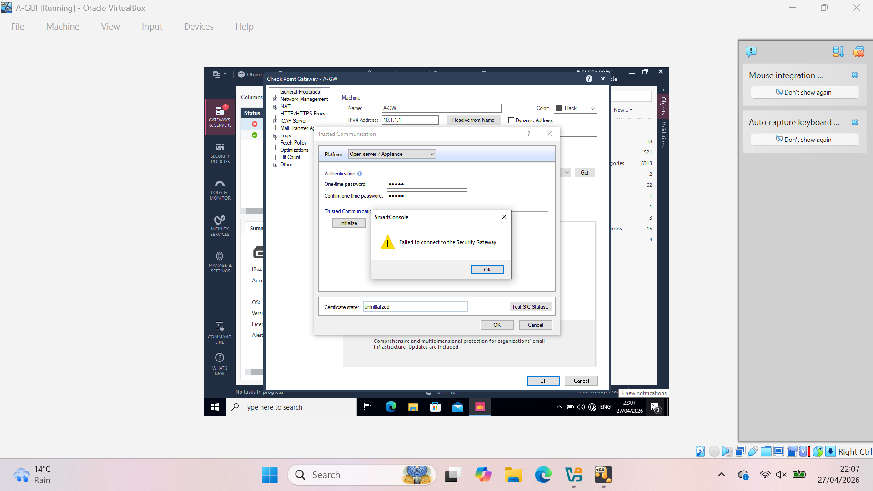
Firewall Policy Implementation
Access Control Policy configured
Rules:
  FTP allowed
  ICMP allowed
  DNS allowed
  HTTPS allowed
  HTTP allowed
Cleanup rule: Drop all other traffic
NAT policy applied
These policies were designed based on enterprise security principles, allowing only required services while restricting unauthorized access.

Slide 19
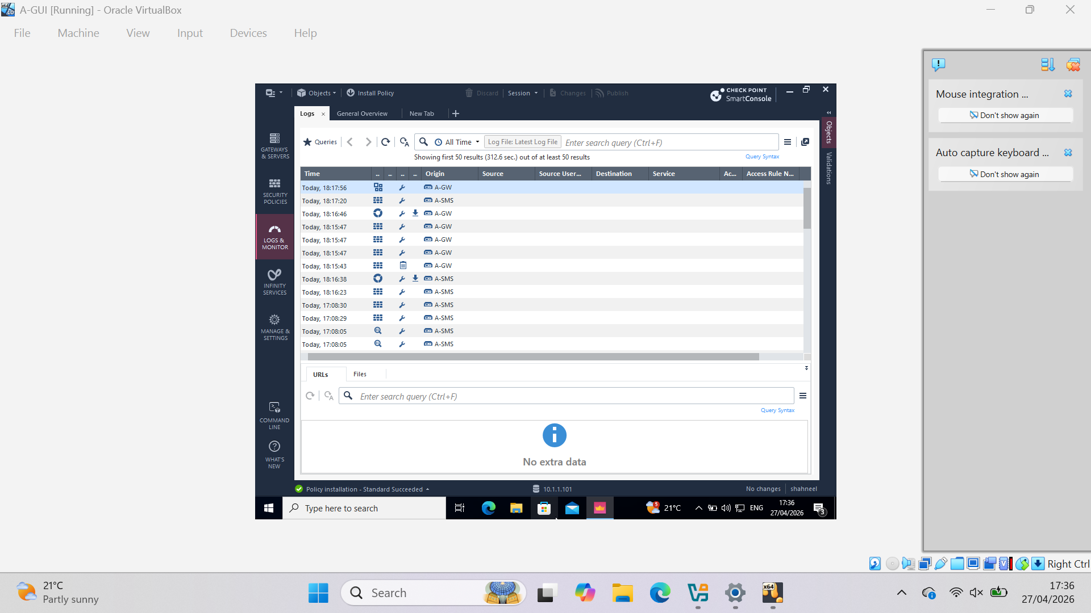
Testing and Results
Firewall policies were successfully configured; however, policy installation faced challenges due to connectivity issues.
Partial system functionality was verified through testing and log analysis.

Slide 20
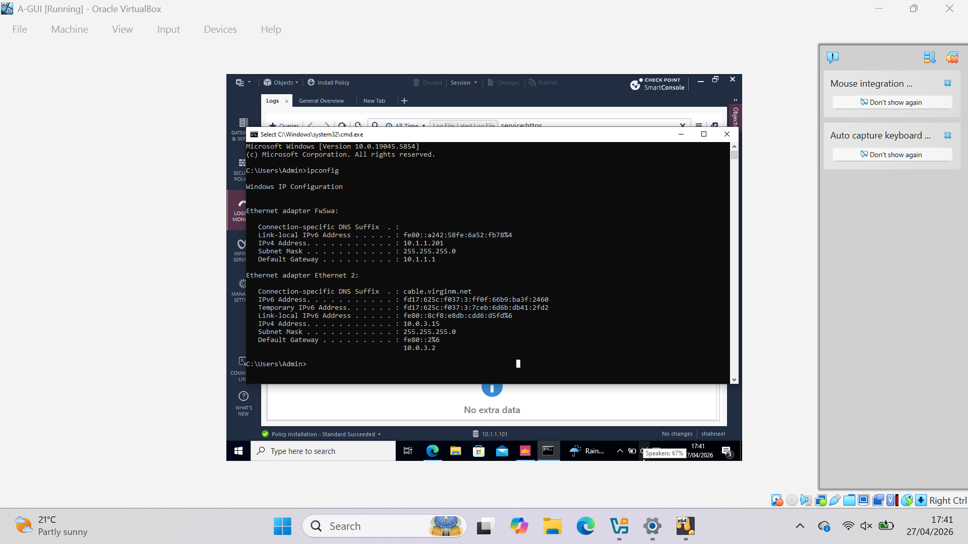
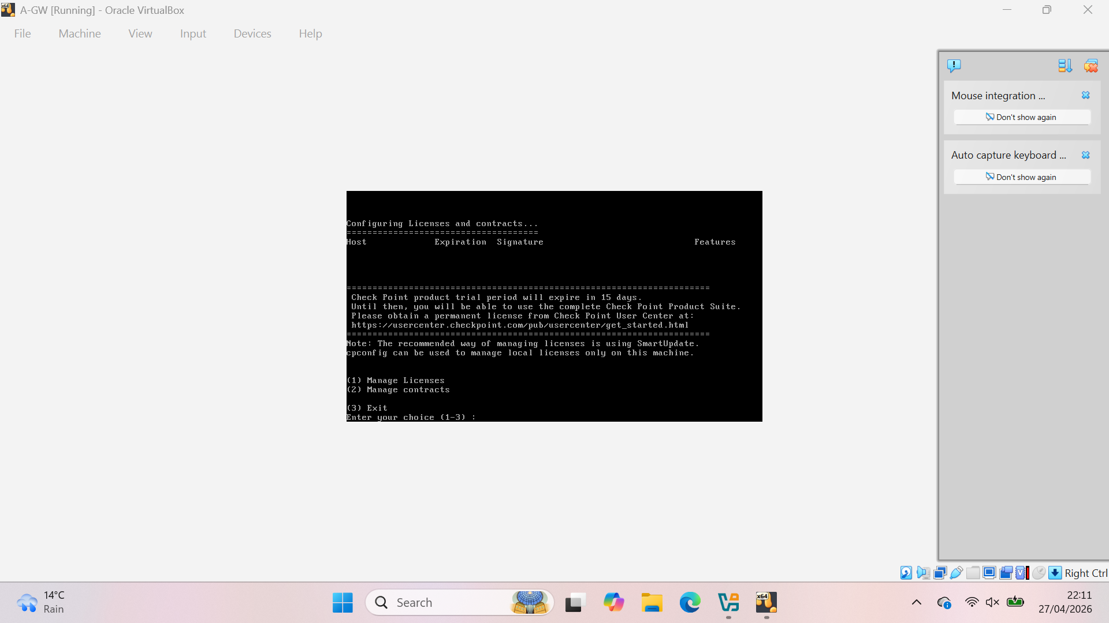

Slide 21
TroubleshootinG AND CHALLENGES
Multiple issues encountered during configuration
Network interface mismatch (IntSwa vs IntCP)
SIC initialization failure* Services not running properly
Gateway remained partially unreachable in some scenarios
Several troubleshooting attempts performed
Core configurations completed successfully
Policy installation and full gateway communication could not be consistently achieved due to virtual network configuration limitations and service synchronization issues.

Slide 22
CONCLUSION
The enterprise network was carried out using Check Point GAiA.
A-SMS and A-GW were configured with required settings.
Firewall policies were created to control network traffic.
Some issues were faced in connectivity and policy installation.
These issues were analyzed and troubleshooting was performed.
Overall, this helped in understanding enterprise network security.

Slide 23


