Slide 1

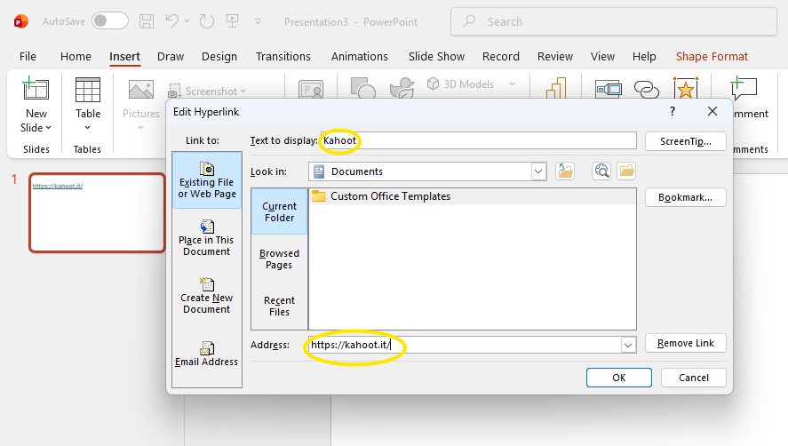

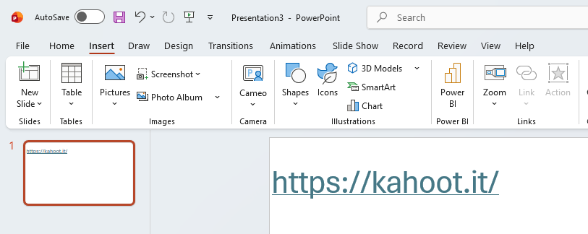
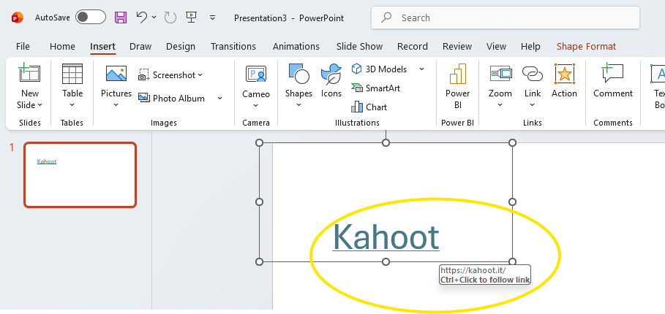
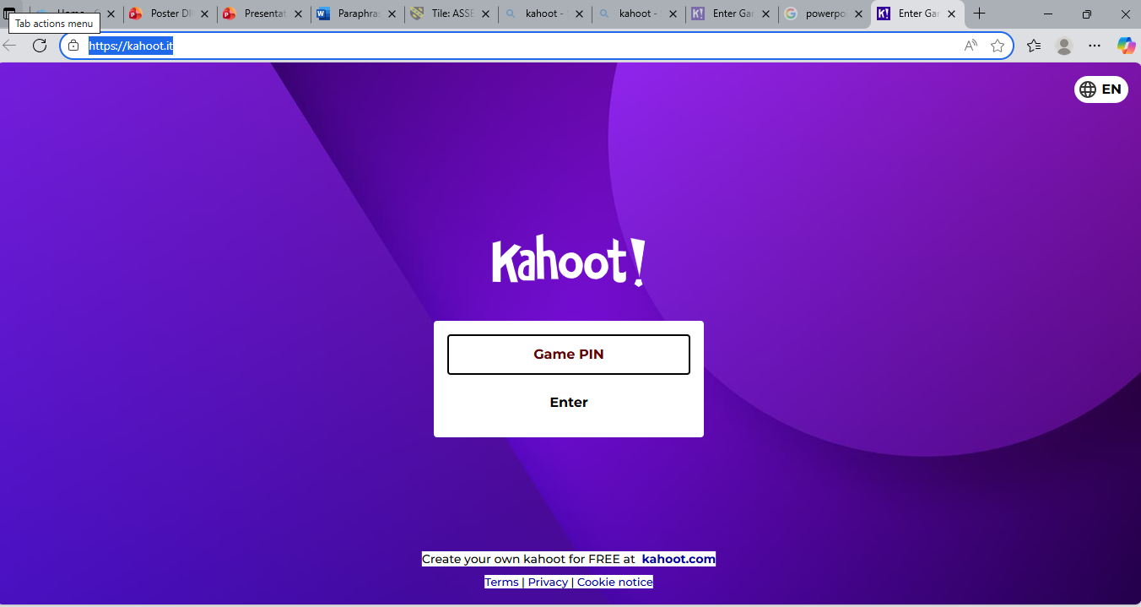
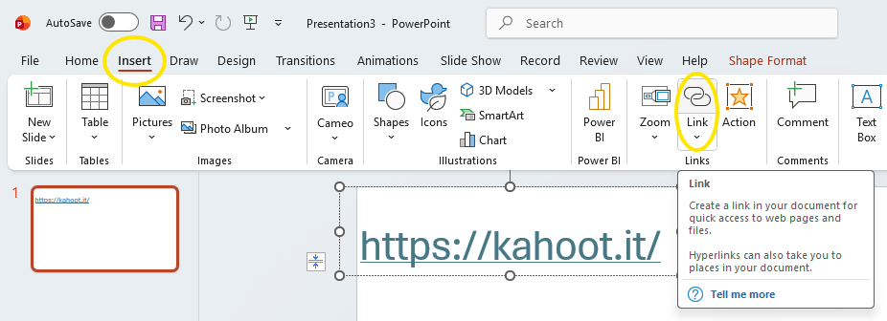
How to insert links in power point
Copy your website link
5. Paste the link on (Address)
Customise the link on (Text to display)
2, Access PowerPoint
3, Paste the link on PowerPoint
6. CTRL + Click on link will take you to the website
4. Go to insert, and access link

