Slide 1

Applying Bowlby's Attachment Theory to Isaac's Development
Gabriela Harissis
2509668
LCHS4010

Slide 2
Introduction to Isaac
Isaac is a 4-year-old boy who attends an early year center and has been referred for a multi-agency early help plan due to concerns about his development and wellbeing. He shows signs of emotional, social, and language development difficulties. This report will examine how his early experiences may have influenced his development and recommend appropriate support strategies.

Slide 3
Introduction to Bowlby's Attachment Theory
Key Concepts
Developed by John Bowlby (1969)
Children have an innate need to form attachments with caregivers.
Secure attachment provides a "safe base" for exploration.
Early relationships influence future emotional and social development.
Reference: Bowlby (1969)

Slide 4

Main Assumptions of the Theory
Bowlby believed:
Attachment is biologically programmed.
The first few years are a critical period for attachment.
Consistent and responsive caregiving promotes secure attachment.
Disrupted attachment may lead to emotional and behavioral difficulties.
Why is it relevant?
Isaac's experiences suggest possible attachment difficulties linked to family circumstances. – change font size min size 28

Slide 5

Applying the Theory to Isaac
Isaac's mother experiences:
Post-natal depression
Low confidence
Limited social support
This may reduce emotional availability and responsiveness.
Possible outcomes:
Anxiety
Clinginess
Insecure attachment
Reduced confidence
Reference: Murray & Cooper (1997)

Slide 6
Impact of Disrupted Childcare
Isaac has experienced:
Disrupted childcare arrangements
Recent relocation
Loss of familiar relationships
According to Bowlby:
Repeated separations can increase insecurity.
Children may struggle to trust unfamiliar adults.
Observed behaviors:
Distress when separated
Withdrawal during play
Difficulty joining groups

Slide 7

Nature and Nurture
Nature
Temperament
Genetics
Brain development
Nurture
Parent-child relationship
Social experiences
Environmental stability
Isaac's development is likely influenced by both biological factors and environmental experiences.
Reference: Bronfenbrenner (1979)

Slide 8

Theory-Informed Support Plan
Emotional Support:
Emotion coaching.
Comfort objects.
Safe and nurturing environment.
Attachment-Based Strategies:
Assign a key worker.
Maintain predictable routines.
Gradual separation strategies.
Build trusting adult-child relationships
These strategies support secure attachment development

Slide 9

Language and Social Development Support
Multi-Agency Collaboration
Speech and Language Therapist
Health Visitor
Family Support Worker
Language-Rich Environment
Daily storytelling
Singing and rhymes
Small group conversations
Modelling language
Social Development
Supported play sessions
Buddy systems
Structured group activities

Slide 10
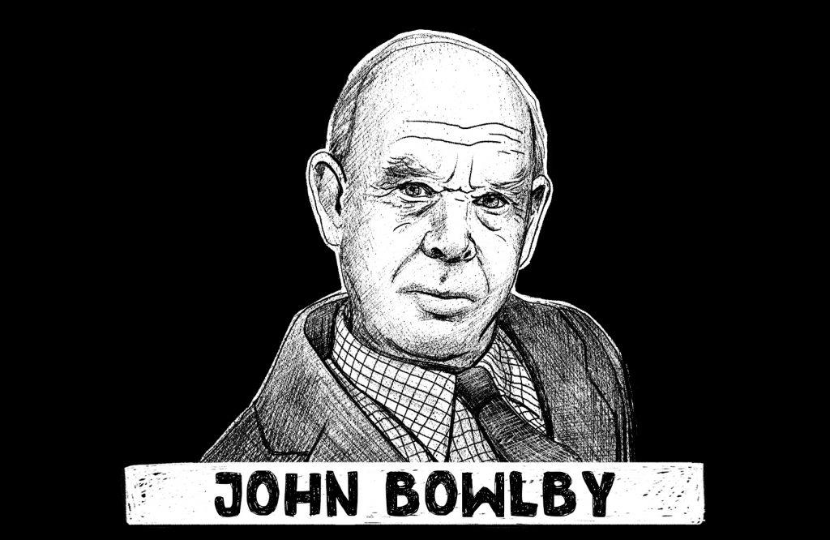
Critical Evaluation of Bowlby's Theory
Strengths
✓ Highlights importance of early relationships
✓ Widely used in childcare practice
✓ Supported by attachment research
Limitations
✗ Focuses mainly on mothers
✗ Underestimates wider social influences
✗ Cultural differences in attachment styles
Relevance to London
Diverse family structures
Different cultural approaches to caregiving
Importance of culturally sensitive practice

Slide 11
Conclusion
Isaac's early experiences may have contributed to insecure attachment behaviors.
Bowlby's theory helps explain his emotional and social difficulties.
Early intervention can improve outcomes.
Consistent support from family and professionals is essential.

Slide 12
References
Bowlby, J. (1969) Attachment and Loss: Volume 1. Attachment. London: Hogarth Press.
Bronfenbrenner, U. (1979) The Ecology of Human Development. Cambridge, MA: Harvard University Press.
Howe, D. (2011) Attachment Across the Lifecourse. Basingstoke: Palgrave Macmillan.
Murray, L. and Cooper, P. (1997) Postpartum Depression and Child Development. New York: Guilford Press.
Ainsworth, M.D.S. et al. (1978) Patterns of Attachment. Hillsdale, NJ: Erlbaum.
Prior, V. and Glaser, D. (2006) Understanding Attachment and Attachment Disorders. London: Jessica Kingsley Publishers.

