Slide 1

Memory Report
Richard Sylvan. University of Wales, Trinity Saint David, Lampeter. 2020

Slide 2
What Is Memory?
Blakemore (1988)
Definition;
(Blakemore 1988 cited in Gross 2010; page 282)
In the broadest sense, learning is the acquisition of knowledge and memory is the storage of an internal representation of that knowledge...
Significance;
(Rose 2003 cited in Gross 2010; page 299)
...Memory defines who we are and shapes how we act more closely than any other aspect of our personhood...
Rose (2003)

Slide 3

The Interrelated Processes Of Memory
Registration
Transforming sensory input.
Storage
Availability. Holding & retaining information.
Retrieval
Accessibility. Extracting information from the memory.

Slide 4
Memory Experiments and Theories
Models
Atkinson and Shiffrin's Multi-store Model (MSM) (1968,1971)
Peterson and Peterson (1971) & Murdoch (1962) provide evidence for Short Term Memory (STM) with different properties from Long Term Memory (LTM)
Craik and Lockheart's Levels-of-Processing (LOP) model (1973)
Baddeley and Hitch's Working Memory (WM) model (1974)
Techniques
Recognition​
Recall (serial and free)​
Paired associates recall​
Memory-span procedure

Slide 5
Serial Recall of Consonants (SRC) with Changing Time Delay Between Presentation And Recall
Method
A brief practice to establish an online method for the experiment
Following the invigilator's verbal instructions I glanced at a row of four consonants
I counted backwards in threes from a specified number while the invigilator kept time
When informed my time was up I attempted to recall and made a note of my guess
This was repeated for twenty rows in total. With five for each time slot
Time delay in seconds (Time spent counting backwards in threes) | Total number of consonants correctly recalled in their right positions
0 | 19
20 | 11
30 | 11
40 | 8
(N=1)

Slide 6
The SRC Experiment
Strengths;
Weaknesses;
This was a simplified version of Murdock's (1962) experiment.
Time delay is the independent variable. The counting down in threes is a method that prevents rehearsal with the inner voice.
The number of correct recalled consonants is the dependant variable.
The results of this small study show STM drop off with increased delay.
Results support MSM theory of importance of rehearsal for transfer from STM to LTM.
Online experimenting, due to Corona social distancing, coupled with imperfect wi-fi made audio and visual distractions.
Consonant choices must avoid familiar initials already lodged in participants memories, in this case K.F.C.(X). These will be culturally variable.
Reflexively I attempted rehearsal despite the counting task and may have delayed STM decay. Experienced close vigilance of participants could limit this.

Slide 7
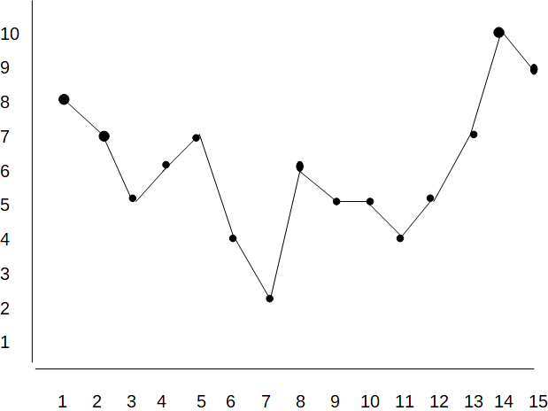
Free Recall of Unrelated Words Immediately after Hearing a List, Serial Position Effect Study (SPES)
Primacy Effect
Recency Effect
Number of words remembered
Position of word on list
(N=1)

Slide 8
About the SPES Experiment
Strengths;
Weaknesses;
The independent variable is the relative position of the words.
The dependant variable is the actual words recalled.
Ongoing list prevents rehearsal.
Miller's rule of 7(+/-2) close match for result
Rough serial position curve supports MSM theory of primacy (LTM) and recency (STM).
A larger study would even out irregular results and could improve the curve of the results graph.
Room to improve by researching and selecting for test words with similar relative frequency of use.
A recorded voice of the lists could improve consistent delivery for multiple participants.

Slide 9
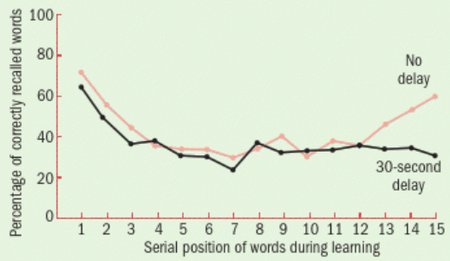
Glanzer & Cunitz (1966)
Procedure
Glanzer and Cunitz presented two groups of participants with the same list of words. One group recalled the words immediately after presentation, while the other group recalled the words after waiting 30 seconds. These participants had to count backwards in threes (the Brown-Peterson technique), which prevented rehearsal and caused the recency effect to disappear. Both groups could free recall the words in any order.
Diagram from Gross (2010) page 288
Results
The words at the end of the list are only remembered if recalled first and tested immediately. Delaying recall by 30 seconds prevented the recency effect.
Applications
The few studies assessing the effects of malingering on serial position suggest that malingerers suppress the primacy effect, a pattern not seen in closed head injury.

Slide 10
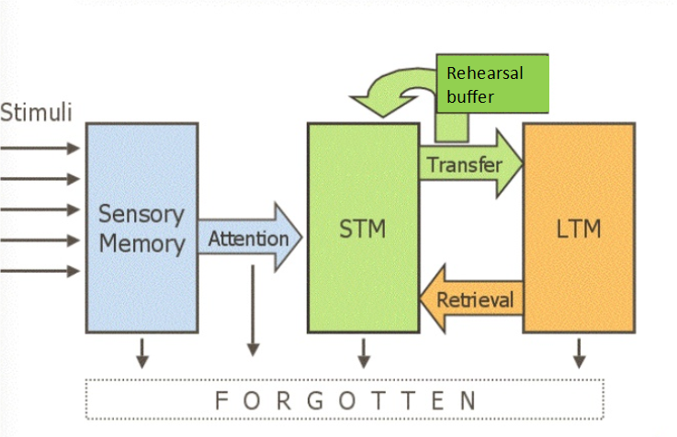
Atkinson and Shiffrin's (1968) MSM
Great theory to build experiments around
Memory stores are structural and unitary
Only one form of rehearsal (maintenance)
More complex models have superceeded this with more emphasis on control processes
Image supplied by lecturer

Slide 11
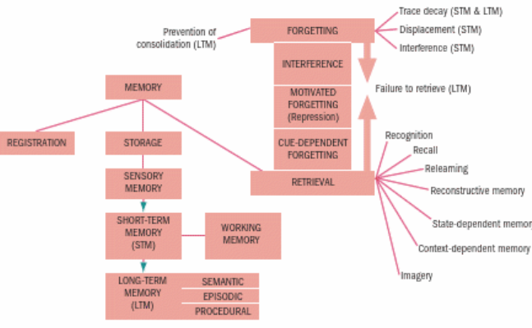
Craik and Lockheart's (1972) LOP
In this model we see imagery as a type of memory retrieval. I found this combined with semantic processes significant in my SPES Experiment.
Gross (2010) page 299

Slide 12
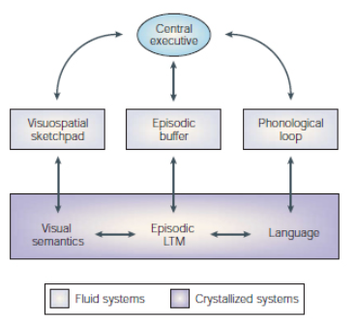
Memory as by-product of perceptual analysis
Baddeley and Hitch (2003) WM Model
In this model we see the phonological loop. The mechanism of rehearsal that was deliberately disrupted by counting backwards in my SRC Experiment
Diagram from Baddeley (2003)

Slide 13

Conclusions and Further Research
Though hypothetical, models of memory have tangible benefits. By testing hypotheses with repeatable experiments psychologists have defined and refined the structures and processes of memory.
Teaching, neurology, advertising and propaganda are enabled by this knowledge.
Access to online data is changing our relationship with our own memories. Future research could monitor these effects and hopefully inform our learning choices.
'You think you have a memory; but it has you!” Irving J, A Prayer for Owen Meany. William Morrow (1989)

Slide 14
References
Atkinson, R, & Shiffrin, R. (1968) Chapter: Human memory: A proposed system and its control processes. In Spence, K. W., & Spence, J. T. The psychology of learning and motivation (Volume 2). New York: Academic Press. pp. 89–195.
Craik, F. and Lockheart, R. (1972) Levels-of-Processing: A Framework for Memory Research. Journal of Verbal Learning and Verbal behaviour 11: 671-684.
Glanzer, M. & Cunitz, A. R. (1966) Two storage mechanisms in free recall. Journal of Verbal Learning and Verbal Behavior, 5, 4, 351-360.
Gross, R. (2010) Psychology: The Science of Mind and Behaviour 6th Edition. London: Hodder Education.
Irving, J. (1989). A prayer for Owen Meany. London: Corgi Books.
Miller, G. (1956) Psychological Review. 63 (2): 81–97.
Murdock, B. (1962) The serial position effect of free recall. Journal of Experimental Psychology, 64(5), 482–488.
Images
Baddeley, A. & Hitch, G. in Recent Advances in Learning and Motivation (ed. Bower, G. A.) 47–89 (Academic, New York, 1974).
Glanzer and Cunitz (1966) diagram from Gross (2010), 288.
Tense Present n.d. Tense Present official website, 10 June 2020 <https://tensepresent.wordpress.com/tag/food-industry/>

