Slide 1
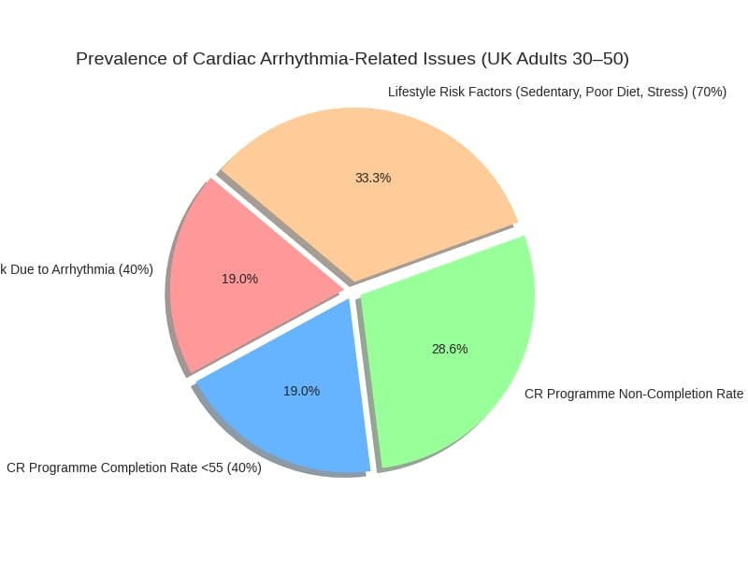

Evaluating the Impact of Cardiac Rehabilitation Programs on Lifestyle Outcomes in Adults Aged 30–50 Diagnosed with Cardiac Arrhythmia
Student name: Arpita chaudhary student ID:2432245 supervisor name: Dr Diola Bijhout
Programme name : MSC public health and social care in practice.
1.Introduction
Cardiac arrhythmia is a growing public health concern among adults aged 30–50, often leading to reduced quality of life, increased stroke risk, and long-term cardiovascular complications (Breeman et al., 2025).
Cardiac rehabilitation (CR) programmes are designed to improve physical activity, dietary habits, stress management, and medication adherence — yet younger adults remain underrepresented in CR participation (Vromen et al., 2016).
Workplace demands, lack of tailored support, and limited awareness contribute to low engagement in CR among this age group (Clark et al., 2014).
This research explores how CR programmes influence lifestyle outcomes in younger adults and identifies barriers to sustained change.
7.Research Impact- Clinical Practice: Tailor CR modules to younger adults using flexible formats and digital tools (Frederix et al., 2015).
- Policy: Inform NHS and employer strategies to improve CR access and completion rates among working-age populations.
Public Health: Support targeted awareness campaigns and early intervention strategies for arrhythmia management.
- Innovation: Encourage integration of wearable tech, telehealth, and personalised coaching to enhance engagement.
- Global Relevance: Findings may be adapted for low-resource settings using community-led CR models.
2. Prevalence-
Over 2 million people in the UK are affected by cardiac arrhythmias, with rising diagnoses among adults aged 30–50 (British Heart Foundation, 2023).
Atrial fibrillation increases stroke risk by 2–5 times (NICE, 2022).
Only 40% of eligible patients aged under 55 complete CR programmes, compared to 70% in older age groups (NACR, 2023).
Lifestyle factors such as sedentary behaviour, poor diet, and stress are prevalent among younger patients post-arrhythmia diagnosis (Ghisi et al., 2014).
3. Aim:
To evaluate the effectiveness of cardiac rehabilitation programmes in promoting and sustaining lifestyle changes among adults aged 30–50 diagnosed with cardiac arrhythmia.
4.ResearchQuestion:
How do cardiac rehabilitation programmes influence lifestyle outcomes—such as physical activity, diet, stress management, and medication adherence—in with cardiac arrhythmia?
5. Objectives:
- To identify which lifestyle domains are most influenced by CR in younger adults.
- To assess the sustainability of lifestyle changes post-rehabilitation.
- To explore barriers and facilitators to lifestyle modification in this age group.
- To evaluate how CR programme design aligns with the needs of working-age.
(Vectormone,2023)
References
Anderson, L. et al. (2016) ‘Exercise-based cardiac rehabilitation for coronary heart disease: A meta-analysis’, Journal of the American College of Cardiology (JACC), 67(1), pp. 1–12.
Breeman, L.D. et al. (2025) ‘Lifestyle behaviour change of patients following cardiac rehabilitation’, European Journal of Preventive Cardiology. Available at: https://doi.org/10.1093/eurjpc/zwaf193 (Accessed: 1 November 2025).
British Heart Foundation (2023) Cardiac rehabilitation statistics. Available at: https://www.bhf.org.uk (Accessed: 1 November 2025).
Clark, A.M. et al. (2014) ‘Barriers to cardiac rehabilitation’, Journal of Cardiopulmonary Rehabilitation and Prevention, 34(6), pp. 355–361.
Dalal, H.M. et al. (2015) ‘Home versus centre-based cardiac rehabilitation: a systematic review’, BMJ, 351, h5000.
Frederix, I. et al. (2015) ‘Digital health in cardiac rehabilitation: a review’, European Journal of Cardiovascular Nursing, 14(5), pp. 342–349.
Ghisi, G.L.M. et al. (2014) ‘Knowledge and adherence in cardiac rehabilitation’, Patient Education and Counseling, 95(2), pp. 209–217.
Heran, B.S. et al. (2011) ‘Exercise-based cardiac rehabilitation for coronary heart disease’, Cochrane Database of Systematic Reviews, Issue 7.
Kraal, J.J. et al. (2017) ‘Effects of home-based training in cardiac rehabilitation: a randomised controlled trial’, European Journal of Preventive Cardiology, 24(2), pp. 148–156.
Lear, S.A. et al. (2017) ‘Lifestyle modification and arrhythmia recurrence’, Canadian Journal of Cardiology, 33(8), pp. 1020–1026.
National Audit of Cardiac Rehabilitation (NACR) (2023) National audit of cardiac rehabilitation. Available at: https://www.nacr.org.uk (Accessed: 1 November 2025).
National Institute for Health and Care Excellence (NICE) (2022) Atrial fibrillation: diagnosis and management (NG196). Available at: https://www.nice.org.uk/guidance/ng196 (Accessed: 1 November 2025).
Rashidi, A. et al. (2025) ‘Quality of life after cardiac rehabilitation: a systematic review’, PLOS One, 20(1), pp. 1–15.
Taylor, R.S. et al. (2019) ‘Exercise-based cardiac rehabilitation for heart failure’, European Journal of Heart Failure, 21(6), pp. 742–752.
Vromen, T. et al. (2016) ‘Cardiac rehabilitation participation in younger adults’, Heart & Lung, 45(6), pp. 486–491
. VectorMine (2023) Concept of cardiac health and lifestyle balance. [Illustration]. Available at: https://www.shutterstock.com (Accessed: 4 November 2025).
6.Rationale of the Research
Despite extensive evidence supporting CR for older adults, younger populations remain under-researched and underserved (Anderson et al., 2016).
This study addresses a critical gap by focusing on adults aged 30–50 — a group balancing work, family, and health — and explores how CR can be adapted to their needs.
The originality lies in synthesising lifestyle outcomes with programme design, digital engagement, and long-term adherence strategies. Findings will inform inclusive CR models and support NHS goals for preventive care and health equity.

