Slide 1


Referencing
By Zita Draper

Slide 2

Content
  Aims and learning objectives
  What is referencing?
  Why is it important?
  Academic misconduct?
  Activity
  AI and the developing world
  Summary
  Thank you, Any questions?

Slide 3

Aims and Learning Objectives
  The aim of today’s session is to discuss and practice referencing.
  By the end of today’s session students should be able to demonstrate their understanding of referencing, its importance, academic misconduct and the use of AI.

Slide 4

What is referencing?
  Acknowledging other people’s work.
  Referencing in accordance with the Harvard referencing guide.
  Details of sources read.
UWTSD, 2024

Slide 5


Why is it important?
  Shows the breadth of your research
  Supports your arguments
  Allows the tutor to follow your research/ writing trail
  Acknowledge the work of others

Slide 6

Plagiarism
  A term you may remember.
  Academic misconduct - Plagiarism, self-plagiarism, collusion falsifying data, authorship and much much more.
  Let’s take a look at the Academic misconduct policy!

Slide 7


Slide 8
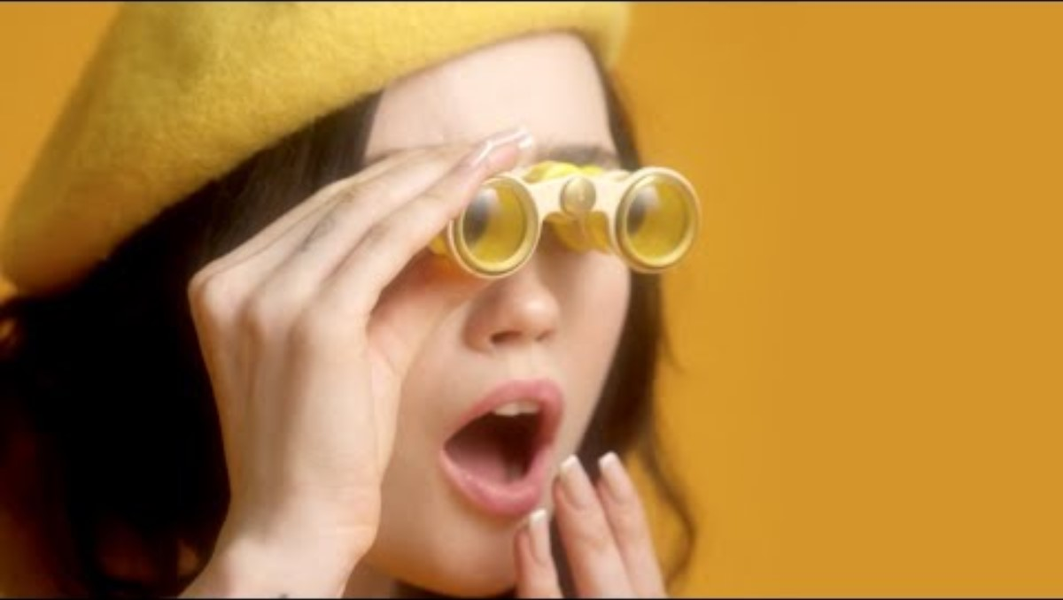

Slide 9
What will happen if I am suspected?
  The tutor will speaker to the academic misconduct co-ordinator.
  The Academic misconduct co-ordinator for the school of law is Zita Draper.
  We will then decide whether you will have;
  1. A warning in your feedback.
  2. A Poor Academic Practice Letter.
  3. Viva Voce - SC05 completed by tutor.
  4. A formal allegation of academic misconduct.

Slide 10
A note from the AMC!
  In the nicest way possible, I do not want to see any of you for academic misconduct claims.
  Use your tutors for support with referencing, we would rather you ask than struggle.
  You can also utilize the library and their study support sessions and Lisa Ellis our academic librarian.

Slide 11
Continued
  After 4 repeated events students are likely to be expelled from the University.
  Have a read of the academic misconduct policy.

Slide 12

Tips
  Always reference as you go along.
  This will make your life easier.
  Give yourself enough time to get a draft checked - a lot of tutors will have a deadline, please ask the tutor.
  Ensure you keep a list of your sources.
  Utilise the Harvard referencing guide.
  Please collect a copy of the Harvard referencing guide from the front of the room.

Slide 13
Paraphrasing
  Taking someone’s idea and put it in your own words.
  Not directly copying.
  But ensuring that the same meaning is brought across.
  What do you understand from what the author is saying?

Slide 14
Summarizing
  Give an overview of someone else’s ideas.
  Remember you need to ensure the same meaning is provided.
  - Do not change the idea.

Slide 15
Quoting
  Directly using the information given by the author.
  In the text if it is more than 30 words it is classed as long – and should have its own paragraph and there should be an indent.
  Short – no need for new paragraph – but does need to be in double quotation marks.

Slide 16
A reminder
  In text citations - Book
(Jackson, 2016, P 17)
or
Jackson (2016, P 17)
  Reference list -
Jackson, L. (2016) How to write academically?. 9th edn.Plymouth: Kiln Press

Slide 17
Let’s practice

Slide 18
What about AI?
Artificial intelligence is here and it is not something to be afraid of.
However, you cannot use of AI for an assessment if your tutor says that you cannot.
Except for the general allowance.
Let’s go back to your assignment brief and look at the AI guidance.

Slide 19
General allowance?
You can use AI for study and assessment for the following;
1. Studying only – Summarizing
2. Study and assessment – Create Bibliography
3. Study and assessment – Note organization
4. Study and assessment – Citation formatting
5. Study and assessment – Basic Proofreading
Notes:
AI in Assessment - May 2025.pdf

Slide 20
What about AI?
  Using things like Chagpt, Microsoft copilot to name a few.
  Do we know how to spot it?
  Yes, we can spot it - because we know you as students.
  Also - there can be some tell tale signs.

Slide 21
What about AI?
  1. A common thing that Chat Gpt does is include ‘’Chatgpt’’ at the end of a source.
Example; https://www.eventinsurancedirect.co.uk/public-liability-insurance-for-events/?utm_source=chatgpt.com

Slide 22
What about AI?
  They provide an answer in a specific format.
  This is usually bullet pointed information or incomplete sentences.
  For example,

Slide 23
What about AI?
Example;
‘’Modern Scotland
In contemporary times, Scotland has continued to evolve while preserving its rich heritage. The capital city, Edinburgh, is a hub of culture and education, home to the renowned University of Edinburgh and the annual Edinburgh Festival, one of the world's largest arts festivals. Glasgow, Scotland's largest city, is known for its vibrant music scene and architectural marvels. Scotland also plays a significant role in the UK's political landscape, with the Scottish Parliament in Holyrood representing the interests of the Scottish people.
Advantages:
  Cultural and Educational Hub: Cities like Edinburgh and Glasgow offer rich cultural experiences and educational opportunities.
  Political Representation: The Scottish Parliament allows for greater representation and autonomy within the UK.
Disadvantages:
  Economic Challenges: Scotland faces economic challenges, including disparities between urban and rural areas.
  Political Tensions: The quest for independence and political differences can create tensions within the country.
Conclusion
Scotland is a land of contrasts, where ancient traditions coexist with modern innovations. Its rich history, vibrant culture, and stunning natural beauty make it a unique and captivating destination.’’

Slide 24
What about AI?
  It can also provide fake sources.
  If your sources do not match your assignment - this is a big read flag and can demonstrate the use of AI.

Slide 25
Activity
  Please get out your laptops and I will put you into groups.
  You are then to complete the activity - AI is not a game which can be access via moodle!

Slide 26

Conclusion
  Referencing is important.
  It is a skill that you will develop.
  If in doubt, please ask!

Slide 27
Thank You

