Slide 1
BMSW5106
Knowledge and Information Management Skills for the Workplace
Week 7
Enterprise Systems

Slide 2

In this session we will…..
Discuss Business Information Systems by
  Enterprise and functional BIS
  Types of enterprise systems
  E-business and e-Commerce

Slide 3
Enterprise and functional BIS
Business information systems can be categorised into operations and management systems which can be implemented as either enterprise or functional business systems.
Firms use enterprise systems to integrate business processes in manufacturing and production, finance and accounting, sales and marketing, and human resources into a single software system.
Enterprise systems handle many operations within a company to facilitate its business and management reporting tasks. They’re built for speed, scale and designed to deploy across a variety of networks like the Internet, an intranet and corporate networks.

Slide 4
Enterprise systems (ES)
  Support the business processes of an organisation across any functional boundaries that exist within that organisation.
  Use internet technology to connect the business with suppliers, customers and partners.
  Rather than storing information in separate places throughout the organization, enterprise systems provide a central repository common to all corporate users.
  It provides a common interface and allows personnel to share information seamlessly no matter where the data is located.
  Advantage of ES is it removes ‘information islands’ (separate applications and data in different parts of the company).
  Disadvantages of ES include high cost, major change required for implementation and need to change working methods to software.

Slide 5
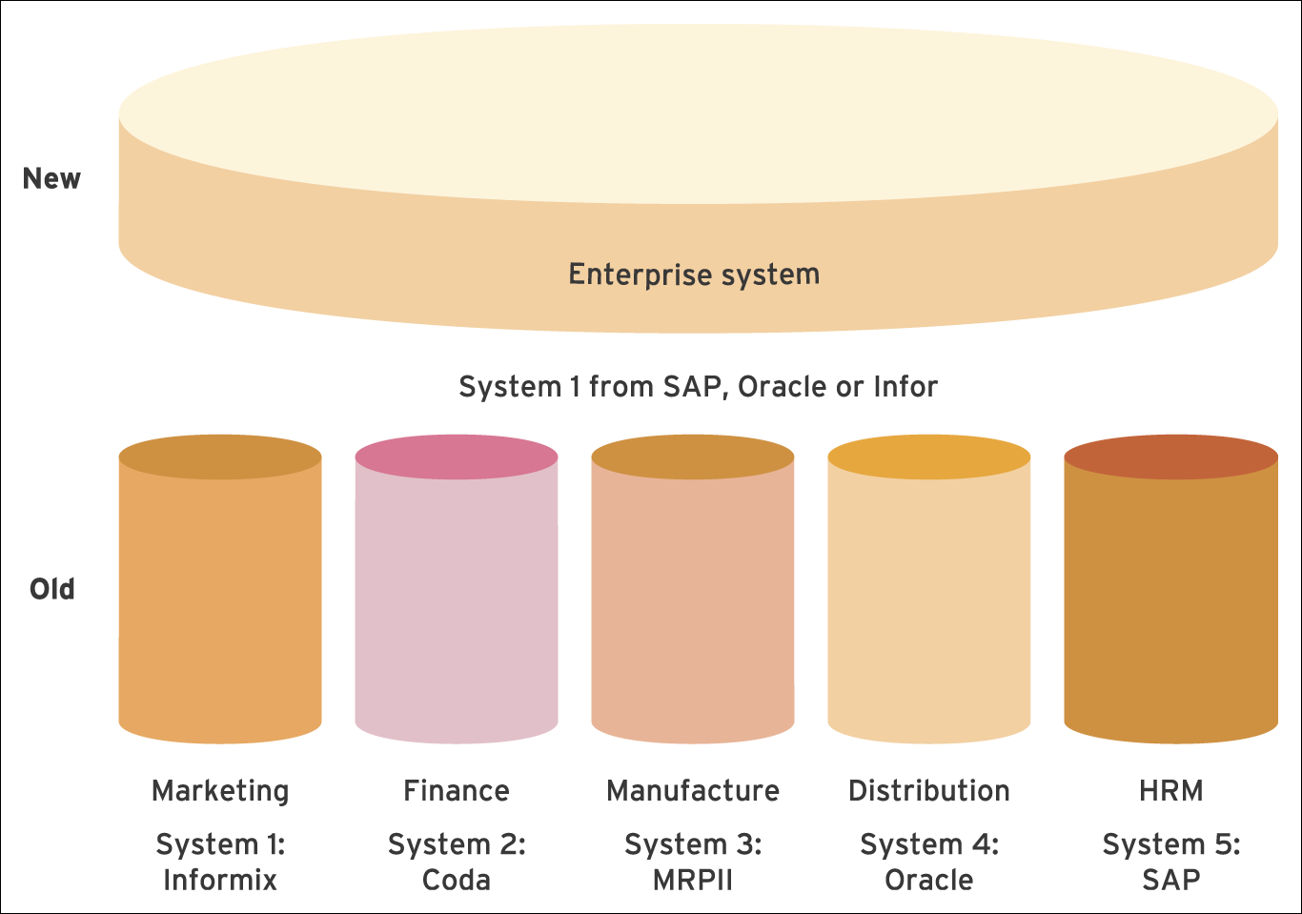
Enterprise application in comparison to separate functional applications
Paul BociJ, Andrew Greasley, Simon Hickie; Business Information Systems, 5th edn: Technology, Development and Management for the E-Business

Slide 6
Types of enterprise systems
Enterprise resource planning (ERP) systems are Enterprise systems which support processes within an organization. These processes include procurement, product development, manufacturing and sales.
An ERP system can be extended to service processes across organizations with the addition of enterprise systems such as supply chain management systems (SCM), and customer relationship management (CRM) systems.

Slide 7
Enterprise resource planning (ERP)
ERP systems offer a single solution from a single supplier with integrated functions for major internal processes such as production, distribution, sales, ﬁnance and human resources management.
The ERP systems are based on a suite of integrated software modules and a common central database. The database collects data from many different divisions, departments and processes in a firm, making the data available for applications that support nearly all of an organization’s internal business activities.
When new information is entered by one process, the information is made immediately available to other business processes.

Slide 8
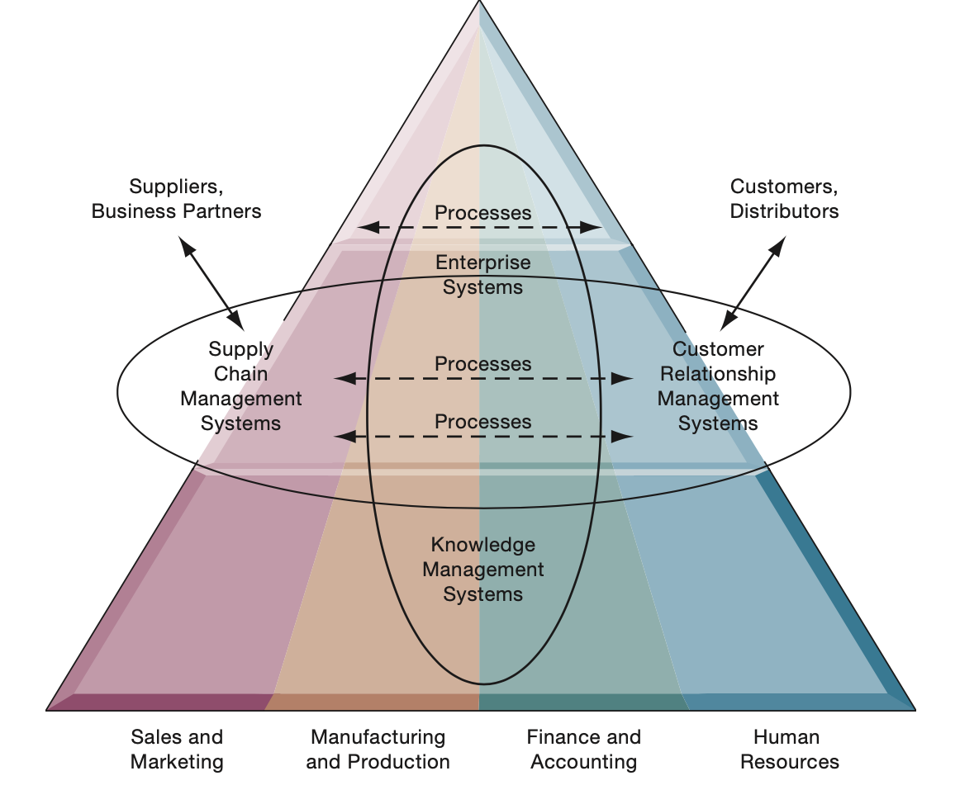
Enterprise Application Architecture
Enterprise applications automate processes that span multiple business functions and organizational levels and may extend outside the organization.

Slide 9
ERP Systems cont.
Integrate many software applications and business functions using a common database
Potential benefits
  – Cycle time reduction
  – Faster information transactions
  – Better financial management
  – Laying the groundwork for electronic commerce
  – Encourages organizations to manage processes more explicitly
Potential risks
  – Difficult to implement
  – Inflexible
  – Overly hierarchical
Adapted from: T. Davenport, Mission Critical, Harvard Business School Press, 2000, p. 7-9.

Slide 10
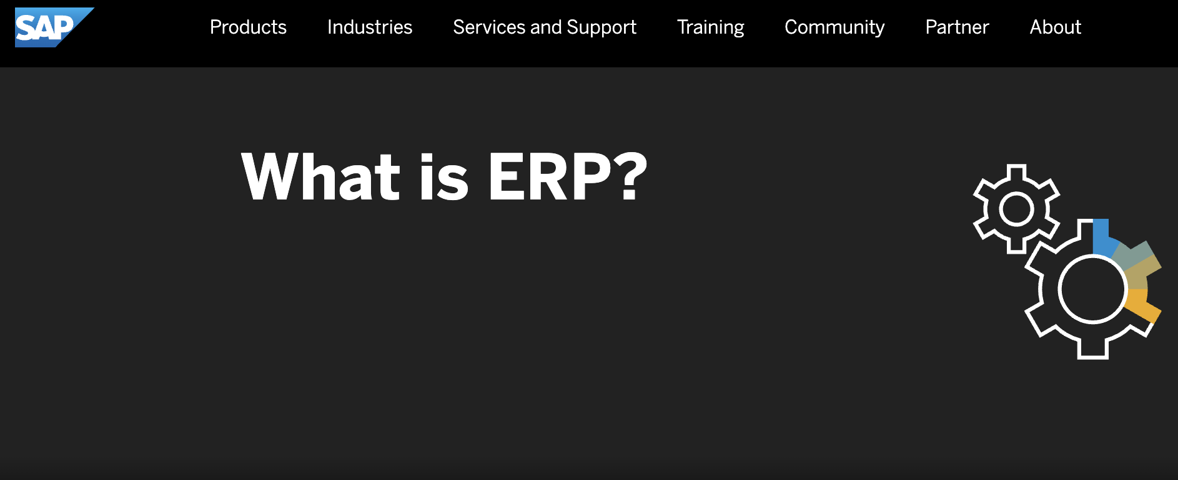
Activity 1:
Explore SAP Website and find the benefits of their ERP systems
https://www.sap.com/products/what-is-erp.html

Slide 11

How does Zara use the ERP System?

Slide 12
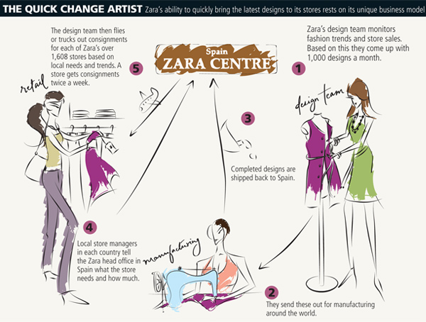
ZARA
Zara designs, manufactures, distributes, and retails clothes within 2 weeks of the original design first appearing on catwalks.
The core of Zara’s success is centralized enterprise resource planning. Inventory, products and logistics are managed in central cloud based software.

Slide 13
Supply chain management (SCM)
  A supply chain consists of the series of activities that moves materials from suppliers through the organisation to customers.
  Supply chain management is the management of this material flow.
  Organisations in the supply chain can have varying degrees of cooperation and integration.
  Supply chain software can help businesses plan their supply chain (demand planning) and help them execute the supply chains steps (execution)

Slide 14
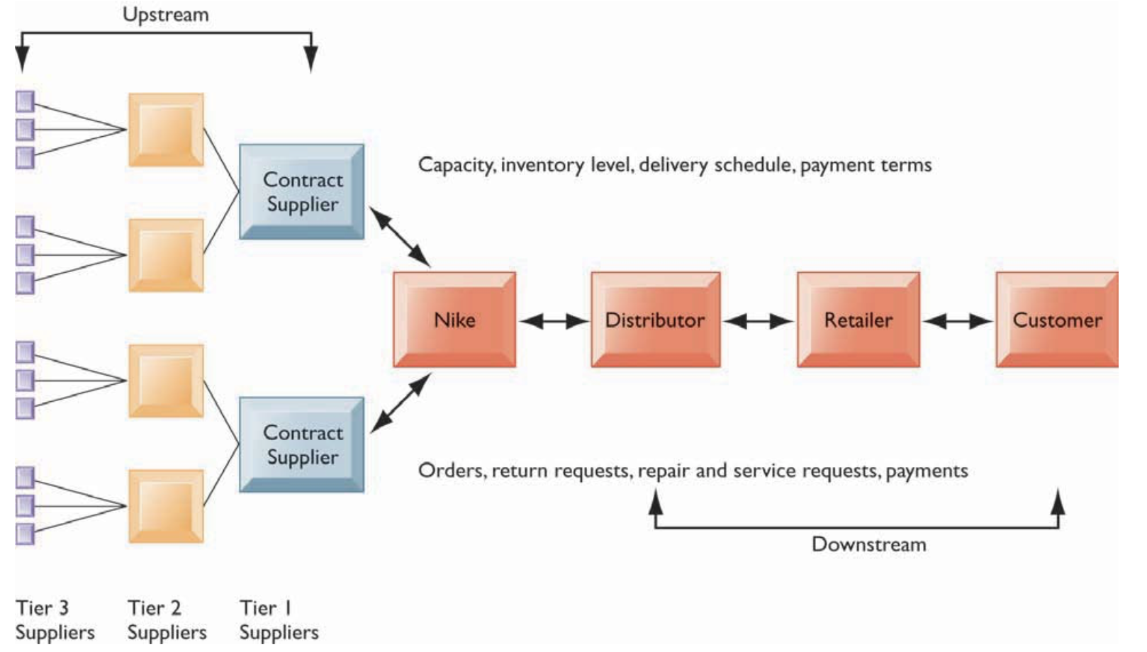
Nike’s Supply Chain
The major entities in Nike’s supply chain and the flow of information upstream and downstream to coordinate the activities involved in buying, making, and moving a product (Laudon and Laudon, 2014)

Slide 15
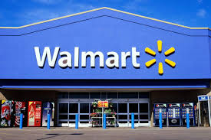
How does Walmart use SCM system?

Slide 16
Walmart
“I don’t believe there is a university in the world that doesn’t talk about Walmart and the supply chain,” said James Crowell, director of the Supply Chain Management Research Center at the Walton College of Business. “They are just so well respected because they do it so well.”
Walmart streamlined supply chain management by constructing communication and relationship networks with suppliers to improve material flow with lower inventories. The network of global suppliers, warehouses, and retail stores has been described as behaving almost like a single firm.
“Wal-Mart’s whole thing was collaboration,”. “That’s a big part of what made them so successful.”

Slide 17
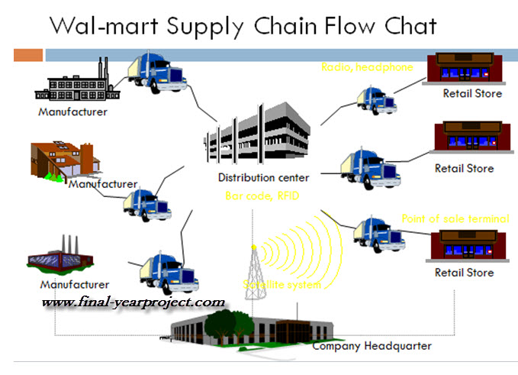
Suppliers and manufacturers within the supply chain synchronize their demand projections under a collaborative planning, forecasting and replenishment scheme, and every link in the chain is connected through technology that includes a central database, store-level point-of-sale systems, and a satellite network.
What made Walmart so innovative was that it has been sharing all these information with all their partners and back in the days, a lot of companies weren’t doing that. In fact, they were using third parties where they had to pay for that information.

Slide 18
Customer relationship management (CRM)
CRM systems are designed to integrate the range of information systems that contain information regarding the customer, e.g. who your customers are, how to contact them, whether they are costly to service and sell to, what kinds of products and services they are interested in, and how much money they spend on your company.
Customers interact with the firm (over the Web, the phone, e-mail, blogs, and in person). It becomes difficult to integrate information from all theses sources and to deal with the large numbers of customers.
CRM capture and integrate customer data from all over the organization, consolidate the data, analyse the data, and then distribute the results to various systems and customer touch points across the enterprise.
A touch point (also known as a contact point) is a method of interaction with the customer, such as telephone, e-mail, customer service desk, conventional mail, Facebook, Twitter, Web site, wireless device, or retail store. Well-designed CRM systems provide a single enterprise view of customers that is useful for improving both sales and customer service

Slide 19
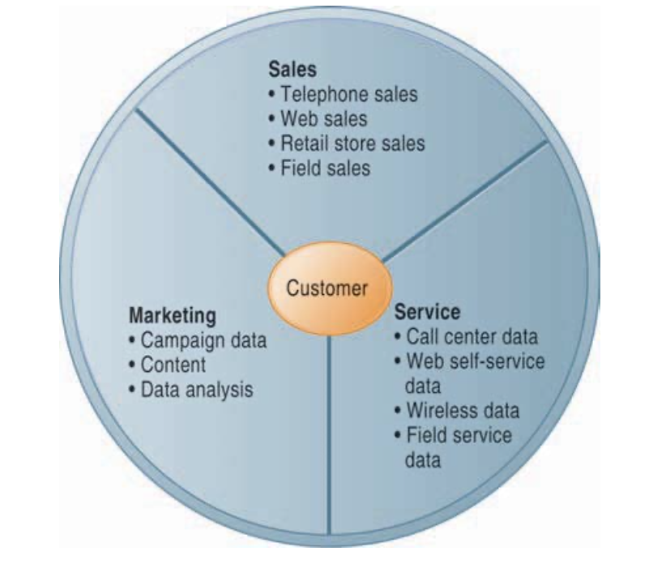
Customer Relationship Management (CRM)
CRM systems examine customers from a multifaceted perspective. These systems use a set of integrated applications to address all aspects of the customer relationship, including customer service, sales, and marketing.
Laudon and Laudon (2014). Management Information Systems: Managing the Digital Firm. 13th edn. Pearson

Slide 20

How does Tesco use the CRM system?

Slide 21
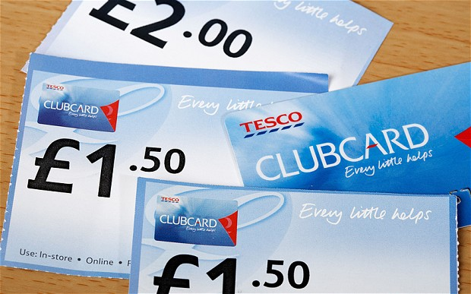
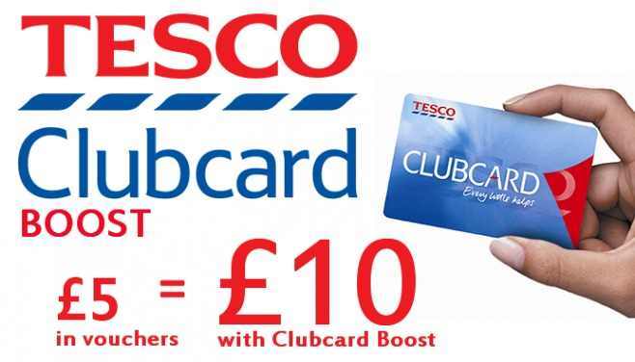
the Clubcard scheme, which by 2012 had been rolled out to twelve of Tesco’s markets, was always far more than a simple customer reward programme. From the outset, the company focused upon capturing, analysing and then, most importantly, using the data and information generated by the twelve million + transactions made each week. The starting point for this involves each of the transactions being linked to individual customer profiles. Data mining techniques are then used to pinpoint when and where purchases are made, the amount that customers have spent and the types of products that have been bought. These purchasing habits & behaviour patterns are then used as the basis for segmenting customers on the basis of need segments and for targeting them with tailor-made campaigns and advertisements, as well as regular mailings of a mass-customised magazine related to Tesco’s offer, and third-party ads.

Slide 22
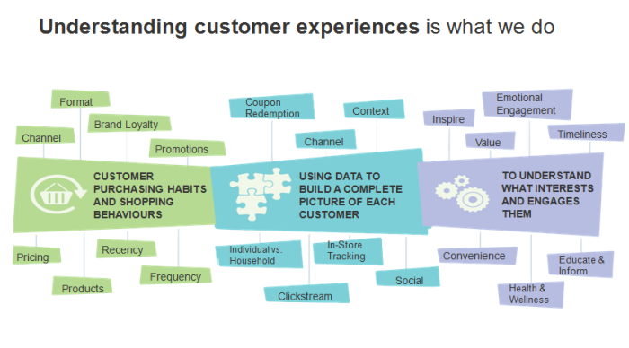

Slide 23
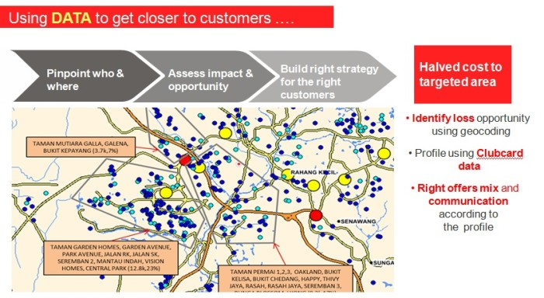
Tesco also designed a personalised promotion that came in the form of coupons. For example, if a family likes a particular brand of ice cream, they will be sent a promotion coupon on that particular brand of ice cream. And the customer will know that it is personalised to them.
“Data integrity is important. It will be quite a disaster if I sent someone who liked pasta, shampoo instead,” .

Slide 24
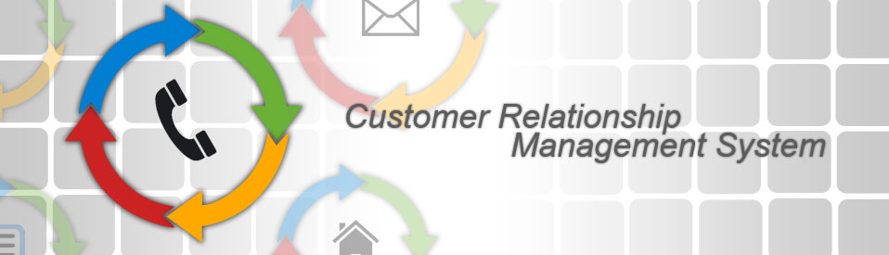
Activity 1:
Can you identify five major CRM software ?

Slide 25
Comparisons between Enterprise Systems
Systems | Goals | Functionality | Users | Boundary
ERP | Improve and streamline internal business processes, which typically requires reengineering of current business processes. | Product planning, parts purchasing, inventory control, product distribution, order tracking as well as finance and human resources aspects of a business. | Employees of the organization at all levels. | The boundary of an ERP system is small than the boundary of the organization that implements the ERP systems. In practice, however, many ERP implementations involve the integration of ERP with external information systems.
CRM | Facilitate acquiring, enhancing and retaining of customers. | Customer contact management, from direct marketing, sales and customer support. | Workers at all levels of an organizations. It may include customers and business partners. | The boundary of an CRM system is small than the boundary of the organization that implements the CRM systems.
SCM | To reduce inventory cost To increase sales To improve the coordination and the collaboration between participants of the supply chain. | Demand forecasting, product planning, parts purchasing, inventory control, manufacturing, product assembly to product distribution. | Workers of supply chain participants at all levels. | The boundary of a SCM system is the boundary of extended enterprise which includes the company, suppliers, partners, distributors and customers.

Slide 26
Key challenges to adopt Enterprise Systems
Whether to buy?
    – Analysing costs and benefits
    – Business benefits vs. technical benefits
    – Buying early vs. buying late
What to buy?
    – Matching capabilities and needs
    – Compatibility and standards
How to implement?
    – Top management support
    – User involvement
    – Phased approach

Slide 27
Internet Economy
This encompasses all of the activities involved in using the internet for commerce. The internet economy is made up of four layers:
Internet Infrastructure: companies that provide the hardware, software, and other equipment for the Internet. Examples: networking companies and manufacturers of PCs and servers (Cisco Systems Inc, British Telecom).
Internet applications infrastructure: companies that provide software facilitating internet transactions. Also, companies that provide web development, design and consulting services. Examples: producers of web development software, web-enabled databases and search engines (Microsoft, Sun Microsystems).
Internet intermediaries: companies that link buyers and sellers, for example by providing content or by creating marketplaces where business can be transacted. Examples: travel agents, content providers and online brokerages (Google, Expedia).
Internet Commerce: companies that sell products and services to consumers or other companies. Examples: online retailers, subscription or fee-based services and manufacturers selling directly to the public (Amazon, itunes).

Slide 28
E-business and e-commerce
Electronic business (e-business): All electronically mediated information exchanges, both within an organisation and with external stakeholders supporting the range of business processes.
It refers to the use of digital technology and the Internet to execute the major business processes in the enterprise. It includes activities for the internal management of the firm and for coordination with suppliers and other business partners. It also includes electronic commerce, or e-commerce.
Notes:
28

Slide 29
e-Commerce
Electronic commerce (e-commerce): All electronically mediated information exchanges between an organisation and its external stakeholders.
  Buy-side e-commerce: E-commerce transactions between a purchasing organisation and its suppliers.
  Sell-side e-commerce: E-commerce transactions between a supplier organisation and its customers.
E-commerce is the part of e-business that deals with the buying and selling of goods and services over the Internet. It also encompasses activities supporting those market transactions, such as advertising, marketing, customer support, security, delivery, and payment.
Laudon and Laudon (2014). Management Information Systems: Managing the Digital Firm. 13th edn. Pearson

Slide 30
E-Business Approach to Business Enhancement
Three areas of business are enhanced by adopting an e-business approach;
Production process-including procurement, ordering stock, payment processing, links with suppliers and production control.
Customer focused processes-including marketing, selling via the Internet, customer support and processing of customer orders and payments.
Internet management processes-including training, recruitment, internal information sharing and other employee services.

Slide 31
Activity 2:
The approaches used by companies such as Argos, Dell and eBay restructure the relationship between manufacturer, retailer and customer to the benefit of all involved.
Discuss this statement with reference to the e-business and e-commerce concepts described in this section.
Manufacturer | Retailer | Customer
What benefits? Challenges ? | What benefits? Challenges? | What benefits? Challenges?

Slide 33
Class Discussion
“Enterprise resource planning software is likely to replace packages used in a single area of the organisation, such as accounting, logistics, production and marketing”. Discuss.

Slide 34
Concluding remarks
What is enterprise systems ?
The types of enterprise systems ?
Difference between e-Business and e-Commerce

Slide 35

Next week: Week 8
Strategic analysis and competitive advantage of Information Systems

Slide 36


