Slide 1
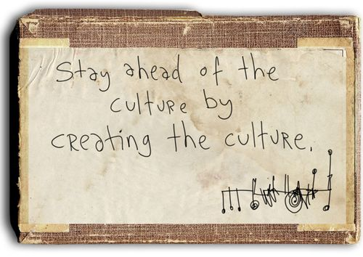
Global Marketing Strategy some cultural considerations in doing International business ernationa

Slide 2
Further cultural studies
“When cultures collide”
Richard Lewis (1996) is a British linguist who plotted world cultures on a chart. From this he recognised that national characteristics can be inaccurate and have exceptions, but that national norms remain stable and so according to him reactions can be expected & anticipated. He identified 3 clear cultural types
linear actives,
multi-actives and
re-actives

Slide 3
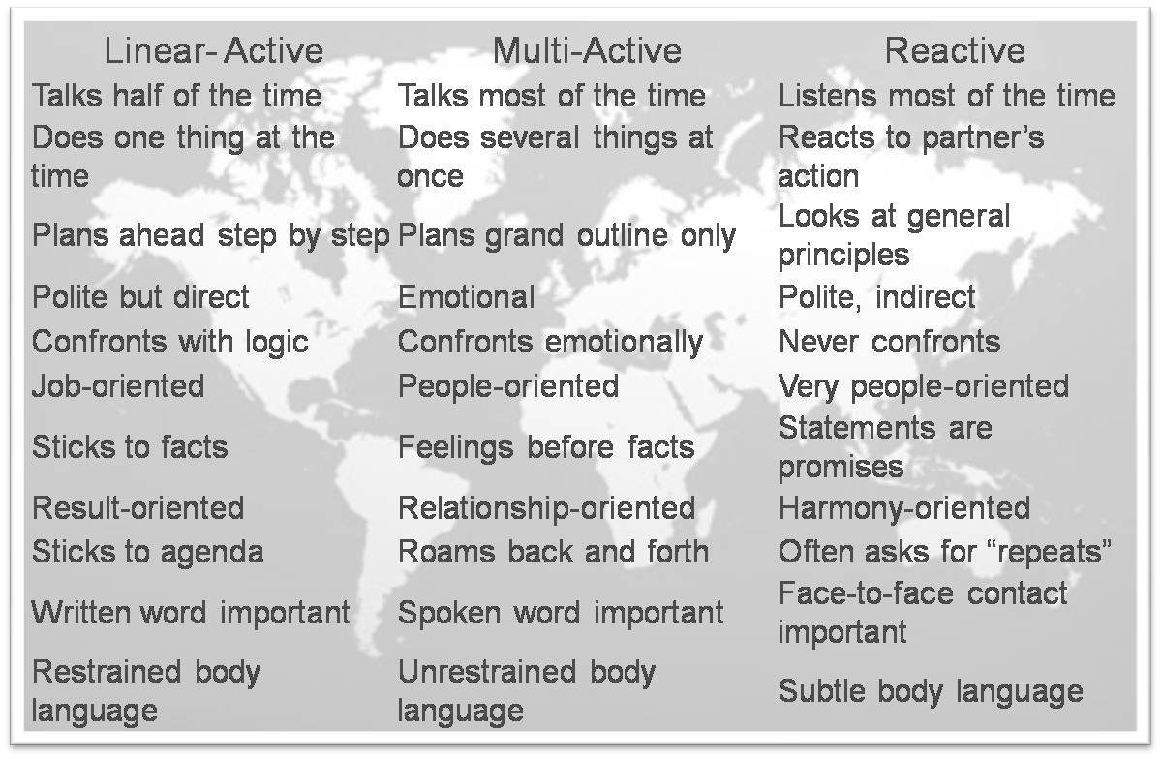
Active type issues

Slide 4
Student task
What type of culture is your culture?
How would you describe the following country cultures in this model in terms of multi-active, linear active and reactive: Germany, India, Brazil, Belgium, Vietnam, Canada, Argentina.

Slide 5
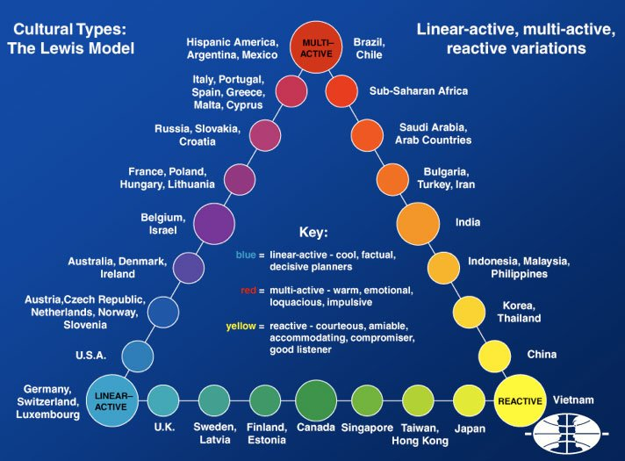
Actives types

Slide 6
Culture and business
The culture of a country clearly impacts on the way in which natives do their business, real issues arise in:
Key cultural issues in business
Business structures
Management style for cultural differences
Communication style and culture
Business dress codes
The role of culture in business
Culture and the customer

Slide 7

The key cultural considerations in the business area
CORPORATE CULTURE
KEY BUSINESS AREAS
Communications delivery: loud, aggressive, greetings
Valuing the Timeframe, family time & work time.
Space, including personal space
Context: Low needs little direction; High needs lots
Culture shock and reverse culture shock (or going back home)

Slide 8
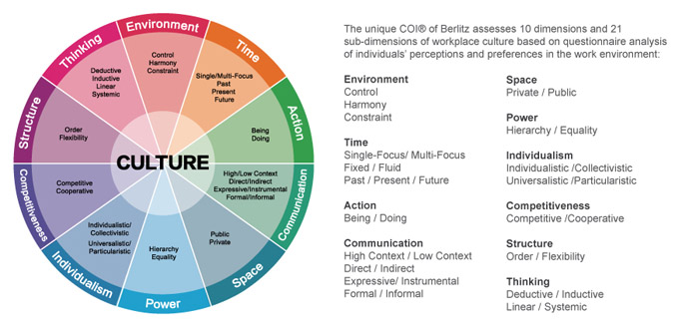
Work based cultural considerations
- the research findings

Slide 9
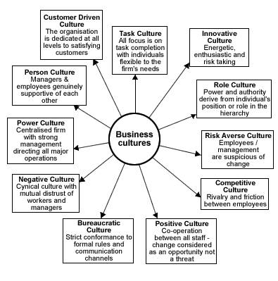
Types of business culture

Slide 10
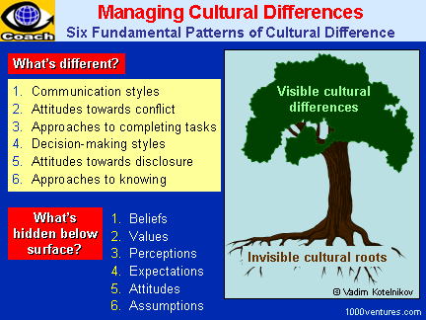
Managing cultural differences

Slide 11
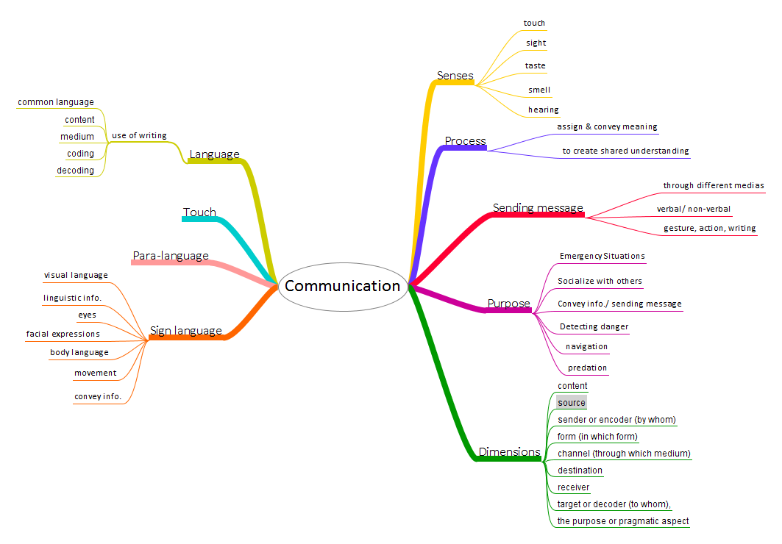

Slide 12
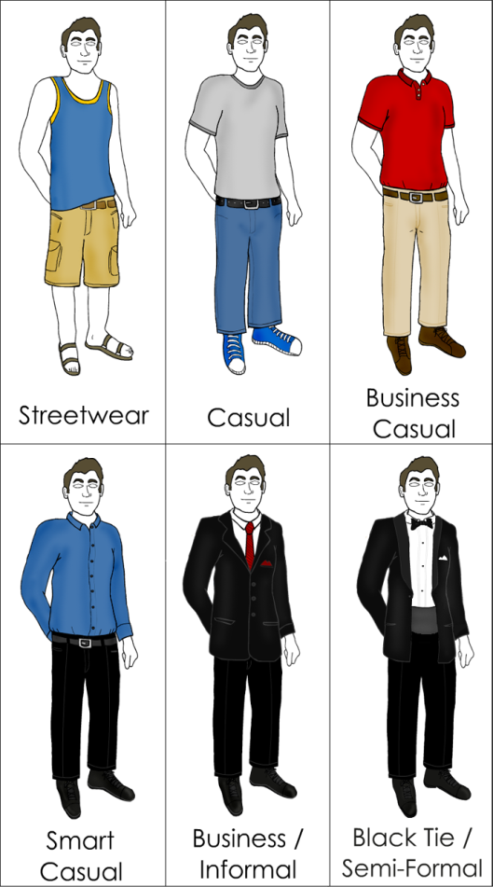

Some simple issues
DRESS SENSE
GREETINGS

Slide 13
Some practical business issues
Enthusiasm and commitment to work and after-work
Gestures – especially greetings and hand gestures
Humour – what is funny to you may not be universally funny
Conversation – discussing personal life? politics? religion? may well be better avoided
Translation – get clarification if you have doubts
Lumping – take care in discussing “you people”
Gift giving – is an easy area to offend rather than delight
Clothes – dress appropriately to weather? norms
Other issues – just take part and join in the experience
Respect – THEIR culture

Slide 14
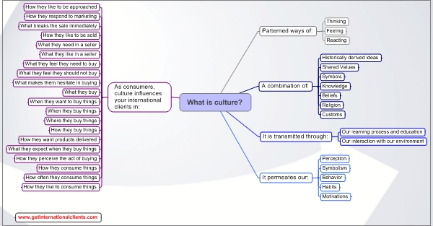
The role of culture in business

Slide 15
Socio-cultural considerations
- consumer behaviour considerations
Determine relevant motivations
Determine characteristic behaviour patterns
Determine broad cultural values to product
Determine characteristic forms of decision making
Evaluate appropriate promotion tools
Determine appropriate institutions to product
Blackwell (2001)..........Lee (1996) identified the
role of the SRC (cultural empathy & neutrality).

Slide 16
Socio-cultural considerations
- consumer buying issues
However the buying process is not consistent across cultures, areas where it differs are in the areas of;
Consumer involvement: low involvement and high involvement situations
Perceived risk: physical, financial and risk
Cognitive styles: logical and rational views versus emotional views

Slide 17
Socio-cultural considerations
- organisation buying behaviour
Buying situations (Robinson et al 1979); straight & modified re-buys and new task
Organisation buying; French [hierarchy], Spanish [autocratic], Germany [technical]
Government buyers; open tenders
Relationships in China

Slide 18
Socio-cultural considerations
- more B2B issues
B2B relies on negotiations
Culture affects negotiation
Problems arise in the linear model of negotiations
Differences exist in buyer-seller relationships
The role of gifts [Swiss – No; Japan – Yes]
Interestingly differences cause failure but awareness does not create success!

Slide 19
A final word???
Textbooks do NOT state for a fact that culture will affect international business decisions.
There is a preponderance to use case study rather than state definitive actions to take with business decisions.
Researchers suggest cultural distance from the domestic market are not significant!(Mitra & Golder).
However, economic knowledge and near-market culture is significant (Mitra and Golder).
Looks like more research is needed in this area….

Slide 20
Videos all about culture that are worth watching.
http://www.youtube.com/watch?v=haohj1sVnyk
http://www.youtube.com/watch?v=TNvaoVM-iqE
http://www.youtube.com/watch?v=ryWdPBdGpAY
http://www.youtube.com/watch?v=xSP_GsmNjj4
http://www.youtube.com/watch?v=2ttxDGrQd7M
http://www.youtube.com/watch?v=cLT0jAAR0B8
http://www.youtube.com/watch?v=wdh40kgyYOY
http://www.youtube.com/watch?v=LBv1wLuY3Ko
http://www.youtube.com/watch?v=blu34t4wu_o
http://www.youtube.com/watch?v=SYbynThuONs
http://www.youtube.com/watch?v=qDzF6U_MANc

Slide 21
Student task for next session
Discuss the importance of culture when doing business.
Provide 5 examples of real overseas cultural business blunders.
Identify 5 examples of real cultural mistakes in global branding.
What do you need for a successful cross cultural encounter with the Chinese when doing business?

Slide 22

A successful cross cultural encounter with the Chinese

